Slide 1

Long Range Planning
presented June 2023
Bond Oversight Committee

Slide 2
Bond Oversight Committee
A bond oversight committee plays a crucial role in ensuring transparency, accountability, and responsible use of funds for a public-school construction project. The committee typically consists of community members, parents, educators, and representatives from various stakeholder groups.
Key responsibilities of a bond oversight committee may include:
Financial Monitoring
Compliance and Legalities
Progress Evaluation
Communication and Transparency
Problem Identification and Resolution
Final Project Evaluation
Overall, a bond oversight committee acts as an independent body that safeguards the public's interest by ensuring the efficient and effective use of bond funds for public school construction projects.

Slide 3
Forecasted Enrollment, 2022-2031
 | 2018 | 2019 | 2020 | 2021 | 2022 | 2023 | 2024 | 2025 | 2026 | 2027 | 2028 | 2029 | 2030 | 2031
PK-1 | 303 | 298 | 327 | 32 | 383.0 | 415.4 | 437.9 | 467.1 | 514.8 | 562.8 | 600.5 | 639.9 | 681.0 | 720.5
2-5 | 584 | 589 | 566 | 586 | 665.3 | 736.7 | 817.1 | 901.6 | 1,016.5 | 1,120.0 | 1,231.8 | 1,319.9 | 1,399.2 | 1,483.1
6-8 | 473 | 470 | 475 | 513 | 544.7 | 592.7 | 600.9 | 700.6 | 809.0 | 945.0 | 1,025.3 | 1,115.6 | 1,208.8 | 1,296.6
9-12 | 609 | 604 | 631 | 631 | 695.1 | 786.2 | 829.5 | 919.2 | 1,050.9 | 1,126.5 | 1,266.4 | 1,421.4 | 1,549.6 | 1,701.0
Total | 1,969 | 1,961 | 1,999 | 2,092 | 2,288.1 | 2,531.0 | 2,685.4 | 2,988.5 | 3,391.2 | 3,754.3 | 4,124.0 | 4,496.8 | 4,838.8 | 5,201.2
Source: Davis Demographics’ Krum ISD Student Forecast 2021-31 District Summary Report
Highlighted segments denote when enrollment surpasses campus functional capacity

Slide 4
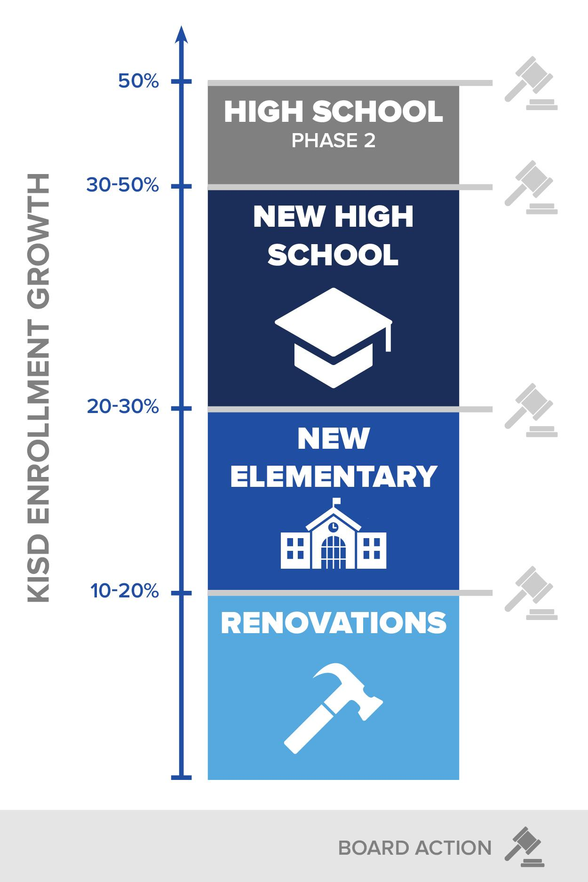
$244,700,000
2021-2022 Planning
CAMPUS RENOVATIONS
& NEW SCHOOLS
Addition to Krum EEC
  10M
Renovations
  20M
New Elementary School
  40-50M
Comprehensive High School (1,800 students)
  140-160M
Notes:
The Stadium is required to be on a separate proposition.
All athletic facilities are used on a regular basis for a wide-range of co-curricular and extracurricular activities.
Physical education classes, band, cheer, baseball/softball, track, basketball

Slide 5
Timeline
2023-2024 20M
Relocation of Daycare
Construction of EEC addition
Remodeling of KALC
Design New Elementary
2024-2025 60M
Opening of EEC as Elementary Campus
Re-Align District Attendance Zones
Re-Align Elementary Grade Levels
Begin Construction of New Elementary
Design New High School Campus
2025-2027 120M
Continue Construction / Open New Elementary Campus (Capacity 750-850)
Repurpose Dyer
2026-2028 40M
Construction / Opening New High School Campus
Junior High moves to old High School Campus

Slide 6
$244,700,000
CAMPUS RENOVATIONS
& NEW SCHOOLS
Addition to Krum EEC
  10M
Renovations
  20M
New Elementary School
  40-50M 56-71M
Comprehensive High School (1,800 students)
  140-160M 198-227M
Notes:
The Stadium is required to be on a separate proposition.
All athletic facilities are used on a regular basis for a wide-range of co-curricular and extracurricular activities.
Physical education classes, band, cheer, baseball/softball, track, basketball

Slide 7
What now?
2023-2024 20M
Relocation of Daycare
Construction of EEC addition
Remodeling of KALC
Design Middle School
2024-2025 60M
Opening of EEC as Elementary Campus
Re-Align District Attendance Zones
Re-Align Elementary Grade Levels
Construction Middle School
Remodel and HS Complex addition (design)
2025-2027 120M
Move in Middle School
Remodel and HS Complex addition
2026-2028 40M
Completion of HS Complex project

Slide 8
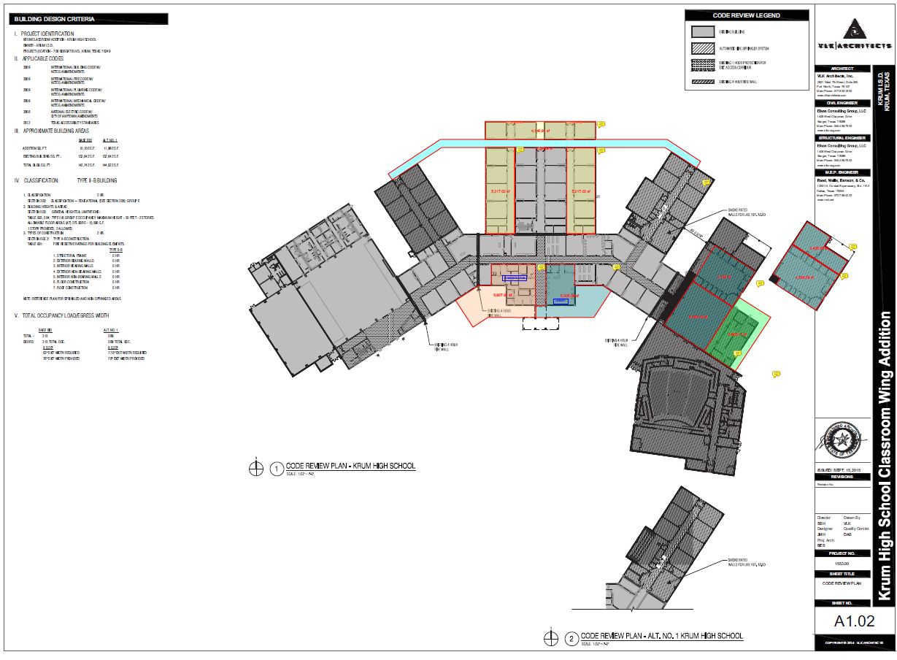

Slide 9
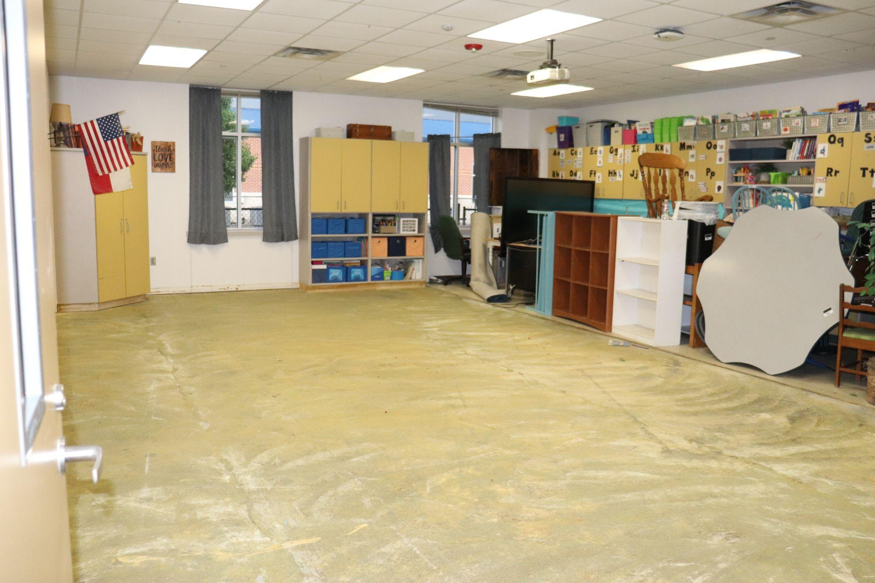
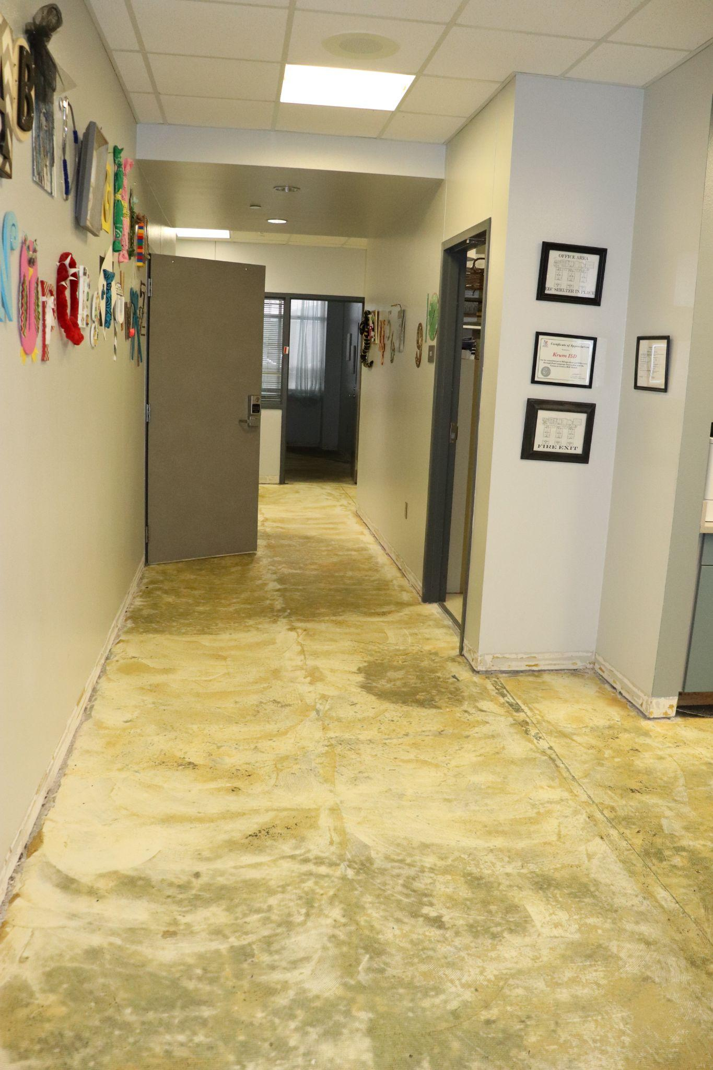
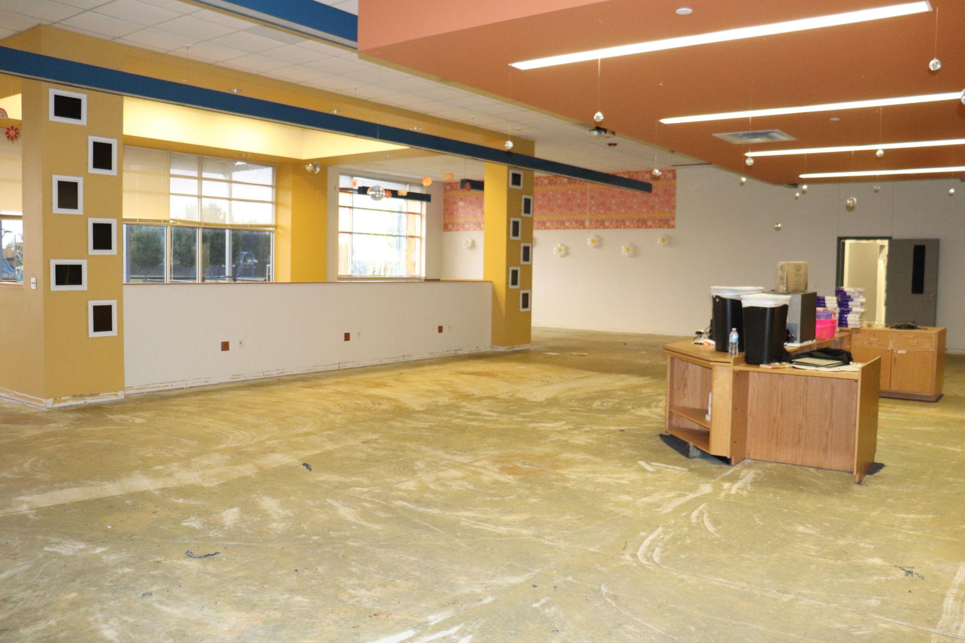
Current Construction-
Krum EEC, New Carpet

Slide 10
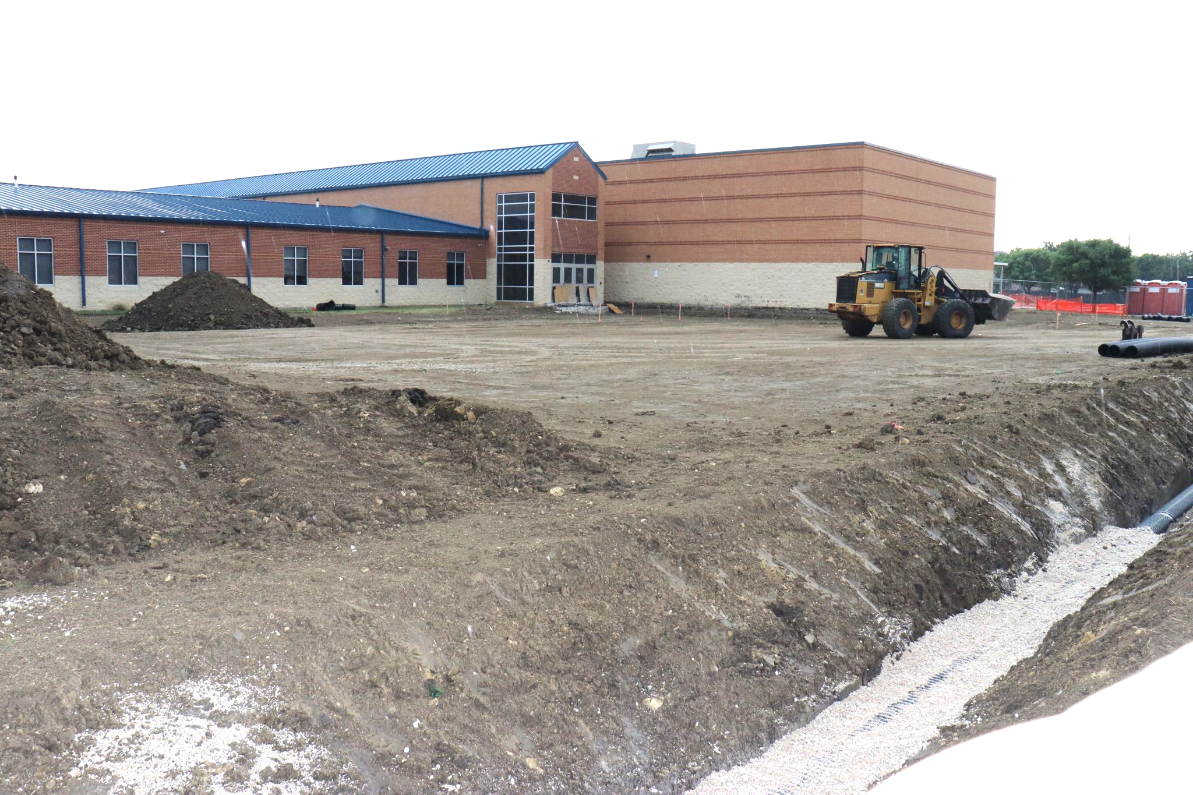
Current Construction- Krum EEC, New Wing

Slide 11
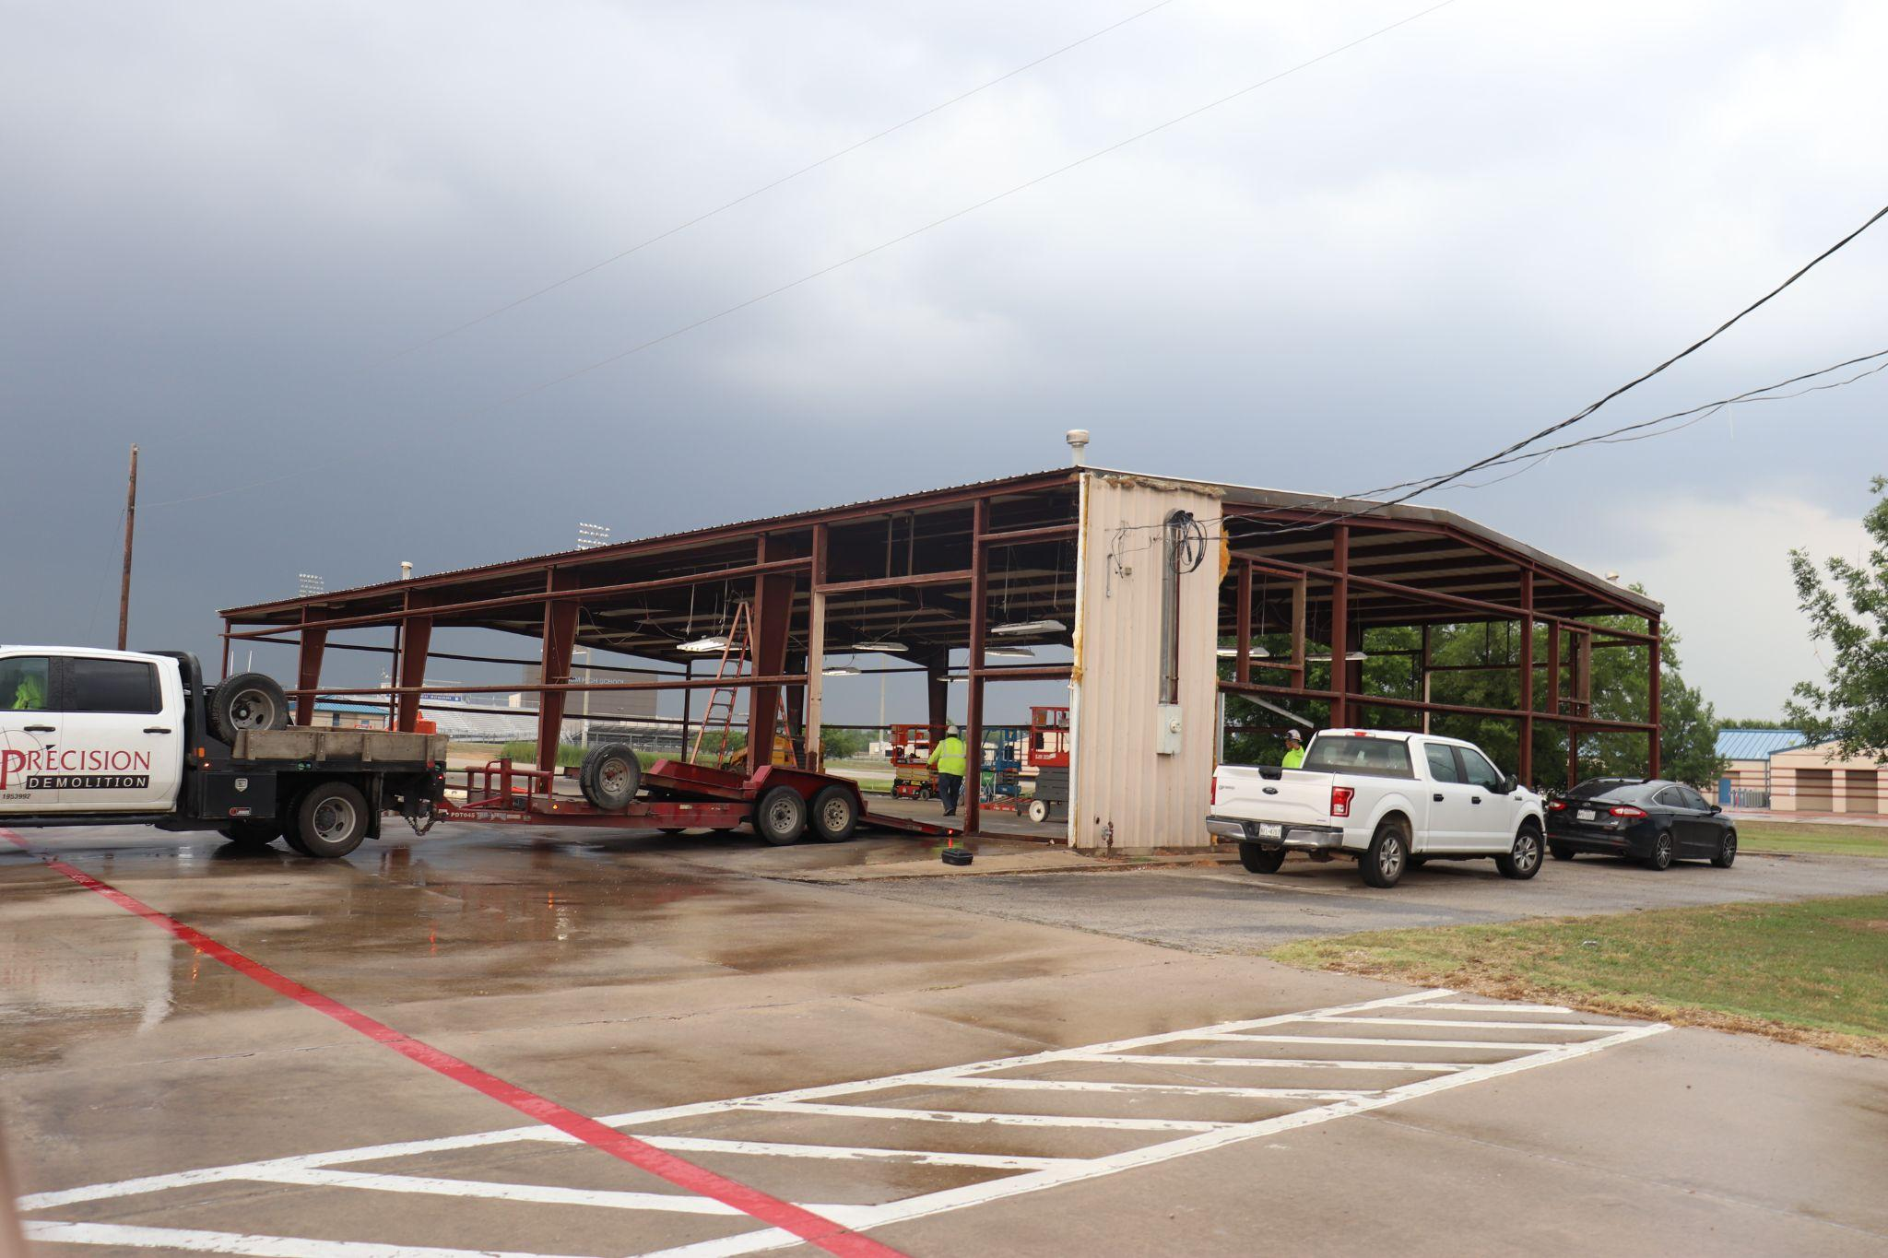
Current Construction- KALC, I.T. Offices

Slide 12
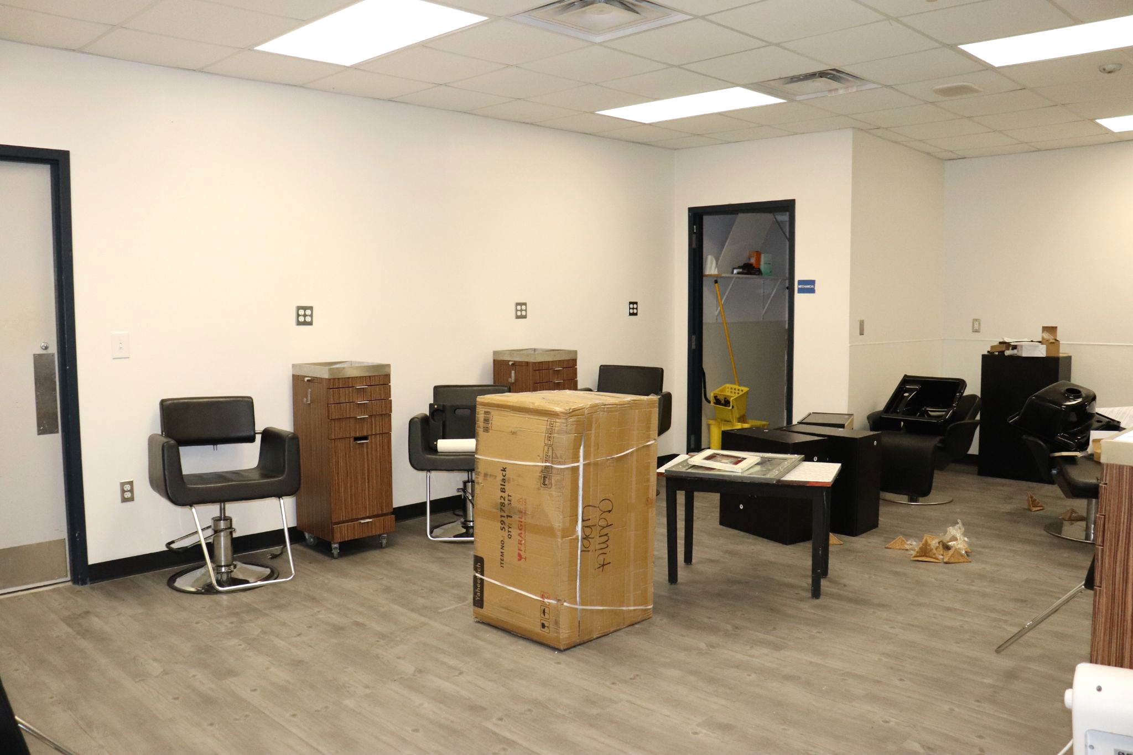
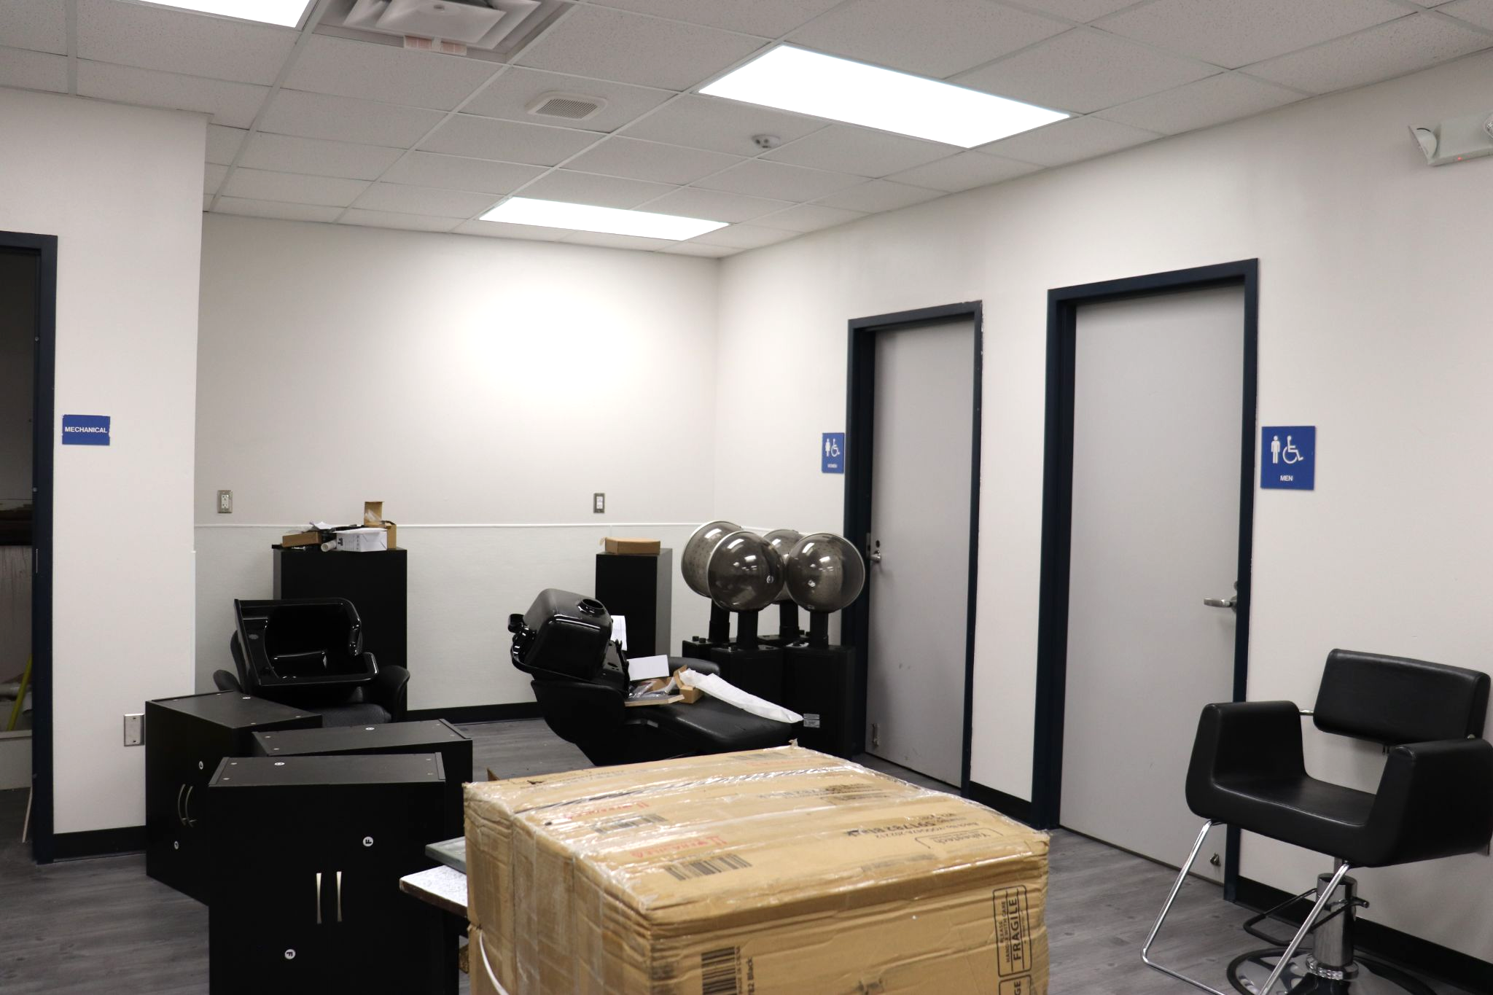
Current Construction- Cosmetology Lab

Slide 13
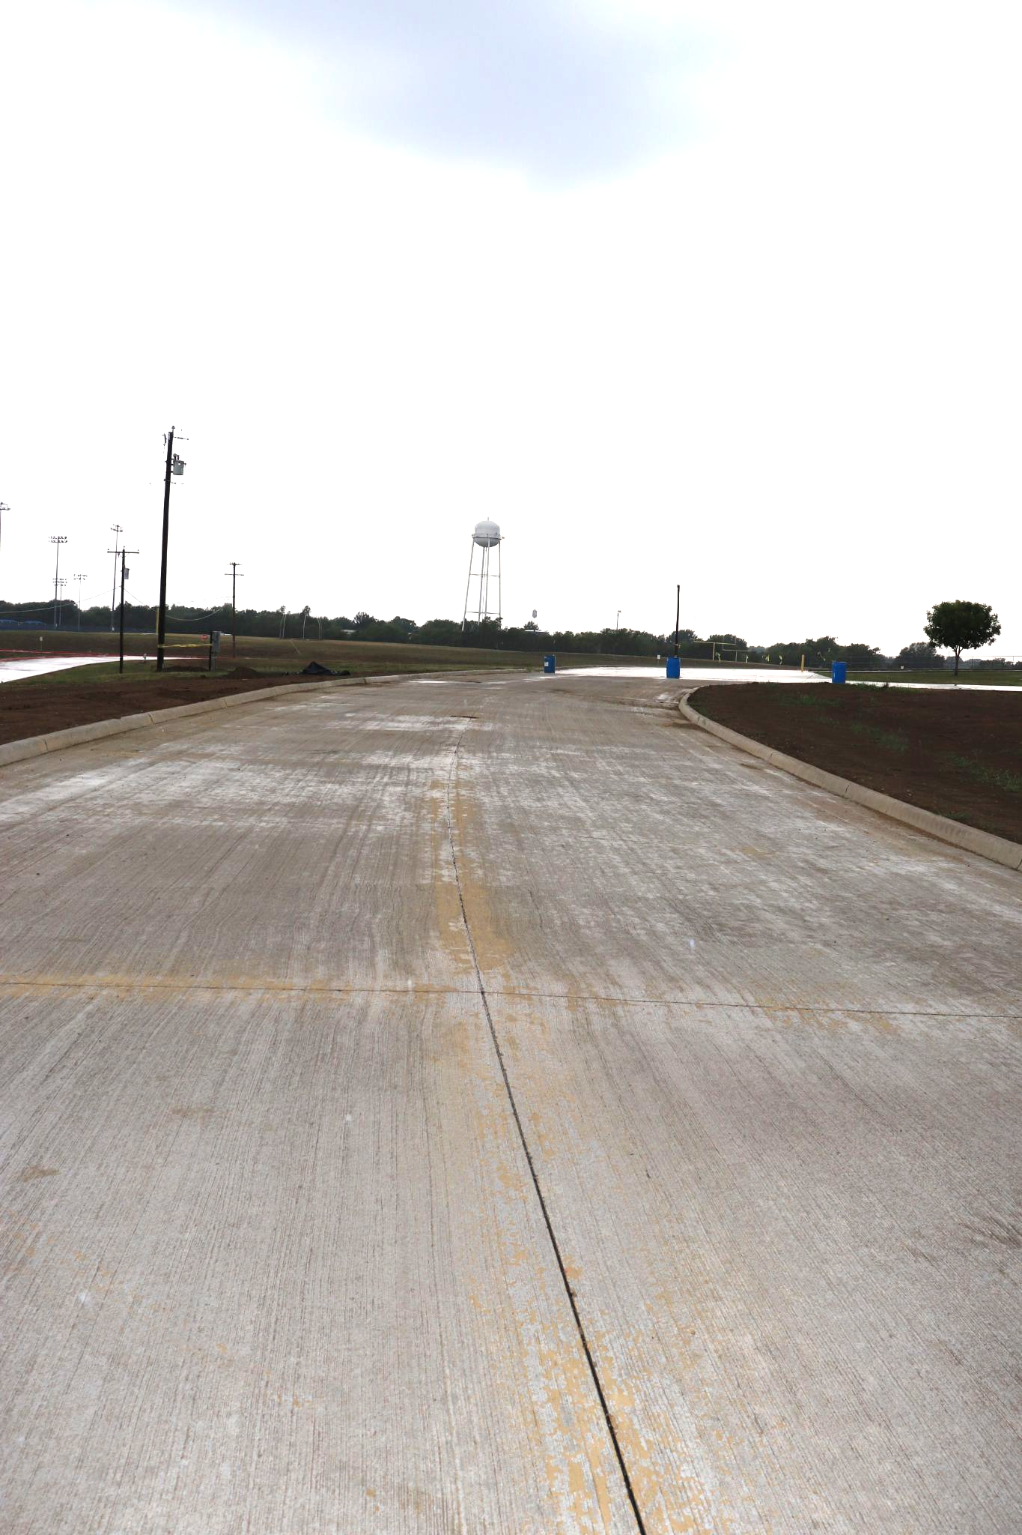
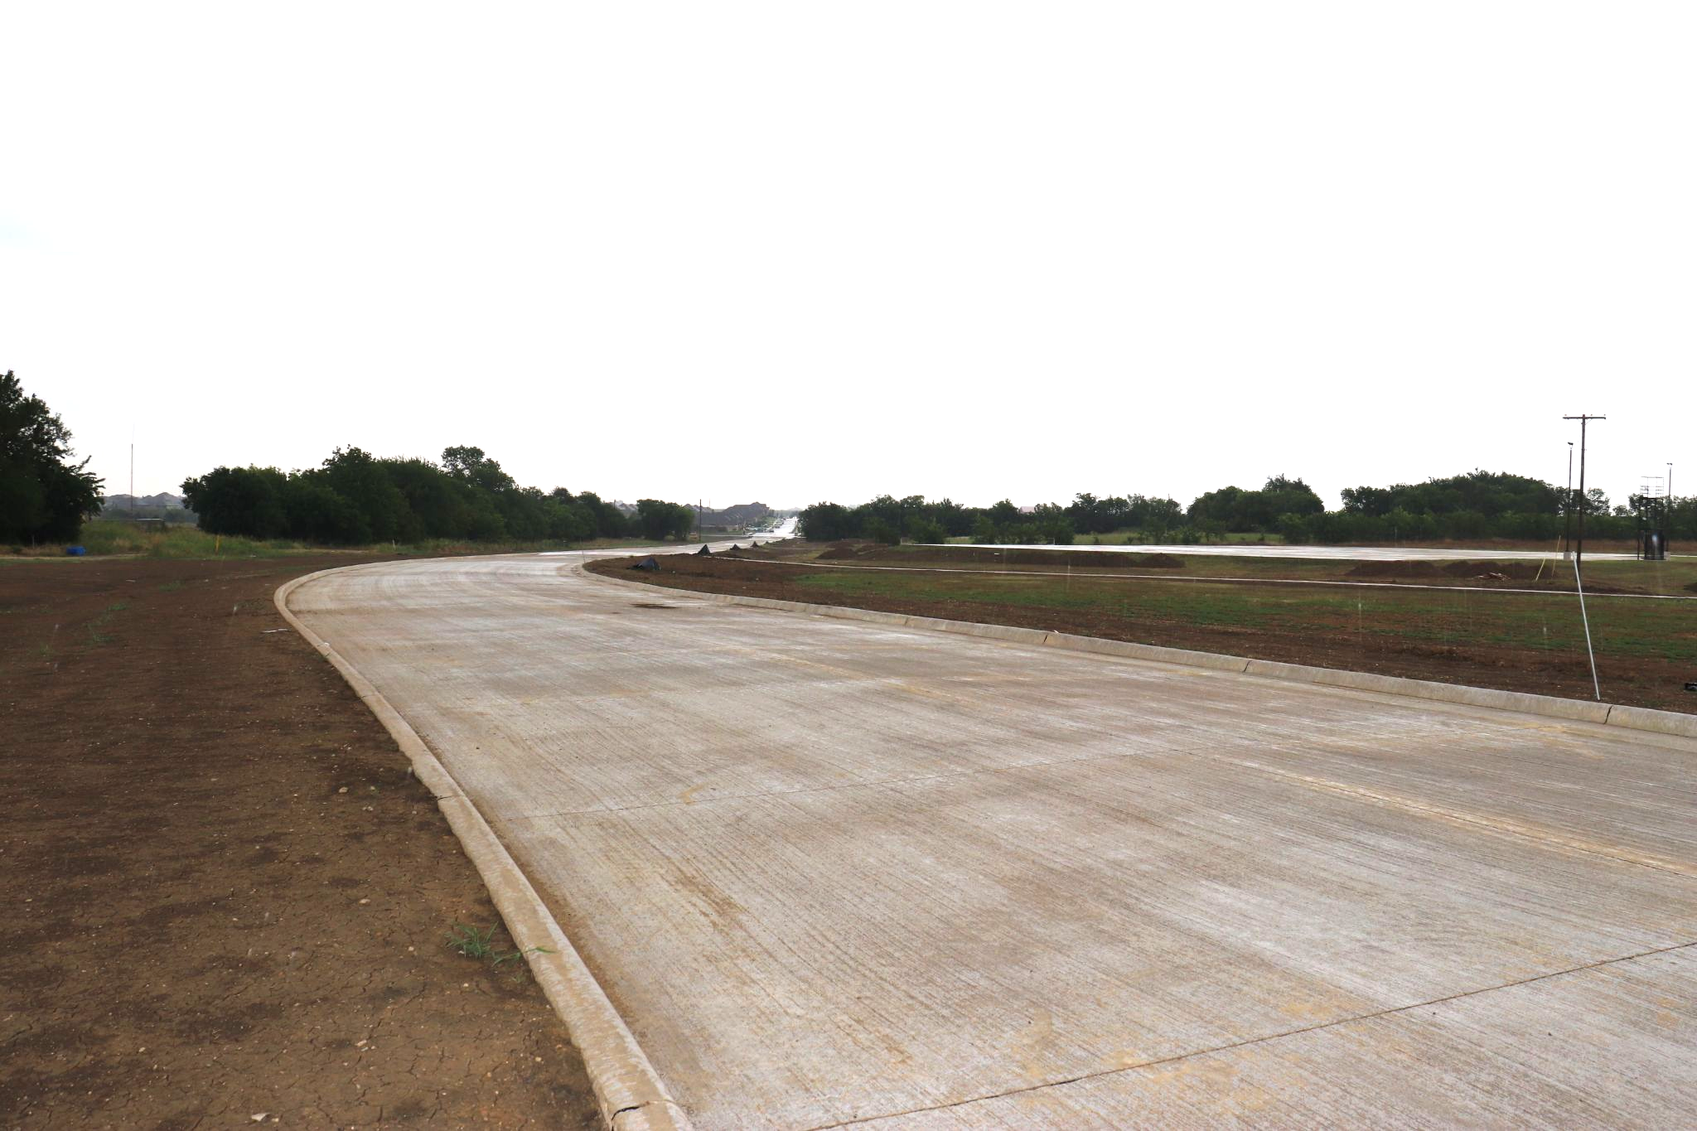
Current Construction- New Road from Bobcat to Hopkins

