Slide 1
SAINT THOMAS ACADEMY & VISITATION SCHOOL
Aquatic Center

Slide 2
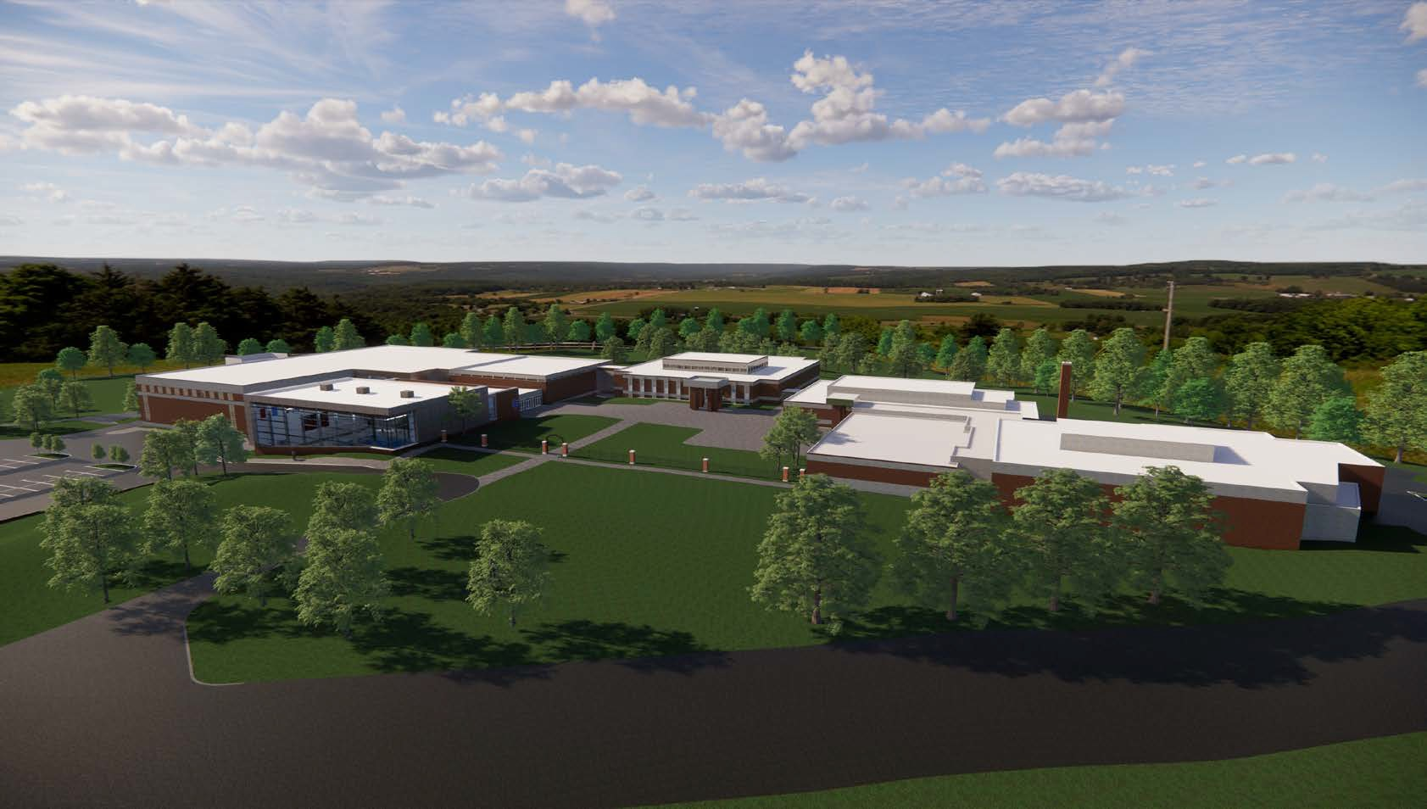


Saint Thomas Academy & Visitation School
CAMPUS VIEW
FABIANO DESIGNS
www.fabianodesigns.com
2
973.746.5100

Slide 3
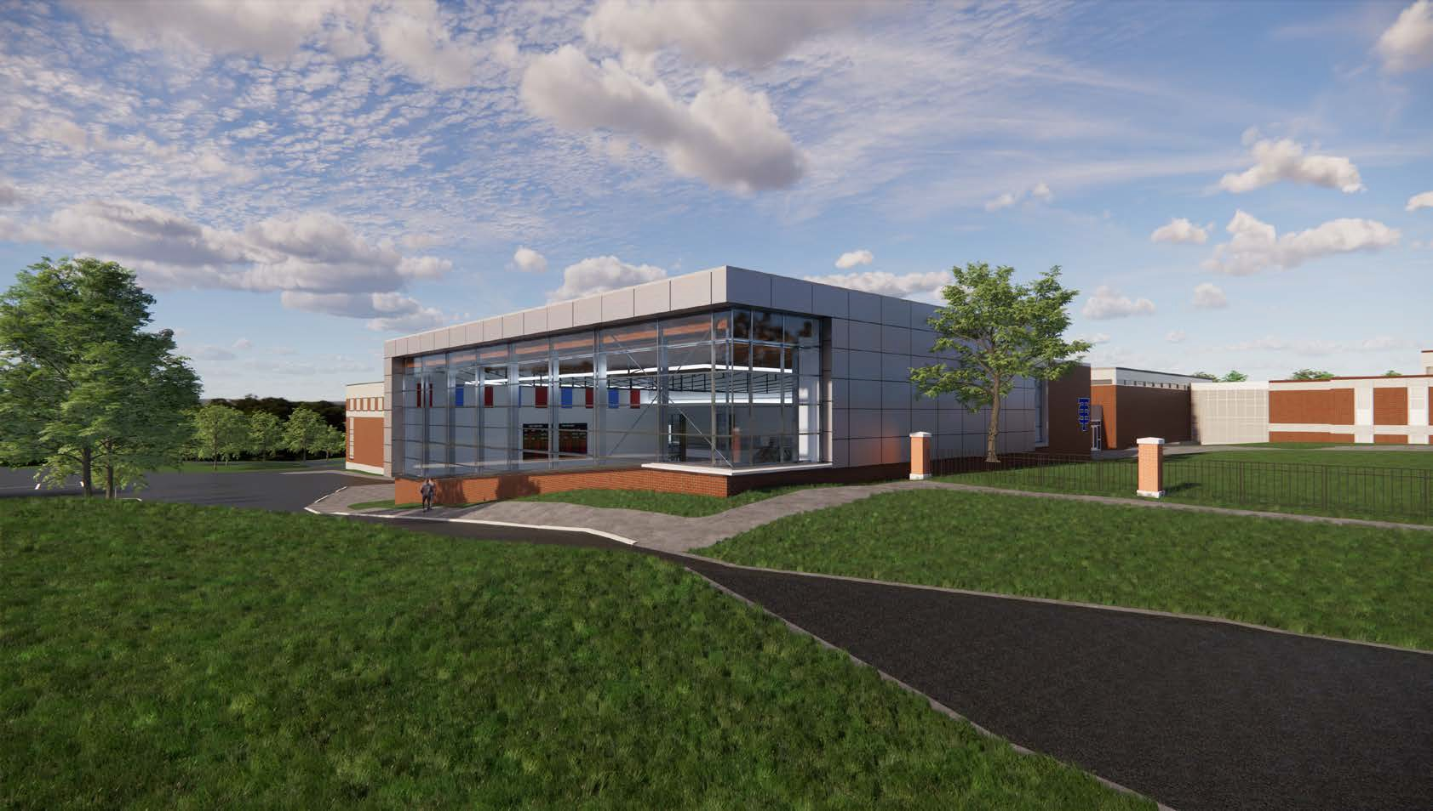
EXTERIOR VIEW
FABIANO DESIGNS
www.fabianodesigns.com
973.746.5100

Slide 4
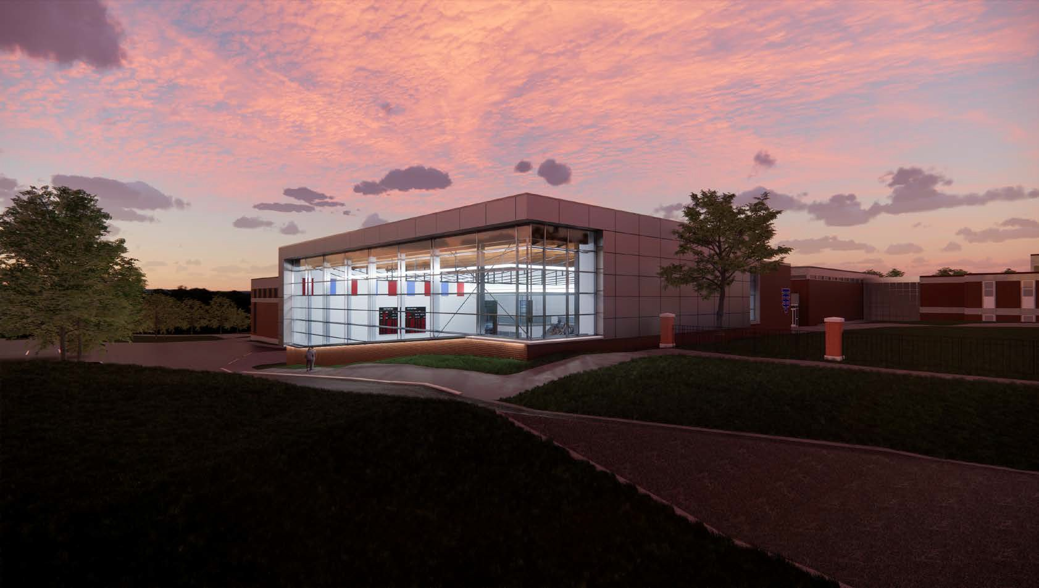
EXTERIOR VIEW
FABIANO DESIGNS
www.fabianodesigns.com
973.746.5100

Slide 5
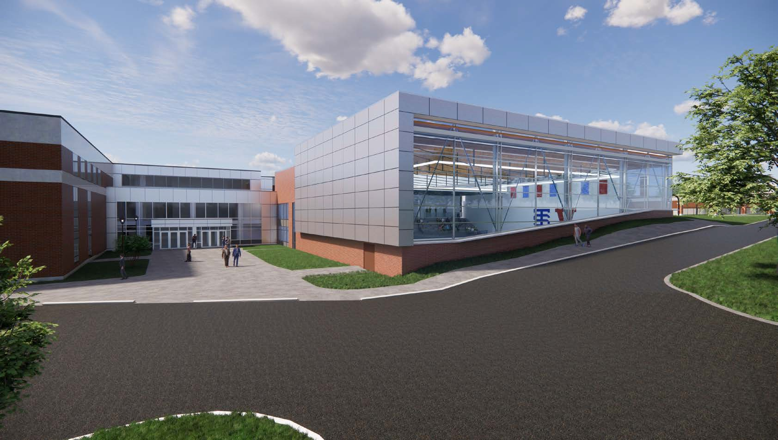
EXTERIOR VIEW
FABIANO DESIGNS
www.fabianodesigns.com
973.746.5100

Slide 6
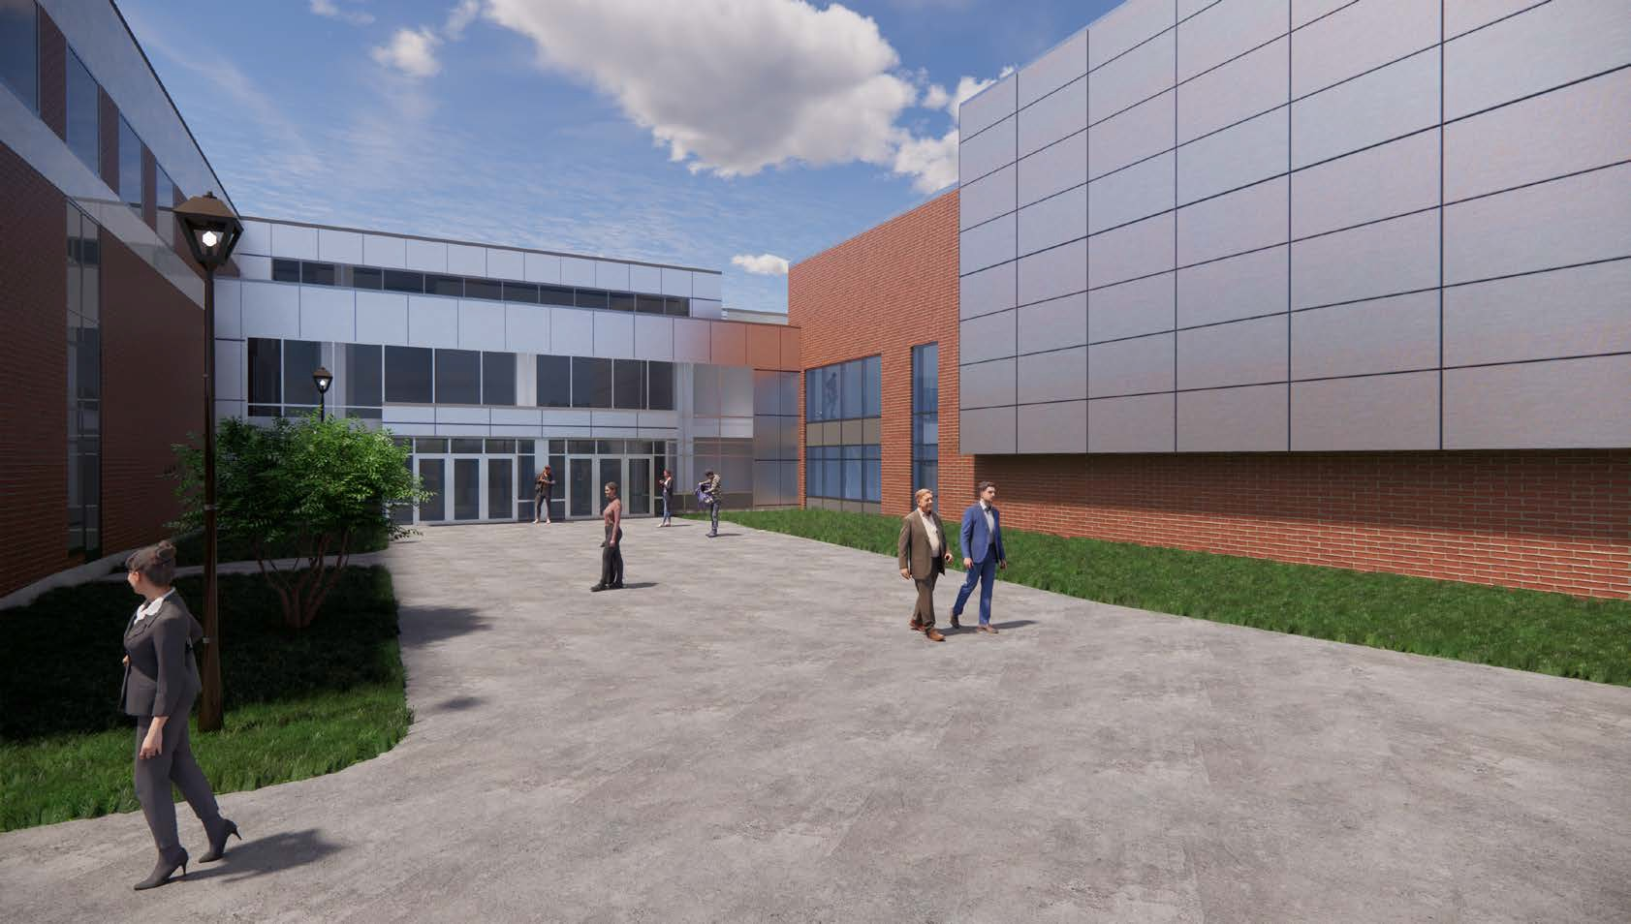
ENTRANCE VIEW
FABIANO DESIGNS
www.fabianodesigns.com
973.746.5100

Slide 7
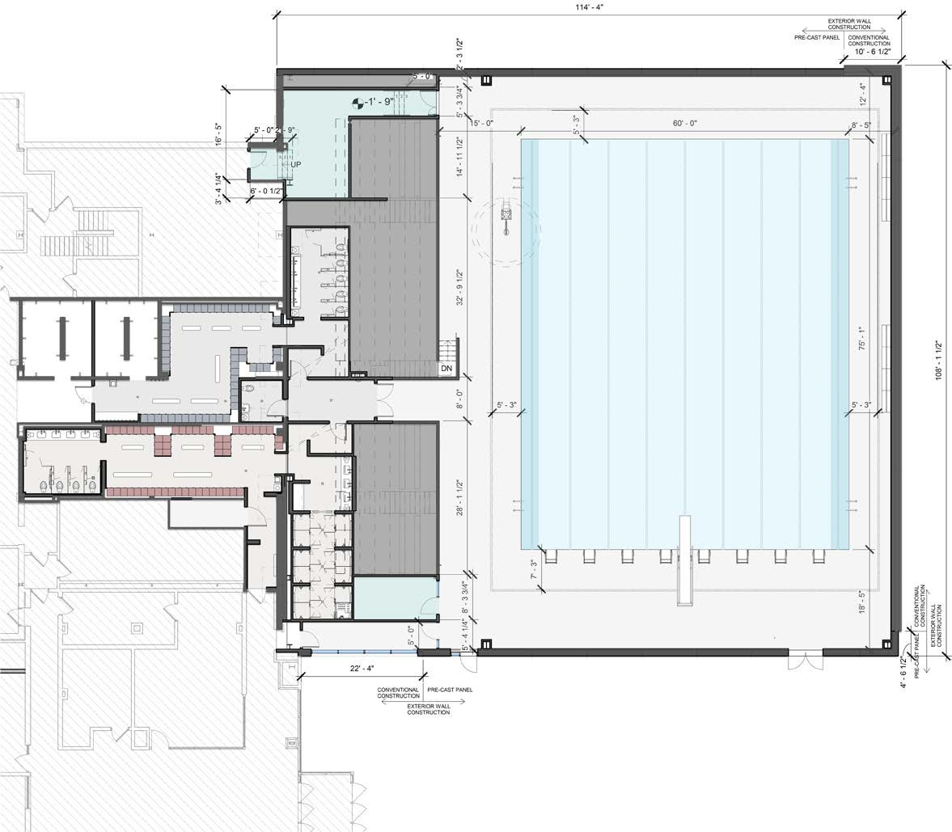
SAND FILTER
346 SF
POOL
4505 SF
OFFICE
120 SF
POOL DECK
4203 SF
HALLWAY
134 SF
FIRST FLOOR PLAN | POOL LEVEL
FABIANO DESIGNS
www.fabianodesigns.com
973.746.5100

Slide 8
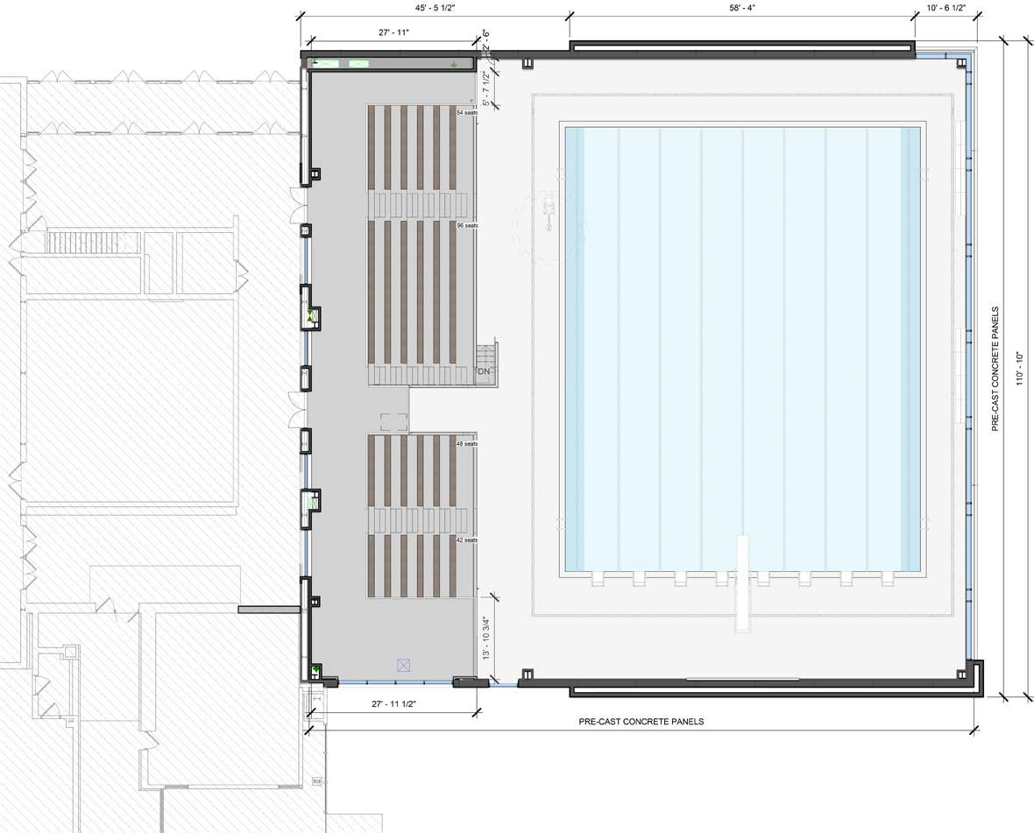
STANDING AREA
97 SF
BLEACHER SEATING
839 SF
WALKWAY
849 SF
BLEACHER SEATING
485 SF
STANDING AREA
391 SF
SECOND FLOOR PLAN | SPECTATOR LEVEL
FABIANO DESIGNS
www.fabianodesigns.com
973.746.5100

Slide 9
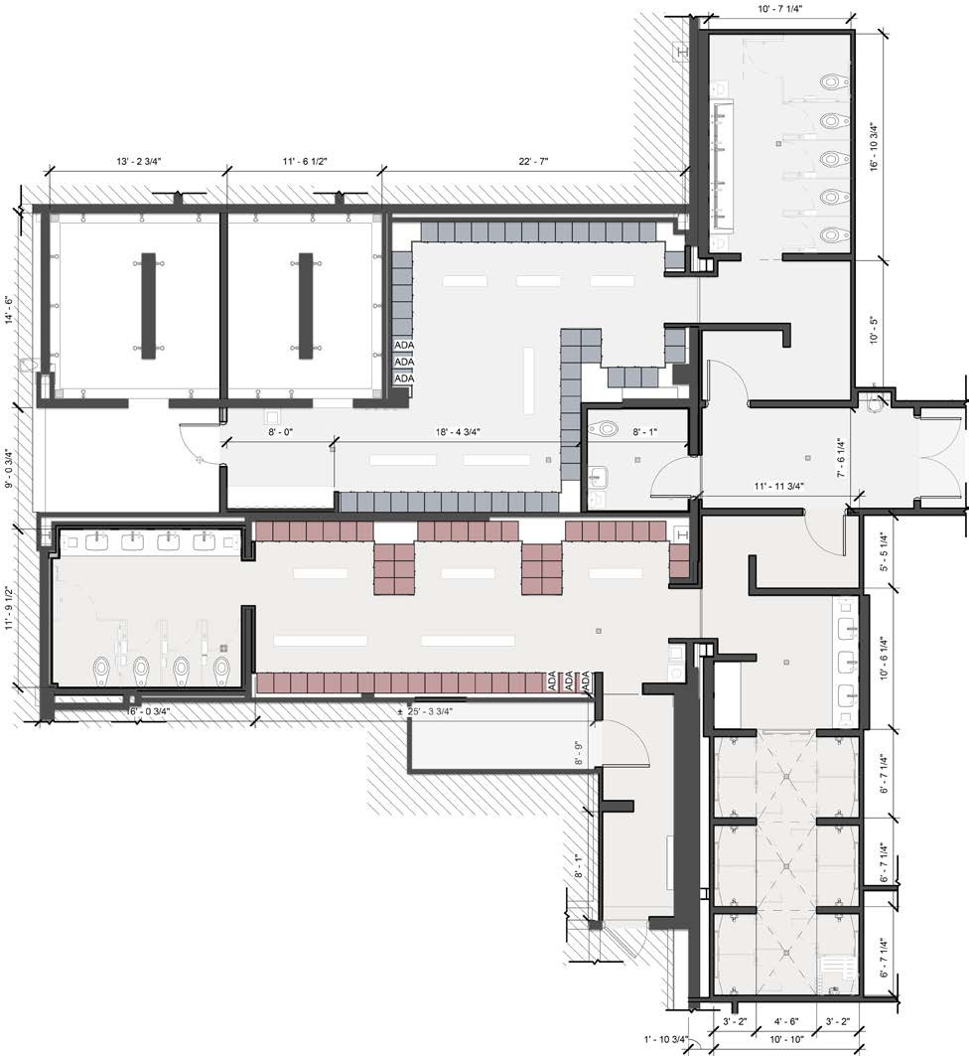
TOILET
295 SF
MID. SCH. BOYS SHOWERS
167 SF
SWIM TEAM BOYS SHOWERS
152 SF
BOYS LOCKER ROOM
491 SF
VESTIBULE
123 SF
REF.
RESTROOM
58 SF
TOILET
167 SF
GIRLS LOCKER ROOM
418 SF
VANITY
184 SF
PLUMB. EQUIP.
68 SF
SHOWER
204 SF
LOCKER ROOM PLANS
FABIANO DESIGNS
www.fabianodesigns.com
973.746.5100

Slide 10
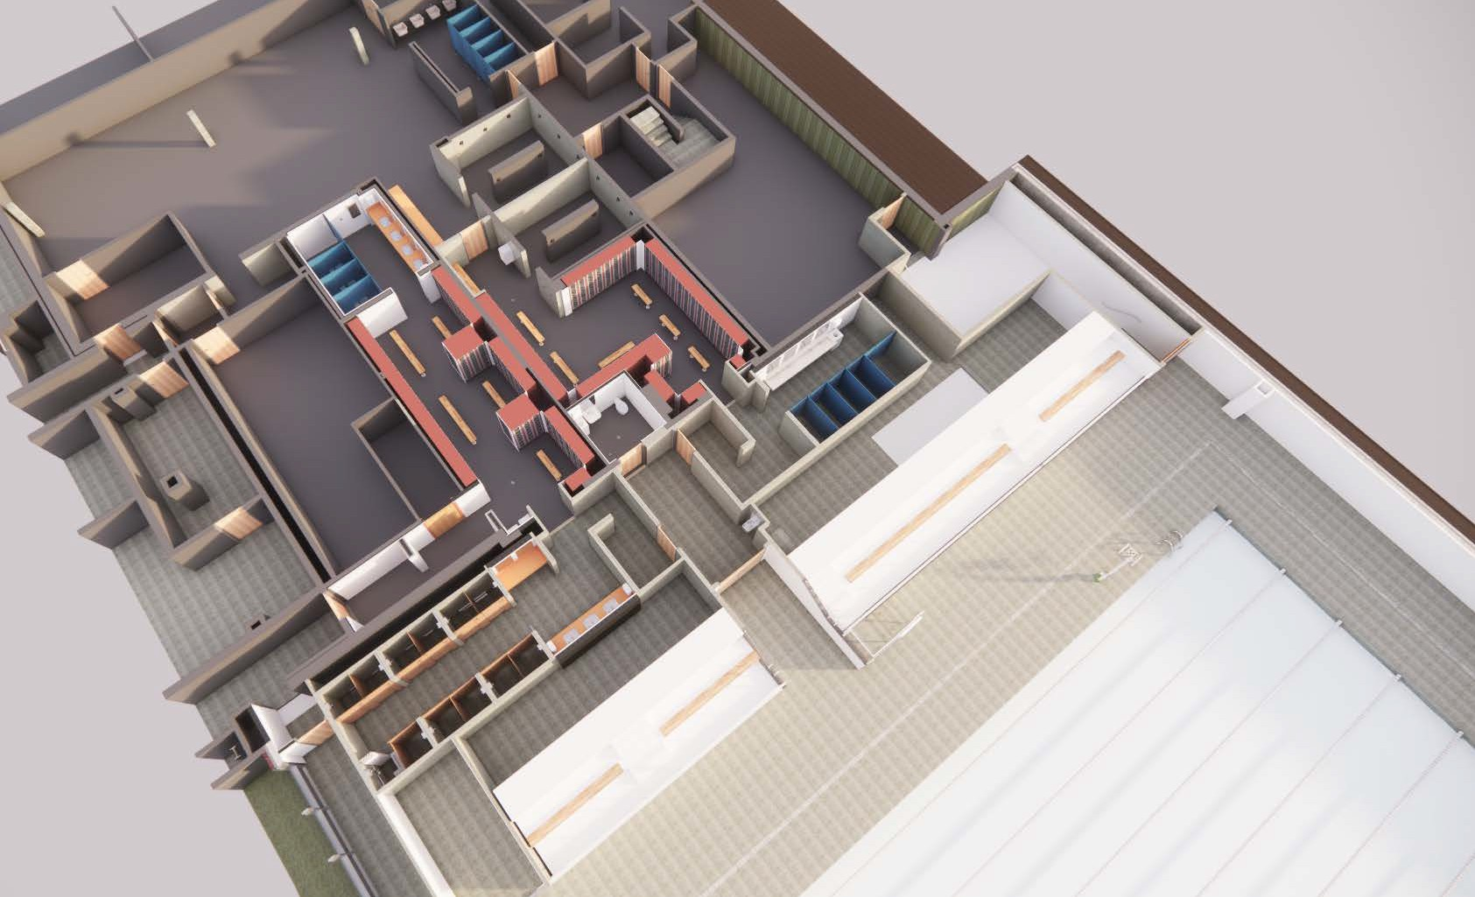
POOL-LOCKER ROOM AXON
FABIANO DESIGNS
www.fabianodesigns.com
973.746.5100
10

Slide 11
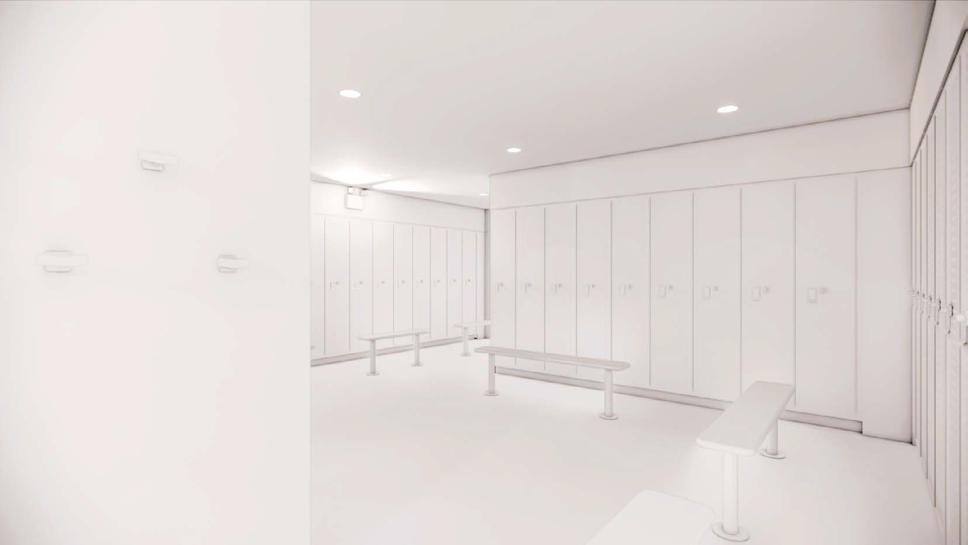
BOY’S LOCKER ROOM RENDERING
FABIANO DESIGNS
www.fabianodesigns.com
973.746.5100

Slide 12
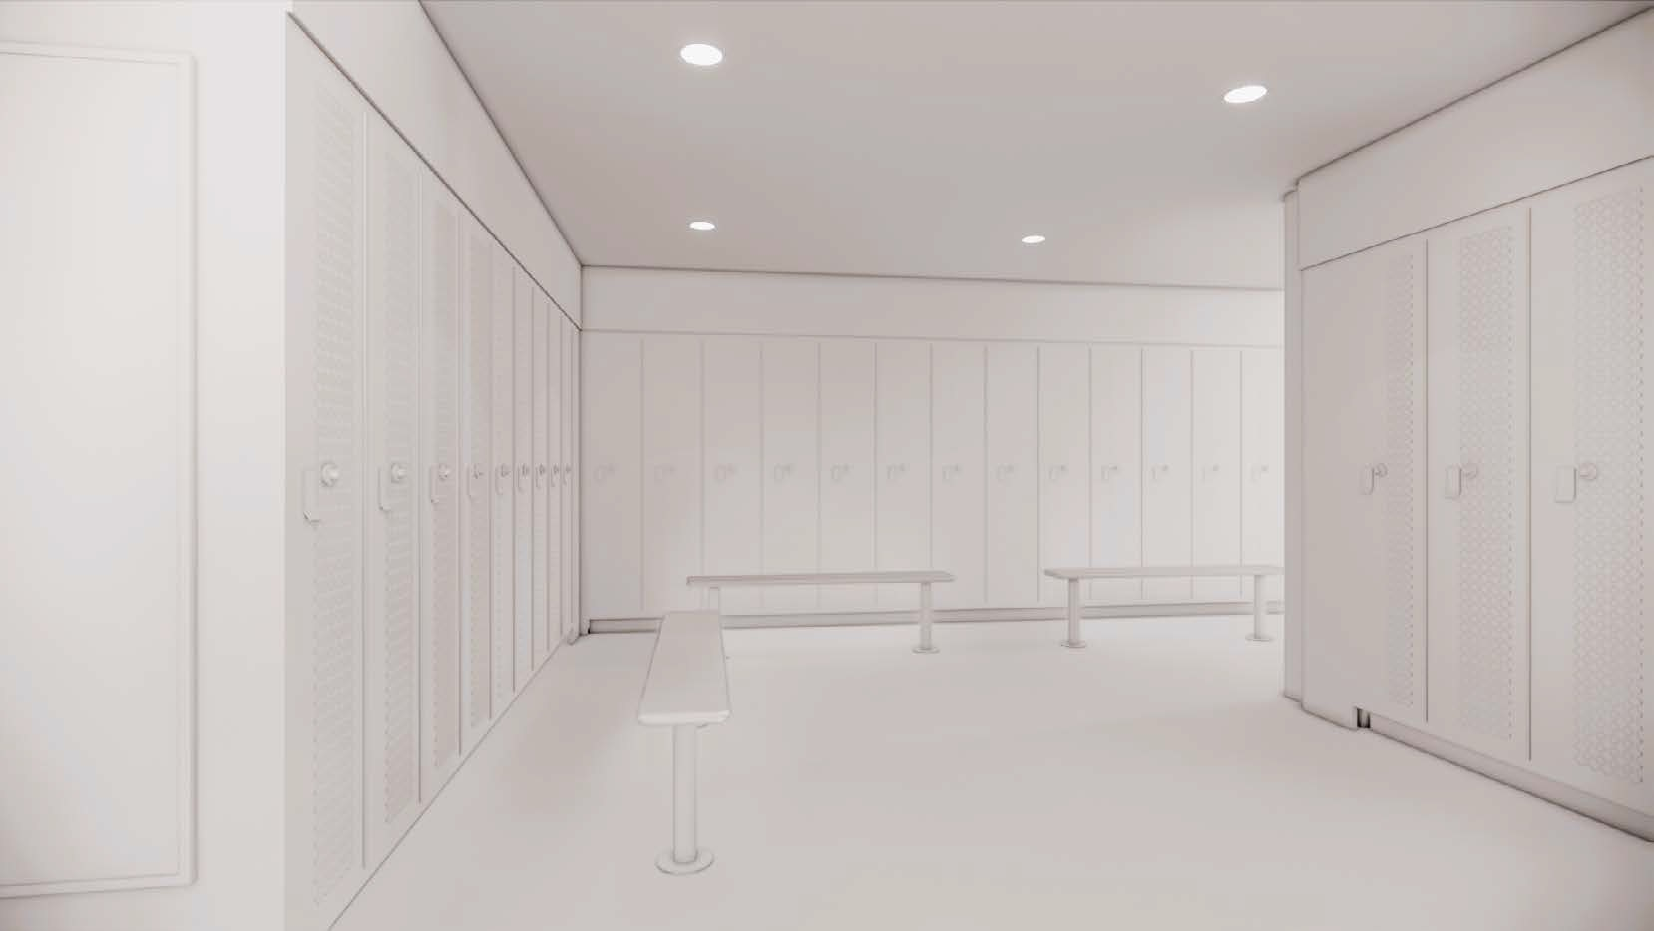
BOY’S LOCKER ROOM RENDERING
FABIANO DESIGNS
www.fabianodesigns.com
973.746.5100

Slide 13
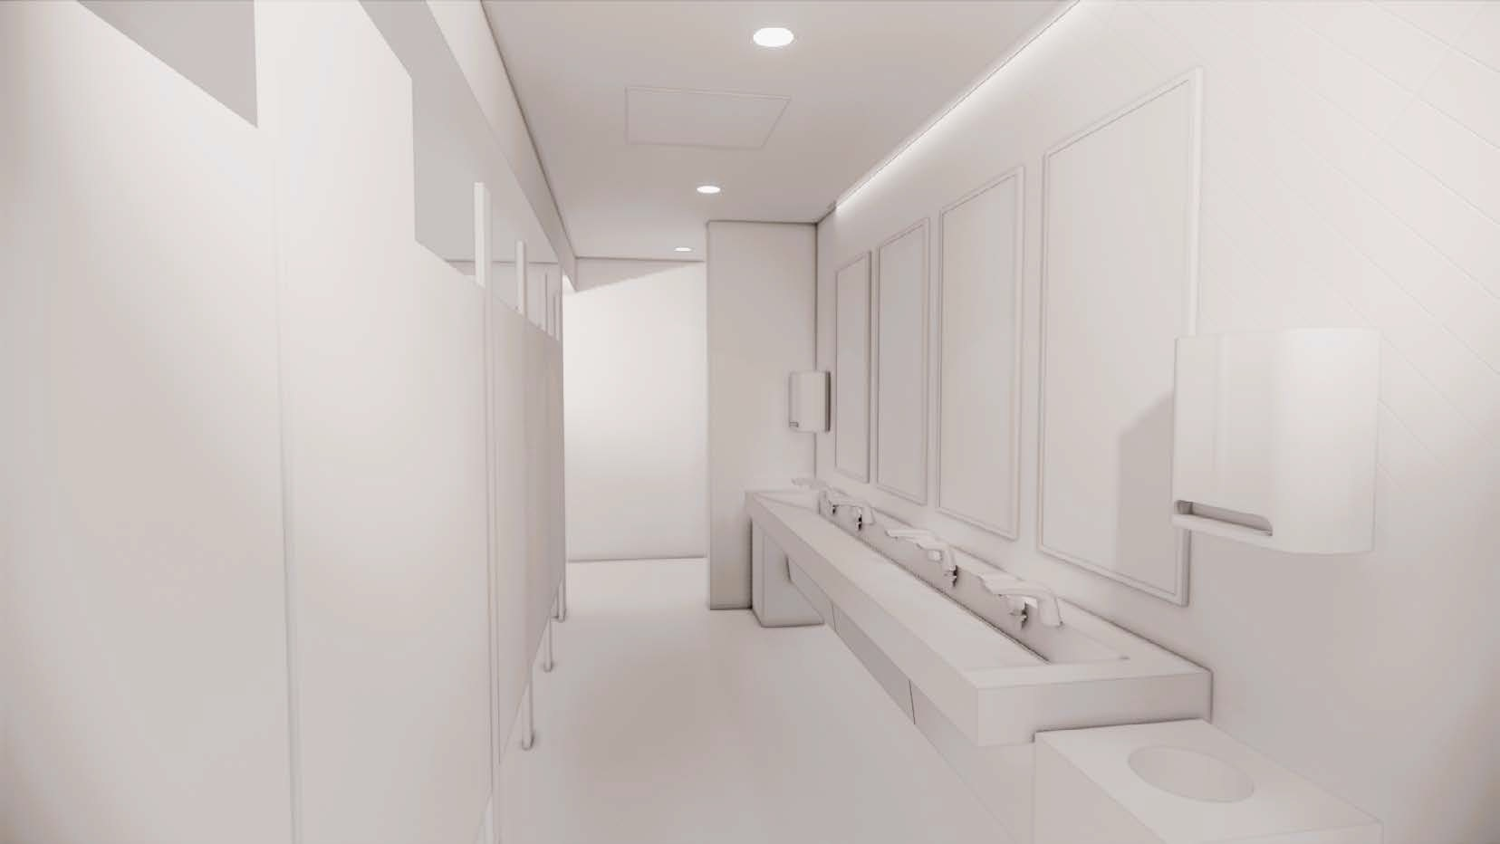
BOY’S TOILET ROOM RENDERING
FABIANO DESIGNS
www.fabianodesigns.com
973.746.5100

Slide 14
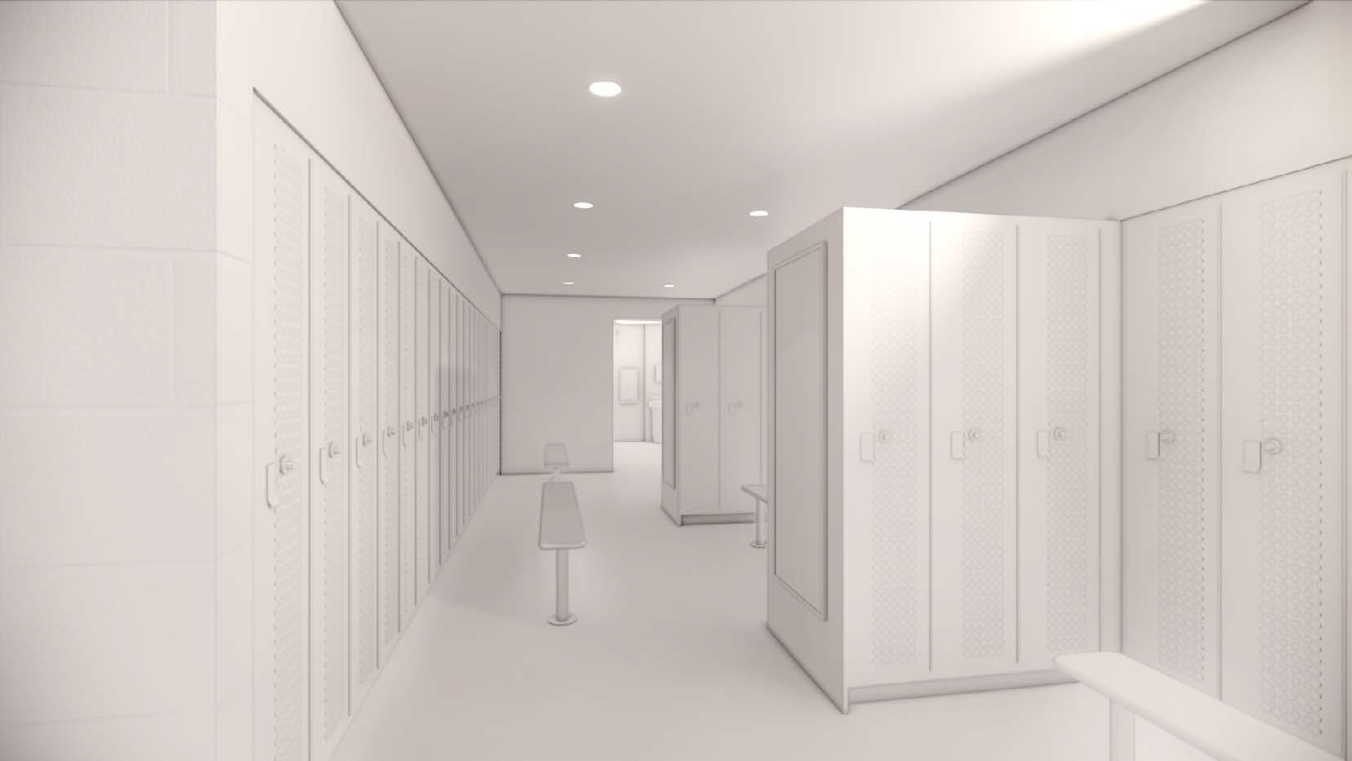
GIRL’S LOCKER ROOM RENDERNG
FABIANO DESIGNS
www.fabianodesigns.com
973.746.5100

Slide 15
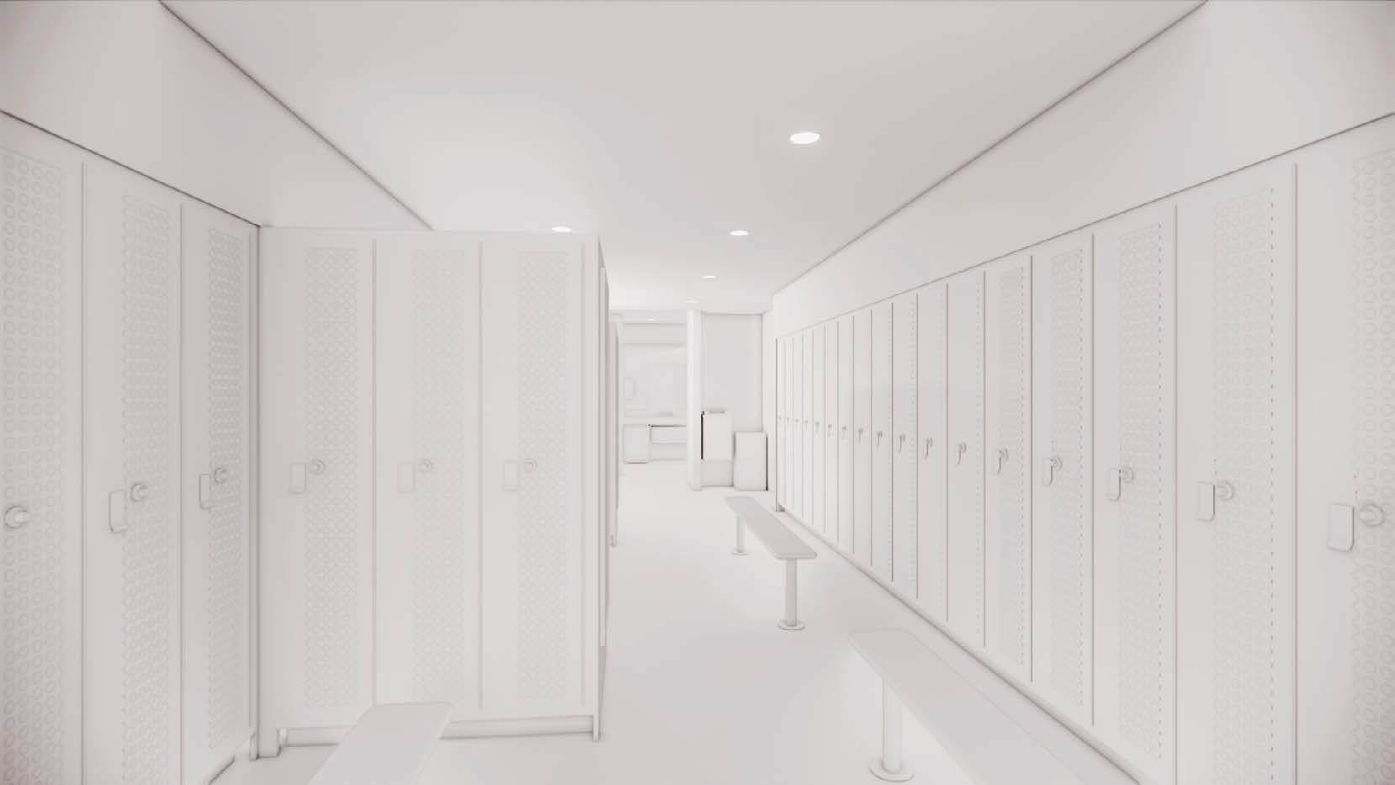
GIRL’S LOCKER ROOM RENDERING
FABIANO DESIGNS
www.fabianodesigns.com
973.746.5100

Slide 16
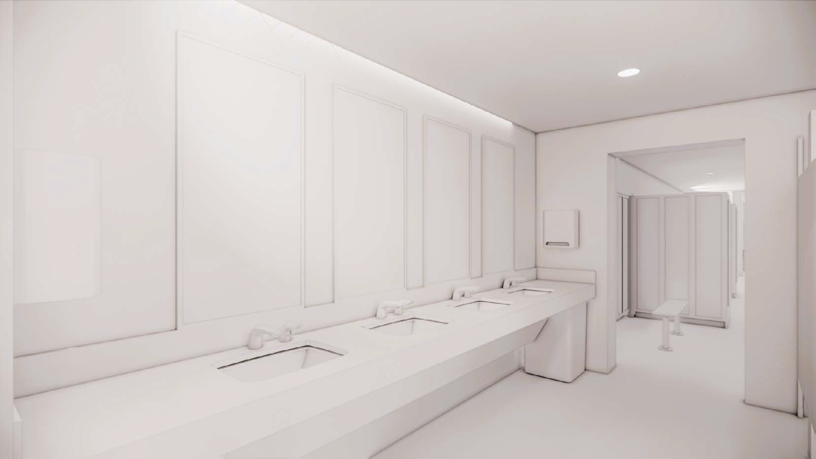
GIRL’S TOILET ROOM RENDERING
FABIANO DESIGNS
www.fabianodesigns.com
973.746.5100

