Slide 1

WILLMAR CARDINALS NORDIC SKI BANQUET
SUNDAY, FEBRUARY 23RD, 2020

Slide 2
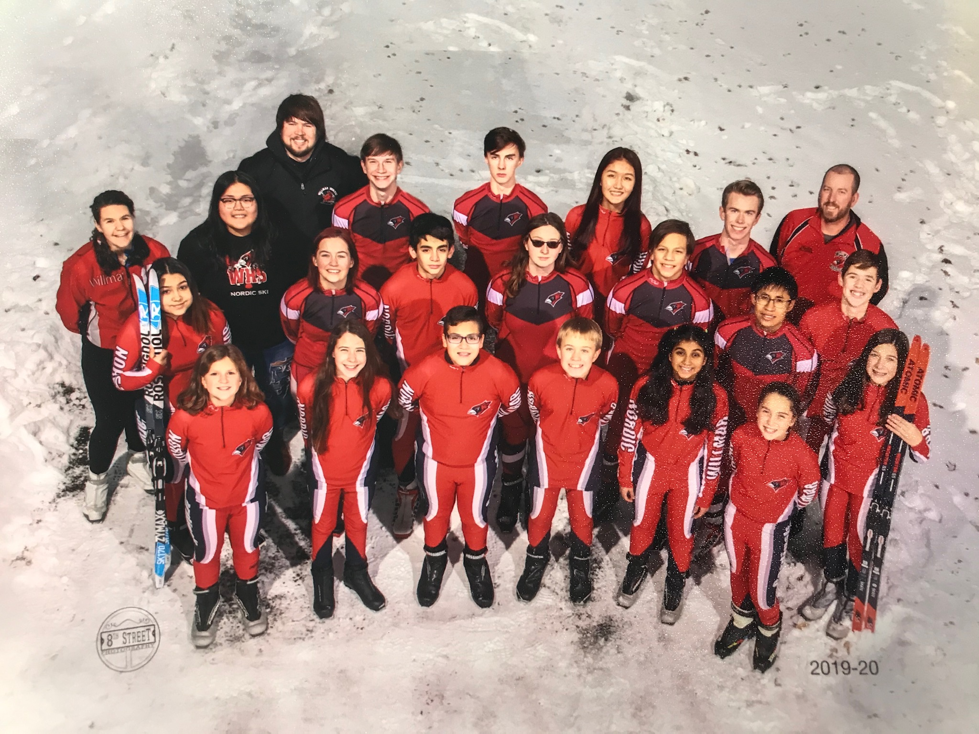

NORDIC SKI TEAM 2019-2020

Slide 3
WILLMAR STANDS FOR:
WORKING HARD BY GIVING YOUR BEST EFFORT AT ALL TIMES.
INVOLVE YOUR TEAMMATES BY CHEERING THEM ON.
LIFE LESSONS ARE LEARNED THROUGH DIGNITY, INTEGRITY, AND GRACE
LOVE THE SPORT.
MENTALLY PUSH YOURSELF TO DO BETTER, TO BE BETTER, AND TO OVERCOME DEFEAT.
ATTITUDE BY KEEPING YOURSELF POSITIVE.
REPRESENT THE RED BY RESPECTING YOURSELF AND OTHERS.

Slide 4
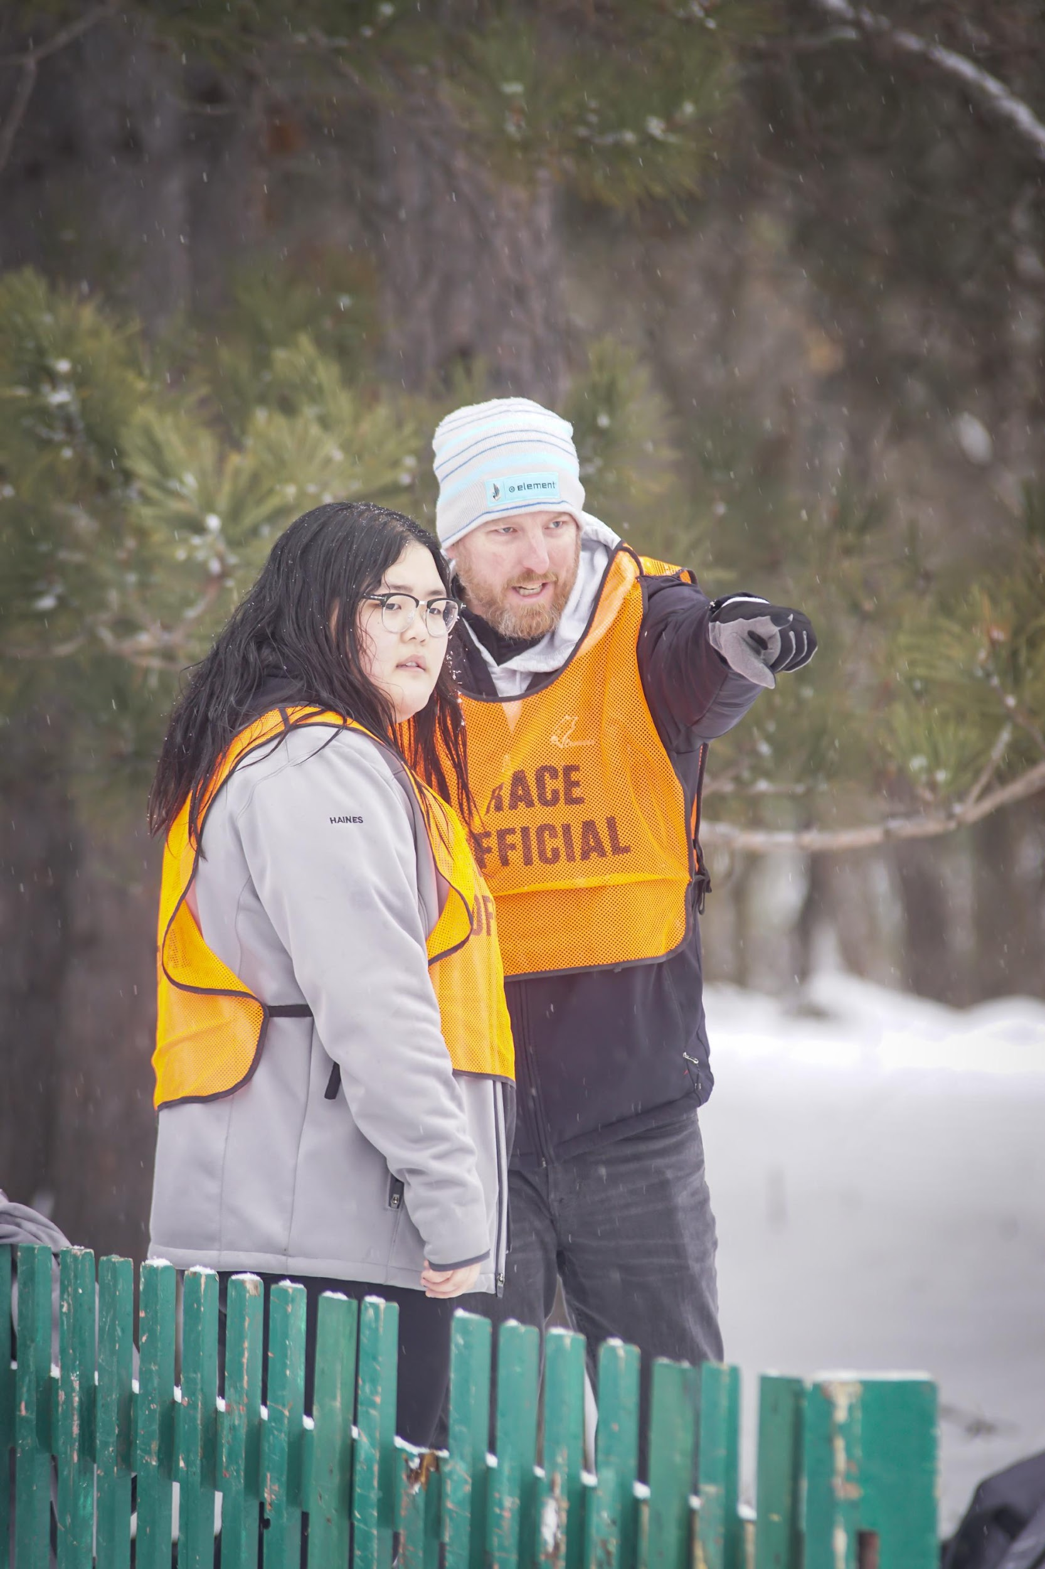
WELCOME
COACH HAUGEN
COACH ERICKSON
COACH LARSEN

Slide 5
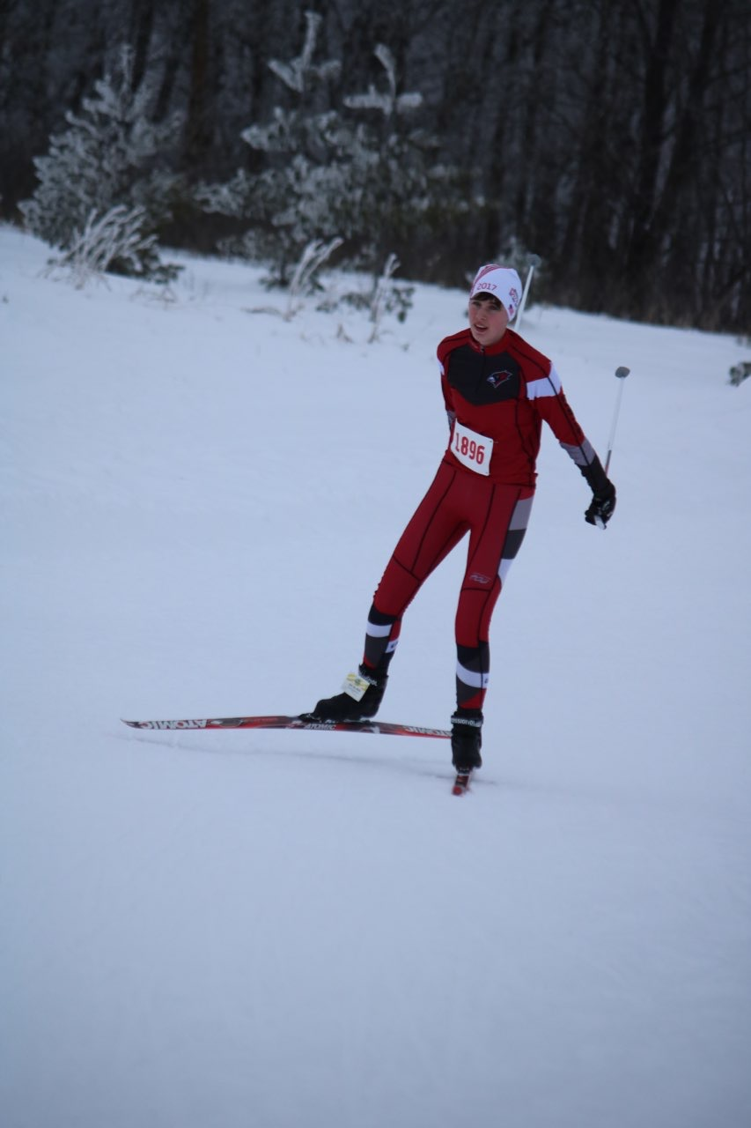
2019-2020 CAPTAINS
DANIEL HALVORSON
WILL TROCHLIL
PARKER COOK
SENIOR
LIKE TO SKI IN COLLEGE
U OF M, PURDUE, NDSU, IOWA ST, OR MIT
AEROSPACE ENGINEERING
SENIOR
COLLEGE
COMPUTER SCIENCE
SENIOR
RIDGEWATER THEN MANKATO
LAW ENFORCEMENT
WOULD LIKE TO BE PART OF THE FBI

Slide 6

AWARDS
Team Awards
Coaches Awards
CLC Senior Scholar Athlete (3.4)
Section Team All State Academic
Section Senior Academic Award (3.9)
Varsity Letters/Participation Awards
Stat Book/Pictures - Online in color
Slide Show

Slide 7
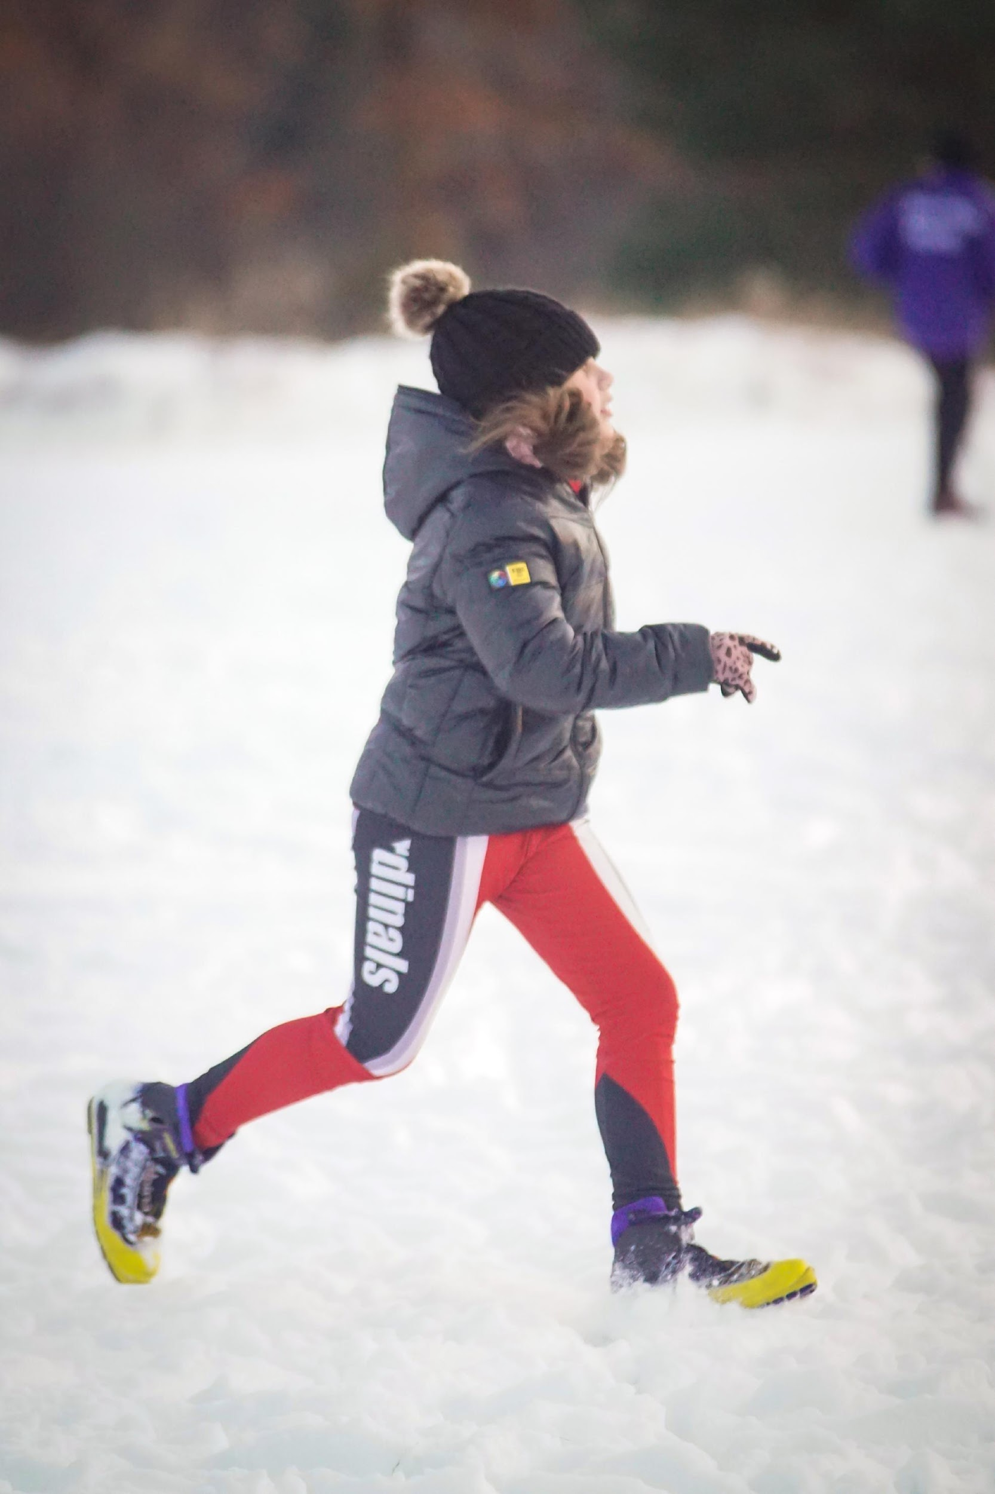
ADELINE ENGAN
ROOKIE
12TH PLACE AT JH CHAMPIONSHIP
NORDIC SKI PARTICIPATION AWARD

Slide 8
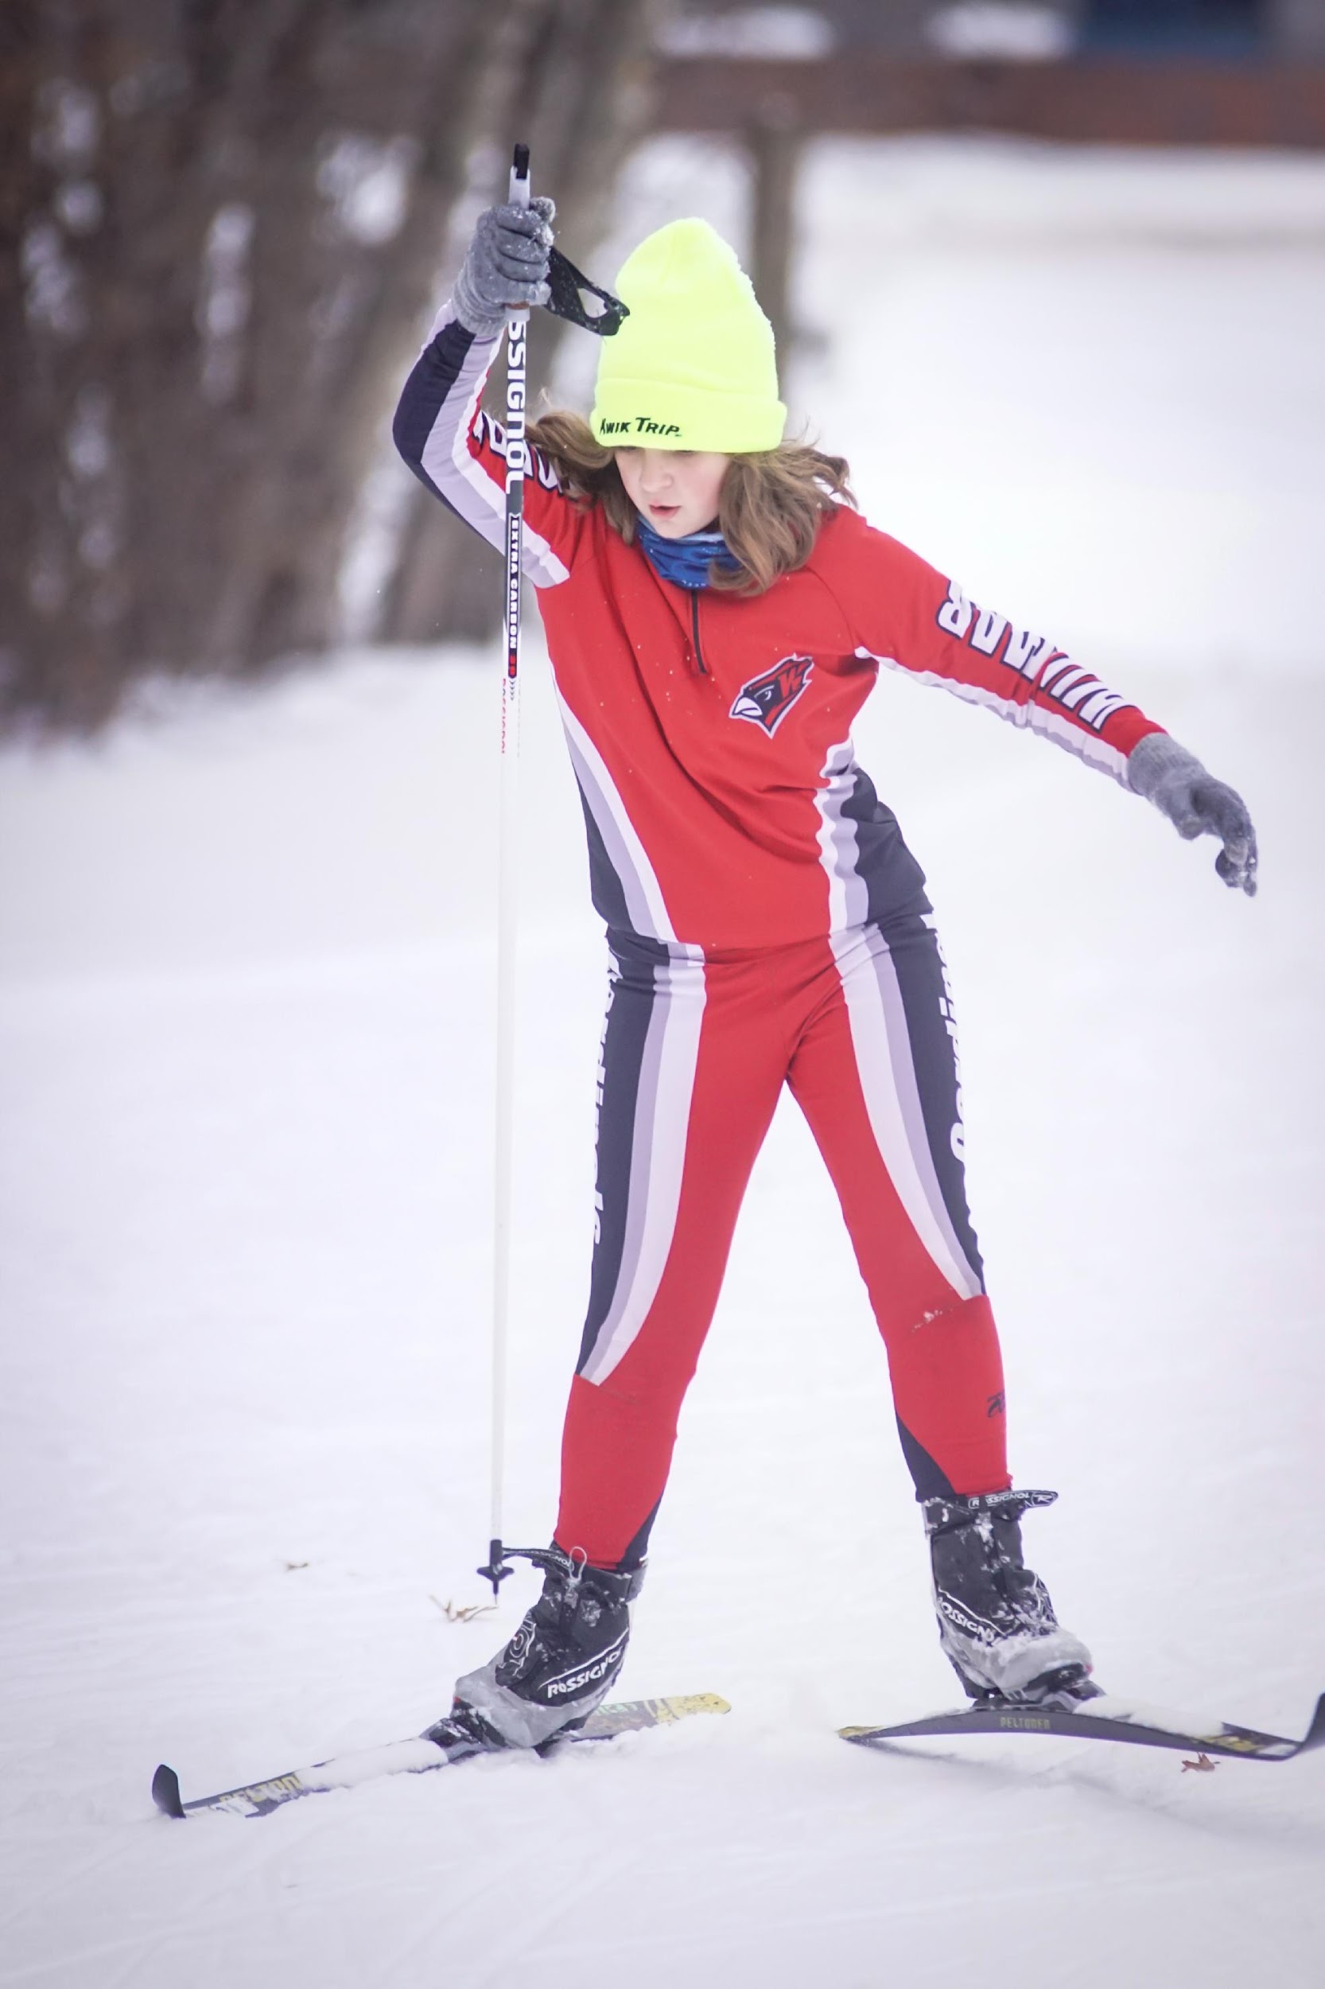
COURTNEY SCHIESSER
ROOKIE
8TH PLACE AT JH CHAMPIONSHIP
MOST AMAZING RACE-JH CHAMPIONSHIP
NORDIC SKI PARTICIPATION AWARD

Slide 9
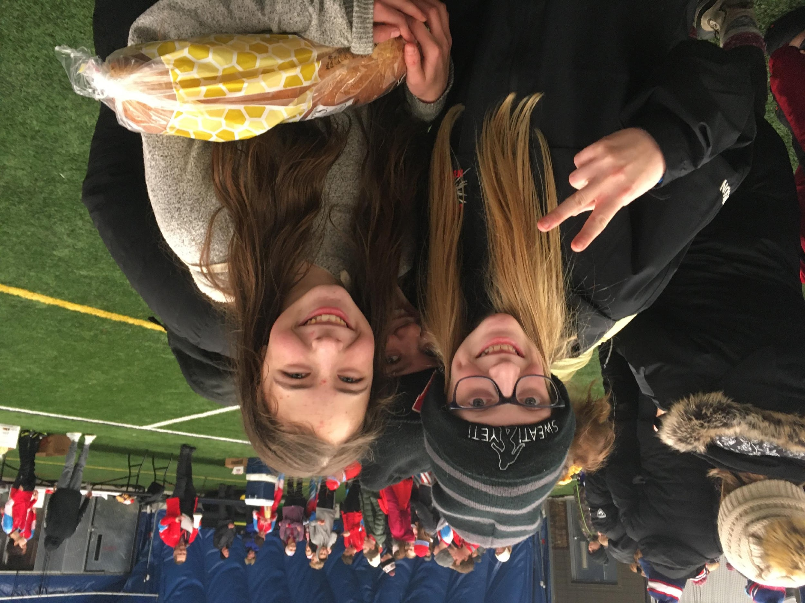
ANNIE MATHISON
SECOND YEAR SKIER
5TH PLACE AT JH CHAMPIONSHIP
MOST IMPROVED
          JV CLC CLASSIC RACE
NORDIC SKI PARTICIPATION AWARD

Slide 10
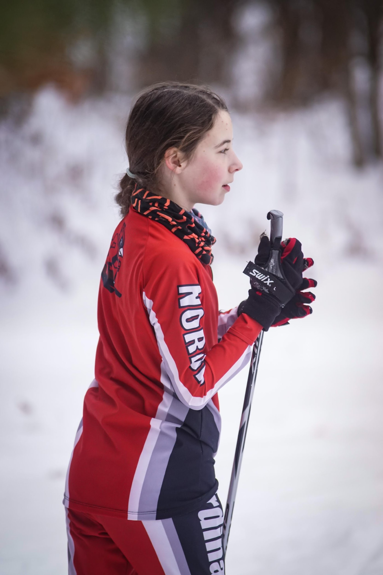
ELIZABETH HAUGEN
2ND YEAR SKIER
3RD PLACE AT JH CHAMPIONSHIP
HARDEST WORKER
MOST AMAZING RACE-JH CHAMPIONSHIP
NORDIC SKI PARTICIPATION AWARD

Slide 11
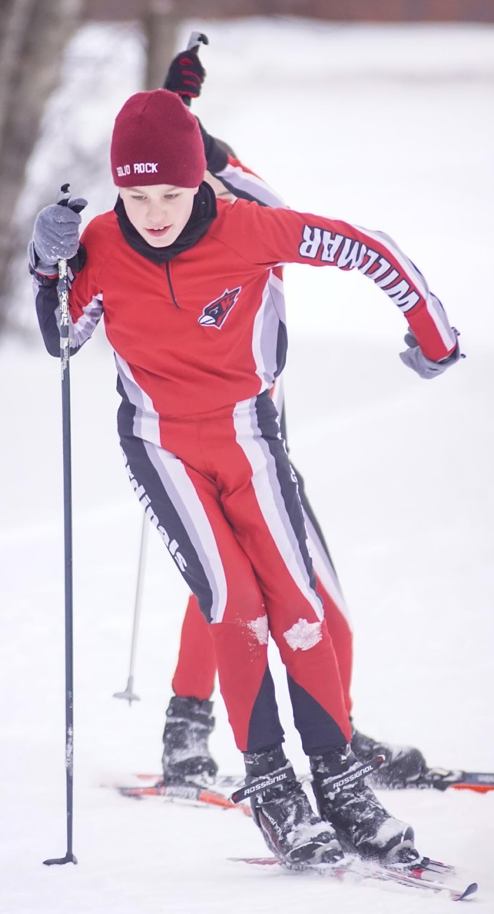
TIMOTHY HALVORSON
2ND YEAR SKIER
4TH PLACE AT JH CHAMPIONSHIP
COACHES AWARD
NORDIC SKI PARTICIPATION AWARD

Slide 12
JARED
BARRERA
2ND YEAR SKIER
22ND PLACE AT JH CHAMPIONSHIP
MOST IMPROVED
MOST AMAZING RACE-JH CHAMPIONSHIP
    EVERY RACE
NORDIC SKI PARTICIPATION AWARD

Slide 13
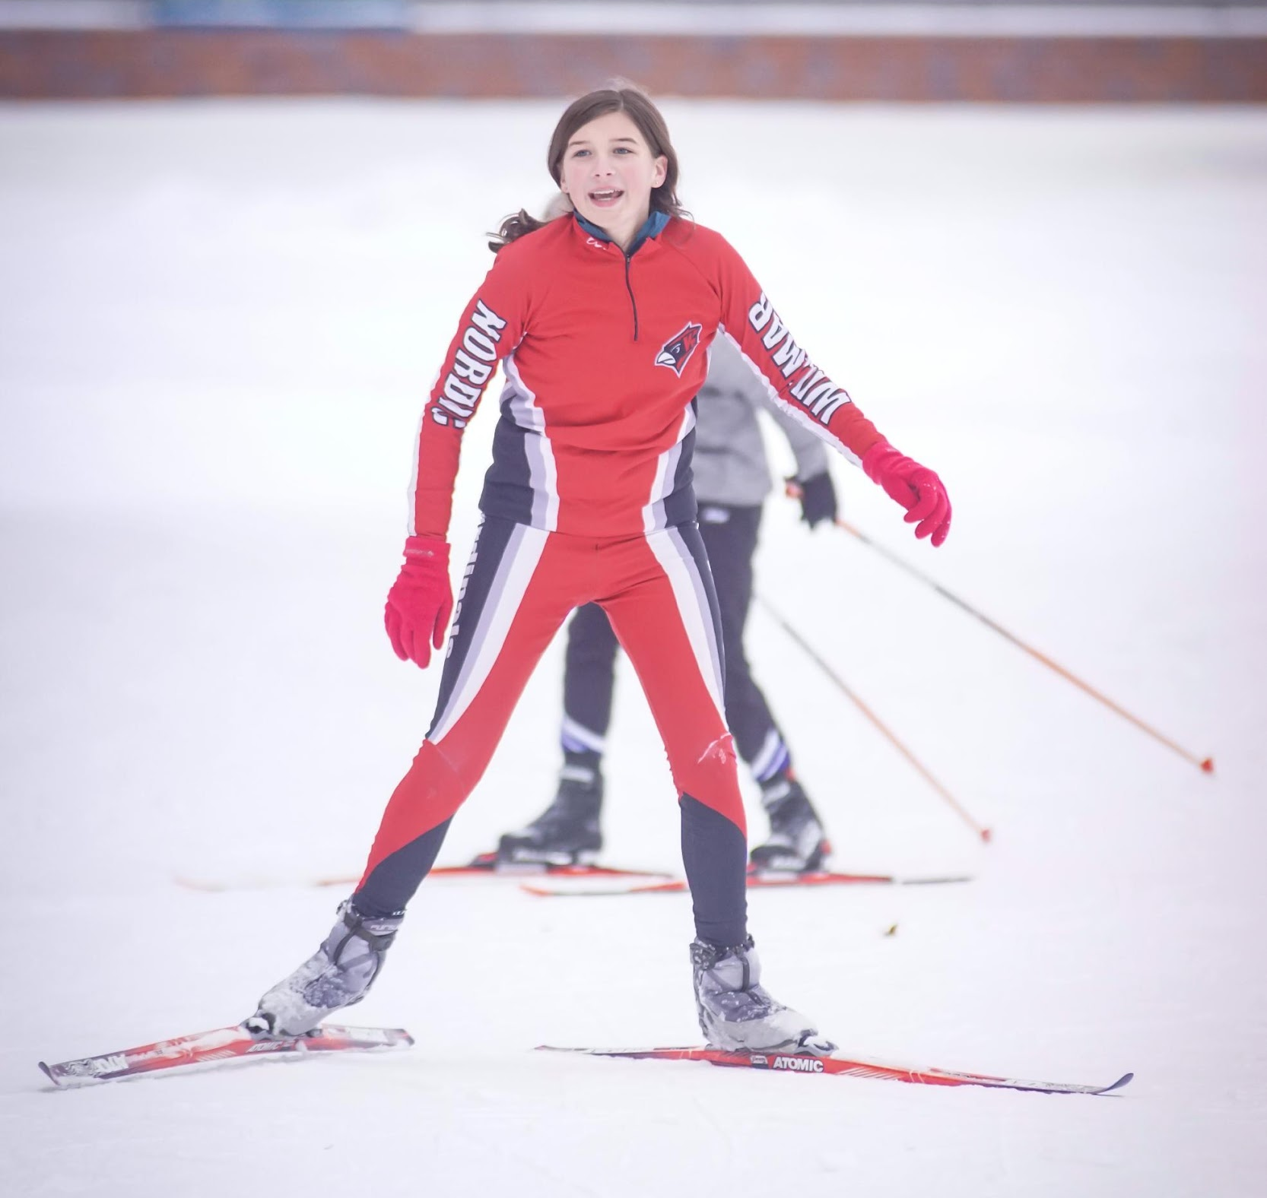
EMMIE LARSON
ROOKIE
15TH PLACE AT JH CHAMPIONSHIP
ROOKIE OF THE YEAR
NORDIC SKI PARTICIPATION AWARD

Slide 14
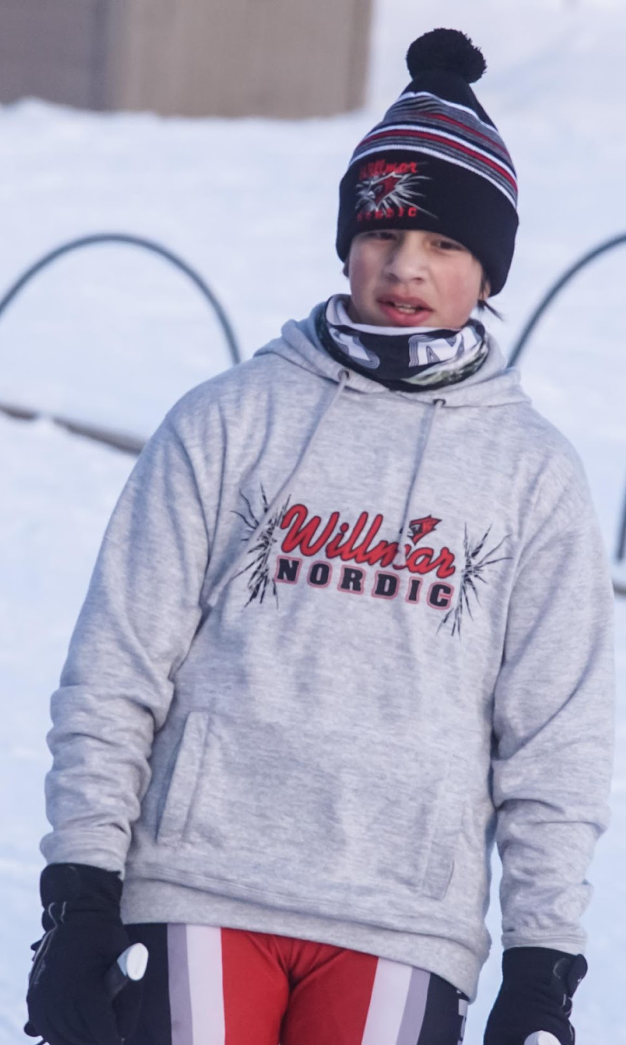
ANDREW RELLER
3RD YEAR SKIER
7TH PLACE AT JH CHAMPIONSHIP
HARDEST WORKER AWARD
MOST AMAZING RACE-ALEXANDRIA CLASSIC
SPIRIT AWARD
NORDIC SKI PARTICIPATION AWARD

Slide 15
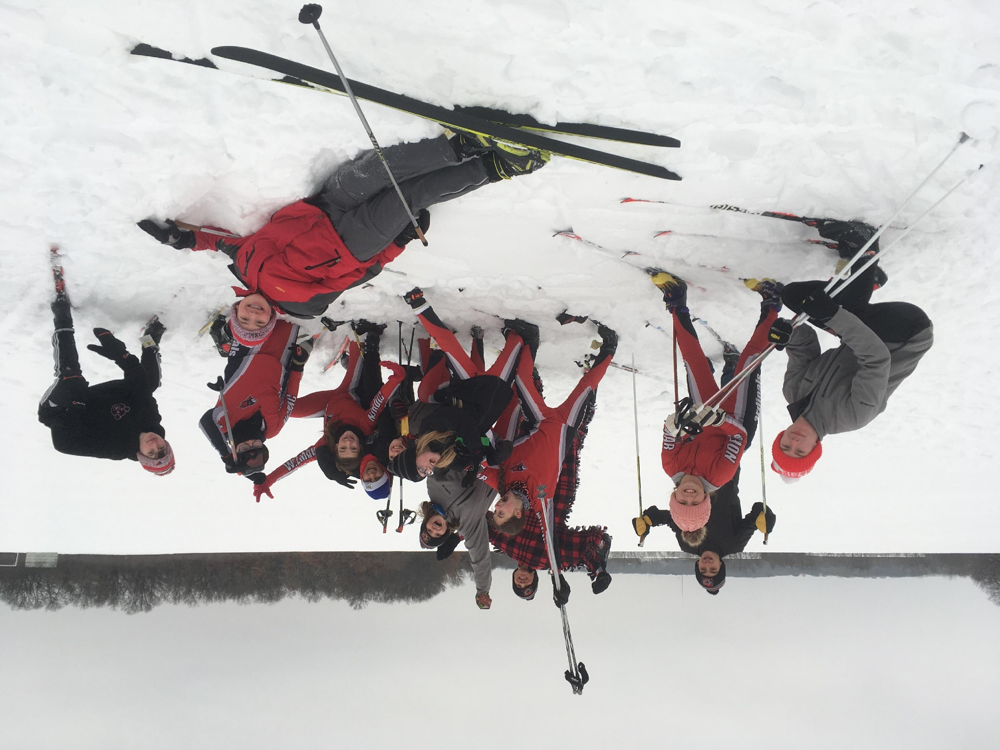
JACOB PETERSON
3RD YEAR SKIER
11TH PLACE AT JH CHAMPIONSHIP
EXPLORER AWARD
NORDIC SKI PARTICIPATION AWARD

Slide 16
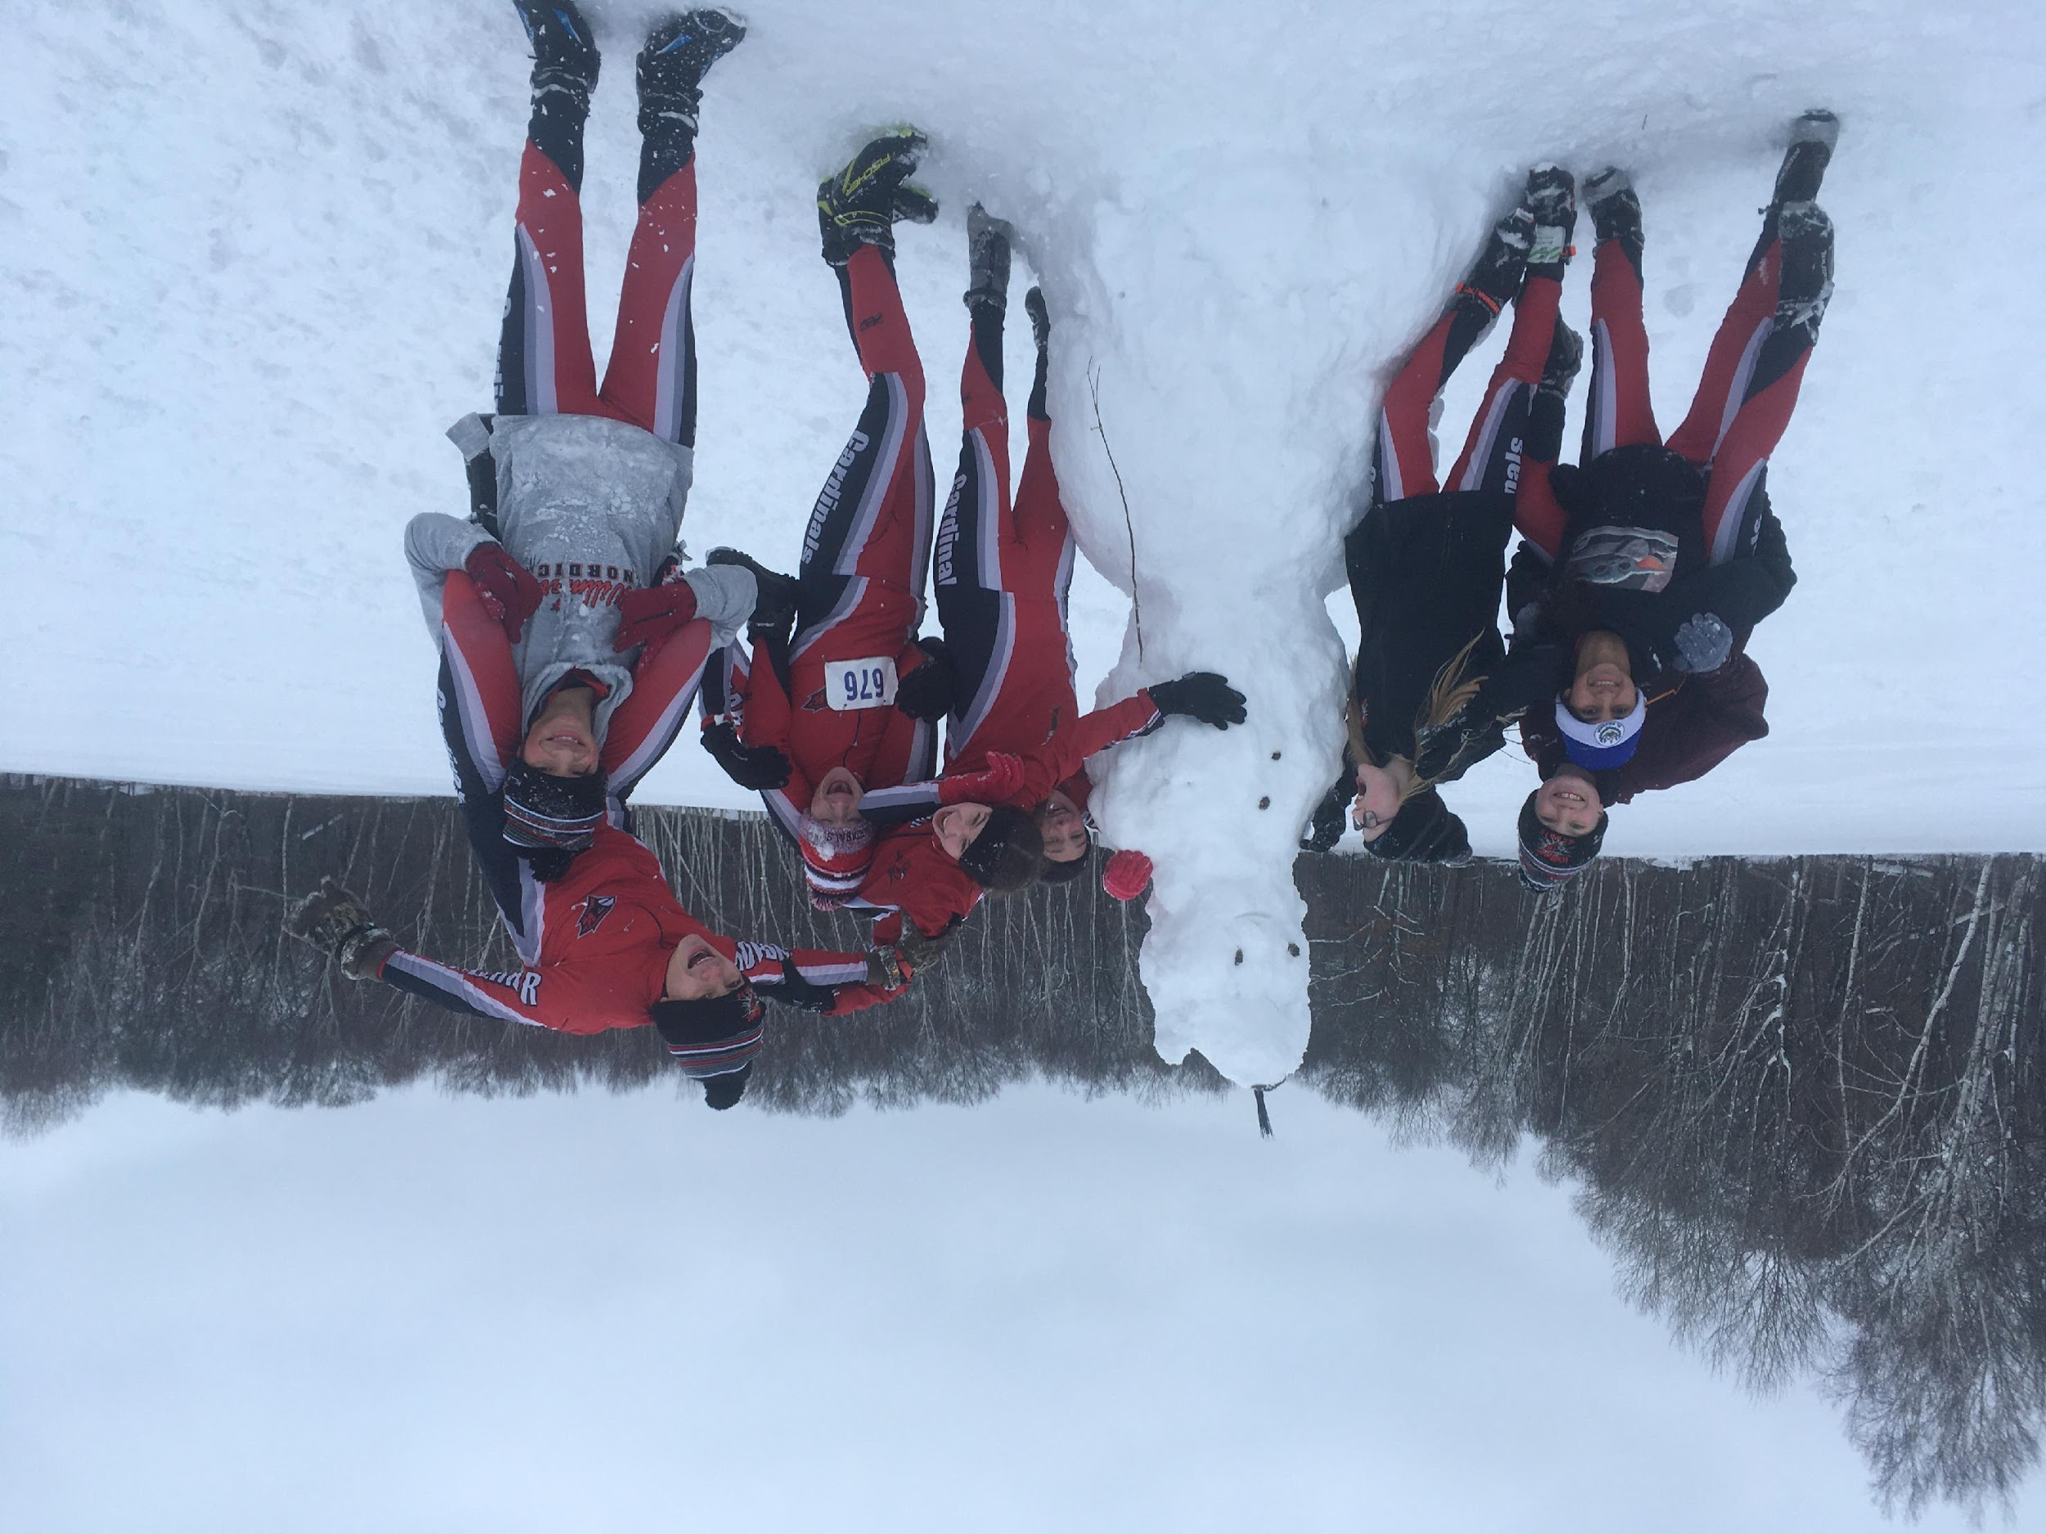
MATEO ENGAN
3RD YEAR SKIER
13TH PLACE AT JH CHAMPIONSHIP
EXPLORER AWARD
NORDIC SKI PARTICIPATION AWARD

Slide 17


Slide 18
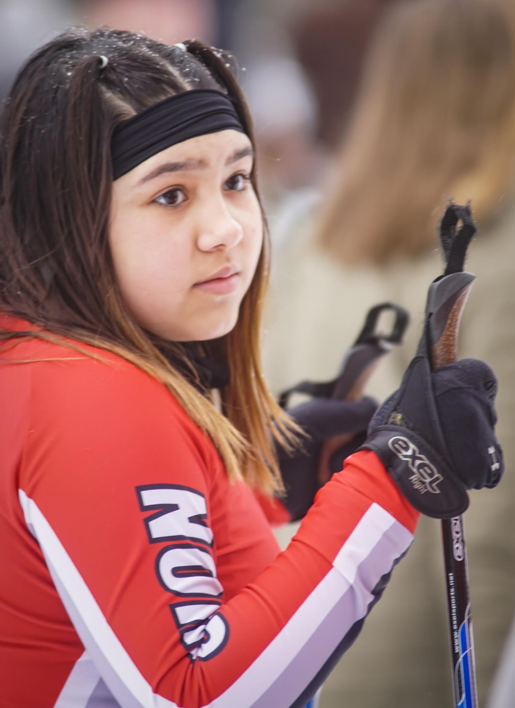
NATALIE GUTIERREZ
ROOKIE
15TH PLACE AT CLC JV CLASSIC
COACHES AWARD
NORDIC SKI PARTICIPATION AWARD

Slide 19
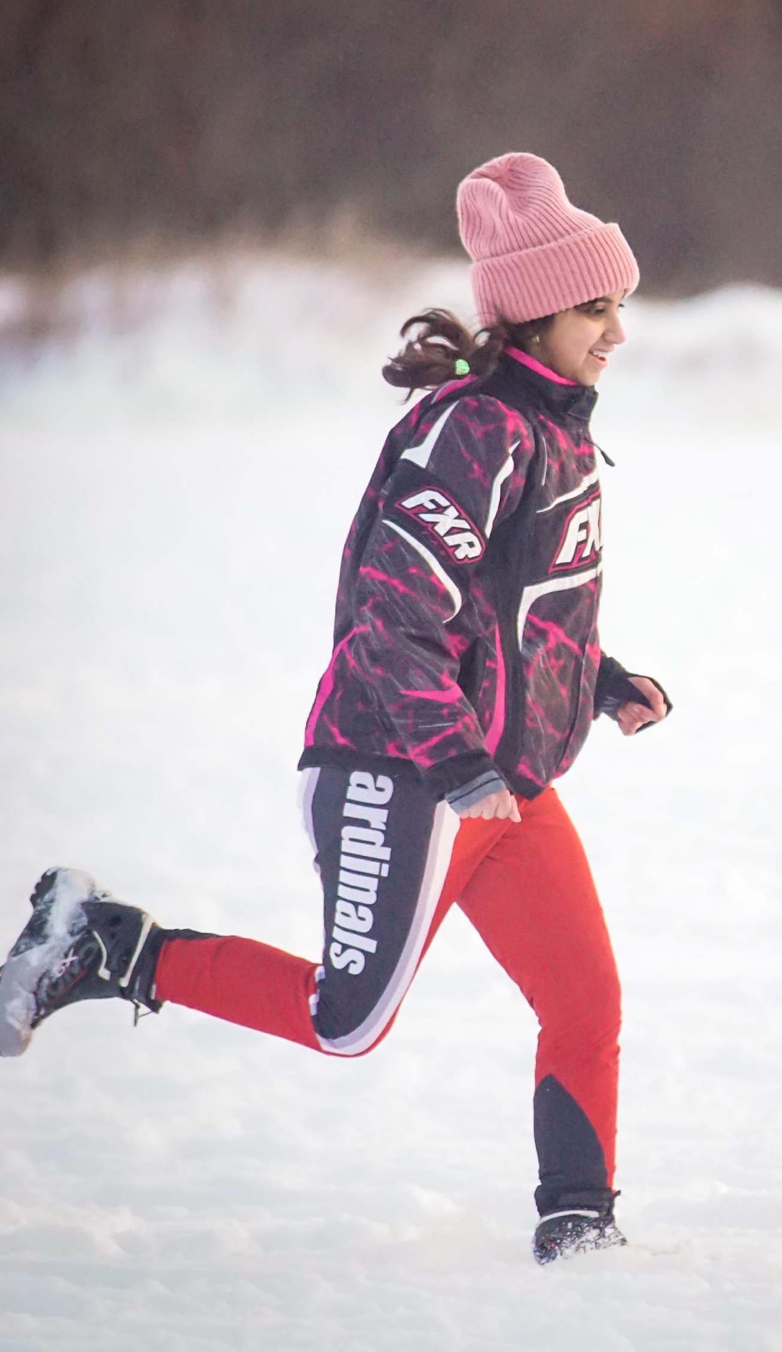
JARY SANTOS SEGOVIA
ROOKIE
14TH PLACE AT CLC JV CLASSIC
SPIRIT AWARD
NORDIC SKI PARTICIPATION AWARD
SECTION TEAM ACADEMIC-SILVER

Slide 20
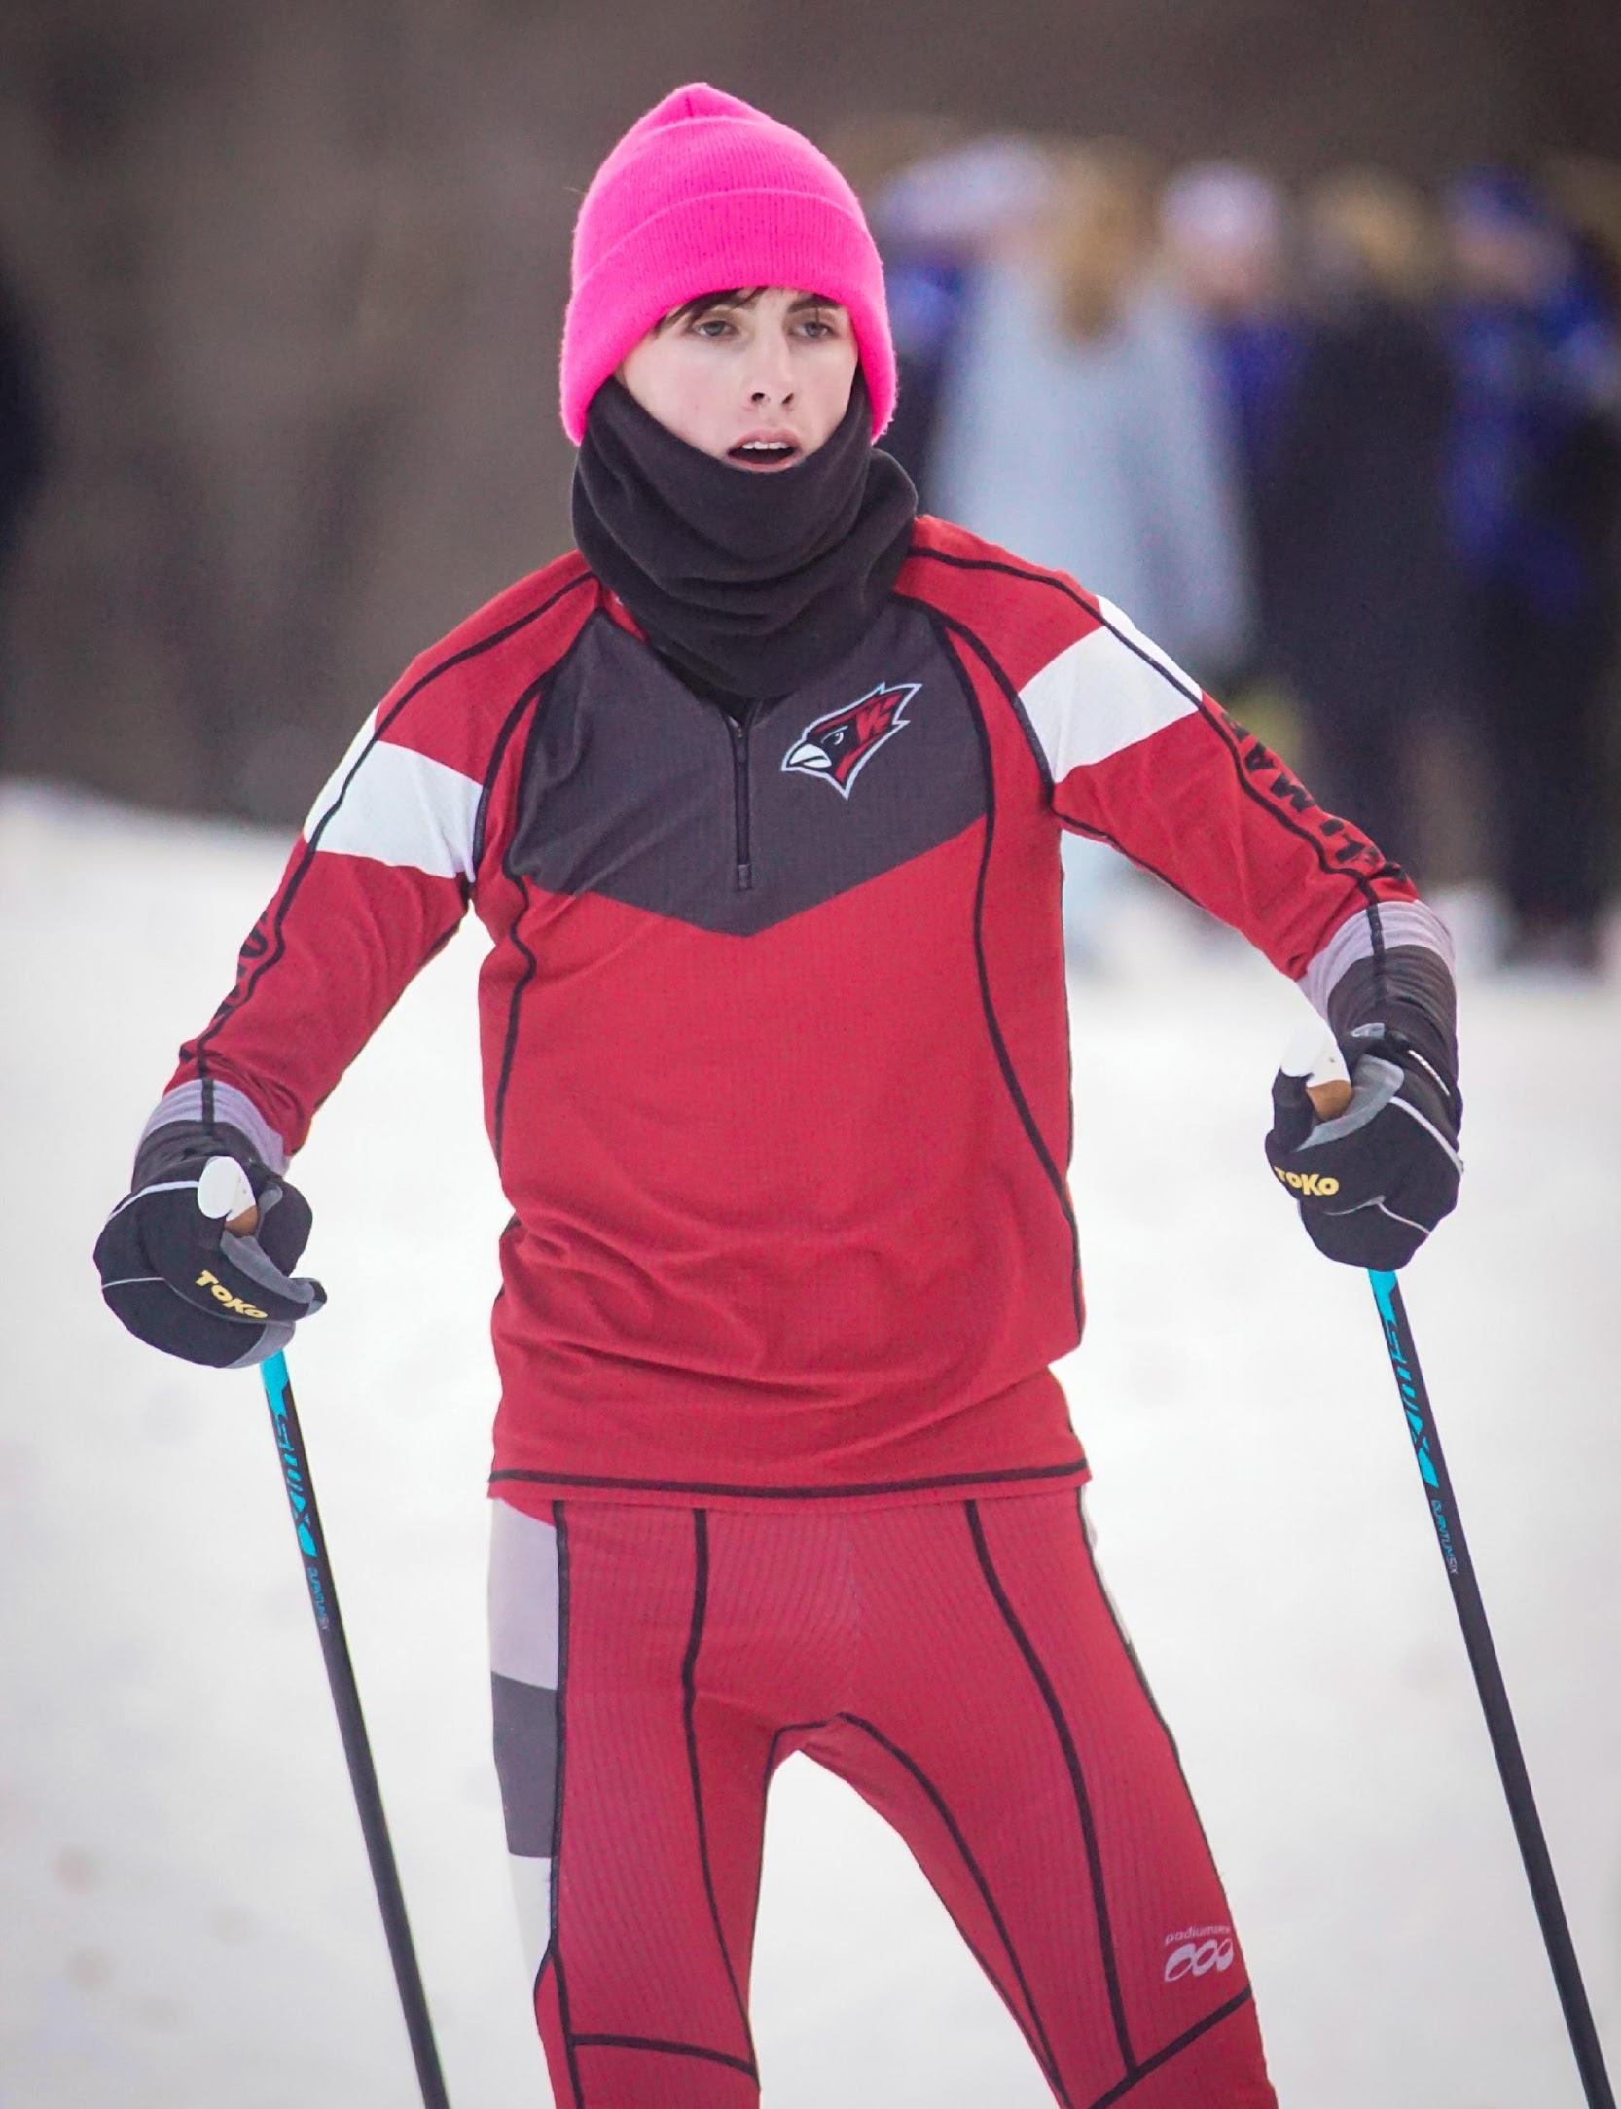
FRITZ TWEDT
5TH YEAR SKIER
23RD PLACE AT CLC VARSITY SKATE
NORDIC SKI VARSITY LETTER

Slide 21
BAILEY STAHL
3RD YEAR SKIER
26TH PLACE AT CLC VARSITY SKATE
NORDIC SKI VARSITY LETTER
SECTION TEAM ACADEMIC-SILVER

Slide 22
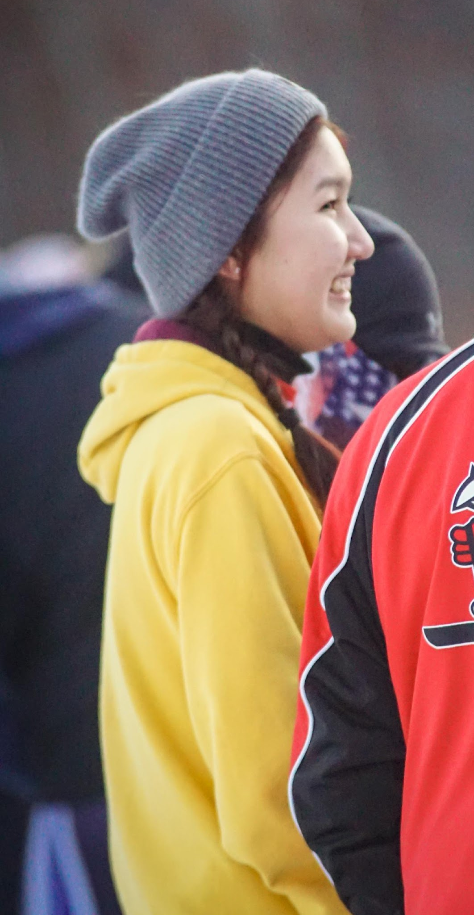
ZHANIYA “JENNY” KERIMKHAN
ROOKIE
50TH PLACE AT CLC JV SKATE
NORDIC SKI VARSITY LETTER
SECTION TEAM ACADEMIC-SILVER

Slide 23
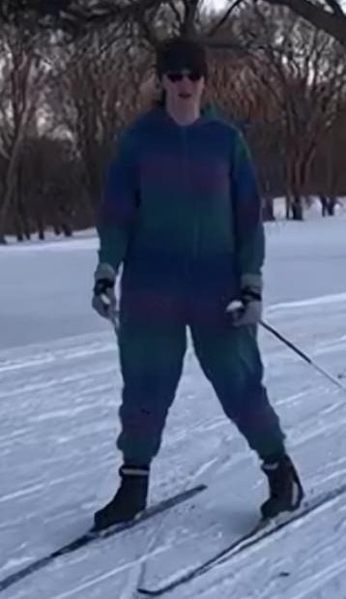
ELEANOR SCHMITZ
6TH YEAR SKIER
16TH PLACE AT CLC JV CLASSIC
CARDINAL AWARD
NORDIC SKI VARSITY LETTER
SECTION TEAM ACADEMIC-SILVER

Slide 24
CARLY
HAINES
6TH YEAR SKIER/1ST YEAR MANAGER
1ST PLACE MANAGER
TEAM MANAGER AWARD
“GREATEST JUNIOR MANAGER EVER!”

Slide 25
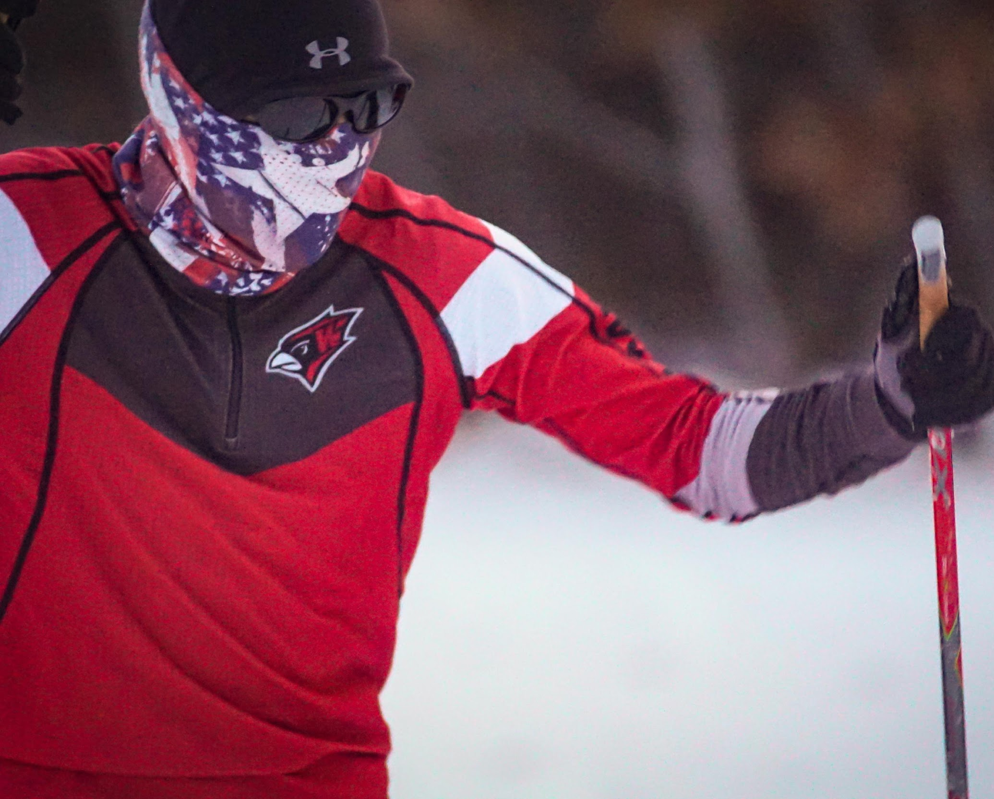
MATTHEW WEISS
3RD YEAR SKIER
20TH PLACE AT CLC VARSITY CLASSIC
NORDIC SKI VARSITY LETTER

Slide 26
PARKER
COOK
6TH YEAR SKIER
20TH PLACE AT CLC VARSITY SKATE
CLC HONORABLE MENTION AT LARGE
CAPTAIN
NORDIC SKI VARSITY LETTER
CLC SENIOR SCHOLAR ATHLETE
SECTION TEAM ACADEMIC-SILVER

Slide 27
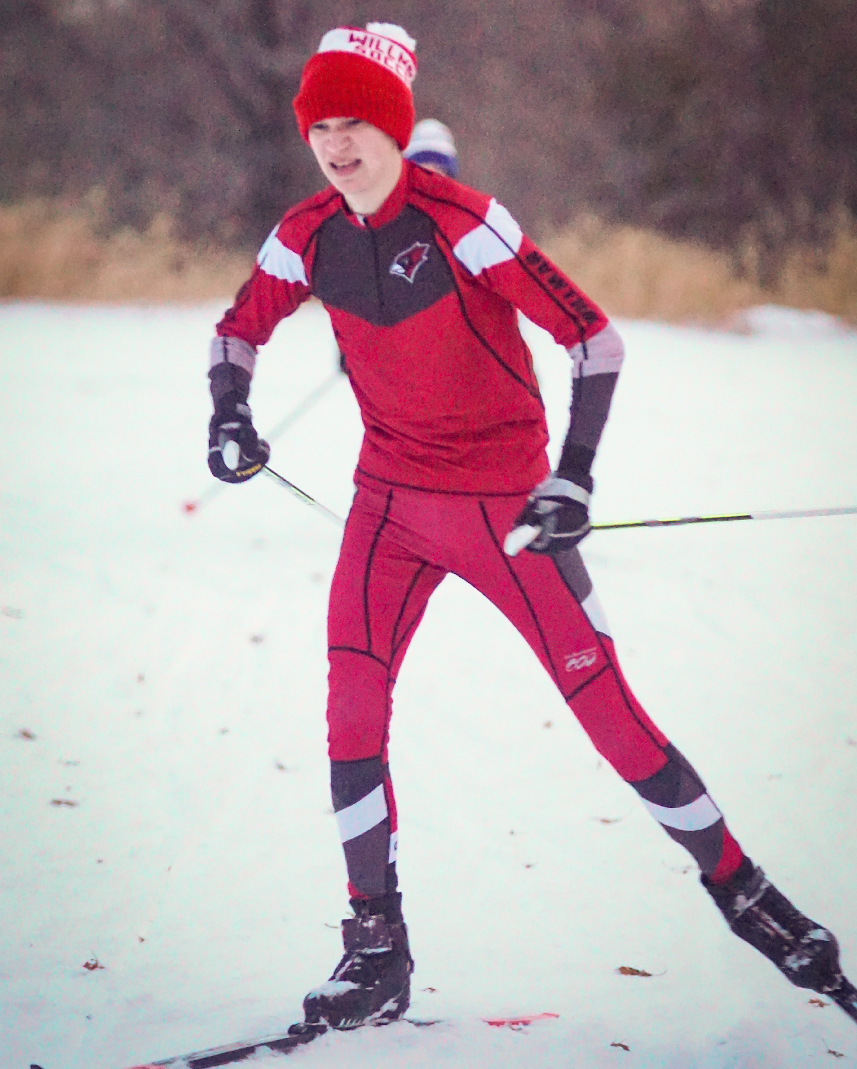
WILL TROCHLIL
7TH YEAR SKIER
24TH PLACE AT CLC VARSITY SKATE
CAPTIAN
CARDINAL AWARD
NORDIC SKI VARSITY LETTER

Slide 28
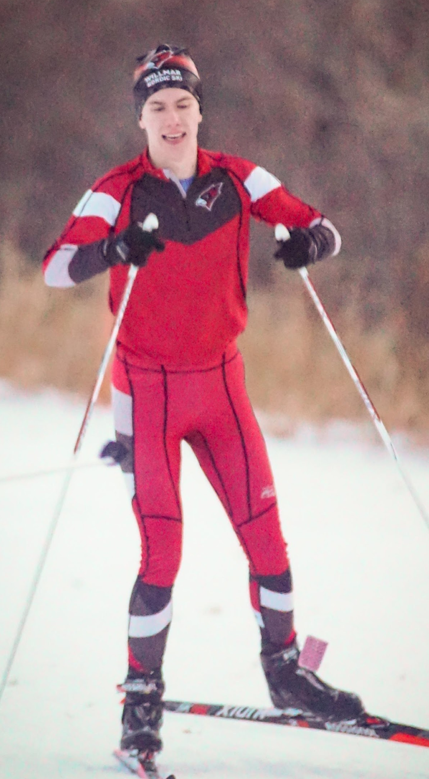
DANIEL HALVORSON
7TH YEAR SKIER
20TH PLACE AT CLC VARSITY SKATE
CLC HONORABLE MENTION AT LARGE
CAPTAIN
MVP
SENIOR SCHOLAR ATHLETE
SENIOR ALL SECTION AWARD
CLC SENIOR SCHOLAR ATHLETE
NORDIC SKI VARSITY LETTER

Slide 29
NEXT YEARS CAPTAINS
BAILEY STAHL
ELEANOR SCHMITZ
FRITZ TWEDT
ANDREW RELLER

Slide 30
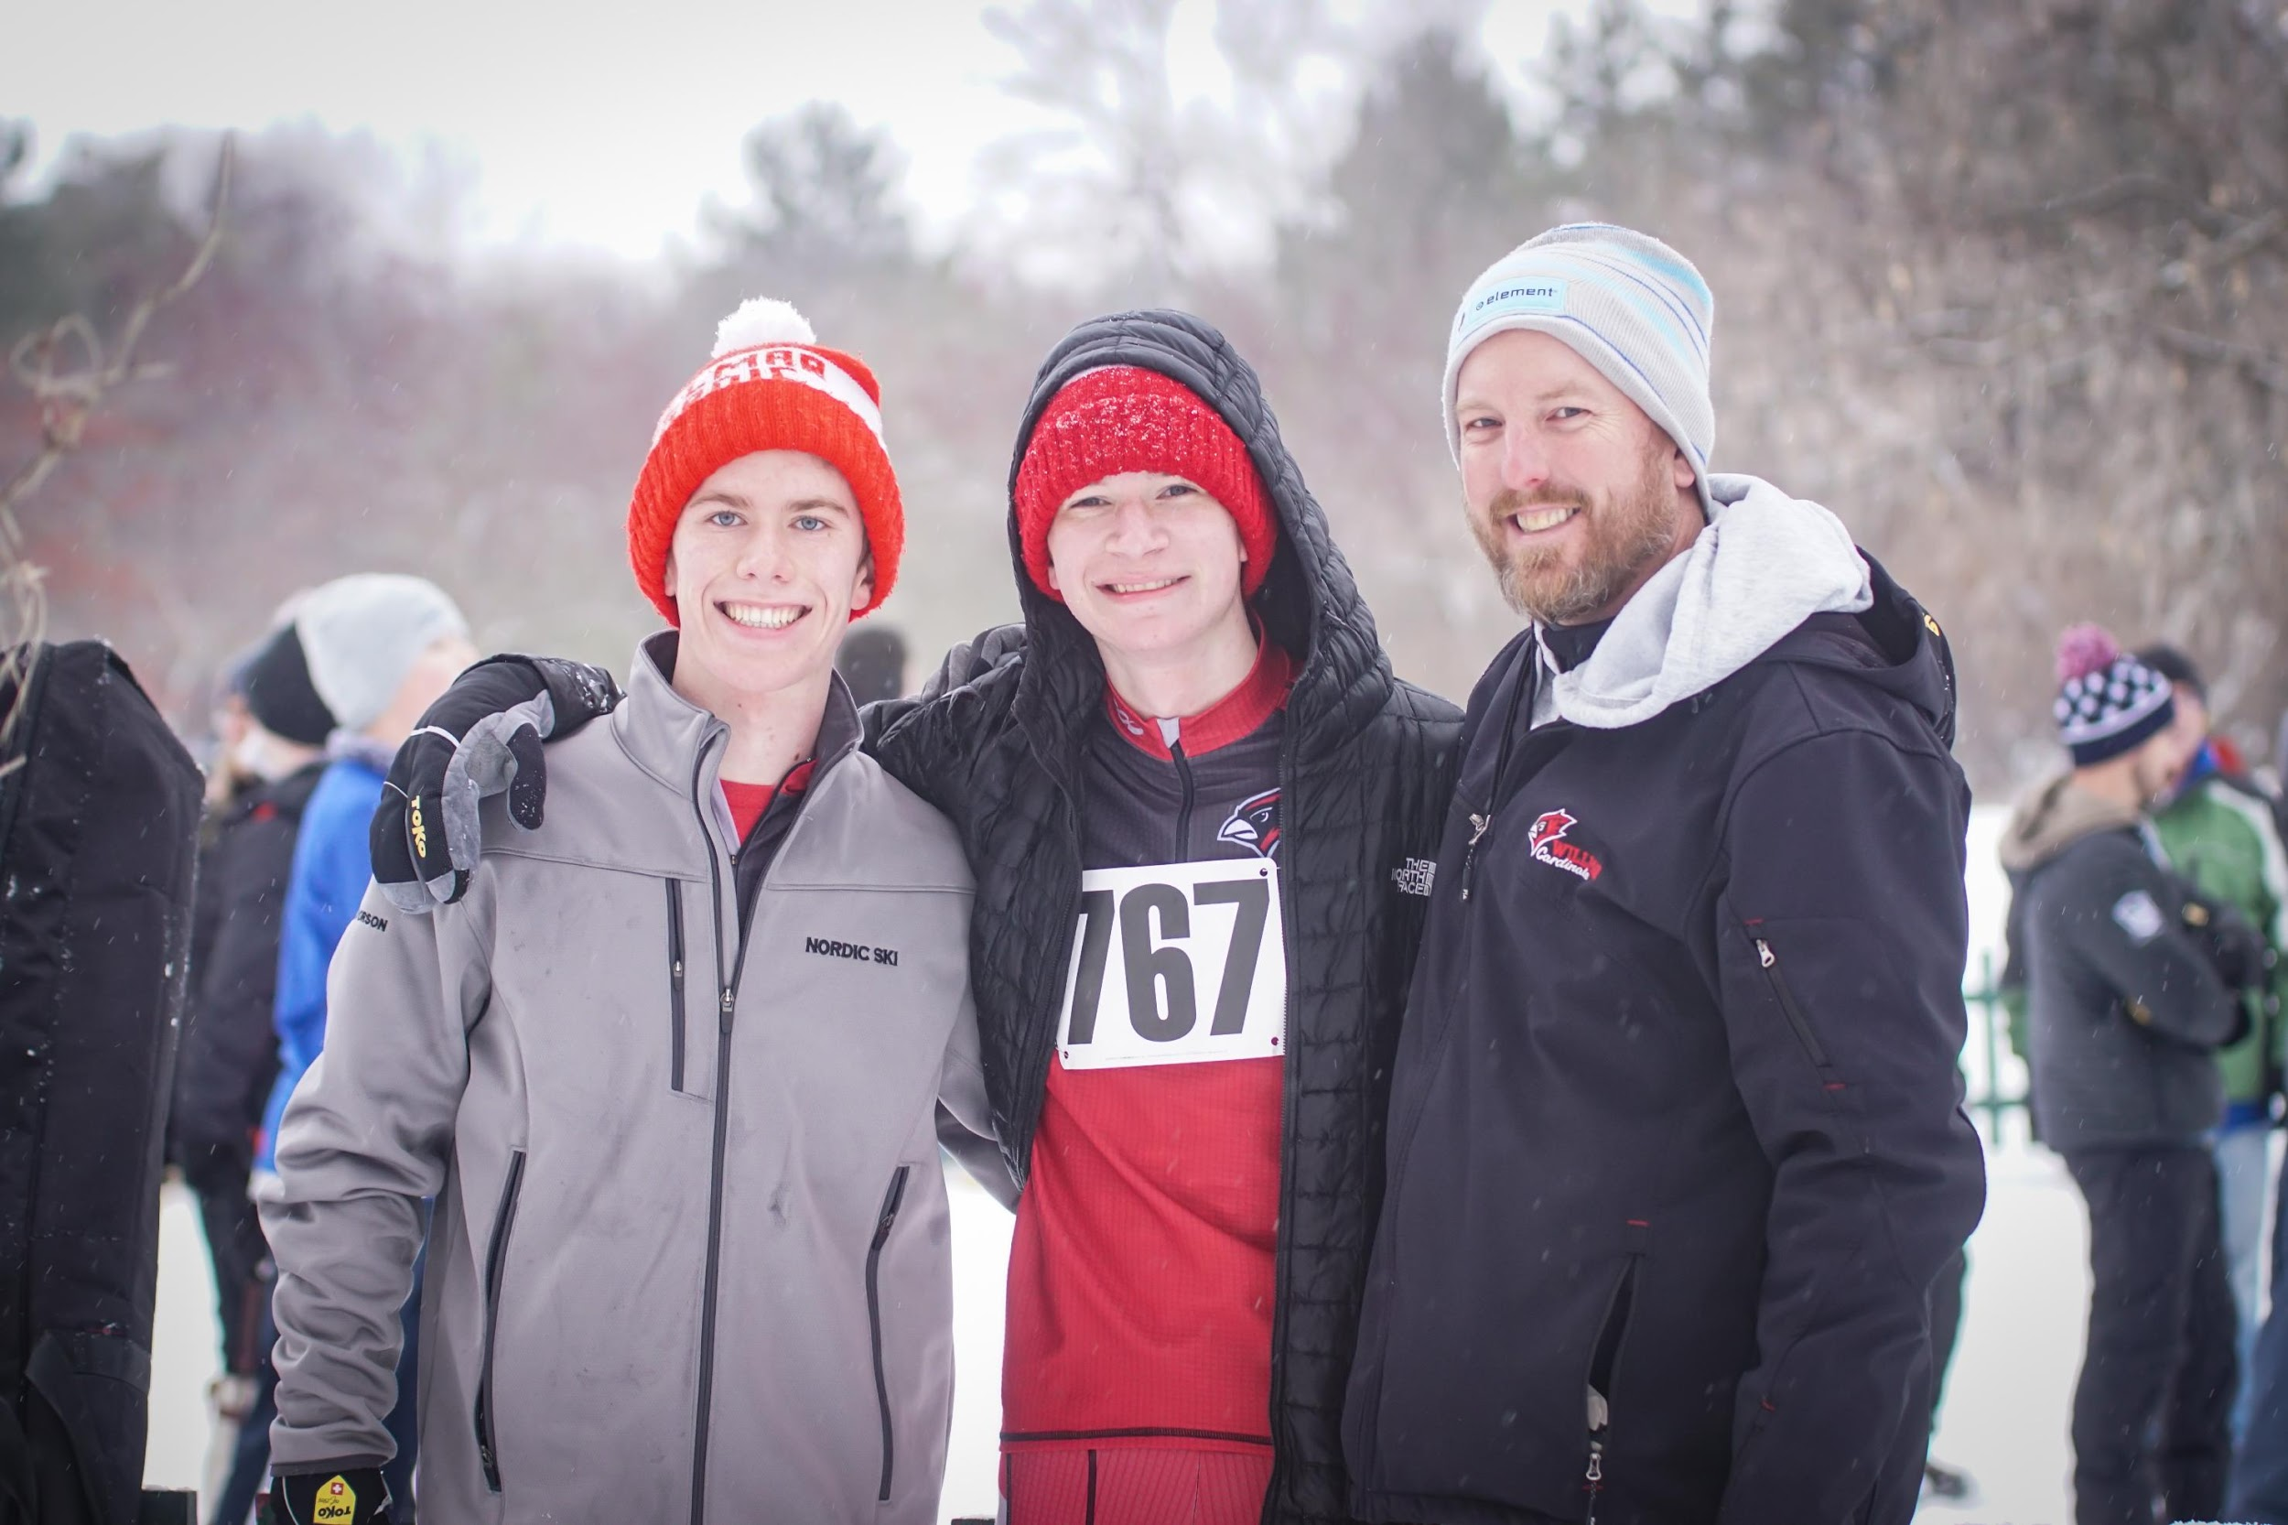
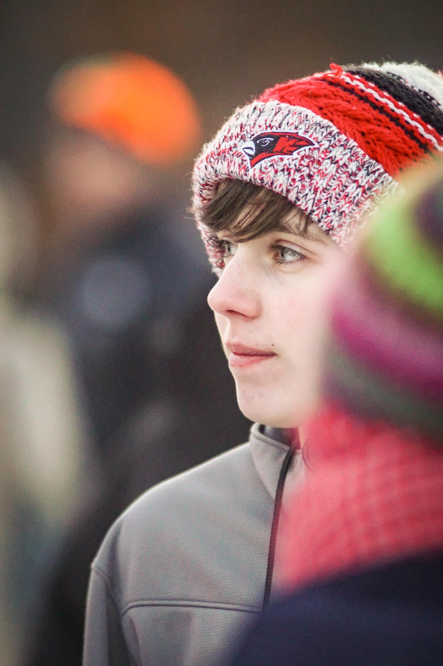
THANK YOU FOR A GREAT SEASON!
SENIORS WE WILL MISS YOU!

Slide 31
GET READY FOR NEXT SEASON
BE READY!
Upcoming Fundraisers
Skis for next year – Skate and Classic
VCD Award
Off season - Summer
  Camps
  Team workouts – cross training
  Cardinal Conditioning
What are you doing to get stronger and faster
  2-3 times a week?
  Spring and Fall sport
  Summer
Goals for next year
  Some ideas are at the end of the stat book
  Be Dedicated
  Be Consistent
Coffee Fundraiser
Brat Stand at Cashwise???
Ongoing fundraiser – Ecophones
Other fundraisers

