Slide 1

Sexual Harassment Under Title IX
Training

Slide 2
Title IX: No person in the United States shall, on the basis of sex, be excluded from participation in, be denied the benefits of, or be subjected to discrimination under any education program or activity receiving Federal financial assistance

Slide 3
Title IX doesn’t just apply to athletics. Sexual harassment, including sexual assault, is unlawful sex discrimination under Title IX.

Slide 4
In order for Title IX to apply, the incident must have occurred in a school program or activity. This includes locations, events or circumstances in which the school exercises substantial control over both the respondent (the person alleged to have committed an offense) and the context in which the alleged offense occurred.
This can include sporting events, bus rides, field trips, dances, etc. even if held off campus. If the alleged incident(s) happen in an environment outside these definitions, other code of conduct actions may be taken but Title IX does not apply.

Slide 5
In order for Title IX to apply, the behavior must have been:
Hostile Environment Sexual Harassment: A District employee, another student, or a third party subjecting a student to sexually harassing conduct that is sufficiently severe, persistent, or pervasive to limit a student’s ability to participate in or benefit from an educational program or activity, or to create a sexually hostile, abusive, or offensive educational environment; or

Slide 6
Quid Pro Quo Sexual Harassment: A District employee basing an educational decision on, or explicitly or implicitly conditioning a student’s participation in an education program or activity on, the student’s submission to unwelcome sexual advances, request for sexual favors, or other verbal, nonverbal, or physical conduct of a sexual nature.

Slide 7
Definitions:
Complainant: The individual alleged to be the victim, should be advised of how to file a formal complaint, and should be provided supportive measures regardless of whether the victim decides to file a formal complaint.
Respondent: The person alleged to be responsible for the behavior prohibited under Title IX; they are presumed innocent during the grievance process.

Slide 8
Definitions cont’:
Supportive Measures: non-disciplinary, non-punitive individualized services offered to the Complainant or Respondent before or after the filing of a Formal Complaint or where no Formal Complaint has been filed.
Supportive measures are designed to restore or preserve equal access to the recipient’s education program or activity without unreasonably burdening the other party. The school must maintain as confidential any supportive measures provided to the complainant or respondent, to the extent that maintaining such confidentiality would not impair the ability of the School to provide the supportive measures.

Slide 9
Examples of Supportive Measures:
Staff escorts for the Complainant
Extending academic deadlines or modifying class schedules
Mutual restrictions between the parties (no-contact agreements)
Leaves of absence
Check ins with a mental health provider or administrator
Increased security and monitoring of certain areas of the school
Other measures that are not unreasonably burdensome to the Respondent

Slide 10
Emergency Removal:
In some cases it may be appropriate for Respondent to be removed from the educational environment or activity. If there is an immediate threat to a person’s physical health or safety arising from the allegations of sexual harassment, and the following criteria are met:

Slide 11
Emergency Removal cont.’:
Must complete an individualized safety risk or safety analysis
School must determine that an immediate threat exists and that it justifies removal
May be determined through a Suicide Risk Review or Threat Assessment process
Respondent must be provided notice and opportunity to contest removal

Slide 12
Situation 1: Allegations Between Students
This would involve severe and pervasive sexual harassment, or sexual violence
1) Report the incident to Title IX Coordinator and follow mandatory reporting requirements if applicable
2) Make sure supportive measures are made available to student(s)
3) Follow the Title IX Grievance Procedures

Slide 13
Situation 2: Allegations Between Employee and Student
This would involve severe and pervasive sexual harassment, quid pro quo sexual harassment, or sexual violence
1) Report the incident to Title IX Coordinator, report the incident to Human Resource, and follow mandatory reporting requirements if applicable
2) Make sure supportive measures are made available to student(s)
3) Follow the Title IX Grievance Procedures and HR Procedures

Slide 14
Title IX Grievance Procedures/
Steps for School Title IX Point of Contact
Sexual Harassment or Discrimination is observed or reported to School Title IX Point of Contact (Title IX POC)
Title IX POC will contact the District’s Title IX Coordinator
Title IX POC will mandatory report (if applicable)
Offer Supportive Measures
School Discipline (if applicable)/HR contact (if applicable)
Advise Students & Parents of Title IX Rights

Slide 15
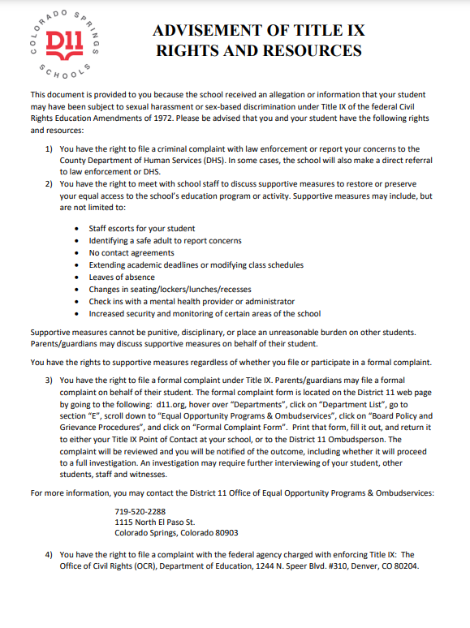
Advisement of rights:

Slide 16
Colorado Springs School District 11 Title IX Coordinator:
District 11 Office of Equal Opportunity Programs & Ombudservices
719-520-2288

Slide 17
Encourage your school community to report concerns directly to a school administrator or the Title IX Coordinator. Anonymous reports via Safe2Tell can be very difficult to investigate.

