Slide 1
2014-15
Nordic Ski Banquet

Slide 2
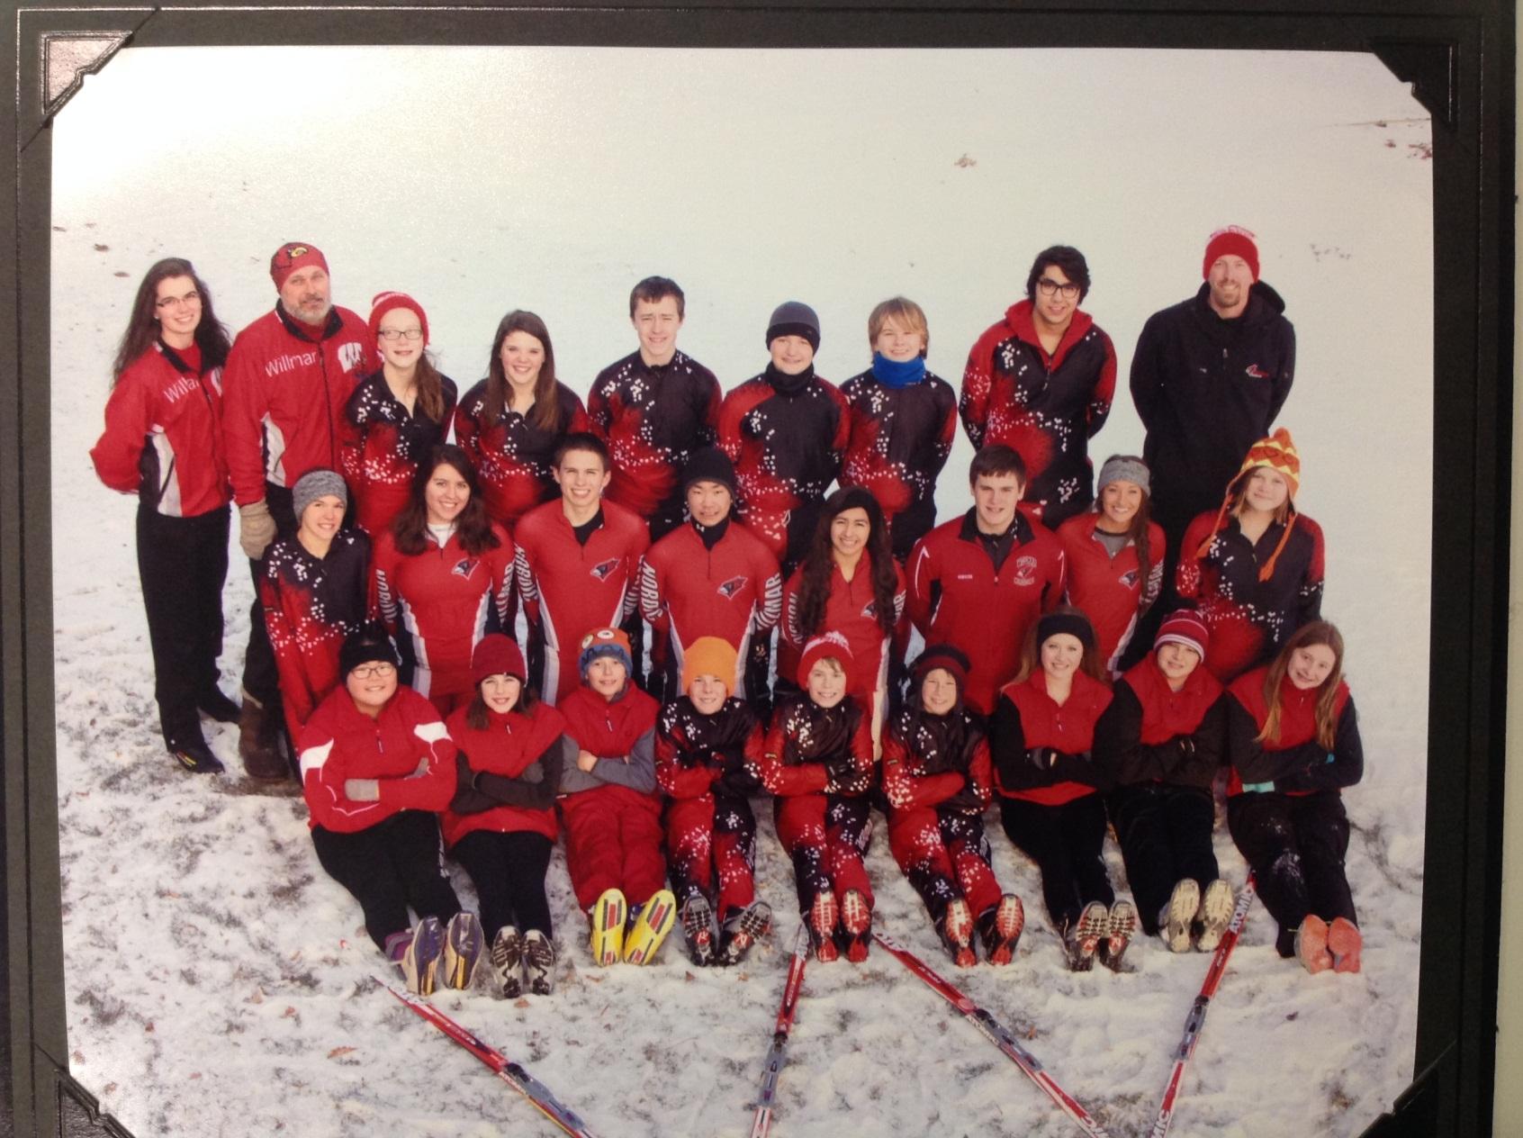
14-15 Ski Team

Slide 3
Welcome
Opening – How the season went
-Coach Haugen
-Coach Palmer
-Coach Hulstrand

Slide 4
Awards
Achievement Awards
Team Letters/Participation
Academic Award
Stat Book

Slide 5
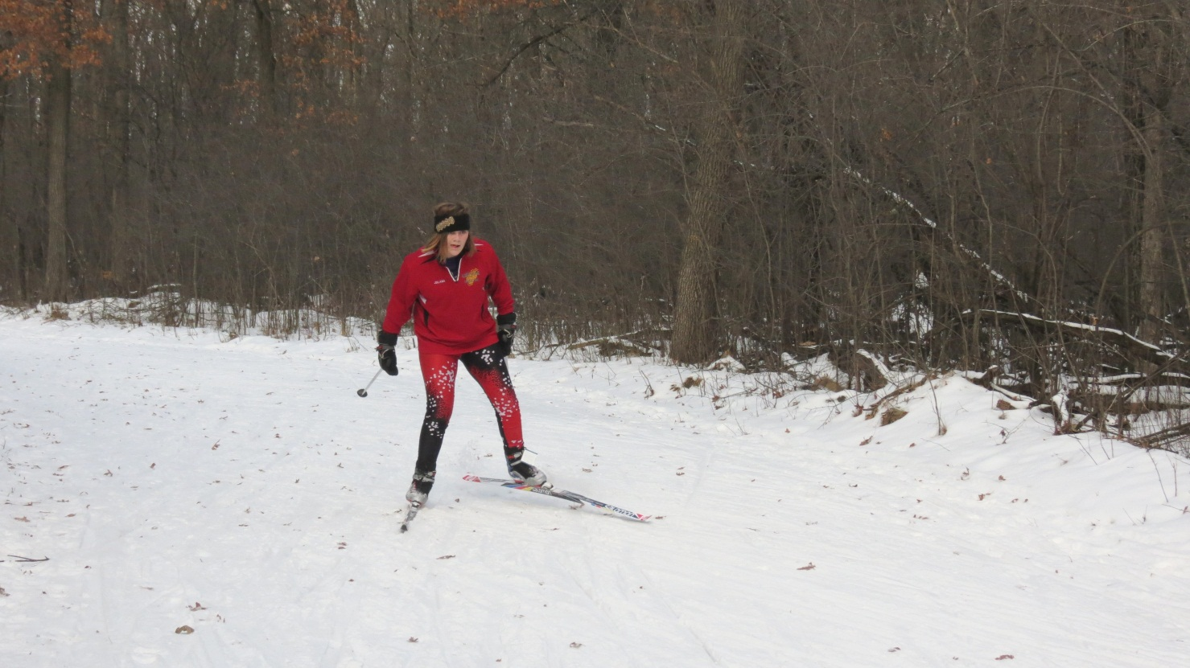
Juliana Palmer
JH most amazing race
  Mora & JH Championship

Slide 6
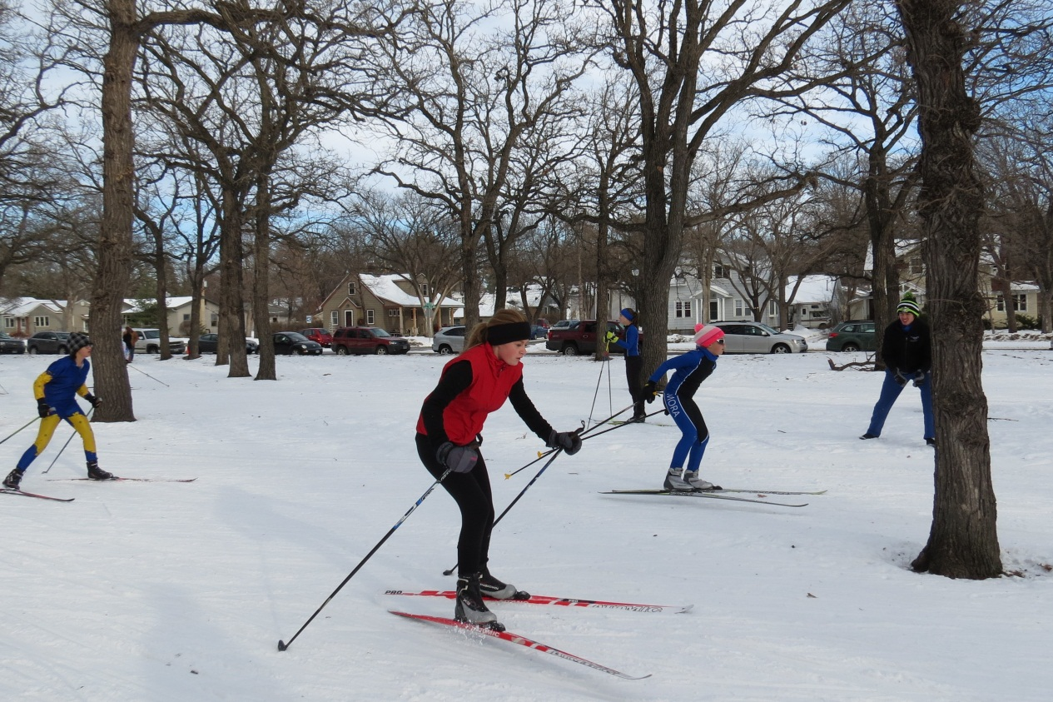
Annika Steglein
Rookie of the Year
JH most improved

Slide 7
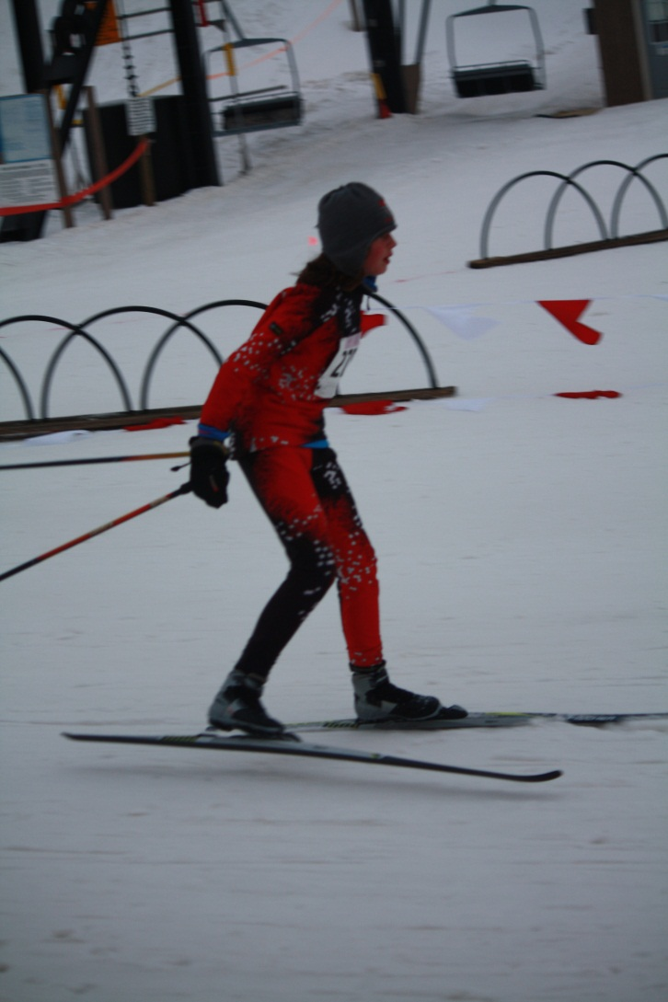
Katelyn Cook
JH hardest worker
JH mvp

Slide 8
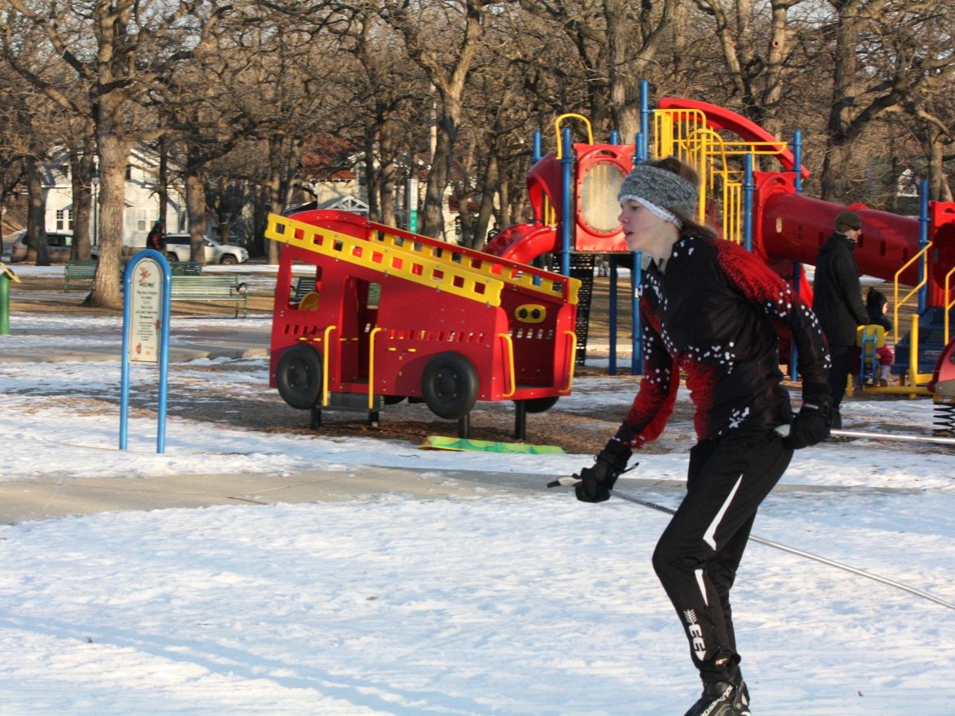
Cassidy Hanson
Most Improved

Slide 9
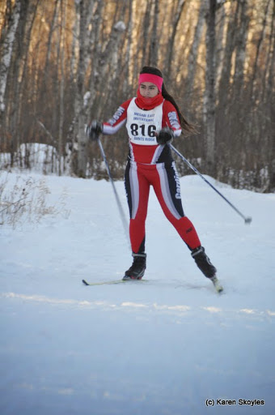
Maite Marin-Mera
Most Amazing Races -Every race
14-15 Captain

Slide 10
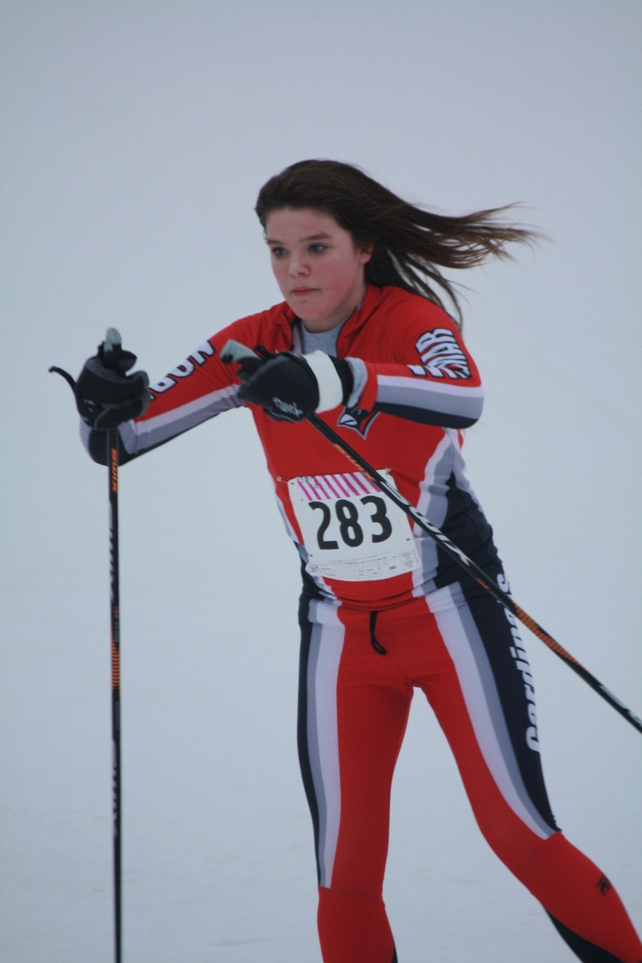
Marina Moyers
CLC at large
  10th place
MVP

Slide 11
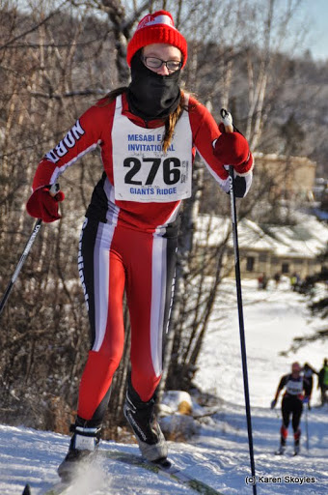
Joely Palmer
Hardest Worker
CLC Honorable Mention
  8th place in the CLC classic race

Slide 12
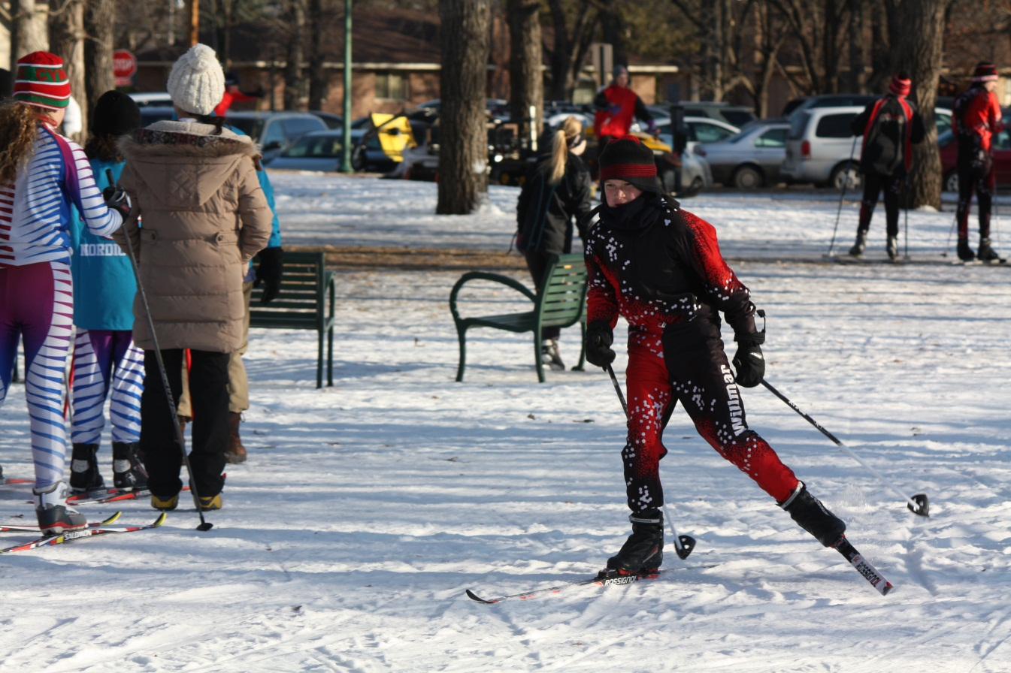
William Trochlil
JH hardest worker

Slide 13
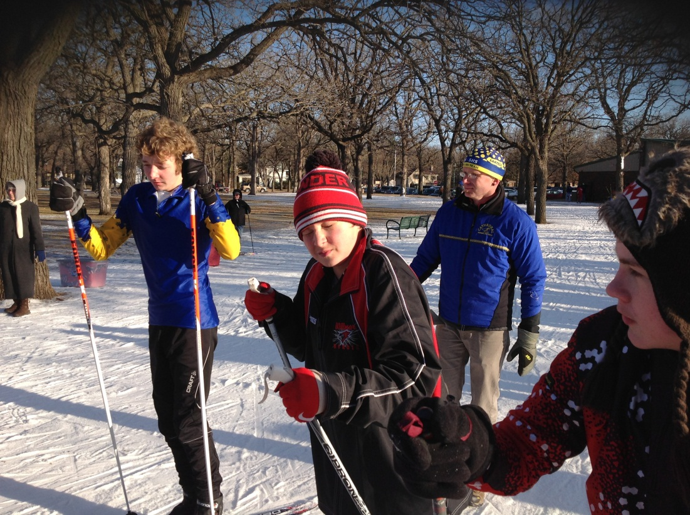
Marquis Christenson
JH most improved
  1st year

Slide 14
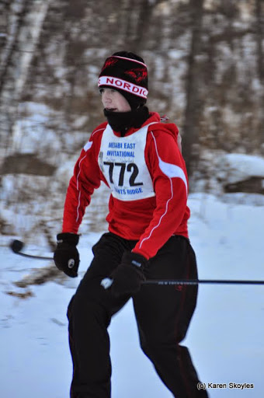
Dalton Underland
JH most improved
  From year to year

Slide 15
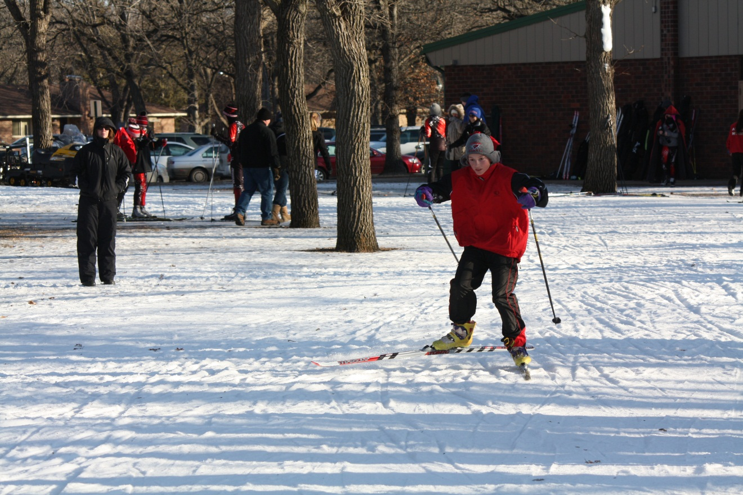
Jonah Panchysyn
Rookie of the Year

Slide 16
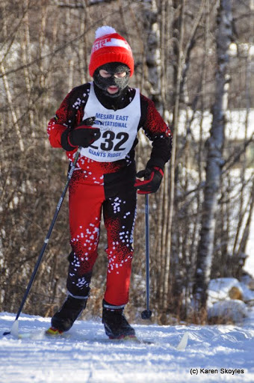
Daniel Halvorson
JH most amazing race
  Mesabi 1st classic race

Slide 17
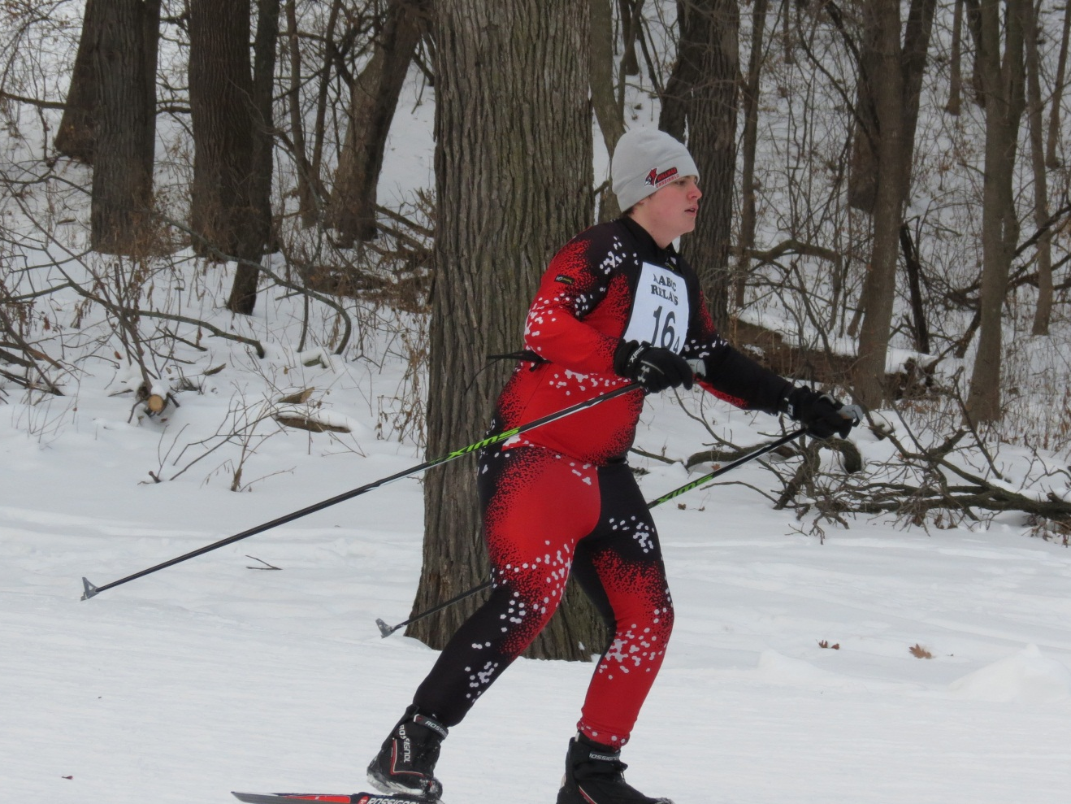
JH mvp
Blake Gibson

Slide 18
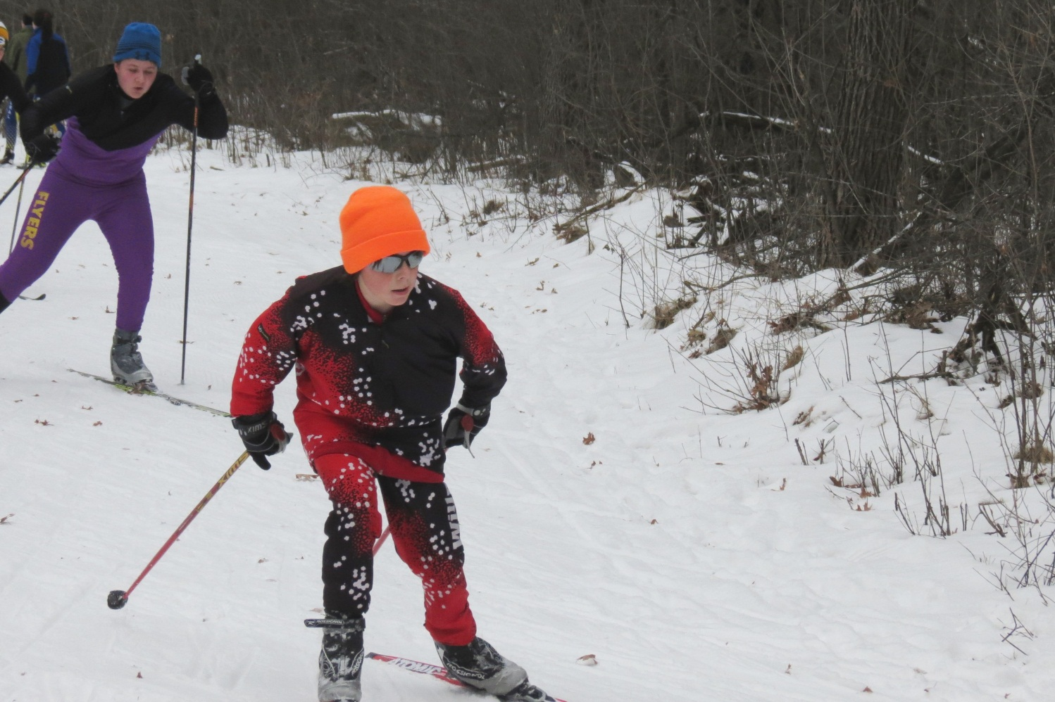
Andrew Haugen
Most Improved

Slide 19
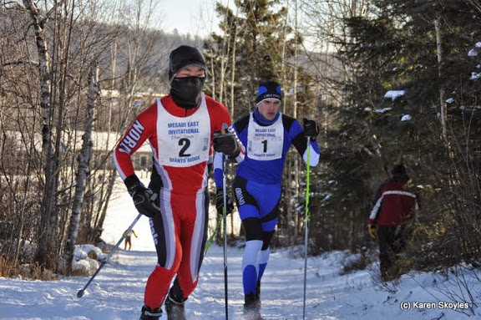
Ethan Haines
Most Amazing Race
  Mesabi

Slide 20
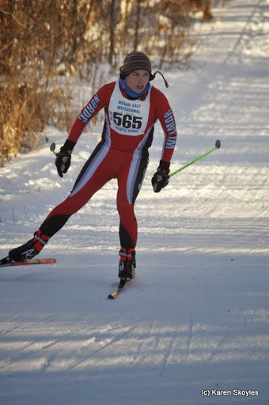
Jack Erickson
Hardest Worker
MVP
CLC Honorable Mention
  7th place in the CLC skate race
14-15 Captain
CLC Performer of the week
  January 19th

Slide 21
Participation Awards
Eleanor Schmitz
Carly Haines
Malena Groothuis
Courtney Lankenau
Juliana Palmer
Annika Stenglein
Katelyn Cook
Cassidy Hanson
Seth Jagow
Connor Olson
Christopher Rieland
William Trochlil
Jonah Panchyshyn
Marquis Christenson
Dalton Underland
Daniel Halvorson
Blake Gibson

Slide 22
Varsity Letter
Maite Marin Mera
Joely Palmer **
Marina Moyers **
Andrew Haugen **
Ethan Haines **
Jack Erickson
Notes:
** Indicates first Varsity Letter

Slide 23
Team Awards
Girls
  CLC Team Sportsmanship
  Section Team Academic Award - SILVER
Boys
  Section Team Academic Award - GOLD

Slide 24
Next Season
Skis for next year – Skate and Classic
VCD Award (talk to Coach Haugen)
Off season
What are you doing to get stronger and faster
Skis for next year – Skate and Classic
Goals for next year

Slide 25
Upcoming Fundraisers
Memorial weekend
    Dad’s Belgium Waffles
Ongoing fundraiser – Ecophones

Slide 26


Slide 27
Thank you & see you next season
Final Waxing Date/Equipment turned in by: Sunday, March 15th
If not turned in yet, please bring your uniform and turn it in
A special thanks to parents and coaching staff for the hard work they put in

