Slide 1
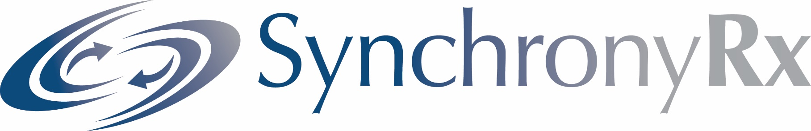

The Educational Services Commission
of New Jersey

Slide 2
Educational Services Commission of NJ Pharmacy Savings
Fiscal Year 2017 Health Benefit Savings | $1,139,913.85
Fiscal Year 2018 Health Benefit Savings (thru April) | $1,042,269.26
Annual ESCNJ Pharmacy Rebates earned under SynchronyRx | $320,241.04
Total Health Benefit Savings | $2,182,183.11

Slide 3

Agenda
Introductions
Who is ARMSRx?
PBM marketplace… what’s happening?
SynchronyRx Program Differentiators
Pharmacogenetics
“Carving Out” advantages
A “Patient-centered” Healthcare Model
Implementation Project Plan Overview
ECSNJ – Annual Savings with SynchronyRx

Slide 4
ARMSRx
ARMSRx has a team of pharmacy benefit experts specializing in:
Rx RFP’s
Audits and Negotiation exposing undisclosed pricing methodologies and ambiguous contract language
Forecasting market changes- employing new cutting edge strategies to compete with the latest options available

Slide 5
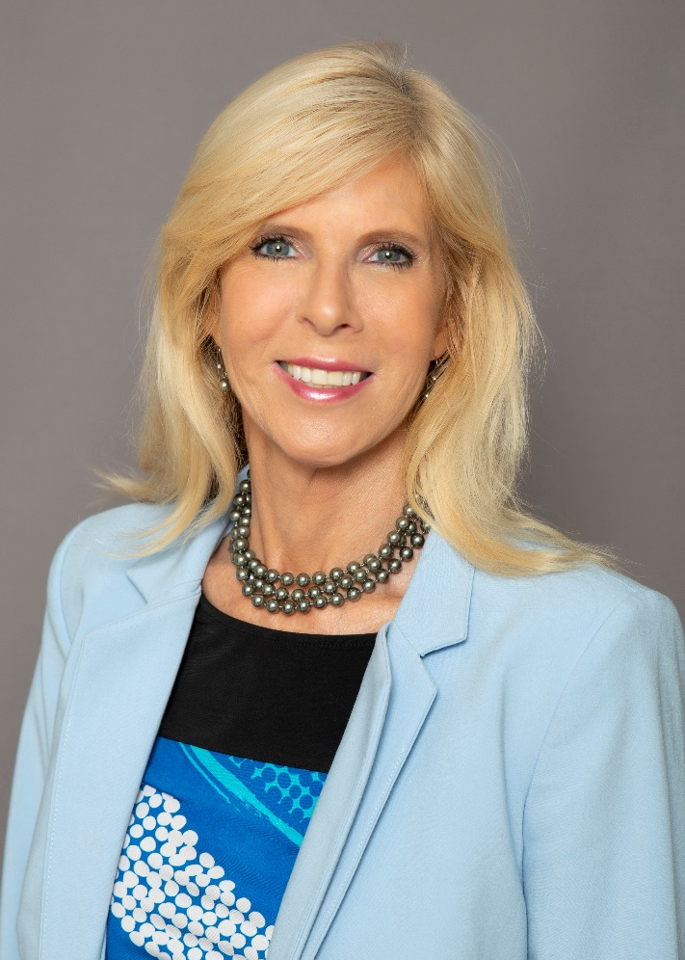
Introduction
Jennifer Wilson:
Managed Care and Self-funded healthcare; Space Founder/CEO of ARMS, Inc. (1991). Started Pharmacy Focus (1995). Founded ARMSRx Pharmacy Benefit Consulting Firm (2004)
Developed the first fully insured prescription Rx carve out plan
Partner for the largest independent pharmacy benefit consulting firm in U.S.
Past Shareholder of PBM and Specialty pharmacy (ESI Acquired)
Focus-Creative positioning of the pharmacy benefit to save on pharmacy costs to improve profitability
In tune with cutting edge industry changes and solutions to ensure clients are up to date, having worthy options for cost savings and pharmacy management

Slide 6

ARMSRx Types of Clients
Healthcare | Middle Market | Vendors
Managed care organizations Health plans/Hospitals Insurance Companies | 340B initiatives Self- funded employers Broker marketplace TPA’s | Specialty pharmacies PBMs - organically built and established Pharmacy Chains

Slide 7



Slide 8

PBM Marketplace
Most Americans fills Generics at a rate of 86.2%
From the January 2008 base price of $100, Dec 2017 prices for most commonly prescribed brand drugs increased 232% to $332.33; generics declined by 78.1% to $21.91
Drug spend for specialty drugs is 40.8% of total pharmacy spend for commercial plans
Diabetes, autoimmune, hepatitis, and oncology drive spending
2017 saw record low drug trend for commercial plans, increasing only 1.5%
ESI Drug Trend Report
Notes:
Update per ESI 2016 DTR

Slide 9
PBM Business Models Are Changing
Stand alone
Integrated vertical
Health Plan integration
Transparent
Considerations:
  Due diligence
  Manage bulk of $$’s
  Manage health
  Fiduciary responsibility
  What do we want to purchase?
  Innovation
  Simplicity
Follow the MONEY!

Slide 10

SynchronyRx Program Differentiators
10
Notes:
Jennifer Kingsley-Wilson

Slide 11

Offering Expertise
To Provide solutions to manage pharmacy benefits from:
  Escalating costs
  Lack of trust in PBM business models
  Leveraged contracts
  Synchrony Rx offering
  Specialty drug costs and choices
  Analytics
  Audits

Slide 12
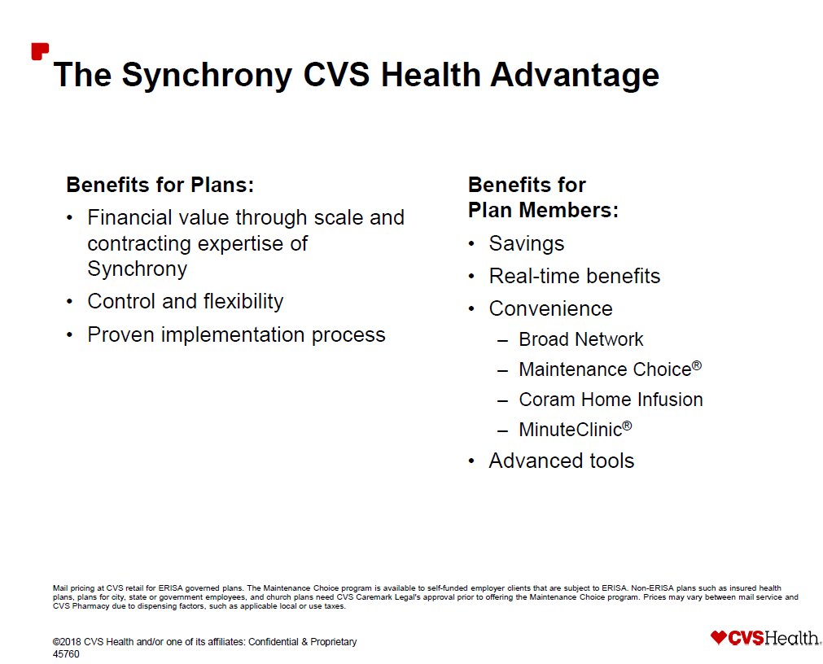

Slide 13

Dedicated Account Management, Clinical and support teams
Expert oversight, analytics, modeling and audits
Additional support to reduce HR administrative burden
13
Notes:
Jennifer Kingsley-Wilson

Slide 14
Timely clinical and strategic support
Drug Genetic
Testing options
Choice to Members
14
Notes:
Jennifer Kingsley-Wilson

Slide 15
Annual market check
Pricing improvements each year
Additional pricing enhancements when population thresholds are met
15
Notes:
Jennifer Kingsley-Wilson –

Slide 16


Financial Advantages
Rebates
Guarantees
Implementation Credit
Clients receive aggressive per brand Rx guarantees
Specific, well-defined rate guarantee definitions, including reconciliation processes and time frame
Competitive Implementation Credit
16
Notes:
Jennifer Kingsley-Wilson – DO NOT GET INTO THE WEEDS, slides 21-23

Slide 17

Data and Analysis
Data & Analysis - Trends in pharmaceutical utilization are spotted quickly and allow for development of effective clinical strategies
  Ongoing pharmacy claims review – “mini audits” includes claim pricing, plan design and rebate monitoring
  Modeling and analysis – copayments, specialty drugs, administrative and clinical programs, channel distribution
  Monthly data - Comprehensive, monthly historical data files retained by Synchrony, available to the client at any time
17
Notes:
Rob Markovich – needs to segue that he works hand in hand with Account Management from the beginning

Slide 18
Drug Adherence
Source: BA Briesacher Pharmacotherapy.
18

Slide 19


38%
ANTI- DEPRESSANTS
40%
ASTHMA DRUGS
43%
DIABETES DRUGS
50%
ARTHIRITIS
DRUGS
70%
ALZHEIMER’S DRUGS
75%
CANCER
DRUGS
% of population for which a particular drug is ineffective

Slide 20

Pharmacogenetics -
and the problem
40 Million Americans are taking 5+ prescriptions
2.3 Million Adverse Drug Reactions (ADRs) per year
Over 100,000+ deaths due to ADRs (4th leading cause of death)
225 prescription medications have FDA biomarker guidance in the Rx insert

Slide 21

Pharmacogenetics offered under Synchrony Rx
Provides medications best suited for patient, based on their DNA | Identifies medications to avoid Lifetime benefit of genetic blueprint for medications | Replaces “Trial & Error” method used by physicians Rx & OTC medications Simple cheek swab

Slide 22
Risk Management – Catastrophic Event
Male Patient was placed on clopidogrel following 1st heart attack and bypass surgery.
Received stent placement in July 2014 following a 2nd heart attack.
Received second stent placement in October 2014 following 3rd heart attack.
From October 2014 to Dec 2014, patient had 2-3 episode of TIA symptoms per week.
PGx testing was performed in early December and revealed very impaired
metabolism making clopidogrel (Plavix) ineffective!
July 2014, heart attack #2 hospital | $16,400
July 2014, stent placement | $30,000
October 2014 heart attack #3 | $16,400
October 2014, stent placement #2 | $30,000
Oct - Dec 2014
- 6 ER visits for TIA symptoms @ $4,300 | $25,800
- 4 EMT home visits w/o hospital transport | $ 1,350
Cost of ineffective Plavix therapy | $11,000
Total PREVENTABLE expenses | $147,350

Slide 23

Reasons for “Carving Out” the Pharmacy Benefit
23
Notes:
Jennifer Kingsley-Wilson

Slide 24

Why Carve Out the Pharmacy Benefit?
Plan contracts directly with PBM for prescription drug coverage.
PBM manages the pharmacy program rather than the health plan.
Self-funded employer gains visibility and understanding of pharmacy plan performance and associated costs.
24

Slide 25
Here is Why to Carve Out
 | Carve In | Carve Out
Plan Design | Off-the-shelf | Complete flexibility
Data | Limited availability; Little insight | Reports available monthly Quarterly and annual reporting Custom ad hoc
Consultative Trend Management | Limited | Expert pharmacy team Data drives plan design decisions
Administration | Generalist | Quick, expert issue resolution Consultation Overall performance guarantees
Integrated Plan | Is it really integrated? | Connectivity already exists Will build connectivity
25

Slide 26

SynchronyRx: A Patient-Centered Healthcare Model
26
Notes:
Jennifer Kingsley-Wilson

Slide 27
Uniquely Meets Evolving Needs …
A Connected Health Care Company
Specialty
Retail
Infusion
Mail
Long Term Care
C O S T Q U A L I T Y A C C E S S
Retail
Clinics
w/telehealth
Medical Claims Editing
Members
Clinical Programs
Digital
Payors
Providers
… helping deliver lowest net cost while improving health
27
37576
Notes:
Slide Objective: Introduce our connected model as our key differentiator and position the enterprise as a connected health care company which evolves to meet market needs.
Key Points:
In the last slide we stated that traditional approaches were not enough to address evolving market forces. This slide focuses on our most essential differentiation from the traditional PBM—we are a connected health care company as shown here. In clearing this slide, move outward from the center.
Our entire enterprise is organized around the 3 key stakeholders—payors, members and providers.
Everything we do, all the assets and service offerings are focused on delivering lower costs, improving quality, and providing greater access.
The “slices” of the fan are arranged to focus attention on the pharmacies—mail, retail, specialty. We also deliver prescriptions through our infusion and long term care services. Along with specialty pharmacy, these services are increasingly billed through the medical benefit, so medical claims editing is next.
Digital capabilities and clinical programs underlie all these service offerings.
All of these offerings and capabilities work together to ensure that we deliver our clients the lowest net cost while improving member health.
With CVS Caremark as your PBM, you are connected to all these services and offerings for a more integrated, consistent experience for your members and enhanced service and coordination for the plan along with the lowest net cost and improved health outcomes.
You may want to note that this representation of our model does not focus on the multiple brands, but the services and advantages we provide.

Slide 28
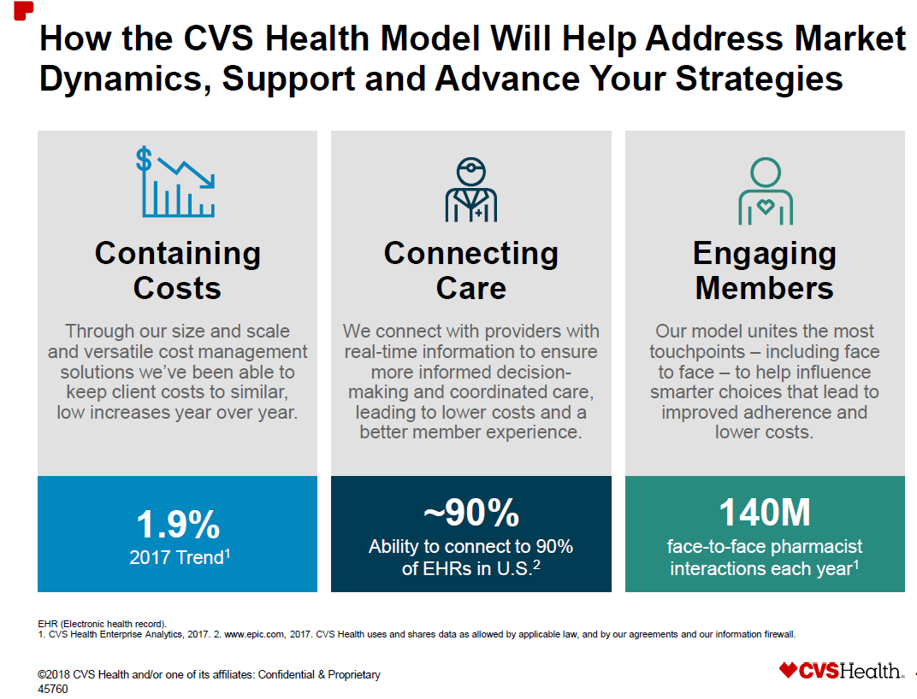

Slide 29
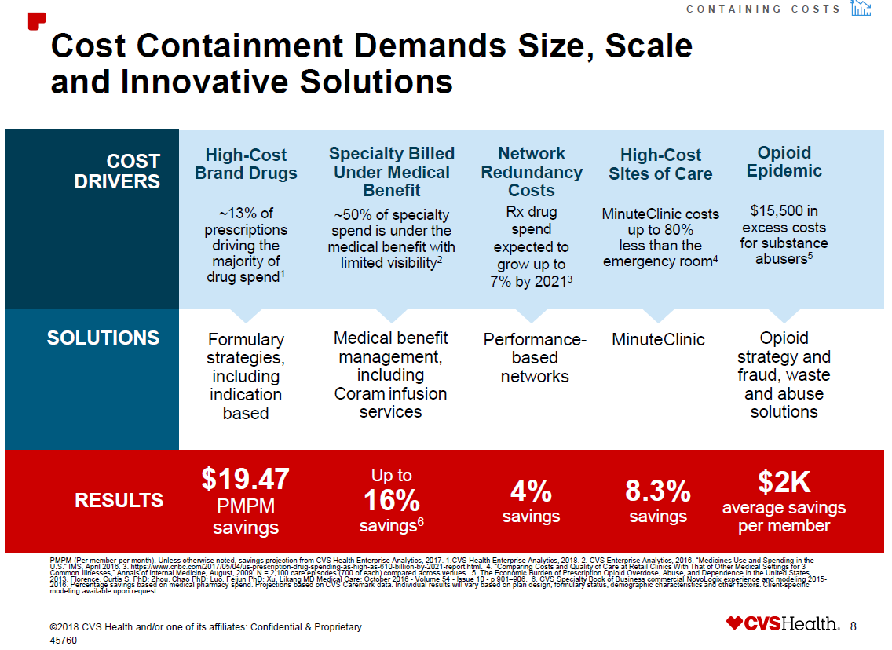

Slide 30

Effectively managing pharmacy
Plan Design | Advantageous | Changing how it is done
What are you including and excluding ? Setting up different formulary options for cost containment. | Copays, deductibles, OOP limits, lesser of copay logic, the greater of rebates, etc. | Specialty pharmacy site of care. Where are these costly drugs administered?

Slide 31
Site of Care for Specialty Drugs
$1B on a 2.4M member commercial plan
Specialty Injectables
Annual Spend = $1.1B
Self-Administered/Oral
(Pharmacy Benefit)
Provider-Administered
(Medical Benefit)
All Channels
($420M)
Fully Insured 798K lives
($225M)
Self Insured
1.6 M lives
($459 M)
Physician Office
$307M
Hospital Outpatient
$261M
Home Infusion
$90M
Specialty Pharmacy
$12M
Other*
$13M
Specialty Distribution
$119M
Retail Distribution
$301M
$271M Drug
$226M Drug
$80M Drug
$11.8M Drug
$36M Admin
$35M Admin
$10M Admin
$1.6M Admin
*Clinics and ESRD facilities
Source: 2014 BCBS Plan

Slide 32
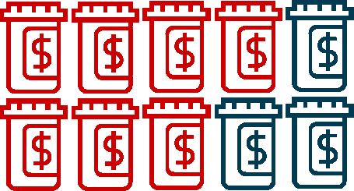
The Right Network Strategy Begins With
Understanding Your Prescription Distribution
IN GENERAL, PRESCRIPTION SPEND IS COMPRISED OF:¹
70% maintenance medications |  | 30% acute medications
Maximize savings by implementing a comprehensive approach
that considers your plan’s distribution of usage.
1. 2014 CVS Health book of business.
©2016 CVS Health and/or one of its affiliates: Confidential & Proprietary 5
38102A
32

Slide 33
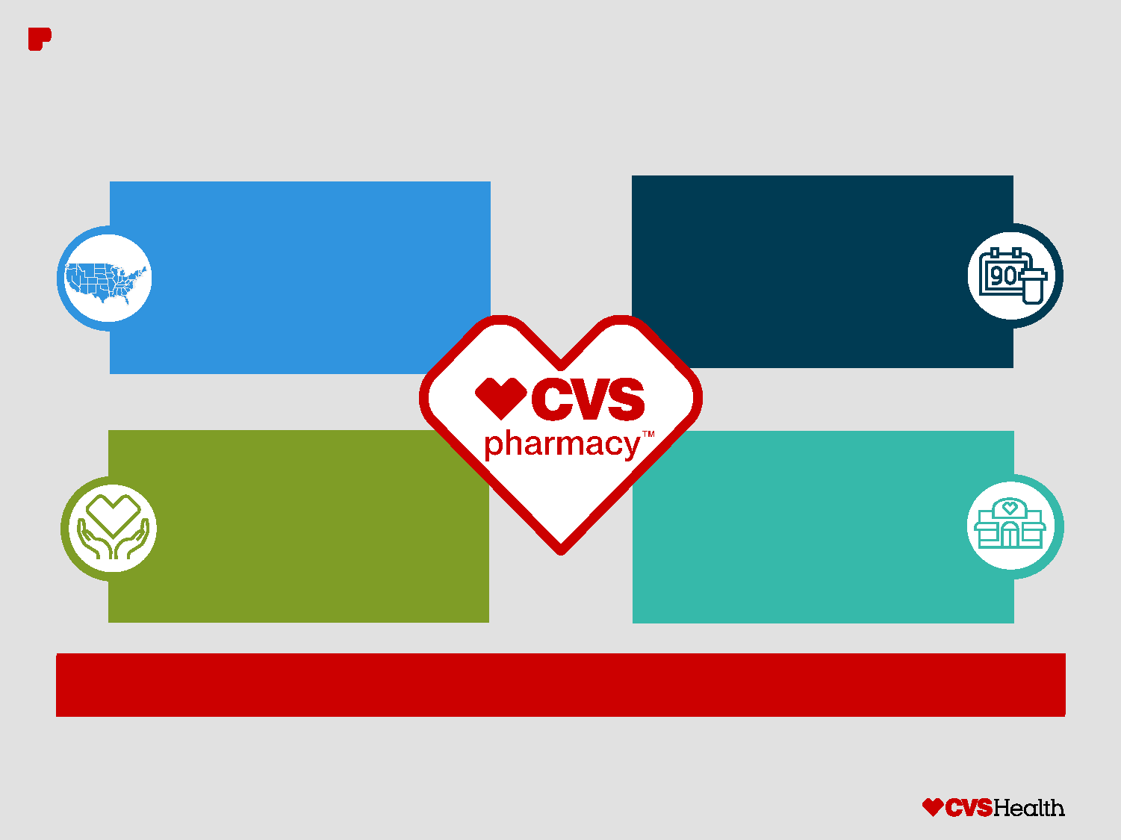
We’ve Added Even More Convenient Access for
Your Members: CVS Pharmacy is Now at Target
CVS Pharmacy network
has increased by 22%
for a total of nearly
9,500 locations
Gives your members
more choice in where
they fill their 30- and
90-day prescriptions
Members will receive
the same high-quality
service and support
New markets include:
Seattle, Denver,
Portland and
Salt Lake City
Re-evaluate your pharmacy network strategy to help optimize your savings.
©2016 CVS Health and/or one of its affiliates: Confidential & Proprietary 8
38102A
33

Slide 34
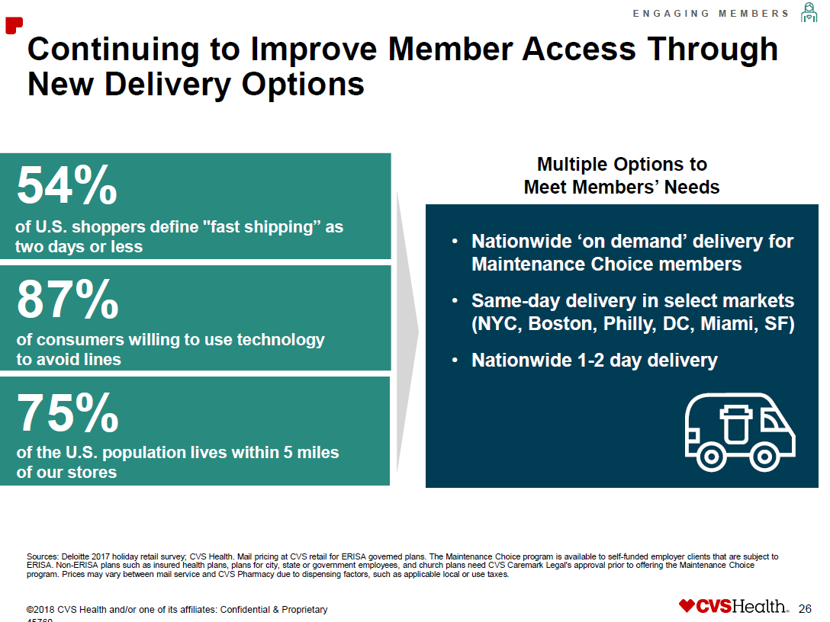

Slide 35

New Client Implementation:
Project Plan Overview

Slide 36
60 Day Plan: Critical Path Overview
The below chart illustrates the key dates of the primary critical path driving tasks, along with the workflow for related functional areas
60 Day Standard Implementation: 1/1/17 Go Live
CRD Approved
11/14
Elig. Prod Files
11/21
Elig. Prod File Load
12/5
Clinical Final
12/24
Mail Materials
12/25
Kickoff
11/1
Release FAF
11/1
VT Test Files
11/13
CPM Approved
11/20
NIF Complete
11/21
Elig. Prod Files
11/28
VT Prod Files
12/10
Benefits Final
12/23
Go Live
1/1/17
 | Nov |  |  |  |  |  |  |  |  |  |  |  |  |  | Dec
Benefits
Clinical
Eligibility
Vendor Transition
MCO
Key Takeaways
Although less than half the duration of the standard 132 day implementation, the 60 day implementation project plan retains nearly all of the key milestone tasks
With limited slack to compensate for potential delays and the uncertainty of custom task durations, nearly all functional areas have indicated that they can only support the most basic and “vanilla” plans – if any – during a 60 day implementation
In order to promote implementation success, the timely completion of initial intake documentation milestone tasks (i.e. FAF, NIF, CRD, CPM)is critical to avoid “final hour” heroic implementation efforts
Key:
Collect
Build
Test
Deploy

Slide 37
Educational Services Commission of NJ Pharmacy Savings
Fiscal Year 2017 Health Benefit Savings | $1,139,913.85
Fiscal Year 2018 Health Benefit Savings (thru April) | $1,042,269.26
Annual ESCNJ Pharmacy Rebates earned under SynchronyRx | $320,241.04
Total Health Benefit Savings | $2,182,183.11

Slide 38
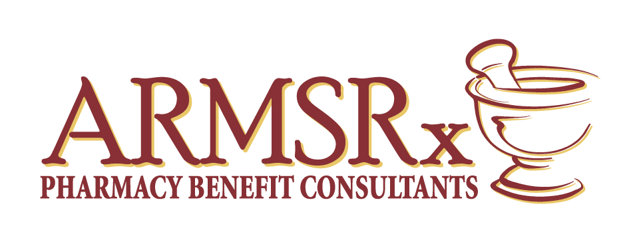

?? Questions ??
ARMSRx
105 Down Court
Windermere, FL 34786
www.ARMSRx.com

