Slide 1


Mrs. Brooks
Careers Technical Fine Art Teacher
Highland High School 678-8800 extension 8861
Basic art
Basic art Teams/zoom
Jewelry
Teams/ zoom
Jewelry

Slide 2

Basic Art
Course syllabus
Introduction
Supply list
Projects
Task
Due dates
FAQ
videos
Zoom

Slide 3
















Symbol’s and their meaning
Hogar home
Goals
Objectives
Metas
objetivos
Inverso/Reverse
Watch video/ or slide show Ver video o presentación de diapositivas
Hacer tarea
Do task
Graphic organizer
Organizador gráfico
Personal growth goalsMetas de crecimiento personal
Proyectos
Projects
Time sheet
Hoja de horas
Reflection
Evaluation
Rubric
Reflexión
Evaluación
Rúbrica
Contract for project
Contrato por proyecto
Manufacturing sheet
Hoja de fabricación
Lecciones
lessons
Turn in completed project
Entregar proyecto terminado
Collaboration
colaboración
Next page
siguiente pagina
Projects due date
Fecha de vencimiento de proyectos
Stop
detener

Slide 4
FAQ
What are the advantages of taking Mrs. Brooks classes online? ​
Convenience and flexibility are the most common advantages of online classes. Taking classes online classes allow you to fit school into your schedule when it's convenient for you. It also allows students to work on projects during a span of time and at a time where the artist student feels more productive and allow more time of the mindset of tasks required to complete projects. ​
How much time should I spend on one class every week for Mrs. Brooks classes? ​
The time you spend on my class can vary. Not every project will be exactly the same. Plan to spend 6-8 hours a week for each project. Small group instruction will be 1 hour each day you are required to be at school. Most projects will take a duration of 2 weeks of working progress. The time you spend doing the projects will also depend on your personal skill level and your ability to manage time effectively. ​
How are instructions for Mrs. Brooks classes available online? ​
My online classes are delivered using a learning management system through zoom, streaming videos and hands on project lessons. Students will be able to log in through Highland District select their course sites. Once a student is in their course site, they can access lectures, PowerPoint, emails, assignments, readings, documents, videos, links, discussion boards, their advisor and the assignment drop box, and clear labeled tubs located in the front of the school for all art projects. ​

Slide 5
FAQ
How do I interact with Mrs. Brooks​?
Through this virtual experience, you will have the opportunity to meet me onetime face to face with one parent at the beginning of the quarter. This enhances the relationship as you will always have a face to connect with me through zoom meetings, small group lessons, email and texting. I will be accessible and responsive to all my students. I will communicate primarily through Highland district site. I will utilize and offer different methods for communications for my classes that meets students need, via through zoom chats, conference calls, emails, and texting.
Will there be interaction with other online students?
You will develop relationships with other students who are in your assigned Pod or small group, which may change throughout the course. While Many of you may not progress at the same pace as other students in a true cohort program, you will find yourself among familiar faces throughout your course and your pod or small group should be able to assist you in meeting your requirements in group discussions and peer evaluations. It is in my hopes to offer quite a bit of interaction between other students including group assignments and discussions, online discussion forums, online posting boards, reading reflections and class discussions, rubrics, and personal growth goals.
c

Slide 6
FAQ
Are there group projects within online courses? ​
Yes, there could be some group projects are a part of my online courses. Students are grouped together and given a topic to investigate and possible a project to produce. The intent is for the students to work together electronically to accomplish their goals. Often, groups prepare and give PowerPoint presentations electronically by emailing each other draft versions, and then posting the final product to the student discussion board. Students are often divided into groups or learning communities to discuss questions or cases developed in my online curriculum. I will divide students into small groups (versus entire class) so students will be getting to know each other better and achieve a higher level of interconnectivity. ​
What is a typical schedule for Mrs. Brooks online class? ​
I will offer daily small group synchronous lessons that students are required to attend. I will have office hours for students to contact me with questions or concerns that I may need to address. Student should expect to work on their individual projects at least 1 hour a day.
c

Slide 7
FAQ
What are some of the challenges when taking online classes? ​
One of the keys to being a successful online student is self-discipline. Because you are not required to be physically in class at a specific time (except for synchronous Instruction) you have to be motivated to get the work done on your own. If you have a family obligation and/or a full-time job while you are taking online classes it is important that you establish schedule of when and how you will get work completed. ​
If you don’t understand an assignment it is important to ask questions for clarification so you don’t fall behind. I will be available to students via e-mail, discussions boards, virtual office hours, zoom meetings, and conference calls. ​
How are online classes graded? What are Mrs. Brooks expectations? ​
Online courses are graded just like classroom courses. High-level critical thinking is required, and students leave the course with an understanding of the subject and an ability to apply their knowledge in a real-world setting. Essential Standard assignments and projects will include researching subject matter, having art materials, active participation in online discussions, quizzes or tests, filling out forms such as time sheets, manufacturing work sheets, personal growth development, rubrics, and evaluations of each project and a final assessment.
c

Slide 8
FAQ
Are tests available online? ​
Yes. There will be a pre-assessment, post assessment and some quizzes throughout the course. Students may be asked to sign an ethical agreement saying they will not copy or share their exam, and that the person taking the test is the person registered for the course. Tests may be timed, monitored through zoom.

Slide 9
Jewelry
Course syllabus
programa del curso
Introduction
Introducción
proyectos
Projects
Supply list
lista de suministros
Due dates
fechas de vencimiento
Task
Tareas
videos
Zoom enfocar

Slide 10
Basic art Syllabus
Instructor: Mrs. Brooks
Course title: Basic Art 1
Place/Time: Distance Learning
Essential Learning Standards
Fine Arts Essential standards
Students will use multiple approaches to begin creative endeavors
Students will organize and develop artistic ideas and work
Students will refine and complete artistic works of art
Students will analyze and interpret artistic work for reflection
Students will analyze and interpret artistic work for community exhibits
c

Slide 11
Basic art Syllabus continued
Course Description: It is my hope that from this course you will gain sufficient knowledge to provide substantive secondary and adult level art instruction. To help you do so, this course entails nine practicum experiences. The majority of the class work entails preparation for these teaching endeavors through discussions, lectures, and assigned projects on the pertinent art education topics. Zoom synchronized and asynchronized videos and instruction.
Course Objective: Students will work towards achieving the general goals of the art education program: 1) To apply a philosophy that is meaningfully integrates an encompassing view of art education and life experiences. 2) To apply a global perspective to issues of culture (including class, race, gender, ethnicity, values, etc.) as they apply to art experience. 3) To effect change through the art experience to improve quality of life. 4) To possess a knowledge of the content area of basic art.
c

Slide 12
Basic art Syllabus continued
Class Projects: During each (quarter) (semester) term, I will assign in class art project in various art media (drawing and painting, and creating). Each student is responsible for completing each project by the due date and keeping that project in his or her portfolio (provided and stored at home). I will assign approximately 10-11 major pieces per term in addition to in class exercises. In the event that an individual may complete all assigned task before the end of the term, that student is expected to complete additional student choice projects until the end of the term.
Test: Student will be asked to complete a Classroom Based Performance Assessment according to Washington State Standards of Learning.
A pre assessment and a post assessment
Participation: Daily effort, class participation, and attendance are important to progress. I encourage each student to do his or her best each day. I follow attendance and make up work policies outlined in the student handbook.

Slide 13
Basic art Syllabus continued
Grading: I will evaluate work as outlined in the attached rubrics, manufacturing sheets, graphic organizers, time sheets and the composition. I assess grades each term according to the following scale:
Class Projects 8 @ 10 pts
Participation/effort(weekly) 10pts
CBPA’s assessents 10pts
Projects will be evaluated according to the following criteria:
Effort:
Puts forth best effort to complete the projects as explained
Craftsmanship:
Handles art materials correctly. Professionally presents final projects (neat, clean, wrinkle-free)
Meets Assignment Objectives:
Completes each project according to instruction
Demonstrates an understanding of the assignment

Slide 14
Basic art Syllabus continued
Fees and Materials
Students will need to be responsible for aquiring their own materials for each project. If student are not able to purchase supplies or tools needed, then they should contact me and request specific supplies they will need to complete each project. I will try to supply the student with minimum supplies required for each project. Students will be able to pick up these supplies in the main office.
Tools if a student request tools, then they will be responsible for maintaining and returning the tools back to HHS. If tools are lost or damaged then the student will need to replace the tools or be subject to a fine.

Slide 15
Basic art Syllabus continued
Projects/Times lines
Zentangle practice/ week 1
Zentangle Project/week 2/3
Facial characteristic practice/ week 4
Family/self Portrait /week 5/6
Paper 3-d black and white Mandala week 7/8
Color wheel/week 9
Color Mandala week10/11
Water color study / week 12/13
Pen/Ink practice/week 14
Pen/Ink Composition/week 15/16
Student choice/ week 17
CBPA’S/week 18
Projects and timeline are subject to change according to quarter or semester scheduling timelines during distance learning quorum.

Slide 16
Jewelry Bead and Wire
Instructor: Mrs. Brooks
Course title: Jewelry Bead/Wire
Place/Time: Distance Learning
Essential Learning Standards
Fine Arts Essential standards
Students will use multiple approaches to begin creative endeavors
Students will organize and develop artistic ideas and work
Students will refine and complete artistic works of art
Students will analyze and interpret artistic work for reflection
Students will analyze and interpret artistic work for community exhibits
Course Description: It is my hope that from this course you will gain sufficient knowledge to provide substantive secondary and adult level art instruction. To help you do so, this course entails nine practicum experiences. The majority of the class work entails preparation for these teaching endeavors through discussions, lectures, and assigned projects on the pertinent art education topics. Zoom synchronized and asynchronized videos and instruction.

Slide 17
Jewelry Bead and Wire continued
Course Objective: Students will work towards achieving the general goals of the art education program: 1) To apply a philosophy that is meaningfully integrates an encompassing view of art education and life experiences. 2) To apply a global perspective to issues of culture (including class, race, gender, ethnicity, values, etc) as they apply to art experience. 3) To effect change through the art experience to improve quality of life. 4) To posses a knowledge
Course Projects: During each trimester term, I will assign in class beaded and wire projects. Each student is responsible for completing each project by the due date. I will assign approximately 14-16 major pieces per semester-approximately one project per week. In the event that an individual may complete all assigned task before the end of the term, that student is expected to complete additional student choice projects until the end of the term.

Slide 18
Jewelry Bead and Wire continued
Participation: Daily effort, class participation, and attendance are important to progress. I encourage each student to do his or her best each day. I follow attendance and make up work policies outlined in the student handbook.
Grading: I will evaluate work as outlined in the attached rubrics, manufacturing sheets, graphic organizers, time sheets and the composition. I assess grades each term according to the following scale:
Class Projects 16 @ 10 pts
Participation/effort(weekly) 10pts
Assessments pre and post
Projects will be evaluated according to the following criteria:
Effort:
Puts forth best effort to complete the projects as explained
Craftsmanship:
Handles art materials correctly. Professionally presents final projects (neat, clean, wrinkle-free)
Meets Assignment Objectives:
Completes each project according to instruction
Demonstrates an understanding of the assignment

Slide 19
Jewelry Bead and Wire continued
Class Projects: During each (quarter) (semester) term, I will assign in class art project in various art media (drawing and painting, and creating). Each student is responsible for completing each project by the due date and keeping that project in his or her portfolio (provided and stored at home). I will assign approximately 14-16 major pieces per term in addition to in class exercises. In the event that an individual may complete all assigned task before the end of the term, that student is expected to complete additional student choice projects until the end of the term.
Test: Pre assessment and post assessment
Participation: Daily effort, class participation, and attendance are important to progress. I encourage each student to do his or her best each day. I follow attendance and make up work policies outlined in the student handbook. Zoom synchronized and asynchronized videos and instruction are vital to attendance regulations for distance learning quorum.

Slide 20
Jewelry Bead and Wire continued
Materials and tools
Students will be responsible for providing their own supplies such as wire, beads, tools and clasps. If a student isn’t able to purchase these items, then the district will provide the minimal supplies that are required for each project. If tools are lost or damaged then the student will be fined according to HHS policies.
Required Projects
1 wire bracelet 1 wire/bead bracelet
1 wire Necklace 1wire/bead Necklace
1 wire earrings 1wire/bead earrings
1 wire ring 1wire/bead ring
7-8 student choice projects
Each project should take approximately 1 week to complete
Projects and timeline are subject to change according to quarter or semester scheduling timelines during distance learning quorum.

Slide 21

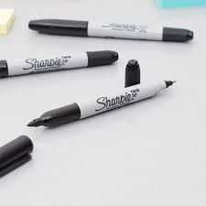

Basic art Supply list
Zentangle
1 medium tip black sharpie(marker)
1 fine tip black sharpie (marker)
1extra fine tip black sharpie (marker)
1 drawing/Card stock paper (11X17)

Slide 22
Introduction to art
Art is the expression or application of human creative skill and imagination, typically in a visual form such as painting or sculpture, producing works to be appreciated primarily for their beauty or emotional power.
Art has various branches of creative activity, such as painting, music, literature, and dance which is known as
"the visual arts“
The visual arts are art forms that create works that are primarily visual in nature, such as ceramics, drawing, painting, sculpture, printmaking, design, crafts, photography, video, film making and architecture.

Slide 23
Introduction to art
There are seven elements in art. They are color, form, line, shape, space, texture, and value.
The ten common principles of art are balance, emphasis, harmony, movement, pattern, proportion, repetition, rhythm, unity, and variety.
In Basic art you are going to apply your understanding of the art elements to create compositions in two and three dimensions using different mediums such as ink, markers, paint, and adhesives.

Slide 24
What is a Zentangle?
• Zen = state of focus or concentration
• An abstract or non-objective art form
• Abstract: recognizable subject matter that is slightly altered.
• Non-Objective: Nothing is recognizable • Repetition of patterns, shapes, and lines to fill a space.

Slide 25
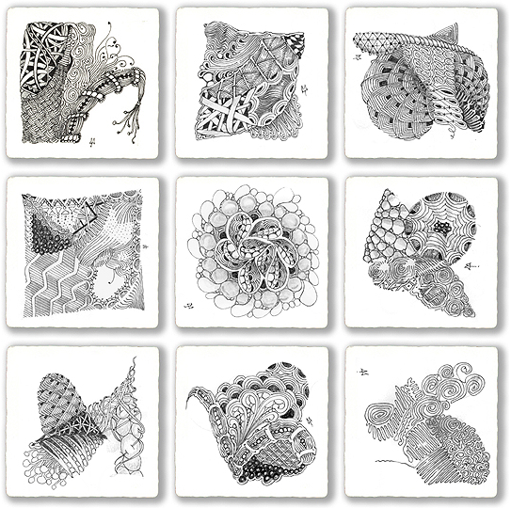
Zentangle
A Zentangle is an abstract drawing created by using repetitive patterns. It is usually structured within a certain shape. Drawing a Zentangle is entertaining, relaxing, and a great way to express yourself creatively.
Notes:
A Zentangle is an abstract drawing created by using repetitive patterns. It is usually structured within a certain shape. Drawing a Zentangle is entertaining, relaxing, and a great way to express yourself creatively.

Slide 26
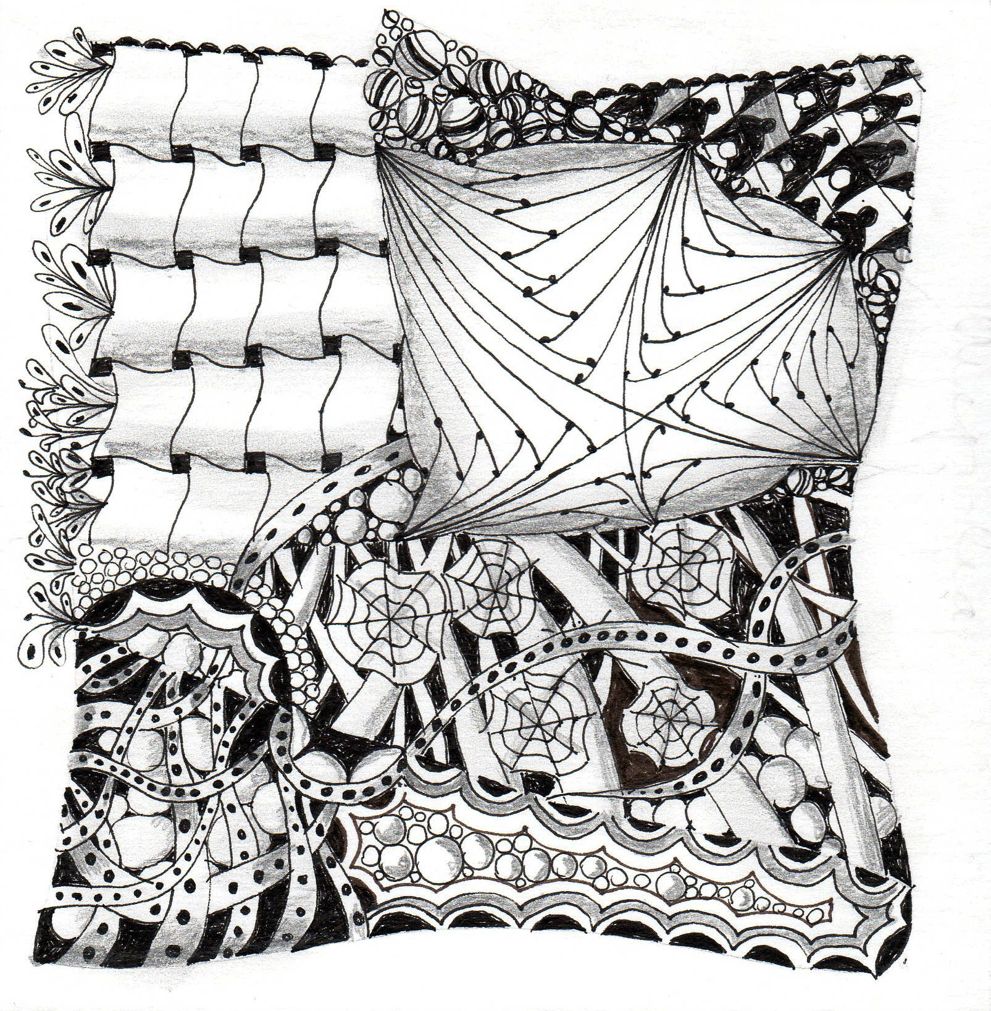
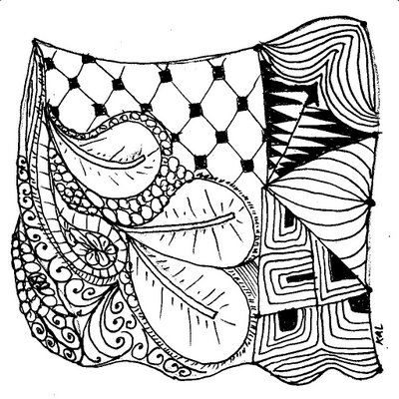

Slide 27
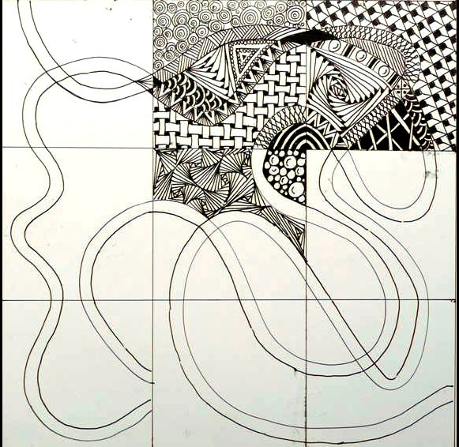
String
A string is generally a random line drawn in pencil which creates an area within which you draw your tangles.
Notes:
A string is generally a random line drawn in pencil which creates an area within which you draw your tangles.

Slide 28
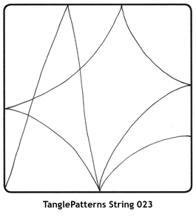
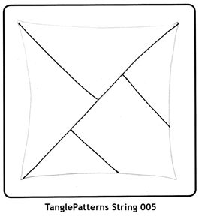

Slide 29
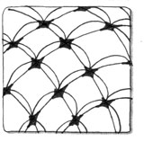
Tangle
In its verb form “tangle” means to draw a tangle. You tangle a tangle, and in that process create Zentangle art.
In its noun form this word is used as a replacement for “pattern.”
Notes:
In its verb form “tangle” means to draw a tangle. You tangle a tangle, and in that process create Zentangle art.
In its noun form this word is used as a replacement for “pattern.”

Slide 30
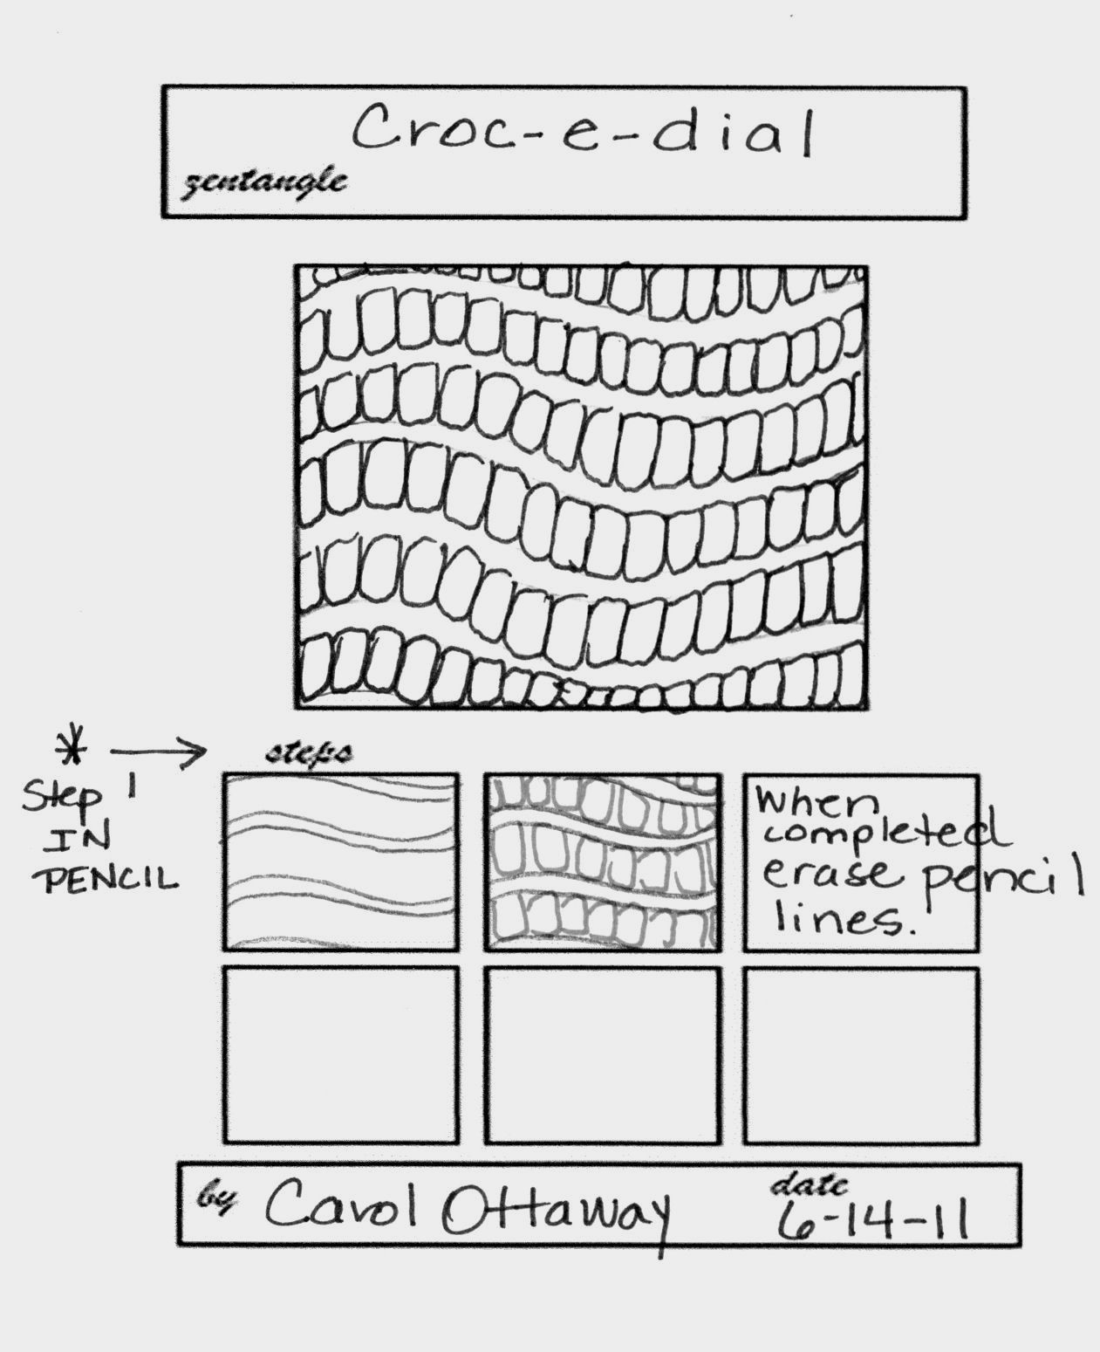
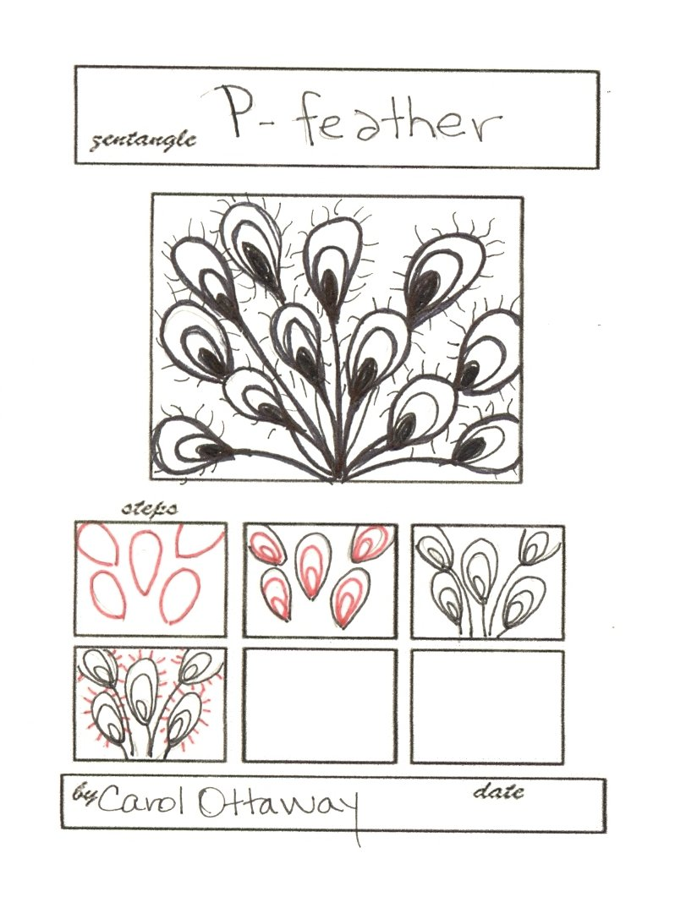
Zentangle patterns
Notes:
There is an unlimited number of tangle tutorials on the internet. These range from simple, to extremely complex.

Slide 31
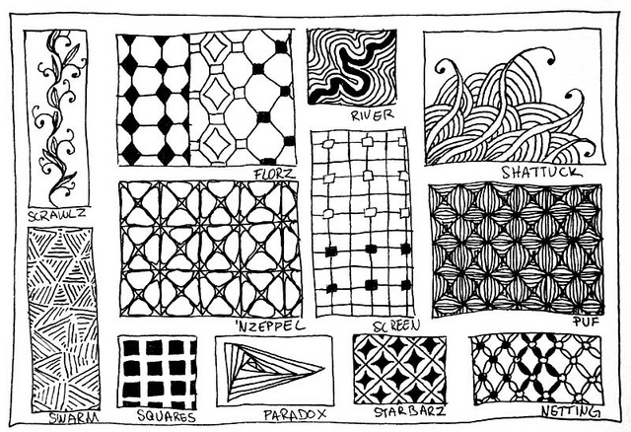
Zentangle patterns

Slide 32
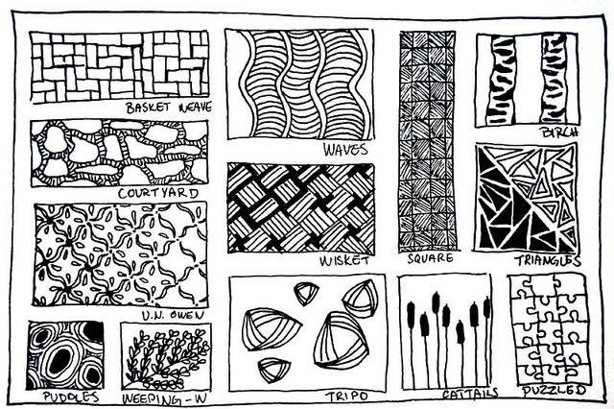
Zentangle patterns

Slide 33
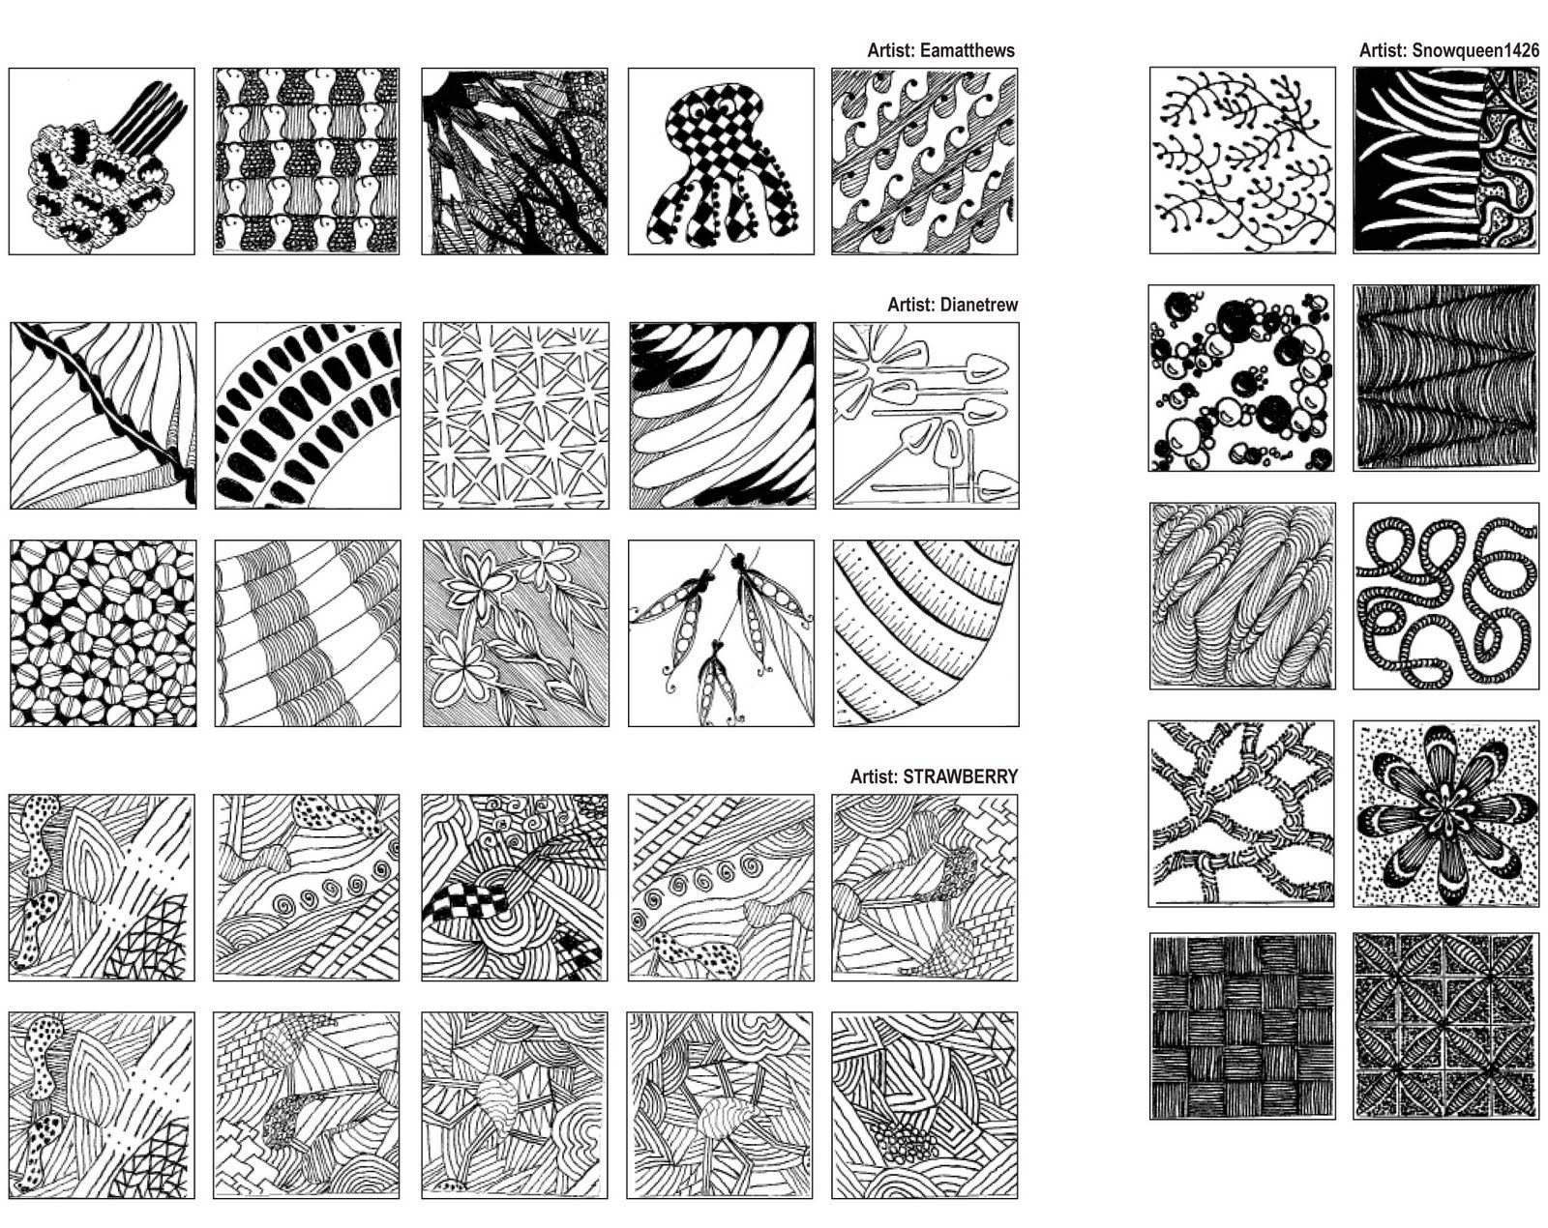
Zentangle patterns

Slide 34
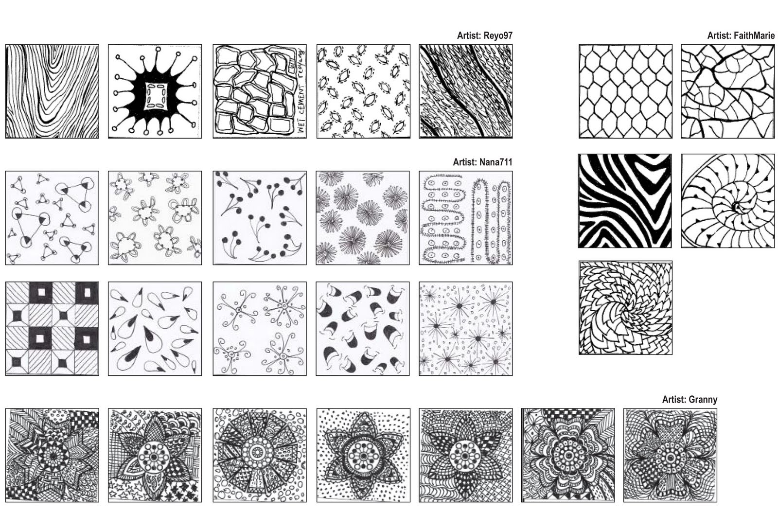
Zentangle patterns

Slide 35
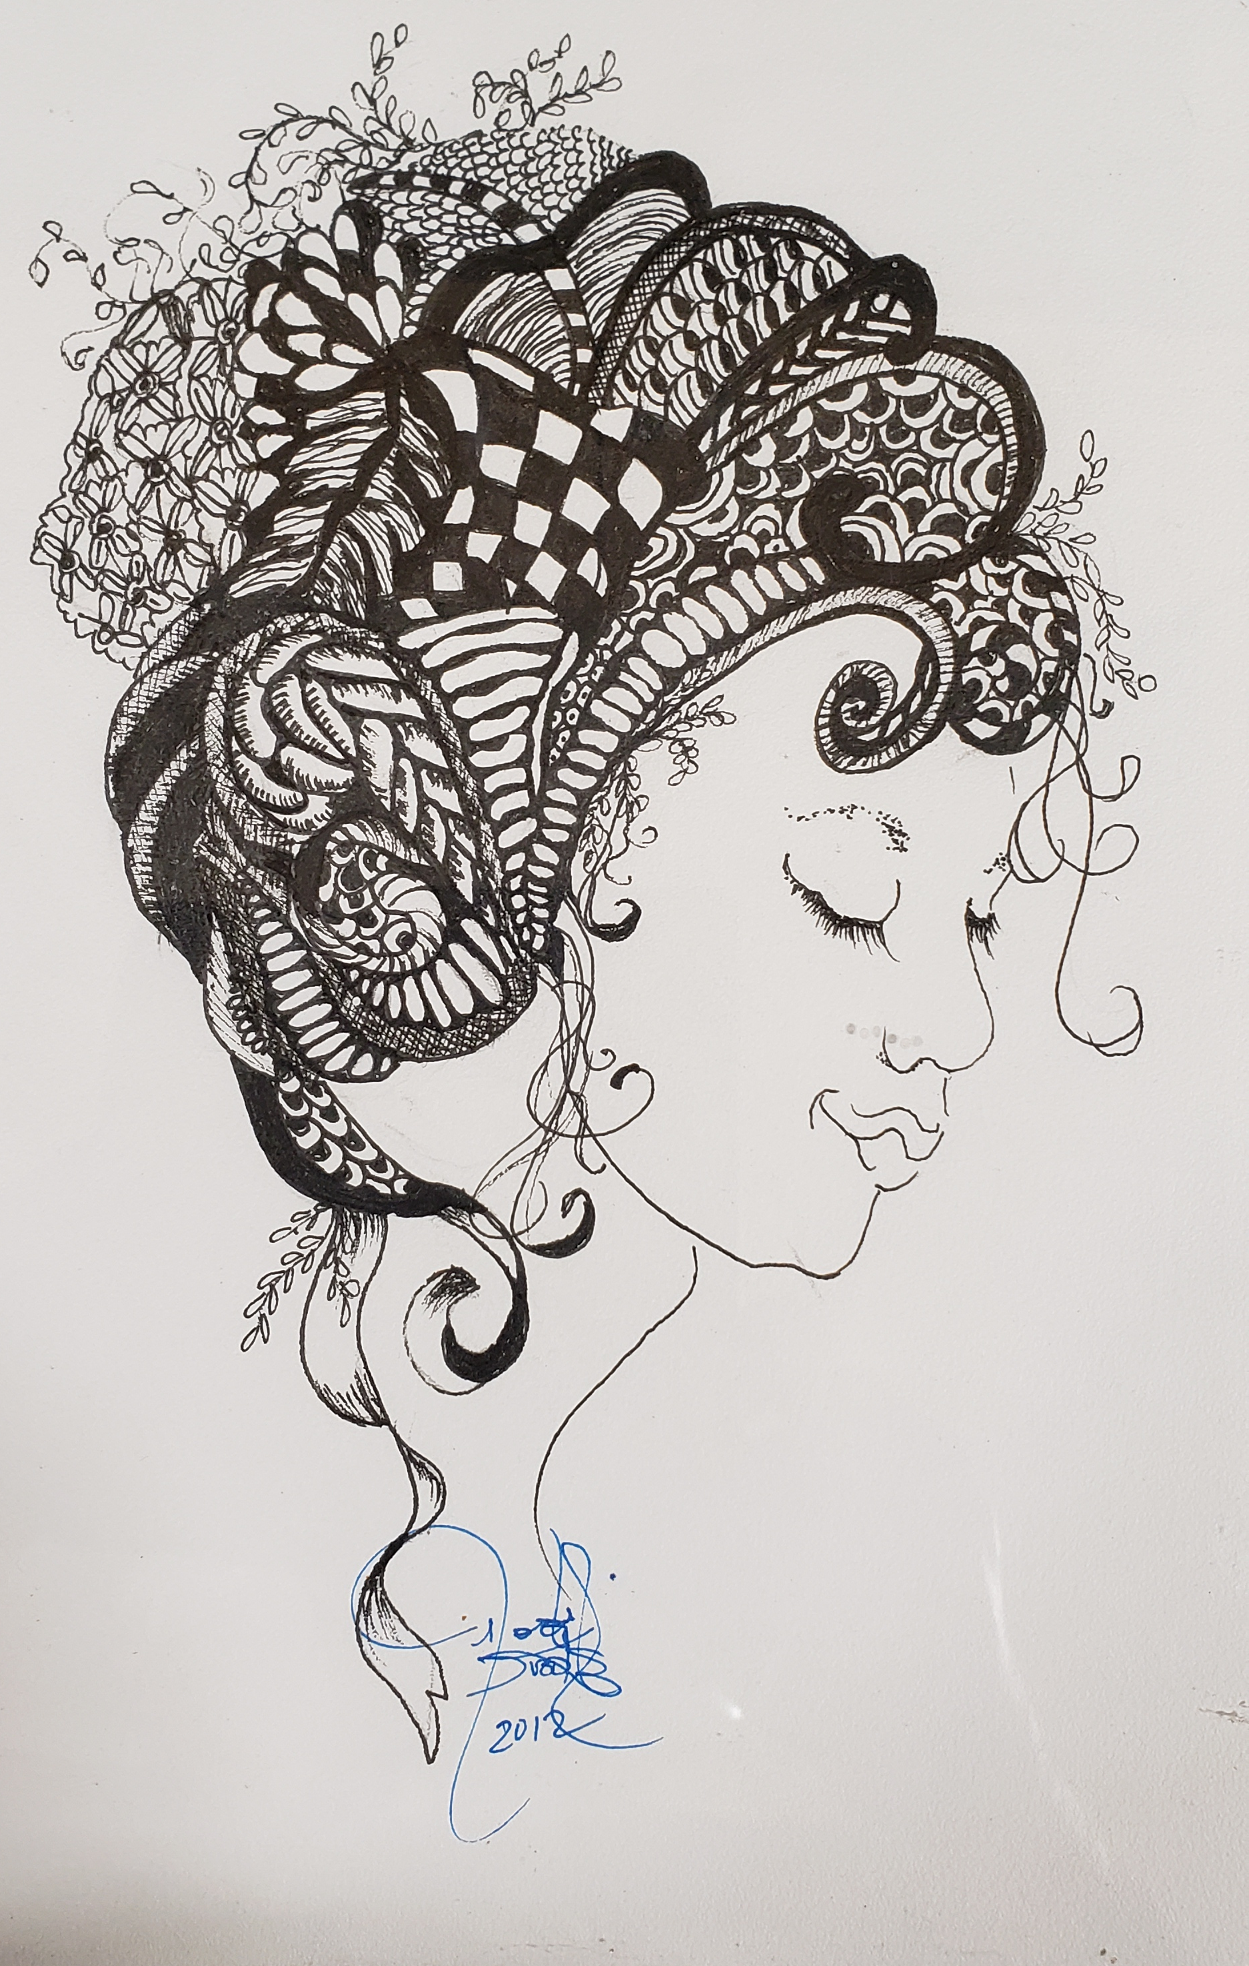
Samples of zentangles

Slide 36
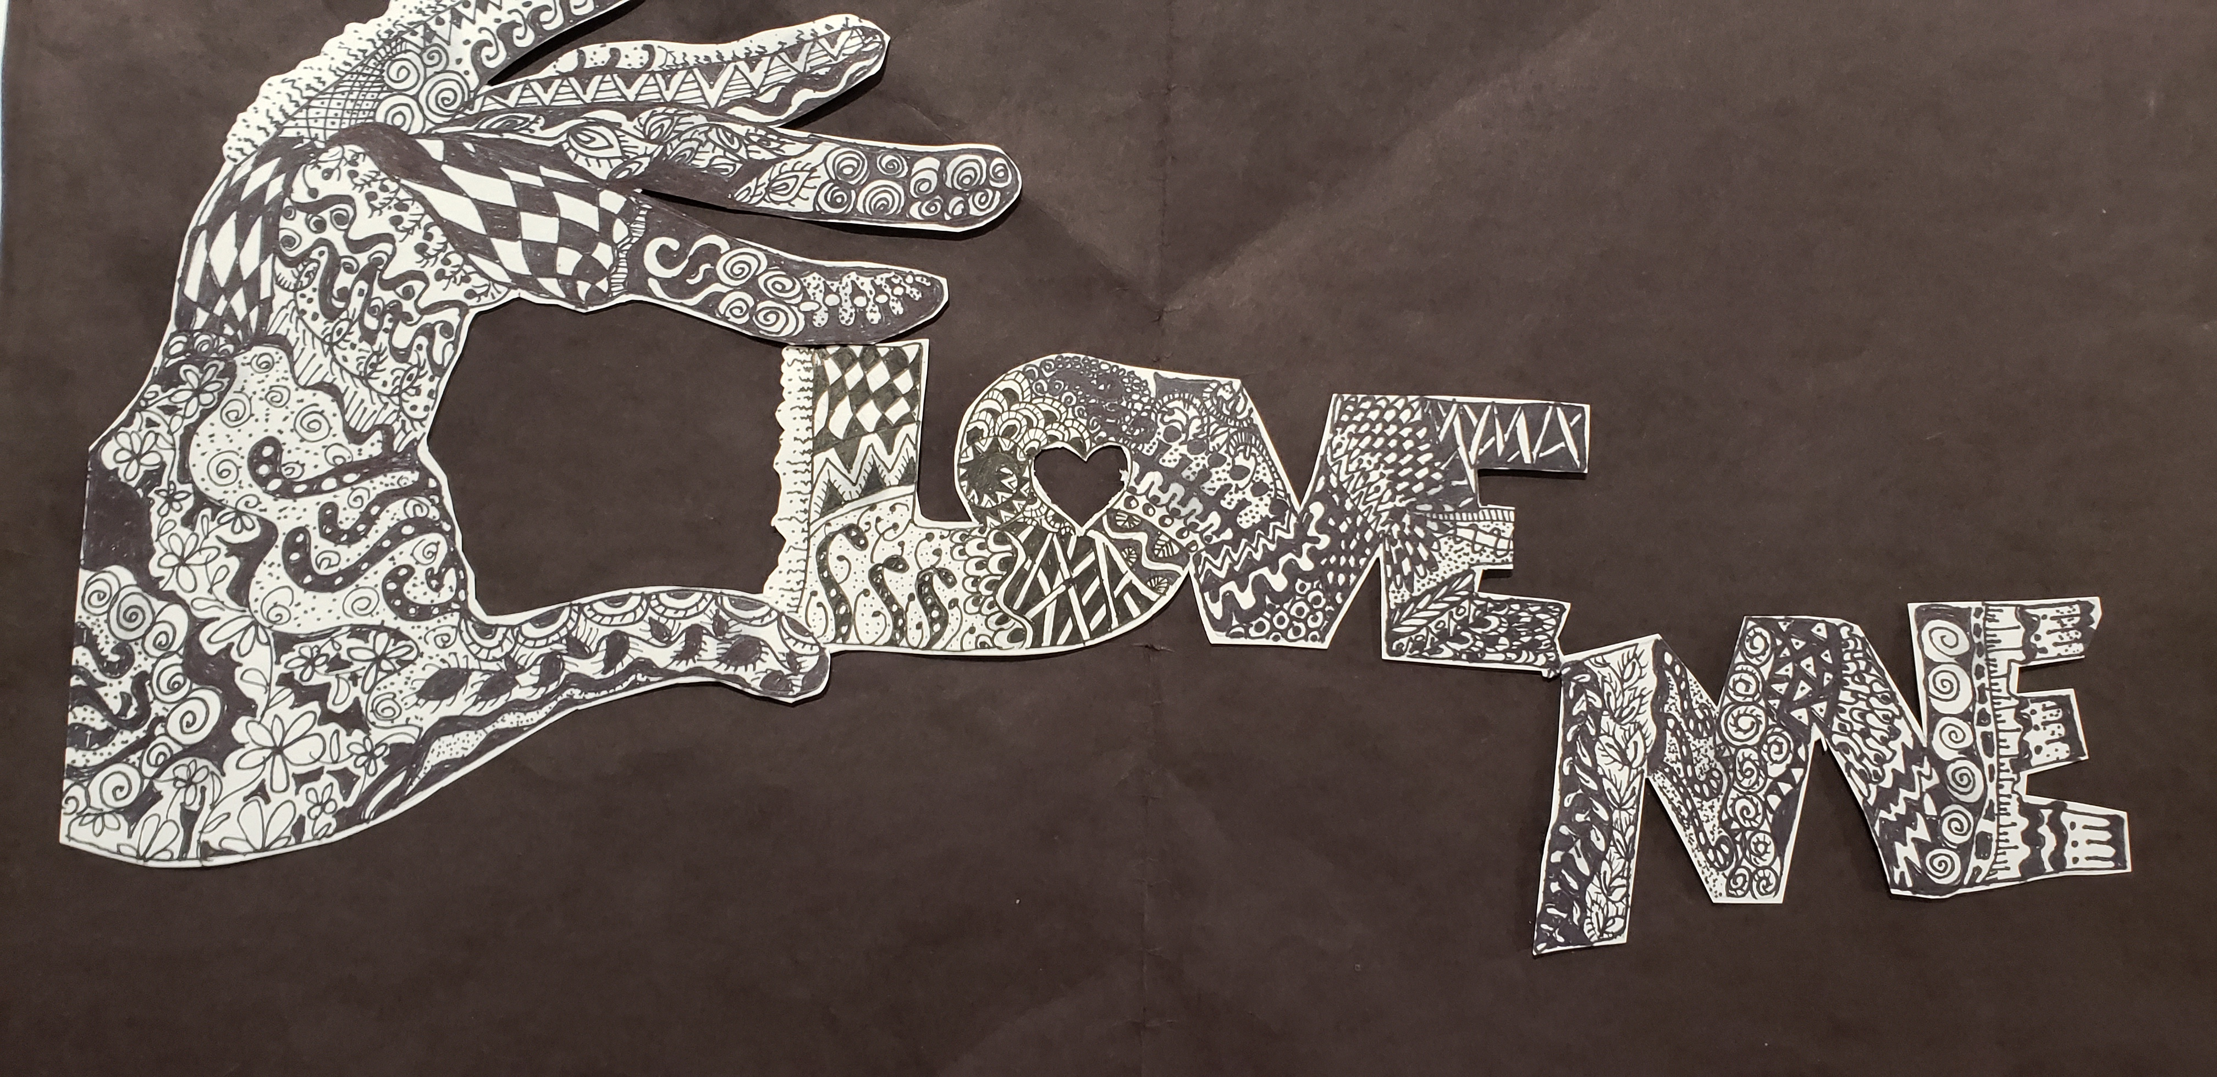
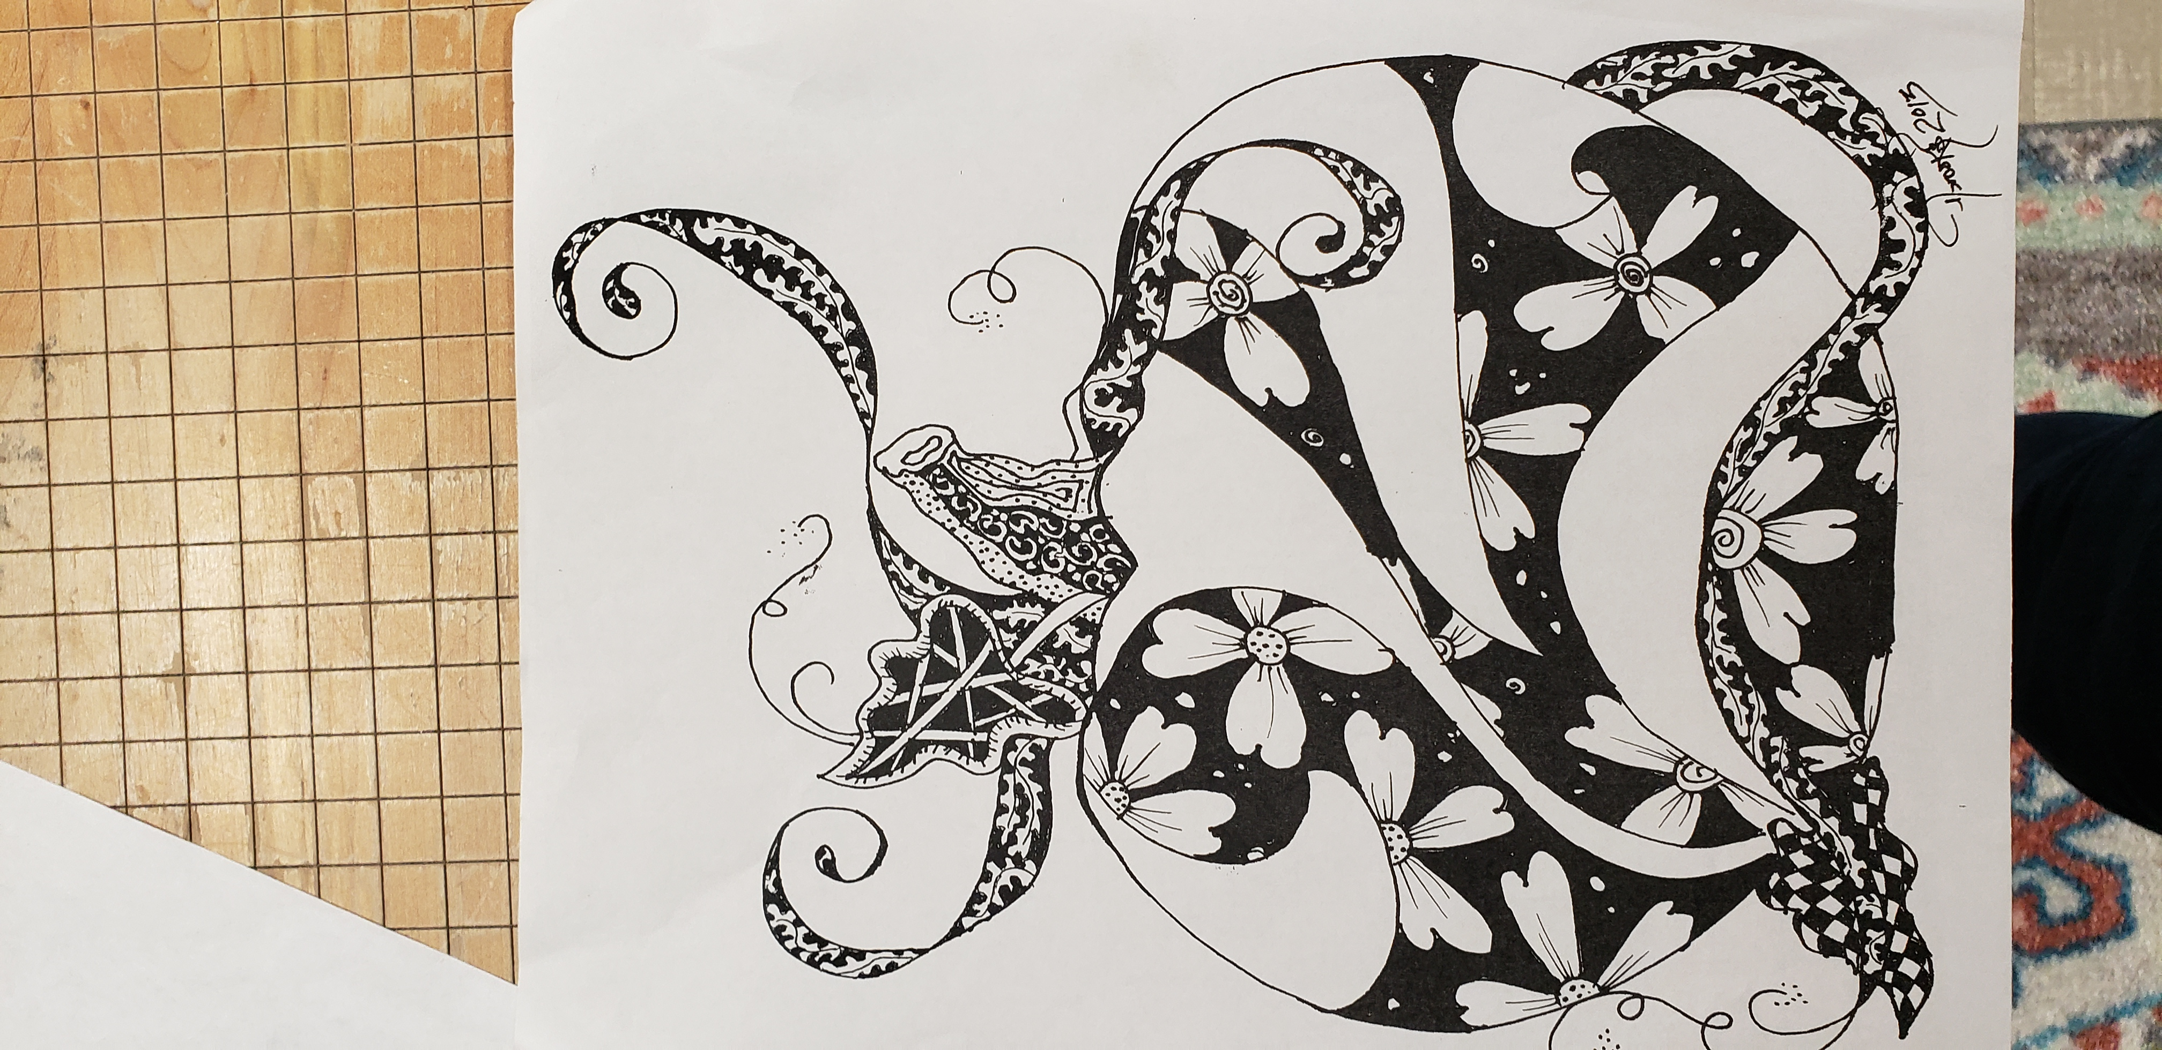

Slide 37
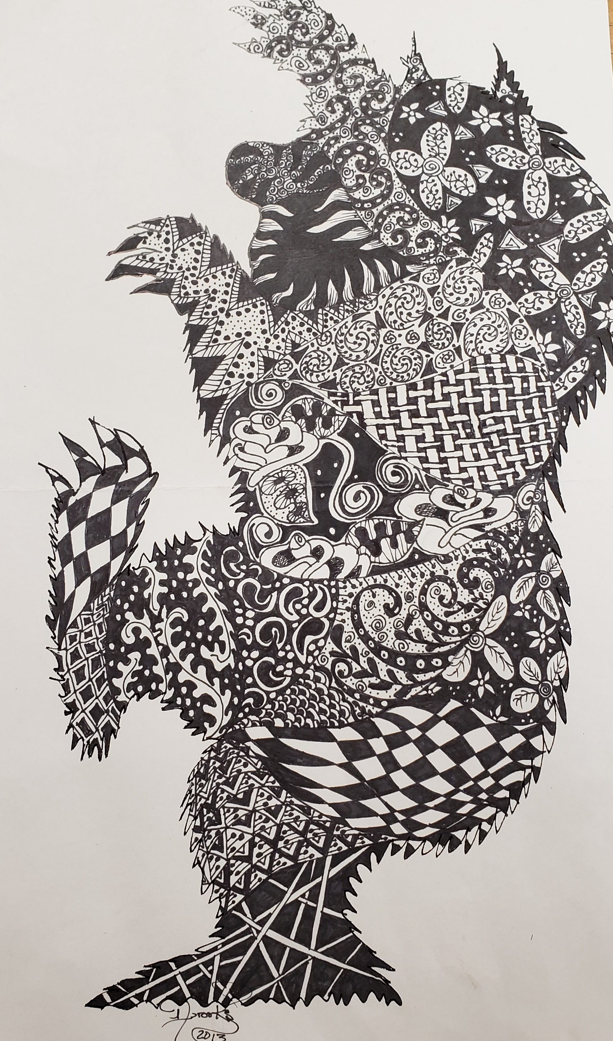
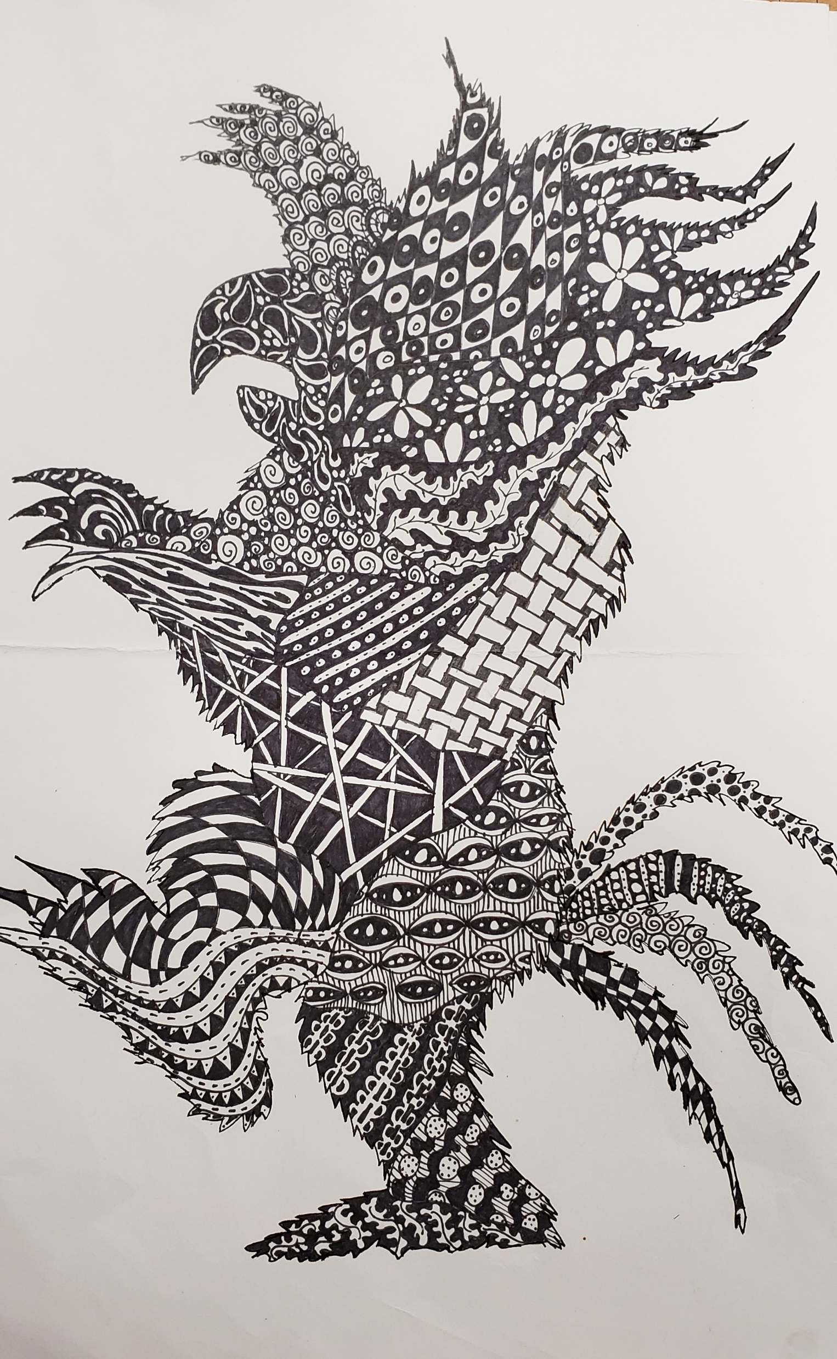
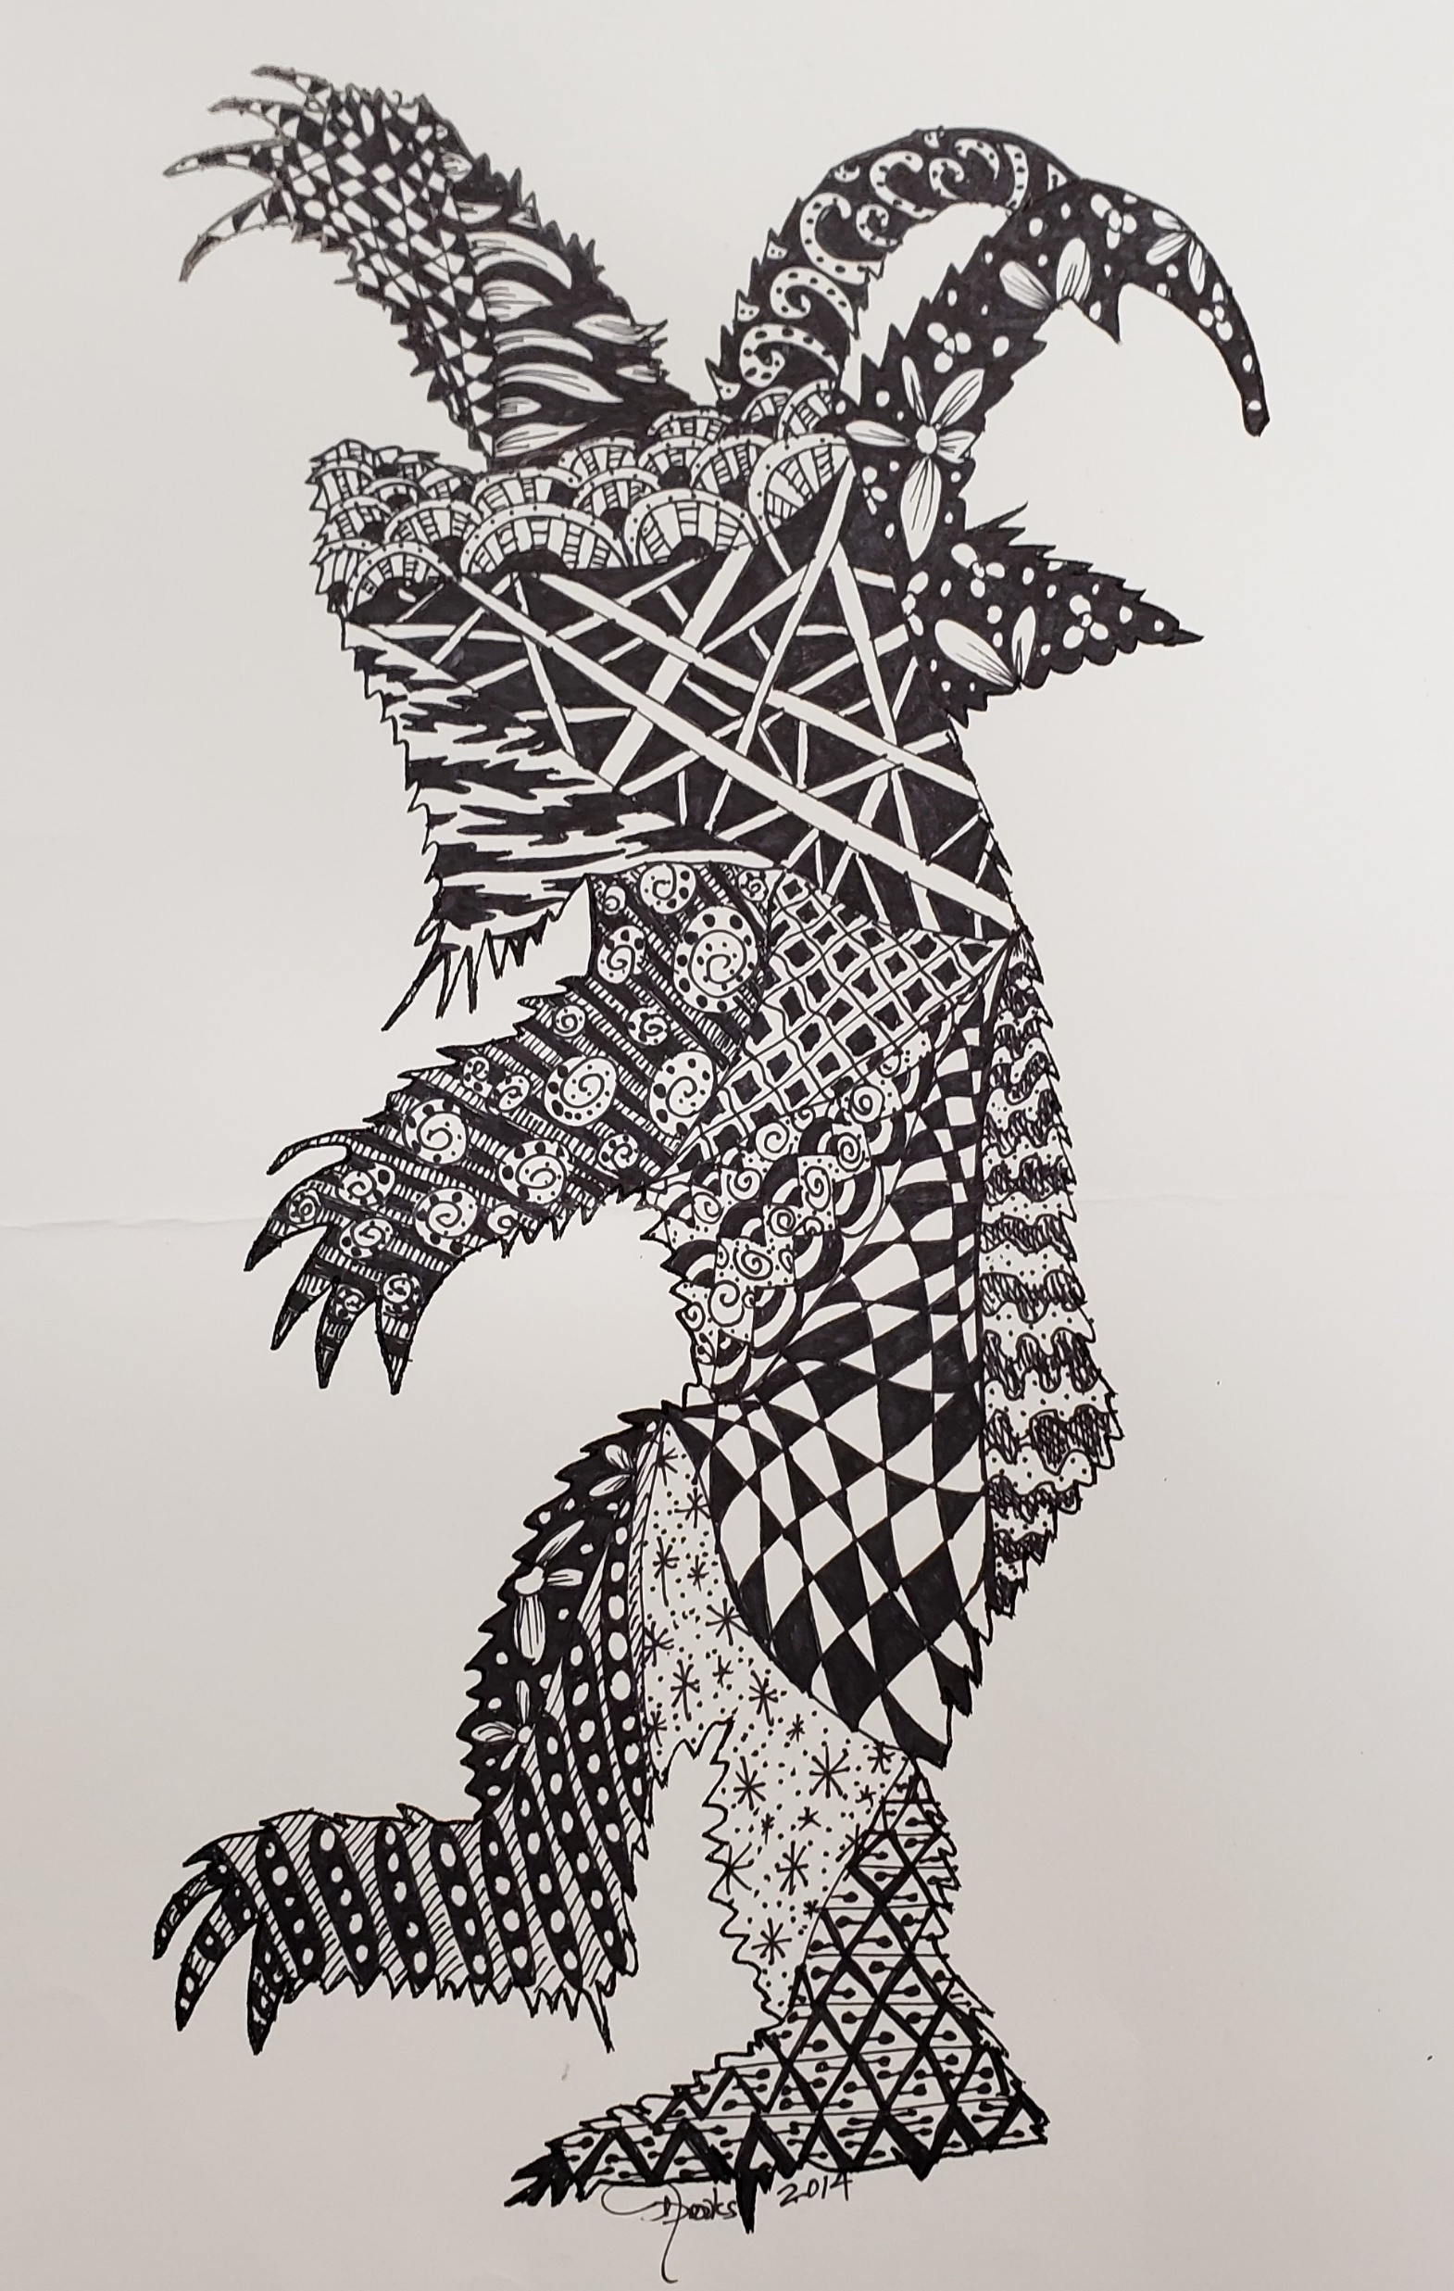
Samples of Zentangle

Slide 38
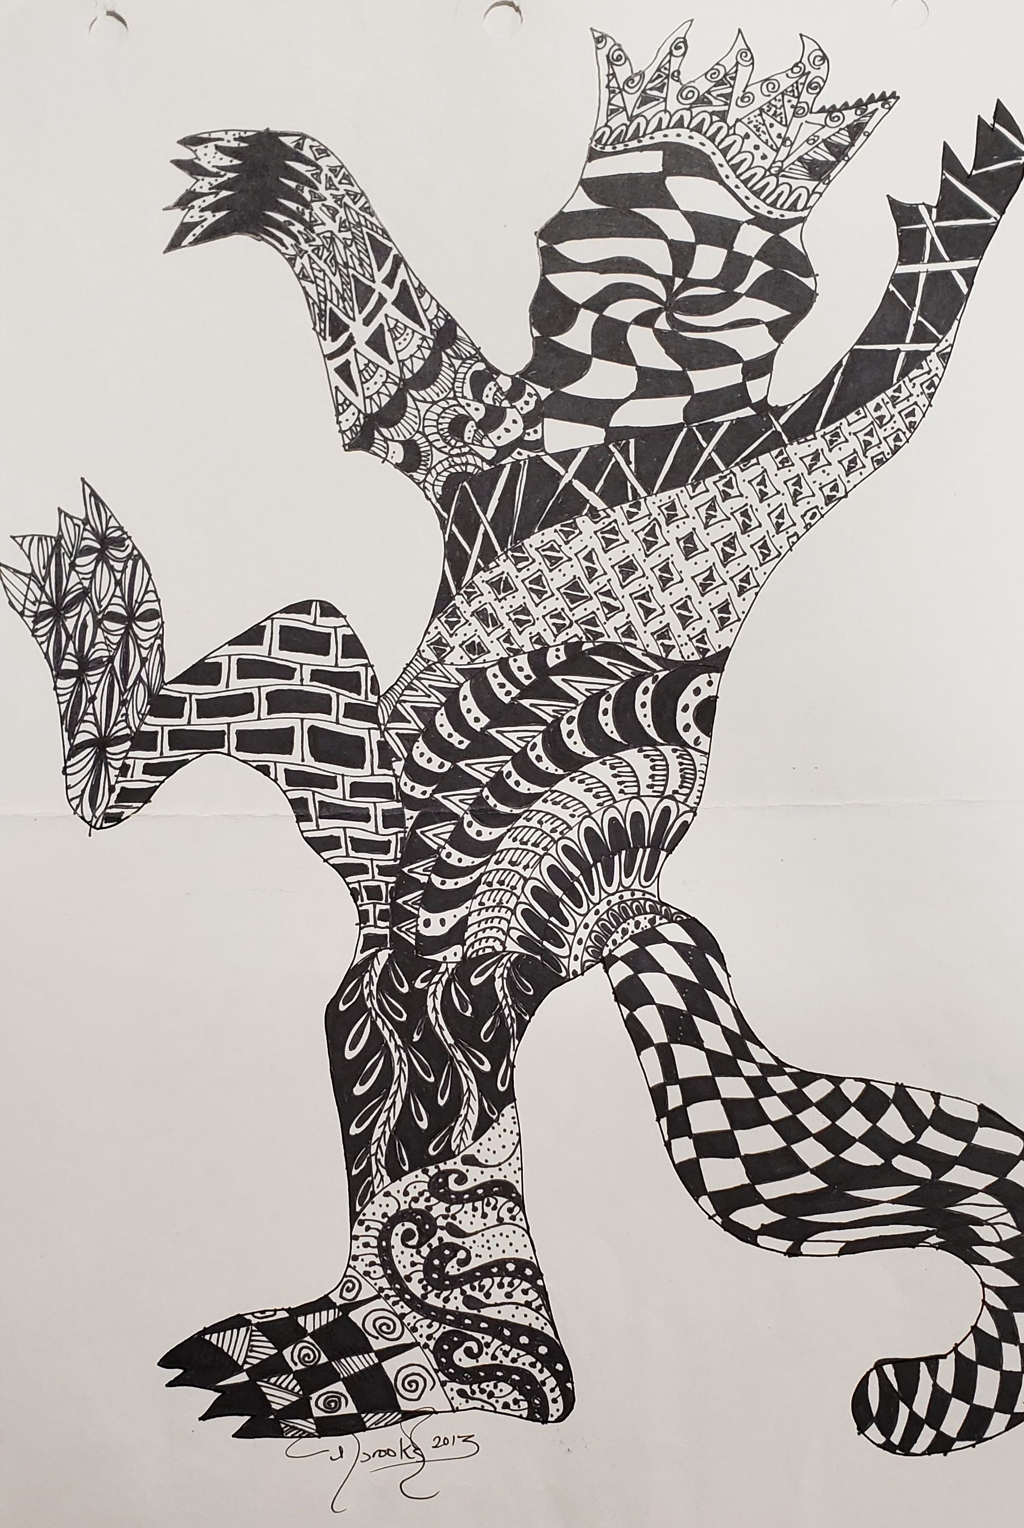
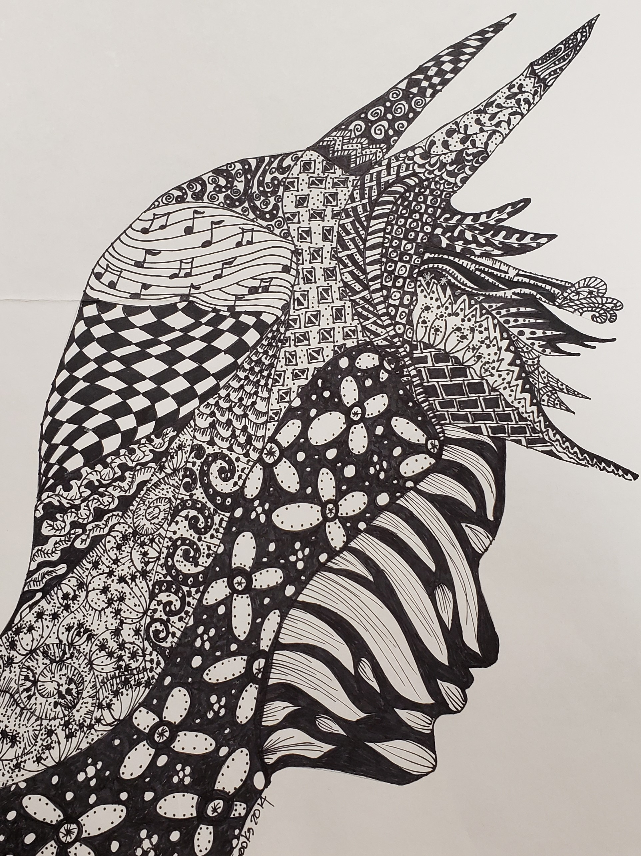
Samples of Zentangle

Slide 39
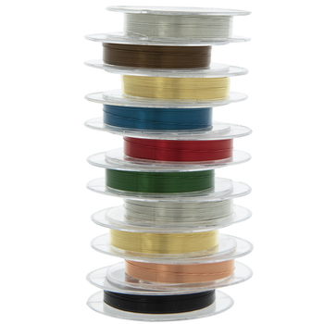
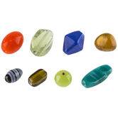
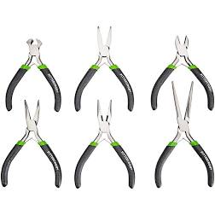
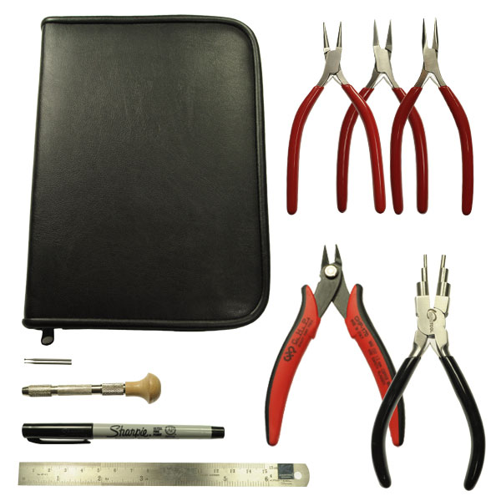
Jewelry wire comes in different gages(sizes) and a variety of colors Chose your gage and colors that you would want to make wearable pendants, bracelets, rings, and earring with.
Beads come in a variety of colors, shapes and sizes- chose beads that are light in weight and will also fit on your gage of wire.
Tools come in many different sets – choose pliers that are specific for jewelry making.

Slide 40
Basic art tasks
Zentangle project

Slide 41
Tasks for Zentangle project
Make sure you fill out your time sheet, graphic organizer and project contract at the beginning of this project
Research silhouettes shapes on the web and choose a shape of something.
Trace or draw silhouette onto 11 x 17 card stock
Break the silhouette into smaller sections
Begin putting in different variety of patterns within the smaller sections
Once the shape of the silhouette is completed make a determination if it is balance, if it looks like it is floating, off sides or needs more details.

Slide 42
Basic art videos
Basic zentangle
https://www.youtube.com/watch?v=l3QuS4Qah60

Slide 43
Jewelry videos
Jewelry design for making shapes from wire
https://www.youtube.com/watch?v=8CS2agxoL_c
Making an alphabet “M” out of wire
https://www.youtube.com/watch?v=Yjl-TbI5ekY

Slide 44
Jewelry introduction
Jewelry is a personal ornaments, such as necklaces, rings, earrings, broaches, or bracelets, that are typically made from or contain jewels and precious metal. Jewelry may be attached to the body or the clothes.
7 Principles of Design for Jewelry-Making Inspiration:Balance –
A Balancing Act
Emphasis - Point of Emphasis
Movement - The Magic of Movement
Proportion - Power of Proportion
Contrast - Contrast Consideration
Unity - Understanding Unity
Harmony - Happiness of Harmony

Slide 45
Jewelry introduction
In this course you will learn various wire techniques in creating wearable jewelry.
Master a Few Basic Skills
Practice with good quality tools and equipment
Learn jewelry terminology
Create a Dedicated Work Space
Look for Inspiration ideas for each project

Slide 46
Jewelry task
Make sure you fill out your time sheet, graphic organizer and project contract at the beginning of this project

Slide 47
Jewelry zoom links

Slide 48
Basic art Zoom links

