Slide 1

Riding Out the Storm: Managing Emotional Intensity in neurodivergent Children
Matthew J. Zakreski, PsyD

Slide 2
Who am I?
Dr. Matt Zakreski – you can call me ”Dr. Matt”
I’m a clinical psychologist, professional speaker, and neurodivergence advocate
I’m known as someone who can bridge neuroscience and clinical practice to make skills accessible for you and your loved ones

Slide 3
Goals for today
1. Learn how to better manage emotional outbursts (Frequency, Intensity, and Duration)
2. Increase understanding of where big emotions come from
3. Develop the language to communicate about emotional intelligence

Slide 4
What we aren’t doing today
1. Teaching our kids not to have feelings
2. Giving up on our abilities to help our kids

Slide 5
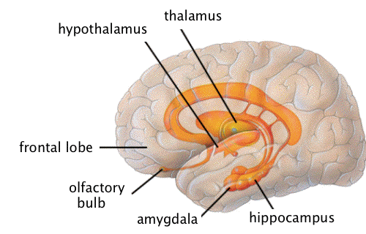
background
The emotional control system in the brain is the Limbic System
  Hypothalamus – relay system
  Hippocampus – memory
  Amygdala – fear and anger responses to stimuli
  Limbic cortex – two structures that impact judgement, mood, and motivation
Neurodivergent brains are more “wired” with interconnecting neurons.
The system that is responsible for regulating our behavioral responses is the Prefrontal Cortex (PFC), which matures later in the gifted brain
Big feelings = Big behaviors

Slide 6
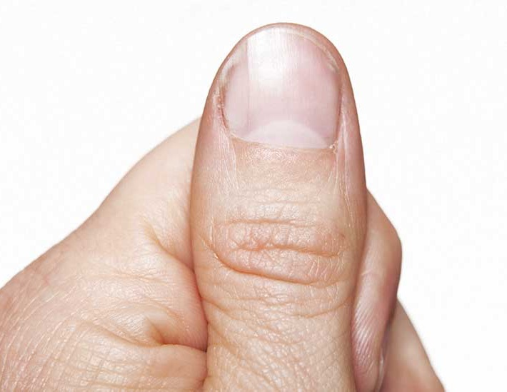
Case in point

Slide 7
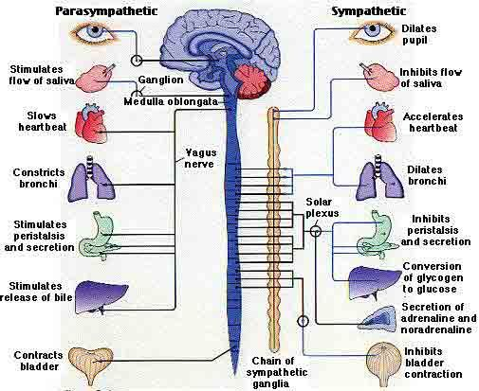

Slide 8
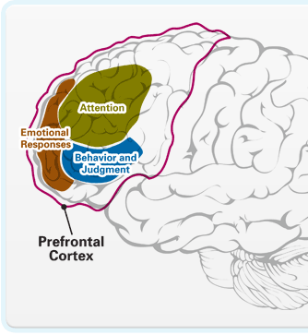
Prefrontal Cortex (PFC)
Located in the Frontal Lobe
Executive Functioning Skills
  Planning
  Follow through
  Task initiation/completion
  Self-regulation (emotional)
  Time management
  Attention
Behavioral Inhibition

Slide 9
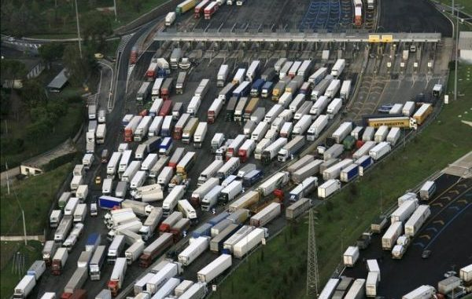

Slide 10

What does that mean?
Two ”levels” of the brain – the wizard and the lizard
When our kids are very upset, their “thinking” brains
cannot respond
- coping skills
- self-regulation skills
  We ask them to use their words when they can’t
We need to help them put the cap back on

Slide 11
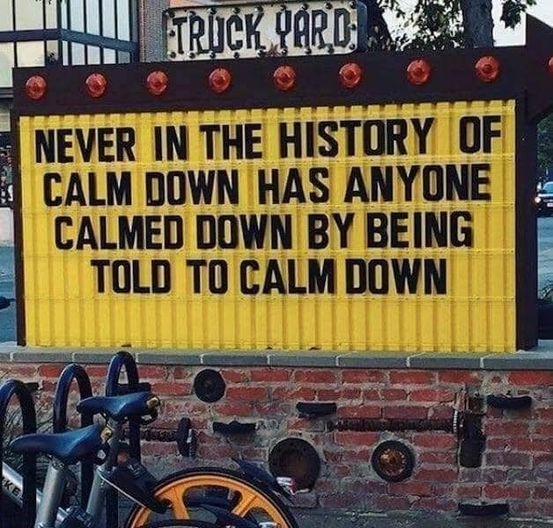
But it is so frustrating
To do this, YOU must be as OK as possible before you intervene
Co-Regulation!
First thing is to check in with yourself about what’s making you so angry.
  Your needs? (i.e., I need you to take out the garbage)
  Their needs? (i.e., your kid is being bullied)
  Society’s needs? (i.e., your kid is refusing to shower)
Second thing is to separate Content vs. Process
  Content: the things that they are saying
  Process: the emotions that drive those comments (<- this is where we want you to be)

Slide 12

The secret
Our brains and bodies WANT to return to homeostasis
The brain needs to have a request to engage the parasympathetic nervous system
The code is “I’m feeling ____________”
Must be spoken OUT LOUD

Slide 13
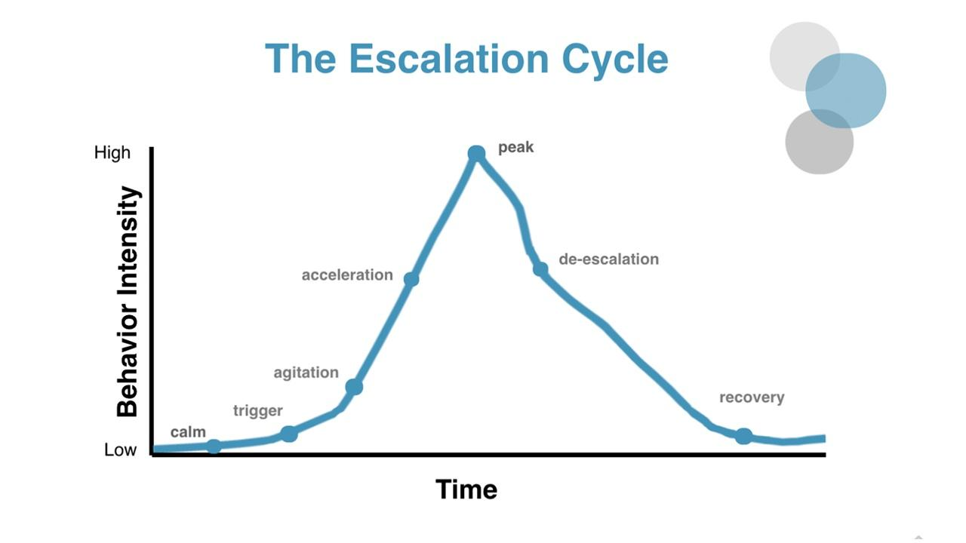
Wait a second…

Slide 14
My rule
You are allowed to feel HOWEVER you want to feel about ANYTHING.
But it’s what you DO with those feelings that matter.

Slide 15
Setting expectations
We may never get these disruptive feelings to ZERO
(F.I.D.)
The presence of a feeling/meltdown does NOT mean that you (or your kids) failed
Progress is not linear, consistent, or forever
The impact of environment (people, places, crowds, etc.) is REAL – pay attention
We want to focus on skills (self-regulation, naming feelings, etc) that can generalize
Praise is way more powerful than punishment
This work is REALLY HARD
It is up to us, the parents/teachers, to help our kids regulate their emotions.

Slide 17

Allow me to introduce our co-pilot…

Slide 18
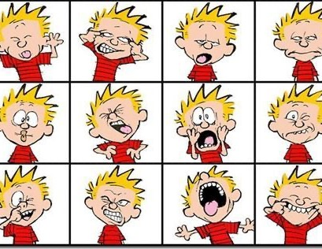
Identifying feelings

Slide 19
Tips and tricks
Becoming more aware of our feelings is a great way to increase control over them
Feelings start in our brain but impact our entire body
What does your ___________ look like when you’re angry?
  Eyes cheeks neck hands feet
  Mouth nose shoulders chest
  Eyebrows forehead arms legs
You may need to prime them early on: “You look ___________ to me because of ___________”
Start someplace safe and accessible: favorite book, best YouTube, etc.
REPEAT!

Slide 20
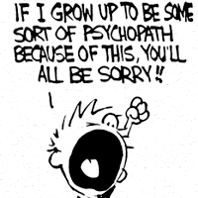
outbursts

Slide 21
Tips and Tricks
Watch out for “replacement language” – kids may use code words/phrases to replace their feelings
  “I’m bored”
  “I’ll kill you!”
  “All of my friends hate me!”
  “School is stupid!”
Validate first. “I’m sorry to hear that.” THEN move into: “How can I help?”
Prompt a use of feelings terms: “I’m _________” or “I feel ____________” (or “you look ______”)
Remember: not everyone knows what you know or experienced what you experienced
Prompt them for problem-solving (when they are calm): “So, what can you do about that?”
Remember: Feelings can’t be WRONG

Slide 22

Verbal aggression

Slide 23
Tips and tricks
Content vs. Process – what are you trying to communicate?
Fairly high-stakes in terms of intervening
What’s the context? Who knows it?
Let’s get away from the person/situation if you can (3-5 minutes at least)
Can you find a safe person?
Never email/text angry
You are allowed to feel angry/scared/jealous – you are NOT allowed to say/threaten inappropriate/unsafe words

Slide 24

In public

Slide 25
Tips and tricks
The stakes for emotional meltdowns in public are (or at least FEEL) higher
Set clear expectations BEFORE you go
  How long What do I need from you there Who else may be there
  Where are we going What do we have to help us be successful Code word
Check in often
What are the triggers? Can you avoid/minimize them?
Don’t panic
Your needs vs. the kid’s needs
“If you haven’t carried your kid out of Target like a football running back, are you even a parent???”

Slide 26
disappointment

Slide 27
Tips and tricks
We tend to rush to “fix” the problem – can minimize their pain
  “OK Boomer” – Do we really even understand?
  Ask if you CAN share a similar anecdote
An upset kid is not the time to have a Life Lesson ®
Empathize first – “you seem really upset” or “I’m sorry that it didn’t go your way.”
What is making them upset?
What can we do to fix the problem? Now? Later?
F.A.I.L. = Frequent Attempts in Learning

Slide 28
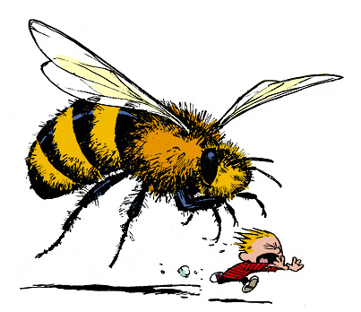
panic

Slide 29
Tips and tricks
We all have different trigger items and levels of response
Get to know your kid and their specific concerns/fears/phobias
“How big is your feeling right now?” (Concretize the feelings – size, shape, rating from 1-10, etc.)
Escape?
  Mentally
  Physically
  Socially
The longer you survive, the longer you can survive
  BE STRATEGIC!

Slide 30

Peer difficulties

Slide 31
Tips and tricks
Other people can make living very difficult – we cannot control their reactions/behavior
There are always other possible explanations
  Start silly/ridiculous
  Prompt – what if?
  Don’t disagree. Just acknowledge
Perspective taking is key – what do we know? What don’t we know?
Positive exposure – can school help?
“Intent vs. Impact” – we must acknowledge both sides
Setting matters – let’s set up for success (birthday parties vs. sleepovers)

Slide 32

The thunderstorm metaphor

Slide 33
steps
1. Get someplace safe
2. Try not to be mad at the thunderstorm
  You are allowed to be disappointed (even scared!)
  But getting angry at the thunderstorm is not helpful (and can be dangerous)
  All storms pass eventually – most are shorter than you think
3. How can we clean up?
4. Let’s get back to what we were doing

Slide 34
processing
When the “storm” is over
When you can both be calm and focused on the task at hand
Non-judgmental – what happened? What made you feel that way? What do you think was the impact?
What can we learn? (WE = parents, teachers, kid, peers, etc.)
It is going to happen again – the trick is to see it coming whenever possible and be proactive

Slide 35
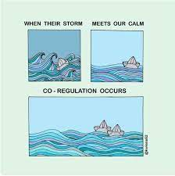
Try to be the lighthouse

Slide 36
Parent skills
We must practice what we preach – modeling behavior
Meta-communication – talking about talking
Remove your ego (as much as possible)
A bit of proactive work goes a long way
Check-ins
Avoid “Shoulds”
Emotions are normal, and non-valued (i.e., not “good or bad” but “comfortable or uncomfortable”)

Slide 37
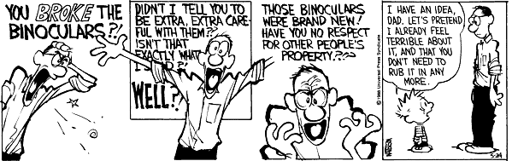
Why we work so hard at this

Slide 38
resources
https://parentswithconfidence.com/calm-down-strategies-for-kids/
https://www.psychologytoday.com/us/blog/peaceful-parents-happy-kids/201307/5-steps-help-kids-learn-control-their-emotions
https://www.gottman.com/blog/age-age-guide-helping-kids-manage-emotions/
https://www.gro-gifted.org/neuroscience-of-giftedness-increased-brain-areas-associated-with-emotional-processing/
https://www.nicoletetreault.com/single-post/2017/07/26/emotionally-gifted-and-navigating-the-world
https://educationaladvancement.org/blog-many-gifted-children-also-highly-sensitive/
https://www.youtube.com/watch?v=J4n2MiGgDUI
https://www.youtube.com/watch?v=JD4O7ama3o8

Slide 39
Questions?
Please feel free to email me at drmattzakreski@gmail.com
And follow me www.facebook.com/drmattzakreski

