Slide 1
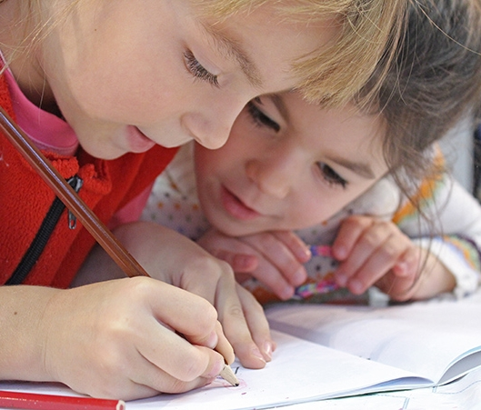
Social Skills Through the Ages
NOV
2023
Understanding & Supporting Your Child’s Social-Emotional Development
Presented by: Kristen Nazzaro, M.A., N.C.S.P
and Claudia Branco, M.A., PsyD Intern
Notes:
Kristen

Slide 2
Outline
Defining Social Skills
Social/Emotional Development Through Childhood
Identifying Social Skills Deficits
Facilitating Social Skills at Home
Questions
Notes:
Kristen

Slide 3
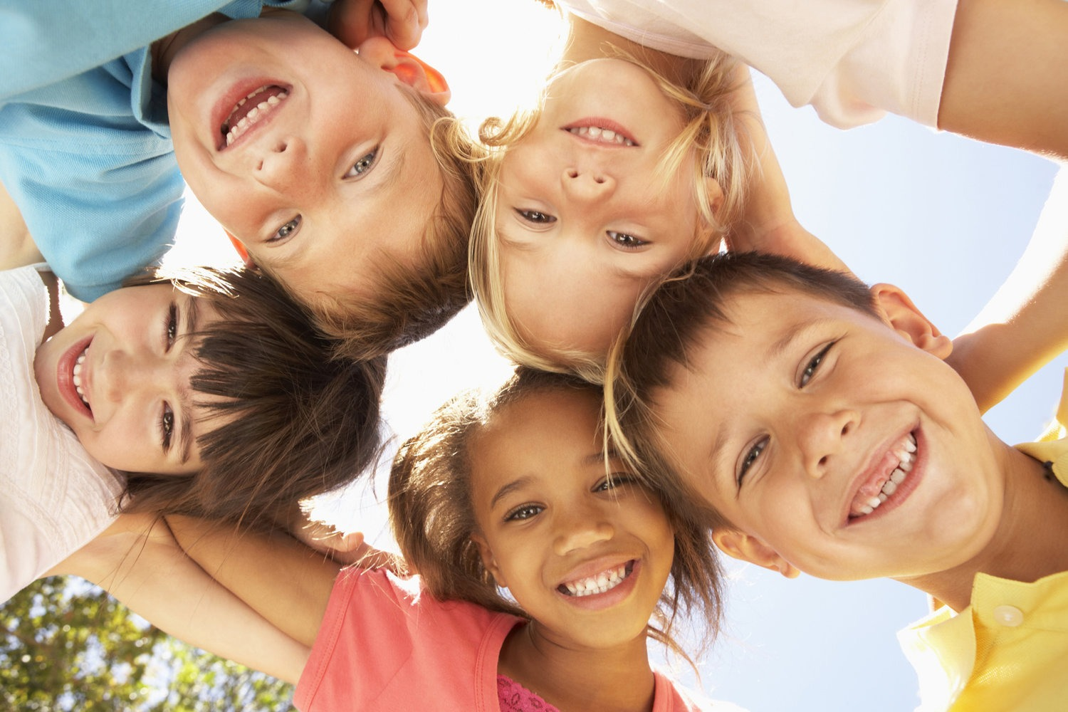
What are Social Skills?
Social rules and relations
Constantly developing
Verbal and nonverbal
Gradual, integrative process
Notes:
Claudia
Any competence facilitating interaction and communication with others where social rules and relations are created, communicated, and changed in verbal and nonverbal ways.
Social development is a gradual, integrative process through which children acquire the capacity to understand, experience, express, and manage emotions/social skills

Slide 4
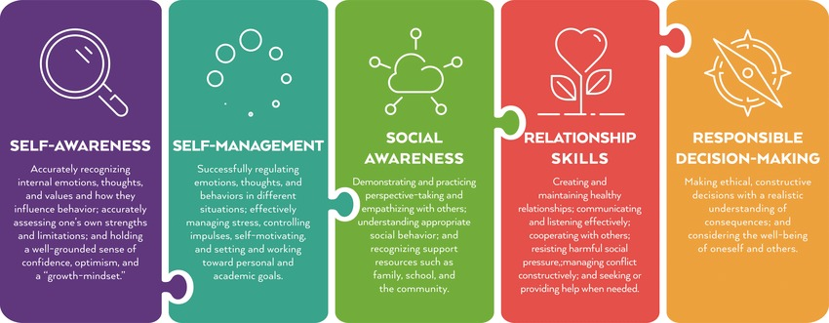
Competencies At A Glance
Notes:
Claudia
Different areas of social development

Slide 5
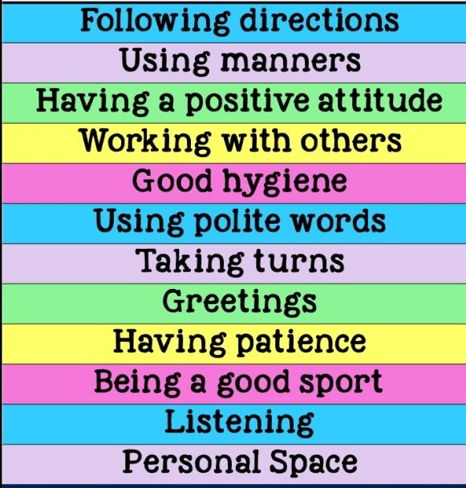
Social Skills Examples
Notes:
Kristen

Slide 6
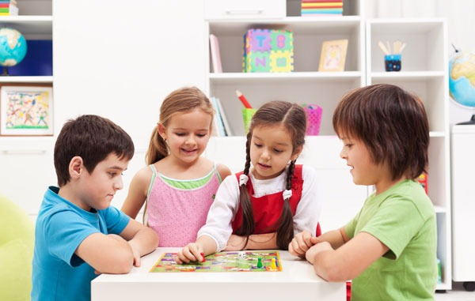
Social Development Through the Ages
Notes:
Kristen

Slide 7
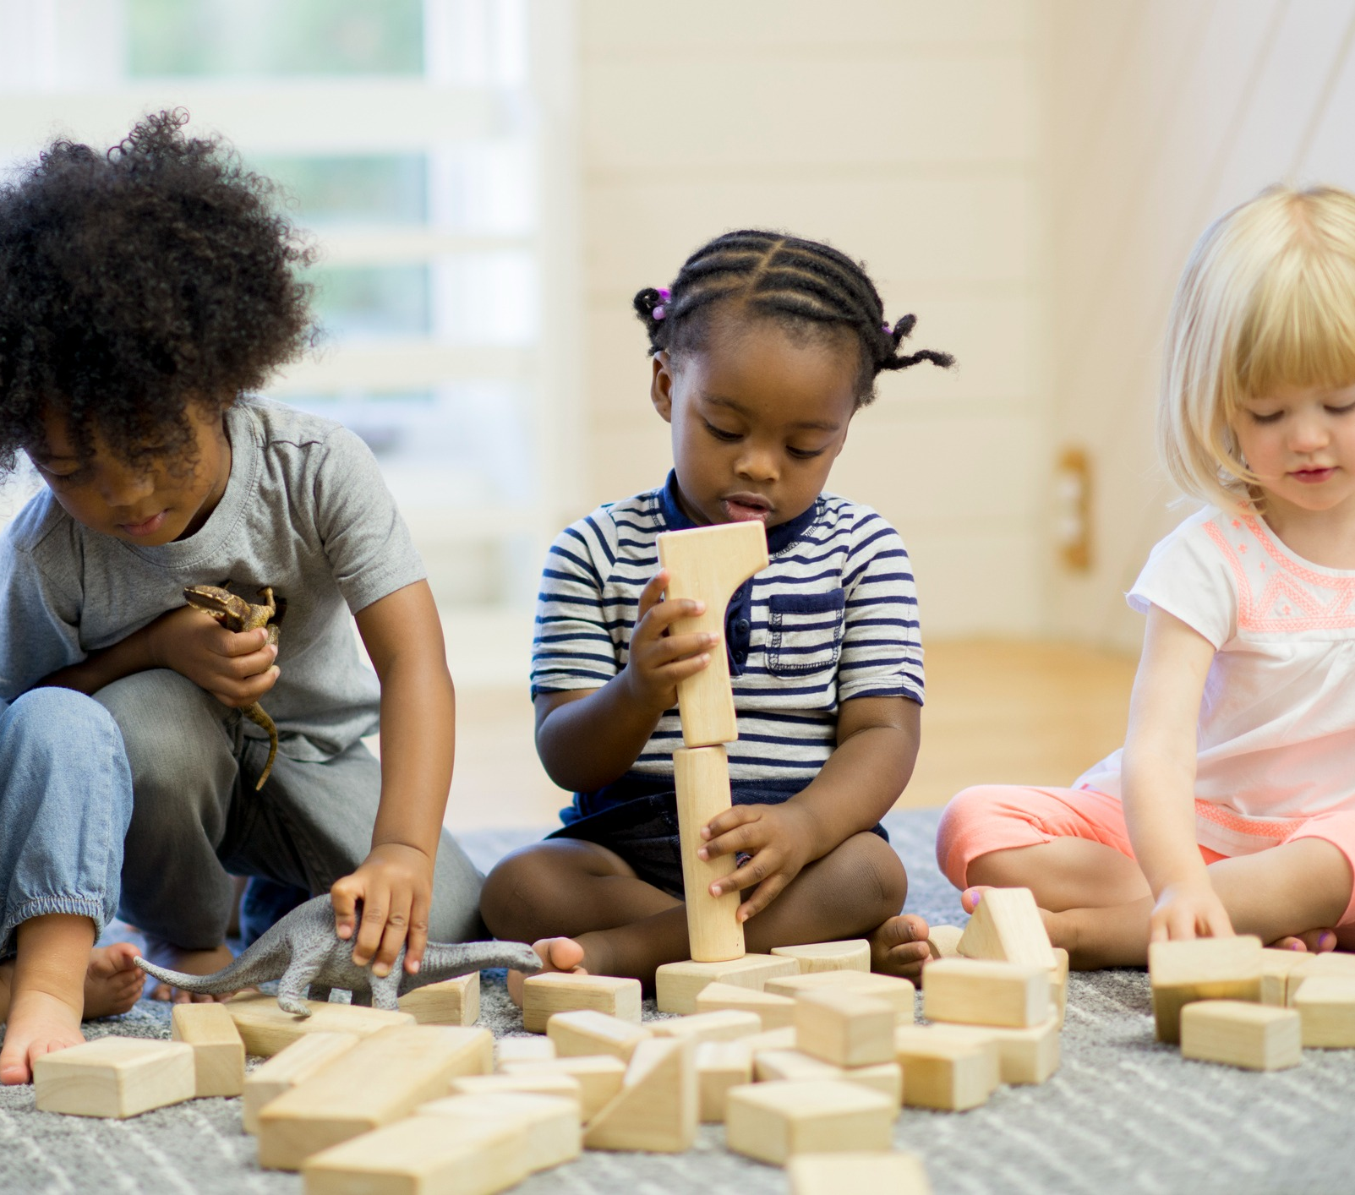
Preschool (3-5)
Exploration & Self-Direction
Curiosity with different types of play
Creative & make-believe play
Understanding presence of others and what sharing is
Want to direct play activities themselves
Testing the boundaries
Self-control when frustrated or upset
Notes:
Claudia

Slide 8
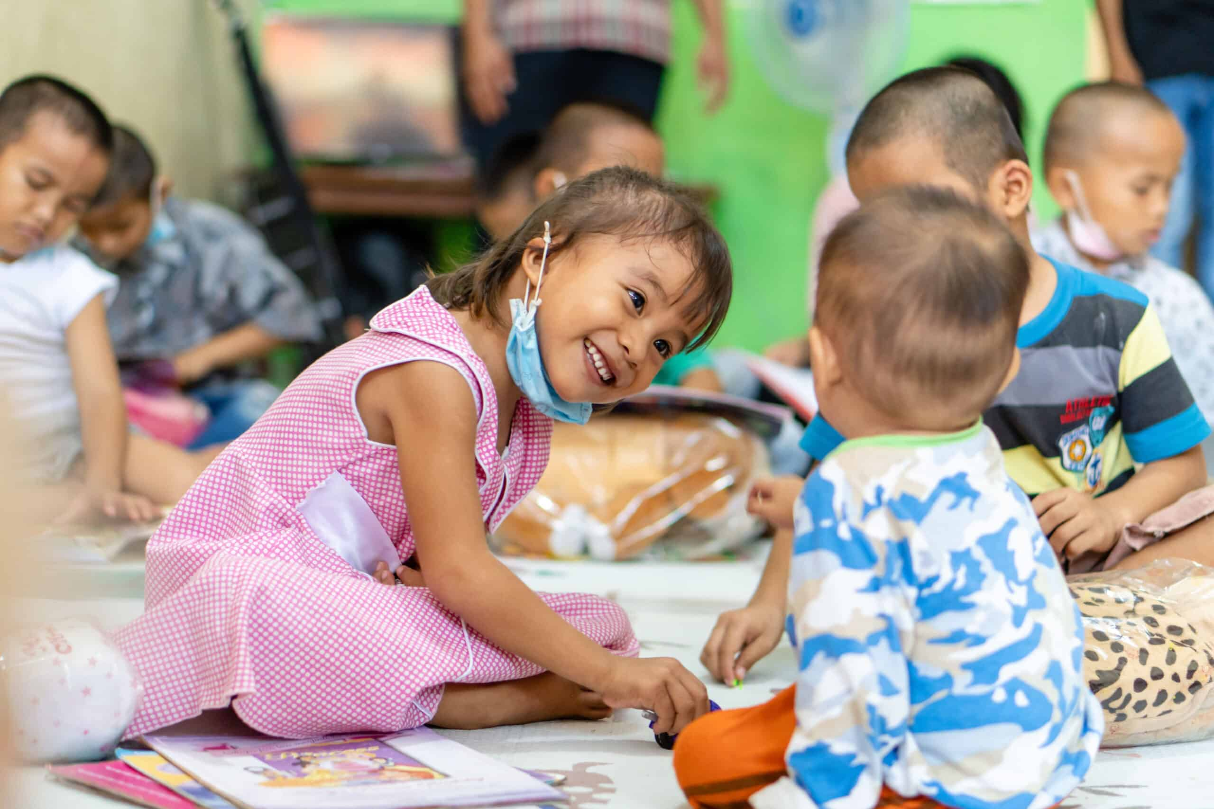
Early Elementary (K-3rd)
Peer Engagement & Play
Parallel play
Developing playmates and “Best friends”
Cooperating with rules during group play activities
Turn-taking, patience, and impulse control
Sensitivity to feelings of others – want to help friends
Notes:
Kristen

Slide 9
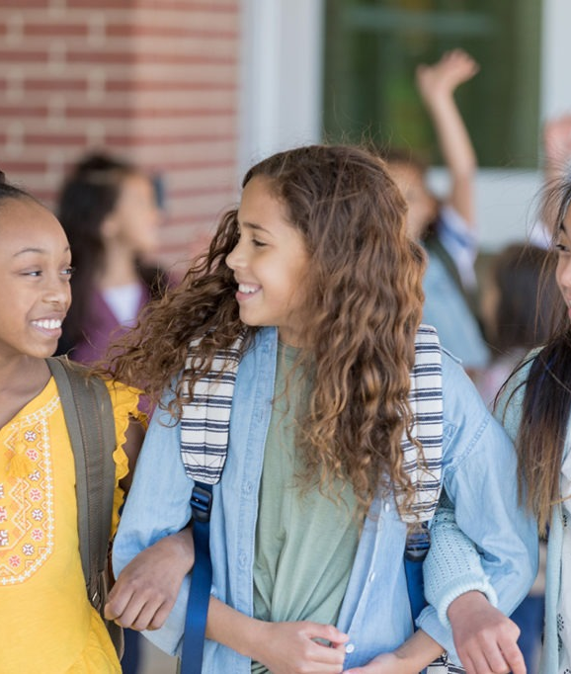
Late Elementary (4th-6th)
Peer Networking
Friendships become deeper, more consideration into who they consider “friends” and who they spend their time with
Development of problem-solving skills
Anger control & emotional regulation skills develop
Carrying a conversation
Understanding of social cues
Notes:
Kristen

Slide 10

Middle School (7th-8th)
Peer Pressure & Comparison
Desire to be liked and accepted by peers
Development of social groups/cliques
Sensitive to the perception of others
Personal morals and questioning authority
Hormonal influences
Notes:
Claudia

Slide 11
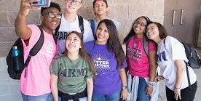
High School (9th-12th)
Social Identity Development
Peers become more influential than the support of family/siblings
Look to peers to help them solve problems
Understand their own values, strengths, and weaknesses
Seek out new experiences
Increased interest in romantic relationships
Shaping their habits to reflect adult life
Notes:
Claudia

Slide 12
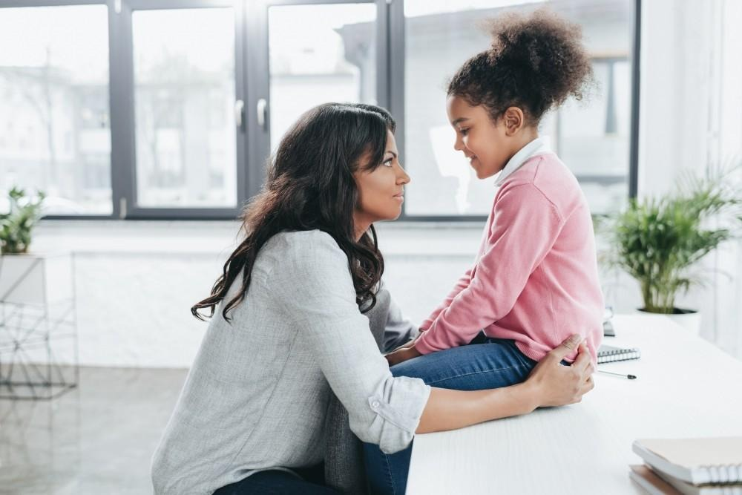
Identifying Delays in Social Development
Notes:
Kristen

Slide 13
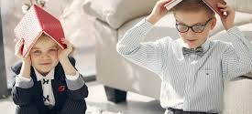
How do you know there’s a problem?
Questions to ask yourself:
What are the developmental milestones of my child’s current age?
Does my child appear to have social challenges that most children their age are skilled in?
What is the skill gap between my child and similar aged peers?
How long has the skill gap existed, and does it appear to be getting bigger?
Are these challenges causing problems for your child in school/community/home?
Notes:
Kristen

Slide 14
Signs & Challenges
Preschool-Elementary
Middle-High School
Lack of interest in playing with peers
Disconnected from environment
Coping with frustration or sadness
Aggressive behavior
Difficulty sharing and turn taking
Conversations are not reciprocal
Unimaginative or incongruent play
Difficulty apologizing and accepting fault
Difficulty following a conversation
Emotional dysregulation becomes more apparent
Cannot identifying and solve problems
Hard time forming deep, meaningful friendships
Giving feedback in socially inappropriate/blunt ways
Inability to change behavior based on nonverbal social cues
Hard time asking for help
“My way or the highway”
14
Notes:
Claudia

Slide 15

Facilitating Social Skills Development
Notes:
Claudia

Slide 16
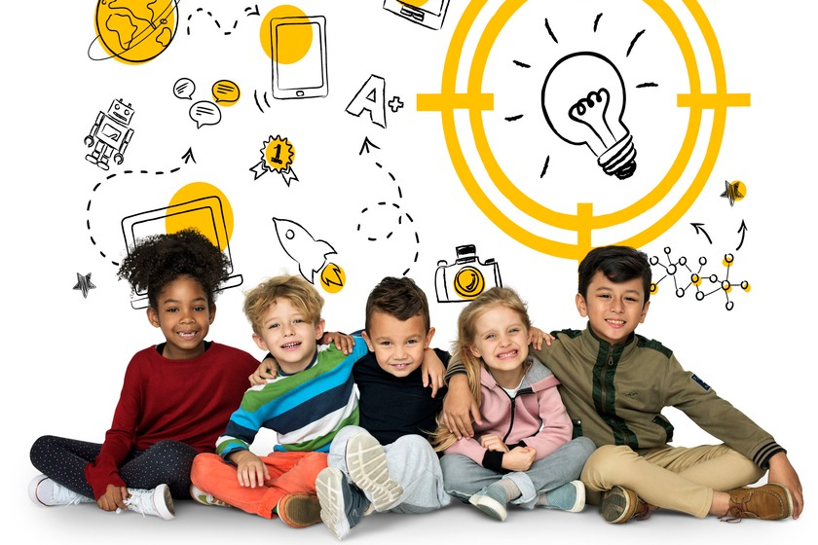
What You Can Do
Provide modeling and guidance
Positive reinforcement & behavior-specific praise when you notice social skill growth
Give alternatives for socially inappropriate behavior
Communicate with the school to learn how they are teaching these skills
Notes:
Kristen

Slide 17
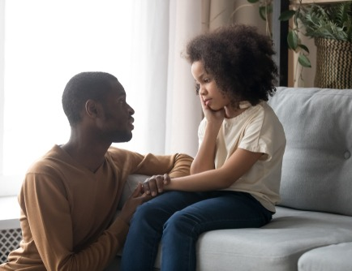
Other Strategies
Facilitate structured play dates with a peer the child engages with frequently
Involve peer/sibling role models
Give your child jobs at home
Roleplay social situations your child struggles with
Get your child involved in small group activities (lunch bunches, extracurriculars, etc.)
Read social stories during bedtime
Talk through social interactions of movies, tv shows, etc.
Notes:
Kristen

Slide 18
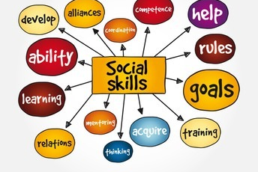
Big Picture
Consistency is key! If your child has social skills deficits, the process of learning may be slow and nonlinear. Stay consistent in what you’re encouraging and how.
Notes:
Claudia

Slide 19
Questions?

Slide 20
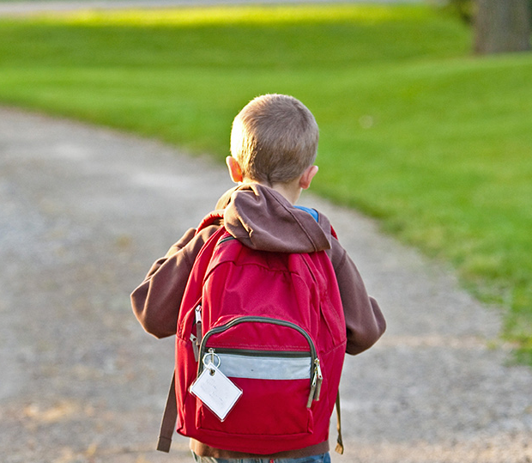
Resources
https://casel.org/
https://www.pbs.org/parents/
https://childmind.org/topics/covid-kids-mental-health-challenges/
A Parent's Resource Guide to Social and Emotional Learning
https://www.autismspeaks.org/social-skills-and-autism

