Slide 1
Financial Aid Night
James Bruggeman
Assistant Director of Data Analysis

Slide 2
Agenda
Free Application for Federal Student Aid (FAFSA)
Cost of Attendance and Student Aid Index (SAI)
Financial Aid Awarding and Types of Aid
Additional Resources
Satisfactory Academic Progress
Contacting our Office

Slide 3

FAFSA Overview
The U.S. Department of Education believes that the responsibility for financing post-secondary education lies with a student and their parents.
Federal financial aid funds are a way to assist families with that expense. Financial aid consists of funds provided to students and families to help pay for postsecondary educational expenses.

Slide 4
FAFSA Overview
FAFSA must be submitted annually and serves as only application for federal/state aid at most schools. Apply at https://studentaid.gov.
You and your parent(s) (if applicable) must approve the transfer of 2022 tax data from the IRS into the 2024-25 FAFSA. Parental tax data is required for most students.
You and your parent(s) must have an FSA ID.

Slide 5
FAFSA Overview
The 2024-25 FAFSA is NOW available as of December 30, 2023. Typically, the FAFSA is available October 1.
Institutions must receive FAFSA results by their first-priority deadlines or consideration dates.
Make sure you complete your FAFSA by the earliest first-priority date of the schools to which you are applying. Ohio University’s first-priority consideration date is February 15.

Slide 6
FAFSA Overview
Apply for an FSA ID
It is ESSENTIAL to request FSA IDs for student and parent(s) before beginning the FAFSA.
FSA ID will require an email address. A mobile phone number can be used to verify the ID. An email address and mobile number can only be associated with one FSAID.
A multi-factor authentication process will happen every time a person logs into the FAFSA.

Slide 7
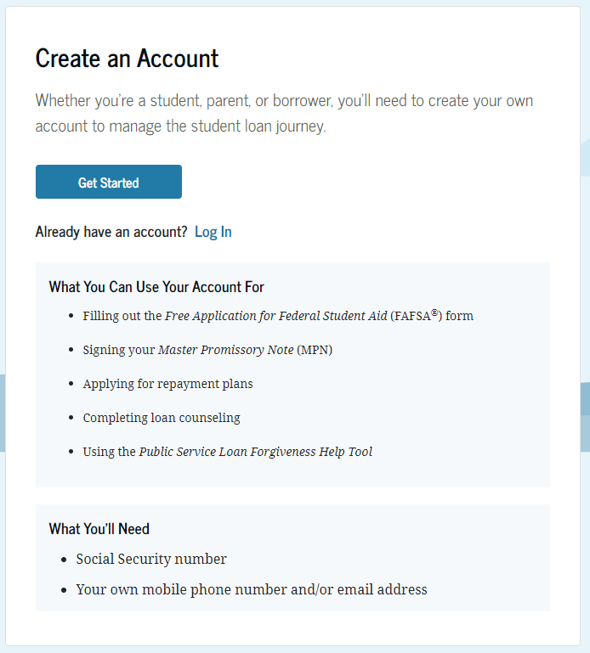
FAFSA Overview
https://studentaid.gov/fsa-id/create-account/launch

Slide 8
FAFSA Overview
Necessary Documents:
Social Security Numbers for Student/Parent
Student Driver’s License
2022 Federal Tax Return (Student/Parent)
2022 untaxed income records (Student/Parent)
  Includes child support paid/received, other income not included in the IRS Adjusted Gross Income.
Current bank statements (Student/Parent)

Slide 9
FAFSA Overview
We recommend that students be the one to first login and start the FAFSA form for 2024-25. Complete the student section and then invite your relevant parent to complete their section.
Dependent students must invite their parent(s) to contribute to their form, if parent information is required.
Students and parent contributors must provide consent and approval to retrieve and disclose federal tax information from IRS for the student to be eligible for federal aid.

Slide 10
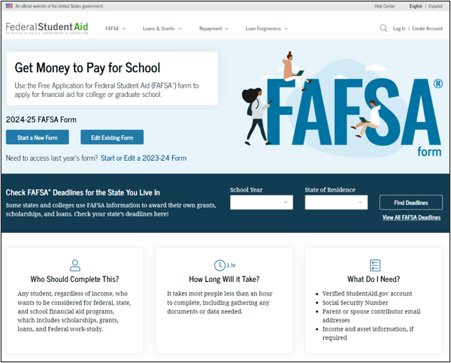
FAFSA Overview
Notes:
Please note with audience that these screenshots are not final and the final “look and feel” may differ once FAFSA is released.

Slide 11
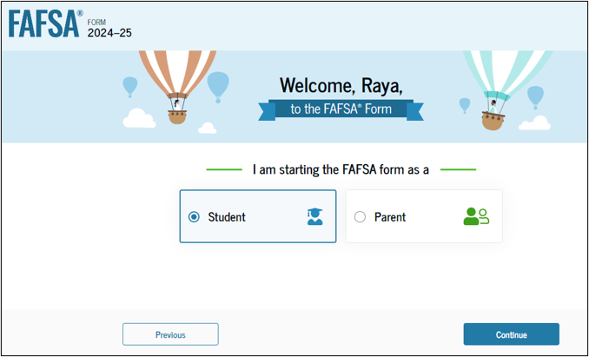
FAFSA Overview

Slide 12
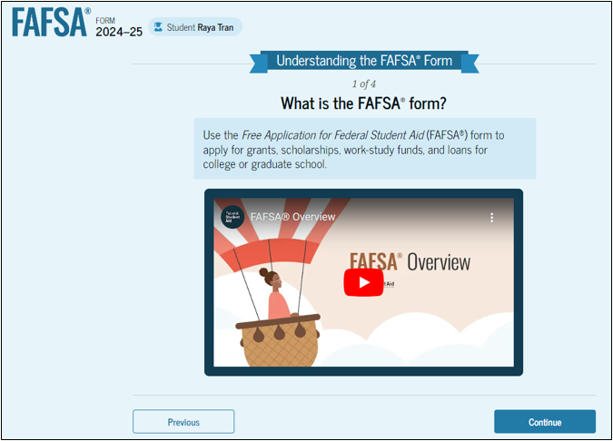
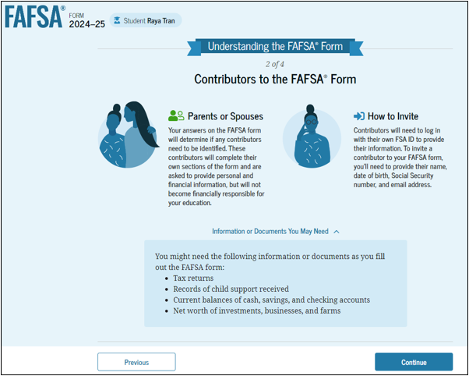
FAFSA Overview - Student
Notes:
When a student starts the 24-25 FAFSA form for the first time, they are taken through the FAFSA onboarding process. Onboarding slides will only appear the first time a student logs in.

Slide 13
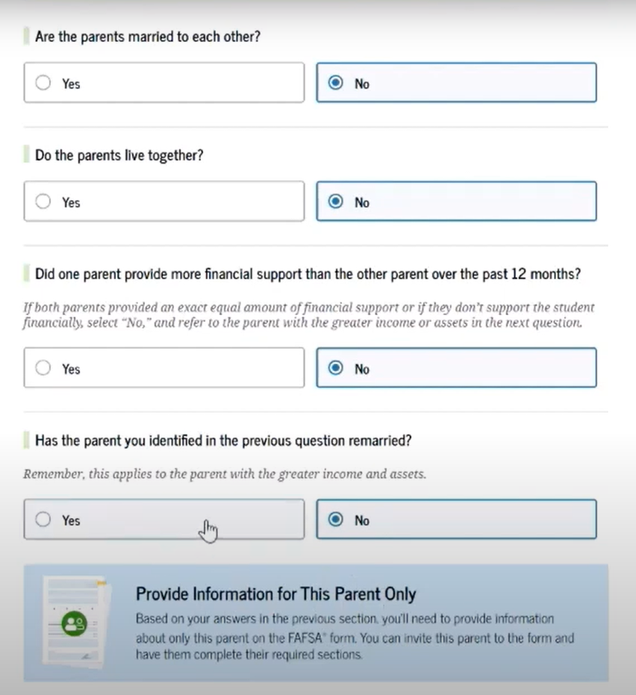
FAFSA Overview
Are your parents married to each other?
If yes, provide information about both parents
If no, next question
Do the parents live together?
If yes, provide information about both parents
If no, next question
Did one parent provide more financial support than the other over the past 12 months?
If both parents provided equal amount of financial support or if they don’t support the student financially, select “No”. You must report the parent with greater income or assets in the next question.
Has parent you identified in previous question remarried?
  If yes, provide information for parent and stepparent.
  If no, provide information about this parent only.

Slide 14
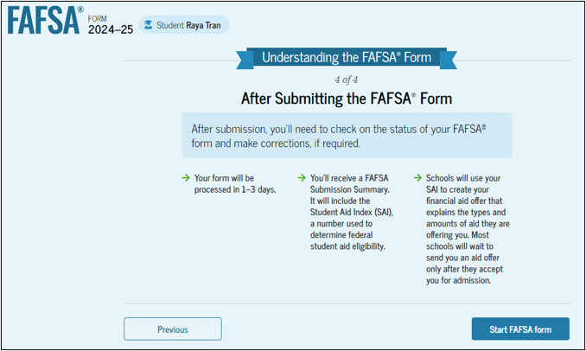
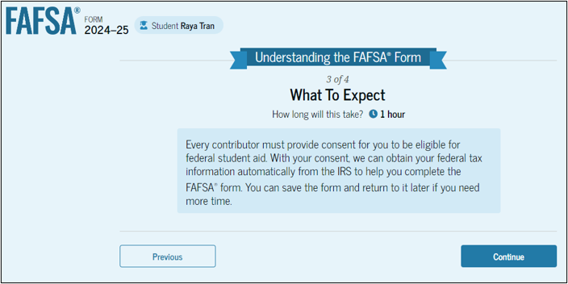
FAFSA Overview - Student
Notes:
These informational slides inform the student of the process and what to expect after submitting the 24-25 FAFSA.

Slide 15
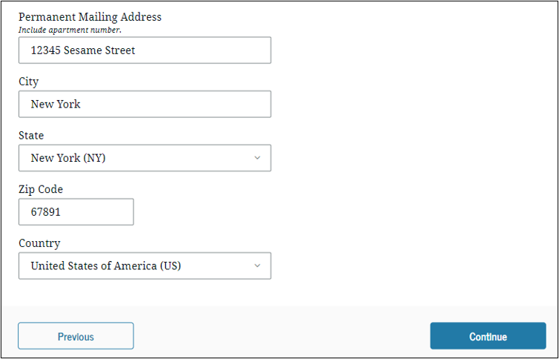
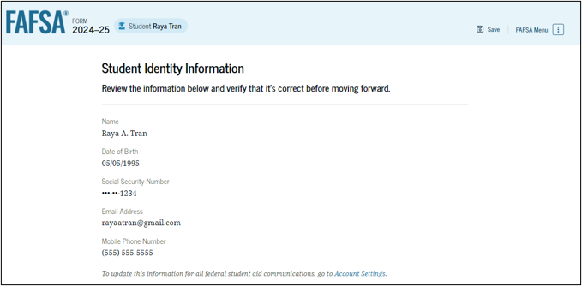
FAFSA Overview - Student

Slide 16
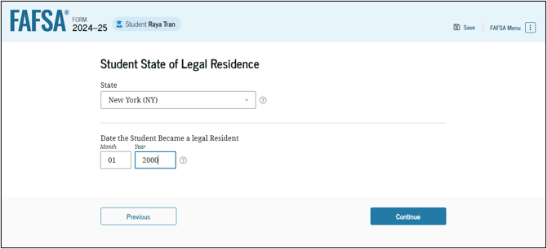
FAFSA Overview - Student

Slide 17
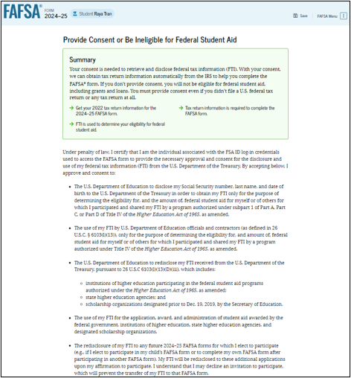
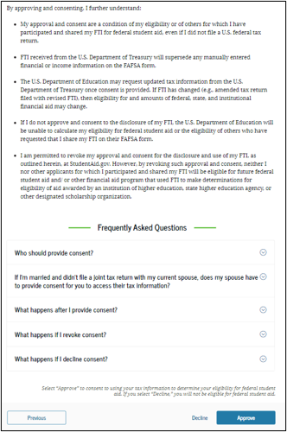
FAFSA Overview - Student
Notes:
Student must consent and approval to the transfer of tax information from the IRS into the 24-25 FAFSA to be eligible for federal student aid.

Slide 18
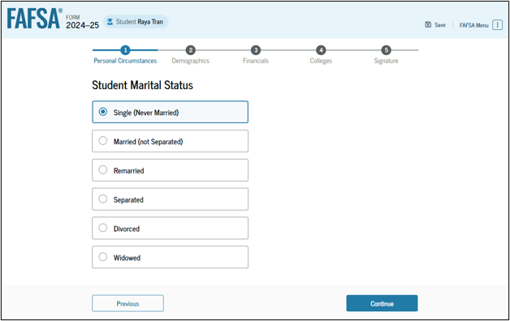
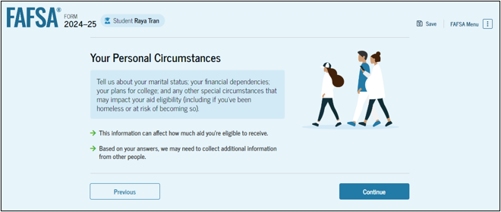
FAFSA Overview - Student
Notes:
The following slides request personal information about student to determine college plans and dependency status.

Slide 19
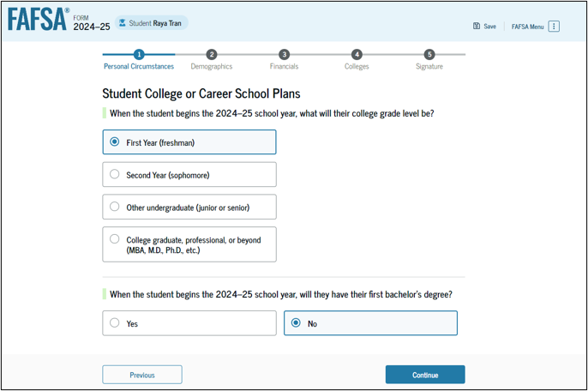
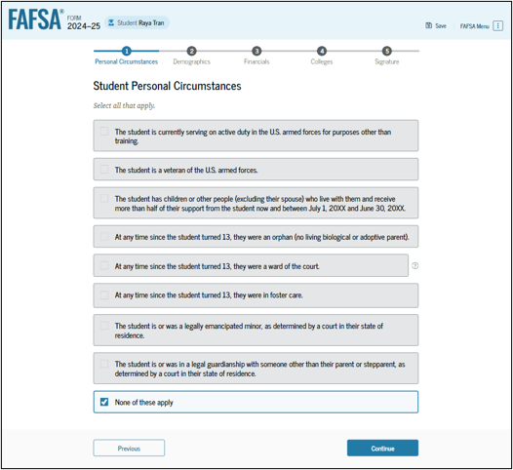
FAFSA Overview - Student

Slide 20
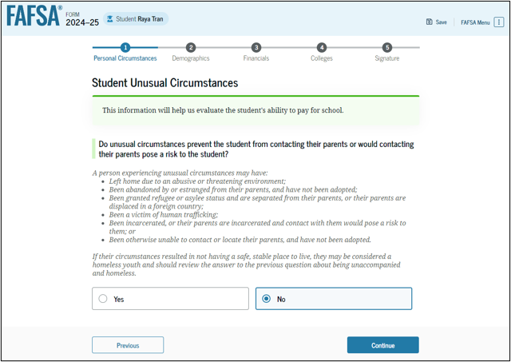
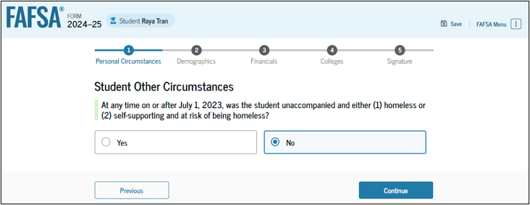
FAFSA Overview - Student

Slide 21
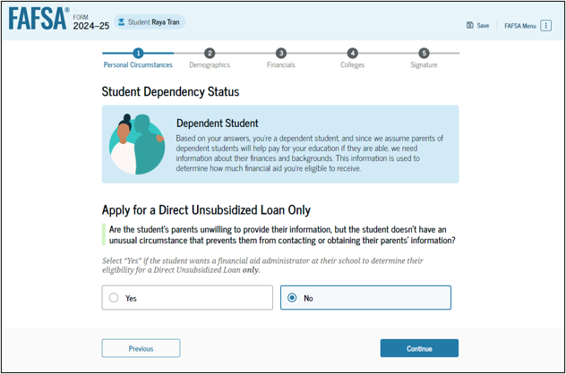
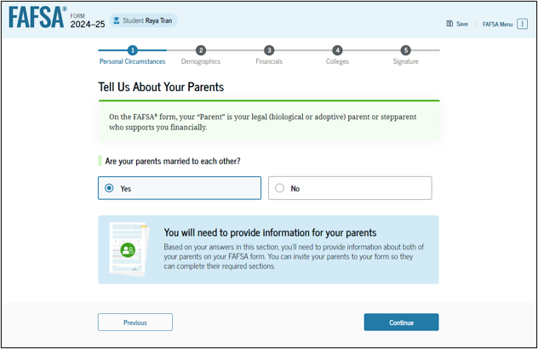
FAFSA Overview - Student
Notes:
Unless you are completely estranged from your parents, you must provide their financial information on the FAFSA. The FAFSA will then ask a series of questions to assist student in determining the appropriate parent or parents to include on 24-25 FAFSA.

Slide 22
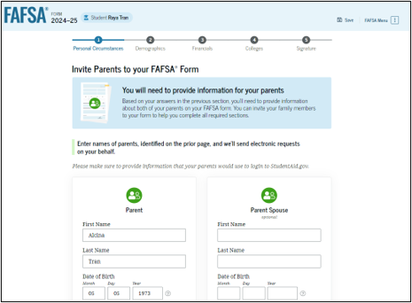
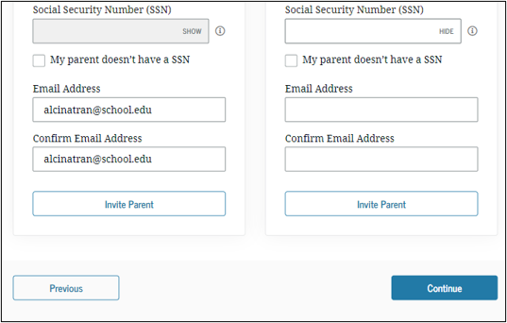
FAFSA Overview - Student
Notes:
Once parent determination has been made a student must invite his/her parent or parents to contribute to the 24-25 FAFSA. Student must provide name, date of birth, social security number and email address to invite a contributor.

Slide 23
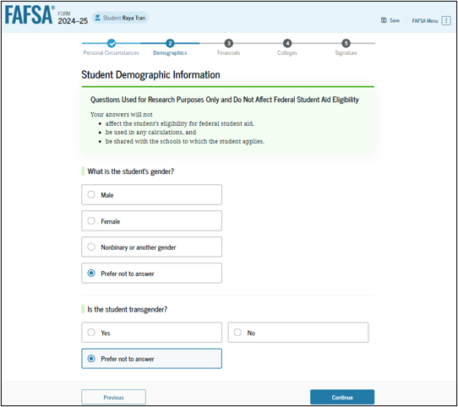
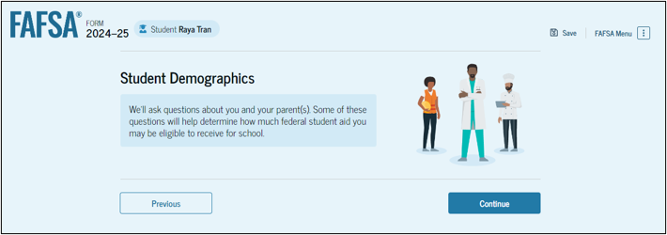
FAFSA Overview - Student

Slide 24
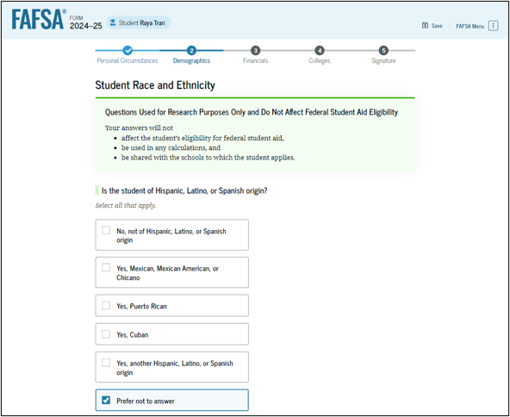
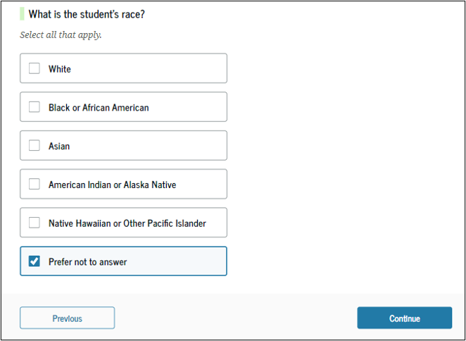
FAFSA Overview - Student
Notes:
These questions are meant for research purposes only and will not be used in determining aid eligibility.

Slide 25
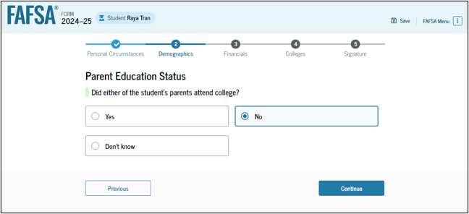
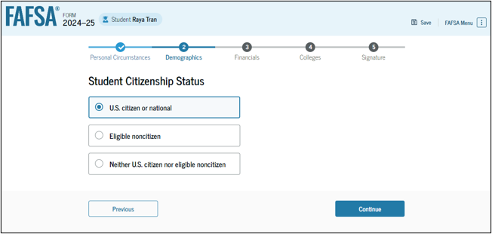
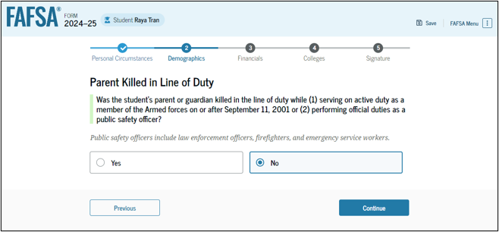
FAFSA Overview - Student

Slide 26
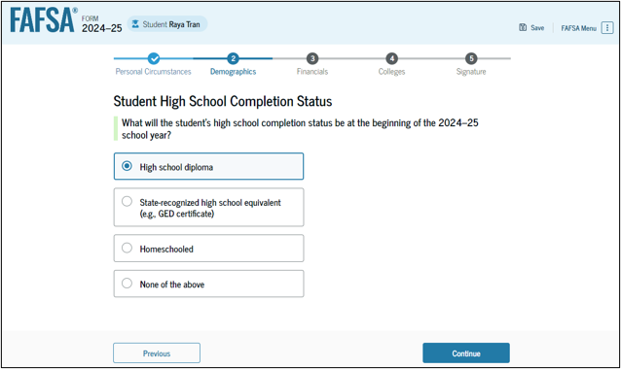
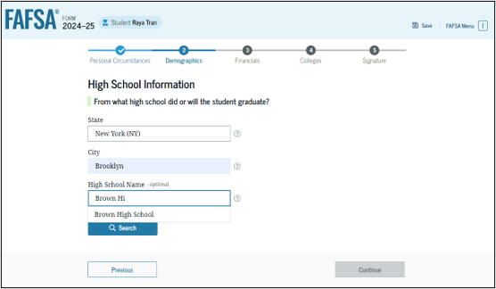
FAFSA Overview - Student

Slide 27
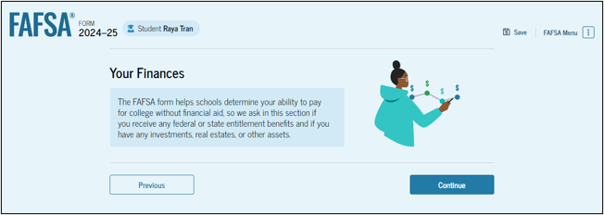
FAFSA Overview - Student

Slide 28
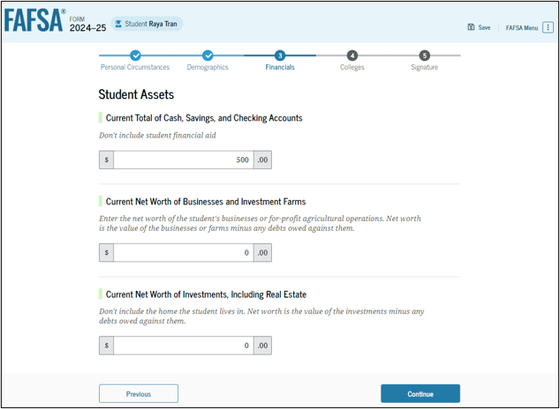
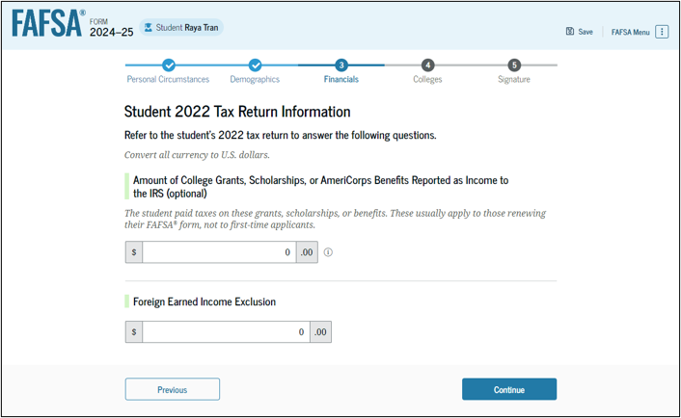
FAFSA Overview - Student

Slide 29
FAFSA Overview - Student

Slide 30
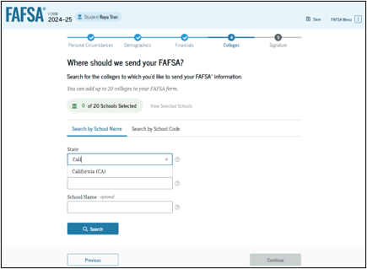
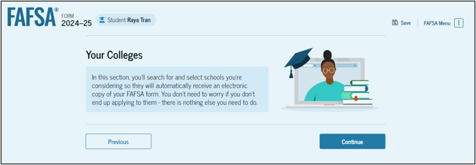
FAFSA Overview - Student
Notes:
A student can include up to 20 colleges on the FAFSA.

Slide 31
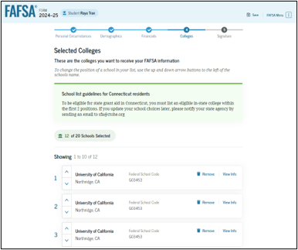
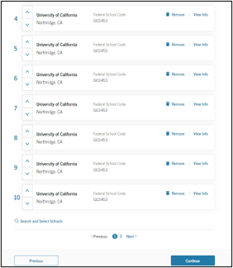
FAFSA Overview - Student

Slide 32
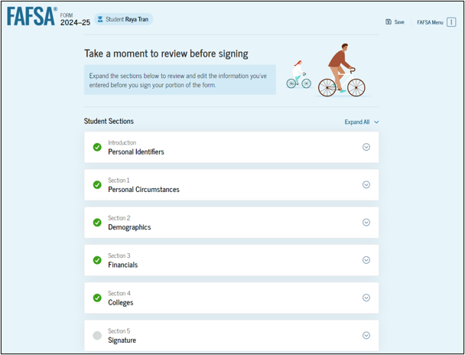
FAFSA Overview - Student

Slide 33
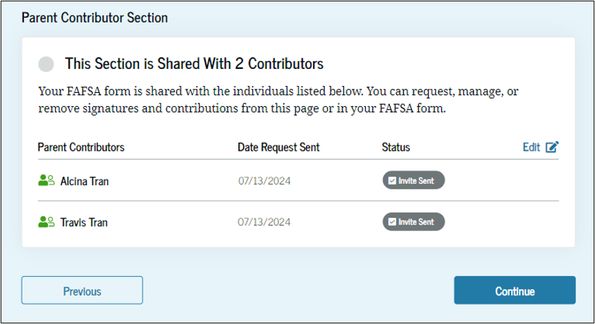
FAFSA Overview - Student

Slide 34
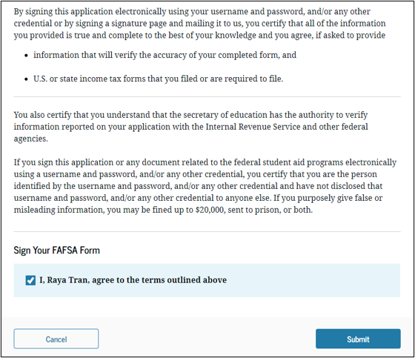
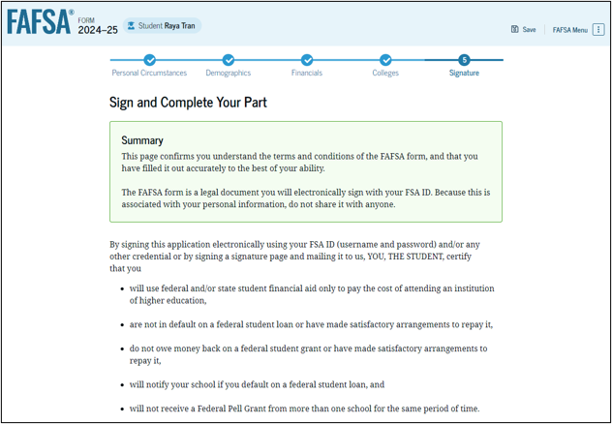
FAFSA Overview - Student

Slide 35
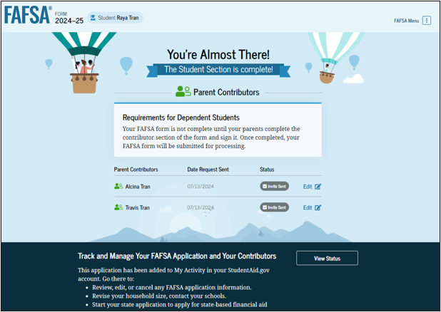
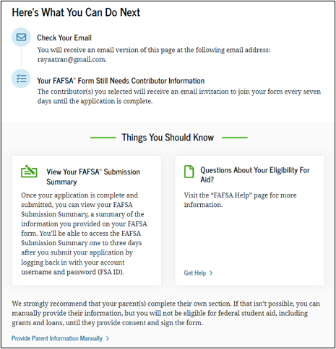
FAFSA Overview - Student
You need the following information about your parent(s):
Legal Name
Social Security Number
Date of Birth
Notes:
Student must sign and submit. Upon submission invitations are sent to contributors. Once the application is complete and submitted, a student can view their FAFSA Submission Summary by logging into studentaid.gov in 1 to 3 days.

Slide 36
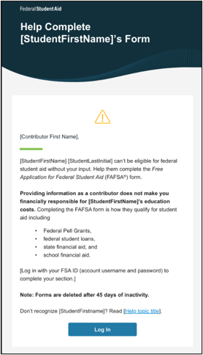
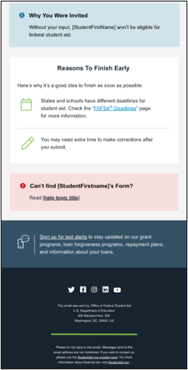
FAFSA Overview – Parent(s)
Notes:
Parent(s) will then receive the invitation to contribute. The invitation stays active for 45 days.

Slide 37
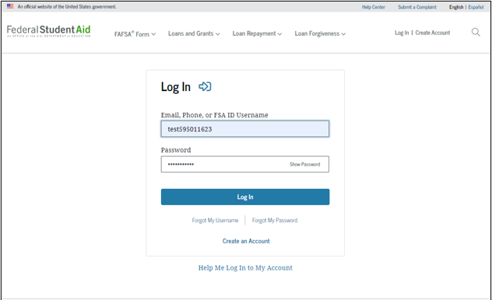
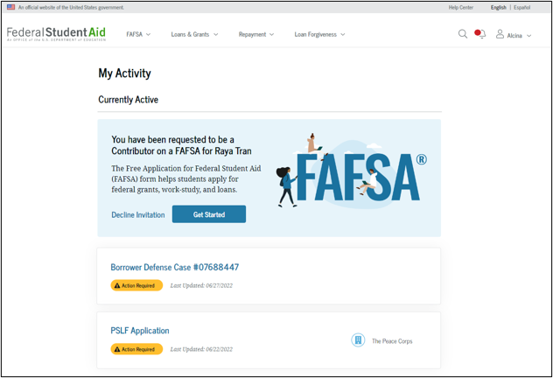
FAFSA Overview – Parent(s)

Slide 38
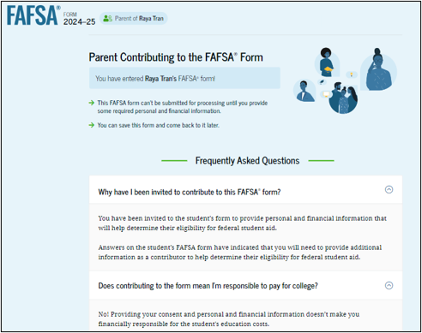

FAFSA Overview – Parent(s)

Slide 39


FAFSA Overview – Parent(s)

Slide 40


FAFSA Overview – Parent(s)
Notes:
Parent must now provide consent and approval to link tax information in order for student to be eligible for federal student aid. If you are married and you filed jointly, only one parent must provide consent. If married parents filed separately both parents must provide consent.

Slide 41


FAFSA Overview – Parent(s)
Notes:
Please note that if you are a parent who has remarried, your spouse’s information must be included.

Slide 42

FAFSA Overview – Parent(s)
Parents who have any student attending a school district where free or reduced-price school lunches are provided to all students, regardless of income, should select that federal benefit. This is correct even if it was another even if the student for whom you are completing the FAFSA is not enrolled there.

Slide 43

FAFSA Overview – Parent(s)

Slide 44


FAFSA Overview – Parent(s)
Notes:
Family size will be determined by number of dependents on 2022 tax forms. If the number in family has changed since filing 2022 tax forms you will be given the opportunity to update the number manually.

Slide 45


FAFSA Overview – Parent(s)
Notes:
Child support is considered an asset.

Slide 46

FAFSA Overview – Parent(s)

Slide 47


FAFSA Overview – Parent(s)

Slide 48

FAFSA Overview – Parent(s)
Notes:
Upon submission, student will receive an email confirming that the form has been received.

Slide 49
FAFSA Overview
Student assets are viewed by the U.S. Department of Education as resources readily available to pay for college courses.
Carefully review your student’s assets, such as checking and savings accounts and any investments.

Slide 50
FAFSA Overview
Ohio University recommends that all families file the FAFSA.
Students of all income levels, meeting other eligibility criteria, are awarded student loans.
Complete your FAFSA as soon as possible.

Slide 51
FAFSA Overview
Ohio University has a first-priority consideration date of February 15. We must receive your FAFSA results by this date to ensure you are considered for all available financial aid programs.
Complete the FAFSA every year. In future years, it will be available October 1 and first-priority dates may be earlier!
Completing the FAFSA is FREE! Never pay someone to assist you in filing the FAFSA.
The FAFSA website is https://studentaid.gov/. This site does not charge a fee.

Slide 52
FAFSA Overview
Each school listed on your FAFSA will receive the results of your FAFSA electronically.
You may be selected for a process called Verification where tax transcripts and/or W-2 forms are requested by your school.
Ohio University will begin mailing financial aid offers to freshmen students in March.

Slide 53
FAFSA Overview
The information requested on the 2024-2025 FAFSA is based on 2022 tax data.
Families who experience changes in their financial situation in 2024 should contact your school’s financial aid office requesting consideration.
Your school may be able to use estimated 2024 tax data to reconsider your financial aid awards.

Slide 54

Cost of Attendance and SAI
College costs depend on many factors:
Will you live in a residence hall or commuting from home?
Will you purchase a meal plan (required for on-campus residents)?
How much are books?
How much will it cost you to travel from home to campus?
How many times a week (or a month) will you need to do laundry?
Notes:
The Student Aid Index is an eligibility index number that will be used to determine how much federal student aid the student will receive. This number results from the information that the student provides in their FAFSA form.

Slide 55
Cost of Attendance and SAI
The Cost of Attendance is a comprehensive budget. It consists of:
Direct Charges – paid directly to the college
Indirect Costs – estimated expenses incurred, but not paid to the college

Slide 56
Cost of Attendance and SAI
Direct Charges include tuition and standard fees, residence hall (Housing) and meal plan (Food) costs.
Indirect Costs include estimates for books and necessary supplies, transportation around campus and trips home, and miscellaneous personal expenses.

Slide 57
Cost of Attendance and SAI
Ohio University proudly offers The OHIO Guarantee, which provides predictability, transparency, and stability of these costs. The OHIO Guarantee is a cohort based, level-rate tuition, housing, dining, and fee model assuring a set of comprehensive rates for the pursuit of an undergraduate degree. The OHIO Guarantee rates remain unchanged for 12 consecutive semesters, four academic years.

Slide 58
Cost of Attendance and SAI
The following is Ohio University’s 2023-24 Cost of Attendance for an undergraduate attending full-time on the Athens campus for two semesters.
 | Semester | Year | Cost Description
Tuition | $6,873 | $13,746 | Billed by Ohio University.
Residence Hall/Meal Plan | $6,797 | $13,594 | Billed by Ohio University. Actual amount determined by meal plan and housing choice.
Books | $420 | $840 | Paid out-of-pocket based on course requirements
Transportation | $990 | $1,980 | Allowance for travel needs.
Personal | $468 | $936 | Allowance for personal needs.
Total In-State Costs | $15,548 | $31,096
Out-of-State Surcharge | $5,184 | $10,368 | Billed by Ohio University.
Out-of-State Total | $20,732 | $41,464

Slide 59
Cost of Attendance and SAI
The Cost of Attendance is useful in estimating your semester bill and determining the amount you will owe the university.
 | Semester | Annually
Total Charges | $13,670 | $27,340
Total Aid Offered | -$2,750 | -$5,500
Out-of-Pocket | $10,920 | $21,840

Slide 60

Cost of Attendance and SAI
Ohio University’s Net Price Calculator is one of the tools on our website to assist you with your financial planning needs.

Slide 61

Financial Aid Awarding
Ohio University begins sending comprehensive Financial Aid Offers to incoming freshmen in March. Federal, state, and institutional financial aid is offered to students whose FAFSA results have been received.
If selected for verification, students must provide requested documents prior to being offered aid.

Slide 62
Financial Aid Awarding
Gift Aid – Scholarships
For all schools you are considering, determine individual scholarship application processes.
Application for admission serves as the only application for freshmen scholarships at Ohio University. Apply by our early action date of November 15 for full scholarship consideration.
Scholarships are typically based on academic merit (high school GPA). Some may consider financial need as well.

Slide 63
Financial Aid Awarding
OHIO Excellence Awards Program
Academic merit demonstrated by high school GPA
Financial need, determined by the FAFSA and received by first-priority consideration date of February 15, 2024.
Updated test scores and GPA received through January 15, 2024
  All applicants receive full scholarship consideration, regardless of ACT/SAT submission or scores. Test scores, if submitted, are considered only if doing so increases award amounts.

Slide 64
Financial Aid Awarding
Gift Aid – Grants
Funds that are not repaid.
Resources include federal, state, and institutional.
Federal Pell Grant eligibility and award amounts are determined by the FAFSA.

Slide 65
Financial Aid Awarding
Self-Help Aid – Federal Work-Study
Funds are earned through work.
Payments are received through bi-weekly paychecks based on hours worked. Funds are not applied directly to university bill.
Awards are based on financial need and funds are limited.
Notes:
Presenter – the question associated with federal work-study is no longer on FAFSA. Do not reference work-study question.

Slide 66
Financial Aid Awarding
Self-Help Aid – Federal Direct Loans
Funds are awarded at maximum amounts.
Loan repayment begins six months after you graduate or drop below half-time enrollment.
Loan funds must be repaid. Only borrow as much as necessary.
Freshmen loan limits are $5,500 per year.

Slide 67
Financial Aid Awarding
Self-Help Aid – Federal Direct Loans
Subsidized loans – These loans are based on financial need and do not accrue interest while in school or during periods of deferment.
Unsubsidized loans – These loans do accrue interest while in school.

Slide 68
Financial Aid Awarding
Financial aid offers are based on the best information available to the school at that time.
If you make changes to your FAFSA or the university updates your FAFSA based on requested documentation, your offer could change.

Slide 69

Additional Resources

Slide 70
Additional Resources
Self-Help Aid – Federal Direct Parent Loans (PLUS)
Loan must be in a biological or step-parent’s name (if step-parent is on the FAFSA). Cannot be transferred to student.
Requires parent to be credit-worthy or have a credit-worthy co-signer.
Repayment can be deferred until 6 months after the student graduates or drops below half-time.

Slide 71
Additional Resources
Self-Help Aid – Private Loans
Loans may be in a student’s name or parent’s name.
Requires student or parent borrower to be credit-worthy or have a credit-worthy co-signer.
Repayment can be deferred until 6 months after graduation or dropping below half-time.
May have higher interest rates than Federal Direct Loans.

Slide 72
Additional Resources
Local Scholarships
Students should research scholarships available in their hometowns. Some organizations offer scholarships, such as churches, unions, employers, and social organizations.
There are online scholarship search engines that are free to use such as www.fastweb.com.

Slide 73

Satisfactory Academic Progress
Students must maintain Satisfactory Academic Progress (SAP) to continue receiving financial aid. Criteria include:
GPA of 1.75 at end of freshmen year and 2.00 at the end subsequent years
Minimum Completion Percentage (MCP) of 67% - passing grades in 67% of courses you annually

Slide 74
Satisfactory Academic Progress
Students deficient in one or more components lose eligibility for financial aid for future years.
Ineligible students can appeal if there are extenuating medical circumstances that contributed to the deficiency.
Students who successfully appeal will be considered for financial aid for one term on a probationary basis.

Slide 75
Thank you!

Slide 76
Office Hours and Contact Info
Office of Student Financial Aid and Scholarships
1 Ohio University Drive
Chubb Hall 020
(740) 593.4141 (Phone)
(740) 593.4140 (Fax)
www.ohio.edu/financial-aid
Email: financial.aid@ohio.edu
Monday – Friday, 8:00 am – 5:00 pm

