Slide 1

Everyday Opportunities for Health in Workplace
Applying Policies, Systems and Environmental Changes

Slide 2
“It is unreasonable to expect that people will change their behavior easily when so many forces in the social, cultural, and physical environment conspire against such change”
-Smedly and Syme (2000)
Notes:
This quote encompasses the purpose of SHIP being focused on policy, systems, and environmental change. The quote, from an Intstitute of Medicine report is: “It is unreasonable to expect that people will change their behavior easily when so many forces in the social, cultural, and physical environment conspire against such change.”
-Smedly and Syme (2000). I like this because right off the top, we’re acknowledging that this work is about creating healthier environments.
So what is PSE change in the context of SHIP?
Policy, Systems, and Environmental Changes
SHIP interventions are designed to reduce the percentage of Minnesotans who use or are exposed to tobacco and who are obese or overweight. To be successful in meeting these goals, SHIP interventions must take steps to support implementation of policy, systems, and environmental change. Policy, systems, and environmental (PSE) changes are sustainable and make it inherently easier for the individual to adopt healthier choices than to choose unhealthy options.

Slide 3
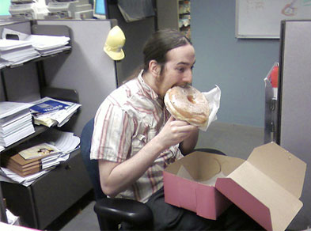
Are we a product of our own personal choices?
Notes:
The prevailing school of thought is that we are a product of our own personal choices. If we would just eat better, move more, not smoke we would be healthier and happier, but are we a product of personal choice, or is there more to the story?

Slide 4



Obstacles to Healthy Living – Your Worksite
We are confronted by choices everyday
Notes:
We can face obstacles to healthy living everyday when we go to work.

Slide 5

Do you have the will power to change?
Notes:
Many of us have grown up hearing about willpower or “pick yourself up by the bootstraps” . It is not all about willpower. The environment in which we live, the people that surround us, and the availability of healthy choices all impact our ability to change – for the good and the bad.

Slide 6



The History of Workplace Wellness
Secure leadership support and a budget
Teach individual behavior change
Save money on healthcare costs
Notes:
If we take a look at the history of workplace, and this of course is a simplification, we said, garner leadership support and a budget, teach the individual to change their behavior (because we assumed people didn’t know what they should be doing), and presto, we will see a nice return on our investment.

Slide 7

The Implementation of Workplace Wellness
Secure leadership support and a budget
Teach individual behavior change
Create wellness committee frustration with little behavior change
Notes:
The actual implementation probably looked like this:
Secure leadership support and a budget (if you are lucky), teach individual behavior change (even though they probably already know what they should be doing), and we get wellness committee frustration with little behavior change.

Slide 8

Individual Change Efforts
Result in temporary behavior change
Can be unevenly applied to a few
May involve expensive campaigns
Are usually time-limited
Notes:
Working on individual change alone can result in temporary behavior change to only a few and can use a lot of resources.
To be clear, there is a place for individual efforts in a workplace wellness program, we just want to ensure the environment supports any individual change efforts your employees may work toward.

Slide 9
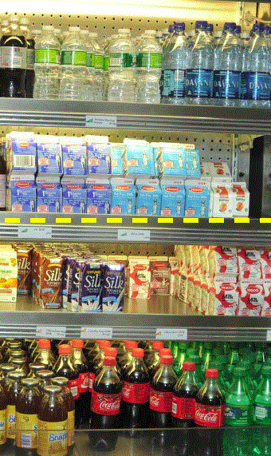

How We Make Decisions
Let’s make the HEALTHY choice the EASY and PREFERRED choice!
Notes:
The world of behavior change theory is changing – from the work of Brian Wansink and others talking about how we make decisions depending on where our food is located and how it is packaged. Product placement and availability make a difference in how we choose what we eat and how much of it we eat.

Slide 10

Workplace Wellness Through a Culture of Health
  A culture of health increases an organization’s visibility as a health advocate, makes healthy choices easier and reaches ALL employees
Notes:
Discuss how changes at work move into your personal life, tell my story (evening walks – environment – healthy eating – learning it here)
Let’s begin to look at workplace wellness a little differently than perhaps we have in the past.

Slide 11
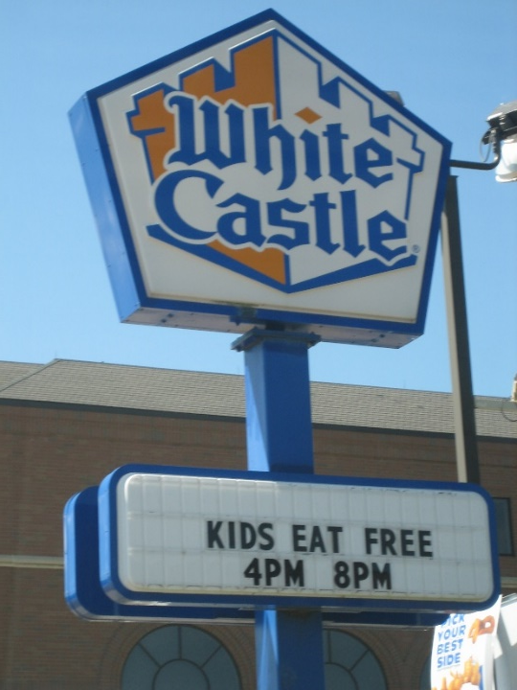
Where We Live Affects How We Live
Policies and environment create choices
Major health problems not solved by individual action and choice alone
Addressing causes and improving environments can prevent many people from becoming chronically ill
Notes:
Importance of PSE Change
Health problems are heavily influenced by societal policies and environments that in some way either sustain the behaviors and practices that contribute to the problems or fail to foster healthier choices that could prevent the problems.
Where you live affects how you live.
If you live in a community with parks and playgrounds, living wages, grocery stores that sell nutritious food, well maintained housing, and high quality public transit, and you’re more likely to thrive. But if you live in a community with dilapidated housing, few job opportunities, limited transit options, and without high quality parks and grocery stores, and you’re more likely to suffer from health problems like obesity, asthma, asthma, heart disease, and high blood pressure.
Ask yourself: Is your neighborhood walkable? Are there sidewalks, bike paths, and pedestrian-friendly environments to support physical activity? Do the amenities in your community – banks, grocery stores, retail shops – feel connected and in close proximity to one another? Are these amenities accessible by public transit? Are there safe, appealing parks where you and your family can play? Are there thriving businesses, such as banks?
It’s hard for community members to stay healthy when residents fear walking outdoors in the evening, and are afraid to allow their children to go outside during the day, after school, or on weekends. A family’s health is adversely impacted when their neighborhood lacks a decent grocery store with fresh fruits and vegetables, or when smog or pollution compromises people’s ability to breathe.
By contrast, when the built environment – buildings, parks, recreational facilities, transportation systems, and the other manmade landscapes in which we live, work, and play – offers clean, safe, healthy options, people thrive, families flourish, and neighborhoods prosper.
The major public health problems of our time will not be solved solely by individual actions and health choices, but by individuals coming together to make our society one in which healthy choices are easy, fun, and popular. Communities in which policies and environments focus on the latter approach will be healthier and more satisfying places to live, work, and play.
By moving upstream to address causes and improving environments where we live, work, learn, play, and receive health care, we can prevent many people from becoming chronically ill in the first place.

Slide 12


The PSE Approach
Notes:
Let’s look a little more closely at the policy, systems and environmental change approach to build a culture of health in the workplace.

Slide 13

Make the Healthy Option More Accessible
Notes:
Twenty-five to 50 percent of all meals are consumed at work. We are constantly confronted by food and sedentary choices everyday.

Slide 14


Move More
Notes:
Twenty-five to 50 percent of all meals are consumed at work. We are constantly confronted by food and sedentary choices everyday.

Slide 15


Break Time
Notes:
Twenty-five to 50 percent of all meals are consumed at work. We are constantly confronted by food and sedentary choices everyday.

Slide 16
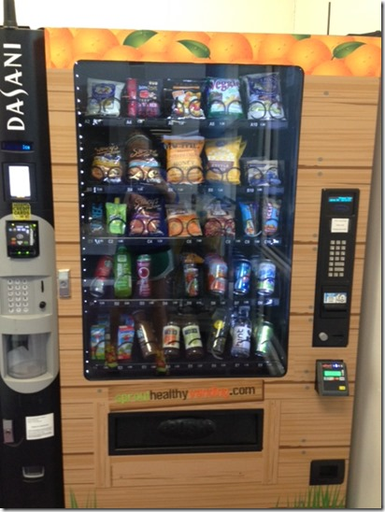
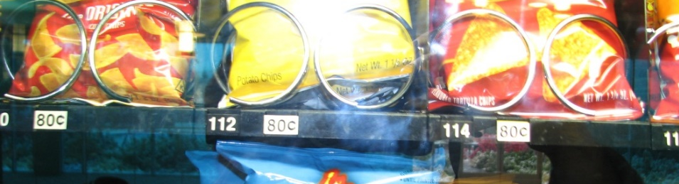
Product Selection and Placement
Notes:
Twenty-five to 50 percent of all meals are consumed at work. We are constantly confronted by food and sedentary choices everyday.

Slide 17
SHIP Wellness Strategies
Healthy Eating Physical Activity Tobacco-Free Breastfeeding Support Well-Being
Policy
Systems
Environment
Social Support
Notes:
PSE (SS) approach applied to the workplace setting.
Environment: Create more places where employees can find healthy options
Policy: Assure the environmental changes will last by adding a healthy foods guideline in your employee handbook that indicates any time you have a meeting where food is served that you serve a healthy option and water.
Systems: Set up a system for working with vending machine vendors to allow for healthier options.
Social support: Social connectedness that fosters healthy choices. Ex. Offer informational sessions that support healthy decisions (lunch and learns, Walk on Wednesdays, etc.)
Role of social support in changing behavior. We will talk about the research about this later.

Slide 18
Address all PSE Components
Physical Activity
Policy
Environment
System
Social Support
Notes:
You can implement a policy that sits on a shelf and no one ever knows about it.
You can have repeated employee wellness challenges to increase PA, shed pounds, etc. But if every day employees find empty calories waiting for them at break and lunch time, they are unlikely to maintain weight loss.
Likewise, you can train your managers to support employee wellness, but if there are no formal policies to guide them, it is very likely they will offer what they remember from training, which may or may not come close to supporting the wellness initiative as intended.

Slide 19
Workplace Examples
Events/Programs | Policy, Systems & Environmental Change
Yoga Classes | Flexible schedule to get away from desk, to attend classes, to visit quiet spaces, respectful workplace. Yoga class then provides social support for relaxation.
Walking Program | Provide maps of safe, scenic walking routes on website, opportunities to walk in groups, and alternatives for people unable to walk, support/subsidize alternative transportation modes
Biggest Loser | Create a healthy food environment-cafeterias, vending, catering and social events. Build social support and opportunities with walking tours of cafeteria with chef, grocery store, farmers market, food coop. Host a healthy salad bar potluck, weekly walks to farmers market.
Health Fair | Provide opportunities for active learning—motivation, skills, opportunities and awareness. Demos, game show with leaders, sample healthy foods from cafeteria and vending
Notes:
Here are additional examples from the health care setting. Again, notice how the program or event fits nicely with the PSE change.
EHR stands for Electronic Health Records
An example from the health care setting:
Let’s say a health care organization is promoting the 10,000 Steps Program. SHIP grantees may work with the health care organization to establish a connection with community-based organizations that can, or already, run evidence-based programs aimed at lifestyle changes to reduce or reverse the impact of chronic disease. Examples include: I CAN Prevent Diabetes, Chronic Disease Self-Management, or Falls Prevention.

Slide 20

Tobacco Free
Rather than just telling people to quit tobacco offer:
  Tobacco free campus that includes e-cigarettes
  Access to cessation support through Quitlines
  Access to cessation medication
Notes:
TF Policy creates tobacco free living as the norm AND it should include e-cigarettes and vaping!

Slide 21
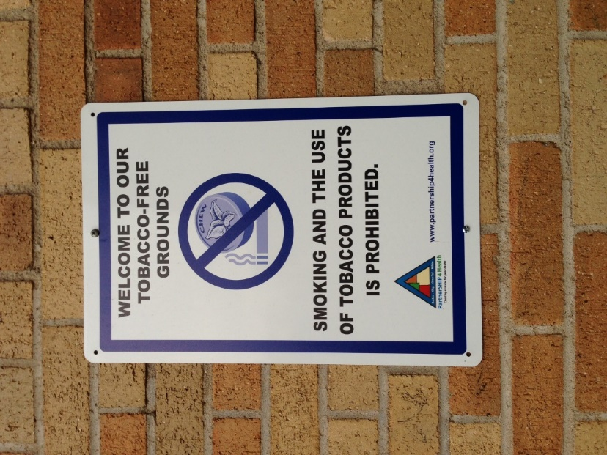
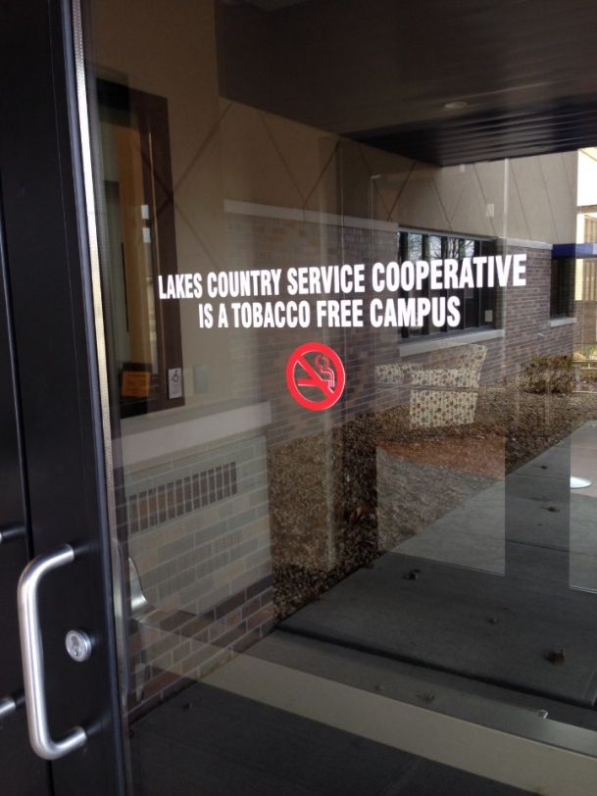
Lakes Country Service Coop
Reducing/Eliminating Tobacco Use
As of July 1, 2014 the LCSC board adopted a Tobacco-Free Worksite Policy including all tobacco products and e-cigarettes.
Public announcement made before each event held in their facility that highlights: TF policy, lactation room, healthy food options.

Slide 22
Tobacco Free Workplaces
E
P
S
SS
Completely tobacco free
Tobacco-free workplace policy
Free quit medications
Tailored tobacco cessation program
Notes:
The worksite strategy for tobacco use and exposure reduction reflects these best practices. Implementing a benefits program that provides quit resources to tobacco users and creates an environment that supports and enforces them increases the likelihood that users will be successful at quitting and non-users will avoid exposure to second-hand smoke.
Let’s take this environmental approach concept and put it into play for Reducing Tobacco Use.
There are simply three national best practices for reducing tobacco use within the workplace. Nothing more. Nationally, we have the benefit of many years of history with tobacco reduction efforts.
First is a program – a tailored tobacco cessation program. Due to the historic tobacco settlement – the state of Minnesota has made use of dollars to support a statewide tobacco quit program QUITPLAN. Every individual in the state can make use of this service. Individuals who have insurance coverage will be referred to their insurance company’s cessation program – such as Blue Cross’ Stop-Smoking Support.
Next is quit medications. Please check with your health plan to determine whether you can improve the coverage for over the counter quit aids – offering them at no cost, and having a minimal co-pay for prescription medication. For those enrolled in QUITPLAN services, over the counter quit aids are provided.
A comprehensive tobacco free worksite policy is a cornerstone of your tobacco reduction efforts.
Let’s take this environmental approach concept and put it into play for Reducing Tobacco Use.
There are simply three national best practices for reducing tobacco use within the workplace. Nothing more. Nationally, we have the benefit of many years of history with tobacco reduction efforts.
First is a program – a tailored tobacco cessation program. Due to the historic tobacco settlement – the state of Minnesota has made use of dollars to support a statewide tobacco quit program QUITPLAN. Every individual in the state can make use of this service. Individuals who have insurance coverage will be referred to their insurance company’s cessation program – such as Blue Cross’ Stop-Smoking Support.
Next is quit medications. Please check with your health plan to determine whether you can improve the coverage for over the counter quit aids – offering them at no cost, and having a minimal co-pay for prescription medication. For those enrolled in QUITPLAN services, over the counter quit aids are provided.
A comprehensive tobacco free worksite policy is a cornerstone of your tobacco reduction efforts.
And,
May involve a law, ordinance, resolution, mandate, regulation, or rule (both formal and informal).
Example: Organizational policies that provide time off during work hours for physical activity.
let’s not for
Can impact all elements of an organization, institution, or system.
Involves the WAY we do the work.
May involve physical or material changes to the economic, social, or physical environment.
Example: Incorporating sidewalks, paths, and informal meeting places to encourage healthy practices and being social at work.
“Choice Architecture”
get promotion of all three of these items.

Slide 23
Healthy Eating
  Healthy snack stations (in some cases financially supported by the organization)
  Healthy catering guide
  Food labeling system for vending machines and cafeteria
  Healthy vending options
  Community Supportive Agriculture (CSA) on site
  Healthy food options during meetings where food is offered
  On-site Farmers Market, community garden and orchards
Notes:
So what are policy approaches in the context of SHIP?

Slide 24
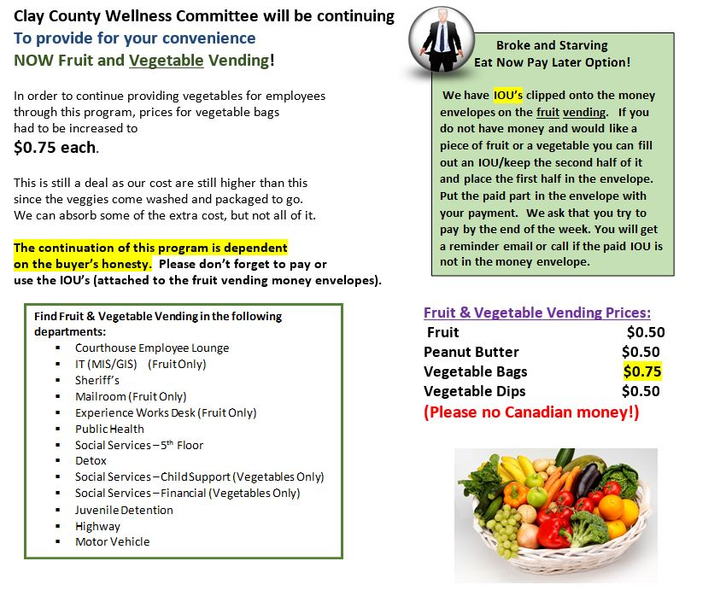
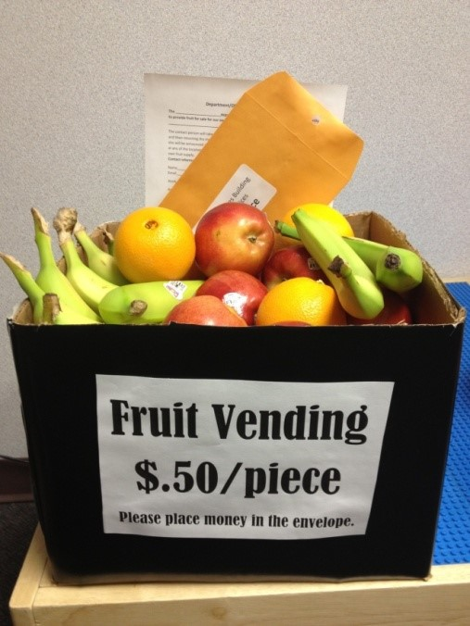
Clay County
Access to Healthy Foods
Fruit & Vegetable Vending
Ongoing program subsidized by wellness budget
Notes:
Give one Take ONE – Isanti County. People bring in their bounty and share it with each other at a table in the employee lunch room. Use the sign “Give one and take one!”

Slide 25
Healthy Eating
E
P
S
SS
Vending, healthy snack station, cafeteria improvements, meetings and events
Policy that sustains the improvements
RFP for vending, quality improvement, catering guide, managing a healthy snack station
Taste testing
Notes:
Likewise, these are the areas to address for healthy eating in the environment. The food environment in some ways is the most complex because there are often multiple ways food is delivered to worksites. Some may choose to take a comprehensive approach and address the entire food environment. Others may take it one area at a time. It will depend on a number of factors such as organizational size, level of leadership support, resources available. In any case, it is most effective to address PSE and social support.
The 2012 Minnesota Workplace Survey indicates that vending is the most common way the food is obtained at work by employees, so vending is an important strategy at the worksite.

Slide 26

Physical Activity
  More bike paths, sidewalks, and safe crosswalks
  Flexible work hours
  Short physical activity breaks during meetings
  Walking meetings
  Onsite fitness center
  Bike share opportunities
Notes:
So what are policy approaches in the context of SHIP? See next slides.

Slide 27
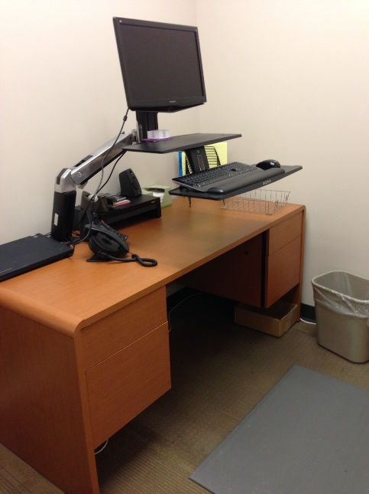

Lakes Country Service Co-op Physical Activity Opportunities
Multiple length walking route maps posted
Daily walking group – 15 min walk at 10 AM & 2 PM
Adjustable Standing Workstations
Participation in annual Corporate Cup and other challenges

Slide 28
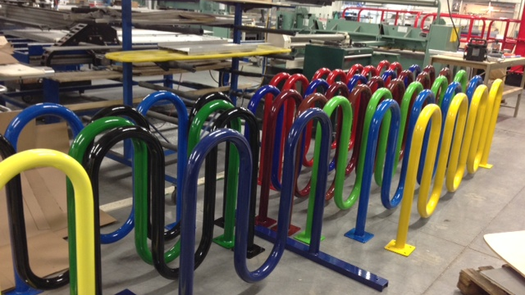
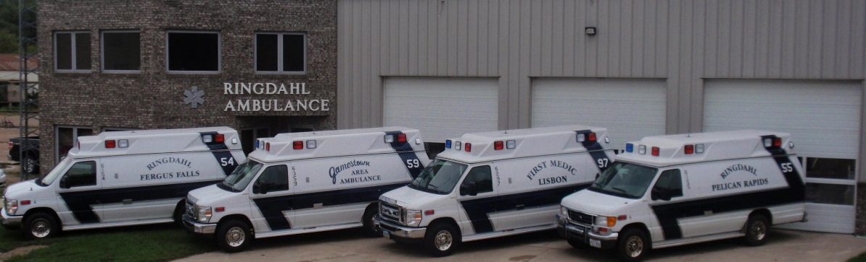
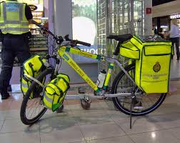
Ringdahl EMS- Fergus Falls, MN
Bike Friendly Business

Slide 29
Physical Activity
E
P
S
SS
Mapped walking routes, bike rooms, showers, lockers, physical activity room
Combining break time, dress code, physical activity breaks, walking meetings
Training for managers to develop flexible schedules to accommodate PA, Walking meetings
Walking clubs, stretch breaks, exercise classes
Notes:
The physical activity strategy is very much about making it more possible for people to be active getting to and from work and well as at work. What that looks like will vary considerably from organization to organization. Key elements are schedule flexibility, infrastructure and support for activity.

Slide 30

Breastfeeding
  Designated space that is available for employees and if possible the public
  A plan around supporting mom’s who may need portable kits and locks

Slide 31
Breastfeeding Support
E
P
S
SS
Lactation room: Locks from inside, chair, table, breast pump, electrical outlet, clean, near water source, place to store milk
Breastfeeding support policy that includes lactation room, FMLA leave and management role in supporting new moms
Training for management staff is developed and implemented
Ongoing nursing mothers support group
Notes:
This slide outlines the best practice strategies to support nursing mothers and again uses a PSE approach along with social support.
This strategy supports the federal law requiring all employers with more than 50 employees to provide lactation support facilities and the Minnesota law, which is stronger than the federal law, requiring all employers with one or more employee(s) to provide adequate facilities and time to pump.

Slide 32
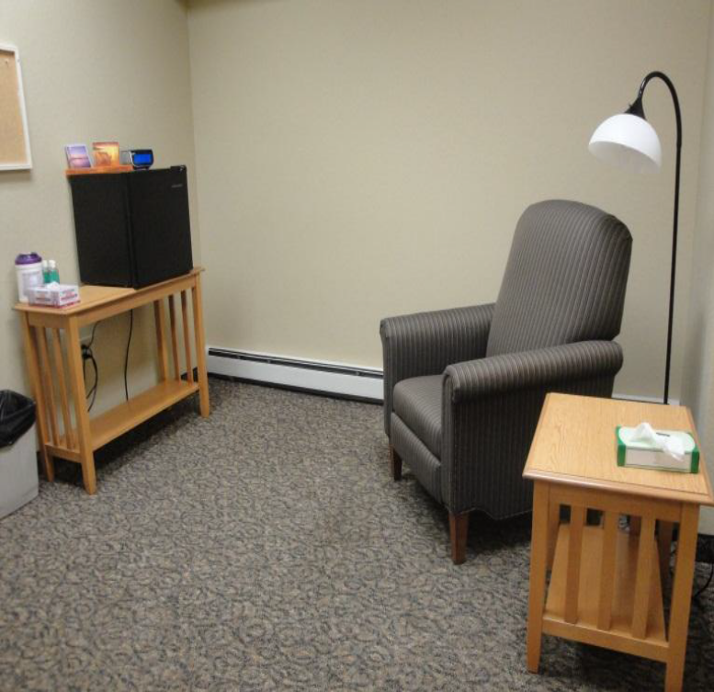
Ecumen- Detroit Lakes Support for Nursing Moms
Ecumen created a dedicated mothers room with locking door, electricity, refrigerator and comfortable chair
They found this to be a key to employee satisfaction and retention

Slide 33
Stress Management
E
P
S
SS
Clean, task appropriate workspaces, quiet room, places for informal meetings, socializing
Support for employee health by addressing: sick leave, PTO, flex time, etc.
Management training that emphasizing support for things like workload
Employee involvement in decision making in events that improve health
Notes:
This slide outlines the best practice strategies to support nursing mothers and again uses a PSE approach along with social support.
This strategy supports the federal law requiring all employers with more than 50 employees to provide lactation support facilities and the Minnesota law, which is stronger than the federal law, requiring all employers with one or more employee(s) to provide adequate facilities and time to pump.

Slide 34

How Do You Know It’s Working
Observe the changes you made:
  More walking at lunch
  Healthy food in vending machine is gone first
  Leaders are involved and visible
  More “engagement” at work

Slide 35
Next Steps
<grantee completes with assignment for OA and deadline to complete, other “homework” and note next meeting date/time/location>

Slide 36
Thanks for engaging in this rewarding work!
<insert grantee contact information>

