Slide 1

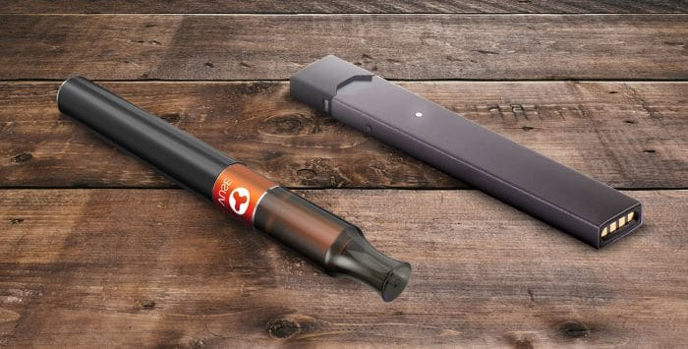
VAPING

Slide 2
SMOKING V. VAPING
SMOKING
VAPING
SMOKING IS THE PRACTICE IN WHICH TOBACCO IS BURNED AND THE SMOKE IS TASTED OR INHALED.
CIGARETTES ARE USED TO SMOKE
TOBACCO IS ROLLED IN PAPER AND LIT BY A FLAME.
VAPING IS THE USE OF E-CIGARETTES THAT STIMULATE THE EXPERIENCE OF SMOKING WITHOUT EXPOSURE TO THE HEALTH RISK OF SMOKING.
E-CIGARETTE USED TO VAPE
A BATTERY POWERED DEVICE WITH LIQUID CARTRIDGE CONTAINING NICOTINE, SOLVENTS AND FLAVORS,BATTERY, HEATING ELEMENT.

Slide 3
SMOKING
VAPING
BANNED IN PUBLIC AREAS, SCHOOLS, RESTAURANTS, ETC.
CONTAINS NICOTINE
TAR AND CARBON MONOXIDE
LINGERING ODOR.
USAGE IS LARGELY UNRESTRICTED.
CONTAINS NICOTINE
NO TAR AND CARBON MONOXIDE.
NO LINGERING ODOR.

Slide 4
SMOKING
VAPING
NICOTINE ADDITION.
LONG TERM HEALTH ISSUES SUCH AS: CANCER, HYPERTENSION AND BIRTH DEFECTS.
NICOTINE ADDICTION
POSSIBLE LUNG DAMAGE.

Slide 5
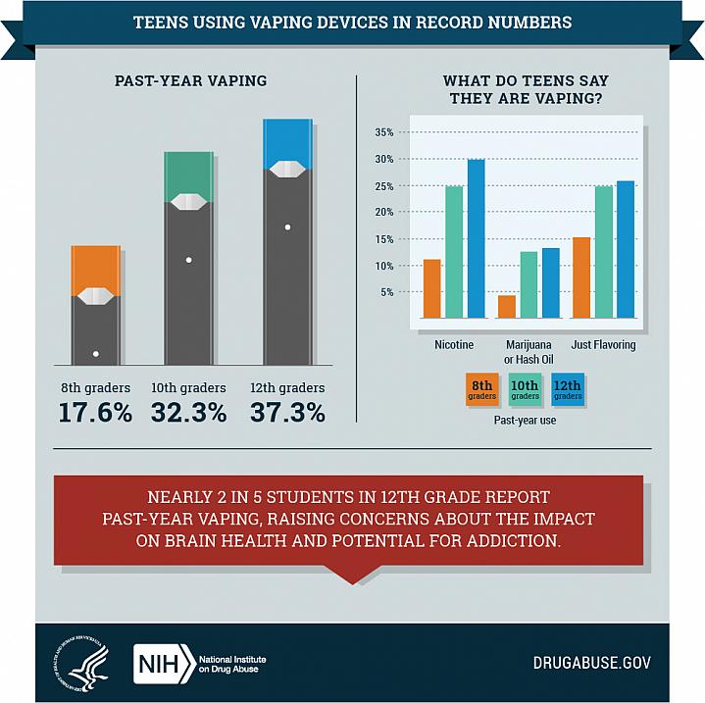

Slide 6
JUULING
JUULING REFERS TO USING A PARTICULAR BRAND AND TYPE OF E-CIGARETTE CALLED A JUUL.
JUULS ARE COMMONLY SHAPED LIKE A USB FLASH DRIVE AND DO NOT LOOK LIKE A TRADITIONAL E-CIGARETTE.
JUULS CAN BE SMALLER IN SIZE.

Slide 7
VAPING V. JUULING
VAPING
JUULING
E- CIGARETTE
USE ELECTRICITY TO HEAT WATER THAT CONTAINS NICOTINE AND TURNING INTO VAPOR WHICH CAN THEN BE INHALED
E – CIGARETTE
CHARGED IN A USB DRIVE. THE FLUID VAPORIZES AND OFTEN CONTAIN FRUIT FLAVORS MAKING JUULS MORE APPEALING.
VERY POPULAR WITH TEENS

Slide 8

FORBIDS THE POSSESSION OR USE OF E – CIGARETTES, VAPING PRODUCTS AND JUULS ON ANY DISTRICT PROPERTY.

Slide 9
PA CRIMES CODE – TITLE 18
6306.1 - USE OF TOBACCO PRODUCTS IN SCHOOL PROHIBITED.
IT’S NOW A VIOLATION OF PENNSYLVANIA LAW TO POSSESS AND/OR USE ANY TYPE OF E-CIGARETTES, VAPES AND JUULS ON SCHOOL PROPERTY.
VIOLATION CONSTITUTES A SUMMARY OFFENSE.

