Slide 1


Selecting Your Career Plan in Skyward
2020

Slide 2
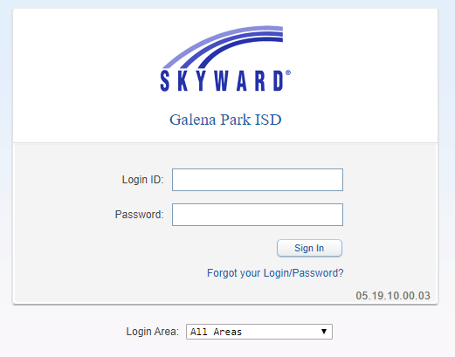

www.galenaparkisd.com/cte

Slide 3
Step One:
LOG INTO SKYWARD
www.galenaparkisd.com/cte
WWW.GALENAPARKISD.COM/CTE

Slide 4
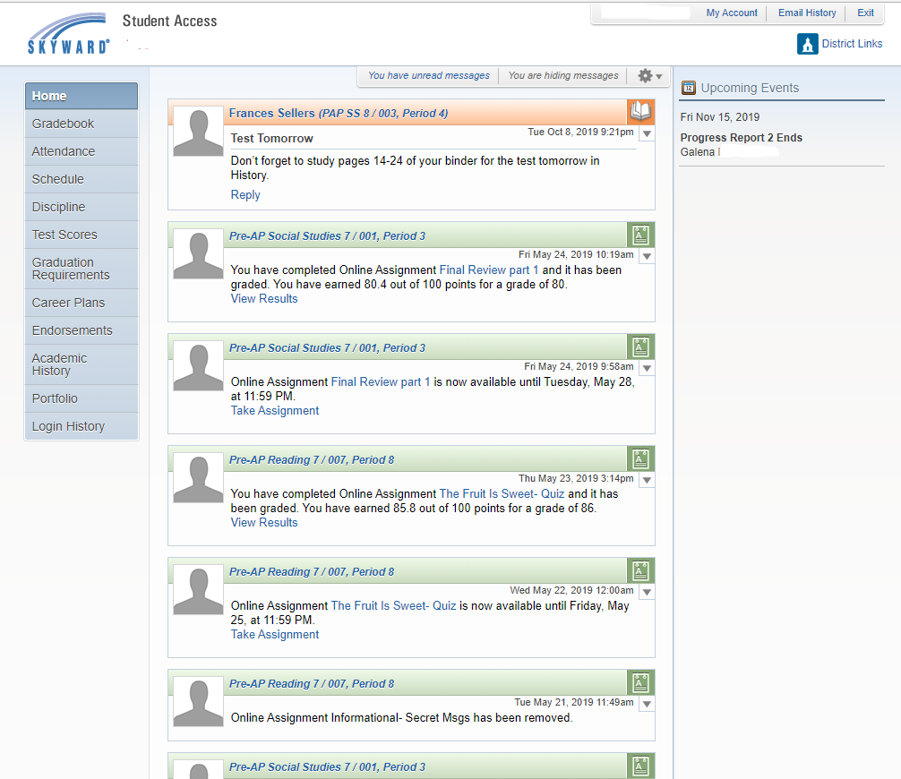

Step Two:
SELECT ENDORSEMENTS
WWW.GALENAPARKISD.COM/CTE

Slide 5
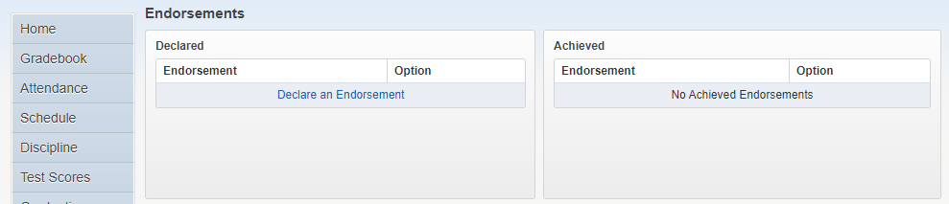
Step Three:
SELECT "DECLARE AN ENDORSEMENT"
WWW.GALENAPARKISD.COM/CTE

Slide 6
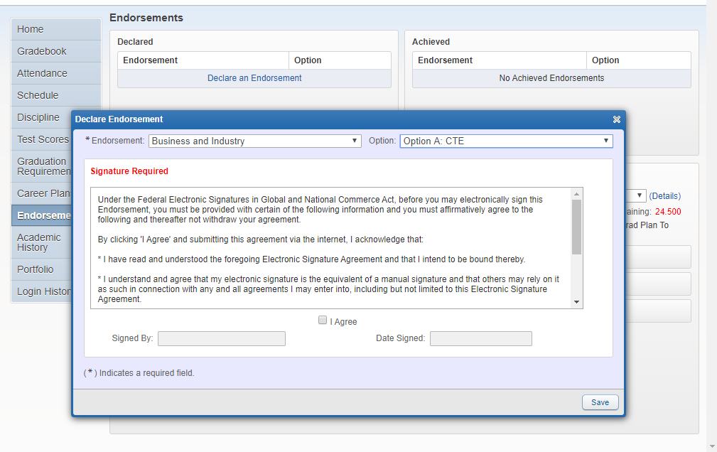
Step Four:
FROM THE DROP-DOWN MENU SELECT:
AN ENDORSEMENT &
(2)AN OPTION
WWW.GALENAPARKISD.COM/CTE

Slide 7
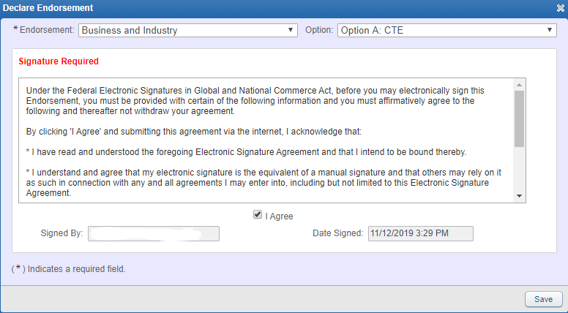
Step Five:
CLICK "I AGREE" THEN PRESS "SAVE"
Then select Endorsements
WWW.GALENAPARKISD.COM/CTE

Slide 8
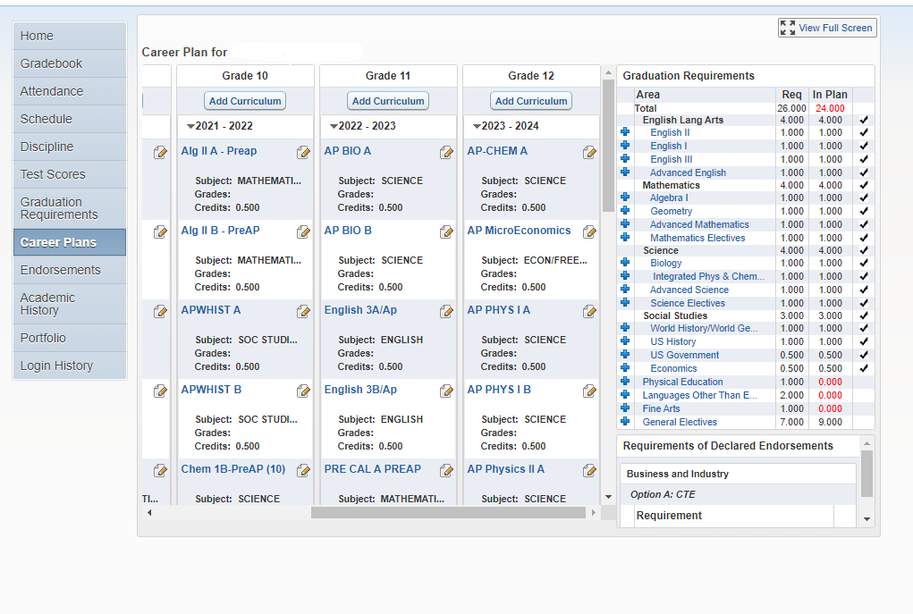
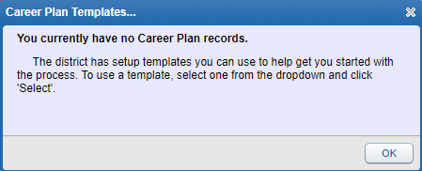
Step Six:
SELECT CAREER PLANS
Press OK on Message Box
WWW.GALENAPARKISD.COM/CTE

Slide 9
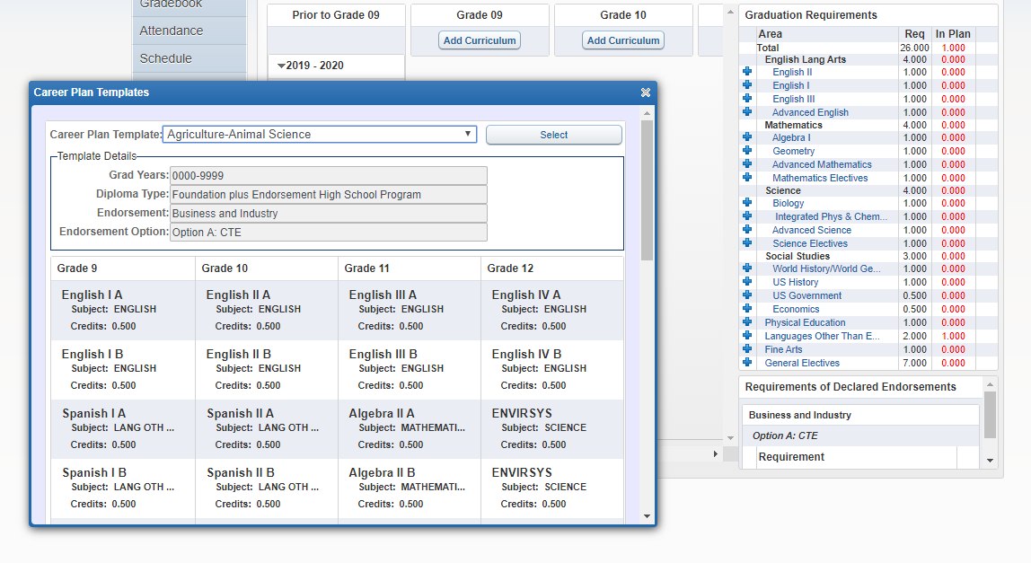
Step Seven:
SELECT A CAREER PLAN TEMPLATE
WWW.GALENAPARKISD.COM/CTE

Slide 10
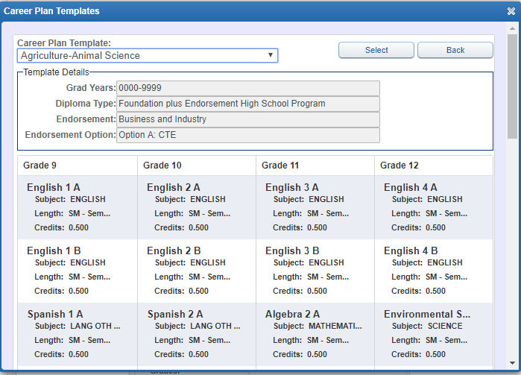
Step Eight:
Click “Select“ to apply template.
WWW.GALENAPARKISD.COM/CTE

Slide 11
You will now tailor your plan.
WWW.GALENAPARKISD.COM/CTE

Slide 12
-Year-long courses will have an “A” class and a “B” class (i.e. English 1A and English 1B).
-Verify you make changes to both when adding or deleting in your plan.
WWW.GALENAPARKISD.COM/CTE

Slide 13
-Students currently taking advanced classes are auto-enrolled into the next advanced course.
-All students are auto-enrolled in PE. Coaches will move athletes into correct sport period.
WWW.GALENAPARKISD.COM/CTE

Slide 14
All Students Must Have Four Basic Core Classes:
-English 1 or Pre-AP English 1
-Algebra 1 or Pre-AP Geometry
-Biology or Pre-AP Biology
-World History or AP Human Geography
WWW.GALENAPARKISD.COM/CTE

Slide 15
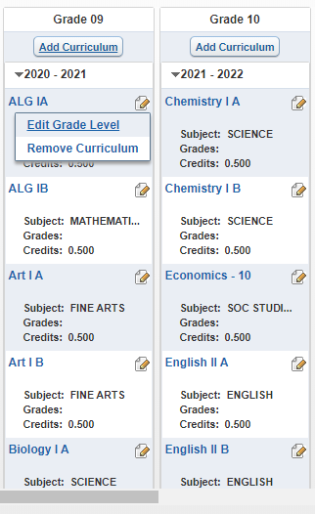

Step Nine:
TO ADD/CHANGE/DELETE CLASSES FROM THE TEMPLATE, SELECT
THEN
WWW.GALENAPARKISD.COM/CTE

Slide 16
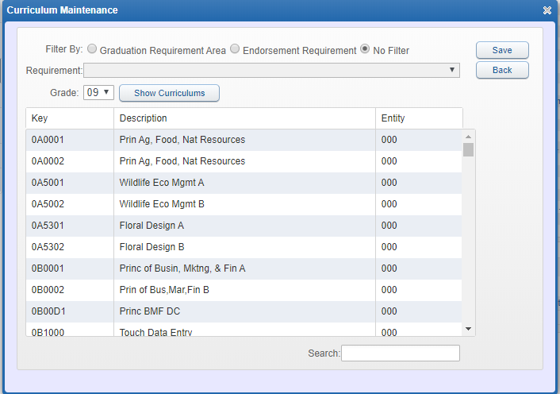
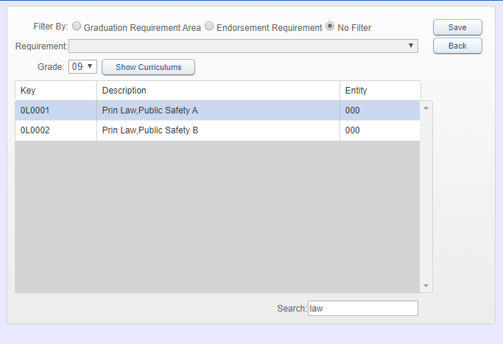
Step Ten:
USE THE CCR CTE GUIDE OR WEBSITE
TO FIND THE LOCAL COURSE # OR COURSE NAME AND PLACE IN THE "SEARCH" FIELD.
SIGN UP FOR BOTH "A" AND "B" SEMESTERS FOR A ONE CREDIT CLASS
BOTH "A" AND "B" MUST BE ADDED FOR A ONE CREDIT, YEAR-LONG CLASS
WWW.GALENAPARKISD.COM/CTE

Slide 17
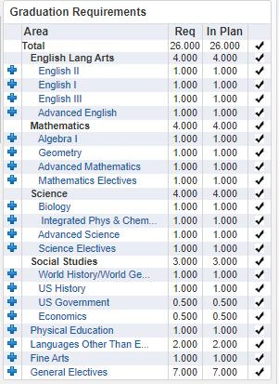
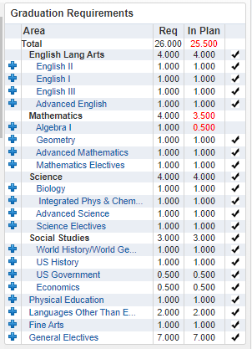



Step Eleven:
VERIFY GRADUATION REQUIREMENTS ARE MET.
You should have 8 credits for your 9th grade year.
MISSING EITHER "A" OR "B" COURSE
WWW.GALENAPARKISD.COM/CTE

Slide 18

Review Process
  COUNSELORS WILL REVIEW PLANS DURING SPRING SEMESTER
  PARENTS WILL CONFIRM CAREER PLAN THROUGH SKYWARD
  COURSES IN THE CAREER PLAN WILL BE USED TO CREATE COURSE REQUESTS AND FUTURE CLASS SCHEDULE(S)
WWW.GALENAPARKISD.COM/CTE

Slide 19
WWW.GALENAPAKISD.COM/CTE

