Slide 1
ABC’s of IEP’s
New Providence SEPAG
October 2021

Slide 2
An Introduction
Individuals with Disabilities Education Act (IDEA 2004): Every student has a right to a Free and Appropriate Public Education in the Least Restrictive Environment.
Parents have the right to participate in their child’s education.
Every student is entitled to an education that provides them with meaningful benefit.
When regular education services do not confer that benefit, Special Education Services should be considered.

Slide 3
Initial Intervention
I&RS: Collaborative school effort between parents and the school to intervene when a student is making minimal educational, emotional, or behavioral progress in school.
  Committee is run by the School’s Assistant Principal (or MS counseling dept.)
  Parental participation in gathering of information and intervention design
  Available at all school levels
  I&RS Is a regular education intervention service.
  May require multiple meetings to redesign plan and measure progress.
  An important first step in getting help for your student.

Slide 4
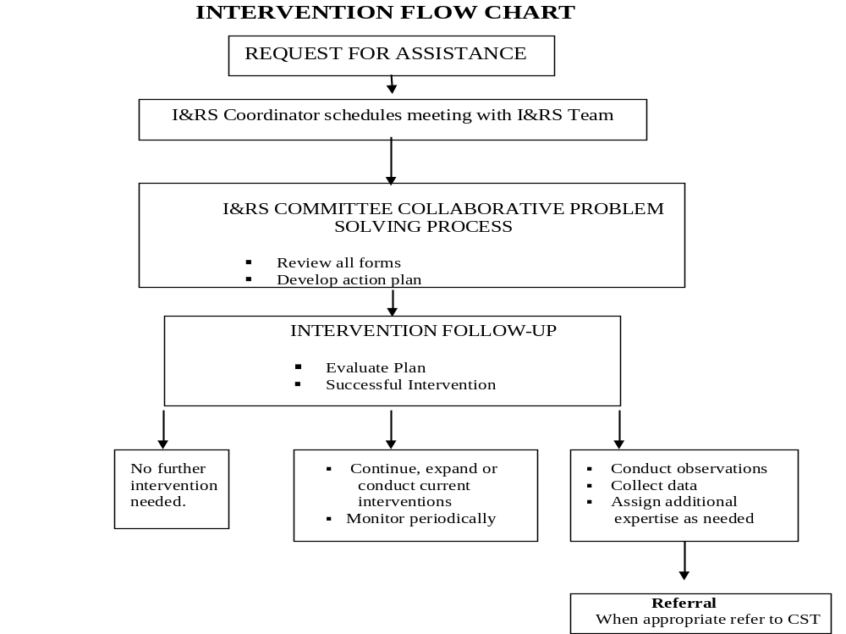

Slide 5
Referral to the CST
A referral is a formal written request that a student be evaluated by a CST to determine eligibility for special education and related services, or by a Speech/Language Specialist to determine eligibility for speech services.
A student may be referred by a parent, school staff or administration, or a community agency.
Parent referrals should be made to the Director of Special Services, and should include: name, address and phone number of student and parents, a request that the child be evaluated for special education and related services.
  Additional information and/or reports are welcomed, but not required.

Slide 6
What Happens Once a Referral is Made?
Parents/Guardians will be invited to an initial meeting to be held within 20 days of receipt of referral (not including school vacations).
  Meeting will also be attended by the student’s teacher, members of the Child Study Team, and relevant support or related services staff.
At this meeting, a determination will be made regarding whether an evaluation will be performed.
  If an evaluation is recommended, a written plan will be developed detailing the scope of the evaluation. Written parental consent is required before an evaluation can begin.
  If an evaluation is not warranted, the CST will provide recommendations for other supports as appropriate, including a referral to the school’s I&RS team.

Slide 7
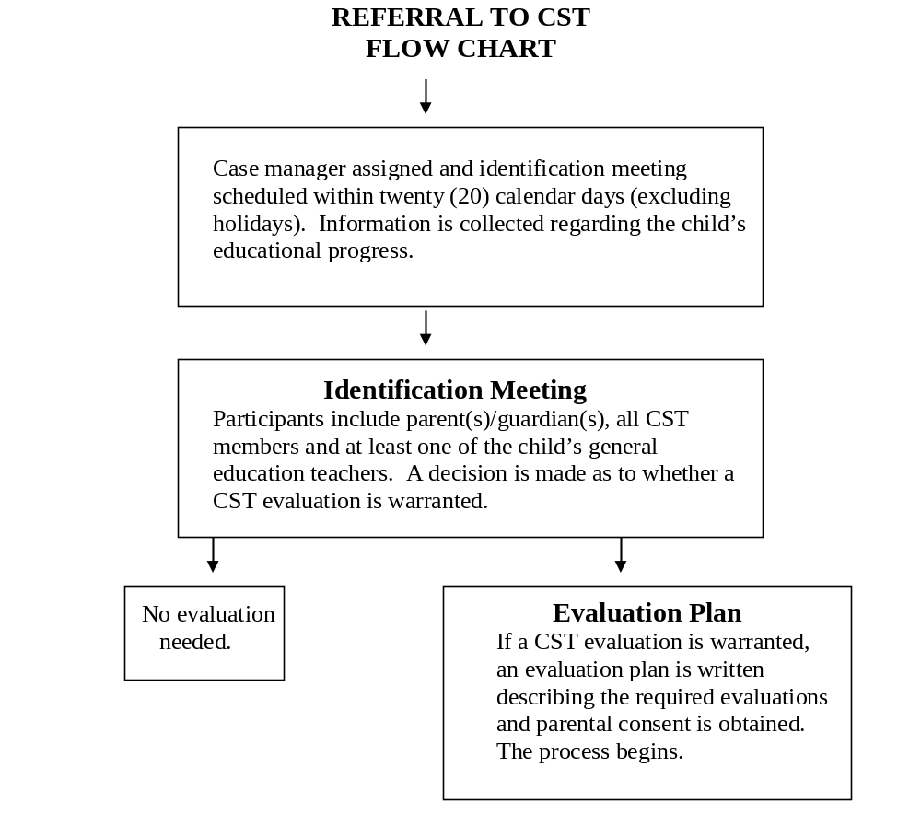

Slide 8
Evaluation and Eligibility
CST evaluation will include assessments by at least 2 members of the team. Related service assessments or outside evaluations may also be considered based on presenting problem
Parentally-provided evaluations will be considered by the CST, who may elect to accept some or all of the testing for assessment and/or planning purposes.
Eligibility for Speech/Language services is performed by the Speech Therapist, and considers voice, fluency, and articulation.

Slide 9
Eligibility Meeting and Recommendations
Completed evaluations are sent to the parents prior to the eligibility meeting
At the eligibility meeting, the CST will explain evaluation results and discuss the rationale for eligibility or non-eligibility for special education and related services.
The Team will determine whether a student possesses an educational disability that adversely impacts educational performance and requires special education services.
  A student is classified into one of 14 categories.
  Parental consent must be given for classification.
If a child is found eligible, the team will then move into the development of an IEP.

Slide 10
Factors Impacting Eligibilty
To be eligible for special education and related services:
  A student must have a disabling condition according to one of the eligibility categories
  The disability must adversely impact the student’s educational performance
  The student must be in need of special education and related services.
To determine eligibility, the CST considers individual testing in the areas of cognition and achievement, outside evaluations, student performance, reports of parents, stakeholders, and functional performance.

Slide 11
Parental Consent
Consent means that the parent has the information necessary to make an informed decision about the proposed activity.
  Consent is immediate, and the school will begin the activity as soon as possible.
Examples of when consent is required:
  Before initial evaluation and before special education begins for the first time.
  Before reevaluation testing, or when waiving a reevaluation is proposed.
  Before records are released
  The IEP is amended without a meeting
  When the team would like to excuse a required team member from a meeting.

Slide 12
Parental Consent continued
If a parent does not give consent:
  The proposed action cannot be done. The District may decide to seek a due process hearing to get permission for an initial evaluation, reevaluation or release of records.
    No due process is possible when the parent refuses consent for the initial IEP implementation, amendment without a meeting, waiving of a reevalaution, or excusing a required team member
Revoke Consent: A parent make revoke consent for an action by writing the district. This is not retroactive.
  If revoking consent for special education, must apply to all services.
  District may propose a meeting to discuss.

Slide 13
Least Restrictive Environment
Each public school must ensure that:
  To the maximum extent appropriate, children with disabilities, including children in public or private institutions or other care facilities, are educated with children who are non-disabled; and
  Special classes, separate schooling, or other removal of children with disabilities from the regular educational environment occurs only if the nature or the severity of the disability is such that education in regular classes with the use of supplementary aids and services cannot be achieved satisfactorily.

Slide 14
IEP Meeting
Can be completed immediately following the determination of eligibility
Parents will receive evaluative reports 10 days prior to the meeting.
Begins with a focus on the student’s academic achievement and functional performance (including impact of disability).
  Includes input from parents, teachers, evals, etc.
From a discussion of student needs, goals and objectives are determined.
Once goals determined, the educational programming can be discussed.
  This includes the extent, if any, that the student will not participate with nondisabled peers in a general education setting.

Slide 15
IEP Meeting continued
Other services, including related services, educational modifications or accommodations, the necessity of an extended school year program (ESY), and a statement of transition (age 14 and up), will be included.
All IEPs will be reviewed annually, or more often if necessary.
Student Performance determines Areas of Need. Areas of Need determine Goals and Objectives. G and O’s determine the types of instruction and support needed for meaningful benefit.

Slide 16
Finding Out More Information
NJ Administrative Code
Parental Rights in Special Education
Case Manager or Director of Special Education
Special Services Website
SEPAG

Slide 17
Special Services Staff: Teachers
Allen W. Roberts
Laura Damico
Colleen Cortese
Marla Malinauskas
Patricia Panzarino-Ramos
Darryl Petrullo
Kristin Witte
Angela Pace
Rachele Petronella
Preschool
Elizabeth Giaime
Deena Rudnicki
Jennifer McSweeney
Britt Boegershausen
Salt Brook
Christina Focacci
Sarah Niez
Allison Parlapanides
Barbara Denike
Dana Gottdiener
Kathryn Press
Beth Smargiassi
Amanda Mahlstedt
Learning and Language Disabilities
Erika Vanadia
Gwen Hermann
Cherilyn Johnson
Middle School
Christine Suczsewski
Leah Russo
Scott Rahner
Patricia Beemer
Brandon Hilf
Gina Bellitti
High School
Alicia Barbour
Denise Thompson
Alexandra Martin
Glen Robertson
Erin Siek
Samantha Cram
Brandon Hilf
Learning and Language Disabilities
Jessica Beltz

Slide 18
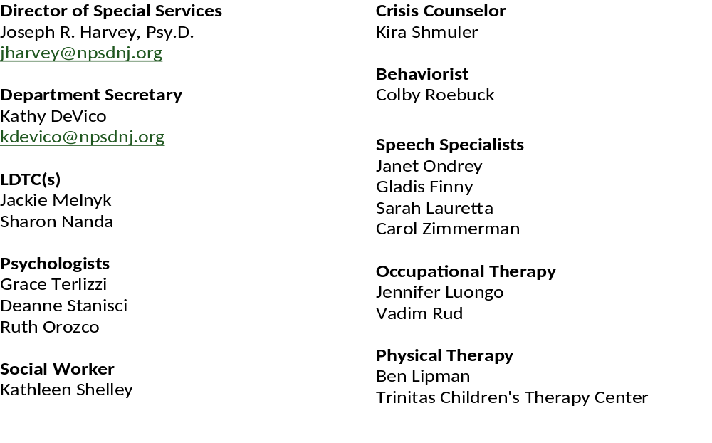
Special Services Staff: District, Case Managers, and Related Services

