Slide 1
Fun Activities that Promote
Speech & Language Skills at Home
Presented by:
New Providence School District
Speech Therapy Department

Slide 2



Speech Language Pathologists
Gladis Finny
Sarah Lauretta
Carol Zimmerman
gfinny@npsdnj.org
slauretta@npsdnj.org
czimmerman@npsdnj.org

Slide 3
What is Speech Therapy?
Speech therapy is a specialized therapy done by a Speech Language Pathologist who treats students with communication delays or disorders

Slide 4
Speech therapy can target...
Language - Expressive or Receptive
Articulation
Fluency
Social or Pragmatic Language
Voice

Slide 5
Language
Expressive Language
  Ability to form meaningful messages using age appropriate grammar
Receptive Language
  Ability to understanding what is being said to them, following directions and answering questions

Slide 6
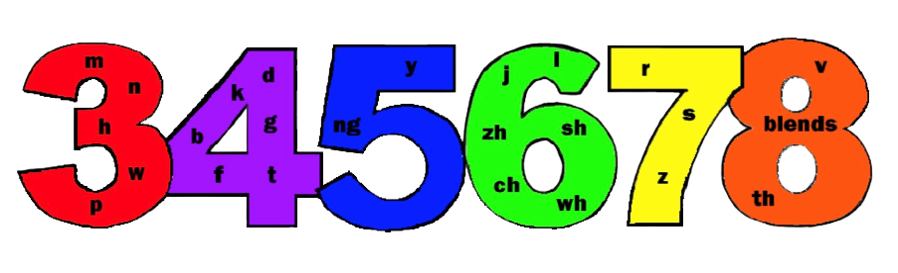
Articulation
Ability to produce age appropriate speech sounds
Age at which 90% of children produce target sound accurately

Slide 7
Fluency
Also known as “stuttering”
Speech that is disrupted, “bumpy”, or effortful
Characterized by prolongations, sound or syllable repetitions, and/or blocks

Slide 8
Social/Pragmatic
Language
Difficulties with turn taking, initiating and maintaining a conversation, repairing conversation breakdowns, perspective taking and interpreting non-verbal cues.

Slide 9
Voice
Disturbance of pitch, loudness or quality in relation to an individual’s age, gender and culture

Slide 10
Everyday Activities
Cook together
  Follow a recipe
Grocery Shopping
Traveling
  Travel with Communication
Car Rides
  Artic In The Car
Conversations at the Dinner Table
  School Day Conversation Starters

Slide 11
Reading Books
Main Idea
  Identifying/stating the main idea is an important skill for both reading comprehension and language development. The main idea is one or two sentences that tell you what the story or paragraph was about.
Story Comprehension & Retell
  Being able to answer questions about stories is an important skill for listening, reading, and writing. Being able to retell stories is an important for oral language development.

Slide 12
Main Idea
Talk about what “main idea” means
  What the whole story/show/movie is about in one or two sentences
After reading a short book, ask your child what the main idea was
If reading a longer book, stop after every few pages or paragraphs and discuss the main idea
Watch a TV show/movie and then talk about the main idea

Slide 13
Story Comprehension & Retell
After reading a story, ask the following questions…
  Who was the main character?
  Where did the story take place?
  What was the problem or what started the action in the story?
  How did the character feel at the beginning? Middle? End?
  What did the character do to try to solve the problem?
  Why did the character make the choices he/she/it did?
  What was the consequence of those attempts?
  What happened at the end of the story?
For retell: If your child is struggling with this, draw a picture to represent all of the story elements and work through it together

Slide 14
Articulation
When reading a book - find words with your child’s sound and practice them
In the car - have a contest to see who can come up with the most words with your child’s sound
In the grocery store - have your child find words with their sound on labels or signs
Write down 5 words with your child’s sound, put them on the fridge and have your child produce them whenever you open the fridge

Slide 15
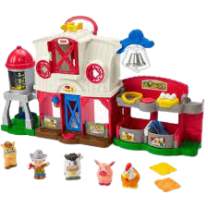
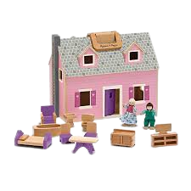
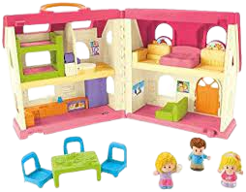
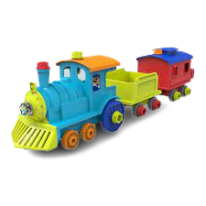
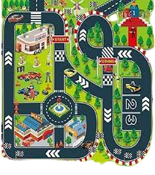
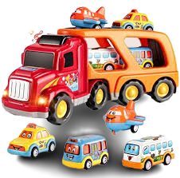
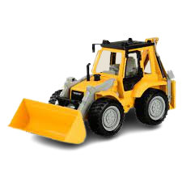
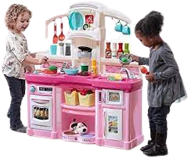
PK-K Play Activities
The Farm Set
Doll House
Kitchen Set &
Store Play Sets
Cars, Trucks, Trains & City Toys

Slide 16
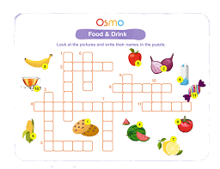
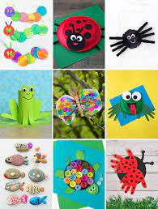
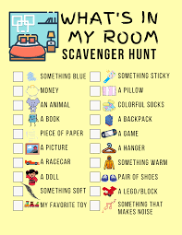


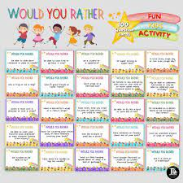
Crosswords
Arts & Crafts
Crafting Beautiful Speech
Scavenger Hunts
Would you Rather

Slide 17
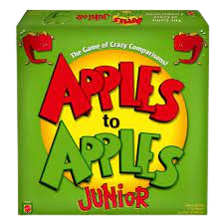
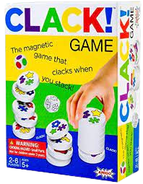
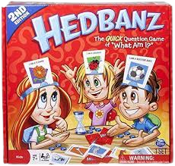
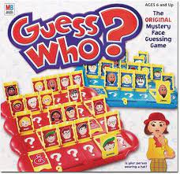
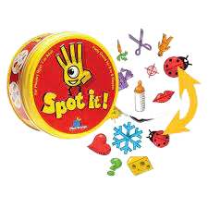
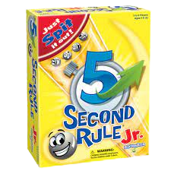
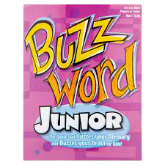
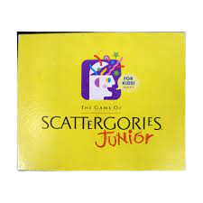
-Play Games-
Helpful Strategies for Teaching Children How to Play Board Games

Slide 18
Questions will be addressed at the end of the session

Slide 19
Doll House
Back
Vocabulary and Labels
  Items in the house as well as the family members/pets in them
Basic Concepts
  You can basically work on ALL basic concepts using the doll house, furniture and dolls
Prepositions
  In, out, on, off, through, next to
Size Concepts
  Big, small, biggest, smallest, bigger, smaller
Colors
Shapes
  Shapes of windows, doors, furniture
Part/Whole Relationship
  You can use the whole house and talk about the parts in MANY different ways – walls, roof, floor, windows, rooms
Verbs
  The possibilities are endless – eat, drink, sit, stand, run, walk, skip, go up, come down, sleep
Following/Giving Directions
  Take turns giving each other directions on what the dolls should do! Incorporate the concepts and vocabulary you are targeting, “Put the doll in the big bed” or “I think the doll is hungry. Put the doll in the chair for dinner time.”
Answering “WH” Questions
  “Who is this?”
  “Where is the mommy doll?”
  “Why is the daddy sleeping?”
Social/Pragmatic Skills
  So many things can be targeted including eye contact, topic initiation, topic maintenance, topic closure, personal space, sharing, asking and answering questions

Slide 20
Cars, Trucks, Trains & City Toys
Back
Here are just some of the language concepts that toy cars can help teach and support:
Basic Concepts
Part/Whole Relationships
  Work on naming the different parts of the car – wheels, windows, bumpers, doors
Verbs and Adjectives
  Go, fast, slow, stop
Answering “WH” Questions
  “Where is the car?”
  “Who is driving the car?”
  “What color is the car?”
  “Where are the wheels?”
Social/Pragmatic Skills
  Practice taking turns
    “My turn” or “May I have the blue car please?”

Slide 21
The Farm Set
Back
You can work on:
Animal names and sounds
Basic Concepts
  In, out, on, under, between, next to
  Some/most/all
  Big/medium/small
  Big/bigger/biggest
  All of the colors
Answering “WH” questions
  “Where is the horse?”
  “Which animal is next to the cow?”
  “Who is eating?”
  “Which animal says ‘Mooo’?”
Social/Pragmatic skills
  Taking turns and eye contact

Slide 22
Kitchen Set &
Store Play Sets
Back
Kids love to play what they see. Playing “store” is one activity most kids love to play and allows for so many communication opportunities!
You can work on learning:
Food Vocabulary
Basic Concepts
Verbs
  Push, stop, go, run, walk, jump, skip
Answering “WH” Questions
  “Where are you going?”
  “Where is the food?”
  “What color is the apple?”
Social/Pragmatic Skills
  Taking turns putting things in, taking things out, and pushing them around the house

Slide 23
-Apples to Apples-
Back
Great for working on articulation carryover at the sentence or conversation level. Simply play the game and work on their sound as it naturally comes up in the game conversation.
Vocabulary - Have you child pick out the best vocabulary card from their hand to match up with the descriptive green card. After the judge picks the winner have each player explain why they chose the card they did.
Compare & Contrast - After the judge has made their decision you can play where you need to compare and contrast the different red noun cards. How are they similar? How are they different?
Describing - A fun adaptation is to reverse the game. Instead of playing a green adjective down and picking the best noun, give everyone all green adjective cards and then place a red noun down. For example, if you lay down the red noun “soup”; pick the best adjective card to describe soup. You might put down words such as “creamy”, “hot” or “tasty”. Have your child explain why the chose the card they did.

Slide 24
-Headbanz-
Back
Formulating Questions – This game is perfect for working on expressively formulating questions. For example, “Am I a type of fruit?”
Answering Yes Or No Questions – In addition to formatting great questions to solve the mystery you also have to answer ‘yes’ or ‘no’ questions about other people’s cards on their heads. For example, “No, you are not a person”.
Deductive Reasoning – After asking multiple questions and getting ‘yes’ or ‘no’ answers you can use deductive reasoning to guess what card is on your head.
Categories – Use categories to help narrow down what card is on your head. For example, “Am I a piece of furniture?”, “Am I alive?”, “Am I an animal?” “Do I have 4 legs?”, etc.

Slide 25
-Guess Who?-
Back
Formulating Questions – This game is perfect for working on expressively formulating wh-questions. For example, “Is your person wearing glasses?”
Answering Yes Or No Questions – Also targets answering ‘yes’ or ‘no’ questions about your own person. For example, “Does your person have a hat on?” “Yes!”
Deductive Reasoning / Critical Thinking – Guess Who is perfect for guessing a conclusion or creating a guess based on reasoning and evidence provided by others.

Slide 26
-Spot It-
Back
Categories – Have your child identify which category the matched word goes in. For example, if the matched word is an elephant they could say, “zoo animal”. For an added challenge you could have them name 3 more items that would fall into that same category. So sticking with the zoo animal category they might say, “penguin, giraffe, and lion.”
Compare & Contrast – After your child matches the words you could have them compare & contrast the two cards.
Colors & Size – Identify the colors and size of the matched item.
Have your child say the word that they match or put that word in a sentence. Fingers crossed it has their articulation word in it! If not you could have a set of words that they use after each time they match a set of pictures.

Slide 27
-More Games Descriptions-
Scattergories Junior – This game allows for practice of naming items in categories. Rapid naming tasks such as these help build and strengthen connections in the brain to connect concepts and ideas.
Buzz Word Junior – This game targets vocabulary, describing and inferencing.
5 Second Rule Junior – This game works on vocabulary and categories.
CLACK! - This fast paced picture making game encourages quick thinking and picture-matching skills. Roll the 2 dice to determine which symbol to search for. Collect matching pieces until no more match. The game continues until all game pieces are collected. The player with the biggest stack wins!

