Slide 1
MAPs Assessments
One Piece of the Instructional Puzzle
Chris Bigger & Sarah Herbert
Notes:
MAPs is only one piece of what is considered when working with students and their needs
We know that data/feedback is important to determining next steps in any situation
Until last school year, elementary teachers had little data at their disposal → ex - reading assessments, some writing rubrics, pre-post math
With MAPs and some of the existing data pieces teachers are able to get a better overall understanding of their students, their academic needs, and their own professional needs

Slide 2


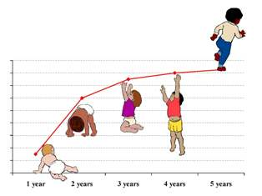
What is MAPs?
Notes:
Short clip if click on NWEA graphic
Simple overview of how MAPs assesses students and what kind of information we can gather
Relate growth to milestones as a child is developing early
When crawl, walk, get teeth, talk, etc. → each child different set of skills
Students at CASD are assessed 2 – 3 times per year in order to determine growth and skill needs

Slide 3
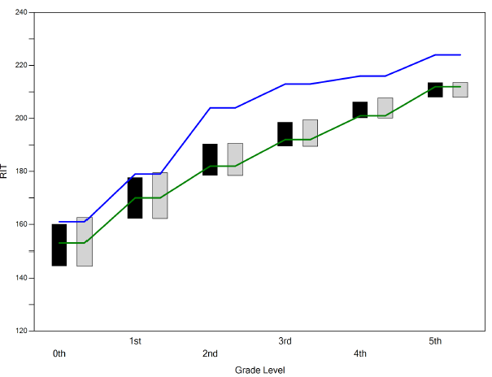

District VCG Report - Reading
Notes:
VCG new to CASD
Allows to look for trends or areas in need of support
Available as district, building and teacher reports
Chart represents Reading comparison only
Dark bar represents CASD
Lighter bar is a set of districts with like characteristics to CASD
Green line represents PSSA expected proficient performance; blue – advanced performance
Questions to ask:
Why are CASD K & 1 lower than peer group?
Why are grades 2-5 not reaching advanced performance levels?
Where do we go from here as a district?

Slide 4
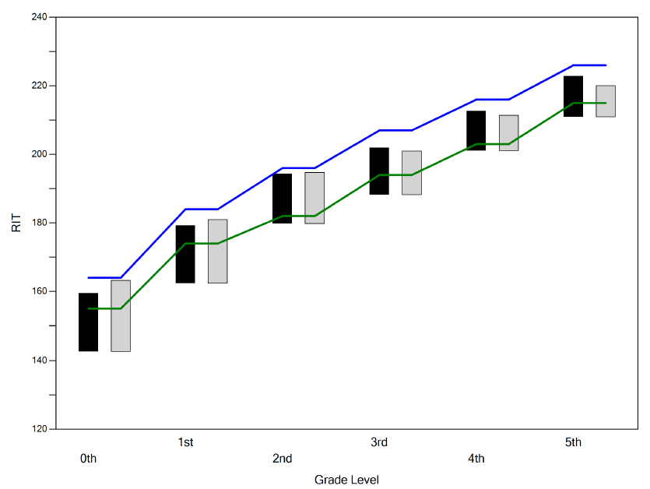

District VCG Report - Math
Notes:
Chart represents Math comparison
Questions:
Why is CASD K low?
How do we reach the advanced line as we are very close?

Slide 5
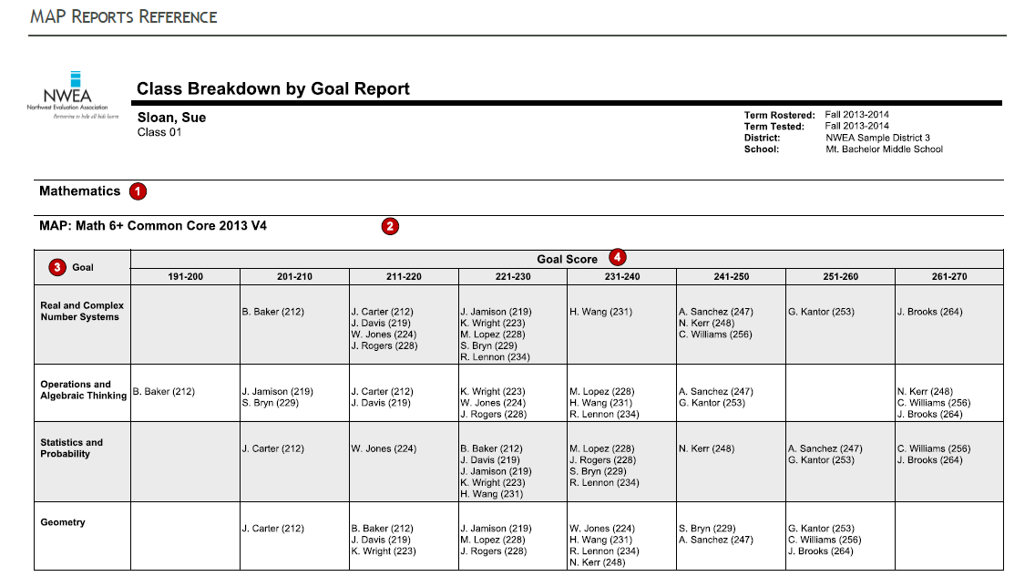
Class Breakdown Reports
How is this report useful?
Helps to form student groups for small group instruction
Identifies areas of instruction needing to be addressed as a whole group
Notes:
Multitude of reports available
Class breakdown
Provides teachers with an overall sense of where students fall in relation to subsets of the overall content
This example shows a clustering of students in the 211-230 range for “Real and Complex Number Systems”
may use information for whole group instruction
Outliers are in need of enrichment or additional support
Other information in the system helps teachers to better identify specifically which skills may need to be targeted next

Slide 6
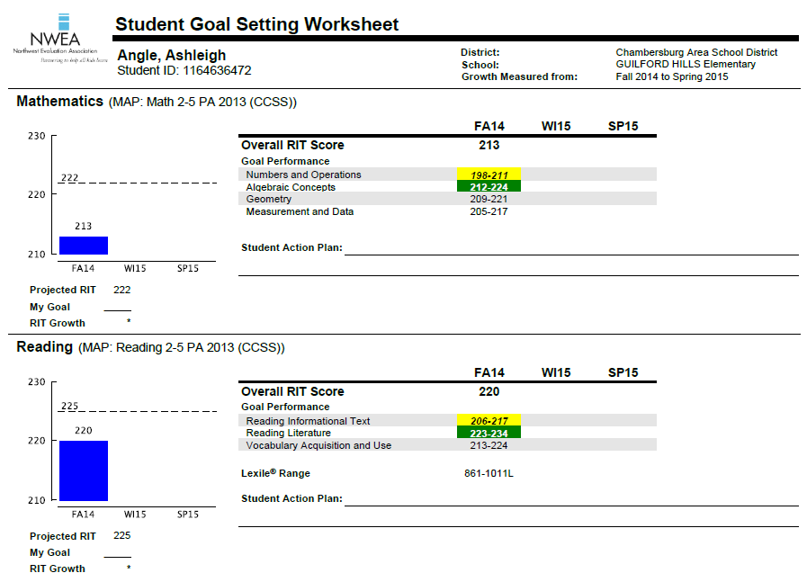
Student Goal Setting
Report Used for:
- student goal setting
- parent-teacher
conferencing
- Helps to identify areas of student strength and concern
Notes:
Reports are available for both students and parent to gage student performance
Parents receive a progress report 2 x’s / year
One example is the Student Goal Setting Report:
Each elementary student will be setting his/her own goals for the year based upon this information (primary slightly different approach than intermediate)
Green indicates that a student is excelling at a particular are of skills; yellow an area of potential concern; no highlighting – right on target
Dotted line offers expected growth for the year
Blue bar indicates where student is starting
Students may also indicate steps taking to reach goal
Sharing goals with parents at P-T conferences in Nov
Students will revisit throughout year

Slide 7

As we continue to improve our instructional programing, MAPs offers one more piece to the puzzle regarding student learning needs.

