Slide 1

Directions
Describe the characteristics of each object shown. Brainstorm as many as possible.

Slide 2
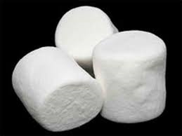

Slide 3
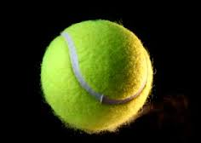

Slide 4
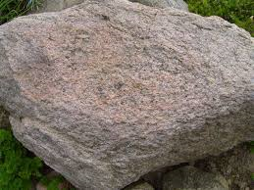

Slide 5


