Slide 1
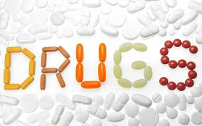
INTRO TO

Slide 2

Drugs
What is a drug?
  Any substance that causes a change in a person’s physical or psychological state.
What are some examples of drugs?

Slide 3
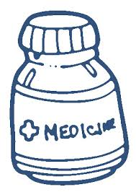
Medicine
What is medicine?
  Any DRUG used to cure, prevent, or treat an illness or discomfort
Prescription
  A written order from a doctor for a specific medicine
OTC (over the counter)
  Any medicine that can be bought without a prescription that are used for common illnesses or injuries
  Examples??

Slide 4
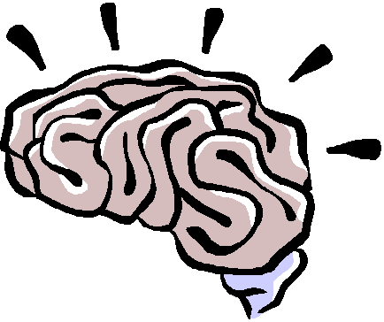
Effects of Drugs:
Psychoactive-
  describes a drug or medicine that affects the brain and changes how a person perceives, thinks, or feels.
Drug interaction-
  When a drug reacts with another drug or food such that the effect of one of the substances is greater or smaller.

Slide 5

What makes a medicine different from a drug?
To be a medicine, a drug must have the following qualities:
  Effective- good at carrying out its task
  Safe- does not damage the body
  Only Minor side effects- (any effect that is caused by a drug and that is different than its intended use) EX:
    Headaches
    Sleepiness
    Nausea

Slide 6

How are Medicines misused/abused?
Prescription meds-
  Give your meds to a friend
  Taking too much, not following dosage
  Mixing it with another medicine
OTC meds-
  used long-term, which may cover up pain or discomfort

Slide 7

Drugs of abuse
Drugs that people take for mind-altering effects that have no medicinal purposes.
  Examples?

Slide 8
Drug Categories
Depressants-
  Drugs that cause relaxation and sleepiness
Stimulants-
  Drugs that temporarily increase a person’s energy and alertness
Opiates-
  A group of highly addictive drugs that are used as pain relievers, anesthetics, and sedatives
Hallucinogens-
  Drugs that distort perceptions and cause a person to see or hear things that are not real

