Slide 1
Writing

Slide 2
So, why does writing matter?

Slide 3
https://www.youtube.com/watch?v=DYYt3nOrSkY

Slide 4

If you were a superhero, what problem in the world would you solve, and what three super powers would you use to solve this problem?

Slide 5

Step 1
Read and review the topic.
Ask: What type of essay am I going to write?
  Expository—informational essay
  Persuasive—essay used to convince
  Compare/Contrast—shows similarities and differences
Brainstorming (This is big!!)
Choose my key points and focus my ideas.
Put ideas into a logical order
  Chronological order –order of time
  Order of importance

Slide 6
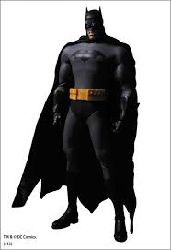
Step 2
Write my thesis statement.
This statement drives the whole essay.
It must contain three main points (directives).
It is always and only one sentence.
It will be the last sentence of my intro paragraph.

Slide 7

Step 3
a) Write my topic sentences.
  These will be the first sentence of each of my body paragraphs.
  They must contain one of my points from the thesis statement.
b) Write my supporting sentences
  These must contain facts, examples, and details.
*Parts “a” and “b” from Step 3 will form the body paragraphs for my essay!

Slide 8
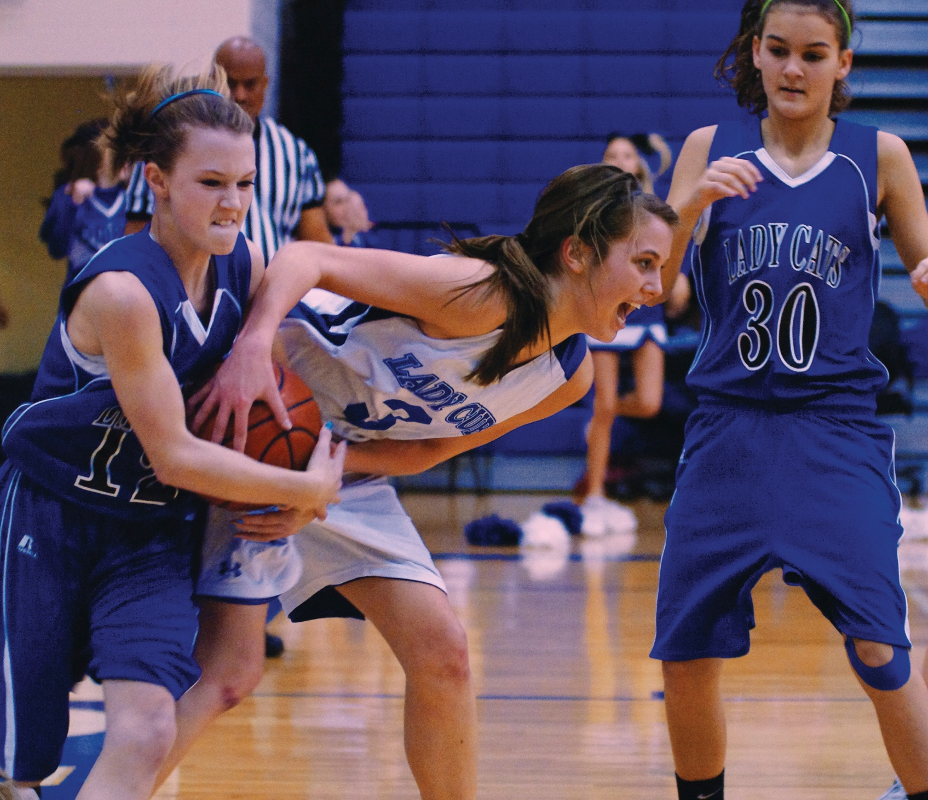
Yearbook Photo
http://media-cache-ec0.pinimg.com/originals/21/7b/9e/217b9eadb508bc5fc7084153dc3c967f.jpg

Slide 9
Sample Body Paragraphs
One major way that I will fight my messy house is with my go-go gadget arms. My house is often peppered with the clutter of toys, shoes, kid’s books, crayons, and cups that are all out of place. It is so bad that I sometimes feel like I am drowning in clutter. When this happens, I will unleash my go-go gadget arms with their ability to extend out of my arms and move around the room to pick up and put away all of my clutter. In addition, when I choose to relax on the couch after a long day, I often find broken toys, straws, junk mail, and old stickers floating around my house. My go-go gadget arms will combat this problem by allowing me to remain in my comfortable state on the couch as they stretch around the room, pick up these unwanted items, and throw them away.

Slide 10
Sample Body Paragraphs
One major way that I will fight my messy house is with my go-go gadget arms. They will pick up clutter. They can do dishes. My go-go gadget arms can also throw away trash.

Slide 11
Body Paragraph Analysis
One major way that I will fight my messy house is with my go-go gadget arms. They will pick up clutter and put it away. They can do dishes. My go-go gadget arms can also throw away trash by letting me sit on the couch.

Slide 12
Step 4
a) Write the introductory paragraph.
b) Start with a hook for the reader.
  This could be a quote or a bold statement to grab the reader’s attention.
c) Write connecting sentences that will connect to my thesis statement.
  These sentences could contain the author’s name, book title, and brief background information on the topic.
d) Plug in the thesis statement as the final sentence of the intro paragraph.

Slide 13
It’s a bird! It’s a plane! It’s a super scrubber! My house is often struck with the evil villains of clutter, junk, trash, dust, spider webs, and dirt. When these villains strike, I am left with a messy house. If I were a superhero, I would fight my messy house with my go-go gadget arms, my finger zap, and my sweeper feet.

Slide 14
Step 5
a) Write the conclusion.
b) Review the thesis and re-read the body paragraphs.
c) Re-state the thesis to begin the conclusion.
d) Write a brief summary of main points.
e) End with insight (expository essay) or a call to action (persuasive essay).

Slide 15
Therefore, if I was a superhero, I would fight my messy house in full force. First, I would combat my clutter and trash with my go-go gadget arms. Then, I would clear away all dust, bugs, and spider webs with my finger zap. Finally, I would battle my dirty floors with my sweeper feet. As a super scrubber, I will always prevail!

Slide 16
Step 6
a) It is time to revise my essay!
b) Re-read the essay and look for coherence.
  Check content: Does everything in my essay flow?
  Do I need to add more information for clarity?
  Do I need to add transition words?
  Do I need to incorporate synonyms?
c) Review the essay and look for unity.
Check content: Does everything support the thesis statement?
Check body paragraphs: Do all supporting sentences connect to the topic sentence?

Slide 17
Conclusion Revising Sample
Therefore, if I was a superhero, I would fight my messy house in full force. First, I would fight my clutter and trash with my go-go gadget arms. Then, I would fight all dust, bugs, and spider webs with my finger zap. Finally, I would fight my dirty floors with my sweeper feet. As a super scrubber, I will always prevail!

Slide 18

Step 7
It is time to edit my essay!
Do I have any grammatical errors?
Do I have any usage errors?
Do I have any mechanical errors?
Do I have any spelling errors?

Slide 19

Step 8
Write the final copy!
My final copy must be typed and double-spaced!
I must follow MLA formatting guidelines.
Complete a works cited page if applicable.

Slide 20
Final Copy of 5-Paragraph Essays—formatting
You must hand in your rough draft and any brainstorming/outlining
The first page must have a “heading” at the top left (see the name example); all other pages must have a “header” with your last name aligned right (see “Brown 1”)
The heading consists of your name; my name; the class name; and the due date (ex: 15 May 2014)
The essay title must be centered on the page.
The essay should be aligned on the left, and each paragraph should be indented once at the start.

