Slide 1
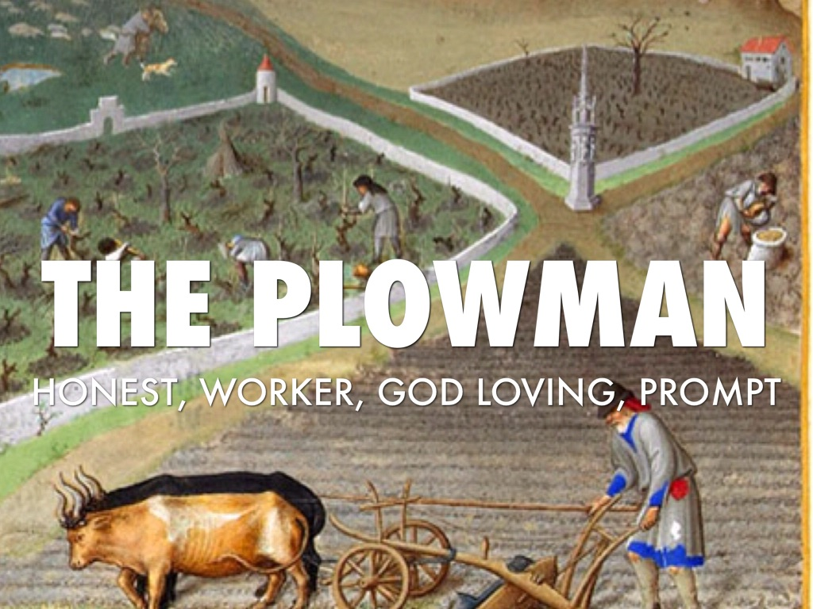

Slide 2
Name/Title | Physical Characteristics | Personality Traits | Interests, Likes, and Dislikes | Chaucer’s Opinion & Conclusions
Plowman | -Parson’s brother -Short jacket -Rode a mare -Farmer | -Generous -Energetic -Devoted to work -Religious | -Wealth +Farm work (loading dung, thrashing corn, etc.) +God +Paying church dues +Helping others | Very favorable – generally, a good man dedicated to god and his community

Slide 3
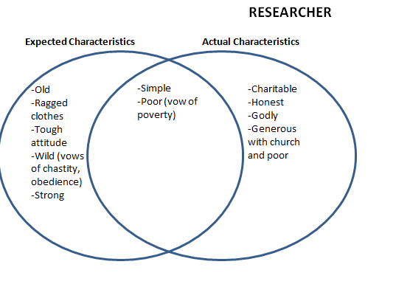

Slide 4
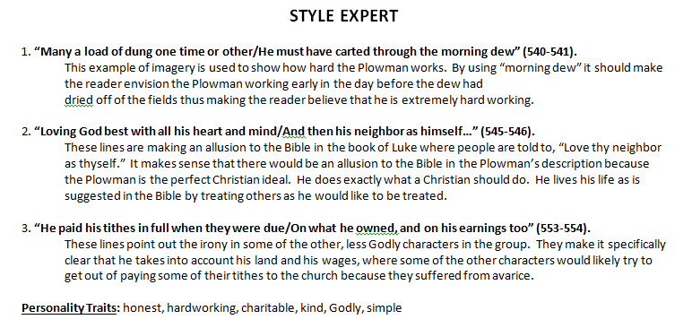

Slide 5
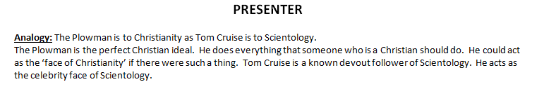

Slide 6
