Slide 1
Mr. Zimmerman
Shark Tank Introductory Essay PowerPoint

Slide 2
General Prompt 1:
Some students have a background, identity, interest, or talent that is so meaningful they believe their introduction would be incomplete without it. If this sounds like you, then please share your story.

Slide 3
Main Idea of Essay
I am a mountain biker.
I am going to write about my first mountain biking experience and overcoming initial failure.

Slide 4
Intriguing Introduction or “Hook”
Story about my first memory of single track… the bucking bronco story.

Slide 5
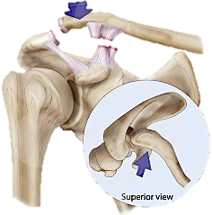
Additional Supporting Details
2005: Serious race injury – stage 3 shoulder dislocation

Slide 6
Additional Supporting Details
2013 – Second race injury – deviated septum
2008 - 2016 – Club advisor struggling mountain bike club

Slide 7
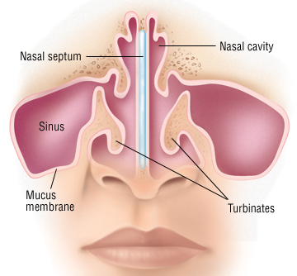
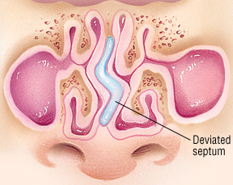
Normal vs. Deviated Septum

Slide 8

Closing or Final “Hook”
2017– Thriving mountain bike Team

