Slide 1
Creating an
AWESOME
Multi-Media Presentation

Slide 2
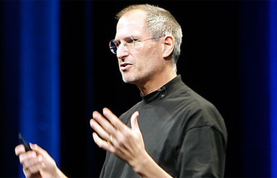
Create Like a Pro
“Present Like Steve Jobs”
Follow along with handout

Slide 3

Do Not Make These Mistakes…
“Death By PowerPoint”
Follow along
with handout

Slide 4
Designing a Multi-Media Presentation
Rules To Follow When Using PowerPoint, Prezi, etc.

Slide 5
Choose a simple background
No Templates

Slide 6
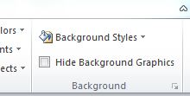
Choose “Background Styles” on the Design Tab to find simple options to build on.

Slide 7
Dark backgrounds
are easiest on
the eyes
with a light colored
font.

Slide 8
Light colored backgrounds tend to
tire the eyes,
but are okay for
shorter presentations.

Slide 9
When it comes to
text on a slide,
“less is more”

Slide 10
Use the
outline feature of PowerPoint to record details. Don’t put them
on the slides.

Slide 11
Better to have
more slides
with less info per slide than
a few slides with
too much info

Slide 12
You have two choices when picking your font…
Serif
or
Sans Serif

Slide 13
Use one type of font for
highlights and accents
and the other type for
other text.

Slide 14
Use no more than 3 colors of text in your entire presentation.
2 warm and 1 cool
or
2 cool and 1 warm.

Slide 15
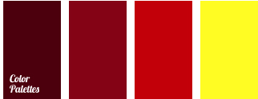
“Warm
Colors”
appear to
come forward.

Slide 16

“Cool
Colors”
appear to
recede.

Slide 17
Use one color for text
and the other two colors for accents
like highlighted terms and quotation marks.

Slide 18
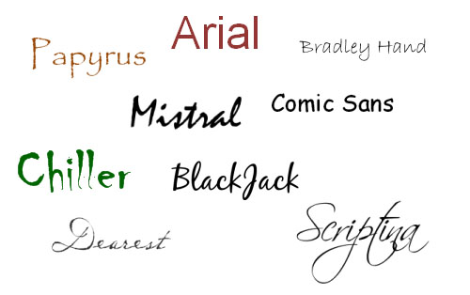
Remember…The font you choose says something about you. So choose wisely!
“Font Wars”

Slide 19
Viewers read in a
“Z” pattern.
Plan your
text and graphics accordingly.

Slide 20
Avoid
using all capitals.
It feels like you are SCREAMING!

Slide 21
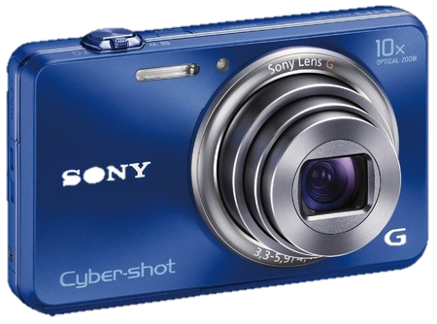
Use
real photos
not
clip art to emphasize meaning

Slide 22
Manipulate photos
to make them blend
better with your style

Slide 23

Change the background of a photo to make it blend with your background
Change this blue to black so it matches the background you chose.

Slide 24

On the
“Picture Format”
tab choose to “Remove Background”

Slide 25

Now the picture seems to pop off the page and creates more of a visual presence.

Slide 26
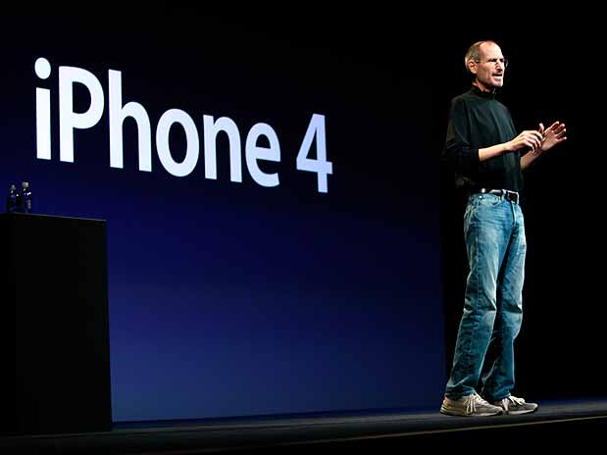
Make photos point toward
your text

Slide 27
If you change the direction
of the photo,
your viewers will
change where they are
looking too.

Slide 28
Now the picture seems to pop off the page and creates more of a visual presence.
Let’s make Betty look at the text on this slide…

Slide 29
Now the picture seems to pop off the page and creates more of a visual presence.
What a difference!

Slide 30
Don’t distort
a picture
when you are
changing its size

Slide 31
Drag only from the
four corners
of the picture and never from the sides.

Slide 32
Properly Resized
Distorted

Slide 33
Avoid using animation with the exception of a “build” or for clarity with a list.

Slide 34
Use SmartArt
instead of
bulleted lists
when possible.

Slide 35
Item 1
Item 2
Item 3

