Slide 1



PARENT POWER SESSION:
PREPARING FOR COLLEGE ATHLETICS
LPHS Counseling Office
March 8, 2023

Slide 2
Objectives
Intro to College Athletics
Understanding the NCAA
NCAA Eligibility Requirements
Defining Core Courses
Step 1: Meet 16 Core Courses
Steps 2&3: NCAA Core GPA Sliding Scales
Division III, NAIA, & NJCAA
Sport Scholarship Availability
What You Can Do Now
Creating A Sport Resume
LPHS Counseling Website

Slide 3
Intro to College Athletics
Various College Athletic Associations
  NCAA, NAIA, NJCAA, etc.
  Sample sports – Baseball, Softball, Volleyball, Hockey, Basketball, Cross Country, Football, Cheerleading, Gymnastics, Soccer, Track, Wrestling, Golf, Swimming & Diving
  Some have athletic scholarships, others do not
  Some have strict recruitment rules, others do not
Requirements to play in college
  Some organizations have eligibility requirements to play
  Most have requirements to remain eligible in college
  4 years of eligibility – if do not compete at all may remain on “red-shirt” list so year does not count against them

Slide 4
Understanding the NCAA
What is the NCAA?
  National Collegiate Athletic Association, est. in 1906
  Governing body for more than 1,200 colleges, universities, conferences, and organizations
  Division I, II, & III
Rules on Recruitment
  NCAA sport-specific Recruiting Calendars
    Different rules for different years in high school and periods (e.g., contact, evaluation, quiet, dead)
  Eligibility requirements for DI & DII only
  Annual contracts (a 4-year, full-ride does not exist)
  Once you sign, the recruitment process ends

Slide 5
NCAA Eligibility Requirements
Student-athletes must meet the following criteria:
  Successfully complete all core courses (16 total for DI & DII)
    10 core courses (including 7 in English, math or natural/physical science) prior to your 7th semester
  Have a min. 2.3 core course gpa (2.2-DII, Aug. 2018)
  Successfully graduate from high school
Maintain academic eligibility during college
$100 fee to register in NCAA Eligibility Center

Slide 6
NCAA Eligibility Requirements: Defining Core Courses
  “Any course at your high school, reviewed/approved by
  NCAA for meeting their academic standards”
    Some LP classes are NOT accepted (ie, Bus Tech Writ/Coll Prep H)
    More gpa points for weighted, honors, & AP classes
  Typical subjects include:
    English, Math, Natural/Physical Science, Social Science and Foreign Language
  Note: 1 full-year LP course = 1 NCAA credit (not 2)
  Different Core Course GPA requirements for Different
  Division levels (DI & DII)
  Core Courses at LP High School (Student Handbook)

Slide 7
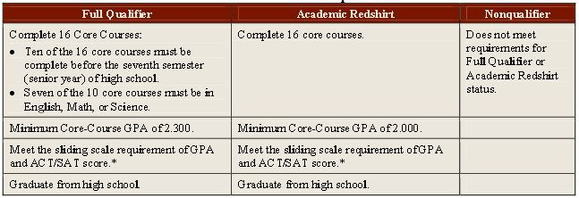
NCAA Eligibility Requirements
There are 3 possible academic outcomes:
  Full qualifier = competition, athletics aid, and practice first year
  Academic redshirt / Partial qualifier = athletics aid first year and practice in first regular academic term, but no competition
  Non-qualifier = no athletics aid, practice or competition first year
2016 Division 1 New Academic Requirements (www.eligibilitycenter.org)
Notes:
School ID – 144255

Slide 8
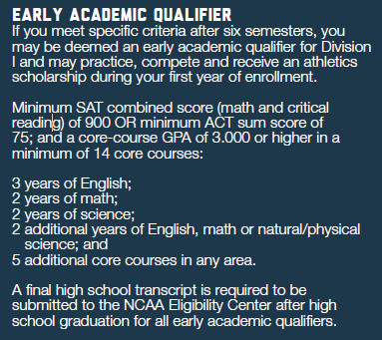
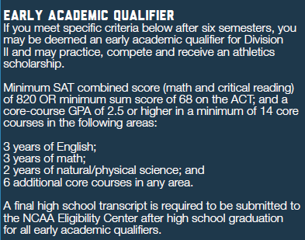
NCAA Eligibility Reqs (Cont.)
Division I
Division II
Notes:
School ID – 144255

Slide 9
Step 1: Meet 16 Core Courses
Division I
Division II
Subject | Requirements
English | 4 years
Mathematics (Algebra I or higher) | 3 years
Natural/Physical Science (1 year of lab if offered) | 2 years
Additional English, Math or Science | 1 year
Social Science | 2 years
Additional Courses (from any above or foreign language) | 4 years
Subject | Requirements
English | 3 years
Mathematics (Algebra I or higher) | 2 years
Natural/Physical Science (1 year of lab if offered) | 2 years
Additional English, Math or Science | 3 years
Social Science | 2 years
Additional Courses (from any above or foreign language) | 4 years
Both Require 16 Core Courses

Slide 10
DIII
Largest division, with more than 188,000 student athletes and 442 schools
Develop student-athlete potential through a holistic, comprehensive educational approach
Focus is on academics
Do not receive athletic aid
80% of all Division III student-athletes receive some form of merit or need-based financial aid
Institutional gift averages $17,000
Not certified by the NCAA Eligibility Center because Division III colleges and universities each set their own admission standards.

Slide 11
NAIA & NJCAA
NAIA (National Association of Intercollegiate Athletics)
  Freshmen MUST meet 2 of the following:
  ACT score of 18 or 970 SAT
  Minimum cumulative high school GPA of 2.0/4.0
  Graduate in top ½ of your high school class
  $100.00 registration fee for U.S. students
  Ex: Lindenwood, Olivet Nazarene, Robert Morris, St. Ambrose
  NAIA schools/information at: www.PlayNAIA.org
NJCCA (National Junior College Athletic Association)
  Some may not have entering eligibility requirements
  NJCCA schools/information at: https://www.njcaa.org/landing/index

Slide 12
Sport Scholarship Availability
www.scholarshipstats.com
Information on playing College Sports and Athletic Scholarships
General Information:
College Athletic Scholarship Limits – NCAA, NAIA, NJCAA
Odds of a US High School Athlete Playing in College
Average Athletic Scholarship per Athlete
Average NCAA I Scholarship by Sport
College Athletic Teams Dropped During 2020/COVID
Sport-specific Information
Odds of Player Competing in College
List of School Sponsoring the Sport
Stats and Links to all US Colleges Sponsoring the Sport
Number of Schools Sponsoring Sport by State

Slide 13
Scholarship Limits – Men’s Sports
Men's Varsity Sports 2020-21 Scholarship limit per Team: |  | NCAA I |  | NCAA II |  | NCAA III |  | NAIA |  | NJCAA
Baseball |  | 11.7 |  | 9 |  | - |  | 12 |  | 24
Basketball * |  | 13 |  | 10 |  | - |  | - |  | 15
Basketball - NAIA Div I |  | - |  | - |  | - |  | 11 |  | -
Basketball - NAIA Div II |  | - |  | - |  | - |  | 7 |  | -
Bowling |  | - |  | - |  | - |  | 5 |  | 12
Cross Country - NCAA limits include T&F |  | 12.6 |  | 12.6 |  | - |  | 5 |  | 10
Fencing |  | 4.5 |  | 4.5 |  | - |  | - |  | -
Football - NCAA I FBS * |  | 85 |  | - |  | - |  | - |  | -
Football - NCAA I FCS |  | 63 |  | - |  | - |  | - |  | -
Football - Other Divisions |  | - |  | 36 |  | - |  | 24 |  | 85
Golf |  | 4.5 |  | 3.6 |  | - |  | 5 |  | 8
Gymnastics |  | 6.3 |  | 5.4 |  | - |  | - |  | -
Ice Hockey |  | 18 |  | 13.5 |  | - |  | - |  | 16
Lacrosse |  | 12.6 |  | 10.8 |  | - |  | 12 |  | 20
Rifle - Includes co-ed teams |  | 3.6 |  | 3.6 |  | - |  | - |  | -
Skiing |  | 6.3 |  | 6.3 |  | - |  | - |  | -
Soccer |  | 9.9 |  | 9 |  | - |  | 12 |  | 24
Swimming & Diving |  | 9.9 |  | 8.1 |  | - |  | 8 |  | 15
Tennis |  | 4.5 |  | 4.5 |  | - |  | 5 |  | 9
Track & Field - NCAA limits include X-C |  | 12.6 |  | 12.6 |  | - |  | 12 |  | 20
Volleyball |  | 4.5 |  | 4.5 |  | - |  | - |  | -
Water Polo |  | 4.5 |  | 4.5 |  | - |  | - |  | -
Wrestling |  | 9.9 |  | 9 |  | - |  | 10 |  | 20
 |  |  |  |  |  | -
Average Athletic Scholarship |  | $18,013 |  | $6,588 |  | - |  | $8,093 |  | $2,376
* Head Count Sport

Slide 14
Scholarship Limits – Women’s Sports
Women's Varsity Sports 2020-21 Scholarship limit per Team: |  | NCAA I |  | NCAA II |  | NCAA III |  | NAIA |  | NJCAA
Basketball * |  | 15 |  | 10 |  | - |  | - |  | 15
Basketball - NAIA Div I |  | - |  | - |  | - |  | 11 |  | -
Basketball - NAIA Div II |  | - |  | - |  | - |  | 7 |  | -
Beach Volleyball ** |  | 6 |  | 5 |  | - |  | - |  | 10
Bowling |  | 5 |  | 5 |  | - |  | 5 |  | 12
Cross Country - NCAA limits include T&F |  | 18 |  | 12.6 |  | - |  | 5 |  | 10
Equestrian |  | 15 |  | 15 |  | - |  | - |  | -
Fencing |  | 5 |  | 4.5 |  | - |  | - |  | -
Field Hockey |  | 12 |  | 6.3 |  | - |  | - |  | -
Golf |  | 6 |  | 5.4 |  | - |  | 5 |  | 8
Gymnastics * |  | 12 |  | 6 |  | - |  | - |  | -
Ice Hockey |  | 18 |  | 18 |  | - |  | - |  | -
Lacrosse |  | 12 |  | 9.9 |  | - |  | 12 |  | 20
Rifle- includes co-ed teams |  | 3.6 |  | 3.6 |  | - |  | - |  | -
Rowing |  | 20 |  | 20 |  | - |  | - |  | -
Rugby |  | 12 |  | 12 |  | - |  | - |  | -
Skiing |  | 7 |  | 6.3 |  | - |  | - |  | -
Soccer |  | 14 |  | 9.9 |  | - |  | 12 |  | 24
Softball |  | 12 |  | 7.2 |  | - |  | 10 |  | 24
Swimming & Diving |  | 14 |  | 8.1 |  | - |  | 8 |  | 15
Tennis * |  | 8 |  | 6 |  | - |  | 5 |  | 9
Track & Field - NCAA limits include X-C |  | 18 |  | 12.6 |  | - |  | 12 |  | 20
Triathlon |  | 6.5 |  | 5 |  | - |  | - |  | -
Volleyball * |  | 12 |  | 8 |  | - |  | 8 |  | 14
Water Polo |  | 8 |  | 8 |  | - |  | - |  | -
Average Athletic Scholarship |  | $18,722 |  | $8,054 |  |  |  | $7,870 |  | $3,259
* Head Count Sport

Slide 15
What Can You Do Now?
BE PROACTIVE
Email college coaches and explain why you are interested in playing for their teams. Make the email personal, informative and concise. Attach a highlight tape or skills/sport resume if you have one.
Attend college camps. Target a few schools where you would like to compete.
Attend showcases. Many college coaches attend these to look at multiple students during 1 event.
Set up a meeting with your high school coach. Ask coach to write a letter of recommendation to a short-list of preferred colleges. Include game schedules.
Complete on-line questionnaires that many colleges post on their athletic websites.

Slide 16
What Can You Do Now?
BE ACTIVE
Play year-round. Play at indoor facilities that offer “high-level” instruction. Join a travel or club team during the off season.
Play another sport. Many coaches are looking for well-rounded athletes.
BE REALISTIC
Research current athletes at the schools you are interested in. Compare your stats to their stats. Be realistic about your options.
BE PERSISTENT
Keep sending emails with updates about you and/or your team’s accomplishments.
Let colleges know if you will be attending a college open house or campus visit.

Slide 17
What Can You Do Now?
BE SMART
Gain attention of college scouts/coaches through high academic achievement.
Keep track of courses and grades & maintain eligibility
  Use NCAA Eligibility Tracking Sheet to calculate.
Register on www.eligibilitycenter.org prior to official visits/signing.
  Create account on website and pay $90 registration fee.
  Send official ACT scores to NCAA through www.actstudent.org.
  Send official SAT scores to NCAA through www.collegeboard.org/mysat.
Become familiar with NCAA recruitment rules/calendars.
Watch your social media use and social behaviors.

Slide 18
Creating a Sport Resume
Include the following information:
    Objective
    Sport Experience - all athletic teams played for
    Educational information (gpa, class rank, and ACT)
    Sport statistics
    Awards and recognitions
    Current year’s athletic schedule
    Any other areas you find useful, but keep short (1-2 pgs)
You may wish to use www.CareerCruising.com:
  Log in using LPHS login/password below:
    Login: lphs541 / Password: cavs
  Create a “My Plan” to save work
    Login: jdavies000000 / Password: 000000
  Access Resume Builder on “My Plan” homepage
  Click “Format & View” then export/save to Word
Notes:
Career Cruising
login: lphs541
password: cavs

Slide 19
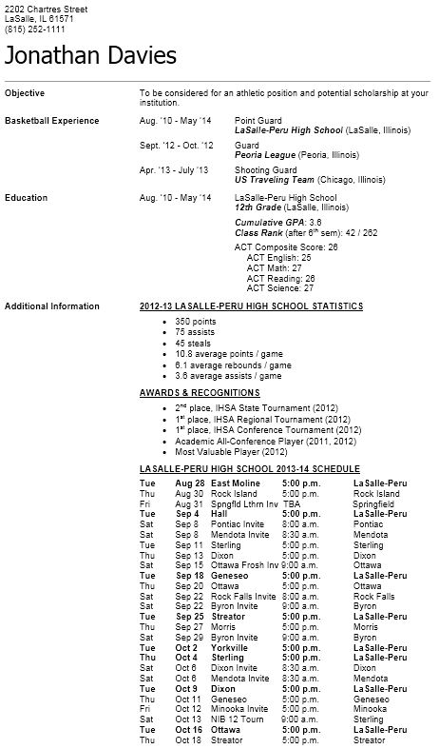
Sample Sport Resume

Slide 20
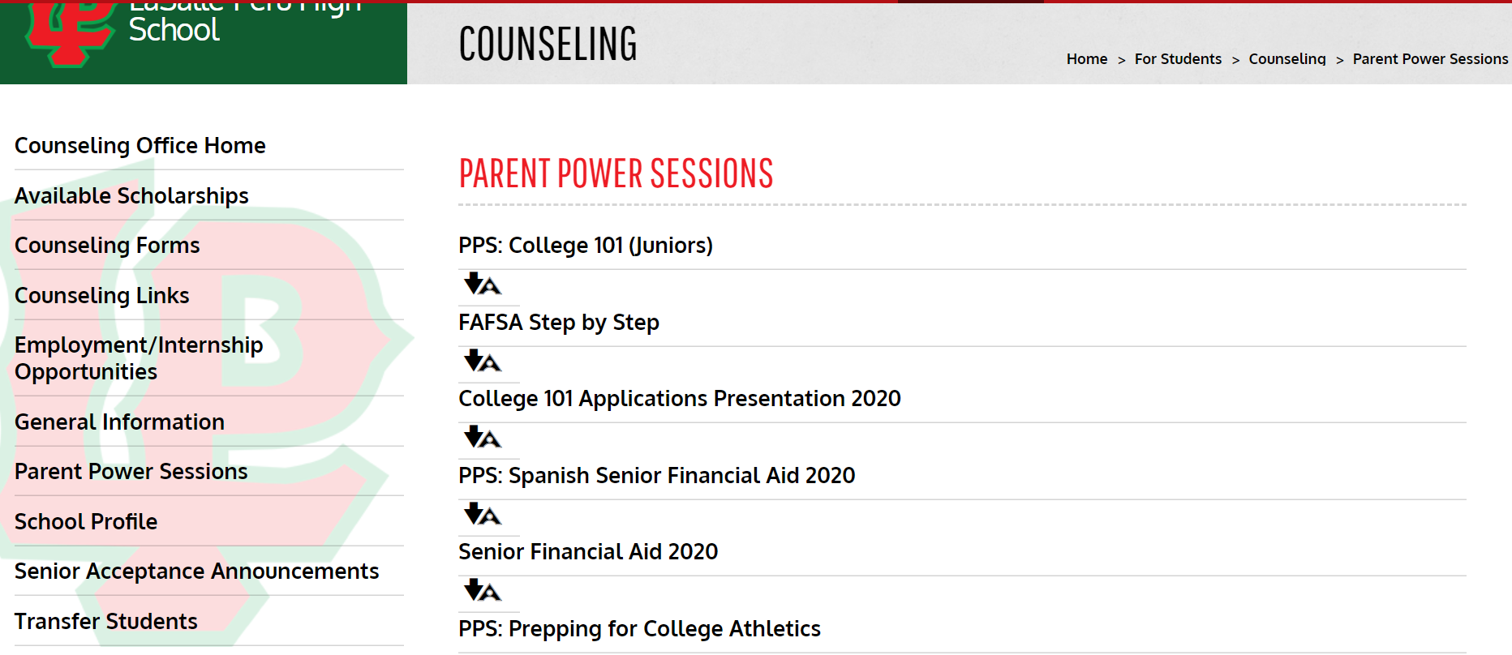
LPHS Counseling Website

Slide 21
Objectives
Intro to College Athletics
Understanding the NCAA
NCAA Eligibility Requirements
Step 1: Defining Core Courses
Step 1: Meet 16 Core Courses
Steps 2&3: NCAA Core GPA Sliding Scales
Division III, NAIA, & NJCAA
Sport Scholarship Availability
What You Can Do Now
Creating A Sport Resume
LPHS Counseling Website

Slide 22
References
  NCAA Eligibility Center (www.ncaa.org/student-athletes/resources)
  Initial Eligibility Toolkits
  NCAA Eligibility Center Quick Reference Guides
  Recruiting Process and Calendars
  Guide for the College-Bound Student-Athlete: http://fs.ncaa.org/Docs/eligibility_center/Student_Resources/CBSA.pdf
    Sport Scholarship Availability (www.scholarshipstats.com)
    NAIA (www.playNAIA.org)
    NJCCA (https://www.njcaa.org/landing/index)
    CareerCruising (www.careercruising.com)
    LPHS Counseling (www.lphs.net/counseling)

