Slide 1

Iceman Interview
Title page:
  Catchy title
  Picture drawn neatly with color
  Intro with a “hook”
  Your name and core
Inside pages
  Five (5) questions and answers supported by info you know from the textbook, web search, documentary, and Otzi worksheet.
Back page
  A list of at least three (3) questions that remain unanswered. What do you still wonder about Otzi?

Slide 2
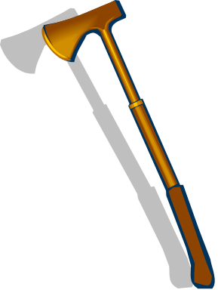
“Hook” Suggestions
I am more famous in death than I ever was in life….
Have you ever heard of an Iceman? Well, this story….
Little did two Europeans who were hiking the Alps realize what they found when….
I never dreamed I would become the center of a world-wide murder mystery.
You have awakened me from death! The world sure isn’t the way I left it.

