Slide 1

by
Smarter Balanced Assessment Consortium
https://smartertoolsforteachers.org/
Notes:
As you may know, the Digital Library has been retired.
A new site for instructional support called Tools for Teachers has arrived!
This is the new site. We will go over the many resources it has to offer.
NOTE: To have full access to the site you need a TOMS account.

Slide 2
What is Tools for Teachers
The Smarter Balanced Assessment Consortium has launched an advanced suite of resources for teachers called Tools for Teachers.
Tools for teachers has replaced the Digital Library
Features instructional and professional learning resources to support teachers in their use of formative assessment
Easy-to-search website
Authored by teachers for teachers
Designed to support teachers during daily instruction
Time saver for identifying learning gaps and meeting student learning needs
Notes:
Tools for teachers is a newly released site by the Smarter Balanced Assessment Consortium.
It’s an easy to use site with resources authored by teachers for teachers.
It was designed to help teachers during daily instruction and to help teachers save some time.

Slide 3
Features included:
  interactive Connections Playlists you can use with interim assessments
  high-quality, accessible resources aligned to learning standards
  formative assessment strategies embedded in every resource
  accessibility instructional strategies
Notes:
The site includes many helpful resources and tools that will help you meet individual student needs.
Just like the digital library, it contains connection playlists that you can use with the IABs.---A connections playlist is a group of instructional resources focusing on the content of a specific IAB. -- There is a connection playlist that corresponds with each of the IABs.
The resources were created with grade level and at standard level in mind.
It also supports differentiating lessons so that they are easily accessible to all students, including those that need additional support or those that need a challenge.
Within the resources are strategies for teachers to use to check for understanding in real time.

Slide 4
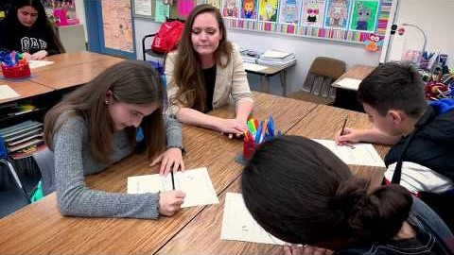
What is tools for teachers
https://youtu.be/YI6bM_3qCos
Notes:
1:33 minute video created by Smarter Balanced on what is tools for teachers

Slide 5
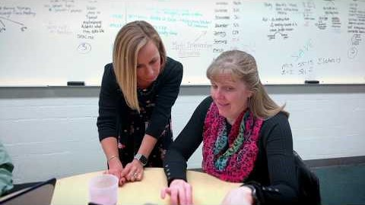
How Tools For Teachers Supports Educators
https://youtu.be/SIg0YZL8-LI
Notes:
4:22 video by Smarter Balanced on how tools for teachers supports educators

Slide 6
How to get to Tools for Teachers
1. https://smartertoolsforteachers.org/
2. CAASPP.org > Resources Tab > Tools for Teachers Tile (green)
3. CDE.CA.org >Testing & Accountability Tab > Smarter Balanced Assessment System > Tools for Teacher Link (under Assessments)
4. ELPAC.org > Tools for Teachers Tile (blue)
5. CERS - Instructional Resources links you directly to Tools for Teachers
6. TOMS account> Links Tab >Tools for Teachers hyperlink
Notes:
You can go to the Tools for Teachers site through the CAASPP.org or ELPAC.org sites.
You can also reach the site through the CDE.org site.
The easiest way would be for you can bookmark the URL for future use.
Lastly, once you have administered an IAB and scores are available, you will be able to access the connection playlists found in Tools for Teachers. See slide 15 for further information.

Slide 7
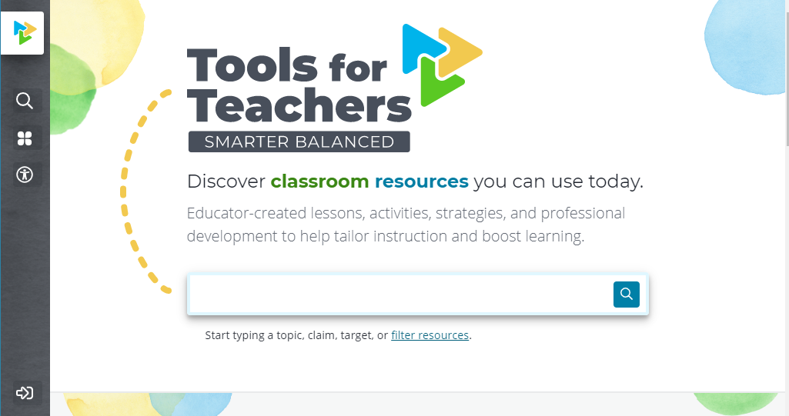
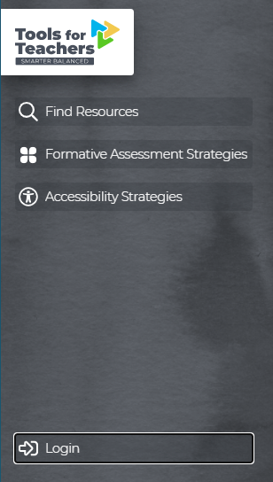
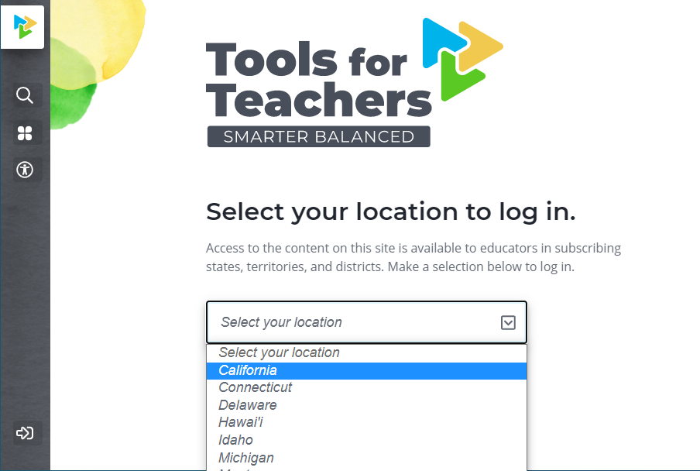

How to Log in
Notes:
Anybody can access the Tools for Teachers site; however, those with an active TOMS account will have access to many more resources.
Notice that the Tools for Teachers icon has Smarter Balanced underneath it. This is letting us know that this portion of the site is accessible to anyone (parents, teachers, students).
Once on the Tools for Teachers homepage, select the arrow found on the bottom left corner of the page and click Login. Again, only those with an active TOMS account will be able to access this portion of the site.
You will be asked to select your state and click GO.

Slide 8
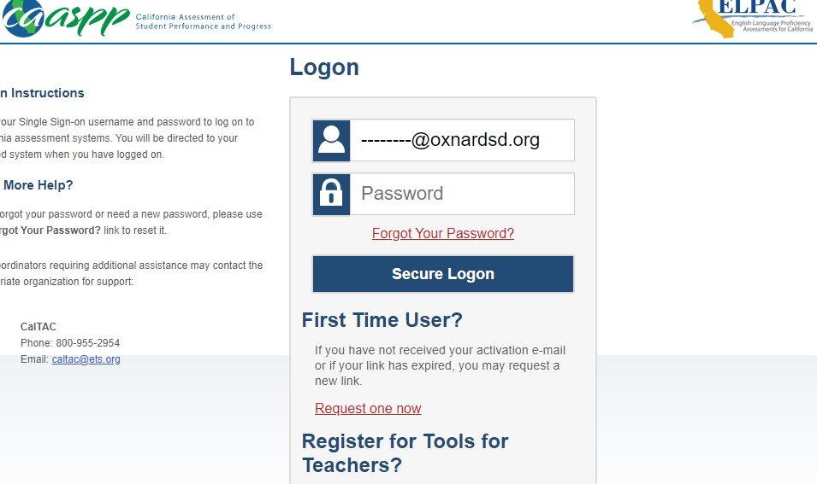
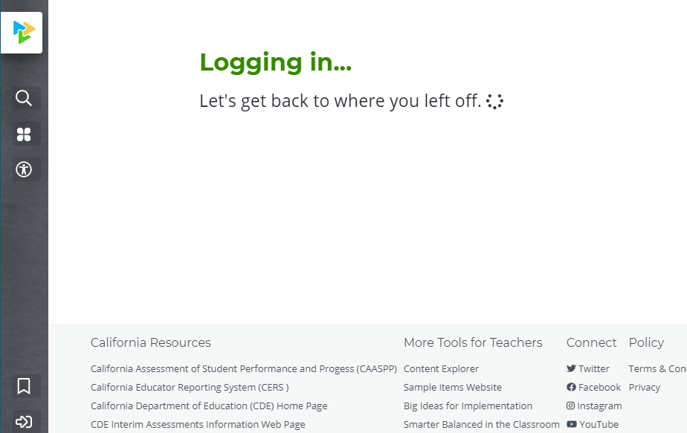
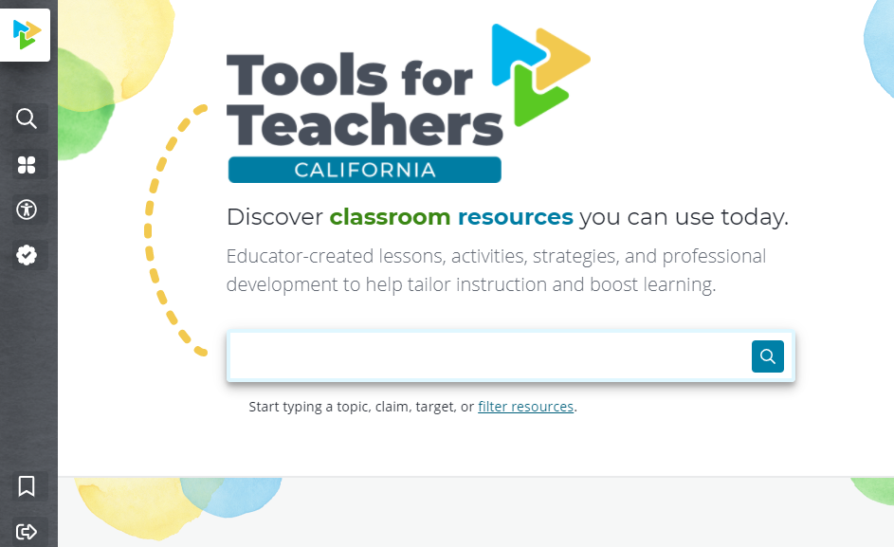
Notes:
You will be redirected to the TOMS log in page, where you will need to type in your OSD email and your TOMS log in password.
You will be redirected to the Tools for Teacher site, where you will have teacher permissions.
Notice that the Tools for Teachers icon has changed to Tools for Teacher California. This is how you will know that you are logged in.

Slide 9

Tools For Teachers Video Demonstration
https://youtu.be/167FjxzHZxc
Notes:
7:54 minute video that points out all the key features found in the Tools for Teachers site

Slide 10
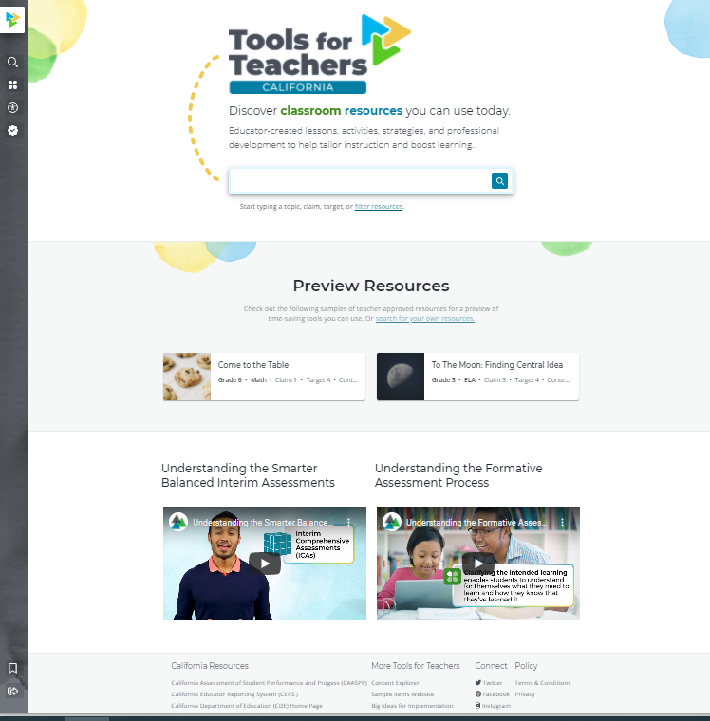
Navigating Tools For Teachers
Search bar using key words with filter link underneath to help you narrow your search
Informational videos
Preview some resources first
External Links: CDE, CERS, CAASPP
Notes:
The landing page has a search bar where you can search for key words. Underneath that is a link which will bring up a filter search, which you can use to narrow down your search.
It also contains some preview items and informational videos you should watch.
Footer of page contains links to other CA resources such as the CAASPP site, CERS, CDE, Smarter Balanced site, social media.

Slide 11
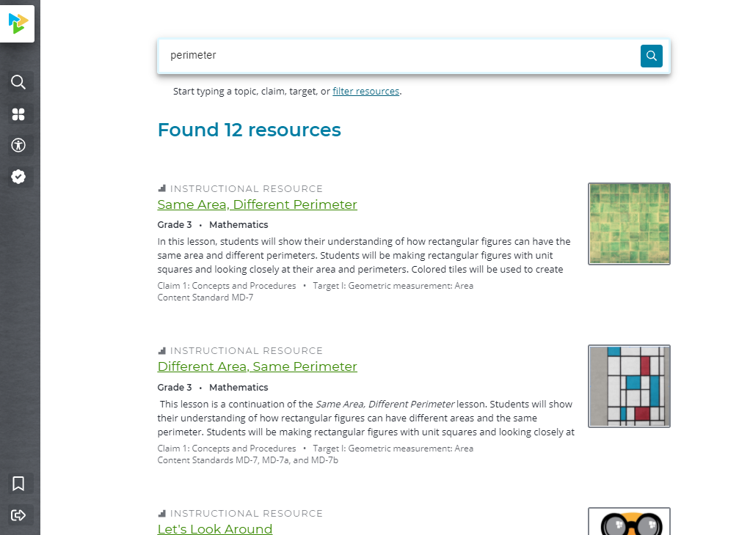
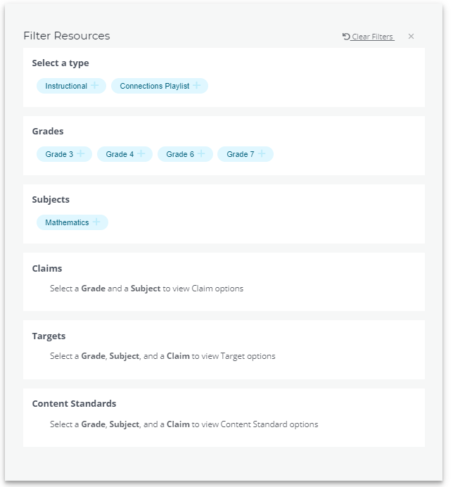
Notes:
Let’s go over an item.
Here I searched for ‘perimeter’ and the search resulted in 12 different resources.
I have the option of narrowing down my search again, if I click on the bottom hyperlink. It gives me the option to filter by grade, subject, type, etc.
I am going to select the first resource – ‘Same are, different perimeter’

Slide 12
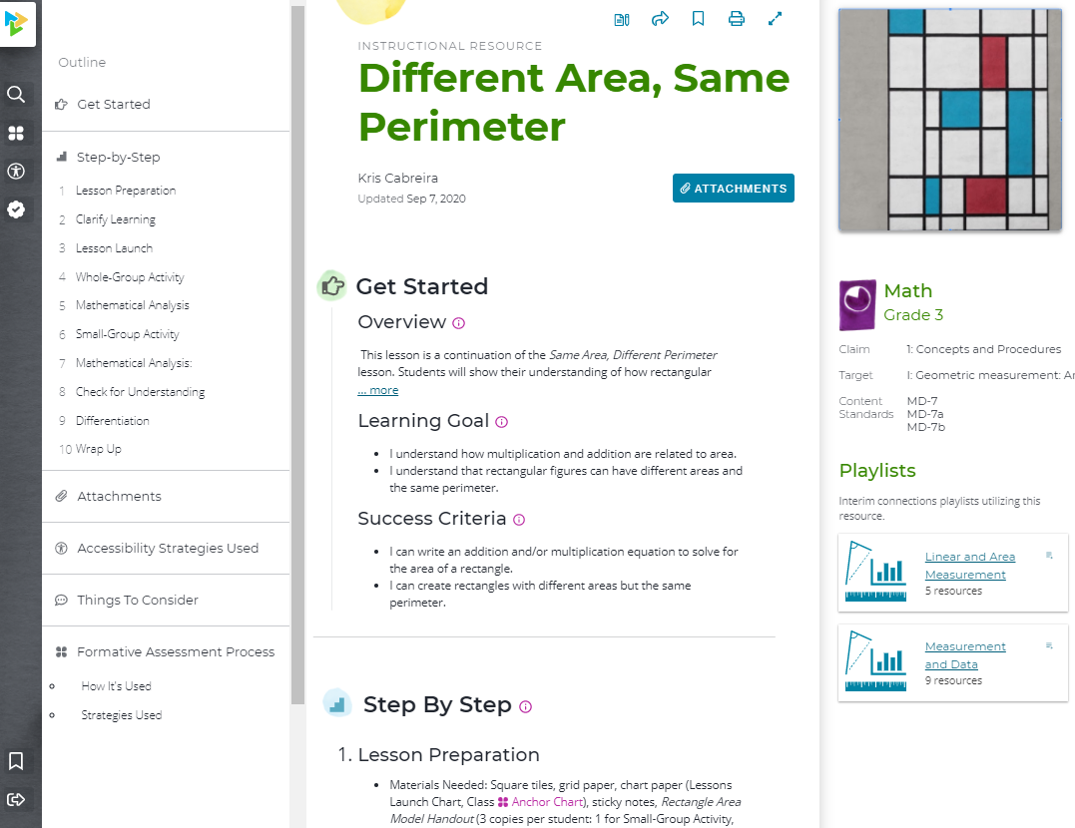
Every Resources follows the same structure
Get Started
Step-by-step directions
Attachments
Accessibility strategies used
Things to consider
Formative assessment strategies used and the formative assessment process
Metadata that includes the content area, grade level, claim, target, and standards covered in the resource
Notes:
This is an instructional resource - stated at the top. In the center, you are provided with an overview of the activity.
The left-hand side contains an outline of the resource, listing the sections of the resource.
On the right side, you will see the claim, target, and content standard.
Every resource follows the same structure!

Slide 13
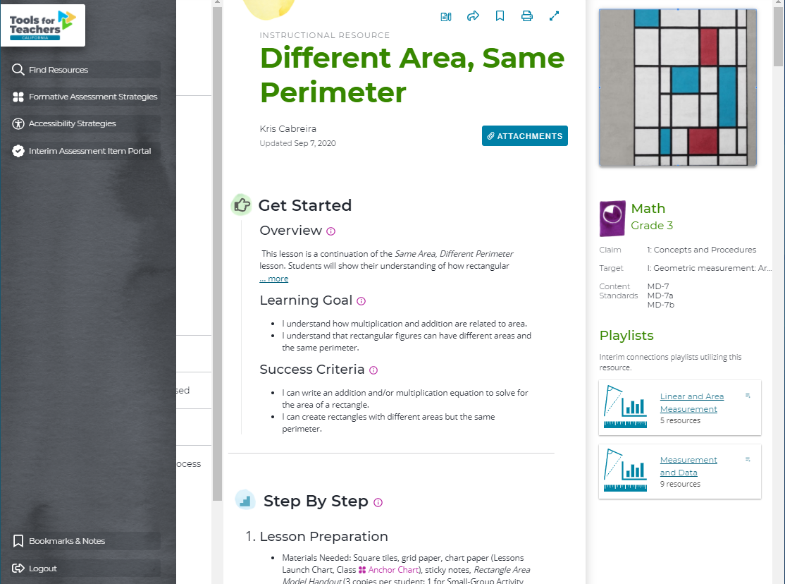
Bookmark
Print
Expand Toggle Reading Mode
Share
Take notes
Embedded Instructional strategies for differentiating student needs
Notes:
At the top of the page, you have 5 different icons.
You can take notes, share, bookmark, print, and expand to toggle reading mode.
More importantly, each resources contains embedded instructional strategies for differentiating student needs (purple hyperlinks).

Slide 14
Shared practice
Collect data using the FIABs or IABs (single subject)
Analyze the Data using CERS – find areas for growth
Make instructional decisions – within CERS, instructional resources are linked directly to Tools for Teachers. It directs you to the connection playlist with resources specific to the items addressed within the assessment
Plan instruction using the Connections Playlist
Reflect- Pre to post test growth?
Notes:
You can use connection playlists in conjunction with the IABs as they can help you identify gaps in student learning and make decisions about their next steps for instruction.
After administering an IAB, you can go into CERS to look at your data.
You ‘re able to view connection playlists that are specific to items addressed within the assessment.
The next slide shows you how to find the playlist specific to the items addressed in the IAB.

Slide 15
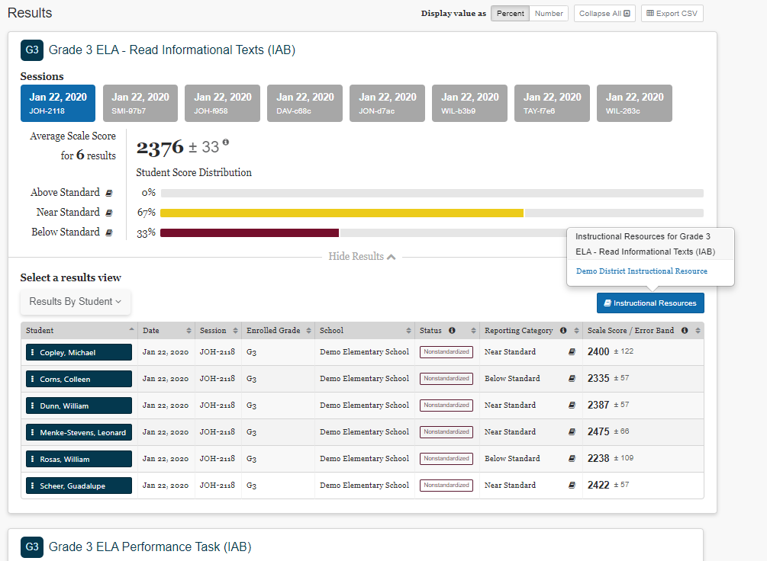
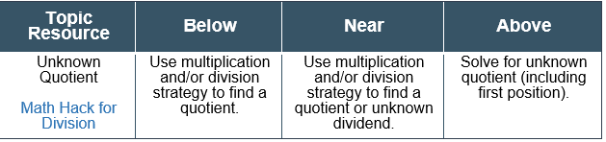
Cers
The Instructional Resources link will redirect you to resources specific to items addressed within the assessment
Notes:
After administering and IAB, to get to the playlists, select Instructional Resources or you can also select the mini textbook icons next to each level.
The instructional resources link will redirect you to the Tools for Teachers site.
Each resources is designed to help with all 3 levels (below standard, near standard, and above standard).

Slide 16
Grand Opening
September 30, 2020
Currently have access if you have set up your TOMS log in credentials
Additional resources to be released on opening day
Future – K-2 Resources
K-5 Elementary Science Resources - COMING SOON!
Notes:
Tools for Teachers is currently available, but on Sept. 30th additional resources will be released.
Elementary science resources will be published very soon (awaiting approval). We will notify you as soon as they are available.
The goal is to provide K-2 resources in the future.

Slide 17
Additional Resources
Support Remote Teaching and Learning - Smarter Balanced*
2020 Back to School Assessment Playbook*
Guidance on Diagnostic and Formative Assessments
Interim Connections Playlist Overview
Tools for Teachers Overview
Link to CDE Formative Assessment in Action Video Series
Notes:
Here are a few links you may want to explore.
Smarter Balanced made available the support remote teaching and learning website which contains tools and suggestions for supporting and advancing distance learning.
Ex. resources to use during synchronous and asynchronous time, an accessibility strategies guide for remote teaching, interim assessments item viewer
They also released the Back to School Assessment Playbook, which describes how educators can use all the resources Smarter Balanced made available. This resource is meant to guide educators during this time to better understand and meet student needs.

Slide 18
Thank you
Notes:
The best way for you to familiarize yourself with the resources Tools for Teachers has to offer is to play around and navigate the site when you have some time.

