Slide 1

Credit Sheets:
How to track your progress…

Slide 2
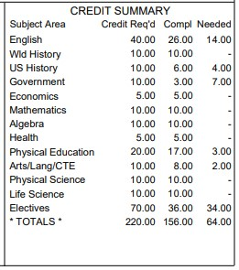
Credit Summary
Each of your transcripts has a credit summary box in the bottom right corner. This box shows what is required, what you have completed, and what you need to complete for graduation. It looks like this:

Slide 3

Credit Summary boxes can’t always be trusted…
Math doesn’t always feed in right
Sometimes it doesn’t know what is first
and what is second semester
Your Grad Status screen in Aeries is also
often incorrect. See Urabe with questions!

Slide 4
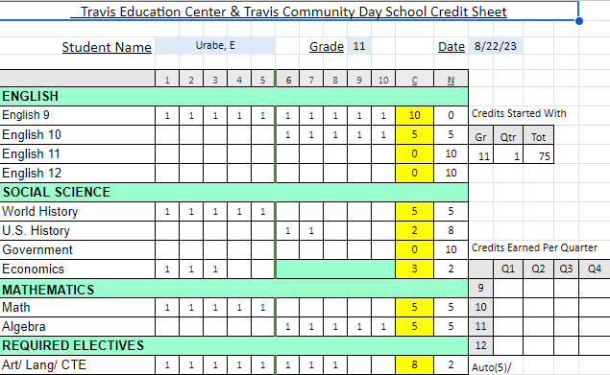
Credit Sheets let you track your progress:
Top of Credit Sheet:

Slide 5
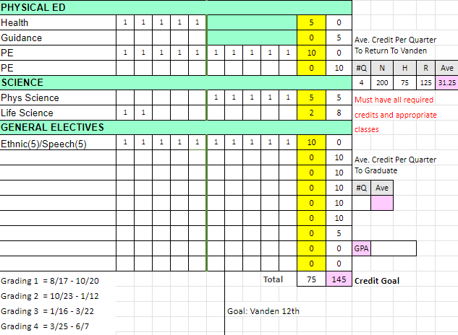
continued…
Bottom of Credit Sheet:

Slide 6
When do I Earn Credits?
Approximately every 2 weeks you have the opportunity to earn 1 credit
At Progress Reports, you should have at least 2 credits in each class (except Guidance)
You can find the dates for the end of each quarter on your Credit Sheet. Here are all the dates:
Q1 Progress Report - Sept. 22 End of Q1 - October 20
Q2 Progress Report - December 1 End of Q2 - January 12
Q3 Progress Report - February 23 End of Q3 - March 22
Q4 Progress Report - May 3 End of Q4 - June 7

Slide 7
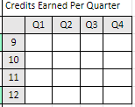

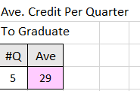
Other Helpful Information:
Track your credits by quarter: 2. Know how many credits you need to
return to Vanden:
3. Know how many credits you need to graduate:

Slide 8
What can my GPA do for me?
At TEC, our main focus is credits, but your GPA can help with:
A higher GPA can make you more marketable to employers.
Most insurance providers offer up to a 25% discount for a 3.0 or higher GPA.
A higher GPA can get you scholarships - free money you don’t have to pay back!
How to calculate your GPA: A = 4, B = 3, C = 2, D = 1, F = 0
Add up your grades and divide by the number of classes to get your grade point average

Slide 9

Things to Know…
Make sure you have completed the Voluntary Placement Agreement and given it to Mrs. Urabe whether or not you plan to return to Vanden.
There is a Goal listed at the bottom of your credit sheet. Please make sure to check this and let Mrs. Urabe know if your goal changes - if I don’t know what you want to do, I can’t help you do it.
Use your Credit Sheet with Aeries Gradebook to mark off your credits when you earn them. Mrs. Urabe does not update Credit Sheets until grades are posted on the transcript.
You have 32.5 credits available to you each quarter -
be sure to earn them all!

