Slide 1
FINANCIAL AID 101
2024 – 2025
FAFSA & Financial aid
Notes:
Introduction

Slide 2
What is Financial Aid
Financial aid includes all funding to help you pay for college, such as:
GRANTS
SCHOLARSHIPS
FEDERAL WORK STUDY
STUDENT LOANS
You have to complete the Free Application for Federal Student Aid, known as the FAFSA, to be eligible for most forms of financial aid.

Slide 3
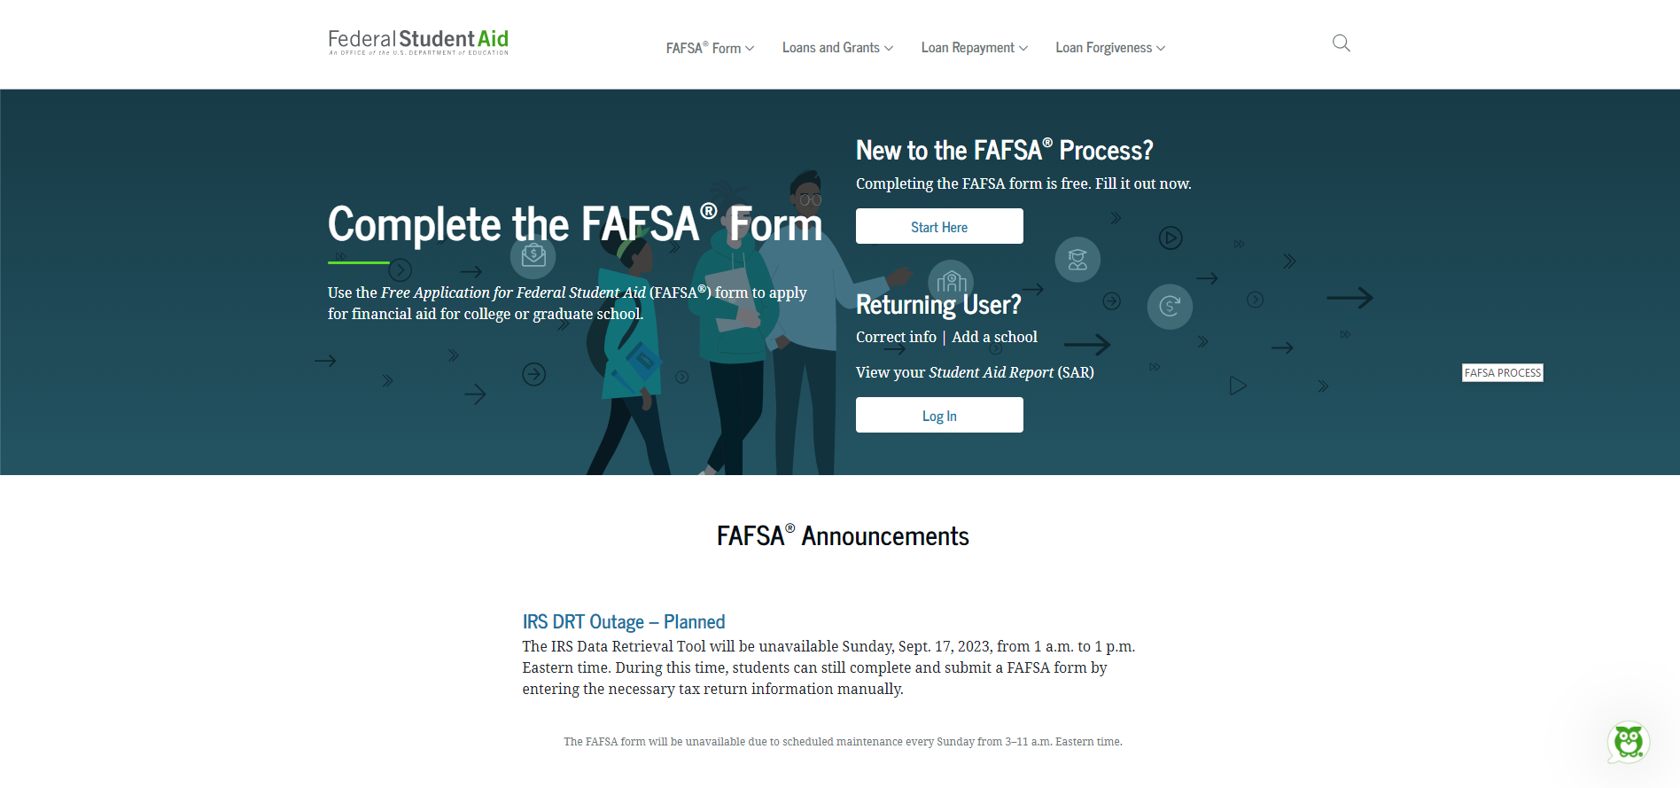
FAFSA PROCESS
StudentAid.gov

Slide 4


FAFSA PROCESS
FAFSA® Form
Notes:
Due to the FAFSA Simplification Act that is in it’s final implementation, the 2024-25 FAFSA will not open on October 1 like it has in the past, they anticipate that it will open on December 23rd. I am unaware of how many of you follow politics, however, due to the climate in Washington, if there is a shut-down, as long as it is less than 10 days we should not have any issues.

Slide 5
FAFSA PROCESS
What’s Changing?
2024-2025 FAFSA completion date
  Normally the FAFSA becomes available October 1st each year, but the 2024-2025 FAFSA will be available December 23.
The term “EFC” (expected family contribution) is changing
  With the 2024-2025 FAFSA, the term Expected Family Contribution (EFC) will be replaced with the Student Aid Index (SAI) – this is a new need analysis formula that we will use when awarding need-based grants and scholarships.
Streamlined application
  You’ll notice fewer questions when completing the 2024-2025 FAFSA and an easier way to transfer tax information directly from the IRS.
  Direct data share with the IRS will replace what is currently known as the IRS Data Retrieval Tool (DRT).
Notes:
The number of questions on the FAFSA went from over 120 down to about 50.

Slide 6
FAFSA PROCESS
New Terminology
Contributor: anyone who is asked to provide information on the FAFSA – student, student spouse, parent(s), and stepparent(s) for example.
Consent: each contributor will now need to provide their consent to their Federal Tax Information (FTI) being included in the FAFSA, even if they did not file a U.S. tax return.
NOTE: If any contributor does not provide their consent the Student Aid Index (SAI) will not be calculated, and we will not be able to determine your eligibility for financial aid.
FTI: Federal Tax Information (FTI) transferred directly from the IRS.

Slide 7
FAFSA PROCESS
Changes to FAFSA
The Department will use data received directly from the IRS to calculate a student’s SAI and Pell Grant award through a secure method – Direct Data Exchange
  Requires consent to use tax information for federal student aid eligibility and includes filing status, nontax filers must also consent.
  For students whose parents are divorced or separated, the Custodial Parent on your FAFSA will be the parent who provides you with the most financial support and will no longer be the parent with whom you lived with the most over the past 12 months.
Family size has changed to align with the number of individuals reported as dependents on the applicant’s (if independent) or applicant’s parents’ (if dependent) U.S. tax return.
  The number of family members in college is no longer a factor in the need analysis.

Slide 8

FAFSA PROCESS
Number in College
EFC
SAI
Family of 5 with 2 in college, EFC $3,000
Each Child has EFC of $1,500
Increase Federal and need based aid
Family of 5 with 2 in college, SAI $3,000
Each Child has SAI of $3,000
Decrease Federal and need based aid

Slide 9
FAFSA PROCESS
Changes to FAFSA
Assets now include the annual amount of child support received (previously included as income in the EFC formula). The recipient of the child support will be asked to report the amount received in the last complete calendar year.
The net worth of a business is no longer limited to those with more than 100 full-time employees. Applicants will be asked to report the net worth of all businesses, regardless of the size of the business.
Net worth of a farm now includes the value of a family farm. However, the value of a family’s primary residence is still excluded. The net worth of a farm may include the fair market value of land, buildings, livestock, unharvested crops, and machinery actively used in investment farms or agricultural or commercial activities, minus any debts held against those assets.

Slide 10
FINANCIAL NEED
COST OF ATTENDANCE (COA) – (billed and miscellaneous non-billed expenses)
SAI – Student Aid Index, this is a new need analysis formula that we will use when awarding need-based grants and scholarships
FINANCIAL NEED - Financial need is the difference between COA and your ability to pay (SAI). COA will vary from school to school while the SAI does not
Need Based Aid – Pell Grant, Work Study, Subsidized Loans, certain scholarships & State aid
Federal and State grants are based off the SAI number while subsidized loans and need based scholarships are determined by the financial need (COA minus SAI)

Slide 11
FEDERAL AID
Federal Pell Grant
Federal Supplemental Educational Opportunity Grant (FSEOG)
Teacher Education Assistance for College and Higher Education (TEACH) Grant
Federal Work-Study (FWS)
Federal Direct Student Loans (Direct Loans)
Iraq Afghanistan Service Grant (IASG)
Federal PLUS Loans

Slide 12
GRANTS
PELL : awarded to high-need, eligible undergraduates
Maximum currently for 23/24 is $7,395
SEOG: need based – high need students priority on a first-come, first-served basis
  Awards vary from $100 - $4,000
  Based on availability of funding
Maximum award based on packaging policy and available funds

Slide 13

FEDERAL WORK STUDY (FWS)
Eligibility based on need, available funding and school policies
Allows student to earn money to help pay educational costs
Paycheck
Employment may be on or off-campus (per school policies)

Slide 14

FEDERAL STUDENT LOANS
DIRECT STUDENT LOANS: Annual loan limits for dependent students
Subsidized: Based on need, 0% interest while enrolled at least half time
Unsubsidized: Not based on need, interest accrues at time of disbursement on the amount disbursed, not the entire loan
$5,500 for 1st year undergraduates
  $3,500 maximum subsidized
$6,500 for 2nd year undergraduates
  $4,500 maximum subsidized
$7,500 for 3rd & 4th year undergraduates
  $5,500 maximum subsidized
2023-2024 Interest Rates:
  5.5 % for Subsidized & Unsubsidized

Slide 15
FEDERAL STUDENT LOANS
DIRECT PLUS LOANS
Parent of dependent student
Requires credit check
Award up to COA
Additional unsubsidized loan for adverse credit history
2023-2024 Interest Rates:
  8.05% Parent PLUS loan

Slide 16
FEDERAL STUDENT LOANS
Student is borrower – no cosigner or credit check
No repayment required while in school at least 6 credit hours
6 month grace period after graduation or if drop below ½ time status
Repayment period between 10 and 30 years depending on repayment plan chosen
Deferment and cancellation provisions available
Loan origination fees: 1.057% for loans first disbursed on or after Oct. 1, 2020
  An origination fee is a percentage of your loan amount charged by the Dept. of Ed. for the processing of your loan
  You’re responsible for repaying the entire amount you borrowed and not just the amount you received
  Example: $5,500 unsubsidized loan = $5,442 disbursed

Slide 17
STATE AID - OHIO
Ohio College Opportunity Grant (OCOG)
Nurse Education Assistance Loan Program (NEALP)
Ohio Safety Officers College Memorial Fund
Ohio War Orphan & Severely Disabled Veterans
Ohio National Guard Scholarship
Choose Ohio First (COF)

Slide 18
STATE AID - OHIO
OCOG : Demonstrate highest levels of need
COF: STEMM programs
NEALP : Student enrolled in an approved Ohio nurse education program - $1,650/year
Ohio Safety Officers/War Orphans : Tuition assistance to child or spouse of an officer or service member killed in line of duty or severely disable veteran
Ohio National Guard : Current members of Ohio Army & Air National Guard

Slide 19

SCHOLARSHIPS
Need Based
  Based on financial need
Merit Based
  Based on specific abilities (athletics, academics, extra curricular activities)
Other
  Not based need or merit. Can be awarded based on interests, demographics

Slide 20

SCHOLARSHIPS
Institutional Scholarships
Foundation Scholarships
Local businesses and civic organizations
Places of employment (student and parent)
Don’t pay for scholarship searches/applications
Start early! Applications deadlines and procedures vary depending on source of aid

Slide 21
EMPLOYERS
May have scholarships available
to the children of employees
May have educational benefits for their employees

Slide 22
PRIVATE SOURCES
Scholarships - Foundations, businesses, churches, civic, and charitable organizations
Loans - Private Lenders, banks, state agencies, county foundations
Deadlines and applications procedures vary
Begin researching private sources early

Slide 23
TIPS: MAKING DECISIONS
Never decline aid you don’t understand
Know whether or not aid is guaranteed through program
Consider Federal Loans before private ones, as these offer fixed interest rates and guaranteed benefits
If applicable, shop around for private loan lenders
Consider the long term costs of borrowing

Slide 24

2024 - 2025 FAFSA FORM
Opens December 23, 2023
The 2024-2025 FAFSA form is for students going to college from July 1, 2024 through June 30, 2025.

