Slide 1

Third-Grade Guarantee Goal:
Ensuring All Students Can Read
Notes:
Talking Points:
-The goal of the TGRG is: That all Ohio students can read at a proficient level by the end of the third grade.
-The purpose is to give greater emphasis to reading instruction and intervention in the early grades.
-Through this initiative, our teachers will diagnose reading deficiencies in students at grades kindergarten through three, create individualized Reading Improvement and Monitoring Plans and provide research-based reading interventions to meet this goal.

Slide 2
Senate Bill 316
Administer reading diagnostics to all K-3 students by Sept. 30 each year
Develop individualized Reading Improvement and Monitoring Plans for students deemed “not on-track” (not reading at grade level)
Provide early intervention and support in reading for at risk students at grades K-3
Notes:
Talking Points:
-SB 316 created new requirements to provide more early intervention and support for literacy beginning in kindergarten, and supporting at-risk students through the third grade.
-Districts must administer reading diagnostics to all K-3 students by September 30 of each year to determine which students are on-track, and which students are not on-track to read at grade level.
-If the diagnostic assessment shows that the student is not on-track to be reading at grade level by the end of the year, schools must provide the parents, in writing:
Notice that the school has identified a reading deficiency with their child;
A description of current services provided to the student;
A description of proposed supplemental instruction services;
Notice that the Ohio Achievement Assessment for third-grade reading is not the only measure of reading competency; and
Notice that unless the student attains the appropriate level of reading competency by the end of Grade 3, the student will be retained.
-For each student shown to be not on-track, schools must:
Develop a reading improvement and monitoring plan within 60 days of learning of the reading deficiency; and
Begin reading intervention immediately using research-based reading strategies targeted at the student’s identified reading deficiencies
Beginning in the 2014-2015 school year, provide a teacher who has either passed a reading instruction test or has a reading endorsement on their teacher's license. (Both Mrs Huber and Mrs. Langhals meet this criteria)

Slide 3
Senate Bill 316
Report data results to the Department of Education
Retain 3rd grade students that do not meet the required cut score, unless the parents, teachers and administrator determines the student can move on, with intense interventions in 4th grade.
Notes:
Talking Points:
-Districts will report diagnostic assessment results to the state each year.
For the Third-Grade Reading Guarantee, districts will report only:
Which students are on-track and not-on-track for reading; and
What types of intervention services are given to each student.
For the Third-Grade Reading Guarantee, students remain in their on or off track status for the entire school year.
The reading diagnostic results are not required to be submitted or posted by September 30, 2014.

Slide 4
Third Grade Reading Guarantee
In the 2022-23 school year, all students scoring below 690 on Ohio’s Third Grade test for English Language Arts must be retained, except for the following students:
  Special education students whose IEPs exempt them;
  Students who demonstrate reading competency on an alternative reading assessment approved by ODE; and
  Any student who was previously retained in grades K-3.
Notes:
Talking Points:
Began last year. This year all students scoring below 683/700 passing on the third-grade reading, OAA must be retained, except for the following students (ORC 3313.608(A)(2)):
Limited English proficient students who have been enrolled in U.S. schools for less than two full school years and have had less than two years of instruction in an English as a Second Language program;
Special education students whose IEPs specifically exempt them from retention under the third grade guarantee;
Students who demonstrate reading competency on an alternative reading assessment approved by ODE; and
Any student who has received intensive remediation for two years and was previously retained in kindergarten through Grade 3.
A student that advances because of this exception must continue to receive intensive reading instruction in the fourth grade, which requires an altered instructional day to accommodate reading interventions, or whatever reading interventions are required by the student’s IEP or 504 plan.

Slide 5
If your child did not pass the 3rd grade ELA state test, he/she is at risk for not passing high school end of course assessment, which can impact graduation.

Slide 6
5 Main Components of Reading
Phonics- connection between sound and letter symbols
Phonemic Awareness- words are created from phonemes (small units of sound in language)
Vocabulary- words have meanings
Fluency- Ability to read with speed, accuracy and expression.
Comprehension- understanding what the text is about.

Slide 7
Diagnostic Assessments
Grades K-4 – Phonological awareness, phonics, high frequency word fluency, vocabulary and comprehension of literary text and informational text.

Slide 8

Reading Improvement and Monitoring Plan
All Reading Improvement and Monitoring Plans must be created within 60 days of when a student is designated not on-track.
  Identify student’ s specific reading deficiency
  Describe supplemental instruction services
  Involve parents and guardians
  Monitor plan’s implementation
  Provide reading curriculum that assists students to read at grade level
  State risk of retention in 3rd grade.
Notes:
Remediation services selected for students on a reading improvement and monitoring plan are based on the judgment of the student’s teacher and parents.
Services must be “research-based reading strategies that have been shown to be successful in improving reading among low-performing readers”
All reading improvement and monitoring plans must be created within 60 days of when a student is designated not on-track. It shall include:
Identification of the student’s specific reading deficiency;
A description of proposed supplemental instruction services that will target the student’s identified reading deficiencies;
Opportunities for the student’s parents or guardians to be involved in the instructional services;
A process to monitor the implementation of the student’s instructional services;
A reading curriculum during regular school hours that assists students to read at grade level, provides for reliable assessments, and provides ongoing analysis of each student’s reading progress; and
A statement that unless the student attains the appropriate level of reading competency by the end of Grade 3, the student will be retained.

Slide 9
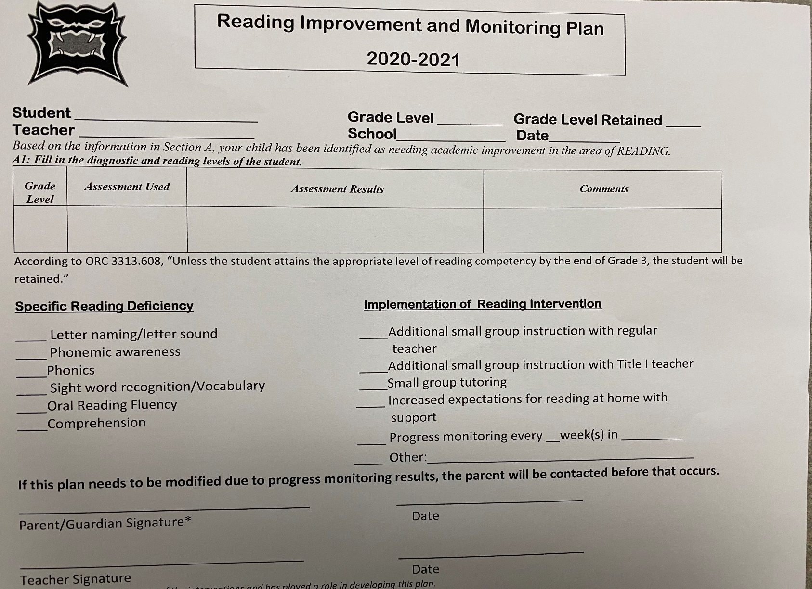
RIMP

Slide 10
Interventions
Orton Gillingham- Tier 1 to ALL students in grades K-2, targeted skills in small groups in grades K-4 as needed
Heggerty- phonological awareness skills- Tier 1 to ALL students in grades K-2, targeted skills in small groups as needed.
Repeated Reading/Guided Reading: Grades K - 4 provided by the teachers during Intervention/Enrichment

Slide 11
Why is fluency important?
Fluency is the reader’s ability to read with speed, accuracy and expression.
Develops automaticity- helps a reader to move quickly through the text so they can develop the meaning of the text.
Appropriate expression and phrasing helps the reader understand the text.

Slide 12
What Can Parents Do at Home to ensure their children are on track to success?

Slide 13

“The more you read, the more things you will know. The more that you learn, the more places you'll go.”
^{- Dr. Seuss}
Notes:
“The more you read, the more things you will know. The more that you learn, the more places you'll go.”
- Dr. Seuss, "I Can Read With My Eyes Shut!"

Slide 14
Support fluency practice with weekly or bi-monthly passages
-time for speed and accuracy
-model for expression
Notes:
Your child’s teacher will meet with you to discuss this specific support you can provide at home.

Slide 15
Read to your child- model good reading
Listen to your child read
Ask them to retell
Make predictions
Make connections
Support Reading Counts Program
Notes:
It’s important to continue reading all summer long..
We have to have all of our testing done by the end of September and we spend time determining whether students have a critical need for interventions or whether they are just rusty from not having read during the summer.
That then takes time away from moving them ahead farther ahead.

