Slide 1
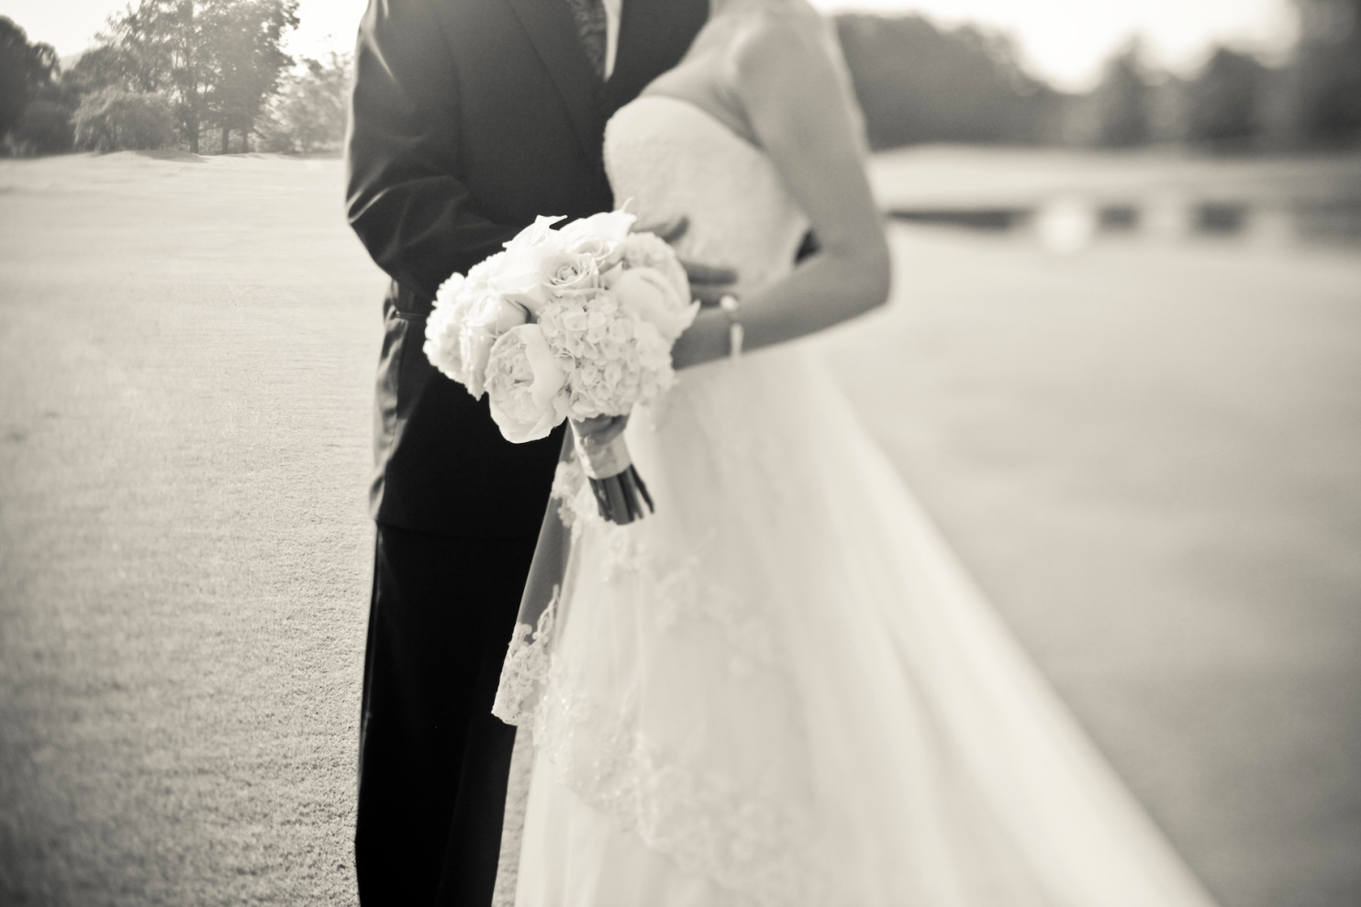
Wedding Flower Portfolio

Slide 2





Wedding Details
Season: Summer wedding (July 15th @4pm)
Color Scheme: Pinks, lime green, and white
Style: Traditional/formal
Event Description: Church with reception at nearby park.

Slide 3
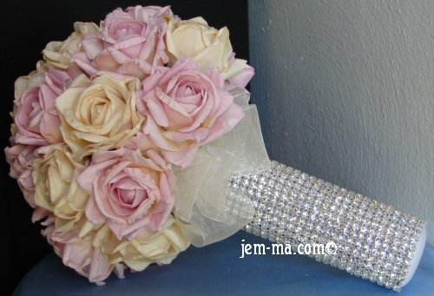
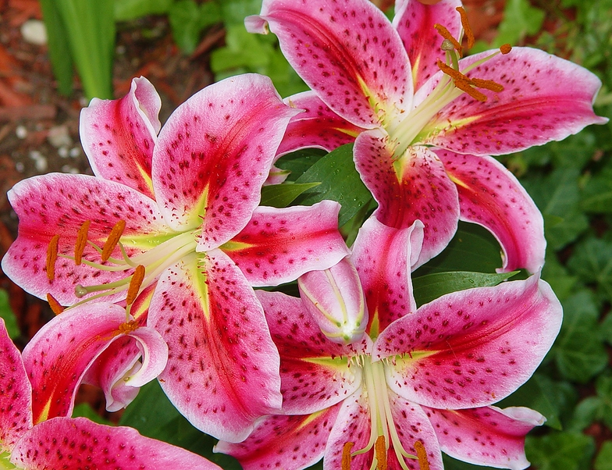
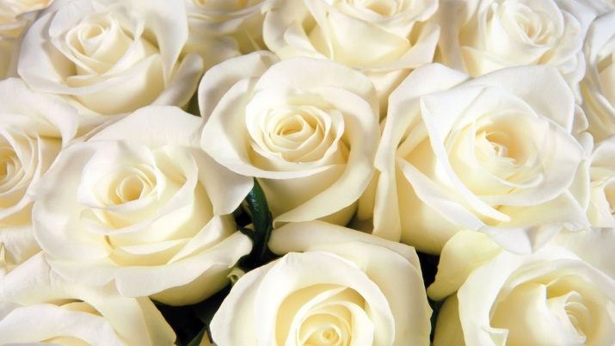
Bridal Bouquet
Traditional
Look with holder
Bright pink stargazer lilies & white roses
Item | Quantity
Stargazer Lilies | 1 bunch
White Roses | 15 stems
Ivy | 1 bunch
Bear Grass | 1 bunch
Salal | 2 bunches

Slide 4
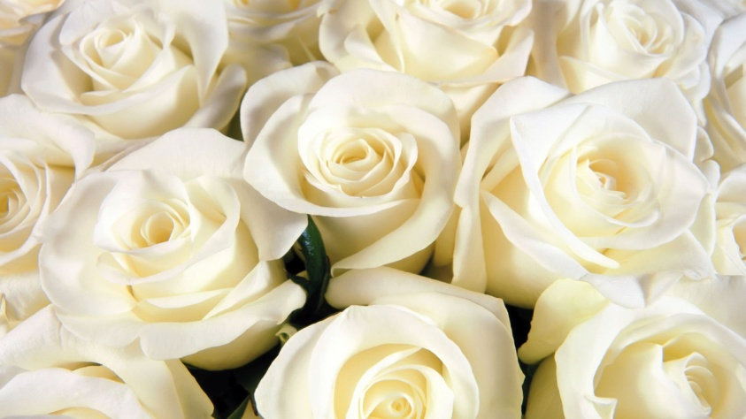
Bridesmaids/Maid of Honor Bouquets
3 bouquets similar to the brides, yet smaller versions.
Item | Quantity
Stargazer Lilies | 2 bunches
White Roses | 20 stems
Ivy | 2 bunches
Bear Grass | 2 bunches
Salal | 4 bunches
Flower girl throws real petals, ring bearer pillow with lace.

Slide 5
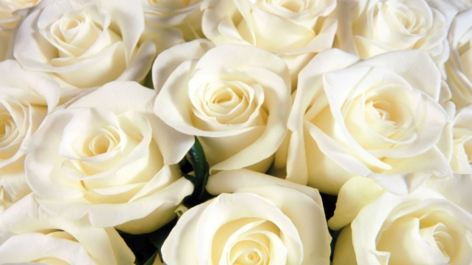
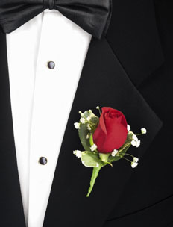
Boutonnieres
14 boutonnieres in total. (With an extra)
White roses with salal and bear grass.
1 Groomsmen
1 Best Man
1 Male Singer
2 Dads
4 Grandpas
4 Ushers
Item | Quantity
White Roses | 14 stems
Salal | 1 bunch
Bear Grass | 1 bunch
Bout. Pins | 14

Slide 6
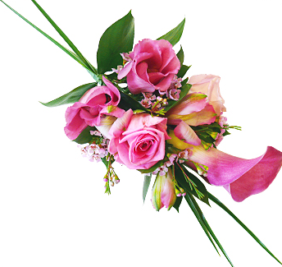
Corsages
15 corsages in total. (With an extra)
Stargazer lilies with salal and bear grass.
1 Maid of Honor(wrist)
1 Singer(pin)
1 Pianist(pin)
2 Bridesmaids(wrist)
2 Moms(wrist)
2 Aunts(wrist)
4 Grandmas(pin)
Item | Quantity
Wristlets | 7
Corsage Pins | 7
Stargazer Lilies | 3 bunches
Salal | 1 bunch
Bear Grass | 1 bunch
Pearl Sprays | 20

Slide 7
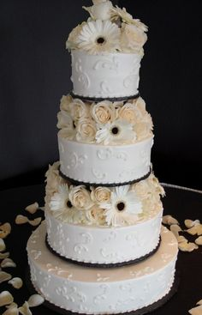
Wedding Cake
Cake is traditional with a twist, composing of real flowers, ribbon, and red velvet under everything.
Item | Quantity
1 Inch Satin Ribbon | 3 yards
White Roses | 30
Stargazer Lilies | 2 bunches

Slide 8
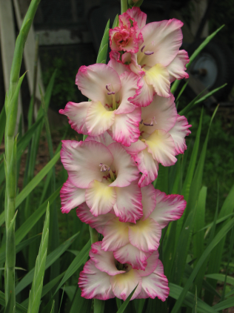
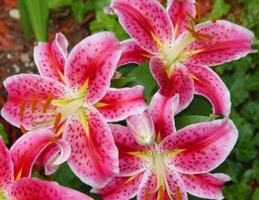
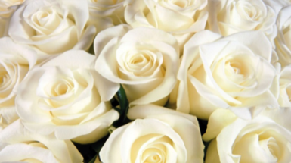
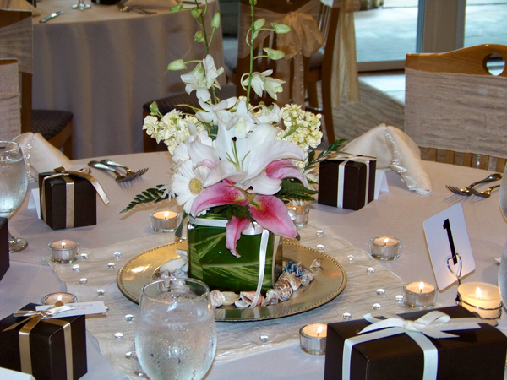
Table Centerpieces
12 tables plus 1 head table and
guest book table.
16 arrangements all together.
Using Stargazer Lilies and White Roses and pink gladiolus.
Item | Quantity
Glass bowls | 18
Marbles | 10 bags
Stargazer Lilies | 5 bunches
White Roses | 50 stems
Gladiolus | 35 stems
Salal | 4 bunches
Bear Grass | 2 bunches

Slide 9
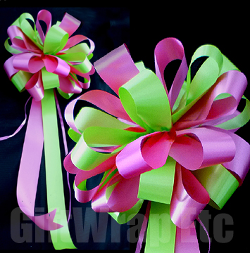
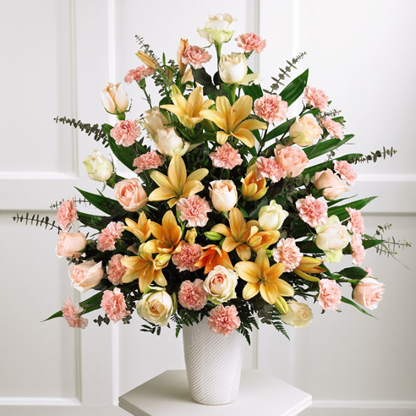
Entry, Arch, Aisles, Altar
Pink and green pew bows on first four pews starting at the altar.
(8 in all)
Stargazer lilies and white roses at altar
(carried to reception)
Item | Quantity
2 inch green & pink ribbon | 40 yards
Wire | Package
White Roses | 35 stems
Stargazer Lilies | 6 bunches
Bear Grass | 5 bunches
Salal | 10 bunches
Vases | 5

Slide 10
Fresh Cut Flower Order
Quantity | Flowers | Color | Cost
19 bunches | Stargazer Lilies | Pink | $361
164 stems | Roses | White | $144.32
35 stems | Gladiolas | Pink | $411.25
12 bunches | Bear Grass | Green | $30
22 bunches | Salal | Green | $110
3 bunches | Ivy | Green | $20.25
 |  |  | Total: $1076.82

Slide 11
Hard Goods & Supplies
Quantity | Item | Cost (each) | Total Cost
1 | Large Bouquet Holder | $50 | $50
3 | Medium Bouquet Holders | $30 | $90
1 | Flower Girls Basket | $5 | $5
1 box | Bout. Pins | $7 | $7
7 | Wristlets | $2 | $14
1 box | Corsage Pins | $7 | $7
1 box | Pearl Sprays | $10 | $10
1 roll (3 yards) | Satin Ribbon | $10 | $10
18 | Glass Bowls | $2 | $36
10 bags | Marbles | $5 | $50
4 rolls (40 yards) | Pink/Green Ribbon | $10 | $40
5 | Vases | $10 | $50
 |  |  | Total: $369

Slide 12
Complete Price List
Total: $4723.50

