Slide 1



Fairport Harbor
Exempted Village Local School District
Board of Education Planning Project Update
April 27, 2021

Slide 2
Overview of the Fairport Harbor Exempted Village School’s Planning Timeline
Existing Conditions Review
January – March 2018
Master Planning
April 2018 – December 2019
Pause in OFCC funding
2020
Finalization of Master Plan
February 2021 – April 2021

Slide 3
Since OFCC Planning Resumed…..
Winter/Spring 2021
Actively Finalizing Master Plan and “Discrete Portion” under ELP Program
Facilities Planning Committee re-convened. Formation of Educational Space Planning Group
Updated Master Plan to OFCC 2021 Cost Set
Current Co-funding Split = Local Share 7% - State Share 93%.
  Project Cost for new PK-12 approximately $41 million. Local Share approximately $3M. State Share approx. $38M.
  Bonding Cap of $5.3M (without applying for exemption)
  OFCC requires ½ mill for Maintenance Fund

Slide 4
Since OFCC Planning Resumed…..
Winter/Spring 2021
Actively Finalized Master Plan and “Discrete Portion” under ELP Program
  Discrete Portion: Build a portion of the work now until OFCC main program (CFAP) comes into play with State Share. Anticipating 2-3 years
  Participating in ELPP project NOW locks in our local share for the balance of work
  However, we only want to go to the ballot ONE time. Thus, we need to raise local share for Discrete Portion
  Consideration for inflation of future CFAP portion

Slide 5
What is the Plan?
Overall Master Plan
New PK-12 Facility
Projected Enrollment 753 students. Square foot of 115,832 SF
Building Features:
  Flexible Learning Spaces
  Recreation of Design Lab
  Expanded Library for continued partnership with the Community Library

Slide 6
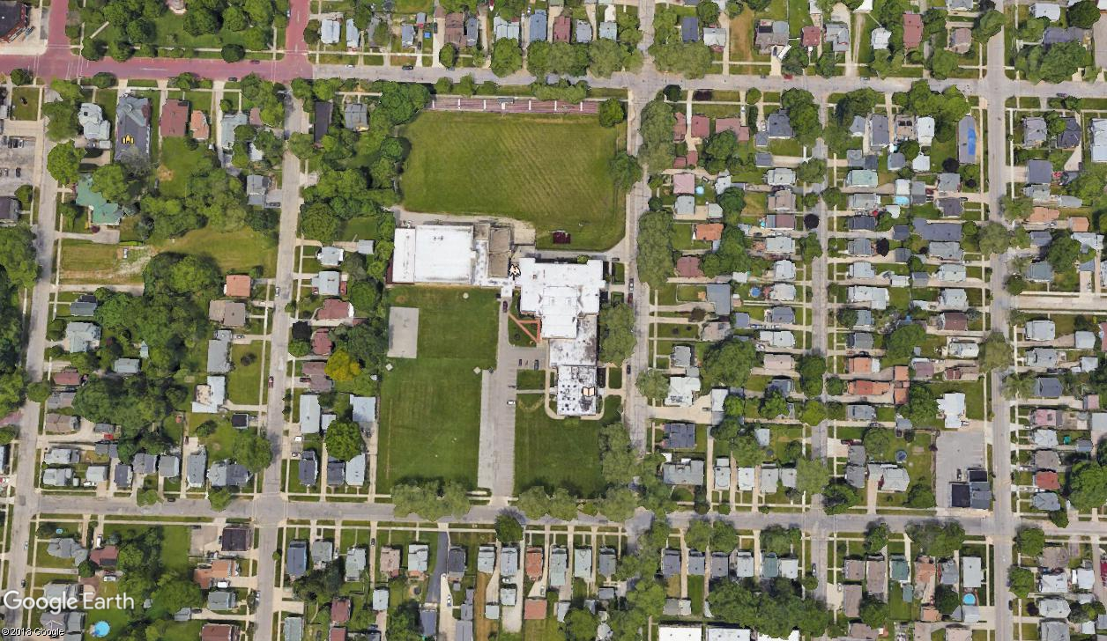
What is the Plan?
Existing Site

Slide 7
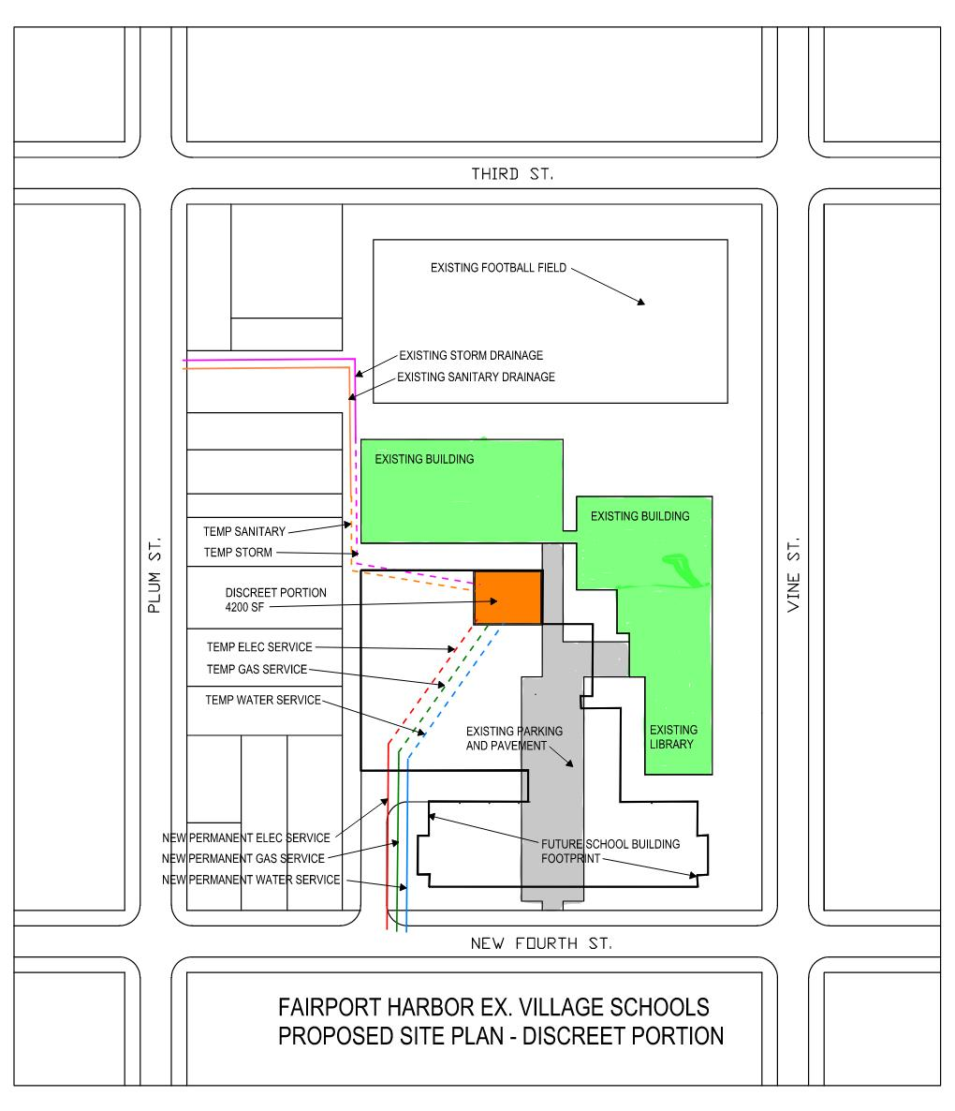
What is the Plan?
Proposed Plan

Slide 8
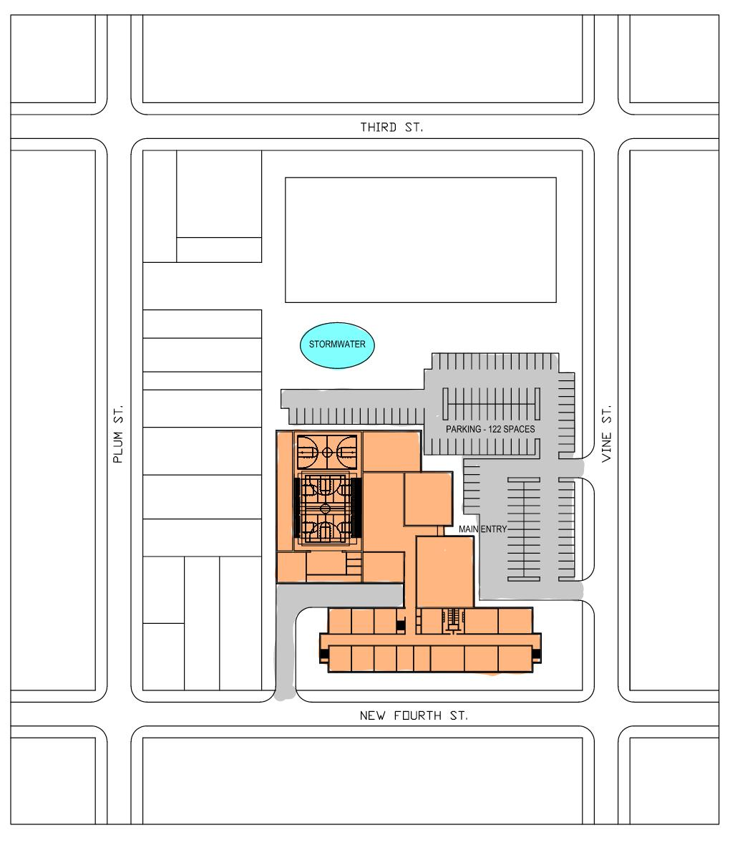
What is the Plan?
Proposed Plan

Slide 9
Overall Master Plan Recommendation – April 2021
753 Student Enrollment
New PK-12 Building – Co-funded | $41,163,092.68
Includes Demo & Abatement of McKinley & Harding Schools
Includes additional cost for infill & compaction of deep foundations at McKinley & Harding Schools
Includes Storm Shelter Allowance & Emergency Responder Systems
Locally Funded Initiatives | $706,984.83
Additional Square footage (approx. 2,000 SF) for Community Library
TOTAL PROJECT COST | $41,870,077.51
Note 1: All costs are currently being finalized. Minor adjustments may occur between now and the beginning of May when plan is formally finalized by OFCC

Slide 10
ELPP Discrete Portion Plan Recommendation – April 2021
For November 2021 Bond Issue
Construct Discrete Portion – Music Department Portion of School | $4,501,633.13
Includes approximately 4,200 SF of music department space
Includes allowance for additional SF of 4,173 SF to build at district’s discretion to secure 93% state match
Includes securing funds for LFI portion of the school (additional library space)
Includes portions of permanent utilities for entire school and some temporary to Music Building
Additional Contingency | $498,366.87
Construction Contingency for Unforeseen/Market Conditions
TOTAL ELPP Discrete Portion | $5,000,000.00
Note 1: All costs are currently being finalized. Minor adjustments may occur between now and the beginning of May when plan is formally finalized by OFCC

Slide 11
Bond Issue
Breakdown of Bond Issue
4.9 mills will generate $5,000,000 million
½ mill OFCC requirement for Maintenance Fund
Total millage = $5.4 mills
Yearly Cost to Homeowner of $100,000 value home = $$$$
Sherry – please calculate # for me to insert here – thanks!

Slide 12
Academic Benefits
Academic Benefits of a New Facility
Increased student achievement and test scores*
Better prepare students for post graduation plans
Increased educational opportunities
Improved student behavior (Case Study – North Ridgeville 3-8 Academic Center)
Increased student engagement
*Statistics derived from Yale University Study
Neilson, C. and Zimmerman, S. (2011), The Effect of School Construction on Test Scores, School Enrollment, and Home Prices

Slide 13
Security Benefits
Security Benefits of a New Facility
Secure Vestibule Entrances
Allows for proper clearance of visitors prior to gaining access into the facility
Emergency Responder Radio Coverage System
System which maintains radio communications with emergency responders during an incident
Thoughtful and purposeful design strategies to maintain corridor line of sites, reduce opportunities for bullying, promote visual observation
i.e.: Design administrative office with clear views to the entrance and street for constant visual monitoring

Slide 14

Next Steps
TDA to send POR and backup docs to Bill P. for Project Agreement by April 23rd
Bill P. to prepare ELPP Project Agreement
Early/Mid May
Board Approves Project Agreement (PA)
June 22nd & returns PA to OFCC
Bond Issue
Campaign
August - November
1st board resolution (certification) to put on ballot sent to county auditor
(May 25th)
File bond paperwork with ODE & ODT (Rick) by
July 5th
April
May
June
July
Aug
Sept
Oct
Nov
Legend:
Red = TDA Action
Yellow = OFCC Action
Orange = District Action
Green = Bond Campaign
2nd board resolution – resolution of necessity
June 22nd
TDA presents project to BOE virtually
April 27th
OFCC Controlling Board Approval of ELPP Project Agreement
September 23rd
File Project
w/County
Board of
Elections by
August 4th
OFCC Commission Approval of ELPP Project Agreement
August 19th
OFCC sends District ELPP Project Agreement
Early/Mid June

Slide 15

Q & A
Thank You!

