Slide 1

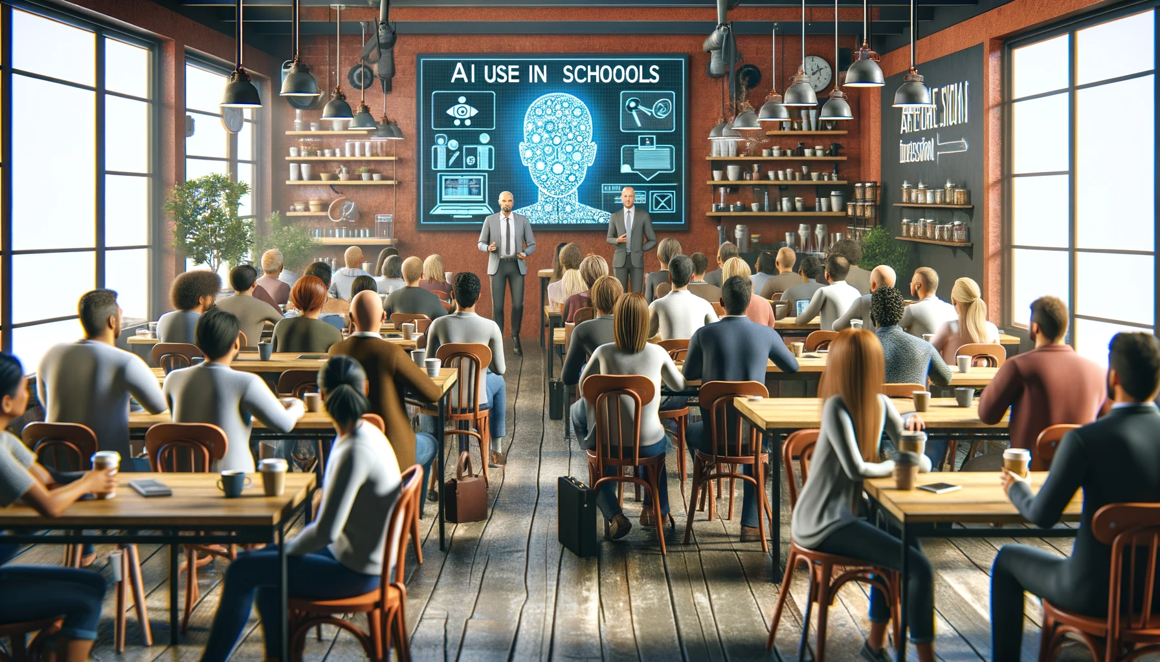
NIS A.I. Update
November 29, 2023
OpenAI. (2023). [”Parent Coffee in a Café about AI in Schools"]. Created using DALL-E on [November 26, 2023].

Slide 2
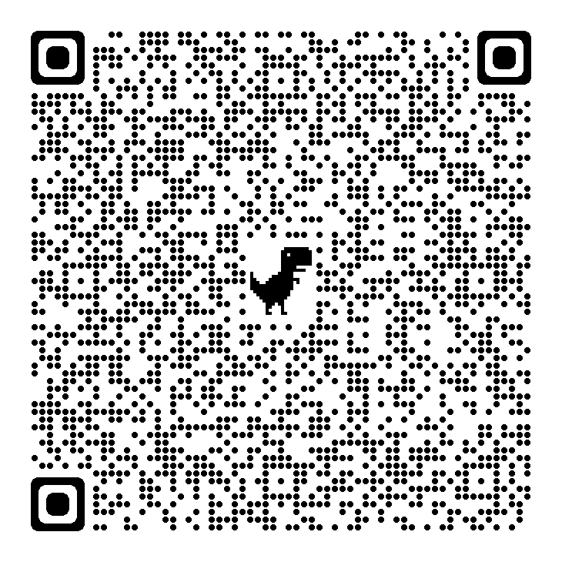
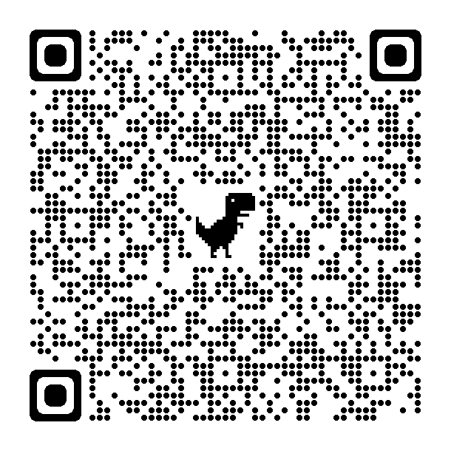
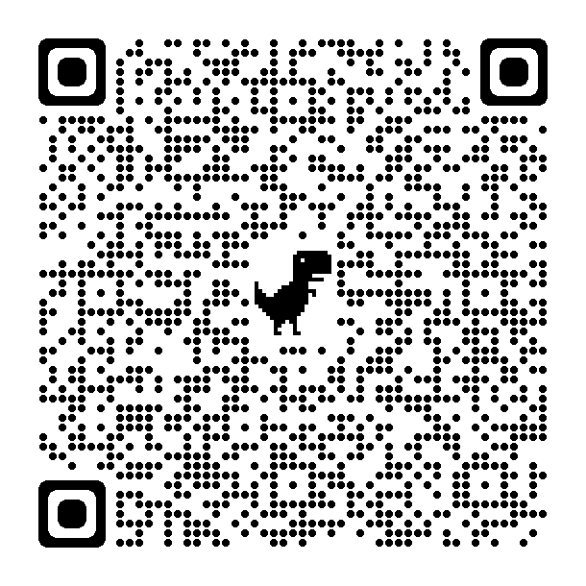
Get a copy of the slide deck
WIFI: AINIS
Password: AI@NISAI
Chinese (中文)
Korean (한국인)
English

Slide 3
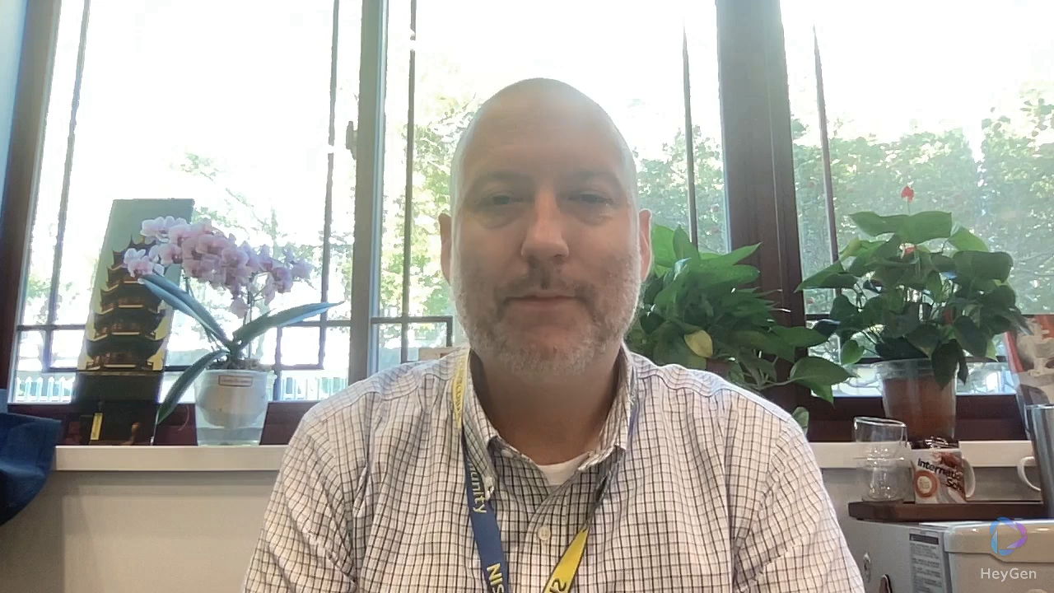

Slide 4
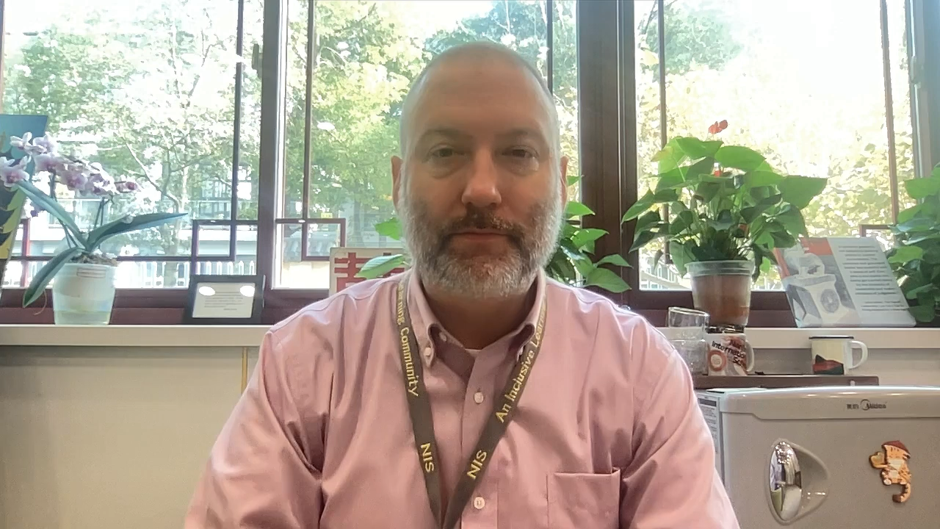
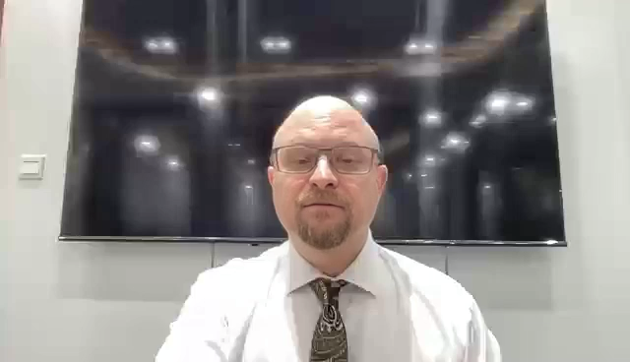

Slide 6


Slide 7
“AI won’t take our jobs, but those who can use it might.”
-Dr. Richard Baldwin

Slide 8
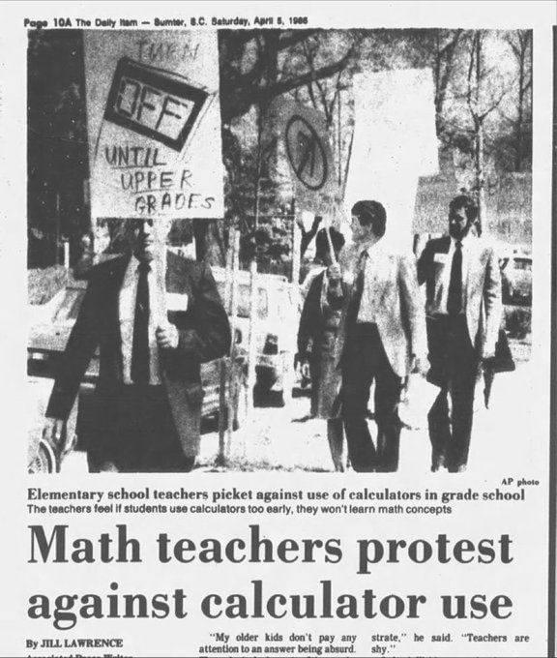
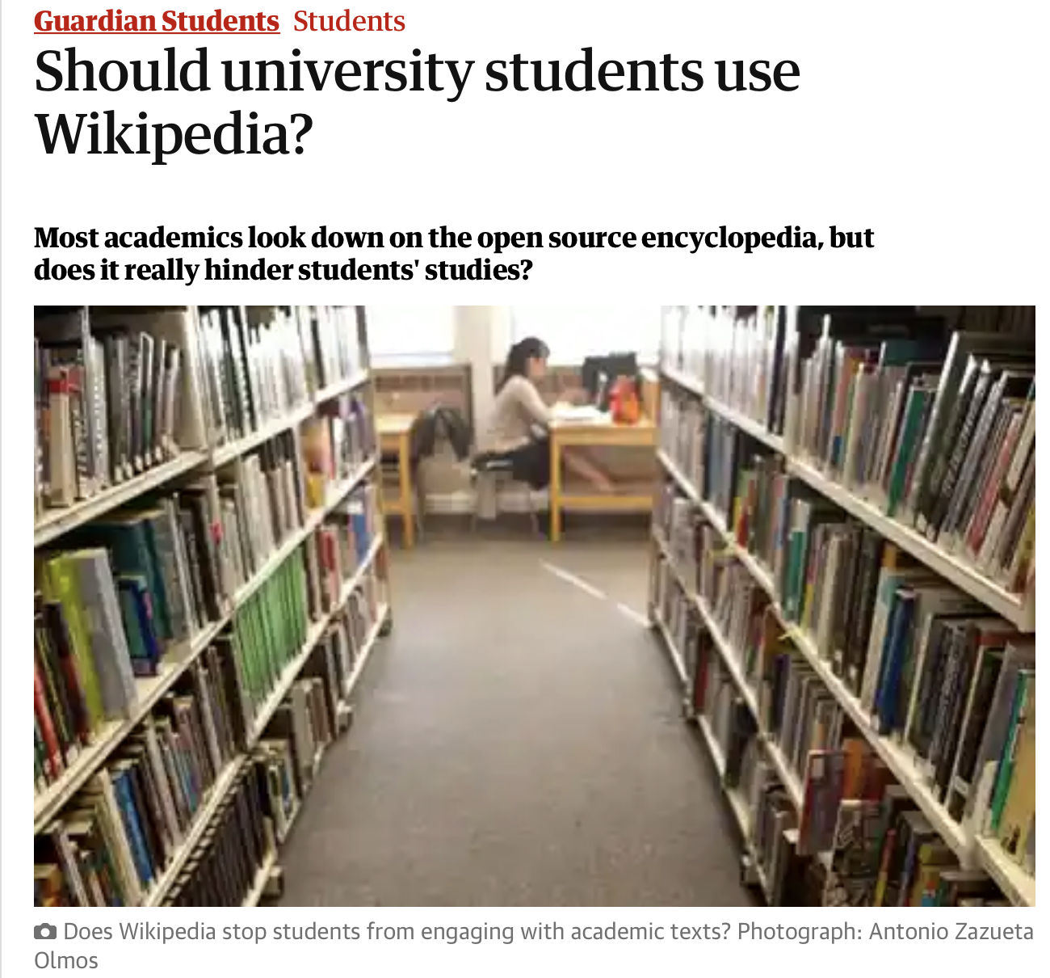
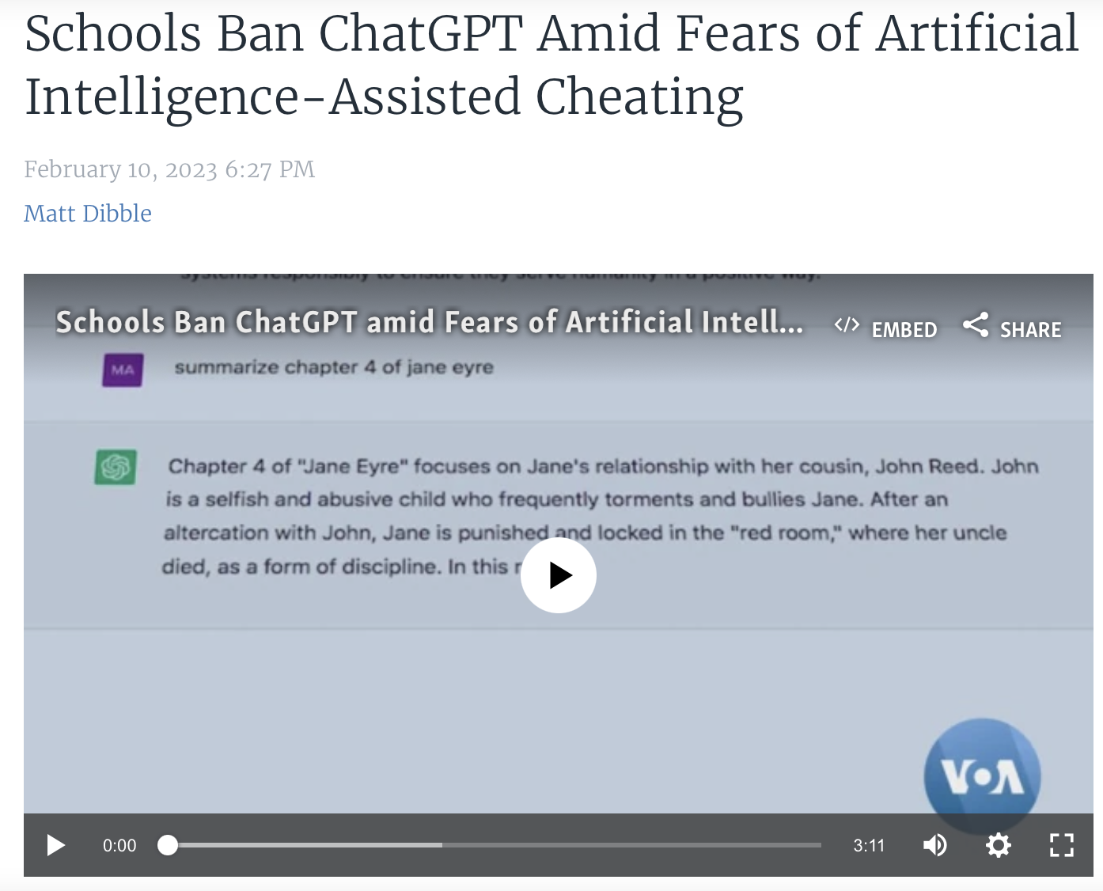
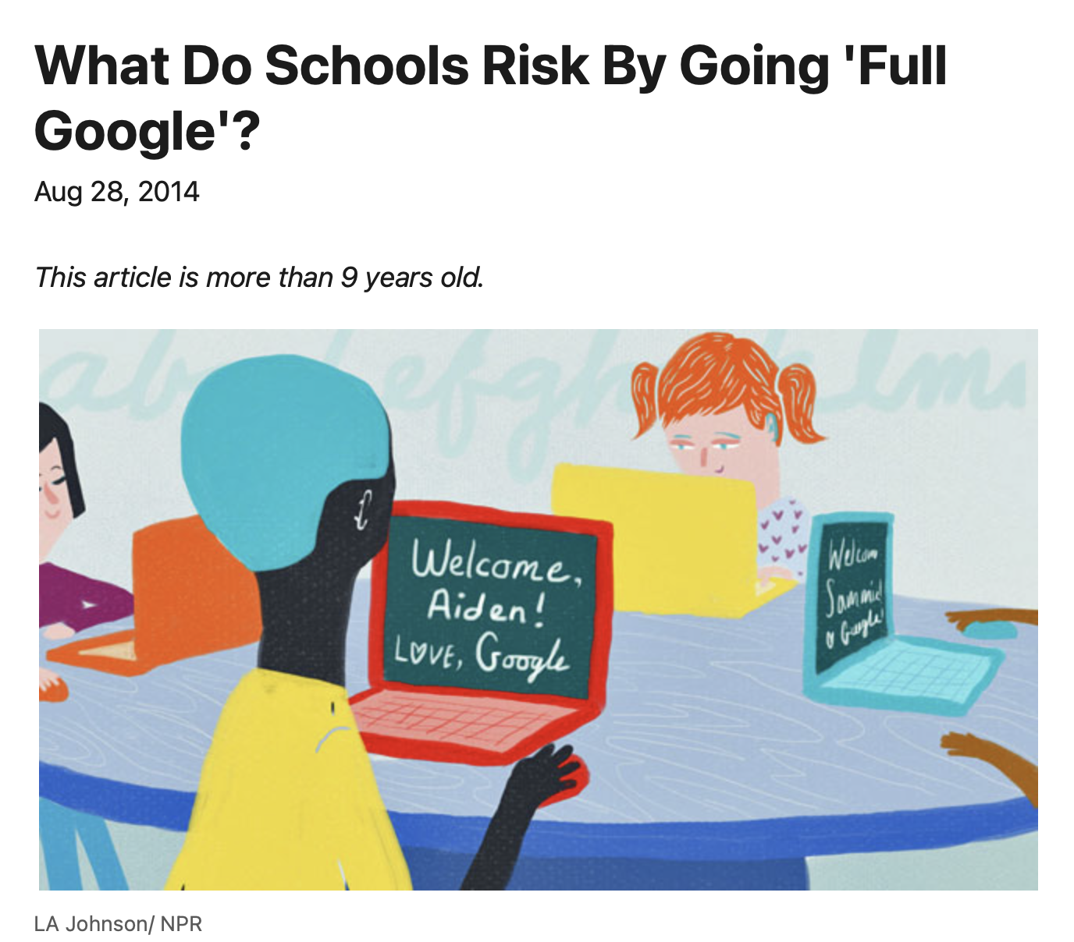
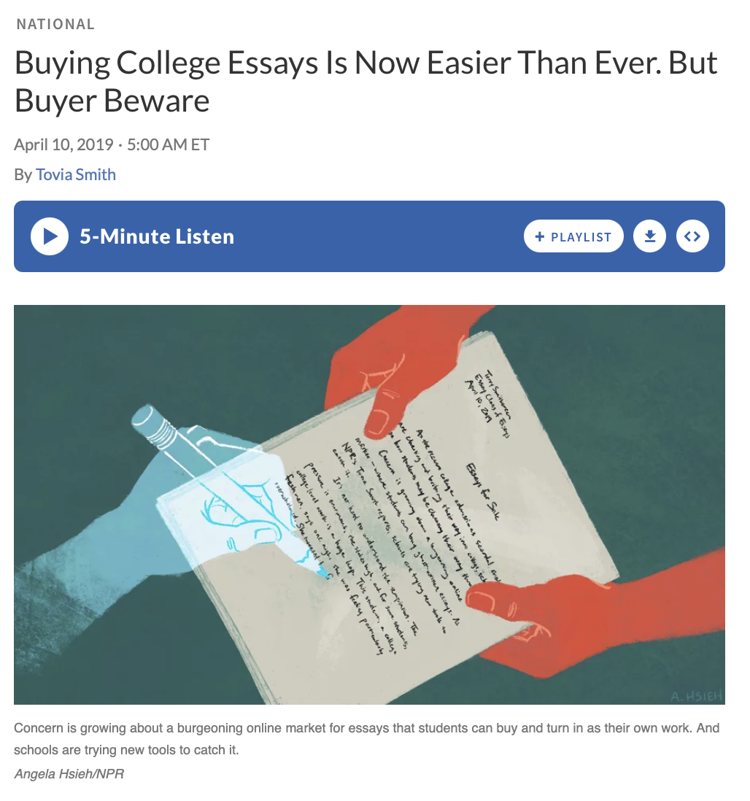

Slide 9
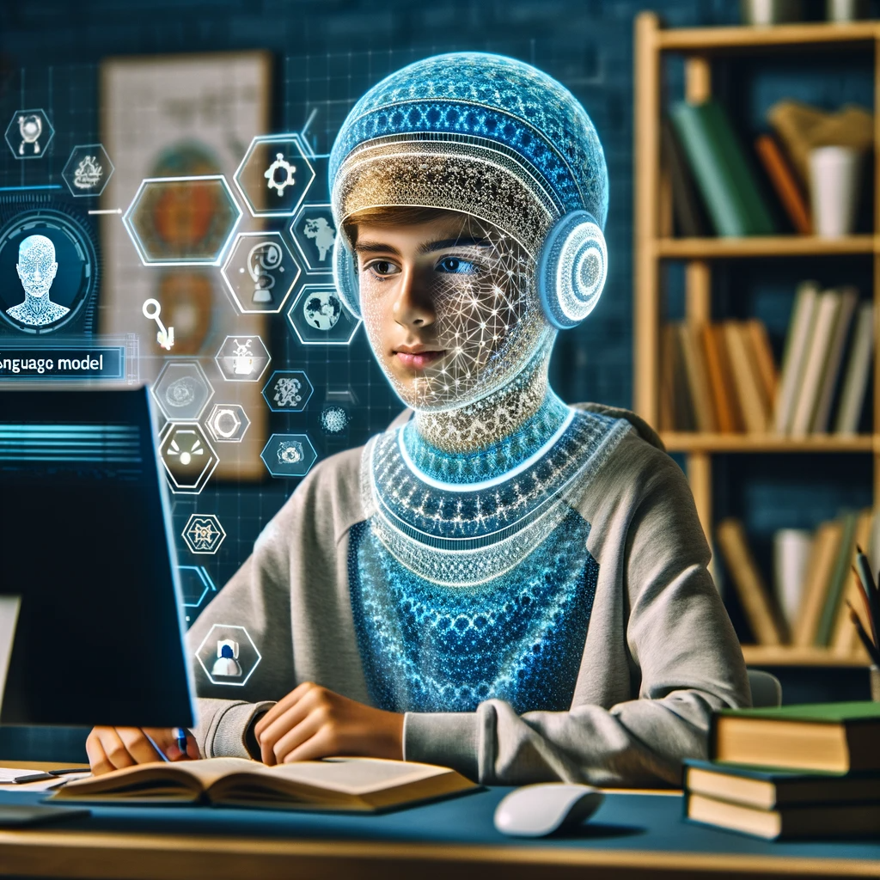
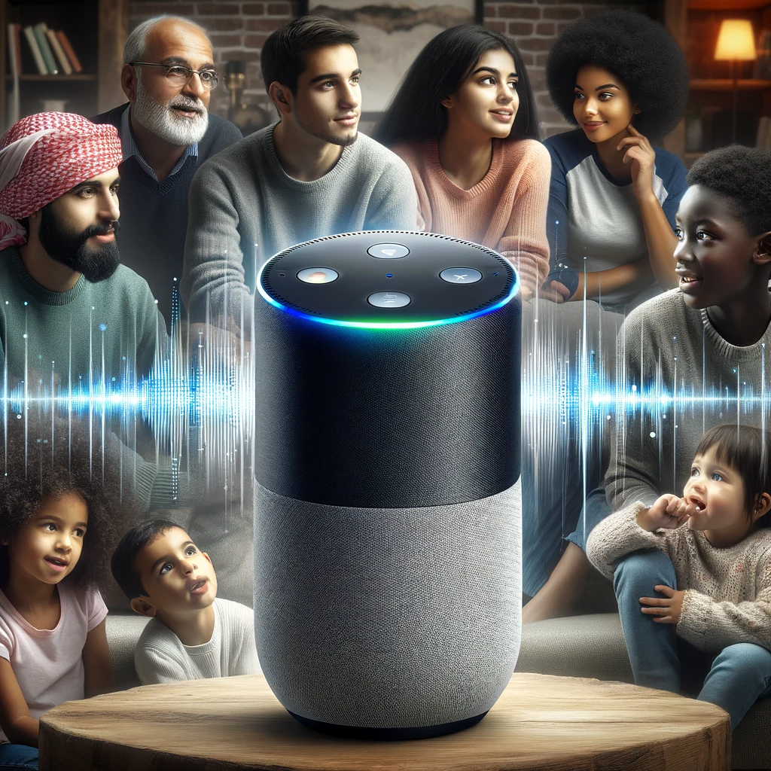



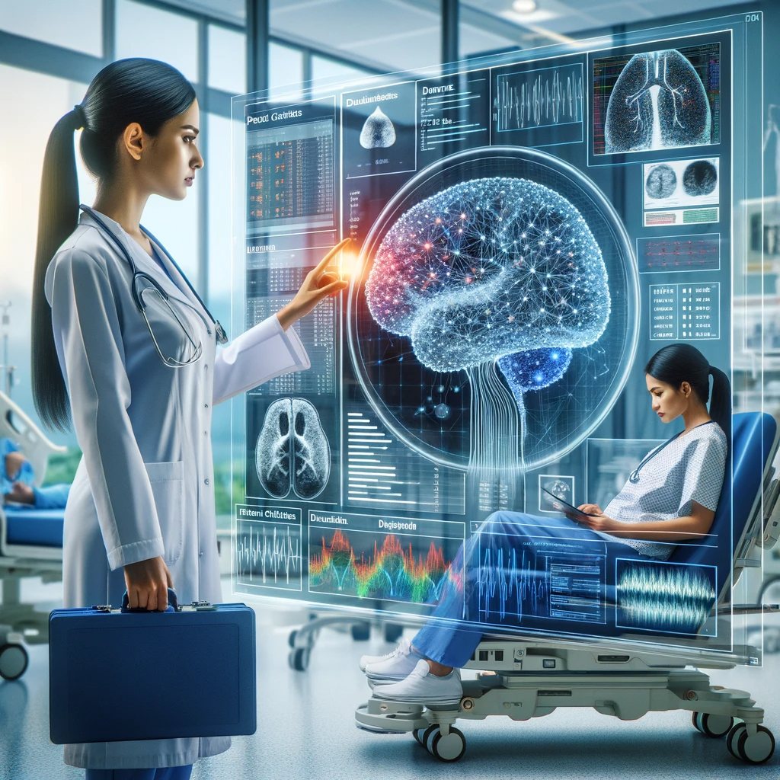
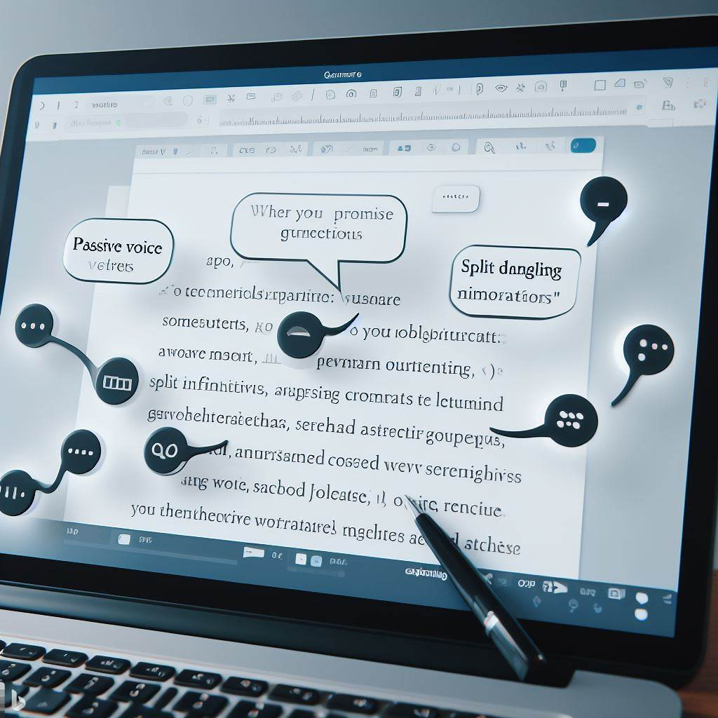
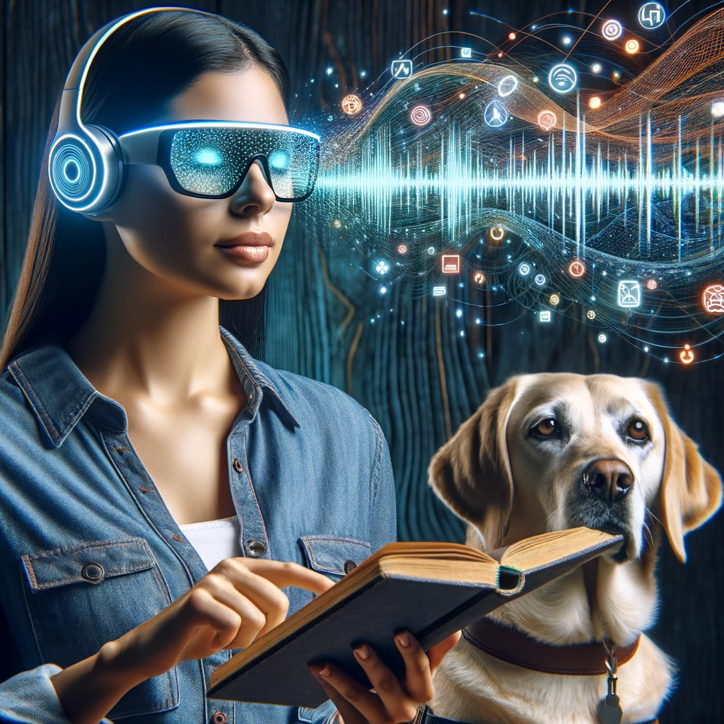
How is AI Disruption Different?
AI stands to make a more holistic and profound impact by personalizing learning, automating tasks, providing analytics, and potentially reshaping the role of educators.
All images created using Dalle-3 via ChatGPTPlus and Bing Create
Notes:
Traditional language models were limited in scope, trained on small datasets for specific tasks such as grammar correction or keyword search, using simpler algorithms like n-gram statistics.
The advent of deep learning spurred the creation of large language models (LLMs) like GPT, which employ transformer architectures capable of processing vast datasets and generating more complex, context-aware text.
LLMs offer versatility in performing diverse language tasks, from writing and summarizing to conversation and translation, without task-specific retraining.
Their ability to understand extended context and maintain textual coherence mirrors human-like interaction, enhancing applications like virtual assistants and accessibility tools.
The shift to LLMs represents a technological leap, promising economic efficiency and a transformative impact on how we use AI in natural language processing.

Slide 10
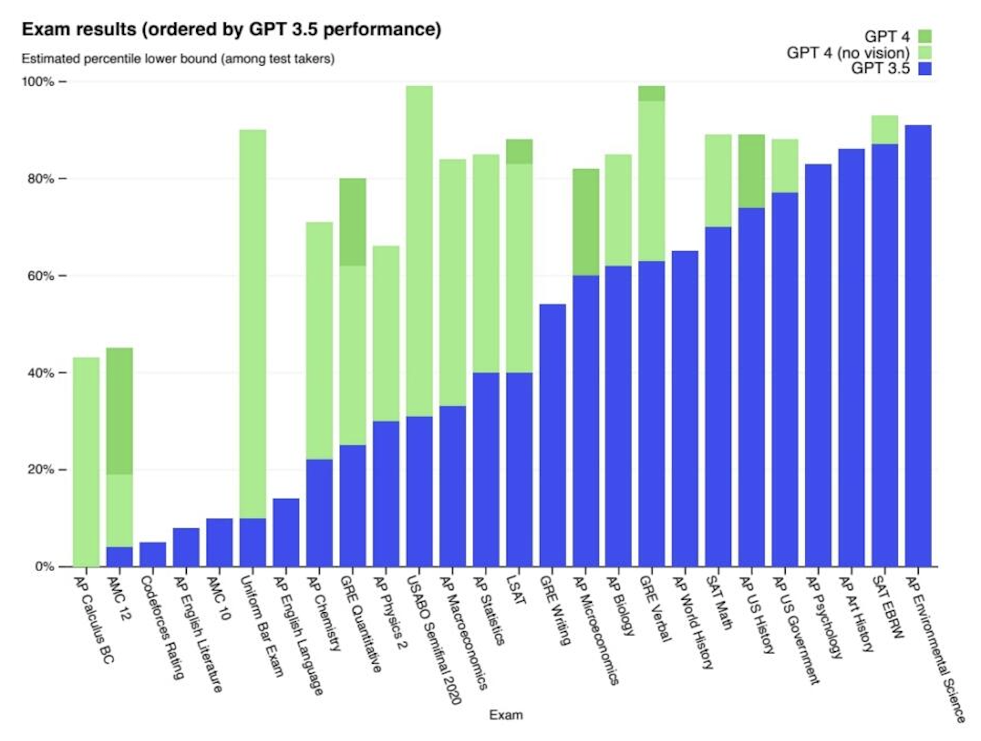
Open AI Releases Chat GPT November 30, 2022, then on March 2023

Slide 11
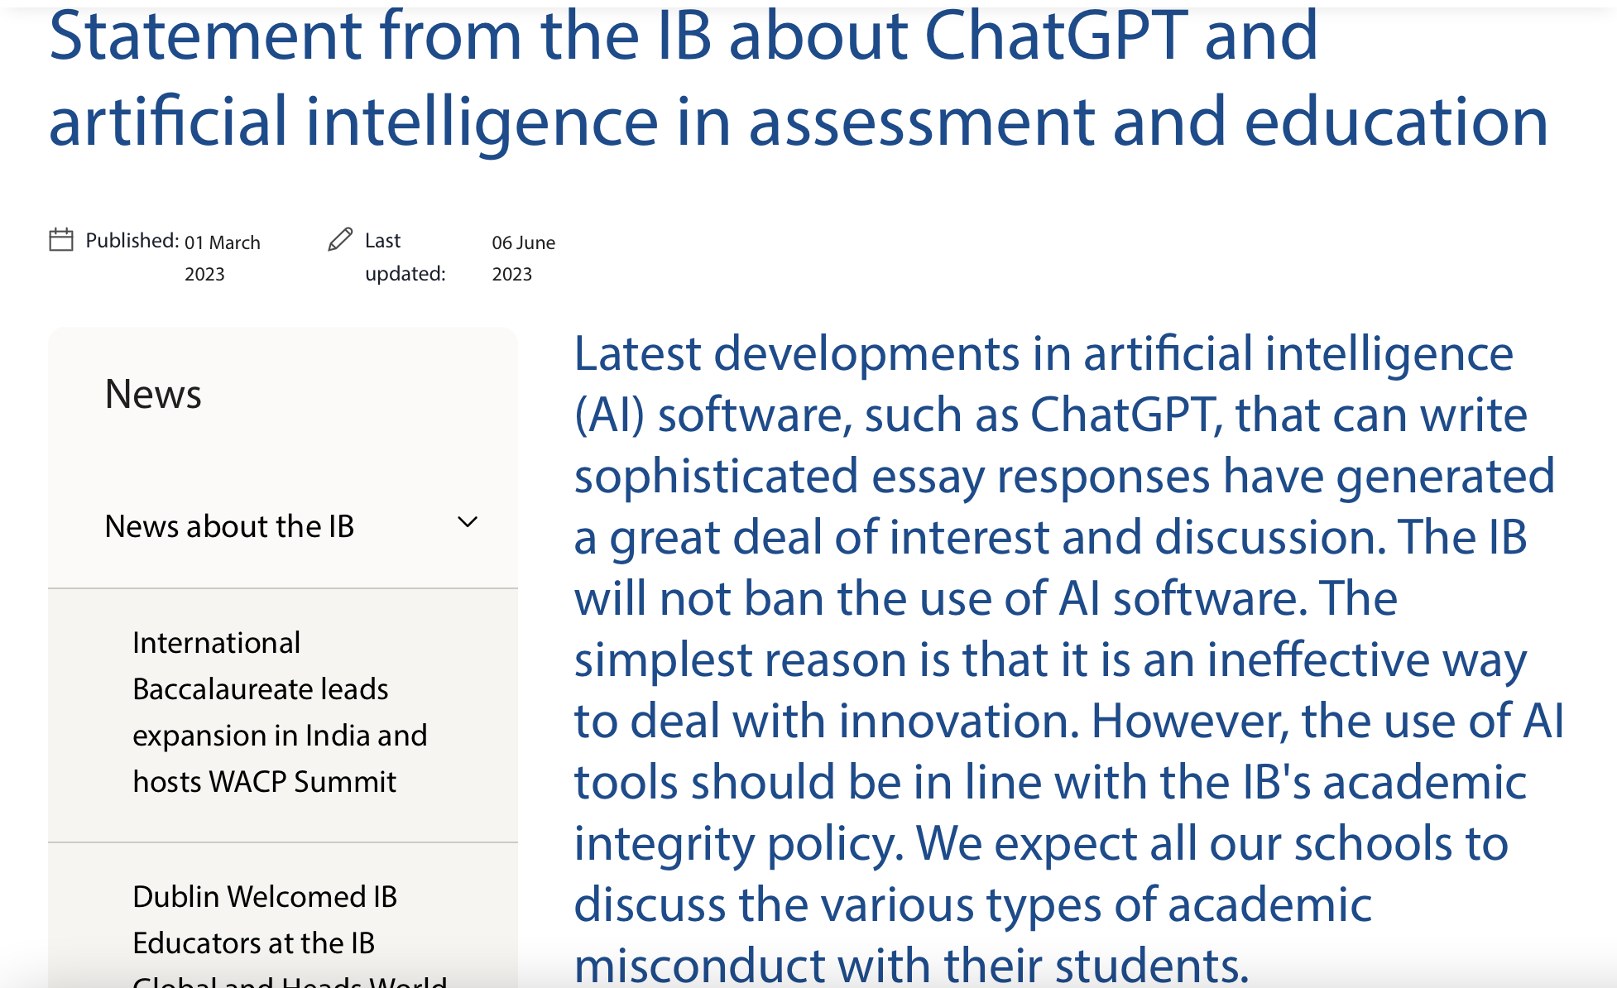
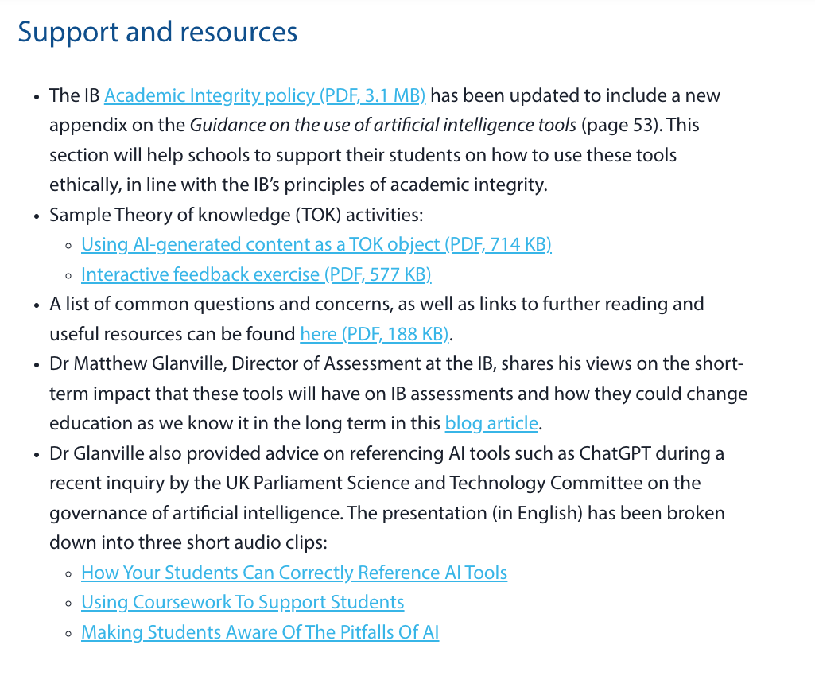
Where are we with AI?

Slide 12
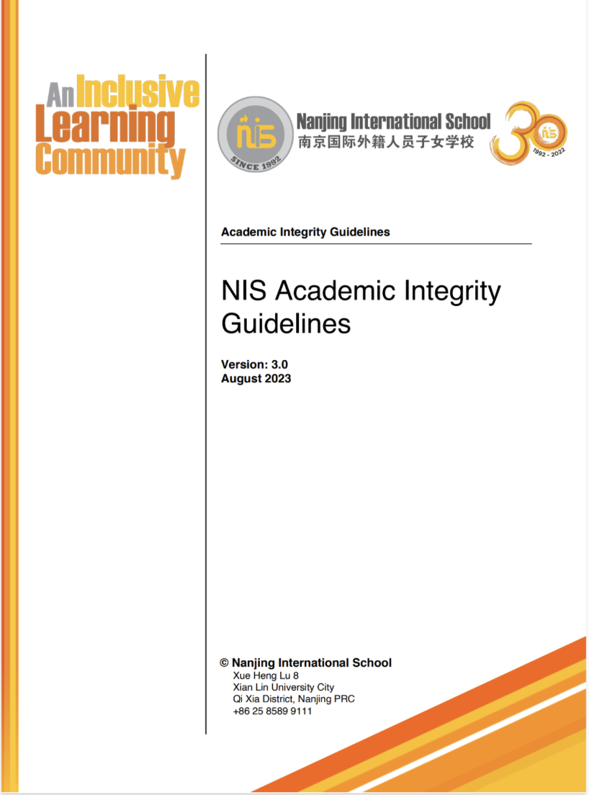
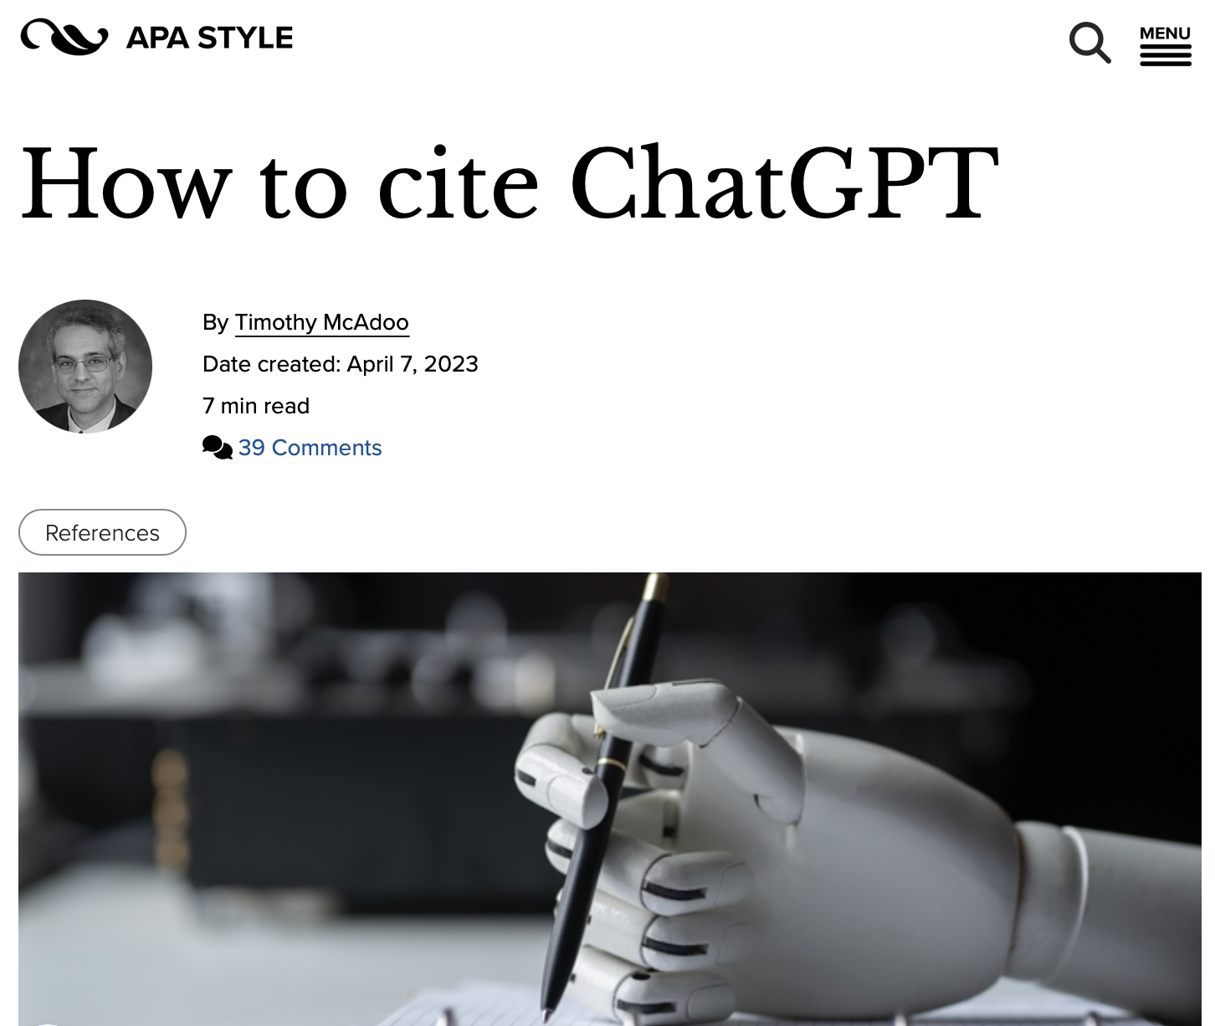
Where are we with AI?

Slide 13
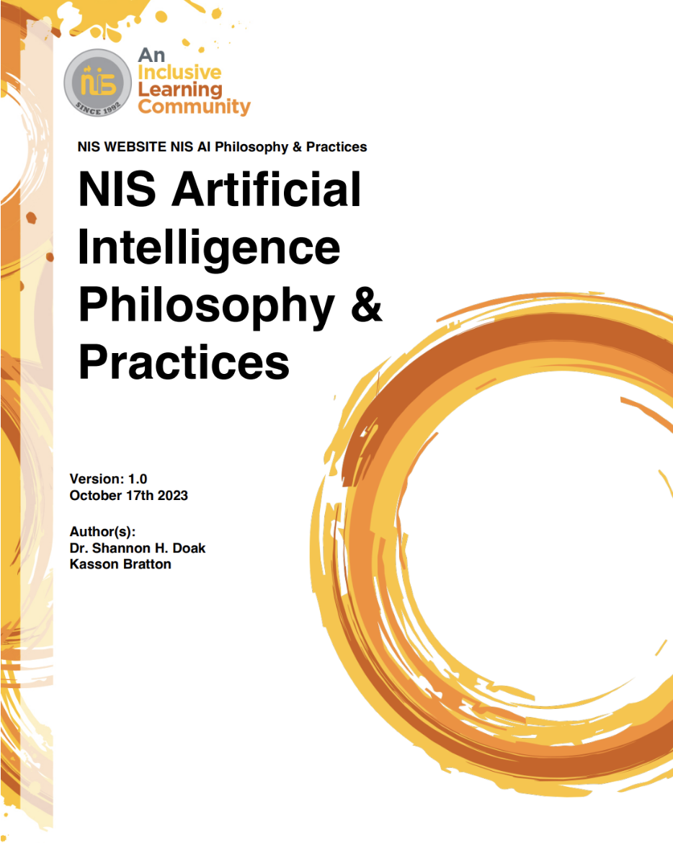
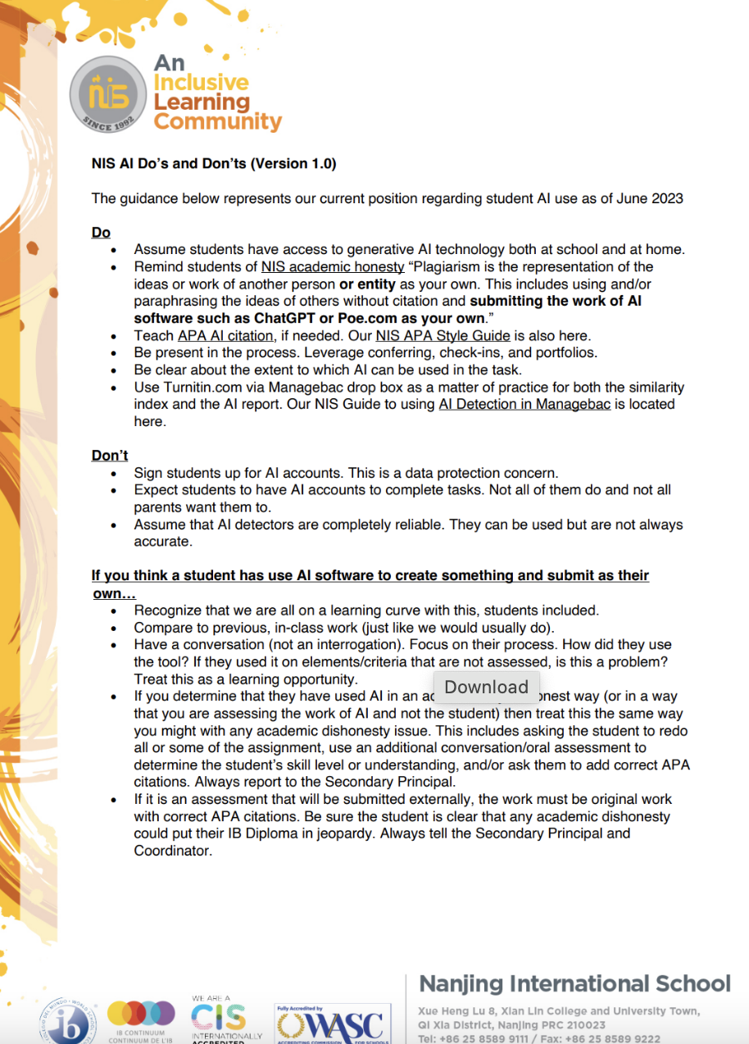
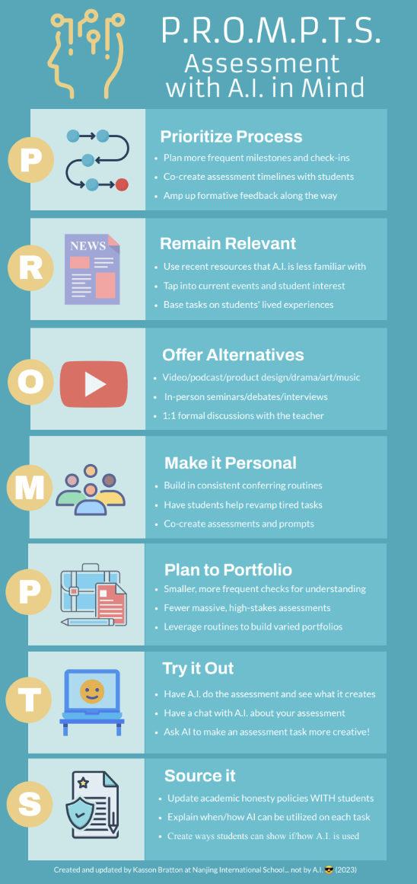
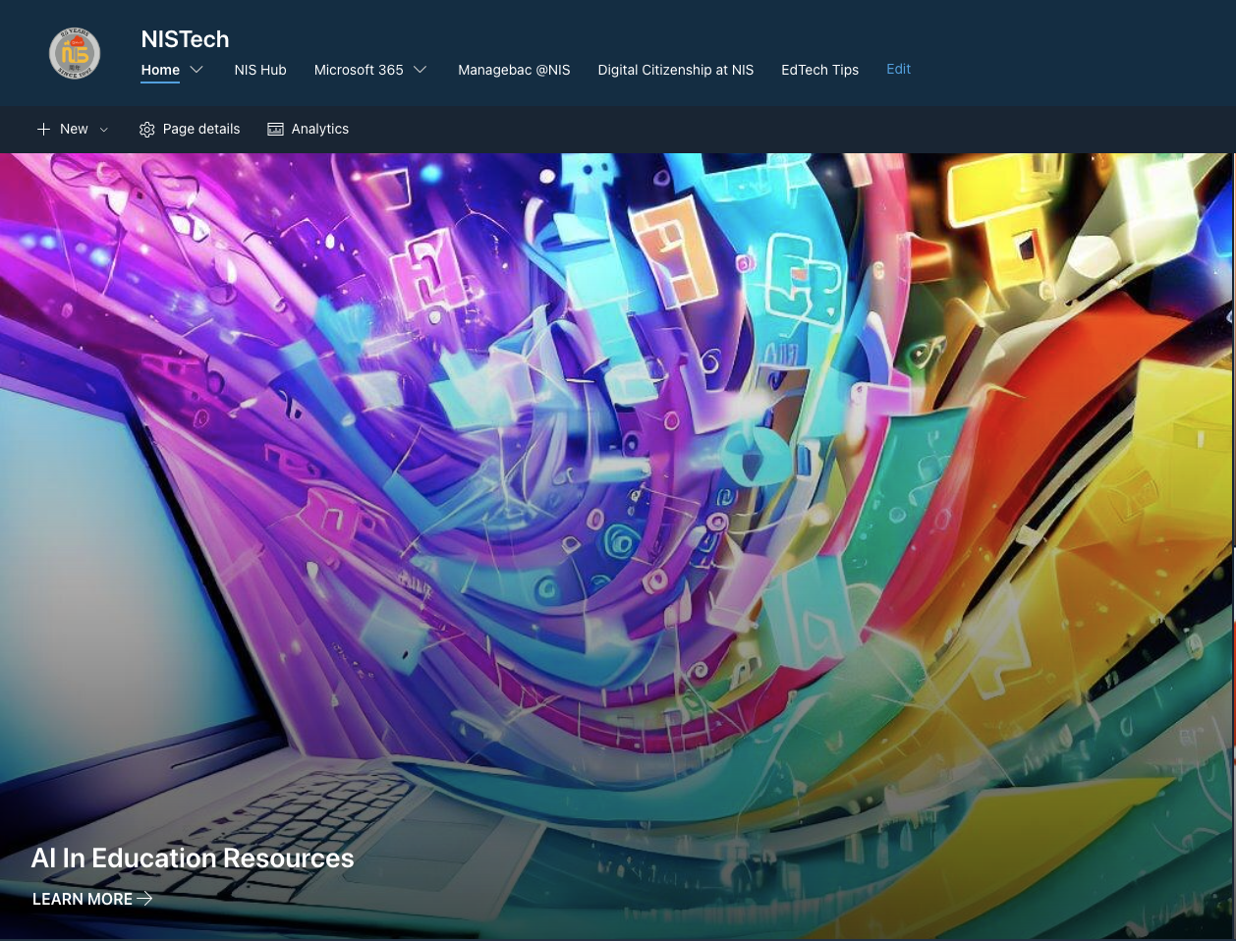
Where are we with AI?

Slide 14


Student Input
138/184 (75%) of students in the secondary school reported using AI Tools on a regular basis (Chat GPT, Poe, Bard, Papago, etc.) as of November 2023.
How can I use these tool appropriately? (15)
How does it work? (10)
How can I use these tools ethically? (7)
All images created using Poe https://poe.com/LogoDsigner

Slide 15
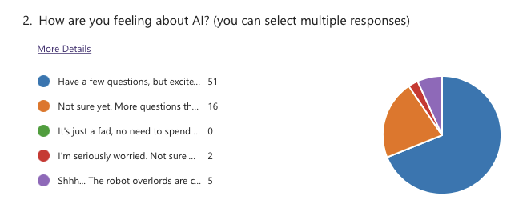
Teacher Input

Slide 16
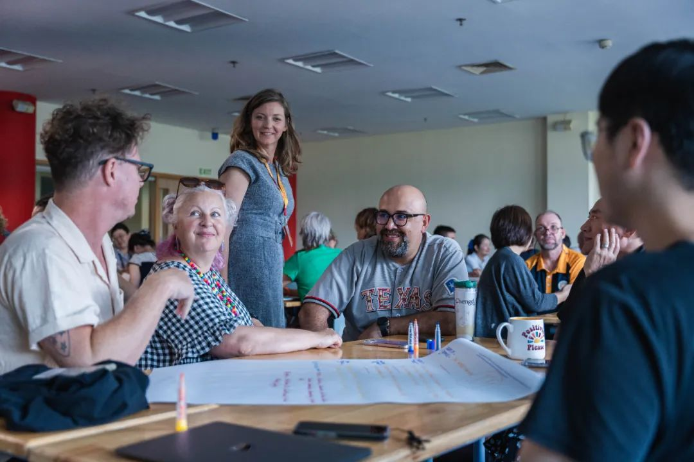
Teacher Input
A.I. Efficient and Effective Use: 17
A.I. Teacher Use in the Classroom: 16
A.I. Student Use in the Classroom: 18
15 teachers put their names forward as advanced users

Slide 17
Instructional Approaches
Short-Term
In-class only
Paper and pencil
Track digital docs
Teach AI citation
AI detection
Forms and signatures

Slide 18
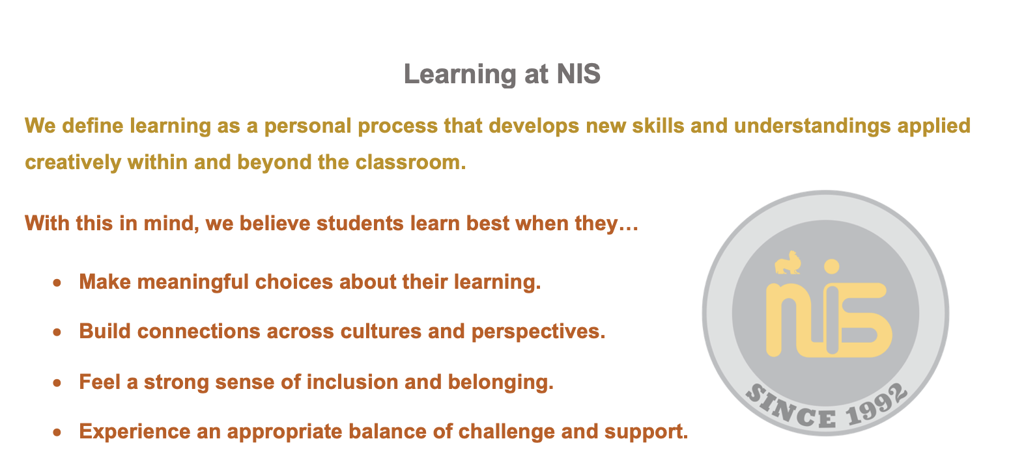
NIS Definition of Learning

Slide 19
Instructional Approaches
Short-Term
In-class only
Paper and pencil
Track digital docs
Teach AI citation
AI detection
Forms and signatures
Longer Term
Co-create assessments with students
Focus on process and check-ins
More recent and relevant
More creative and personal
More formative and feedback
Be explicit about amount of AI use

Slide 20
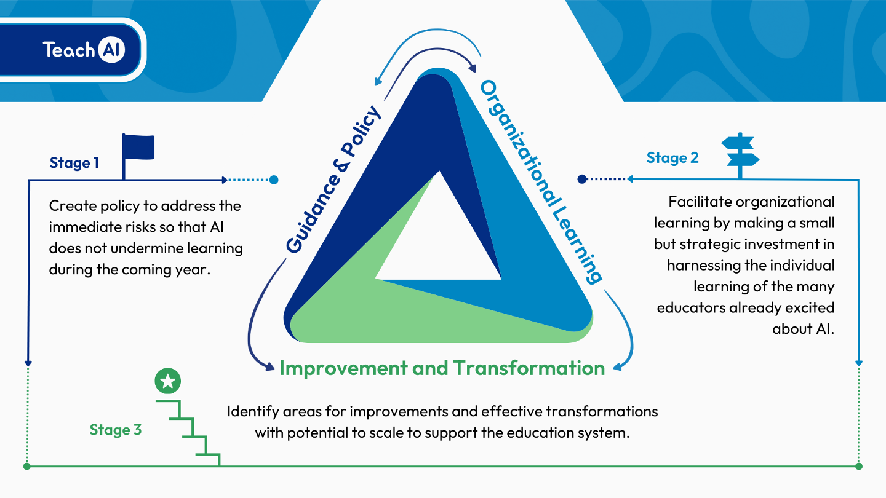
Where are we with AI?
Notes:
Stage 1
Ensure that AI use at NIS complies with existing security and privacy and educational policies,
Provide guidance to students and staff on topics such as the opportunities and risks of AI
Clarify responsible and appropriate uses of AI tools, by teachers and students
Define academic integrity standards related to AI.
Stage 2
Focusing on professional development for all staff
Bring together individual educators' experiences with AI to build collective organizational knowledge and capacity.
Include operational considerations such as evaluating AI tools already in use and reviewing our practices, particularly around assessment with AI in mind
Stage 3
Personalized learning and PD for staff based on individual needs and goals
Embedding of targeted AI practices in learning and assessment
NIS is consolidating Stage 1 and moving into Stage 2

Slide 21

What’s the hold up?
Ethics and Legal
Accuracy Considerations
Assessment and Curriculum
Digital Divide
Notes:
Ethical Considerations
Bias and Fairness: Generative AI models may inadvertently perpetuate or amplify biases present in their training data, potentially leading to unfair outcomes for certain groups of students.
Privacy: The use of AI in educational settings raises concerns about student privacy, especially if the AI processes sensitive or personal data.
Intellectual Property: There are questions about the ownership of content created by AI, such as essays or art, and whether it can be considered original work by the student.
Transparency: Students and educators may not fully understand how AI systems make decisions, which can lead to trust issues.
Legal Considerations
Compliance with Regulations: Schools must ensure that their use of AI complies with educational laws and regulations, such as the Family Educational Rights and Privacy Act (FERPA) in the U.S., which protects student education records.
Liability: There could be legal implications if the AI provides incorrect information that leads to negative consequences for students.
Accuracy Considerations
Reliability of Content: AI-generated information may not always be accurate, and relying on it for educational content could lead to misinformation.
Data Quality: The output quality of AI is contingent on the quality of the input data; inaccurate data can lead to flawed conclusions or recommendations.
Assessment Considerations
Cheating and Plagiarism: AI makes it easier for students to generate essays and answers that are not their own work, complicating academic integrity efforts.
Evaluation of AI-generated Work: Teachers may need new tools and methods to assess work created with the aid of AI, as traditional metrics may no longer apply.
Curricular Considerations
Integration into Existing Curricula: Deciding how AI fits into the existing curriculum can be challenging, as it may not align with current learning objectives or standards.
Teacher Preparedness: Educators may require additional training to effectively incorporate AI tools into their teaching methods and to understand their limitations.

Slide 22
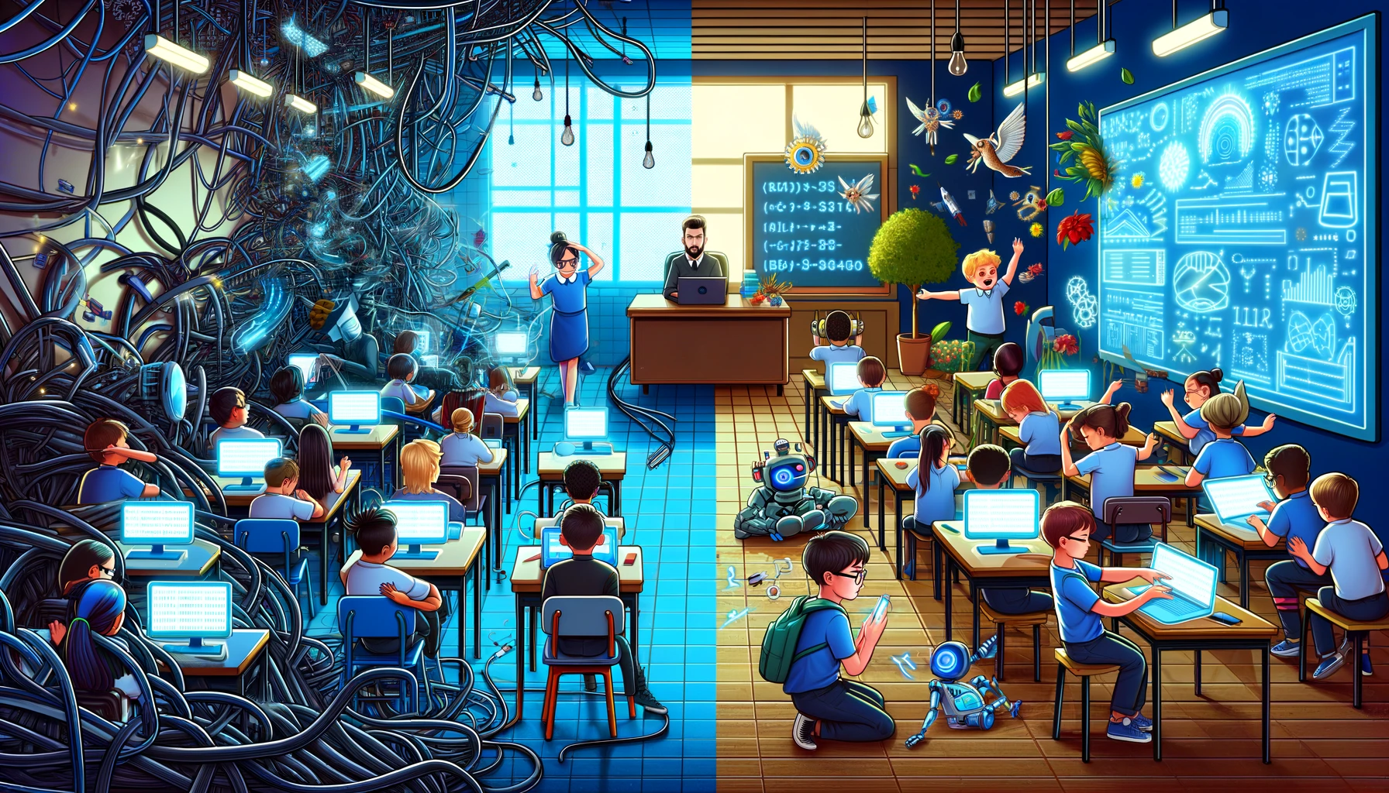
Now and Next…
Communication and experimentation
Professional learning
Supporting use by teachers
Reconsidering assessment
First “Poe Pilot” underway (G9)
OpenAI. (2023). ["Split image depicting challenges and opportunities of AI use in schools"]. Created using DALL-E on [November 23, 2023].
Notes:
Take a look at our AI Documentation (Link shared in Tuesday Tech Tips or scan the QR Code)
Play around with AI chatbots like Poe.com (Guide on how to install POE in Latest Tech Tip)
Share what you are doing with others
Begin to use in planning and instruction, when appropriate
Be conscious of the “digital divide”
Begin to reconsider assessments in the age of AI (PROMPTS)

Slide 23
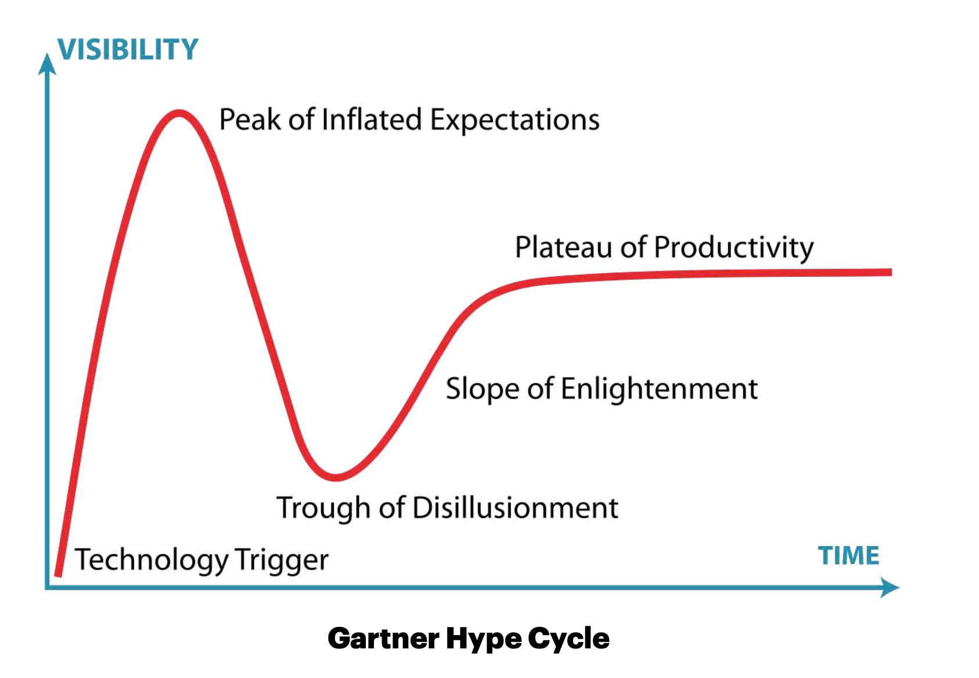


AI
https://www.gartner.com/en/newsroom/press-releases/2023-08-16-gartner-places-generative-ai-on-the-peak-of-inflated-expectations-on-the-2023-hype-cycle-for-emerging-technologies
"Generative artificial intelligence (AI) is positioned on the Peak of Inflated Expectations on the Gartner, Inc. Hype Cycle for Emerging Technologies, 2023, projected to reach transformational benefit within two to five years." (STAMFORD, Conn., August 16, 2023)

Slide 24
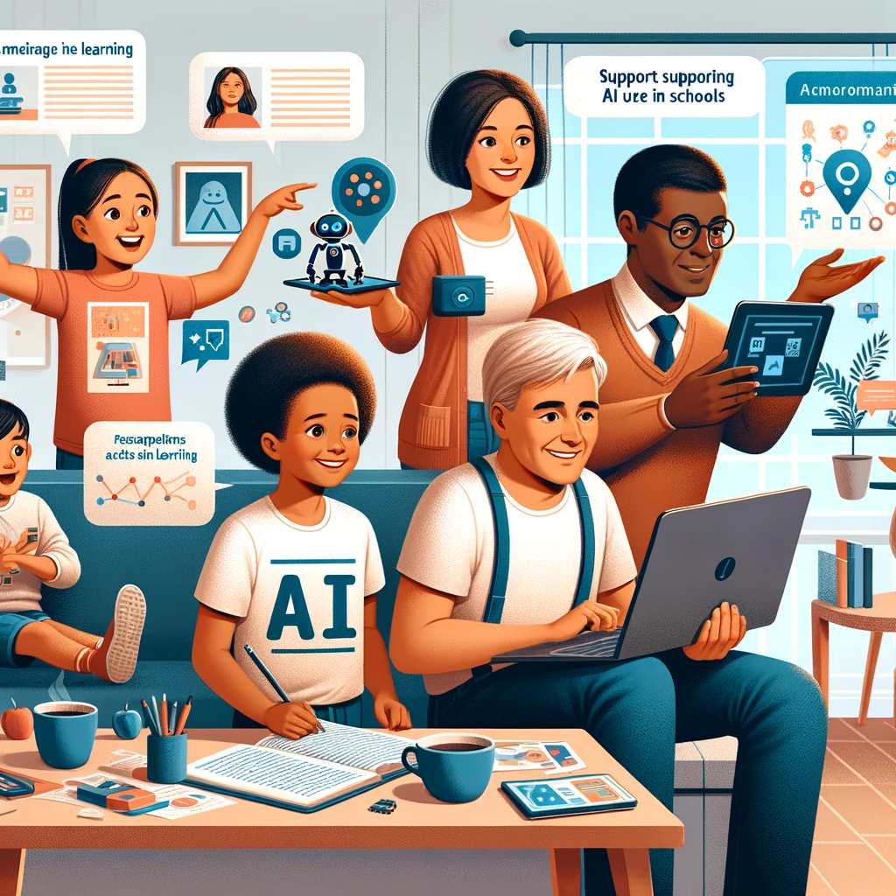
3 Simple Steps to Support Your
Child's AI Learning Journey
Stay Up-to-Date with AI Developments
Experiment with AI Yourself
Learn from Your Child and Us!

Slide 25
Parent Prompts
Using the language of your choice…
I would like you to act as a child psychologist. I will give you a situation and I would like you to give me advice to help me best parent my child. For your information, my child is [X] years old.
I would like you to act as an educational technologist expert. I will give you a situation and I would like you to to help me best parent my child. For your information, my child is [X] years old.
I would like you to act as an expert trip organizer. I will give you information about where we will travel, the dates of our travel and how many adults and children will be traveling. Please based your responses on the information I give.
Help me create some digital agreements for my [x] year old’s phone use at home.
Write an email to my child’s [Grade] [Subject] teacher asking for feedback on how to help my student at home.
Ask Poe!

Slide 26
NIS A.I. Update
November 27, 2023
OpenAI. (2023). [”Parent Coffee in a Café about AI in Schools"]. Created using DALL-E on [November 26, 2023].

