Slide 1



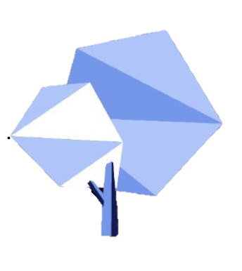






ChatGPT & Other AI
@ NIS
Notes:
Situation
AI Tools are becoming available (and indeed proliferating) that can generate content including text, art, code etc.
These tools are also improving at a rapid rate.
Which of these do you know? What do they do?

Slide 2


Can you access ChatGPT?
Registration and Access
You must be at least 13 years old to use the Services.
If you are under 18 you must have your parent or legal guardian’s permission to use the Services.
If you use the Services on behalf of another person or entity, you must have the authority to accept the Terms on their behalf. You must provide accurate and complete information to register for an account.
You may not make your access credentials or account available to others outside your organization, and you are responsible for all activities that occur using your credentials.

Slide 3
Can you access POE?
Age Requirements.
Use of Poe by anyone under 13 years of age is prohibited.
You represent that you are at least the age of majority in the jurisdiction where you live or, if you are not, your parent or legal guardian must consent to these Poe Terms of Service and affirm that they accept these Terms on your behalf and bear responsibility for your use.
Bots accessed via Poe may produce content that is not suitable for minors.
If you are accepting these Poe Terms of Service on behalf of someone else or an entity, you confirm that you have the legal authority to bind that person or entity to these Terms.

Slide 4
So what do you need to do!
To access Poe (and ChatGPT) you MUST get parent permission
You need to discuss this with your parents and they must agree to you creating an account
NIS will be checking that permission has been given
Once you have approval, you can install the Poe App
An account for ChatGPT is not accesible within China
An account ChatGPT via Poe is accesible within China
(you do still need a VPN to use it ChatGPT via Poe)

Slide 5

Let's try it out !
Example Diploma Exam Question
Economics
Using real world examples, evaluate the argument that economic growth is always good.
Notes:
Lets try it out with two examples – See its pros and cons, what works well, what problems it has
1st Example - Economics
Using real world examples, evaluate the argument that economic growth is always good.

Slide 6
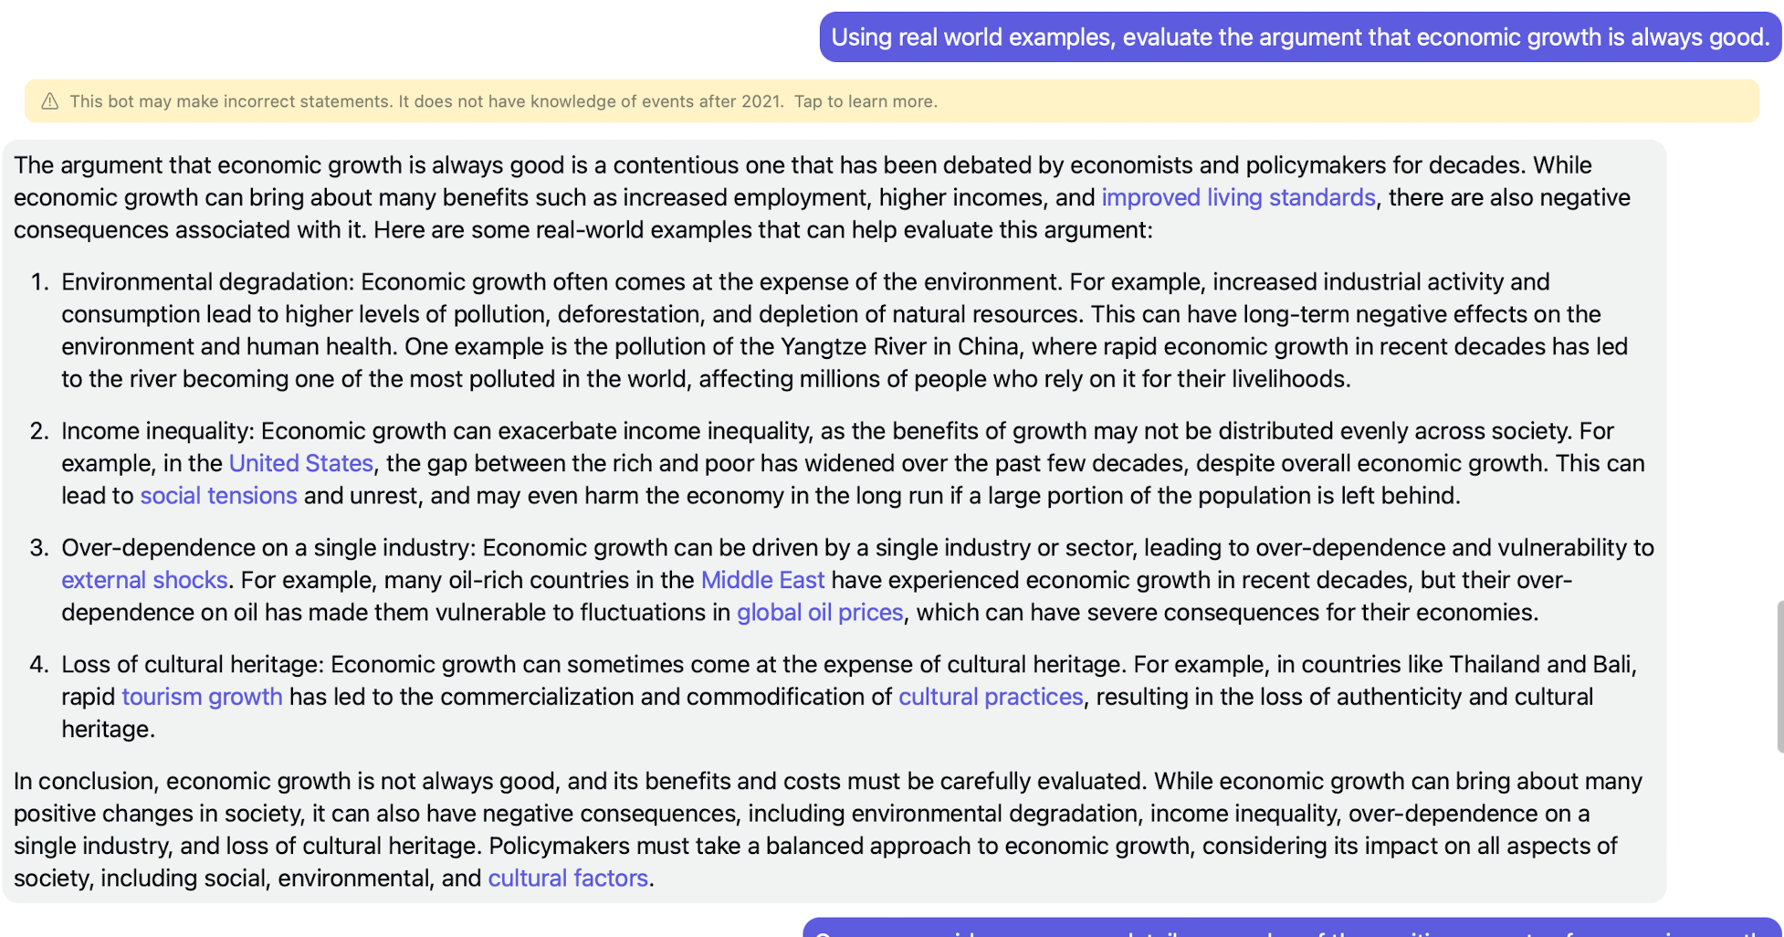
Responses
Notes:
Three important things here. - Give them time to read to see if they can see what they are
1. The words in purple can be clicked to get additional information (kind of like Wikipedia)
2. And it hasn’t given any real examples of the positives.
3. The response may not have correct information (Click link to see what this means)

Slide 7
Trustworthiness
Should I trust what the bots say?
The bots are usually correct, but may make incorrect statements, so if you are making an important decision based on information from a bot, you will want to verify the information elsewhere.
The bots also should not be solely relied upon for medical, legal or investing advice – please consult a professional.
And the bots may not have knowledge of current events, so some information may be out of date.
We expect all of these issues to improve considerably over the next six months as AI research continues.
Notes:
Key point..... The importance of verifying the information, not just trusting it as the only source.

Slide 8
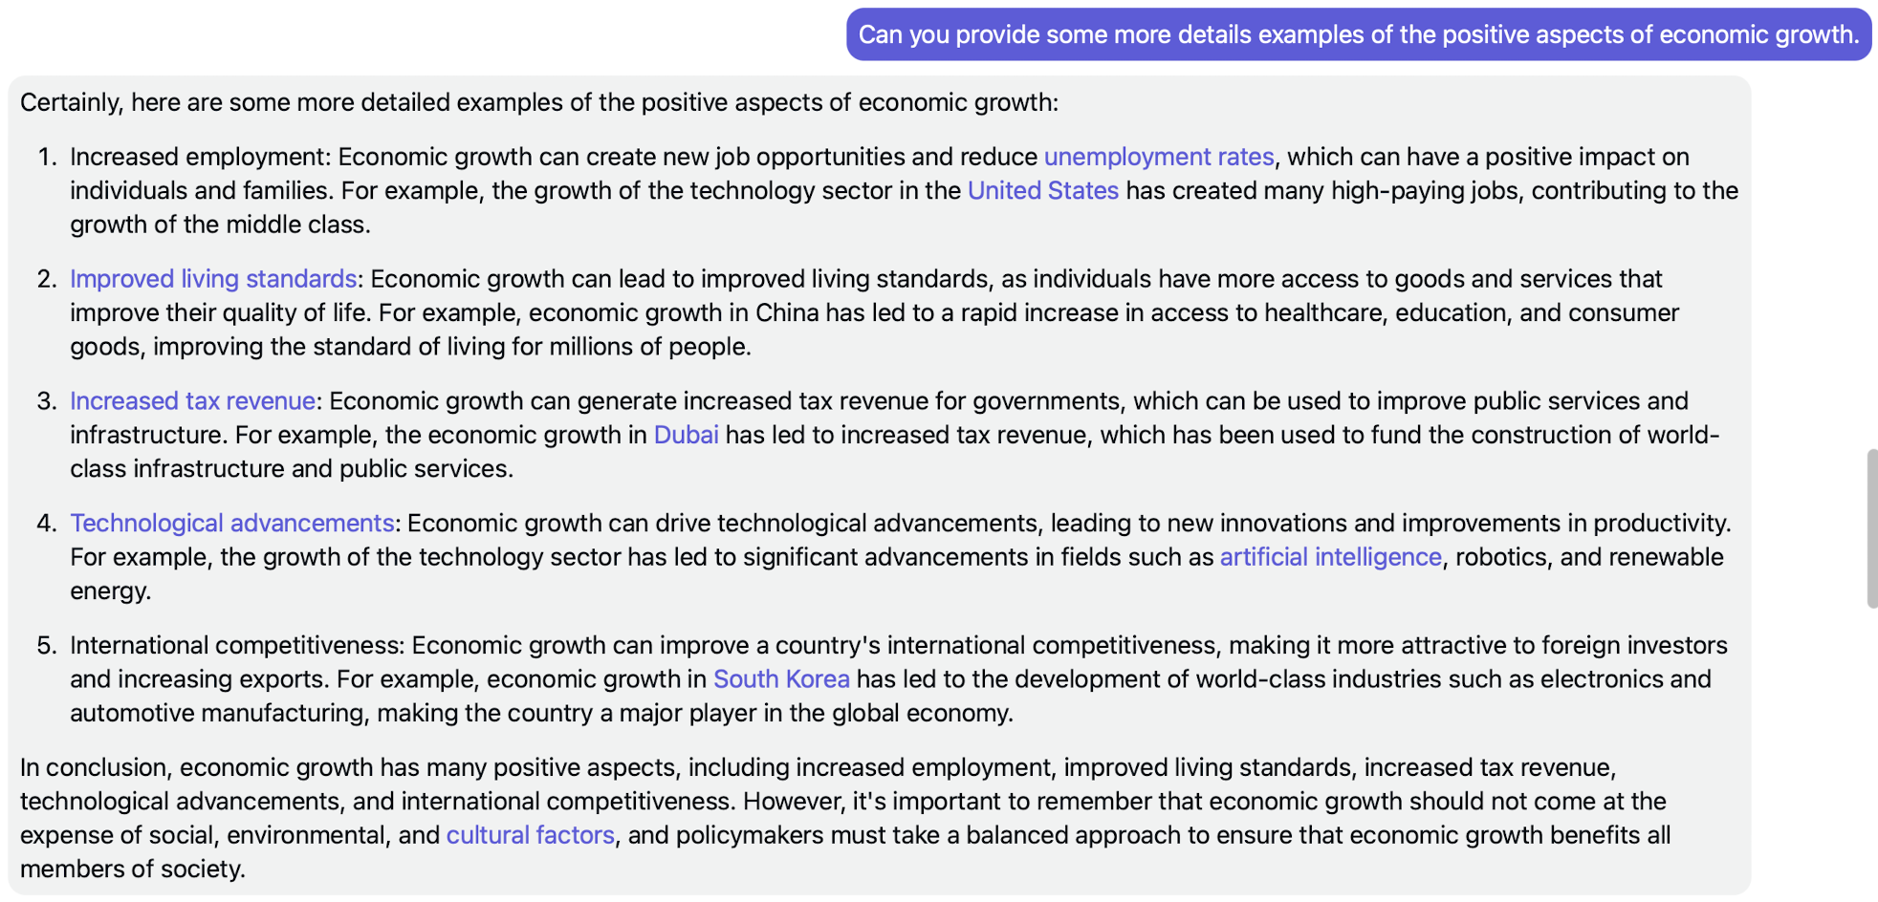
Responses
Notes:
So lets ask it an additional question using its previous response as context.
"Can you provide some more detailed examples of the positive aspects of economic growth"
The AI will use the existing conversation as context for its response.

Slide 9
So what pitfalls do we need to be aware of?
Notes:
So we’ve just seen one potential problem with AI, it may give incorrect, incomplete or not current information.
(Think - Pair - Share) What are some other protentional downsides to unfettered use of AI? Why does there need to be a balance?
Ensuring that the learning is taking place
Fallibility of AI responses (hallucinations when it can’t find an answer)
Bias
Inappropriateness of the response
It could erode the learning experience if its use is abused. (Probe to get them to give this response)

Slide 10
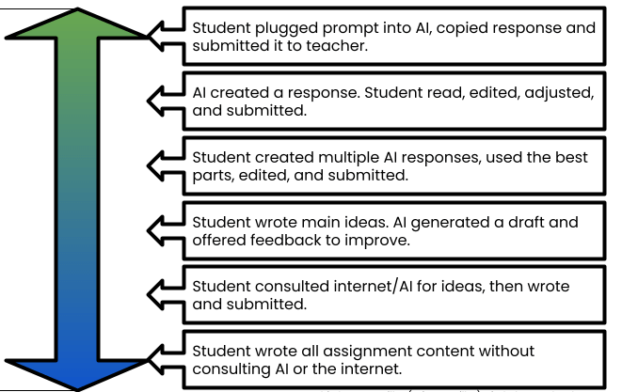
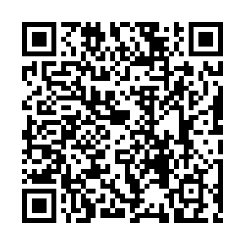
Appropriate Use
AI Created
Student Created
Notes:
Student activity about where they see the balance should be. (Make sure the PollEverywhere Survey is active)

Slide 11
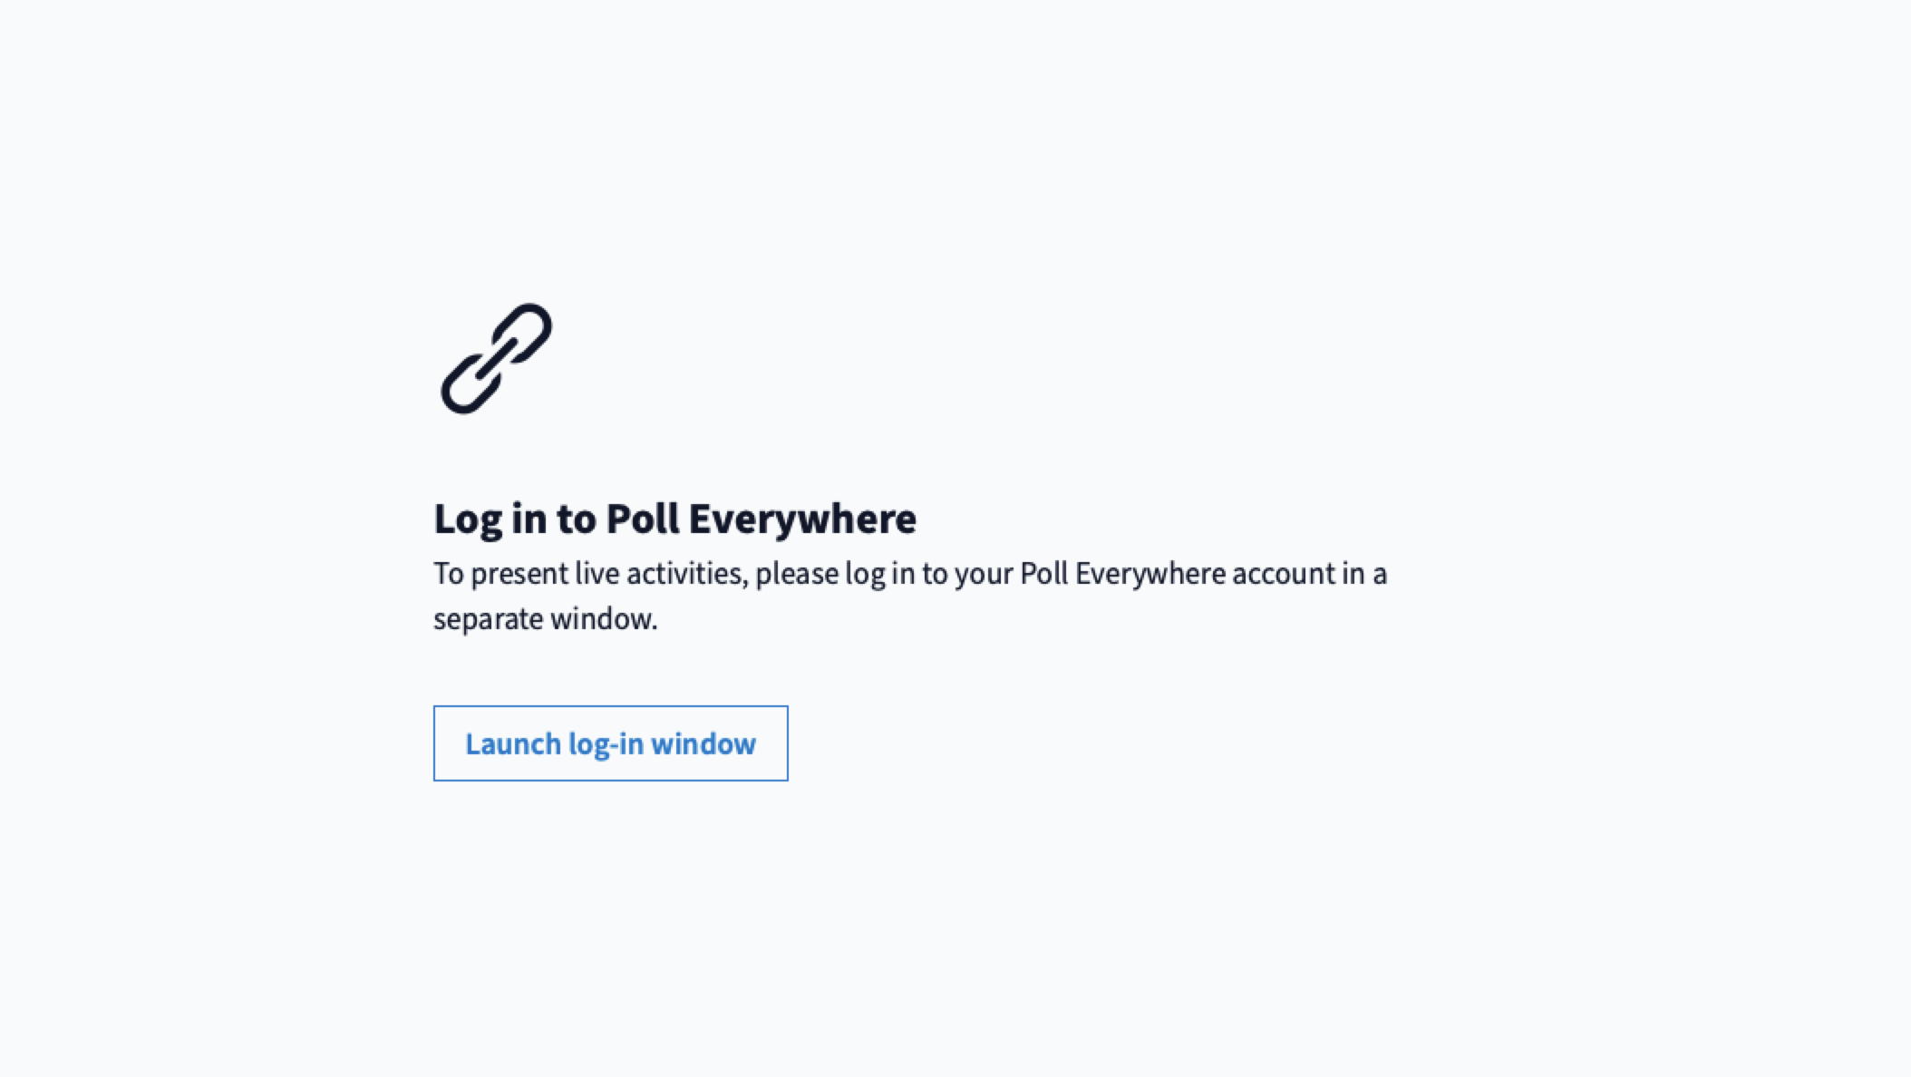
IB Academic Integrity

Slide 12
What is acceptable use of AI?
Example Diploma Exam Question
Economics
Using real world examples, evaluate the argument that economic growth is always good.
Notes:
Back to our First example - Economics
Using real world examples, evaluate the argument that economic growth is always good.

Slide 13
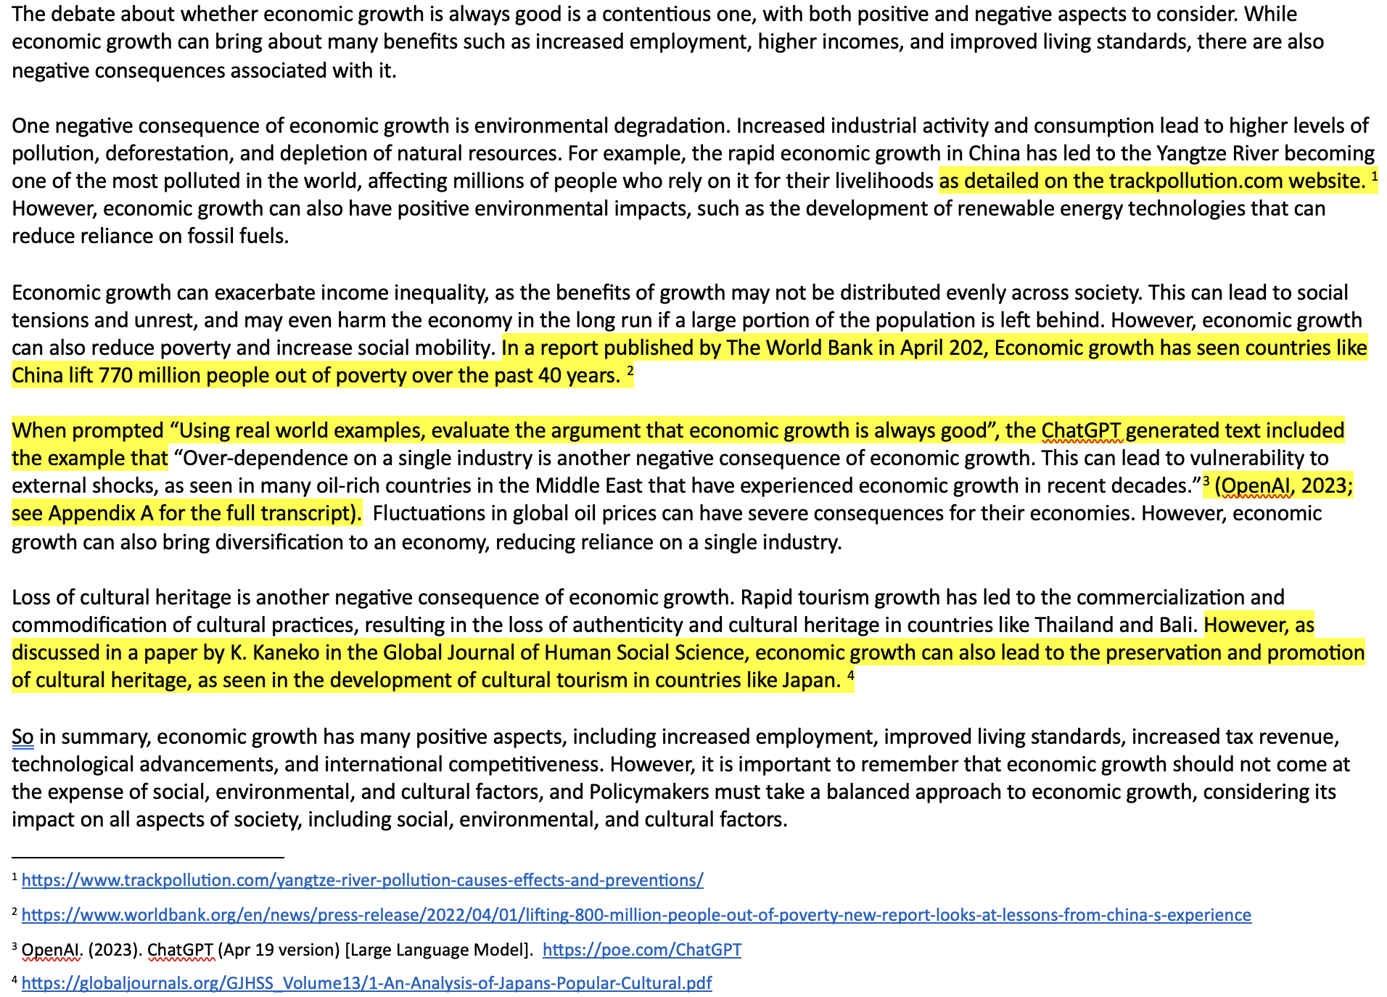
Notes:
What makes this acceptable?
Multiple responses generated to get all aspects (positive and negative)
The content has been taken, read, and edited to appropriately respond to the question
The information has been checked and verified both other sources, incorporating this additional resources into the response.
Use of ChatGPT has been cited

Slide 14
AI Created
Student Created
Notes:
So where/how did this example fit into our scale? Can we see the difference in academic integrity in the way AI was used?
Question to the group......
If we look at the three highlighted possible uses of AI in the classroom, what can we see that is common in all of them?
Answer......
AI is being used as a tool to support the learning, whilst the student is doing the thinking and the synthesizing of information to grow their understanding.
So if NIS is going to be embracing students using AI as a tool to expand their learning opportunities, what are the responsibilities going to be for students if and when they use AI in an ethical way ?

Slide 15


IB Academic Integrity
Key concepts include
responsibility for producing authentic work,
correctly attributing sources,
responsible use of technology and
adherence to ethical practice during exams.
Notes:
So how will this look?
Ensuring academic integrity – We need the use of AI to be expanding the educational growth opportunities for students, not eroding the learning that takes place in class and through assessment tasks.
IMPORTANT NOTE: From Grade 10 onwards, all instances of academic dishonesty are tracked and recorded.
Why? Because Universities ask this question when applications are submitted and the councilors are required to pass on this information.

Slide 16
APA Citing Guide
Unfortunately, the results of a ChatGPT “chat” are not retrievable by other readers, and although non-retrievable data or quotations in APA Style papers are usually cited as personal communications, with ChatGPT-generated text there is no person communicating.
Quoting ChatGPT’s text from a chat session is therefore more like sharing an algorithm’s output; thus, credit the author of the algorithm with a reference list entry and the corresponding in-text citation
https://apastyle.apa.org/blog/how-to-cite-chatgpt
Notes:
So, what will be the requirements?
Students will be required to acknowledge and cite their use of any AI resources

Slide 17
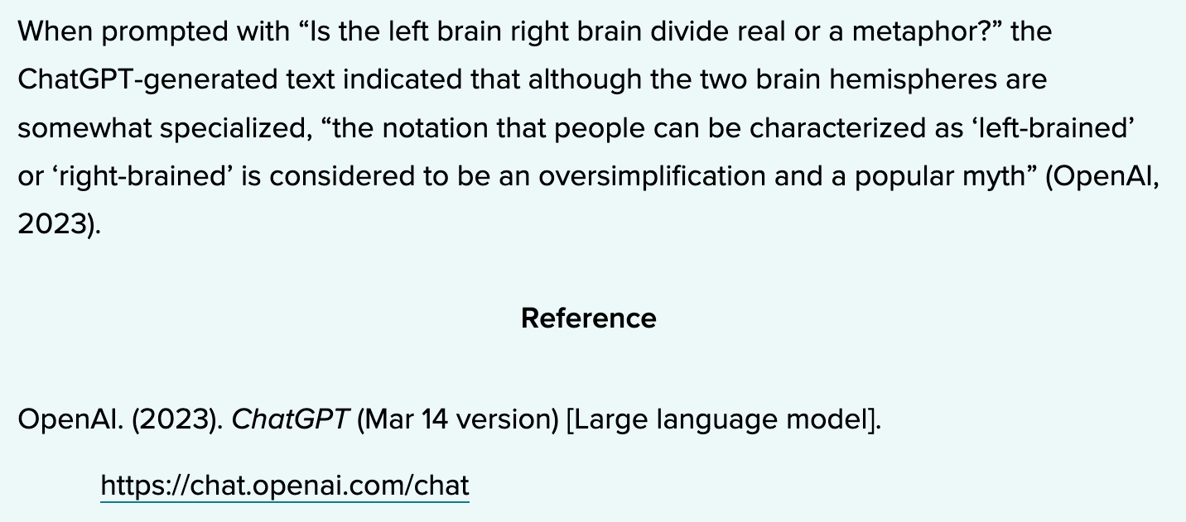

APA Citing Guide
Example:
https://apastyle.apa.org/blog/how-to-cite-chatgpt
Notes:
What will this look like ?
Citing the use of ChatGPT as a source of content

Slide 18
APA Citing Guide
You may also put the full text of long responses from ChatGPT in an appendix of your paper or in online supplemental materials, so readers have access to the exact text that was generated.
It is particularly important to document the exact text created because ChatGPT will generate a unique response in each chat session, even if given the same prompt.
If you create appendices or supplemental materials, remember that each should be called out at least once in the body of your APA Style paper.
https://apastyle.apa.org/blog/how-to-cite-chatgpt

Slide 19
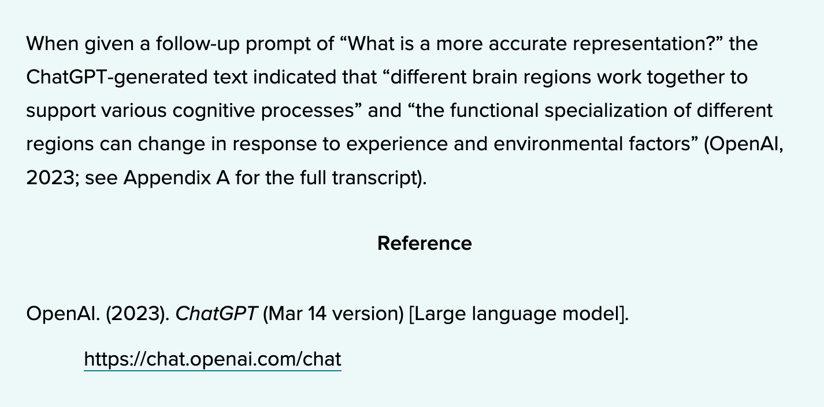
APA Citing Guide
Example:
https://apastyle.apa.org/blog/how-to-cite-chatgpt

Slide 20
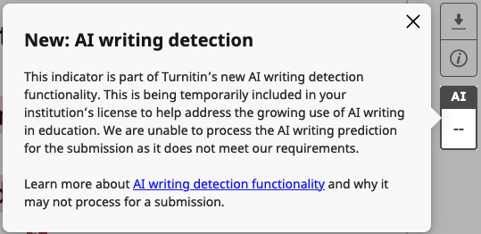
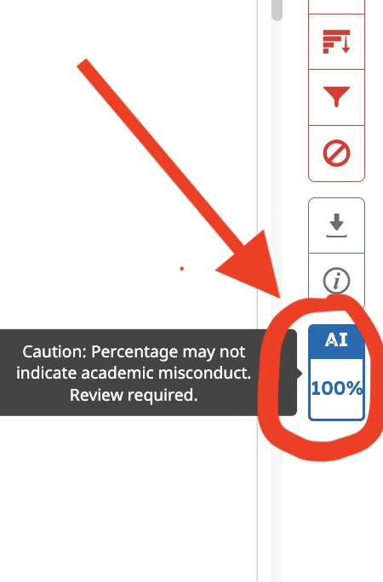
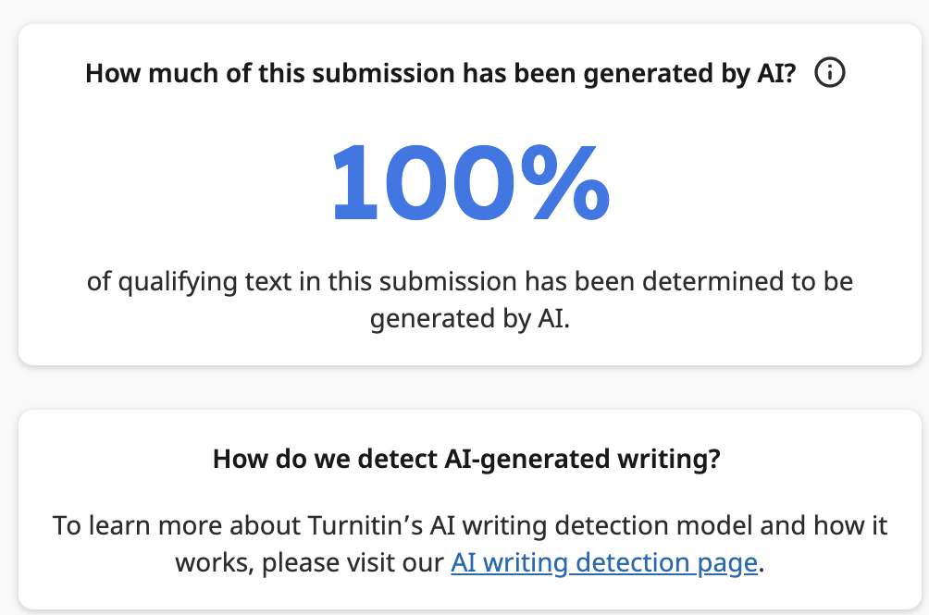
Going Beyond Citation
Notes:
What will be the requirements?
Students may be required to discuss if or how they used AI generated content -> Based on feedback from Turnitin Tracker

Slide 21
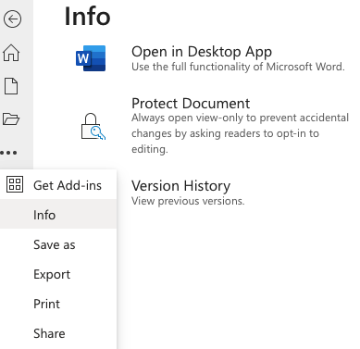
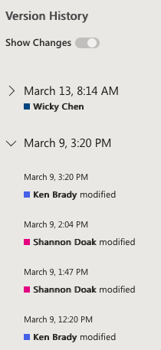
Going Beyond Citation
Notes:
What will be the requirements?
Students may be required to show their document version history – showing the progressive development of their assessment tasks

Slide 22
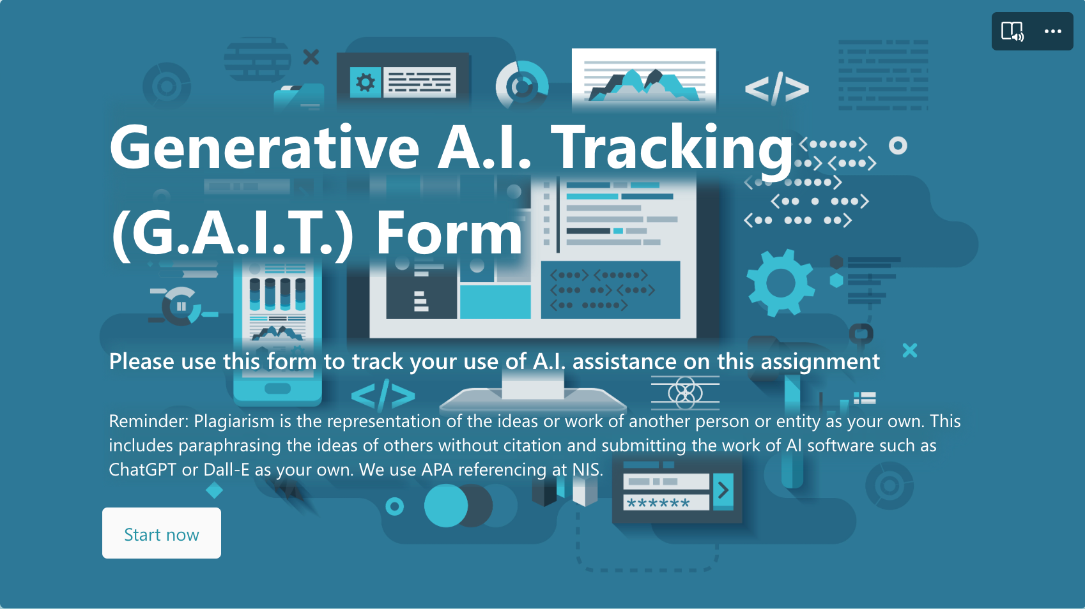
Going Beyond Citation
Notes:
What will be the requirements?
Students will be required to complete a GAIT tracking form if they use AI tools for their assessment tasks

Slide 23
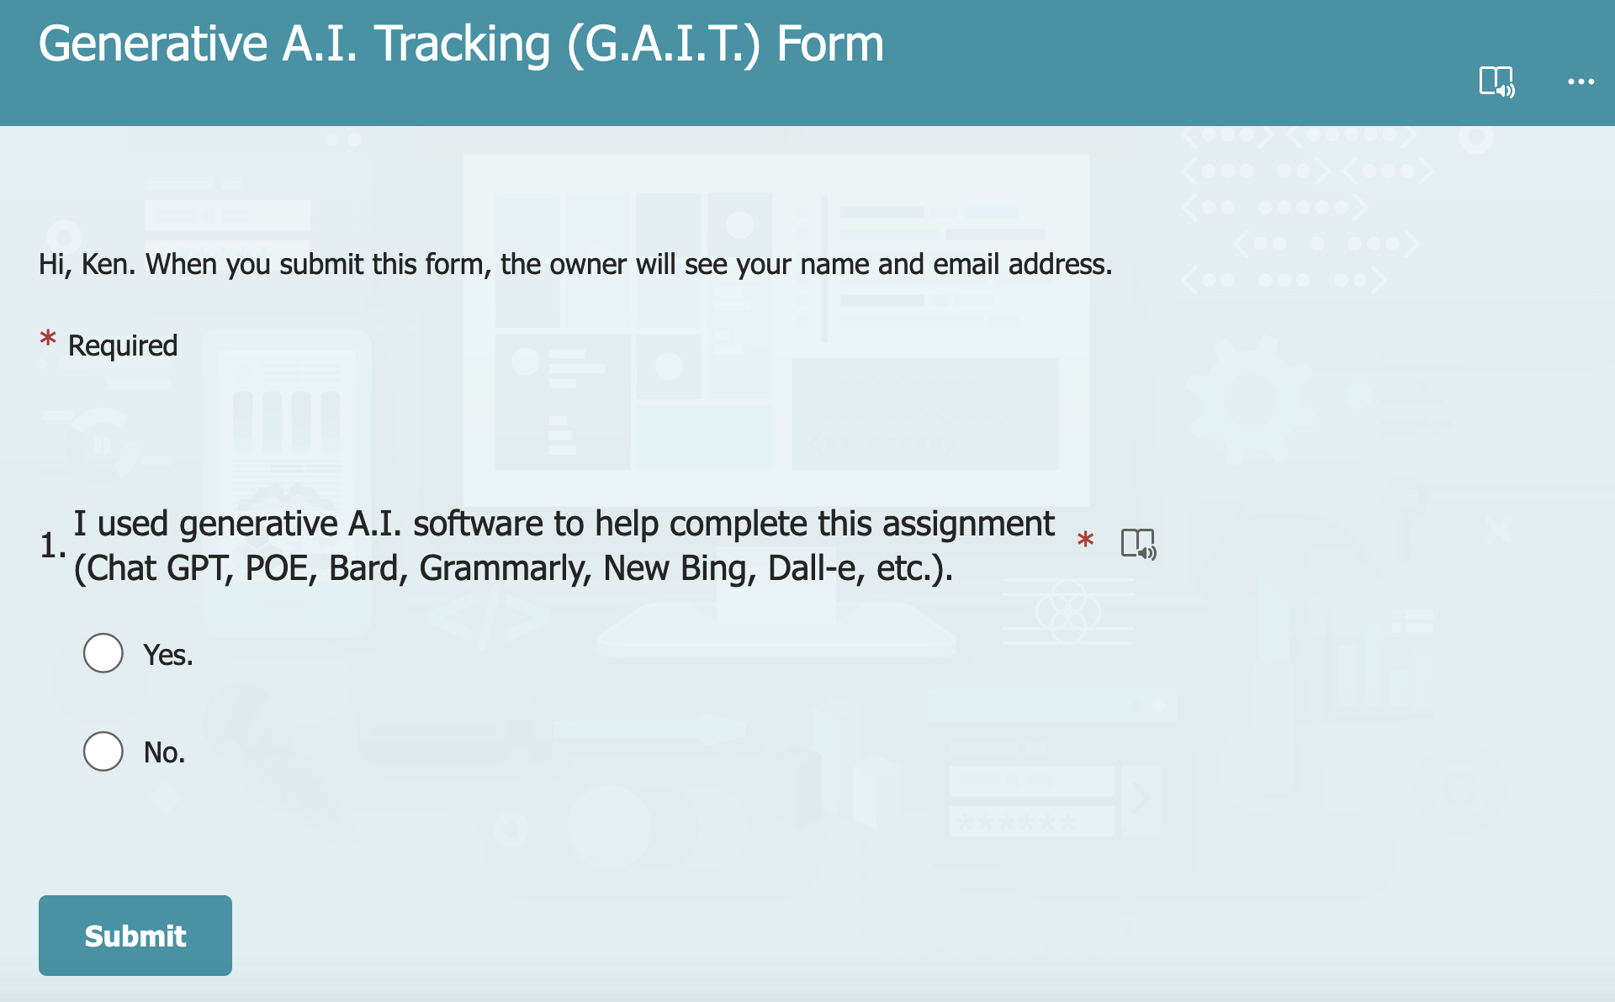
G.A.I.T.

Slide 24
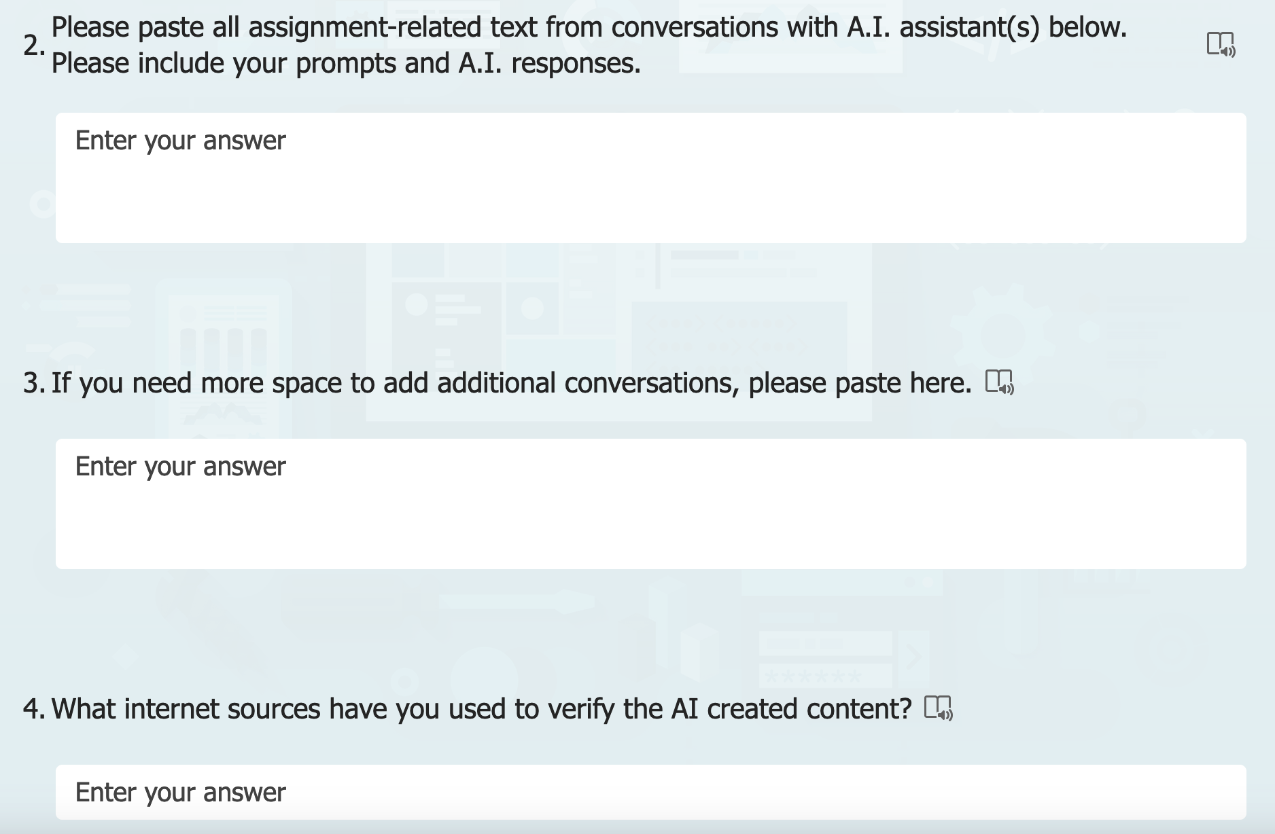
G.A.I.T.

Slide 25

Thoughts? Discussion?
Notes:
This is the current planning by NIS, and it will likely change and adapt over time as do the qnantity and power of AI based tools that can be used for education.
How do you foresee you will be able to use AI to help with your learning?
How do you foresee that you will end up using AI in your future careers?

Slide 26

Notes:
Many schools, districts and even whole countries are trying to block access.
Basically, the world is changing and people are trying to figure out how to adapt to this change.
NIS Stance
NIS teachers and staff believe AI tools are going to be throughout the workforce once you graduate -> You are going to need to learn how to navigate life where AI is present and expanding.

Slide 27
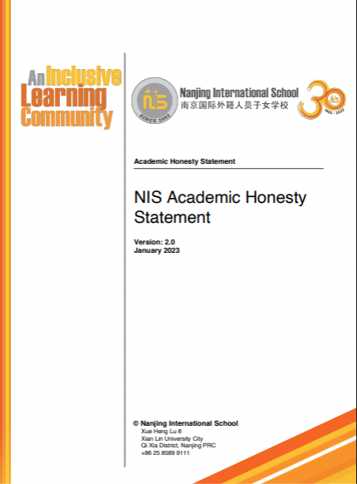
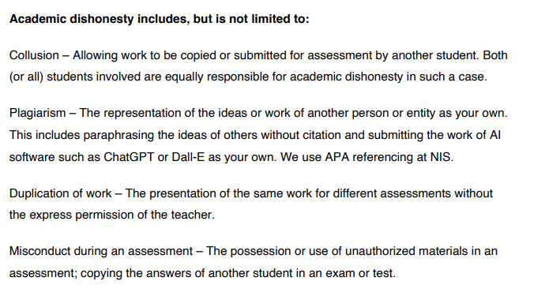

Notes:
NIS therefore believes it is very important for students to be aware of, and able to use these tools competently and ethically
So, NIS will not be blocking student access to these tools. We wont be saying “OK, you’ve now got to do everything with a pencil on paper”.
Instead NIS will be teaching students how to use these tools ethically and in keeping with the NIS academic honesty statement

Slide 28
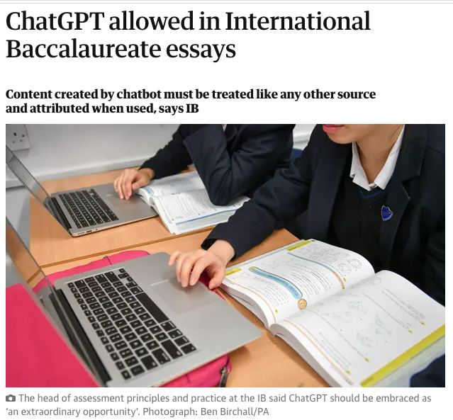

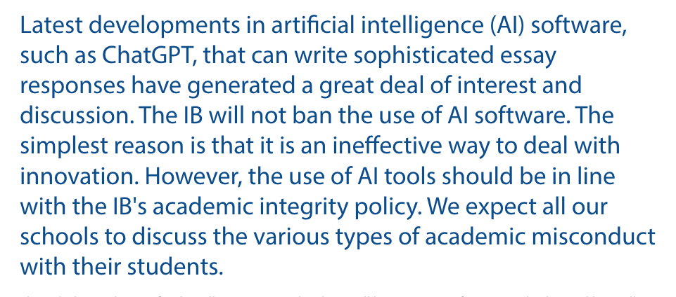
Notes:
The International Baccalaureate is in agreement with this stance, and is supporting the use of AI tools in the classroom.

Slide 29
Let's try it out !
Example Diploma Exam Question
English
Writers of fiction do not always relate events in chronological order.
By using examples from two works you have studied, explore the effects of telling the story in a non-chronological manner.
Notes:
English
Writers of fiction do not always relate events in chronological order.
By using examples from two works from different authors, explore the effects of telling the story in a non-chronological manner.

Slide 30
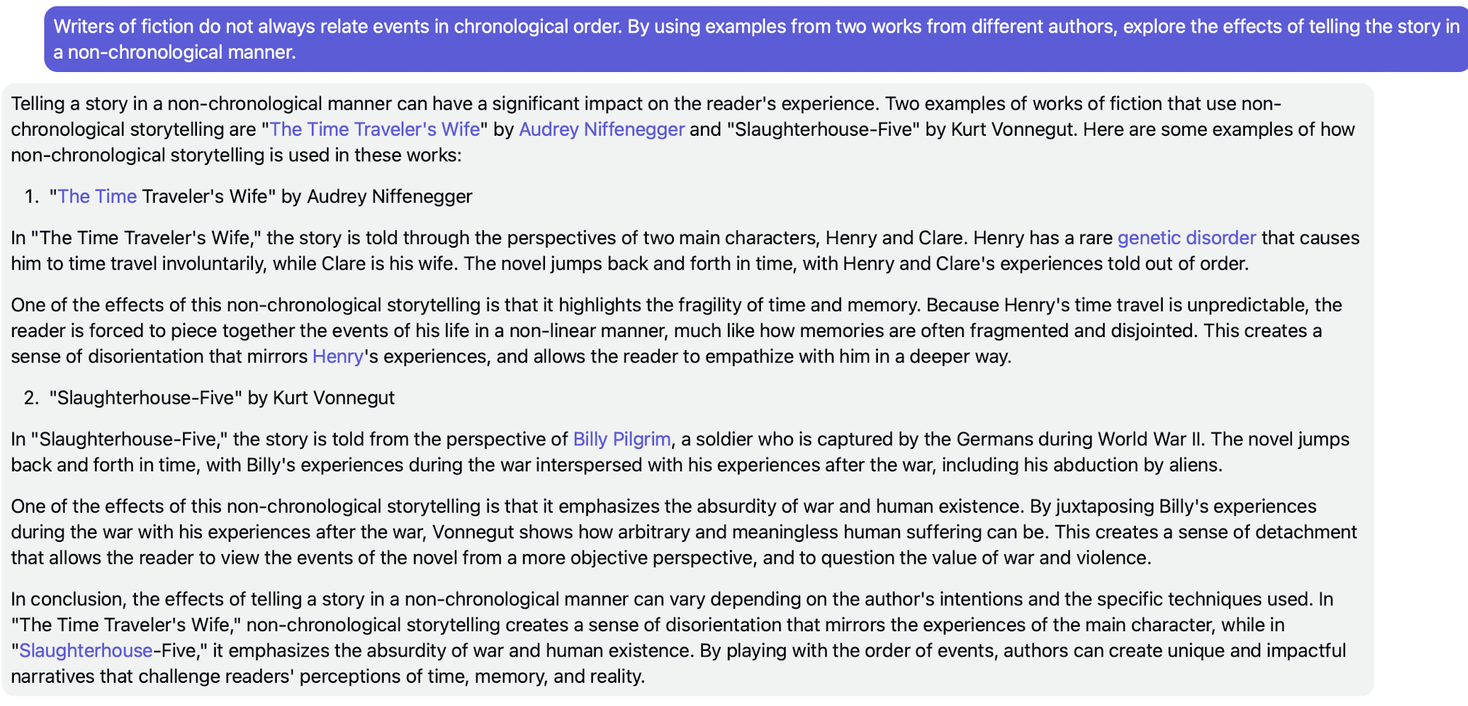
Responses

Slide 31
What is and isn’t acceptable
Example Diploma Exam Question
Chemistry
Discuss the differences between the two forms of polythene, (low-density and high-density) by referring to the amount of branching, the forces between the polymer chains and the physical properties.
Notes:
2nd Example - Chemistry
Discuss the differences between the two forms of polythene, (low-density and high-density) by referring to the amount of branching, the forces between the polymer chains and the physical properties.

Slide 32
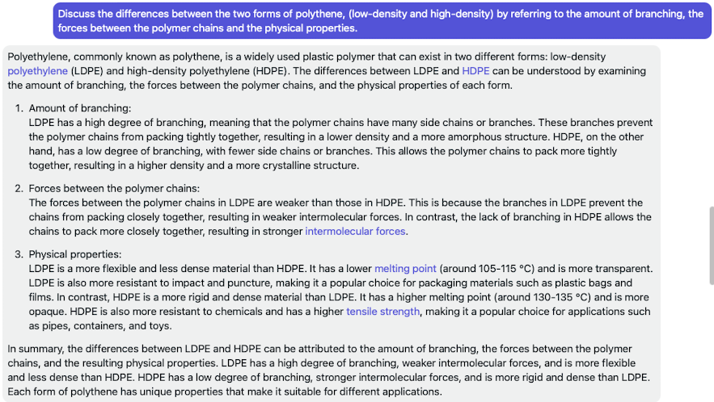
Notes:
What makes this unacceptable?
The content has been completely generated by AI and then after a few headings were removed, it was just copied and pasted.

Slide 33
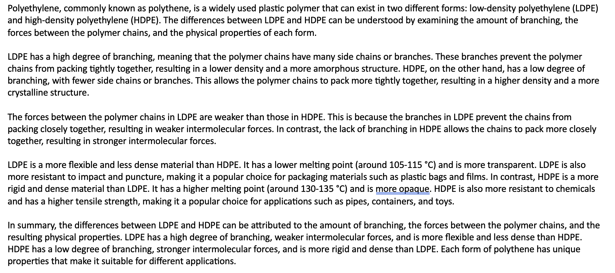
Notes:
What makes this unacceptable?
The content has been completely generated by AI and then after a few headings were removed, it was just copied and pasted.

Slide 34
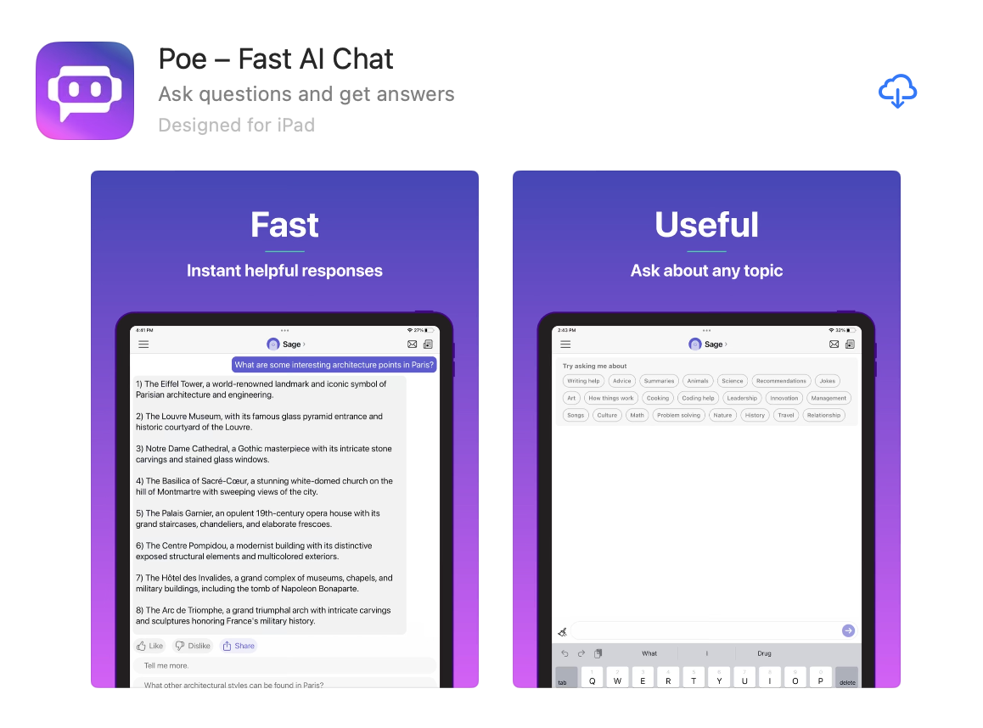
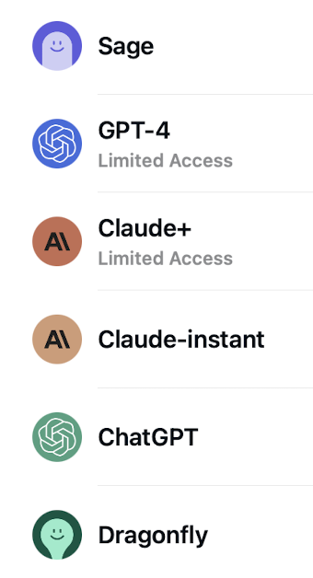
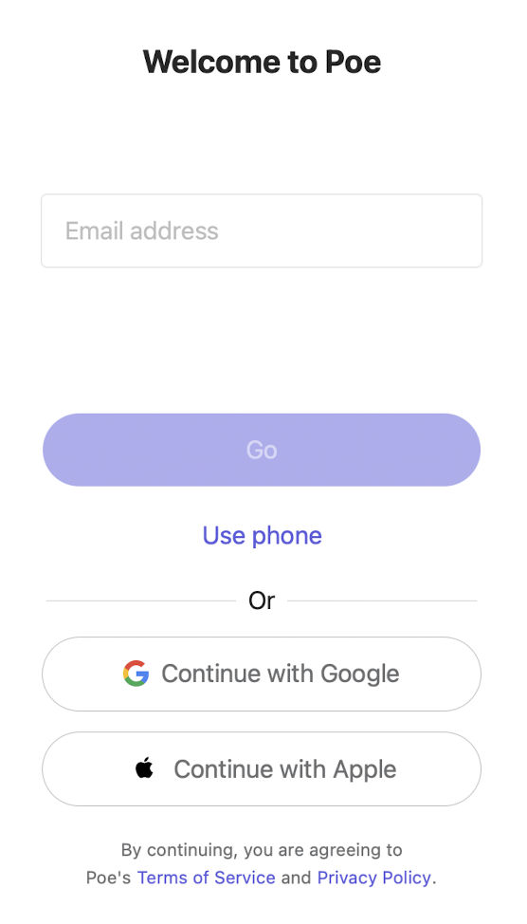

Setting up Poe
Notes:
1. Install POE from the App Store
2. Create an account using your school email address
3. Verify your account using the code sent to you
4. Open Poe and select ChatGPT

