Slide 1
Middle School Education Program
2022-2023

Slide 2
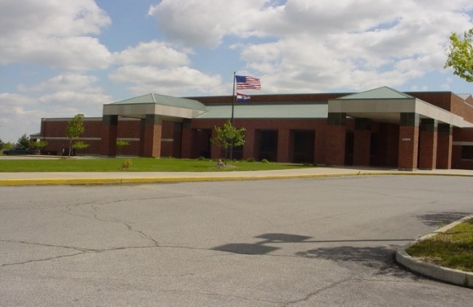
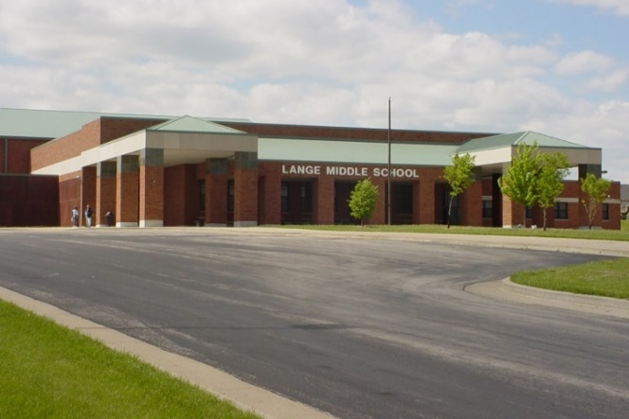
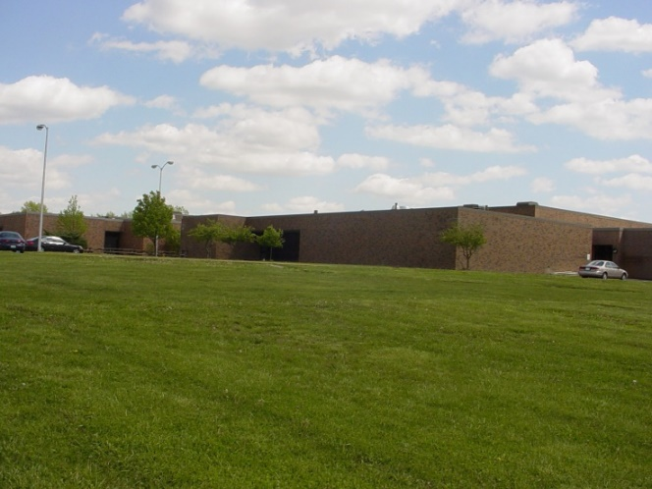
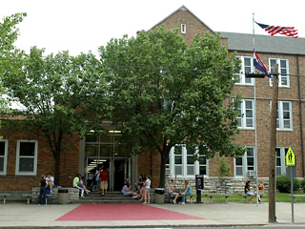
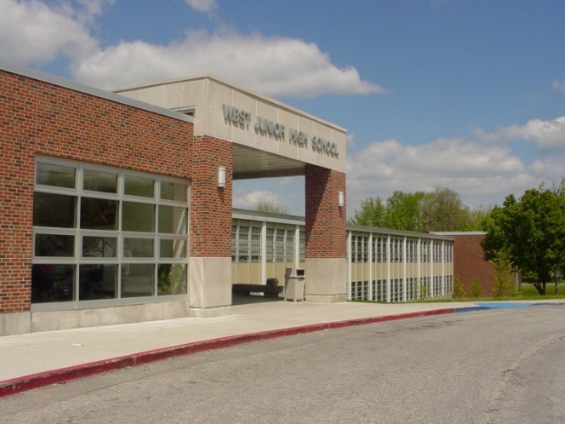
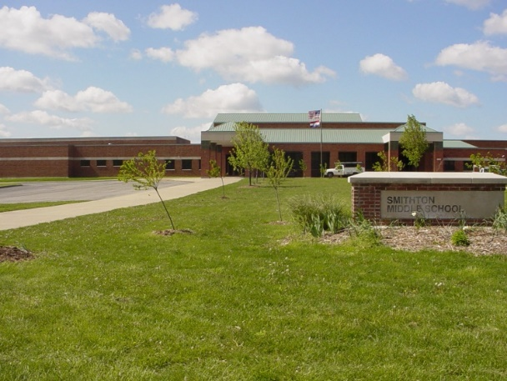
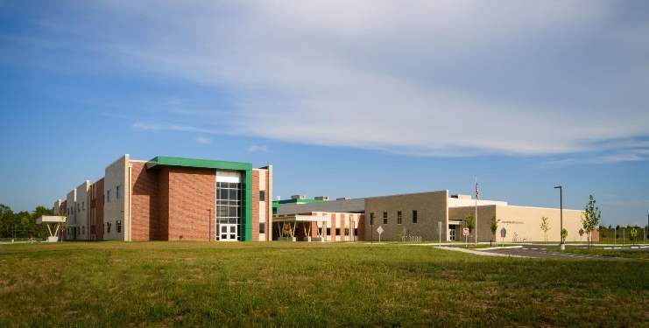
CPS Middle Schools
Columbia Public Schools

Slide 3

Leia: Sixth Grader
Starts her day at 7:30 and ends at 2:35
Is excited about new opportunities
Will be a part of a team of teachers/students
Has 4 core classes taught by her team teachers (ELA/English Language Arts, Social Studies, Math, and Science)
Will have 2 periods when she can experience elective or exploratory classes
Has PE every other day
Can choose to be involved in extracurricular clubs and intramural sports
Columbia Public Schools

Slide 4


Grades, what Grades?…
Core Class Letter Grades/Percentages
(pass/fail for Exploratory)
Success Ready Skill Marks
(Work Habits, Interaction with Peers and Adults)
A & B Honor Roll
Do your homework and… TURN IT IN!!!
Home Access for students and parents

Slide 5
Math Considerations
Students will be placed in 6th grade Math based on 5th grade teacher recommendation with parent input.

Slide 6




Exploratory Electives
World Languages Exploration **
Life Readiness**
Art
Theatrical Arts
Choir
Exploring Technology
Exploring FACS
Exploring Computers
** Everyone takes!

Slide 7

Band/Orchestra Elective
Students can choose to participate in
Band or Orchestra
Daily Elective Choice
Year-long commitment

Slide 8


Middle School Lockers
Locker in team area for books, coat, etc.
Locker partners (sometimes)
Combination locks
Students manage locker time during passing time. Your team will help you.

Slide 9



P.E. & SPORTS
Locker rooms – Dressing Out (optional)
Alternating day PE/Advisory/EEE (A/B Day)
6th Grade Intramurals Sports Program
7th/8th Grade - compete against other middle schools (basketball, cheer, cross country, football, track, volleyball)
No Recess in Middle School!

Slide 10




LUNCH, LUNCH, LUNCH!!!
Hot Lunch, Cheeseburger or Pizza daily
Lots of extra choices
Eat with your entire grade level
Same Lunch or Student ID Number
Clean-up your own area

Slide 11





CLUBS & ACTIVITIES
Such as….
Student Council
Robotics Club
Drama Club/School Plays
Chess Club
Games Club
Math Counts
Reading Club
Fandom Club

Slide 12
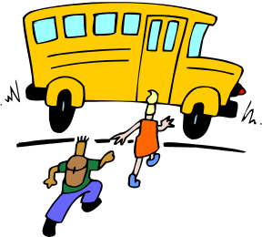

So…What is 6th grade really like…
Team of Teachers & Students
4 Core Classes and 2 Exploratory Periods
Hallway time - Change Classes/Teachers
PE & Advisory/ EEE rotate every other day
New Friends!
Exciting Opportunities!
More Freedom = More Responsibility!
Jump Start Day…
ARE YOU READY FOR THE CHALLENGE!!???!!

Slide 13
ORIENTATION NIGHTS
Coming this Spring!
Virtual Visit YOUR Middle School- Monday May 2, 2022
Presentation for students and families
Hear more about what it’s like to be a 6th grader
Find out about before and after school opportunities
Tour the building (check out classrooms, lockers, gym, lunchroom, etc.)
Each Middle School will share specifics about orientation night.

Slide 14







Questions? School Counselors
Gentry Middle School 573-214-3243
Jeanine Atwell jatwell@cpsk12.org
Abi Elliott aelliott@cpsk12.org
Joel Harris jharris@cpsk12.org
Jefferson Middle School 573-214-3212
Mike Hogan mhogan@cpsk12.org
Barbara Moore bmoore@cpsk12.org
Lange Middle School 573-214-3253
Rachelle LeCure rlecure@cpsk12.org
Belinda Woods - Galbreath bwoods@cpsk12.org
Oakland Middle School 573-214-3220
Eric Hudson ehudson@cpsk12.org
Nawassa Logan nlogan@cpsk12.org
Smithton Middle School 573-214-3263
Danielle Sipe dsipe@cpsk12.org
Raine Fick rfick@cpsk12.org
West Middle School 573-214-3233
Joel Harris jharris@cpsk12.org
Debbie Poese dpoese@cpsk12.org
Lauren Truelove ltruelove@cpsk12.org
John Warner Middle School 573-214-3890
Jessica Nicewarner jnicewarner@cpsk12.org
Kacie Sapp ksapp@cpsk12.org

Slide 15


Go… Middle School!!!
Lange Leopards
West Vikings
Smithton Wildcats

