Slide 1



CONNECTICUT STATE DEPARTMENT OF EDUCATION
Civil Rights
Your Responsibilities in the School Nutrition Programs
August 2023

Slide 2
Topics
Civil Rights Overview
Assurances
Public Notification
Data Collection
Language Assistance
Accommodations
Customer Service
Conflict Resolution
Complaint Procedure
Compliance Reviews/Resolution

Slide 3
Civil Rights Legislation
Law | Addresses
Title VI – Civil Rights Act of 1964 | Race, color and national origin
Civil Rights Restoration Act of 1987 | Clarifies scope of Civil Rights Act of 1964
Section 504 of the Rehabilitation Act of 1973, Americans with Disabilities Act (ADA) of 1990, and ADA Amendments Act of 2008 | Disability
Title IX of the Education Amendments of 1972 | Sex (including gender identity and sexual orientation)
Age Discrimination Act of 1975 | Age

Slide 4
Civil Rights Program Authorities
28 CFR Part 42: Nondiscrimination
in Federally Assisted Programs
U.S. Department of Agriculture (USDA)
Food and Nutrition Service (FNS) Instruction 113-1 Appendix B
Executive Order 13166: Addresses/improves access requirements for persons with Limited English Proficiency (LEP)

Slide 5
Civil Rights Program Authorities
USDA LEP Policy Guidance
(79 Federal Register No. 229. Friday, November 28, 2014)
7 CFR Part 16: “Equal Opportunity for Religious Organizations”

Slide 6
Civil Rights Program Authorities
USDA Regulation 4330-2: Prohibits discrimination in programs and activities receiving Federal financial assistance from USDA
Bostock v. Clayton County, 140 S. Ct. 1731, 590 U.S.___(2020)

Slide 7
USDA Civil Rights Policy
FNS Instruction 113-1
To establish and convey policy and provide guidance and direction to the USDA FNS and its recipients and customers and ensure compliance with and enforcement of the prohibition against discrimination in all FNS programs and activities whether federally funded or not
https://www.fns.usda.gov/fns-instruction-113-1

Slide 8
USDA Civil Rights Policy
FNS Instruction 113-1 applies to
National School Lunch Program (NSLP)
School Breakfast Program (SBP)
Special Milk Program (SMP)
Fresh Fruit and Vegetable Program (FFVP)
Afterschool Snack Program (ASP)
Seamless Summer Option (SSO) of the NSLP
https://www.fns.usda.gov/fns-instruction-113-1

Slide 9
Purpose of Civil Rights
Equal opportunity to participate in
and access benefits and services

Slide 10
Civil Rights Overview
USDA protected classes | CSDE protected classes
Race Color National origin Sex (including gender identity and sexual orientation) Disability Age Reprisal or retaliation for prior civil rights activity | All federal, plus Religious creed Ancestry Marital status Gender expression Genetic information

Slide 11
What is Discrimination
The act of distinguishing one person
or group of persons from others based
on the protected bases
  Intentional, e.g., not accommodating a disabled child with a dietary need is verified by a recognized medical authority
  Neglect or omission
  Effect of actions or lack of actions, e.g., intentionally delaying approval of an eligibility application

Slide 12
Assurances
To qualify for federal financial assistance, all programs need a written assurance that the program or facility will be operated in compliance with the civil rights laws and implementing nondiscrimination regulations

Slide 13
Assurances
A civil rights assurance must be incorporated in all agreements
between state and local agencies
  Included in CSDE’s Permanent Agreement for Child Nutrition Programs (CNPs)
FNS Instruction 113-1 Appendix B contains required language for NSLP, SMP, SBP, FFVP, and ASP

Slide 14
Assurances
Retailer and vendor agreements and contracts (including food service management company (FSMC) contracts) must also include an assurance of nondiscrimination
Example: If school food authority (SFA) contracts with FSMC to provide food service to students, SFA is responsible for ensuring that FSMC complies with civil rights requirements

Slide 15
Assurances
Prescribed language must be included in all
  contracts
  Memoranda of Understanding (MOU)
  Memoranda of Agreement (MOA)

Slide 16
Assurances
Assurance is binding on program application and its successors, transferees, and assignees as long as they receive assistance or retain possession of any assistance from the USDA

Slide 17
Civil Rights Assurance Statement
NSLP, SBP, SMP, FFVP, ASP
"The program applicant hereby agrees that it will comply with Title VI of the Civil Rights Act of 1964 (42 U.S.C. § 2000d et seq.), Title IX of the Education Amendments of 1972 (20 U.S.C. § 1681 et seq.), Section 504 of the Rehabilitation Act of 1973 (29 U.S.C. § 794), the Age Discrimination Act of 1975 (42 U.S.C. § 6101 et seq.); all provisions required by the implementing regulations of the Department of Agriculture; Department of Justice Enforcement Guidelines, 28 CFR Part SO.3 and 42; and FNS directives and guidelines, to the effect that, no person shall, on the grounds of race, color, national origin, sex (including gender identity and sexual orientation), disability, age, or reprisal or retaliation for prior civil rights activity be excluded from participation in, be denied benefits of, or otherwise be subject to discrimination under any program or activity for which the program applicant receives Federal financial assistance from FNS; and hereby gives assurance that it will immediately take measures necessary to effectuate this agreement.”
“By accepting this assurance, the Program applicant agrees to compile data, maintain records, and submit reports as required, to permit effective enforcement of nondiscrimination laws and permit authorized USDA personnel during hours of program operation to review such records, books, and accounts as needed to ascertain compliance with the nondiscrimination laws. If there are any violations of this assurance, the Department of Agriculture, FNS, shall have the right to seek judicial enforcement of this assurance. This assurance is binding on the Program applicant, its successors, transferees, and assignees as long as it receives assistance or retains possession of any assistance from USDA. The person or persons whose signatures appear below are authorized to sign this assurance on the behalf of the Program applicant.”
FNS 113-1 Appendix B
https://www.fns.usda.gov/fns-instruction-113-1

Slide 18
Public Notification
SFAs must notify the public of their participation in USDA school nutrition programs
Program availability
Program rights and responsibilities
Policy of nondiscrimination
Procedure for filing a complaint

Slide 19
Public Notification Methods
Inform community of program and details
  Internet, newspaper articles, radio and
  TV announcements, letters, bulletins, etc.
  Eligibility, benefits, services, facility location,
  hours and delivery points
Provide appropriate information in alternative formats for person with disabilities and in the appropriate languages for LEP persons

Slide 20
Public Notification Methods
Convey equal opportunity in photos and other graphics in program-related information
Include the required nondiscrimination statement on all appropriate publications, websites, posters, and informational materials

Slide 21
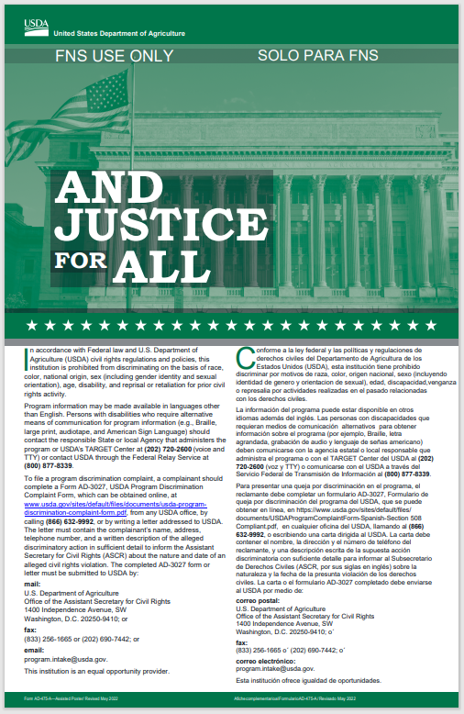
“And Justice for All” (AJFA) Poster
New Posters
All entities participating in Child Nutrition Programs must prominently display the USDA’s “And Justice for All” (AJFA) poster where participants and potential participants have access
https://fns-prod.azureedge.net/sites/
default/files/cr/Justice-poster-general.pdf

Slide 22
“And Justice for All” (AJFA) Poster
Updated USDA AJFA posters are in production and will be distributed to all SFAs when available
AJFA posters dated September 2019 can be displayed until new posters are received

Slide 23
“And Justice for All” (AJFA) Poster
For school year 2023-24
The AJFA poster must be prominently displayed in all facilities and locations that distribute Program benefits or administer services
If the 2019 AJFA posters are not available for display, paper copies may be substituted as necessary if SFA has not received new posters (issued 2019)
Poster and translations available at:
https://www.fns.usda.gov/cr/and-justice-all-posters-guidance-and-translations

Slide 24
“And Justice for All” (AJFA) Poster
For school year 2023-24
Schools serving all meals in classroom can display posters in prominent locations throughout the school
  bulletin board in the building entrance
  school office
  another area frequently visited by parents/guardians and children
Schools may copy posters and put one in each classroom

Slide 25
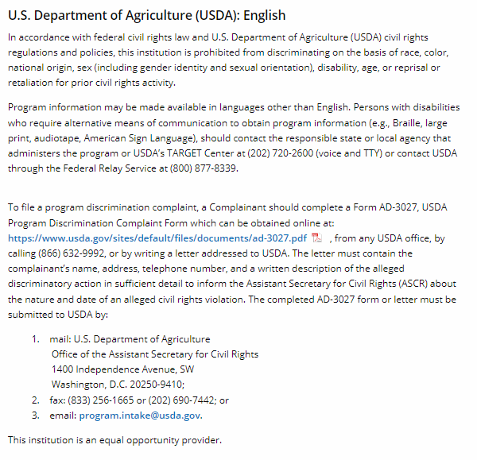
USDA Nondiscrimination Statement

Slide 26
Nondiscrimination Statement
The most current nondiscrimination statement (2022) must be on
  application forms
  notification letters
  state agency and SFA program webpages (English and Spanish)
  information developed for public information

Slide 27
Nondiscrimination Statement
Short statement can be used only in special circumstances (e.g., menu, one-page flier)
    “This institution is an equal opportunity provider.”

Slide 28
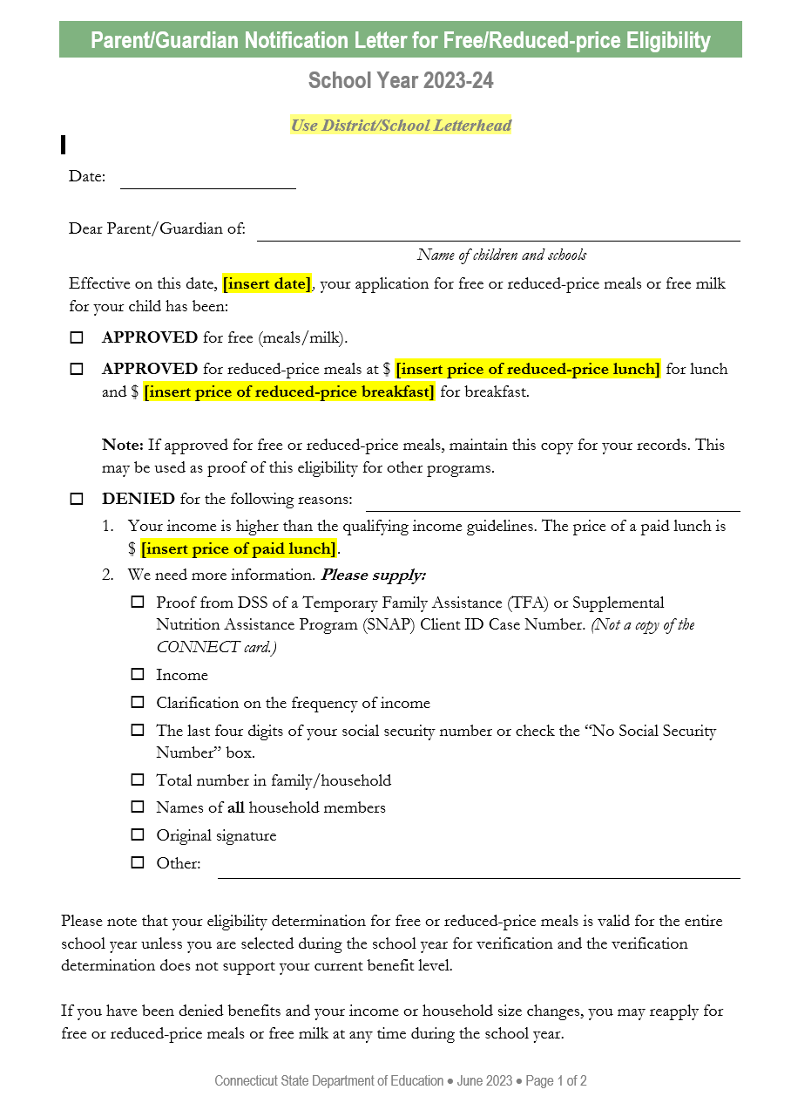
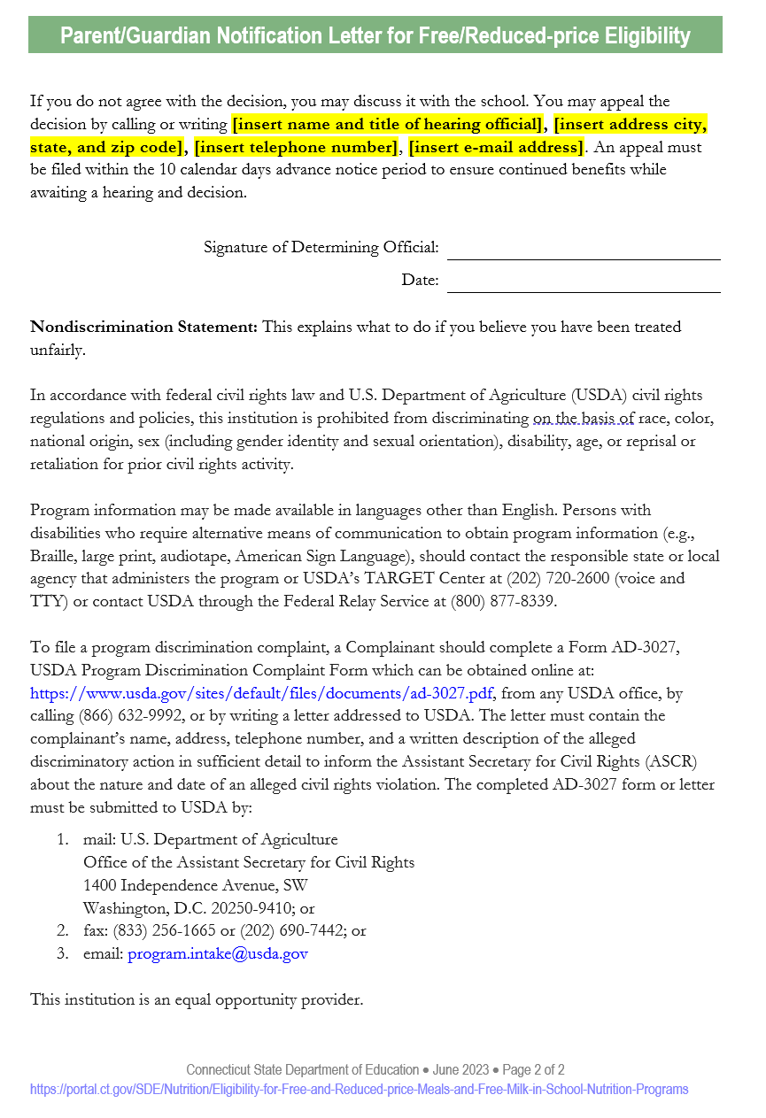
Nondiscrimination Statement
Vital documents about sensitive topics require full statement, even if one page
  Example: CSDE’s one-page sample parent/guardian notification letter for free and reduced-price meals has full USDA nondiscrimination statement on page 2
Letter (page 1) Nondiscrimination Statement (page 2)
https://portal.ct.gov/-/media/SDE/Nutrition/NSLP/Forms/FreeRed/
Parent_Letter_FAQ_Free_Reduced_Meals_NSLP_SBP.docx

Slide 29
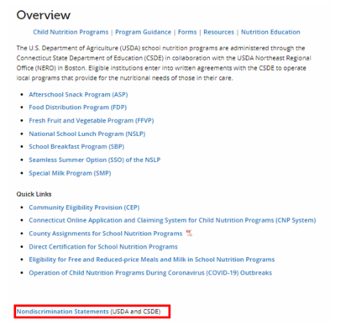
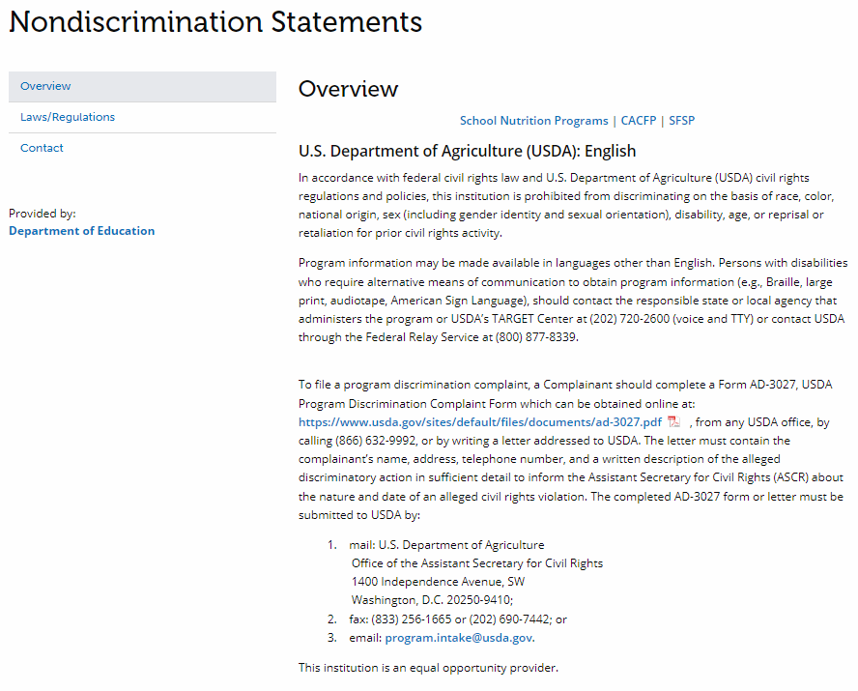
Nondiscrimination Statement
Webpages with information pertaining to Child Nutrition Programs must
  include full statement OR
  contain a direct link to full statement
Letter (page 1) Nondiscrimination Statement (page 2)

Slide 30
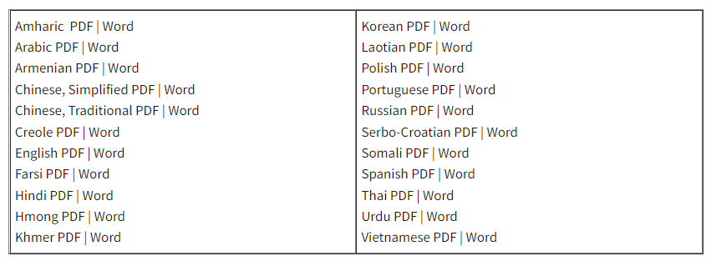
Nondiscrimination Statement
Other language translations available on FNS Civil Rights webpage
https://www.fns.usda.gov/cr/fns-nondiscrimination-statement

Slide 31
Collection and Use of Data
Collection of Data
Develop a method for data collection on the racial/ethnic breakdown of potential participants (free and reduced applications or data collected by school officials)
  Sources include census or public school enrollment

Slide 32
Collection and Use of Data
Collection of Data
Any data collected about beneficiaries must be kept secure and confidential
Maintain all records
  Current to 3 years prior

Slide 33
Collection and Use of Data
Use of Data
To determine how effectively CNPs are reaching potentially eligible persons and beneficiaries
Outreach efforts can be targeted
Information is used for statistical purposes only and has no effect on eligibility criteria

Slide 34
Collection and Use of Data
Use of Data
Verification of citizenship or immigration status should never give rise to discrimination

Slide 35
Complaint Procedures
Civil Rights complaint procedures
are outlined in FNS Instruction 113-1
SFA must have a written formal procedure for receiving and processing complaints alleging discrimination within FNS programs (NSLP, SBP, SMP, FFVP, ASP)
SFA must use CSDE-issued complaint procedure dated February 2023
  The procedure as written cannot be edited
https://portal.ct.gov/-/media/SDE/Nutrition/CivilRights/
Civil_Rights_SNP_Complaint_Procedures.docx

Slide 36
Complaint Procedures
SFA will provide complainant with information pertaining to filing a Program Discrimination Complaint as a USDA Customer
Nondiscrimination statement provides instructions (English and Spanish)
SFA will refer complainant to FNS Civil Rights website

Slide 37
Complaint Procedures
All civil rights complaints shall be accepted and forwarded to the USDA Office of the Assistant Secretary for Civil Rights (OASCR)
  mail: U.S. Department of Agriculture Office
  of the Assistant Secretary for Civil Rights
  1400 Independence Avenue, SW
  Washington, D.C. 20250-9410; or
  fax: (833) 256-1665 or (202) 690-7442; or
  email: program.intake@usda.gov

Slide 38
Complaint Procedures
Individuals must file a complaint within
180 days from the act of discrimination
Complaints may be written or verbal
Never discourage groups or individuals from filing complaints or from voicing allegations of discrimination
Notify CSDE that a complaint has been or may be filed

Slide 39
Complaint Procedures
Maintain tracking log of complaints received and forwarded to OSCAR
The procedures for receiving a complaint should not prevent a complaint from being accepted
SFA will not attempt to resolve the complaint themselves

Slide 40
Verbal Complaints
If complainant will not put the complaint
in writing, SFA must do so
Use USDA Discrimination Complaint Form to ensure you capture all required information
  English
  Spanish
https://www.usda.gov/sites/default/files/documents/ad-3027.pdf
https://www.usda.gov/sites/default/files/documents/ad-3027s.pdf

Slide 41
Language Assistance
Limited English Proficiency (LEP) individuals
  do not speak English as their primary language
  have limited ability to read, speak, write, or understand English
SFAs have a responsibility to take “reasonable steps” to ensure meaningful access to their programs and activities by
a LEP person

Slide 42
Language Assistance
Must take reasonable steps to ensure meaningful access to the programs and activities
  Providing documents in a variety of languages (translation)
  Providing interpretation services to those that need help in completing applications
  Providing verbal information for individuals who are unable to read the written information provided

Slide 43
Language Assistance
What constitutes “reasonable steps” depends on four factors
  Number or proportion of LEP persons eligible to be served or likely to be encountered within the area serviced by the recipient
  Frequency with which LEP individuals come in contact with the program
  Nature and importance of the program, activity, or service provided by the program
  Resources available and their costs

Slide 44
Language Assistance
What is meaningful access?
Meaningful access is accomplished by providing reasonable, competent/qualified, accurate, and effective language services to individuals with LEP when accessing recipient programs and activities

Slide 45
Language Assistance
USDA provides application forms in
many foreign languages
Foreign language teachers and community organizations may have resources to help with translations (written and verbal)
https://www.fns.usda.gov/cn/translated-applications

Slide 46
Language Assistance
May use volunteers but make sure they are competent/qualified, understand interpreter ethics, and maintain participant confidentiality
  Children cannot be used as interpreters

Slide 47
Language Assistance
SFAs must identify their district’s predominant languages and provide documents or services to participants and their families in those languages
    Free and reduced-price applications
    Notification letters
    Interpretive services for parent questions

Slide 48
Language Assistance
LEP Taglines
A phrase in different languages that guides a person to where they can obtain language assistance services
Top six languages spoken in Connecticut for school year 2019-20 (EdSight)
    Spanish
    Portuguese
    Arabic
    Creole-Haitian
    Mandarin
    Albanian

Slide 49
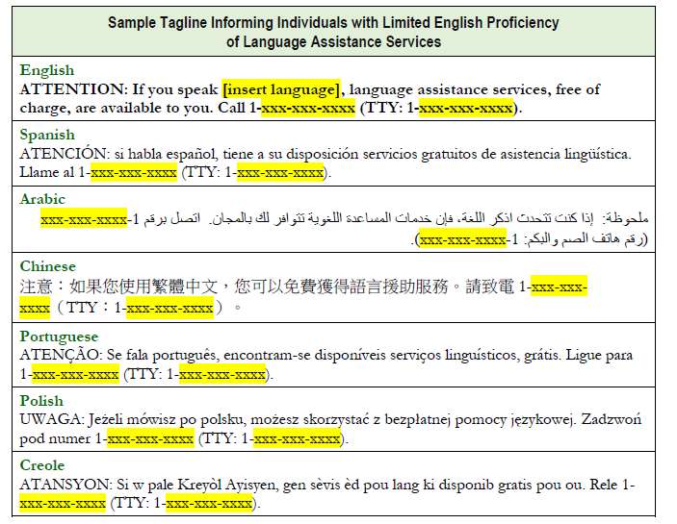
Language Assistance
LEP Taglines
Samples available
https://portal.ct.gov/-/media/SDE/Nutrition/NSLP/Forms/FreeRed/
Taglines_Providing_Meaningful_Access_CNPs.pdf

Slide 50
Language Assistance
District Website
  Does the website have the ability to provide information in another language?
  Would an LEP individual be able to find out how to access the webpage in another language?
  Work with your IT department to make the district website more accessible to LEP persons

Slide 51

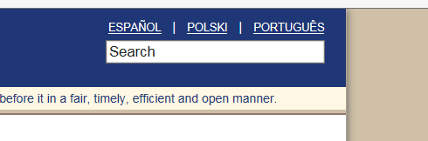
Language Assistance
Compare the two examples
If Spanish was your native language and you could not read English, which format would be the most helpful to indicate the website was available in other languages?
Example 1
Example 2

Slide 52
Language Assistance
Answer: Example 2
Example 2 shows
the language options recognizable to a LEP individual
Example 2
  Work with your district or school website designer to see if the website has the capability to offer language assistance in this way

Slide 53
Language Assistance
CSDE English Learners Website
English Learners and Bilingual Education Statues
Connecticut English Language Proficiency (CELP) Standards
English Learners Data Bulletin
https://portal.ct.gov/SDE/English-Learners/English-Learners

Slide 54
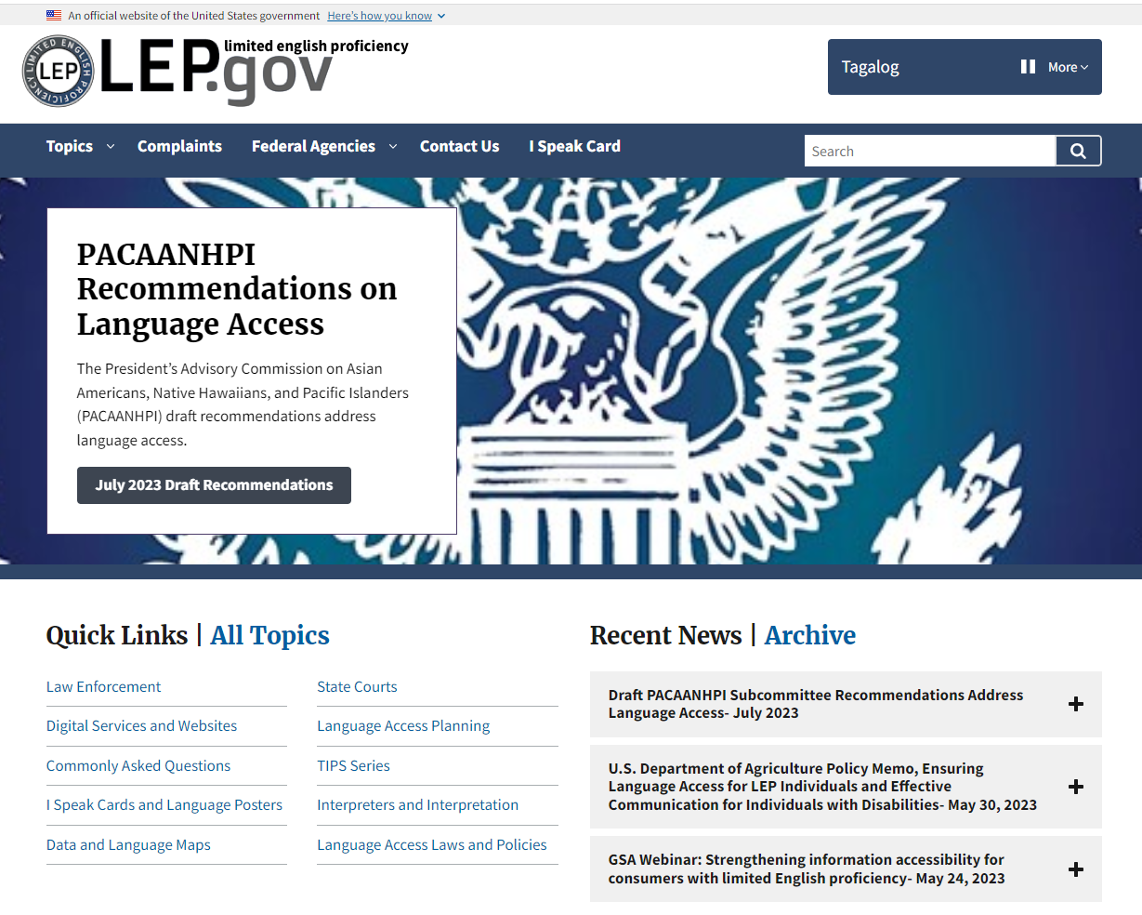
Language Assistance
More information
and resources available on the LEP Website
https://www.lep.gov/

Slide 55
Disability Discrimination
Sections 504 and 508 of the Rehabilitation Act of 1973 and 7CFR Part 15b, prohibit discrimination based on disability in programs or activities receiving Federal financial assistance
The ADA, 28 CFR Part 35, Title II, Subtitle A, prohibits discrimination on the basis of disability in all services, programs and activities provided to the public by State and local government
These civil rights laws protect persons with disabilities if they are potential applicants or participants in any FNS funded programs

Slide 56
Disability Discrimination
“Person with a disability” has a
physical or mental impairment which substantially limits one or more major life activity, has a record of such an impairment, or is regarded as having and impairment
    Source: Section 504 of the Rehabilitation Act of 1973 and the American with Disabilities Act (ADA) of 1900, and the ADA Amendments Act of 2008 (P.L. 110-325)

Slide 57
Disability Discrimination
It is imperative that SFA websites and online application systems are readily accessible to and useable by persons with visual impairments and other disabilities
Programs must ensure physical accessibility for buildings and facilities, particularly to persons in wheelchairs and with mobility disabilities

Slide 58
Disability Discrimination
In some cases, different or special treatment may be necessary to ensure effective aids, benefits and services are reasonable

Slide 59
Examples of Accommodations
Access for persons in wheelchairs and other mobility limitations
Access for those with limited vision
Using American Sign Language (ASL) and interpreters
Substitutions for children whose disability restricts their diet

Slide 60
Special Diets Resources
CSDE website: Accommodating Special
Diets in School Nutrition Programs
  CSDE’s Guide: Accommodating Special Diets
  in School Nutrition Programs
  Summary Chart (Overview of USDA Requirements)
  Medical Statement
  Guidance and Instructions for Medical Statement
  Allowable Milk Substitutes
  Additional Resources
https://portal.ct.gov/SDE/Nutrition/Special-Diets-in-School-Nutrition-Programs

Slide 61
Special Diets Resources
CSDE Presentation: Requirements for Meal Modifications in School Nutrition Programs
CSDE Presentation: Managing Food Allergies in the Cafeteria: The Role of School Food Service Managers and Staff
https://portal.ct.gov/-/media/SDE/Nutrition/NSLP/SpecDiet/Meal_Modifications_SNP_Presentation.pdf
https://portal.ct.gov/-/media/SDE/Nutrition/NSLP/SpecDiet/Managing_Food_Allergies_Cafeteria_SNP_Presentation.pdf

Slide 62
Customer Service
Good customer service reduces chances of discrimination complaints
  Be courteous and thoughtful
  Be patient and listen carefully
  Treat all students equally (no seating arrangements, serving lines, services and facilities, or eating periods separated by protected class)

Slide 63
Conflict Resolution
This area must be covered in
SFA’s Civil Rights procedures
Include how SFA will process a complaint with the goal of providing a solution with assistance of state agency and USDA, as needed
Refer to “FNS-113 Complaint Processing Procedures & Timelines” diagram for a summary of handling Civil Rights complaints and required timeframes
https://www.fns.usda.gov/fns-instruction-113-1

Slide 64
Conflict Resolution
If a situation has potential to become a
civil rights complaint, it may be possible to deescalate with mediation or conflict resolution techniques
  Remain calm and ask about the situation
  Repeat the complaint back and make sure you understand the complaint
  Try to help those involved work out differences
  Get help if threats or violence is possible

Slide 65
Compliance
Pre-award compliance review
Ongoing compliance is verified during Administrative Reviews
  Pre-award and ongoing: SFA must inform CSDE of any complaints or litigation filed against SFA
CSDE reports significant findings to USDA
All findings require corrective action
Follow-up visit may be needed to assure compliance

Slide 66
Required Training
USDA requires that all staff who work with program applicants or participants receive annual Civil Rights training
All staff includes front line staff, supervisors, and determining, verifying, and hearing officials
Training records are required
  Agendas, sign-in sheets

Slide 67
Required Training Topics
Data collection and use
Effective public notification
Complaint procedure
Compliance review techniques
Resolution of noncompliance
Reasonable accommodation
for disabilities
Language assistance
Conflict resolution
Customer service

Slide 68
Required Training
This PowerPoint presentation is available on the CSDE’s Civil Rights website for SFAs to provide staff training
Training should be documented for each staff member as part of the Professional Standards training requirements
https://portal.ct.gov/SDE/Nutrition/Civil-Rights-for-Child-Nutrition-Programs

Slide 69
CSDE Contacts
CSDE School Nutrition Programs
County | Consultant
Fairfield County (includes Region 9) Litchfield County (includes Regions 1, 6, 7, 12, and 14) | Fionnuala Brown fionnuala.brown@ct.gov 860-807-2129
Hartford County (includes Region 10) Middlesex County (includes Regions 4, 13, and 17 | Teri Dandeneau teri.dandeneau@ct.gov 860-807-2079
New Haven County (includes Regions 5, 15, and 16) | Greg King 860-713-6804 greg.king@ct.gov
New London County Tolland County (includes Regions 8 and 19) Windham County (includes Region 11) | Susan Alston susan.alston@ct.gov 860-807-2081
Connecticut State Department of Education Bureau of Child Nutrition Programs 450 Columbus Boulevard, Suite 504, Hartford, CT 06103-1841

Slide 70
Questions

