Slide 1

Sensory Processing
Home and school
BSD Special Ed. Family Resource Training Series
Notes:
Michelle

Slide 2

This event is organized & hosted in partnership with the BSNPTA
https://www.bellevuespecialneedspta.com/
Lisa Ritchie - Board Member
Notes:
Michelle

Slide 3

Housekeeping
Q&A during presentation
Bathrooms
For translation services for those on Teams, please open Google Translate on your smartphones
Your feedback is important! Feedback forms for this session will be available either hardcopy or via Microsoft Forms at the end of the presentation
Don't forget to record this session!
Notes:
Michelle

Slide 4

Providing E-mails
Please provide your e-mail addresses for us so we can send you materials from tonight’s presentation after!
  Teams: please drop your address in the chat
  In Person: Please write it at the sign in sheet at the front table
Your e-mail addresses will only be used to distribute the flyers to you and will be kept private

Slide 5

About Katherine
Graduated OT school in 2011
Previously worked as a Special Education Pre-K teacher
OT work experience includes hospital, inpatient, outpatient, skilled nursing, acute rehab, home health
Started working in BSD in 2017 and has worked in pre-k, elementary, high school, and Transitions program
Interested in assistive technology, assistive devices, Inclusive Practices

Slide 6


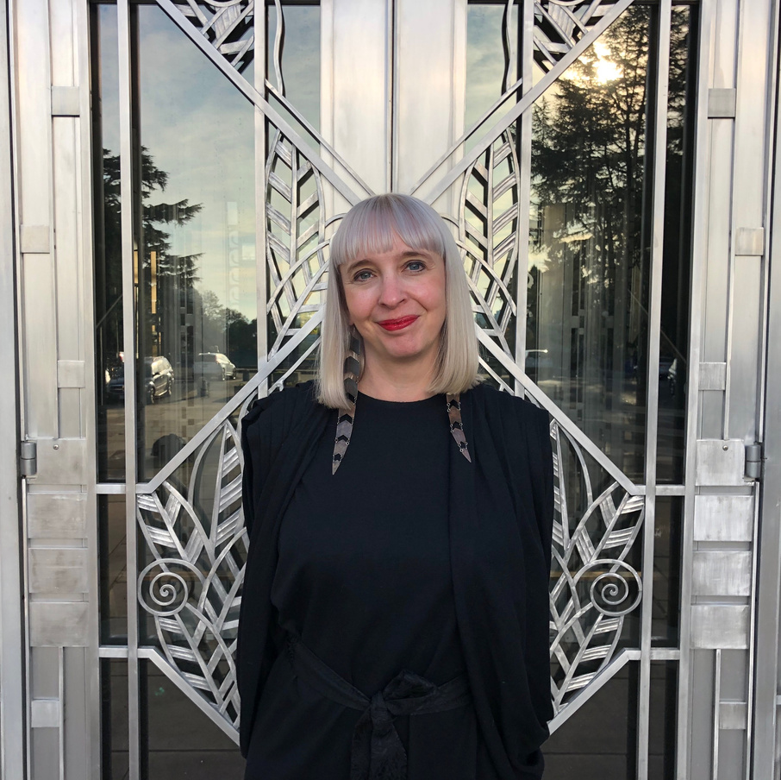
ABOUT DIANE
  I have been an OT since 2002
  Worked in school and clinics with ages 2 through adults
  I run a nonprofit visual arts day program, called Vibrant Palette Arts Center
  I started Cascadia Therapy Services after seeing the sensory needs that weren't being addressed with the artists I worked with at VPAC.
  I teach the pediatrics course at the OTA program in Renton, WA
  I have consulted with Sea-Tac International Airport regarding their upcoming sensory room.
Diane Knoll, OTR/L
Founder and Owner of Cascadia Therapy Services

Slide 7


Sensory Processing and Autism Across the Lifespan
DIANE KNOLL OTR/L
CASCADIA THERAPY SERVICES

Slide 8



Today we're going to talk about
Sensory Solutions for a Lifetime
  What is sensory processing?
  What are our 8 senses?
  What kinds of sensory processing challenges are there?
  What do sensory challenges look like across the lifespan for the Autistic community?
  Helpful sensory strategies

Slide 9
What is Sensory Processing?
Sensory processing is our brain's ability to take
in information from our senses and respond.
“Over 80% of the nervous system is involved in processing or organizing sensory input, & thus the brain is primarily a sensory processing machine”~A. Jean Ayres

Slide 10
Sensory Processing and Autism
Up to 90% of autistic individuals experience some sort of sensory processing challenges.

Slide 11
What are our 8 senses?
Gustatory - Taste
Olfactory - Smell
Visual - See
Auditory - Hear
Tactile - Touch
Vestibular - Balance & Movement
Proprioception - Body Awareness and Location
Interoception - Internal Body Cues

Slide 12

Pyramid of Learning
(Williams and Shellenberger
1996)
Academic Learning
Daily Living Activities
Behavior
Cognitive Intellect
Auditory Language skills,Visual Spatial Perception, Attention Center Functions, Eye-Hand Coordination, Occular Motor Control, Postural Adjustment
Perceptual Motor
Development
Body Scheme, Reflex Maturation, Postural Security,
Ability to Screen Input, Awareness of 2 Sides of Body, Motor Planning
Sensory Motor
Development
Visual, Olfactory, Tactile, Gustatory, Vestibular
Proprioception, Interoception, Auditory
Sensory Systems
Central Nervous System

Slide 13
Types of Sensory Processing Challenges
Sensory Modulation
Adjusting or adapting to new sensory input. Includes arousal, attention, emotion, and self-regulation.
Sensory Discrimination
Being able to distinguish and organize sensory input
Praxis
The process that allows someone to interact with objects and their environment.
It includes ideation, planning,
and executing a motor task.
Notes:
Sensory modulation problems happen when there is a mismatch between an expected response and how the person actually perceives the sensory information.

Slide 14

Sensory Modulation Problems Looks Like:
Seekers/Avoiders
Low/High Thresholds for Response
  Tactile Modulation
  Vestibular Modulation
  Visual Modulation
  Auditory Modulation
Notes:
Sensory modulation problems happen when there is a mismatch between an expected response and how the person actually perceives the sensory information.
Tactile modulation -
seekers You have to touch everything and everyone in sight!
You prefer tight clothing - you like the compression from workout clothing or hosiery.
You crave cuddles and hugs
You mouth objects or clothing frequently
You crave texture on your clothes or blankets
You touch others without asking and don't realize it
Avoiders - don't like slimy/sticky, tags, respond negatively to light touch
Vestibular - Seekers are constantly moving, avoiders are the opposite- motion sickness in cars, avoid elevators/escalators, overly cautious on uneven surfaces
Visual modulation - seekers crave Like to stare at lights or oncoming headlights
Enjoys changing the channel quickly with the remote
You love bright colors and bold patterns.
You frequently look out of the corners of your eyes versus straight on
You like looking at flashing lights or spinning objects
You are easily distracted when there is a lot of visual stimulation surrounding you.
Avoiders avoid bright lights, like dark rooms, overwhelmed by bright colors/ high visual input
Auditory - seekers are going to seek out auditory - like loud music, make noises with mouth or with objects,
Avoiders - cover ears, upset by noises like fire alarms or sirens, lawn mowers. may also make noises to drown out other sounds

Slide 15

Sensory Discrimination Problems Looks Like:
  Tactile - Poor awareness of clothing on body, can't find items in a pocket or bag without looking for them, can't button or engage a zipper without vision.
  Vestibular - Falls out of seat when leaning over, poor balance especially when in motion, does not get dizzy.
  Visual - Difficulty locating an object in a room, letter reversals, challenges with matching color/shapes/sizes, lining up numbers for a math problem, judging distances
  Proprioception - Excessive force or too light of pressure with writing, crashes into people or furniture, petting animals with too much force.
  Auditory - Talks too loudly or softly, trouble differentiating what noises to listen to resulting in ignoring person speaking to them.
Notes:
Sensory modulation problems happen when there is a mismatch between an expected response and how the person actually perceives the sensory information.

Slide 16

Praxis Problems Looks Like:
  Ideation - Difficulty with coming up with the idea for movement or in how to use objects.
  Motor Planning - Challenges with body awareness, planning and sequencing, and the ability to adjust to actions and objects.
  Bilateral Coordination - Problems with using both sides of our body together, crossing the midline, and rotating at the trunk.
  Projected Action Sequence - Difficulty with anticipating future events in your surroundings and the ability to adjust accordingly.
Notes:
Sensory modulation problems happen when there is a mismatch between an expected response and how the person actually perceives the sensory information.

Slide 17

SENSORY PROCESSING CHALLENGES IN CHILDHOOD
Living in a constant state of "fight, flight, or freeze can take a toll on child and the entire family.
Autistic children want to engage with other kids, but sensory processing challenges can make it intolerable for them.
Autistic children may be stigmatized as a "bad kid" by those that don't understand or are unwilling to accommodate their sensory needs.
Sensory processing challenges impact all areas of a child's life, including play, self-care, school, and community access.

Slide 18

A 2016, study showed when asked if Autistic teens felt their sensory processing impacted their learning, 100% responded yes. Most cited a "reduction in concentration". Auditory differences were reported to be the most challenging.(Howe and Stagg, 2016)
Puberty! Remember that interoception involves sexual drive- some teens may need more stimulation in order to stay regulated
(Koscinski, 2020)
Sensory differences can impact dating- considering not only the physical factors of dating but the actual date itself depending on location can lead to sensory overload.
Driving!
SENSORY PROCESSING CHALLENGES IN ADOLESCENCE

Slide 19

Research shows there is a high correlation between anxiety and sensory processing differences in the adult autistic community.
Sensory processing differences persist in the areas of work - including challenges with noise, lighting, smells, and touch input.
Serious relationships and marriages can be impacted due to hypersensitivity to touch or the need for more touch than what one's partner may be comfortable with.
More people are receiving Autism diagnoses in their adult years, that were missed as children.
SENSORY CHALLENGES IN ADULTHOOD

Slide 20
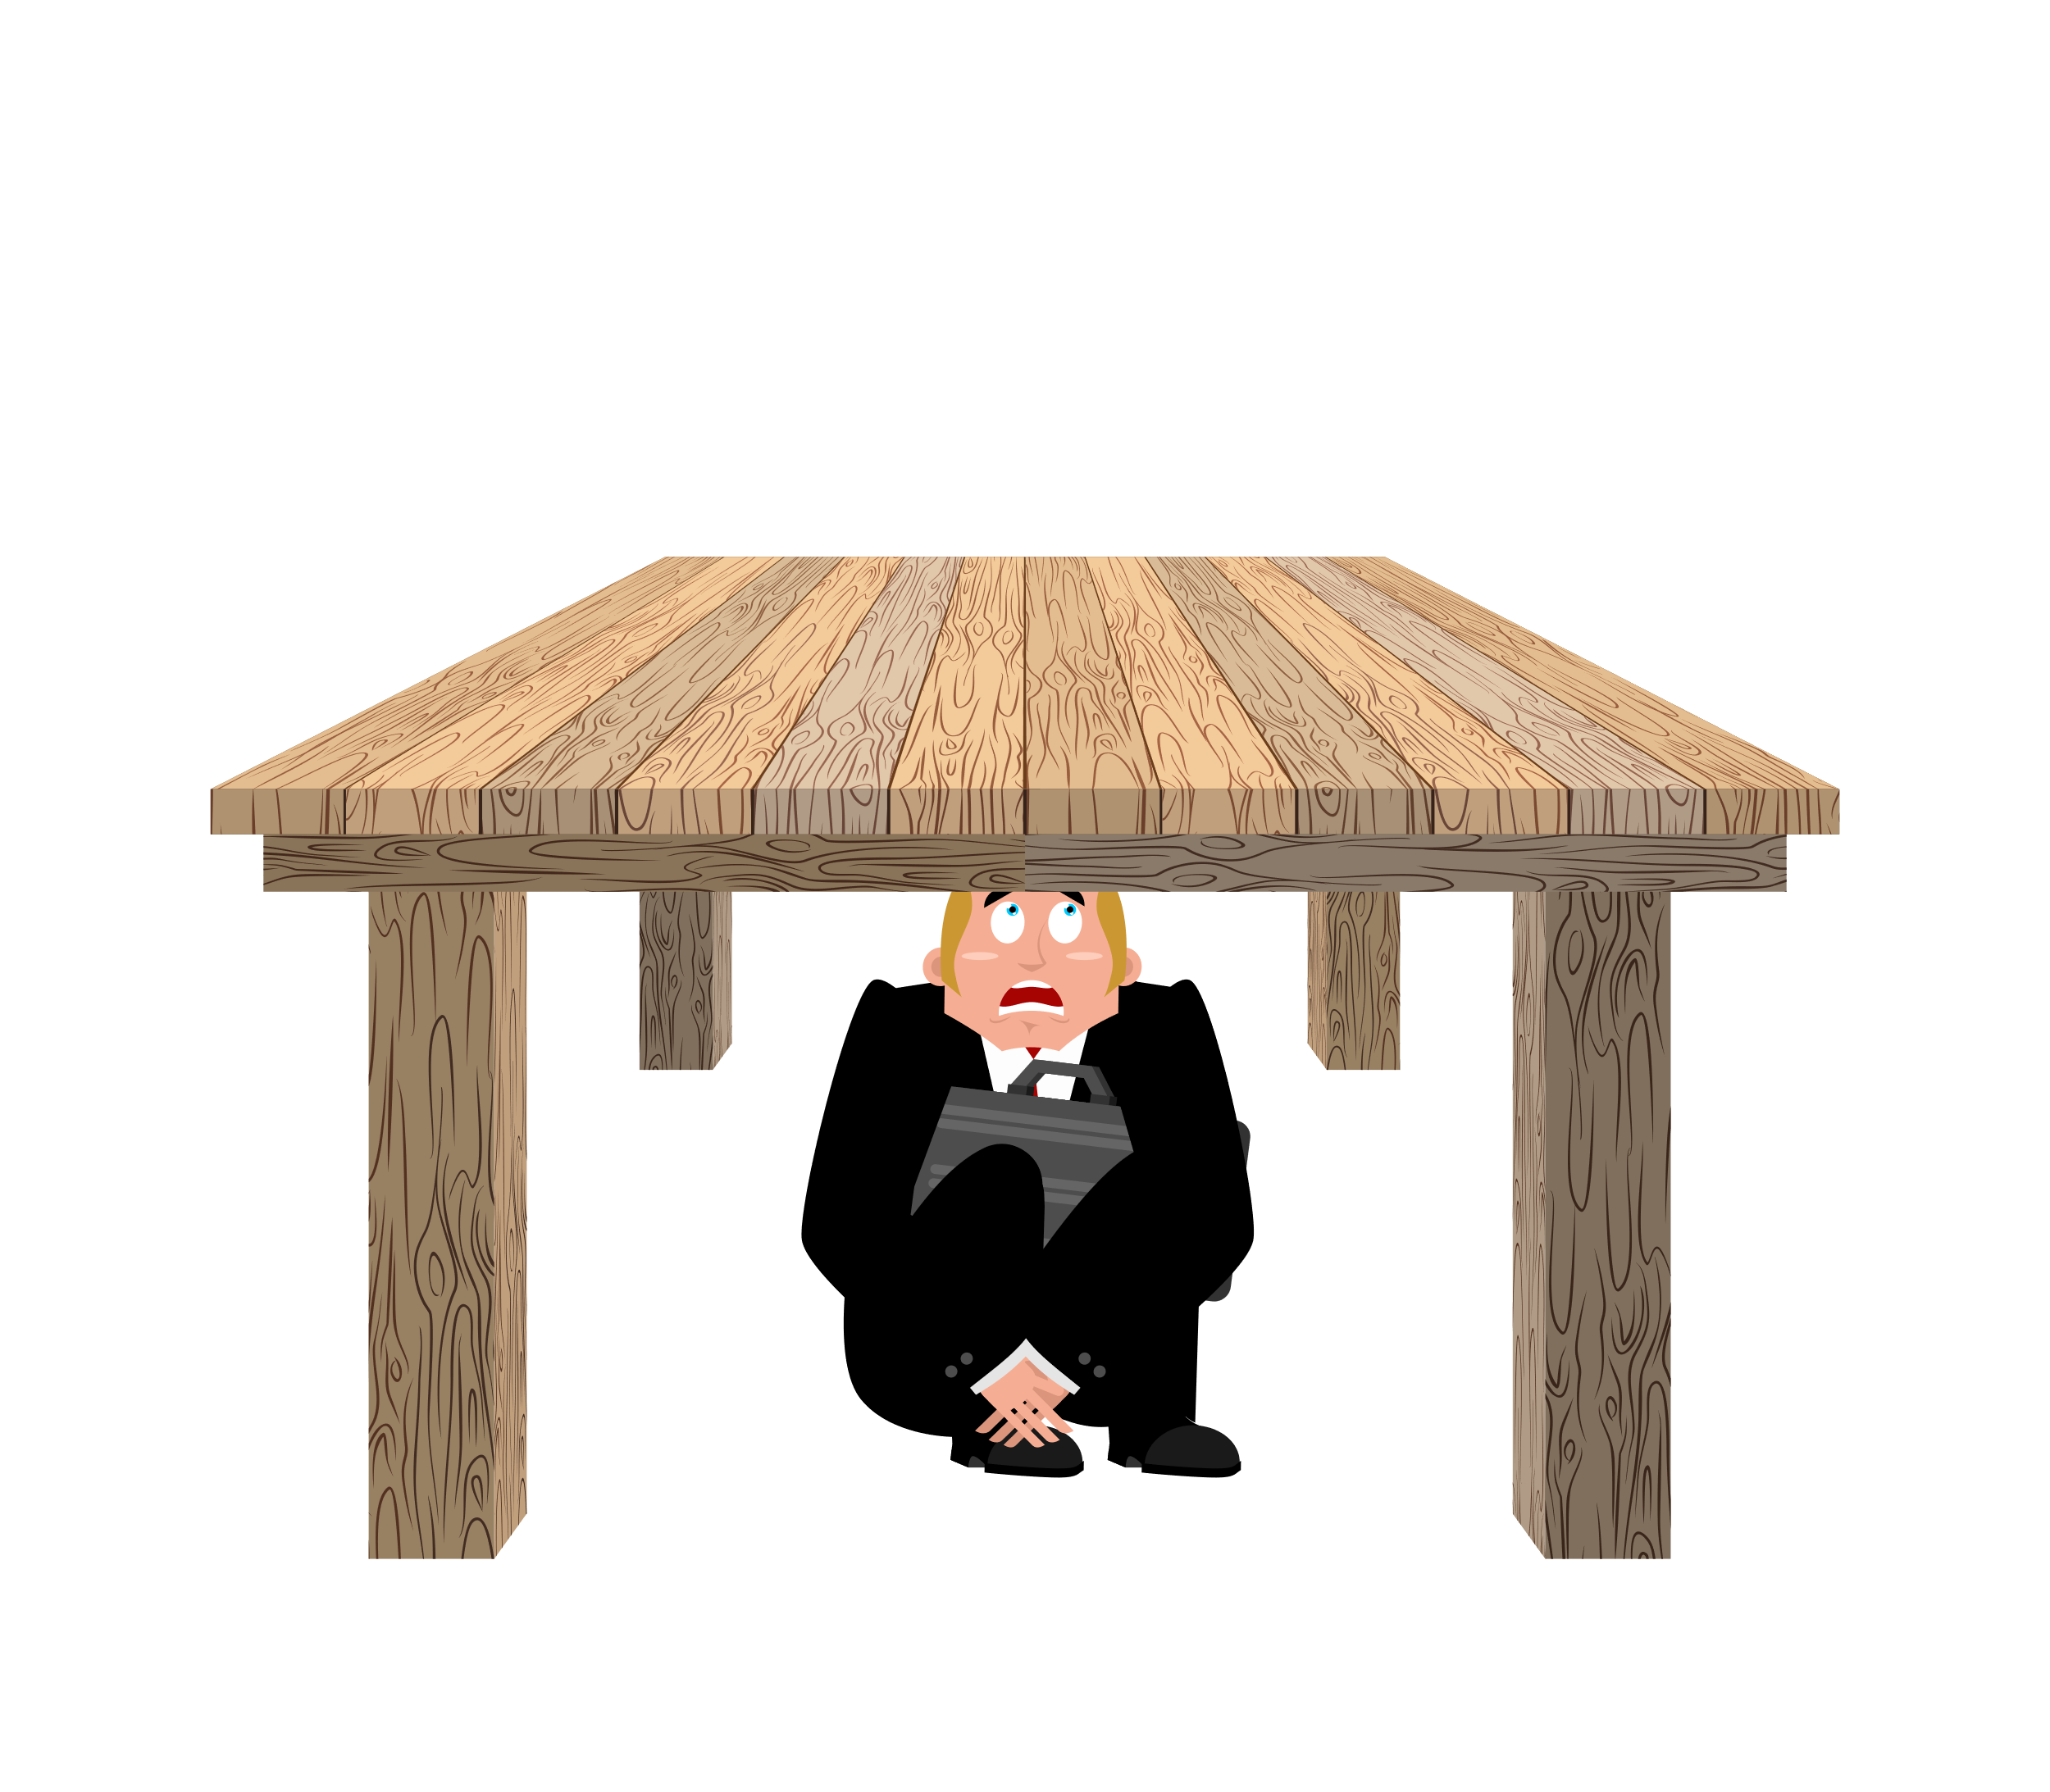
Autistic Burnout is a term described by the autistic community to describe a period of immense physical and mental fatigue.
Research shows that the more a person needs to mask, the more likely they will experience burnout.
It impacts an autistic person ability to manage life skills, social interactions, and sensory input.
Skills regression often occurs during this time.
It is associated with life transitions, and many report their first burnout experience happens during transition from adolescence to adulthood.
(Dora Reymaker, 2019)
AUTISM BURNOUT

Slide 21

AUTISM BURNOUT - SO WHAT HELPS?
  More time with special interests and stimming
  Self-advocacy for one's own sensory needs
  Soothing sensory activities and a sensory diet

Slide 22

  Sensory Diets are a program of sensory activities that can help improve regulation throughout a person's day.
  These activities should be provided about every two hours and be easy to incorporate into one's routine.
  Occupational Therapists specialize in helping autistic individuals develop and tailor a sensory diet to that person's unique sensory system.
Sensory Diets need to be adjusted as each person matures into different phases of their life, and education for new relationships should occur about why they are essential.
SENSORY DIETS AND SELF-REGULATION

Slide 23

  Most OTs that specialize in sensory integration typically work with children, so there are more resources available for this age group.
  OTs are starting to realize the importance of offering sensory integration through adulthood.
Cascadia Therapy Services does serve people in Washington State of all ages with sensory processing challenges. CTS provides not only direct intervention, but also consulting services to group homes and businesses that want to make their environments more sensory friendly.
OCCUPATIONAL THERAPISTS - HOW DO I FIND ONE?

Slide 24

  Most OTs that specialize in sensory integration typically work with children, so there are more resources available for this age group.
  OTs are starting to realize the importance of offering sensory integration through adulthood.
Cascadia Therapy Services does serve people of all ages with sensory processing challenges. CTS provides not only direct intervention, but also consulting services to group homes and businesses that want to make their environments more sensory friendly.

Slide 25


  Join the Facebook Group,"Sensory Support for Adults with SPD"
  Follow CTS! facebook.com/cascadiatherapy/
  Subscribe on YouTube
  Sign up for our newsletter on cascadiatherapy.com
Stay Connected

Slide 26

References
Avery, J., Collins, M., Gotts, S., Kenworthy, L., Ingeholm, J., Martin, A., Riddell, C., Simmons, W., Wallace, G., & Wohltjen, S. (2018). Neural Correlates of Reactivity in Autism Spectrum Disorder. NeuroImage Clinical, Volume 19. 38-46.
Furfaro, H. (2018). Social Smells Evoke Unusual Responses in People with Autism, Spectrum, Accessed May 2020, <https://www.spectrumnews.org/news/social-smells-evoke-unusual-responses-people-autism/>
Howe, F.E.J., Stagg, S.D. How Sensory Experiences Affect Adolescents with an Autistic Spectrum Condition Within the Classroom. J Autism Dev Disord 46, 1656–1668 (2016). https://doi.org/10.1007/s10803-015-2693-1
Koscinski, C. (2020) Puberty in Autism, The Pocket OT, Accessed May 2020, <https://www.pocketot.com/puberty-in-autism-sensory-processing-disorder-5-tips-for-teens/>
Raymaker, D. (2019) Autistic Burnout: My Physical Body and Mind Started Shutting Down, Accessed May 2020, <https://www.seattlechildrens.org/globalassets/documents/health-and-safety/autism/autism_206_raymaker_slides.pdf>
Sarris, M. (2015). What do we know about noise sensitivity in autism? Access May 2020, <https://iancommunity.org/ssc/noise-sensitivity-autism>
Taylor, K.M. and Trott, M. A. 1991 in Williams, M.S. and Shellenberger, S. (1996). “How Does Your Engine Run?”® A leader’s guide to the Alert Program® for self-regulation. Albuquerque, NM: TherapyWorks, Inc.

Slide 27
Interoception
By Diane Knoll, OTR/l

Slide 28
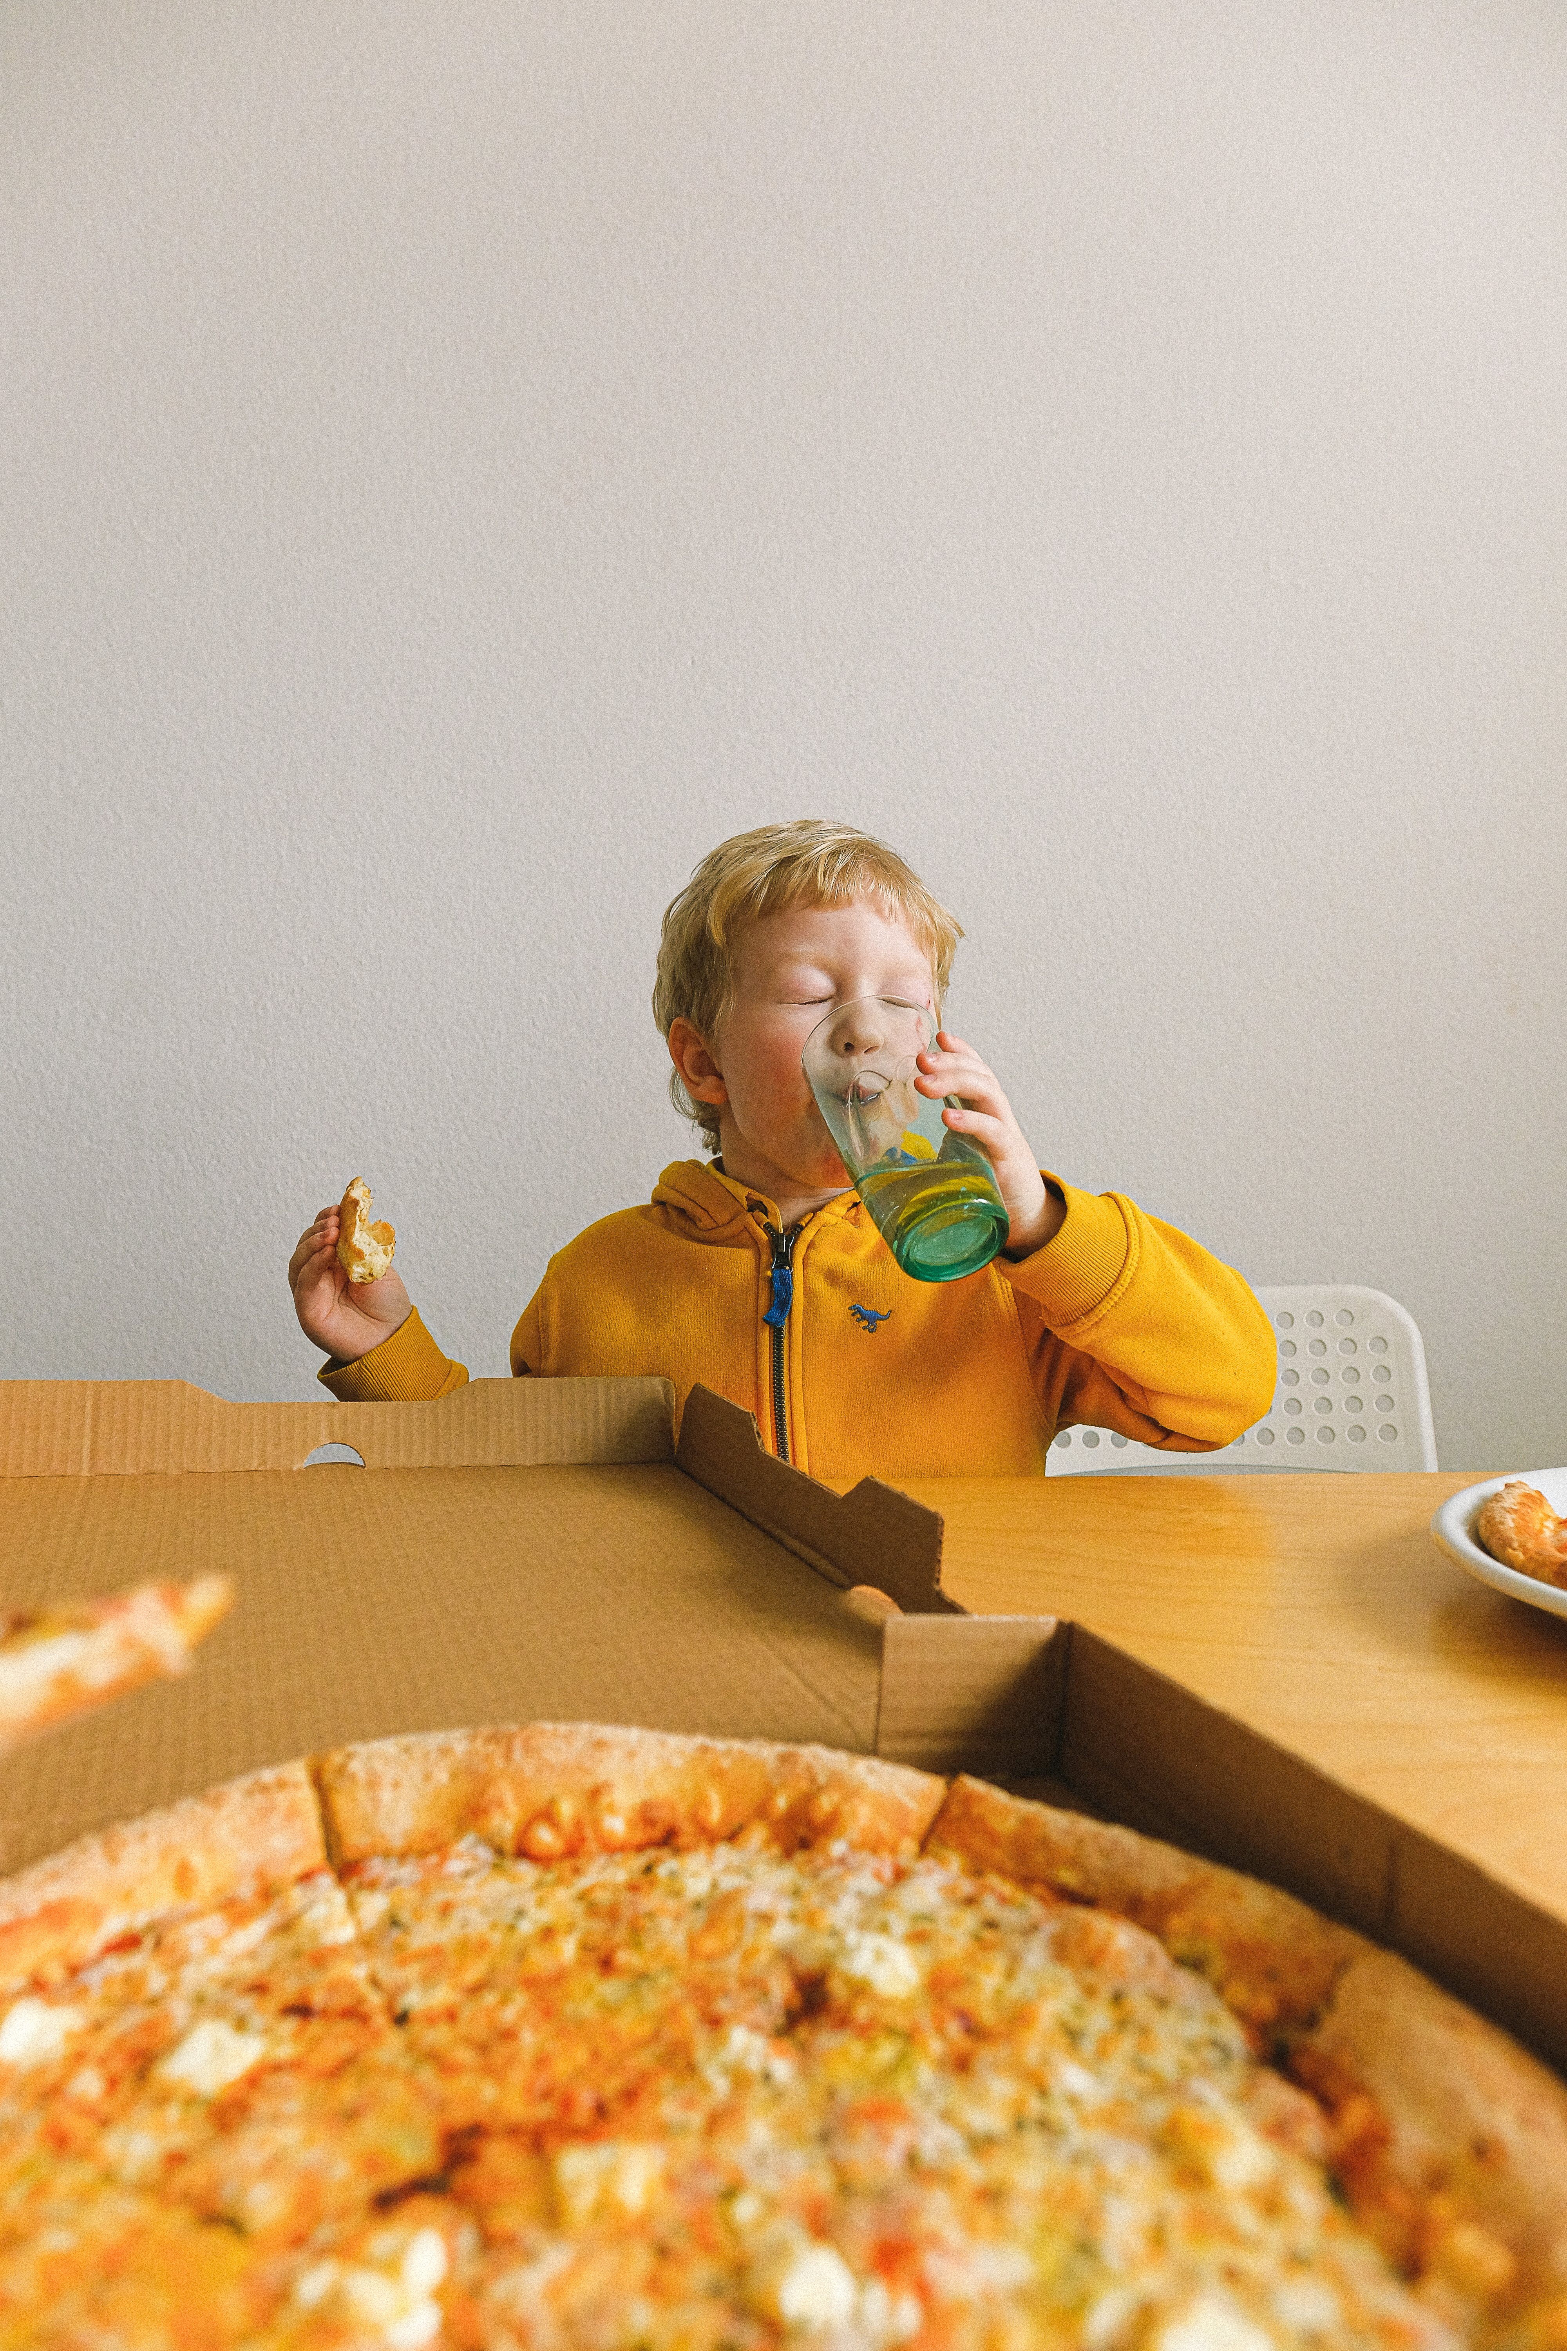
What is interoception?
Interoception is our 8th sense and helps us read our internal body clues. It includes:
Hunger or Fullness
Thirst
Pain
Body Temperature
Heart and Breathing Rate
Social Touch
Muscle Tension

Slide 29

Interoception Cont.
Itch
Nausea
Sleepiness
Tickle
Physical Exertion
Social Touch
Need For The Bathroom

Slide 30
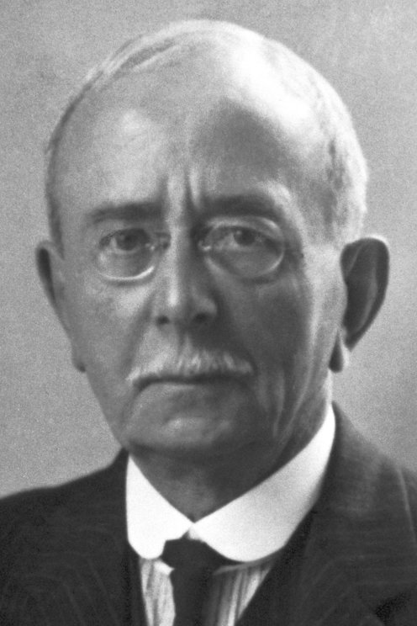

Interoception history
Sir Charles Sherrington, a Nobel-Prize winning doctor, first coined the term in 1906.
He described it as ”the feelings we get from our internal organs”.
Interoception remained mostly unknow for almost 90 years until Neuroscientist A.D. Craig published new research.
Dr. Craig’s research discovered that there are pathways that lead from tissues and organs in the body spinal cord to a specific parts of the brain.
Dr. Craig’s research found that interoception is more than feelings from our organs, but instead the entire condition of the inner body.
This includes temperature, pain, and itch.

Slide 31
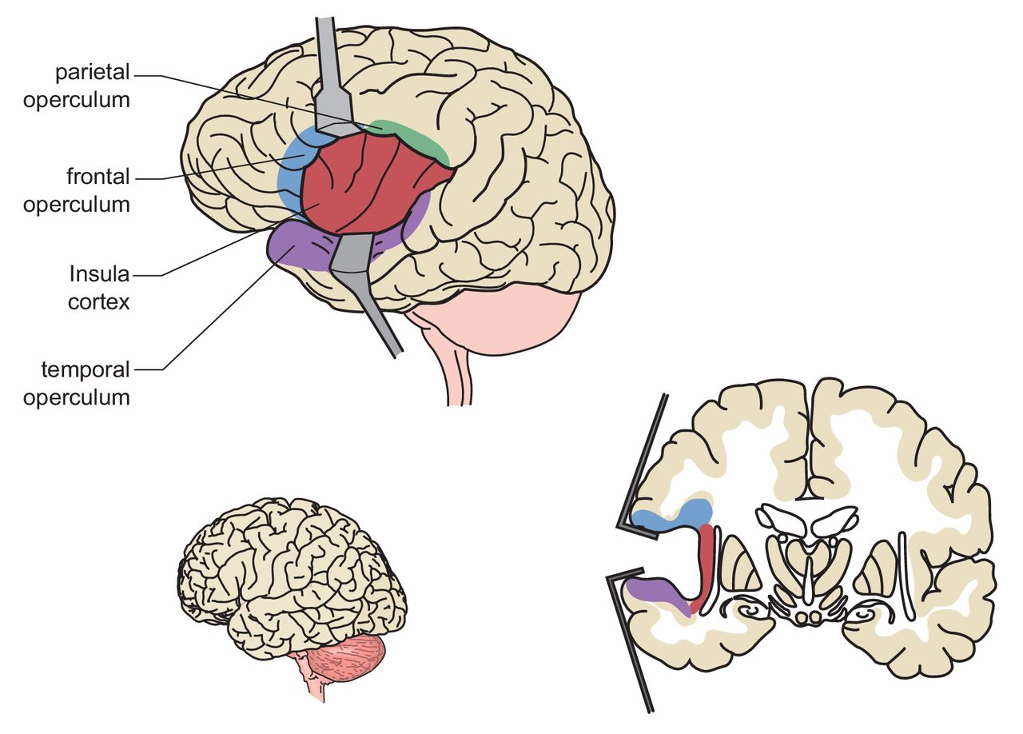
Role of the insula
The insular cortex is the part of the brain that receives the most interoceptive information.
It is called the insula for short.
It uses information from the heart, bladder, and stomach and translates that data into a message that makes sense to us on a conscious level.
It includes emotional states such as fear, anxiety, happiness, excitement, and frustration.
The insula lets us interpret ”how do I feel?”

Slide 32
Interoception and autism
Research shows there is a significant difference between the insula in the Autistic population and those who are not autistic
Connectivity within the subdivisions of the insula and between the insula and other parts of the brain showed a low connectivity of the mid and posterior insula in adolescents and adults with ASD (DiMartino et al., 2014)
In young children with ASD, brain studies have shown a hyper-connectivity.
This suggests a shift may occur from childhood to adolescents and adults with ASD. (Dickstein et. Al., 2013; Nomi & Uddin, 2015).
Structural differences – Reduced gray matter volume in the insula in Autistic individuals (Radeloff et al.)

Slide 33

How do we know when we are thirsty?
We feel the sensation
Dry throat, dry mouth
Body figures out what state it is in or emotion
“I’m Thirsty”
Urge to act
Action
Get a drink
Outcome
No longer have a dry throat, more comfortable

Slide 34
What happens if we have poor interoceptive awareness of thirst?
We don’t feel the sensation
Our body doesn’t figure out it’s current state or emotion
We don’t get the urge to act
Inaction
Consequences – our body becomes more uncomfortable and eventually leads to dehydration.
Impacts our emotional state, energy, and focus. Can lead to heat exhaustion and poor kidney health.

Slide 35
What does an emotion “feel” like?
SAD
Lump in the throat, tight chest, wave of pain through the body
ANXIOUS
Increased heart rate and breathing, break out into hives, feel flushed in the face
EXCITEMENT
Butterflies in stomach, jittery, hard to sit still

Slide 36
Problems with interoception look like:
Waiting until the last minute to use the bathroom
Always feeling hungry or thirsty
Panicking after a brief time of physical exertion
Frequent trips to the nurse’s office at school w/complaints of aches and pains
Insistence that they are feeling ok even when they are visibly angry
Poor flexibility and control of emotions
High rates of depression and poor self-esteem
Poor empathy

Slide 37
How ot helps
Research shows interoception can be improved with 2 types of interventions:
Adaptations for reduced interoceptive awareness
Interoceptive awareness building activities

Slide 38
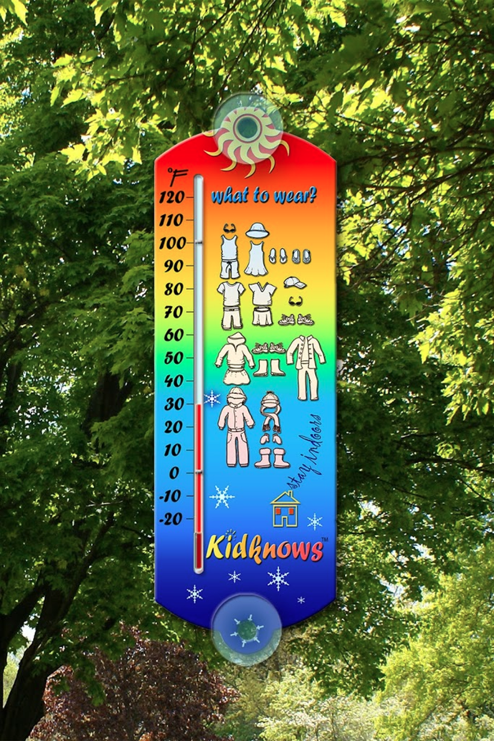
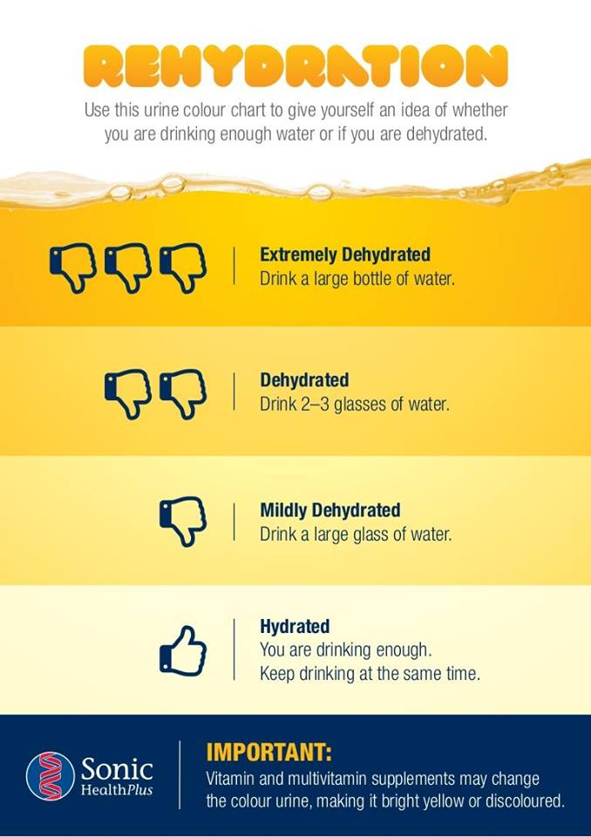
Adaptations for reduced iA – Visual supports

Slide 39

Adaptations for reduced iA – Social narratives

Slide 40
Interoceptive Awareness builders
Body checks and scans
Mindfulness Activities
Emotional Regulation and Emotion Identification

Slide 41
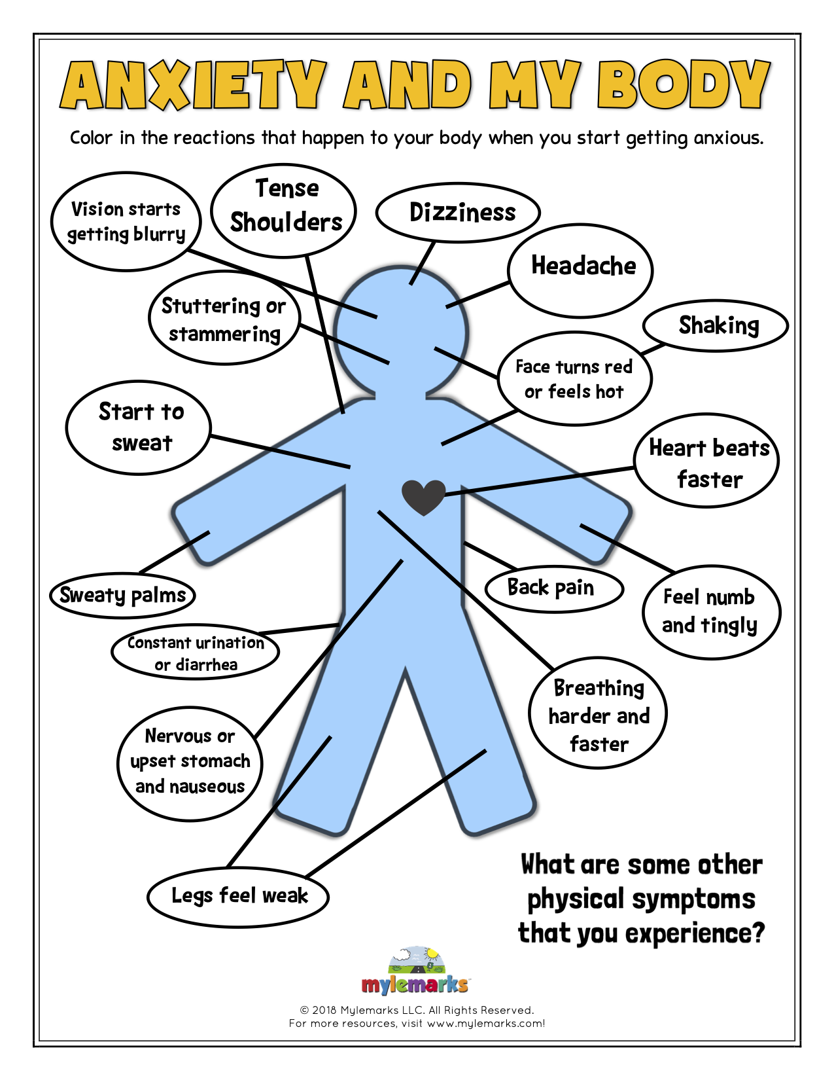
Body Check/Scan

Slide 42
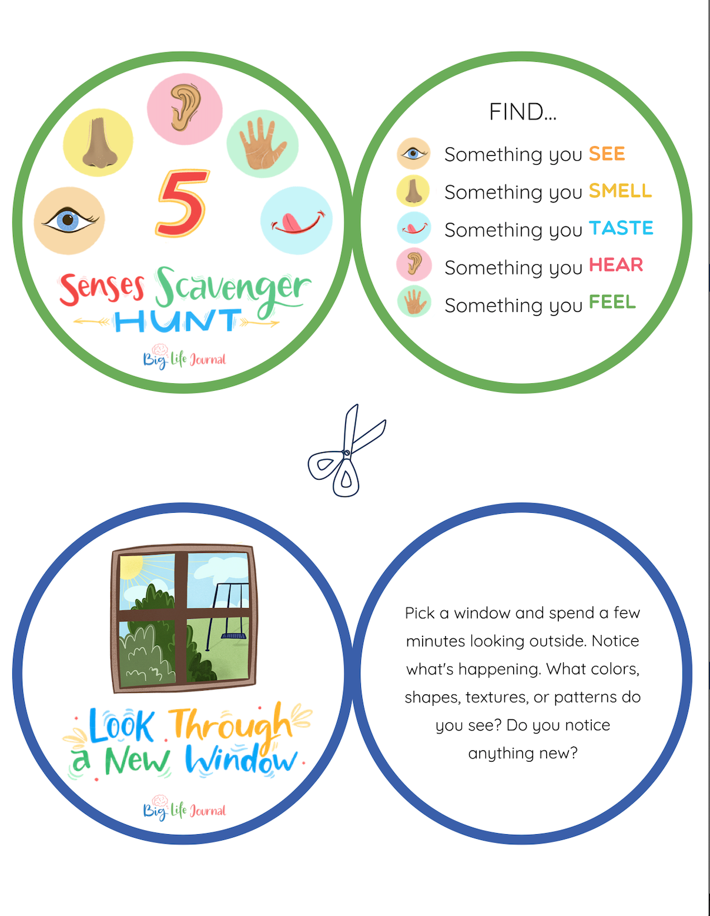
Mindfulness Activities

Slide 43
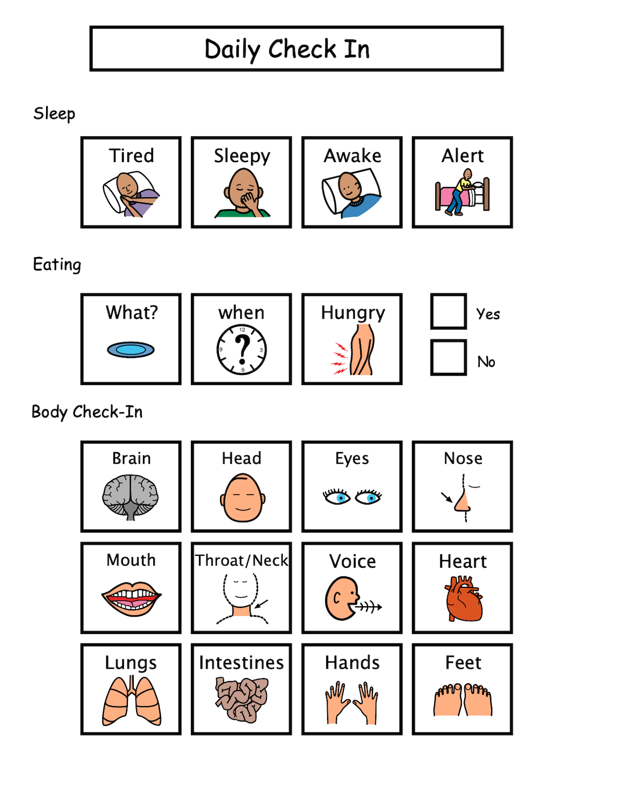
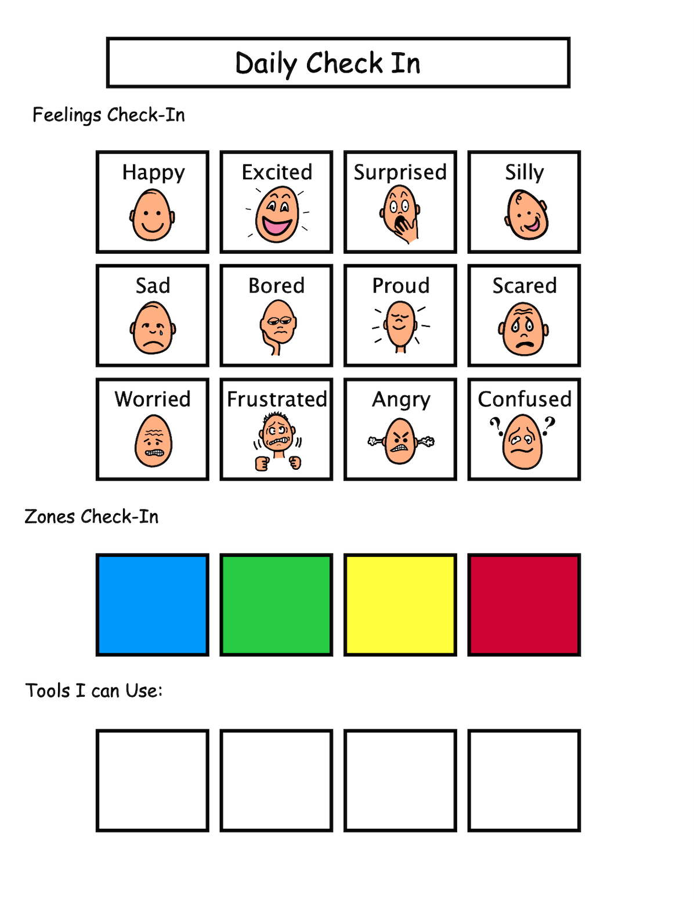
Emotional regulation and emotional identification

Slide 44
Listening to the experts…
“Difficulties with interoception help to explain why I have such a hard time identifying my exact symptoms when I am sick, why sometimes I can eat snack after snack without feeling full and why I get upset so quickly, because I don’t feel it until I’m already far into the storm of the discomfort and frustration.” – Chloe Rothschild, 23
“A lot of times the inside of my body feels like one of those glitter timers—the ones that you can shake and the glitter goes every which way. I feel so many different things at once and I’m not sure what is important. It is very overwhelming.”—Gracie, a 13-year-old with autism
“My son walked around on a broken leg for 2 days without a single complaint or indication of pain. It wasn’t until I noticed the swelling and bruising, that I realized he had a serious injury.”—Nick, father of a 14-year old son with autism

Slide 45

Sensory Processing in Action:
Education and Participation…and the Many Layers
Katherine Legros
Occupational Therapist
Notes:
Schools:
Person, Place, Thing, and….Sensory Processing

Slide 46
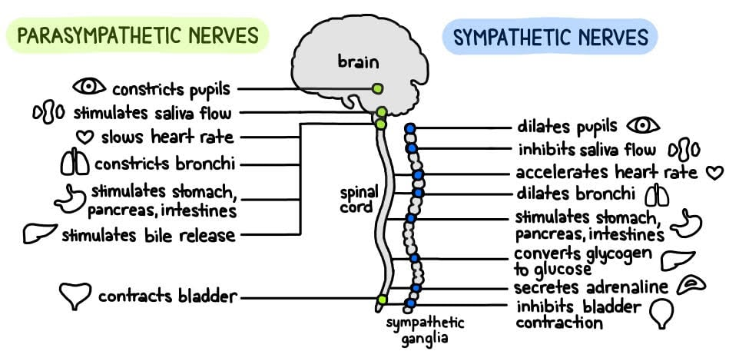
Quick Overview of Our Autonomic Nervous System
Notes:
When thinking about sensory processing I first like to think about our nervous system….
Our peripheral nervous system is made up of our somatic (voluntary actions) and autonomic (unvoluntary) as you can imagine, this is rooted in survival and how we react to danger.

Slide 47

Experience through our Senses
Sound – A LOT
Sight - BUSY
Smell - YIKES
Touch – weather, people, locating objects
Taste – a lot of flavor
Vestibular – visual movement and physical movement (screens)
Proprioception – hard ground, body coordination, posture
Interoception – feelings, pain, body functions
Notes:
Before we talk about sensory processing, I wanted to present to you 2 different environments….
Sam presents
Main point: this experience being in new York can be really overwhelming for some people and takes a lot of integrated sensory information; this can also be stimulating and enjoyable for some people.
Now think about doing a task like walking across the street: your body and brain has to process all of this information to come up with a goal (walking across the street) and executing it while keeping your body safe and organized to do the task.
Thinking about our students, if they already have difficulties processing sensory information, tasks that seem “simple” like crossing the street could be extremely difficult. It is so hard to focus and control their bodies in this environment.
Possible sensory challenges in this environment: not feeling safe, getting hit by a car or people, falling down, fight or flight or freeze, can’t access public transportation, feeling overwhelmed

Slide 48

Experience through our Senses
Sound – fairly quiet, nature
Sight – minimal, muted, low stimulation
Smell – fresh air, nature
Touch – wet, dry, weather, sunshine, feeling textures
Taste – dust
Vestibular – different surfaces, movement of trees, minimal obstacles
Proprioception – posture, body coordination, ducking, minimal obstacles
Interoception – feelings, body functions, pain
Notes:
Katherine presents
If we compare this scenario to the New York City scenario, we can see that there’s less stimulation. It feels “cleaner”, it’s easier to process what is happening. If we needed to do a task or respond to a change in our environment, we could most likely do that.
Imagine walking across the road. What would you need…
Walking across the road-you wouldn’t need to process as much information. You will be able to hear if a car was coming. You would be able to easily see if a car was coming. There’s not a lot of obstacles.
If a person had sensory challenges, there is time and space and filter the information that they’re receiving. We don’t need to react super quickly or do complex skills.

Slide 49
Sensory Processing and Students in SPED
Every person has sensory processing preferences and a unique profile
Sensory Processing Differences - 5% of general population
ADHD – 40%
Autism – 95%
  Stimming – “… a way of using our senses to calm ourselves, entertain ourselves, and enjoy being alive and in the world.”
Cerebral Palsy
Trauma
Notes:
Sam presents
In Our Own Words: The Complex Sensory Experiences of Autistic Adults | SpringerLink
Qualitative research: autistic adults report difficulty with mental health and anxiety due to sensory experiences. They feel they experience physical pain and this impacts their sleep and eating patterns. In general, they report feeling overwhelmed and disengaged to the point of “shutting down”. They may seek soothing sensory input to cope and we may be interpreting this as sensory seeking. This can lead to a desire for control and predictability. They found that having support from relationships helps them manage their differences. Their energy level or mood also impacted their tolerance.
Sensory processing disorder: seen as a separate diagnosis and presents differently than other diagnoses
ADHD: There is a 40% overlap of students with sensory differences and ADHD (40% of kids with ADHD will have sensory differences)
Difference between SPD and ADHD is that kids with ADHD will react less and less to new stimuli
Autism: Not all students with sensory processing differences are autistic. Autistic students tend to have decreased general “arousal” at baseline (meaning, require more input). Autistic students tend to have more challenges with praxis (motor planning, sequencing, problem-solving, coming up with ideas), posture, and discrimination… this may present as more physical challenges or difficulty coming up with play ideas.
****Important to note that even though our students may be more likely to have sensory processing disroders… every single person has a unique sensory profile and sensory processing preferences.

Slide 50

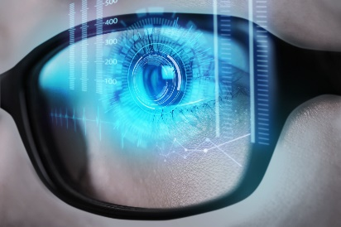
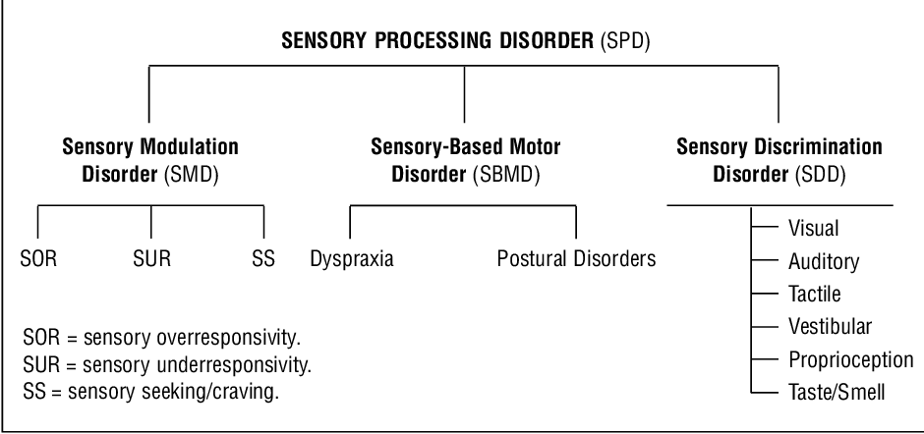


Sensory processing challenges
Notes:
I highlighted the yellow because this is what a lot of people think about when we discuss sensory processing. These are often “visible” to people because they look like a behavior.
Sam
Katherine does 2 examples
People often think about sensory issues as disruptive behavior, aggression, meltdown, etc; THIS is what sensory processing issues actually ARE.
This is just to show the complexity of sensory processing challenges. An OT has the training and background in neurology and motor development to tease out which sensory area a child is having difficulty with. Often, these areas are overlapping.
We have to be extremely careful when we are providing sensory interventions, especially when we are using sensory equipment and tools such as swings, weighted vests, or special gyms. The input has to match a child’s sensory profile and meet their needs, otherwise we can cause more challenges or dysregulation.
Most people think about sensory as just Sensory Modulation Disorder, where a child is too sensitive or craves additional input (called “sensory seeker”).
Movement Disorders – PROP and VESTIBULAR are impaired
But sensory processing challenges can also impact a child’s movement/physical development, ability to plan and problem-solve. It can also impact their ability to tell where their body is in space, or identify stimuli (finding something in a crowded room, etc.).
Sensory Modulation Story – Katherine’s example
***always occurs with Motor and Discrimination
Sensory-Based Motor Disorder Story – Sam’s story
Sensory Discrimination Disorder Story – Katherine’s example, BM
Katherine will find a video re: what dyspraxia or postural disorder
Dyspraxia
Planning (Motor Planning)
Sequencing body actions
Problem-solving
Difficult transitions
Emotional dysregulation
Frustrated when unable to complete tasks
Prefers sedentary
Postural Disorder
Fine motor and gross motor
Eyes and mouth coordination
Postural stability
Appears lazy, weak, limp
Seems tired most of the time
Low endurance
Discrimination Disorder
Overlaps with sensory modulation or motor disorders
Difficulty to differentiate sensations or distinguish intensity
Slow to respond to sensory experiences
Needs process time
Responses to sensory input are inaccurate
Handwriting
Sports
Standing in line and managing personal space
Visually finding stuff
Knowing where body is in relation to other objects

Slide 51
“Sensory seeking” can be many things…
Over-responsive – Avoiding input, coping with stress
Under-responsive – Trying to raise arousal
Craving – seeks more and more input, becomes disorganized
Posture challenges – Trying to find stability
Dyspraxia – Trying to find a plan, trying to coordinate their body
Discrimination – Trying to obtain more information about the body
Keeping this in mind, we are careful when applying sensory techniques!
Notes:
Sam
The intervention is different for different sensory profiles so we want to be careful about what interventions we are applying.

Slide 52
Sensory Modulation Approaches
Overresponders
“Low and Slow” sensations
Model
Never forcing or surprising
Student has control over input
Calming activities
Underresponders
“Fast/Blast” activities for alerting
Combine input (multisensory)
Functional tasks (game, etc.)
High Affect
Cravers/Seekers
Physical resistance activities with “start/stop”
Classroom tasks
Functional activities with beginning and end
Notes:
Sam
Underresponsive kids – these kids look disengaged; doing a lot of imitation of their preferred activities will help them start to pay attention to you

Slide 53
Experience through our Senses
Sound – A LOT
Sight - BUSY
Smell - YIKES
Touch – weather, people, locating objects
Taste – a lot of flavor
Vestibular – visual movement and physical movement (screens)
Proprioception – hard ground, body coordination, posture
Interoception – feelings, pain, body functions
Notes:
Now think about this if you were an over responder, or under, or a seeker….how might your nervous system be acting? Maybe in alert? Slightly flight or flight or in rest and digest?
Before we talk about sensory processing, I wanted to present to you 2 different environments….
Sam presents
Main point: this experience being in new York can be really overwhelming for some people and takes a lot of integrated sensory information; this can also be stimulating and enjoyable for some people.
Now think about doing a task like walking across the street: your body and brain has to process all of this information to come up with a goal (walking across the street) and executing it while keeping your body safe and organized to do the task.
Thinking about our students, if they already have difficulties processing sensory information, tasks that seem “simple” like crossing the street could be extremely difficult. It is so hard to focus and control their bodies in this environment.
Possible sensory challenges in this environment: not feeling safe, getting hit by a car or people, falling down, fight or flight or freeze, can’t access public transportation, feeling overwhelmed

Slide 54



What does dysregulation look like?
Extremely “silly”
Running around/away
Difficult transitions
Aggression
Low tolerance for activities
Easily frustrated
Shutdown
Full trauma response – fight, flight, freeze
Physical signs – fisted hands, glaring, eyes darting around the room, restlessness, rapid breathing, etc
Notes:
Sam presents ?
We are going to talk about what happens when the coffee is overflowing. These kids are so overwhelmed and stressed that they are not thinking clearly. They may even be in a “fight or flight” response. We call this “survival brain”.
Survival brain is not a learning brain. If a child is in “survival mode”, they’re not able to take any information in. They’re not thinking clearly. They’re not able to follow directions and academic tasks will be meaningless unless they are regulated.
During a time of dysregulation, it is pointless to teach children consequences or give them explanations about why their behavior is “bad”. It’s only going to increase the dysregulation.
This is not a complete list. Dysregulation can look different for different children. Children could also be laughing and extremely silly and dysregulated.
We often talk about “teaching” self-regulation, but some kids need adult support to regulate. They cannot do it on their own. They may ALWAYS need a regulation partner, even as adults. Self-regulation is LEARNED through having an adult be a supportive regulation partner.
We have our partners, our friends, colleagues to do this stuff with.
For those of us who have kids, we know that our babies need to be held and comforted and they can’t calm down without us. It’s the same thing.

Slide 55
Supporting Sensory Modulation and discrimination difficulties in school
Meaningful movement breaks
  Heavy work, Vestibular
Coping strategies including deep breathing (activates parasympathetic nervous system= rest and digest)
Visual schedule and routines (predictability)
Task analysis, modify or adapt task to fit personal factors, functional
  School
  Job
Environment
“Just right challenge” and calming occupations (think of the coloring book trend)
Co-regulation
  Trust
  Communication
  Guidance
Accommodations
  Not always visual, think of glasses…without them one might assume a person can see perfect

Slide 56
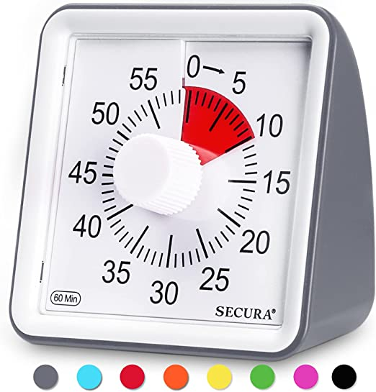


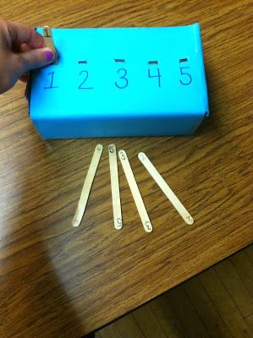
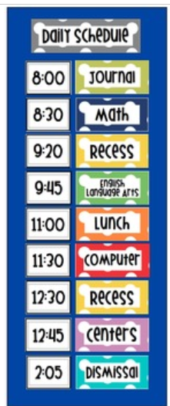
What does predictably Look like?
Notes:
Katherine
Talking points:
Knowing what the day looks like – using a schedule that matches the child’s developmental level (see printed infographic in your handouts)
https://learnplaythrive.com/making-schedules-for-kids-on-the-spectrum/
Getting needs met (having access to bathroom, food, comfort, play at regular and consistent intervals; having someone acknowledge and respond to your stress as it changes over time)
Seeing finished – it’s hard to know how long a task will take, when something will start; this creates a lot of anxiety. Having tasks where the child can SEE the finish and they feel a sense of completion can be very powerful.
Can use task boxes and visual timers
EXAMPLE: cutting and putting pieces in a container, etc.
All of these skills relate to executive functioning; we may have to be that executive functioning support for that child by creating the structure

Slide 57

Sensory processing challenges
Notes:
Now lets talk about another way sensory process challenges may present….
I highlighted the yellow because this is what a lot of people think about when we discuss sensory processing. These are often “visible” to people because they look like a behavior.
Sam
Katherine does 2 examples
People often think about sensory issues as disruptive behavior, aggression, meltdown, etc; THIS is what sensory processing issues actually ARE.
This is just to show the complexity of sensory processing challenges. An OT has the training and background in neurology and motor development to tease out which sensory area a child is having difficulty with. Often, these areas are overlapping.
We have to be extremely careful when we are providing sensory interventions, especially when we are using sensory equipment and tools such as swings, weighted vests, or special gyms. The input has to match a child’s sensory profile and meet their needs, otherwise we can cause more challenges or dysregulation.
Most people think about sensory as just Sensory Modulation Disorder, where a child is too sensitive or craves additional input (called “sensory seeker”).
Movement Disorders – PROP and VESTIBULAR are impaired
But sensory processing challenges can also impact a child’s movement/physical development, ability to plan and problem-solve. It can also impact their ability to tell where their body is in space, or identify stimuli (finding something in a crowded room, etc.).
Sensory Modulation Story – Katherine’s example
***always occurs with Motor and Discrimination
Sensory-Based Motor Disorder Story – Sam’s story
Sensory Discrimination Disorder Story – Katherine’s example, BM
Katherine will find a video re: what dyspraxia or postural disorder
Dyspraxia
Planning (Motor Planning)
Sequencing body actions
Problem-solving
Difficult transitions
Emotional dysregulation
Frustrated when unable to complete tasks
Prefers sedentary
Postural Disorder
Fine motor and gross motor
Eyes and mouth coordination
Postural stability
Appears lazy, weak, limp
Seems tired most of the time
Low endurance
Discrimination Disorder
Overlaps with sensory modulation or motor disorders
Difficulty to differentiate sensations or distinguish intensity
Slow to respond to sensory experiences
Needs process time
Responses to sensory input are inaccurate
Handwriting
Sports
Standing in line and managing personal space
Visually finding stuff
Knowing where body is in relation to other objects

Slide 58
Sensory-Based Motor Disorder
Dyspraxia, Developmental Coordination Disorder
  Planning (Motor Planning)
  Sequencing body actions
  Problem-solving
  Difficult transitions
  Emotional dysregulation
  Frustrated when unable to complete tasks
  Prefers sedentary
  5%–6% and under diagnosed (NIH report)
Postural Disorder
  Fine motor and gross motor
  Often co-occurs with sensory modulation difficulties and is under-responsive to inputs
  Eyes and mouth coordination
  Postural stability
  Appears lazy, weak, limp
  Seems tired most of the time
  Low endurance
Notes:
The diagnosis of DCD is usually made by a pediatrician, often in collaboration with an occupational therapist. Generally, a paediatrician is involved in diagnosis and an occupational therapist is involved in both diagnosis and treatment.
Dyspraxia
Planning (Motor Planning)
Sequencing body actions
Problem-solving
Difficult transitions
Emotional dysregulation
Frustrated when unable to complete tasks
Prefers sedentary
Postural Disorder
Fine motor and gross motor
Eyes and mouth coordination
Postural stability
Appears lazy, weak, limp
Seems tired most of the time
Low endurance

Slide 59
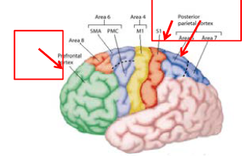
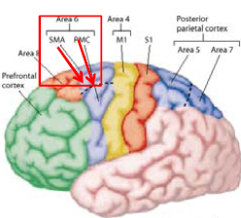
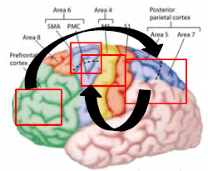
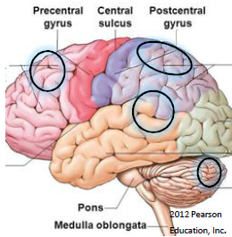
Motor planning: A whole brain activity
Motor planning is the ability to organize the body’s actions: to conceive, plan, and carry out a skilled, non-habitual motor act in the correct sequence from beginning to end.
Step | Processes in the brain |  | Example
Ideation: What movement should I perform? | Cognitive skills, visual processing, creativity, receptive language. Selectively attending to and integrating relevant stimuli, spatial organization and judging distances. |  | It’s my turn to bat. I’m going to go hit the ball off the tee.
Planning and organization: How do I plan to perform that movement? | Involves the ability to plan and order the actions necessary to achieve a goal. Includes what materials are needed, setting up the space, sequencing steps involved, integrating the cognitive plan with physical abilities. Must choose the suitable motor response, including timing and force. Greatly impacted by sensory processing, body awareness, and executive functioning. |  | First, I’ll leave the dugout and find the bat and then walk to the base. I’ll hold the bat with both hands, stand sideways to the tee, wind up, and swing the bat to hit the ball.
Execution: Take action! | Motor coordination, muscle strength, flexibility, and endurance. Remembering the sequence for a movement response that was developed from previous experience. |  | I carry out my plan and swing the bat – requires dynamic balance, visual perception, shoulder and spine mobility, muscle activation
Adaptation: How did it go? (important for motor learning) | Incorporation of internal and external feedback. Consider was the end result aligned with the intended plan? Was I successful? The ability to use information arising as a consequence of the motor execution to modify future performance. |  | I hit it straight! I’ll do the same thing next time …or… I missed. Next time I’ll swing the bat lower, keep my eyes on the ball, and maybe try swinging slower.
Sources: Ayres model of sensory integration (1985); Motor Planning: The Impact on Communication and Beyond (2022) by Joleen R. Fernald PhD CCC-SLP, BCS-CL and Lyn Bennet OTR/L; Developing Strategic Partnerships to Meet the Diverse Needs of Children with Developmental Coordination Disorder (Presentation: APTA Academy of Pediatric Physical Therapy Annual Conference 2019) by Mary Jo Davenport, PT, PhD
Slide created by: Laura Kredit, PT, DPT
Notes:
Based on Ayres model, 1985
Images from AAPTAC Presentation, 2019

Slide 60

Sensory processing challenges
Notes:
Now lets talk about another way sensory process challenges may present….
I highlighted the yellow because this is what a lot of people think about when we discuss sensory processing. These are often “visible” to people because they look like a behavior.
Sam
Katherine does 2 examples
People often think about sensory issues as disruptive behavior, aggression, meltdown, etc; THIS is what sensory processing issues actually ARE.
This is just to show the complexity of sensory processing challenges. An OT has the training and background in neurology and motor development to tease out which sensory area a child is having difficulty with. Often, these areas are overlapping.
We have to be extremely careful when we are providing sensory interventions, especially when we are using sensory equipment and tools such as swings, weighted vests, or special gyms. The input has to match a child’s sensory profile and meet their needs, otherwise we can cause more challenges or dysregulation.
Most people think about sensory as just Sensory Modulation Disorder, where a child is too sensitive or craves additional input (called “sensory seeker”).
Movement Disorders – PROP and VESTIBULAR are impaired
But sensory processing challenges can also impact a child’s movement/physical development, ability to plan and problem-solve. It can also impact their ability to tell where their body is in space, or identify stimuli (finding something in a crowded room, etc.).
Sensory Modulation Story – Katherine’s example
***always occurs with Motor and Discrimination
Sensory-Based Motor Disorder Story – Sam’s story
Sensory Discrimination Disorder Story – Katherine’s example, BM
Katherine will find a video re: what dyspraxia or postural disorder
Dyspraxia
Planning (Motor Planning)
Sequencing body actions
Problem-solving
Difficult transitions
Emotional dysregulation
Frustrated when unable to complete tasks
Prefers sedentary
Postural Disorder
Fine motor and gross motor
Eyes and mouth coordination
Postural stability
Appears lazy, weak, limp
Seems tired most of the time
Low endurance
Discrimination Disorder
Overlaps with sensory modulation or motor disorders
Difficulty to differentiate sensations or distinguish intensity
Slow to respond to sensory experiences
Needs process time
Responses to sensory input are inaccurate
Handwriting
Sports
Standing in line and managing personal space
Visually finding stuff
Knowing where body is in relation to other objects

Slide 61
Sensory Discrimination Disorder
Discrimination Disorder
Overlaps with sensory modulation or motor disorders
Difficulty to differentiate sensations or distinguish intensity
Slow to respond to sensory experiences
Needs process time
Responses to sensory input are inaccurate
Handwriting
Sports
Standing in line and managing personal space
Visually finding stuff
Knowing where body is in relation to other objects
Notes:
Important when looking at a task. I.e.

Slide 62
Supporting Sensory-Based Motor Difficulties In School
Meaningful or interesting to student
Build and expand
Support/guide student coming up with steps or strategies to achieve task
Motor planning
Accommodations
Increasing support or input in seating
Technology/ Assistive technology
Word processing over handwriting
Strength based approach
Meaningful to student
Success to be built on
Access point

Slide 63

How could this impact a kid at school?
Sound – tuning out classroom noises, processing instructions
Sight – tuning out distractions, visual perception, guiding your hand with your eyes, organization/alignment/spacing
Smell – tolerating smells
Touch – sensation, coordinating fingers, texture (pencil scratching, etc.)
Taste – lunch
Vestibular – balance, coordinating vision with balance, muscle tone
Proprioception – posture, body coordination, pencil pressure, planning letters and executing
Interoception – feelings, body functions, pain
Notes:
Sam presents (Katherine will talk about with the sensory processing disorder…prong)
Let’s just look at this picture…
This is just breaking down the sensory components of handwriting but handwriting is an extremely complex process.
Cognitive skills (working memory, spelling, attention, planning, self-regulation) Motor skills (muscle strength, coordination, endurance) AND sensory integration
But if you have a child with sensory processing issues, the very FOUNDATION of handwriting can be impacted; even though they may WANT to hold a pencil and write and learn to write, their brain isn’t efficiently integrating this information.
So in this example, giving a kid a weighted vest or a trampoline or a fidget, won’t fix the issue with handwriting…
This is the FOUNDATION that leads to adequate participation in the classroom

Slide 64
Sensory is ONE piece of the puzzle…
Sensory
Trauma and Stress
Lack of Coping Skills
Task does not match child’s level
Executive Functioning (organization, planning)
Communication
Classroom environment
Notes:
Sam and Katherine present
Sam leads talking points
Katherine’s example
It’s important as a team that we are doing DIFFERENTIAL DIAGNOSIS… we are trying to get at the root of the problem. Sometimes labelling a problem as just SENSORY ignores other factors the child or team is dealing with. Sensory can also look like many different things. A trauma response can look like a sensory meltdown, but a child having a trauma response probably needs more than just a weighted vest or a trampoline.
Difficulty with communication can look like sensory challenges (easily frustrated, difficulty with group activities, sensory seeking behaviors)
Child doesn’t have the emerging skills to do the academic task, and their behaviors can look like sensory or work avoidance
Executive Functioning – the routines and schedules of the classroom are unclear. The child doesn’t know what to do and how to get started. People give the child a lot of verbal directions and then are frustrated when the child can’t follow them. The child has no sense of time and they can’t see when the task will be finished.
Classroom environment – the child’s sensory profile may be mismatched to the classroom environment and they can’t manage the environment + educational demands
Marken example in the motor room. (Katherine)
Behavior of student: runs, jumps around room, tries to leave room. Appears sensitive to busy classroom, new people in classroom. Brought to the motor room to help “regulate” Given lot of heavy work (weighted balls, high stepping) and swinging. OT brought out white erase markers and student started banging chest, jumping, making loud frustrated vocal sounds. OT put the markers away and student stopped. Through out our session, student followed all verbal instructions (put red ball in basket, etc and transition well.)
Thoughts: Student using white boards in classroom to demonstrate work. Handwriting and writing is a challenge. Student has difficulty motor planning. He lights up when given positive praise and will continue to work when feeling successful (as evident of giving highfives, coming back to work). To be successful he needs to have several models, feel successful (needs routine), and needs movement.

Slide 65

Is it sensory or is it behavior?
All sensory processing difficulties are observable behaviors
Sensory – a child’s biological, neurological need, child cannot “control” these behaviors
Chasing the “why” behind the behavior
Sensory integration techniques are not compatible with a “behavior” approach (token boards, contingent rewards, punishment, etc.)
“Kids do well if they can.” (Dr. Ross Greene)
Beyond Behaviors (Dr. Mona Delahooke)
Notes:
Katherine and Sam presents
Katherine leads
Sam follows with talking about Dr. Ross (kids do well if they can), Beyond Behaviors, and bear as a reward example
Behaviors – screaming, kicking, shouting, stomping, swearing, biting, throwing, hitting, inattentive, unable to follow directions, etc
An OT will be able to tell you if a behavior is sensory-driven. However, we know that sensory can look like many different things. It’s still up to us to “chase the why” as to why a behavior is happening
For example, is the student getting enough sleep? Was there a dietary or medical change? Are they feeling hungry and can’t communicate that? Is it a new school? Do they know the schedule, routine, expectations? (think about how you feel starting a new job or traveling somewhere new?)
If it is sensory-based, then we have to assume that the child has to meet their sensory NEEDS first before we can expect school participation.
(new edit, KL) given vestibular (swing, spinning) or heavy work (proprioception) should have lasting input (4 hours). If given that input and student is still not “regulated” is it sensory?
Sam Story example: student with the stuffed bear… team was using it as a “reward” and not a sensory strategy
Concern about “reinforcing” a behavior by giving a child access to sensory strategies; however, if a child is seeking out what they need to be regulated, then it’s an opportunity for us to build those accommodations into their day.
So apart from sensory, there has recently been a shift in behavior management strategies because of research about our brains. Work of Dr. Ross Greene and Dr. Mona Delahooke, as well as work on a trauma-informed approach.
Goes beyond “escape”, “control”, or “gaining attention”
Almost all challenging behaviors are due to challenges in the child’s nervous system (this is neurological, developmental)… is the child in Fight or Flight or Freeze???
We work on these behaviors through building safe, responsive relationships with students, modelling regulation, and helping them solve problems
Even if it is behavior, what unmet need does the child have?
Additionally, these approaches are more trauma-informed and students are less likely to experience restraint and isolation, which has lasting negative effects on a child, even if the team felt it was necessary for safety in that moment.

Slide 66
Holistic Approach to Strengths-Based Practices
Relationship
Sensory Regulation
Acceptance
Comfort
Autonomy
“Children do well when they can.”
-Ross Greene
Access
Active Participation
Personal Factors
Meaningful and Purposeful Activities
Skill building
Notes:
Laura + Katherine
Compliance based practices teach individuals that their own body doesn’t matter, that what they’re feeling inside doesn’t matter. It leads to depression, anxiety, increased vulnerability to abuse.
https://autismspectrumnews.org/authentic-strength-based-practice-can-neurotypical-professionals-make-a-paradigm-shift/

Slide 67
What is sensory integration? *Disclaimer*
“Sensory integration is a developmental theory describing how people organize sensory information from their bodies and the environment to move, play and learn. It’s an intervention approach using specialized therapy from a trained clinician.”
Individualized to the child, play-based, child-led
Not always “fixable” – we are accommodating and supporting
Notes:
Katherine and Sam presents
Sam shares this part…
This is grounded in developmental and neuroscience research.
Sensory information goes into the body through our 8 senses… it passes through multiple brain structures to interpret the information. This guides our body’s responses to the stimuli. We have achieved sensory integration when we are using sensory information adaptively, almost automatically. We are able to function.
Katherine shares this part
We are thinking about how sensory integration impacts the whole child and everything the child does.
We are not FIXING the child’s nervous system. Sometimes we are modifying the environment or changing our own behavior so the child can be successful. Sensory integration principles can help a child feel safer and more successful, but true sensory integration therapy cannot be achieved simply by having sensory equipment such as a swing.
This is an individualized approach that requires careful observation and adjusting the activities based on how the child is `responding.
We are going to give specific examples in the next few slides.

Slide 68
Possible Outcomes for Supporting Students’ Sensory Needs at School
Less aggression and trauma responses
Improved regulation and engagement
Improved attention and class participation
Improved play skills and motor skills
Increased independence
Sense of belonging/safety at school
Notes:
Sam presents
These are all things that we want as educators
Based on 2018 systematic review

