Slide 1

WELCOME TO KINDERGARTEN!
everything you needed to know about the social emotional aspect of transitioning from pre-k to kindergarten

Slide 2
This presentation will provide you with helpful hints, strategies and activities to prepare your student (and yourself!) for the start of Kindergarten!

Slide 3
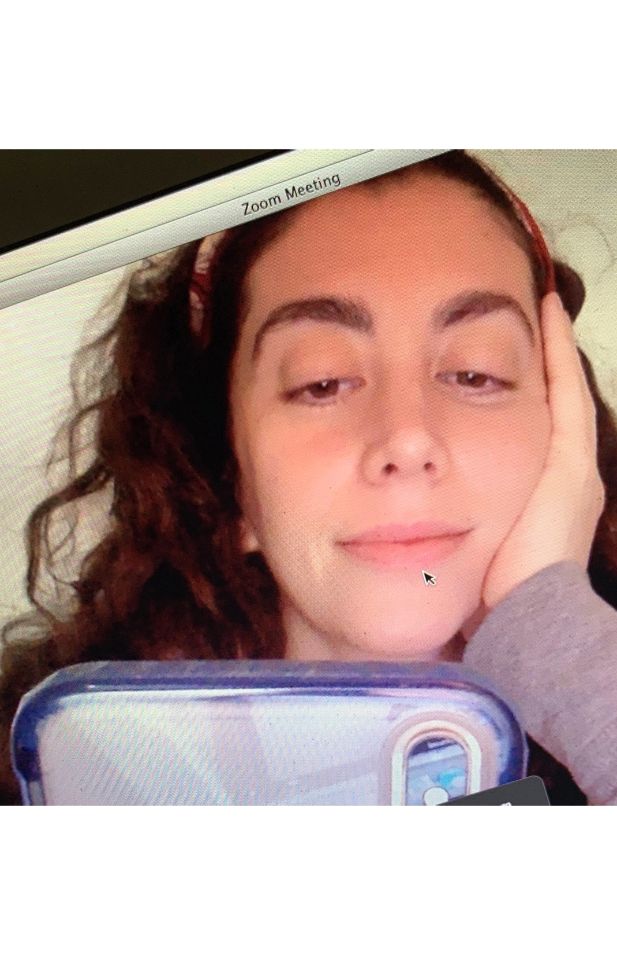
Before we start, a little bit about me. My name is Pamela Fernandez and I am the current School Counselor at Stoy, Strawbridge and Jennings.
This is me remote learning since March 16th!
Currently, most of my days are filled with Zooms. Zoom meetings. Zoom class check ins. Zoom social groups. Zoom individual sessions. I miss the kids and my co-workers so much! But I am fortunate for many things and that I can still "see" them.
Ok, now that you can put a face to the name, onto the most thrilling presentation of your lives!

Slide 4

Ok…maybe not THAT thrilling…

Slide 5

HELPFUL TIPS!

Slide 6
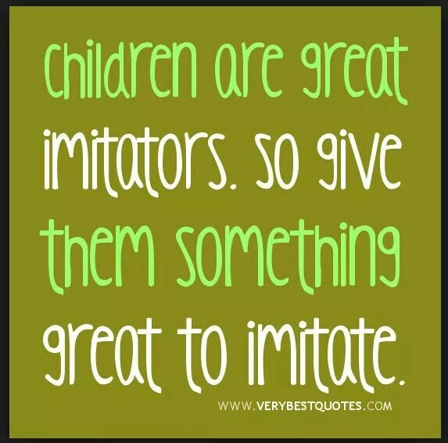
Helpful Tip Number 1:
Modeling Behaviors

Slide 7
Take a deep breath. And another, one. Fine, one more for good luck. This is an exciting time for everyone involved. Your child might come to you in tears about Kindergarten. This is typical! You may want to cry right along with your child. But modeling calm behaviors will serve your child better. Validate their feelings. Listen to their words. And try to respond back in a calm way...even if you want to cry and scream, too!

Slide 8
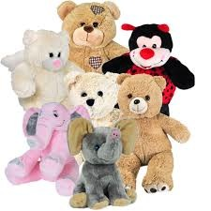
Use puppets or stuffed animals to model appropriate behaviors and reactions to different situations such as:
              “what can you do if…”
              “show me how to share”
              “how would you ask someone to play?”
              “how do you lose a game?

Slide 9
helpful articles:
Modeling Behaviors Article 1
Modeling Behaviors Article 2

Slide 10
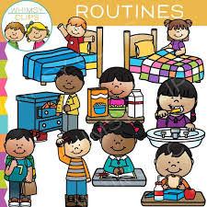
Helpful Tip Number 2:
Routines

Slide 11
Children feel secure when they can anticipate what happens next. The Kindergarten day is very structured and kids love this!
What can you do at home?
Create a picture schedule
Create a calendar for your child with special events
Create job charts
Create a chart of morning & bedtime routines
Healthy Routines Article

Slide 12
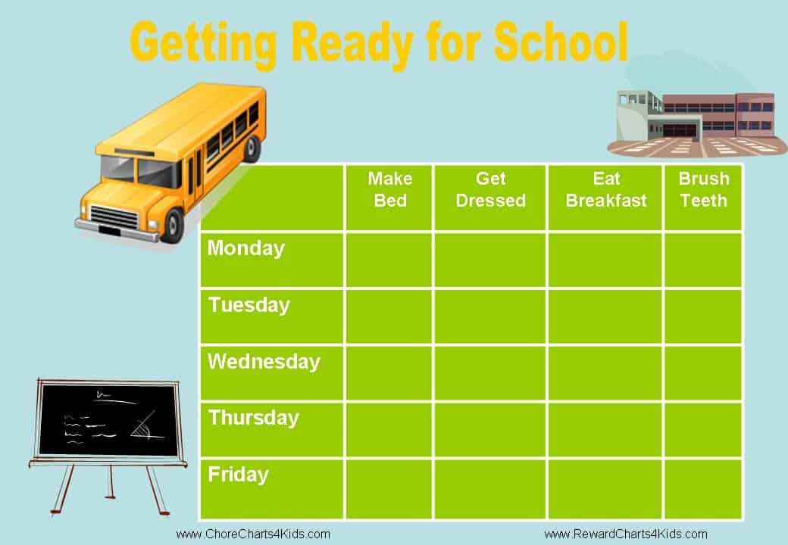

Slide 13
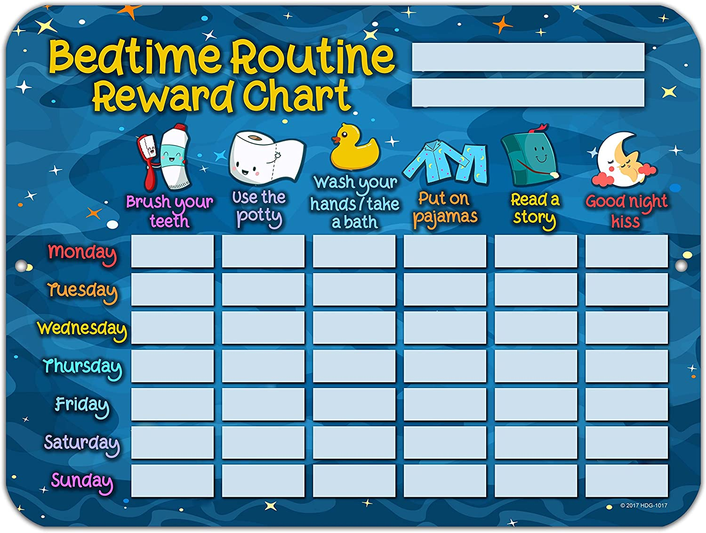

Slide 14
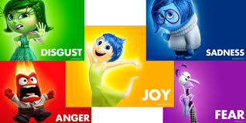
Healthy Tip Number 3: Feelings

Slide 15
Since we are all human, we are allowed to have many different feelings every day! All feelings are ok!
Kids will learn that it's how we react to our feelings that are important.

Slide 16
What can you do at home?
Talk about feelings with your child
Talk about appropriate actions when you feel different feelings
Use books and movies to support and work through different feelings and situations
Use art to retell situations that brought different feelings

Slide 17
helpful articles:
School Anxiety Article
Feelings Article

Slide 18
YouTube Video about Feelings

Slide 19
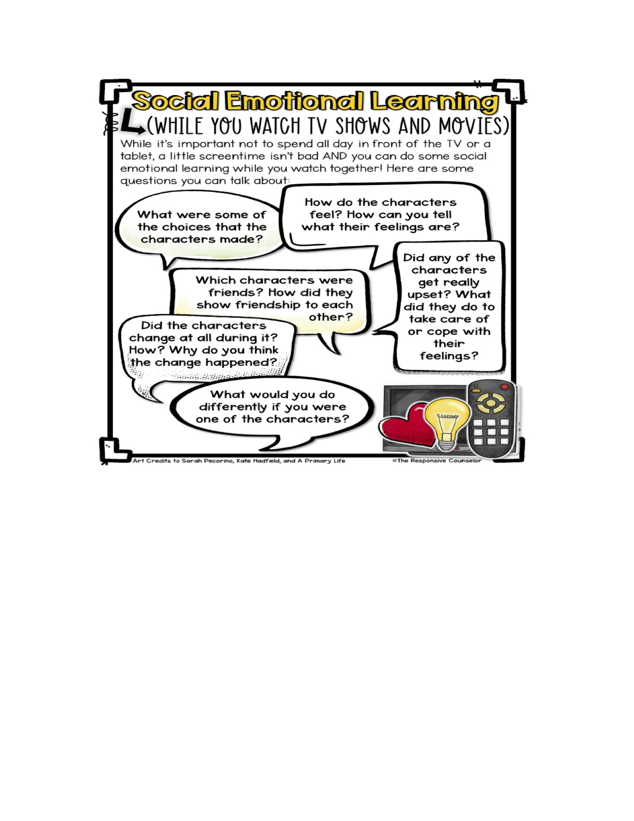

Slide 20
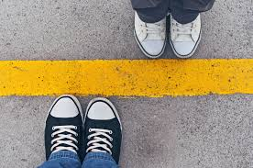
Helpful Tip Number 4: Expectations and Boundaries

Slide 21
All children need limits. They also need to know your expectations and what you believe they can do.
What can you do at home?
Talk it out! What are your expectations? Make them clear, concise and achievable!
Make a list of rules! Use pictures!
Set up rewards and consequences
Be consistent and fair!

Slide 22
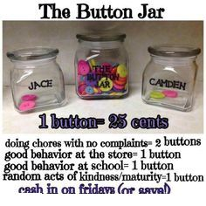

Slide 23
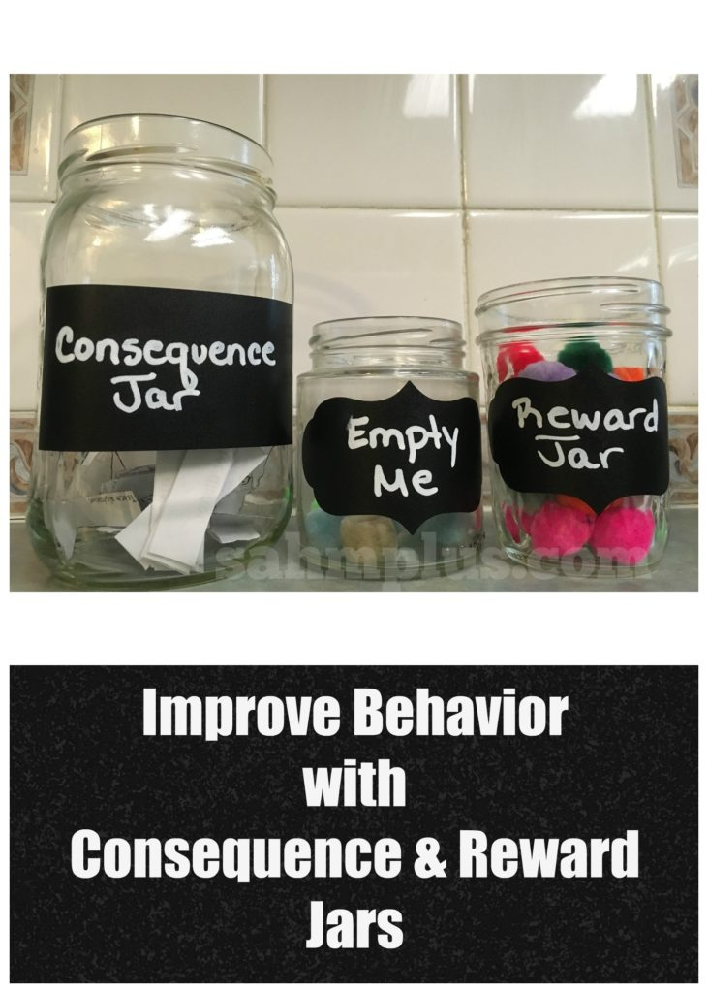

Slide 24
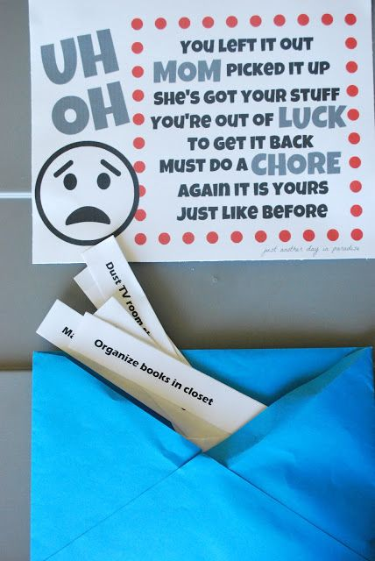

Slide 25
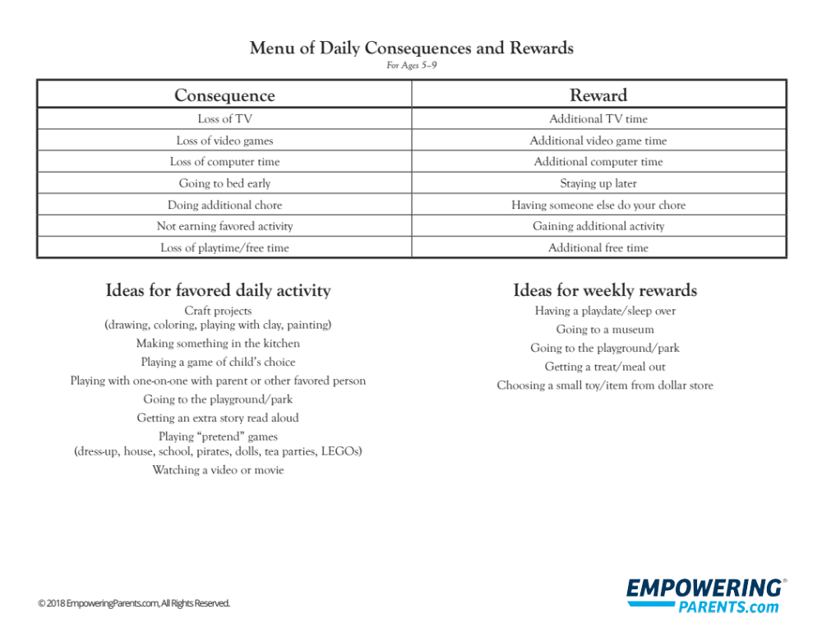

Slide 26
Important reminders:
Please do not take away a reward.
For instance, if you praise your child because they put their coat away without being asked, and you put a puff in the jar, and then they decide to sneak-eat 10 Fruit by the Foots...don't take a puff out! They earned that puff for the coat.

Slide 27
Not all rewards have to hurt the bank. You do NOT need to buy a new game for the Switch each time your child pushes in his chair after dinner. Get creative with rewards:
Watch your child's favorite movie for family movie night.
Allow your child to eat dessert before dinner.
Have a picnic dinner in the living room.
Mmm, I'm hungry. Oh yeah, back to the presentation...

Slide 28
Children like to see immediate gratification (immediate earning) for good behavior. Try to be consistent and timely when you give them a puff/sticker/token…
Children don’t have to earn for each puff/sticker/token. You can place a value on each puff/sticker/token so children will have to collect a certain amount to earn a reward.

Slide 29
Without fail, I have parents ask me why they should reward their child for doing something they SHOULD be doing.
They SHOULD go to school without gripping the iPad in their hands and then crying when it's taken away. They SHOULD be nice to their sibling.
No judgment…it’s a great question.
However, sometimes, we need to reinforce positive behavior in children until it becomes a habit. Other times, children need extra motivation.
Would you go to work without a paycheck? Many of us are positively reinforced til this day thanks to our regular pay.

Slide 30
helpful articles:
Expectations Article 1
Expectations Article 2
Boundaries Article

Slide 31
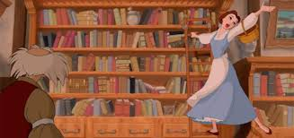
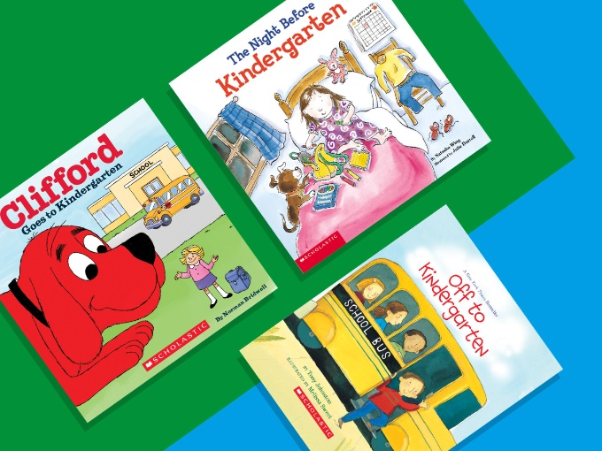
BOOK SUGGESTIONS

Slide 32
Anxiety:
How Big Are Your Worries, Little Bear? by Jayneen Sanders
Hey Warrior by Karen Young
The Huge Bag of Worries by Virginia Ironside
It's Ok to Make Mistakes by Tedd Parr
Wilma Jean the Worry Machine by Julia Cook
Don't Feed the Worry Bug by Andi Green

Slide 33
Behavior:
My Mouth is a Volcano by Julia Cook
Hands are Not for Hitting by Martine Agassi
Recess Queen by Alexis O'Neill
Howard B. Wigglebottom Learns to Listen by Howard Binkow

Slide 34
Friendship:
Enemy Pie by Derek Munson
Hunter's Best Friend at School by Laura Malone Elliott
Scaredy Squirrel Makes a Friend by Melanie Watt
The Juice Box Bully: Empowering Kids to Stand Up to Others by Bob Sornson and Maria Dismondy

Slide 35
Feelings:
Mouse Was Mad by Linda Urban
How Are You Peeling: Foods with Moods by Saxton Freymann
Taking a Bath with the Dog and Other Things That Make Me Happy by Scott Menchin
The Invisible Boy by Trudy Ludwig (also a great friendship book!)
Mary Wrightly, So Politely by Shirin Yim Bridges

Slide 36
How Are You Peeling? YouTube Video
Pro Tip: Save some money and search for a book in YouTube.
Many people enjoy reading these books and uploading them! (Strange hobby, but who am I to judge?!)
As always, preview the video first before you share it with your child.

Slide 37
helpful articles:
Best Books for Kindergarten
10 Books to Prepare for Kindergarten
Even More Book Recommendations for Kindergarten

Slide 38
What kindergarten teachers want...

Slide 39
Students to have the ability to play well with others.
What can you do?
Go to the park or library. Praise sharing and other positive social behaviors. Act out situations using stuffed animals.

Slide 40
Students to have the desire to be independent.
What can you do?
Let your child get dressed, blow their own nose, get coats on and off. Give your child some responsibility a.k.a chores.

Slide 41
Students to possess enthusiasm towards learning.
What can you do?
Show your child learning is fun. Show them how things work. Praise curiosity. Encourage your child to ask questions. Encourage their interests.

Slide 42
Students to possess solid oral language skills.
What can you do?
Help your child express what they need in words. Encourage sentences with at least 5 words.

Slide 43
Students to have the ability to listen.
What can you do?
Be sure that your child can follow one-step directions. Introduce two-step directions. (One-step example: Please put on your jacket. Two-step example: Please put on your jacket and brush your hair.) Ask them to repeat the directions back to you.

Slide 44
The night before school starts, the day school starts, and all the other days after...

Slide 45
Children can experience a variety of feelings the night before school starts, the morning of the first day of school and the many days after their first day.
Here's where your adult self-care comes in...take those deep breaths!
Some kids will take to school like they've been doing it their whole life.
Some kids are super scared and hardly get rest before the big day.
Others absolutely love the clothes and supply shopping, the morning photo shoot, the first day meeting their teacher and meeting new friends...and then they realize that this will be life for well over a decade.
All of these feelings and reactions are PERFECTLY NORMAL. And I am a therapist. I never like to use the word normal! But trust me, it is. Here are some super handy tips to use until you can't possibly get away with it any longer:

Slide 46
Calm Down Jars or Bottles:
Calm down bottles help young children relax and soothe themselves by focusing on the motion happening inside the calm down bottle. They are an effective and easy way to help children focus on deep breaths and relaxing after a temper tantrum or an upsetting event.
Fill it with some LEGO minifigures and tell your child to make the figures dance.
Fill it with alphabet letters and ask your child to spell something out.

Slide 47
Easy Recipe:
Add warm water to your jar or bottle until it reaches about a third of the way up.
Add glitter glue and stir until it is combined with the water.
Add around 3 drops of food coloring and stir
Put some regular glitter in there, too
Top your jar off with the rest of the warm water until it’s full.
PLEASE MAKE SURE THE CAP IS ON SUPER TIGHT.
Parents, use your adult strength to do this part.

Slide 48
11 Best Calm Down Jars Recipes
LEGO Calm Down Jar Recipe

Slide 49
Magic is Everywhere:
Hand your child a special bracelet, ring, necklace, rubber band, keychain, feather, (you get the picture) and tell them it's filled with magic to make the owner brave. Get creative and elaborate. Create a story. Make a spell. Discuss how a child can touch the item to get a zap! of powers.
Create a special potion/lotion/spray that will bring super powers of bravery, happiness and fun. Use regular lotion but say some magic words. Spray your child with some essential oils that are filled with magic. Spray your child’s pillow for good dreams. Spray your child’s book-bag for a happy day at school.

Slide 50
Magic Bracelet Description
Do's and Don'ts of an Anxious Child

Slide 51
Meditate together:
Check out apps such as "Calm" or Headspace" or google fun "Jedi Meditations for Kids" or "Barbie Meditations".
Try different breathing techniques together. Practice these together as a family even when you are not stressed to introduce coping skills.

Slide 52
Barbie Meditation

Slide 53
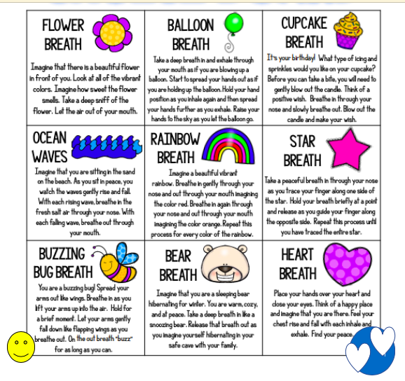

Slide 54
Exercise:
Get your child moving. It helps pop endorphins and eases stress. (https://marathonkids.org/physical-activity-benefits/) Move with your child to shake away any anxieties. Have an impromptu dance party in the kitchen. Or try some of these exercises:
Melting Activity
Lion King Exercises
Calming Activities for Kids

Slide 55
Some More Tips…

Slide 56
Over the summer, drive to your child's school. Play on the playground. Explore the area. Get your child used to the building and walk to school.

Slide 57
Don't wait until the night before to start a bedtime routine, a behavior chart, and to teach deep breathing.
Start over the summer.
A week or two prior to the first day of school, start having your child go to bed at a good time and get up early.
Practice routines!

Slide 58
Sesame Street Startin’ Kindergarten Song
Sesame Street Ready for Kindergarten Activities

Slide 59
Thank you for listening to my presentation! Please reach out to me with specific questions or concerns!
See you in September!
pfernandez@htsd.us

