Slide 1
The 2018-19 Budget
Bonnie J. Edwards, Superintendent
Jennifer Gauld, School Business Administrator / Board Secretary
Elizabeth Mennig, Assistant Superintendent for Curriculum and Instruction
Haddon Township Board of Education
March 27, 2018

Slide 2
Budget Priorities 2018-19
Substance Abuse Coordinator
  Currently outsourced – hire district employee
Support for in-district programming for students with disabilities
  .5 FTE Speech Therapist
  Paraprofessional support & training
  Supports for students with physical disabilities
  Technology-based support for 504s
  Training for inclusion

Slide 3
Budget Priorities 2018-19 (cont’d)
Buildings Maintenance & Grounds
  1 FTE 2nd Shift Custodian/Supervisor
  District-wide painting
  Concrete replacement as needed
  New electronic sign for the high school
  Replacement of a four-wheel drive mower with snow attachment

Slide 4
Budget Priorities 2018-19 (cont’d)
Technology Maintenance & Enhancement
  Improve internet accessibility
Transportation & Security
  Replace one out-of-date bus – 54 passenger (#5)
  New transportation van – 9 passenger (#20)
  Two-way radios
  Security camera upgrades

Slide 5
Budget Priorities 2018-19 (cont’d)
Curriculum
  Pilot for math at middle school
  Complete Math in Focus implementation at elementary level
  Implement Touchstones Project at high school

Slide 6
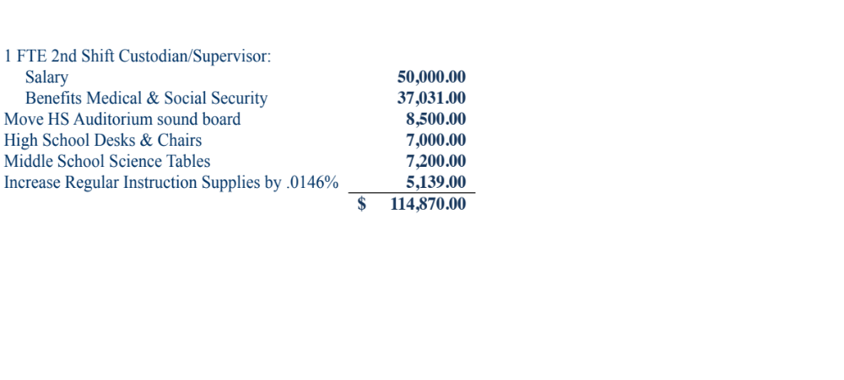
Revenue for 2018-19
State Aid figures Increase $114,870

Slide 7
New Jersey State Aid Revenue Analysis
YEAR | STATE AID
2009-2010 | $8,891,153
2010-2011 | $7,399,451
2011-2012 | $7,698,150
2012-2013 | $8,353,533
2013-2014 | $8,353,533
2014-2015 | $8,392,963
2015-2016 | $8,392,963
2016-2017 | $8,443,633
2017-2018 | $8,443,633
2018-2019 | $8,558,503
2018-2019 State Aid is $332,650 below what the district received in 2009-2010
Notes:
From 2009-10 to 2010-11 we lost 1.7 million

Slide 8
Why 2%?
$114,870 increase in State aid =
  1 FTE + Benefits
  Minor increase in supplies
  Expenditures continue to rise
      Increases beyond our control:
      Anticipate increase in medical benefits alone = 256k
      Salaries/costs of programs/supplies/out of district tuition

Slide 9
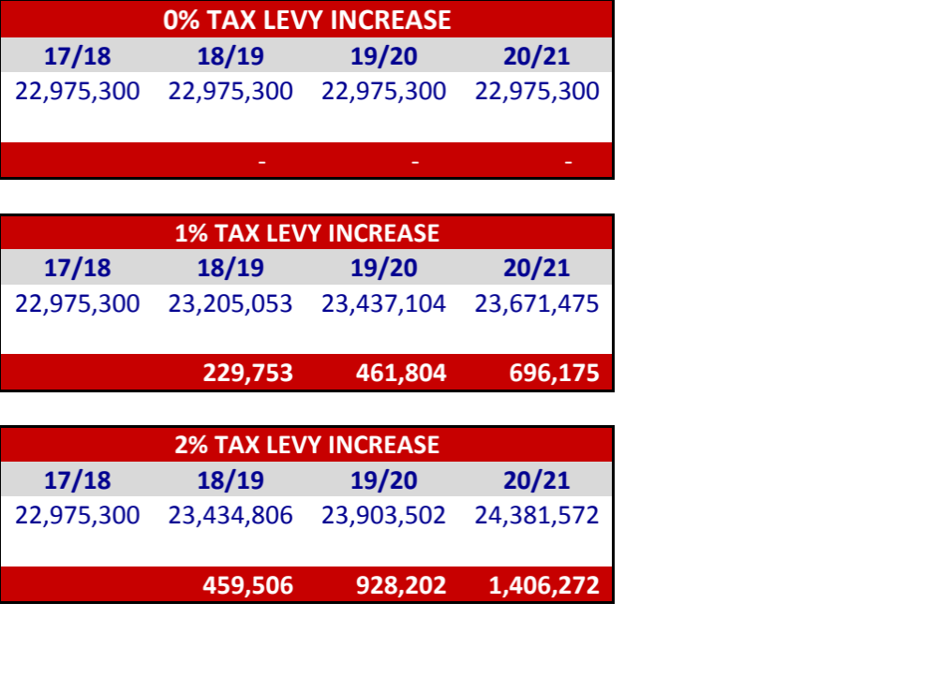
2% Builds a Revenue Base

Slide 10
How Are We Saving?
  Uniflow:
    System for tracking printing in an effort to reduce printing costs
  Decreasing the amount of out of district placements –
    33 - 14/15 school year
    24 - 17/18 school year
  Share services
    Educational Data Services Inc. - EDS
      Cooperative bidding management program
    Alliance for Competitive Energy Services - ACES
      Electric & gas consortium
    Educational Services Commission of NJ – ESCNJ formerly Mercer County Regional Services Cooperative (MRESC)
      Purchasing consortium (buses)
    Camden County Education Services Commission (CCESC)
      Services consortium

Slide 11
Impact on the Haddon Township Taxpayer
Increase in tax levy – General Fund:
.04014 cents per $100 of assessed value.
For a home assessed at $225,796, this is a total increase of $90.63 per year.
.
Increase in tax levy – Debt Service Fund:
(.00086) cents per $100 of assessed value.
For a home assessed at $225,796, this is a total increase of $(1.94) per year.

Slide 12
Impact on the Haddon Township Taxpayer
Increase in tax levy - General Fund $459,506 Increase in tax levy - Debt $(15,599)
Total tax levy increase $443,907
2017 Ratables $1,259,248,750
The 2018-19 proposed budget represents . . .
an increase of .03928 cents per $100 of assessed value.
For a home assessed at $225,796, this is an increase of $88.69 per year.
($225,796/$100) x $0.03928 = $88.69

Slide 13
Analysis of Revenue 2018-2019

Slide 14
Expenditure Budget by Major Function

Slide 15
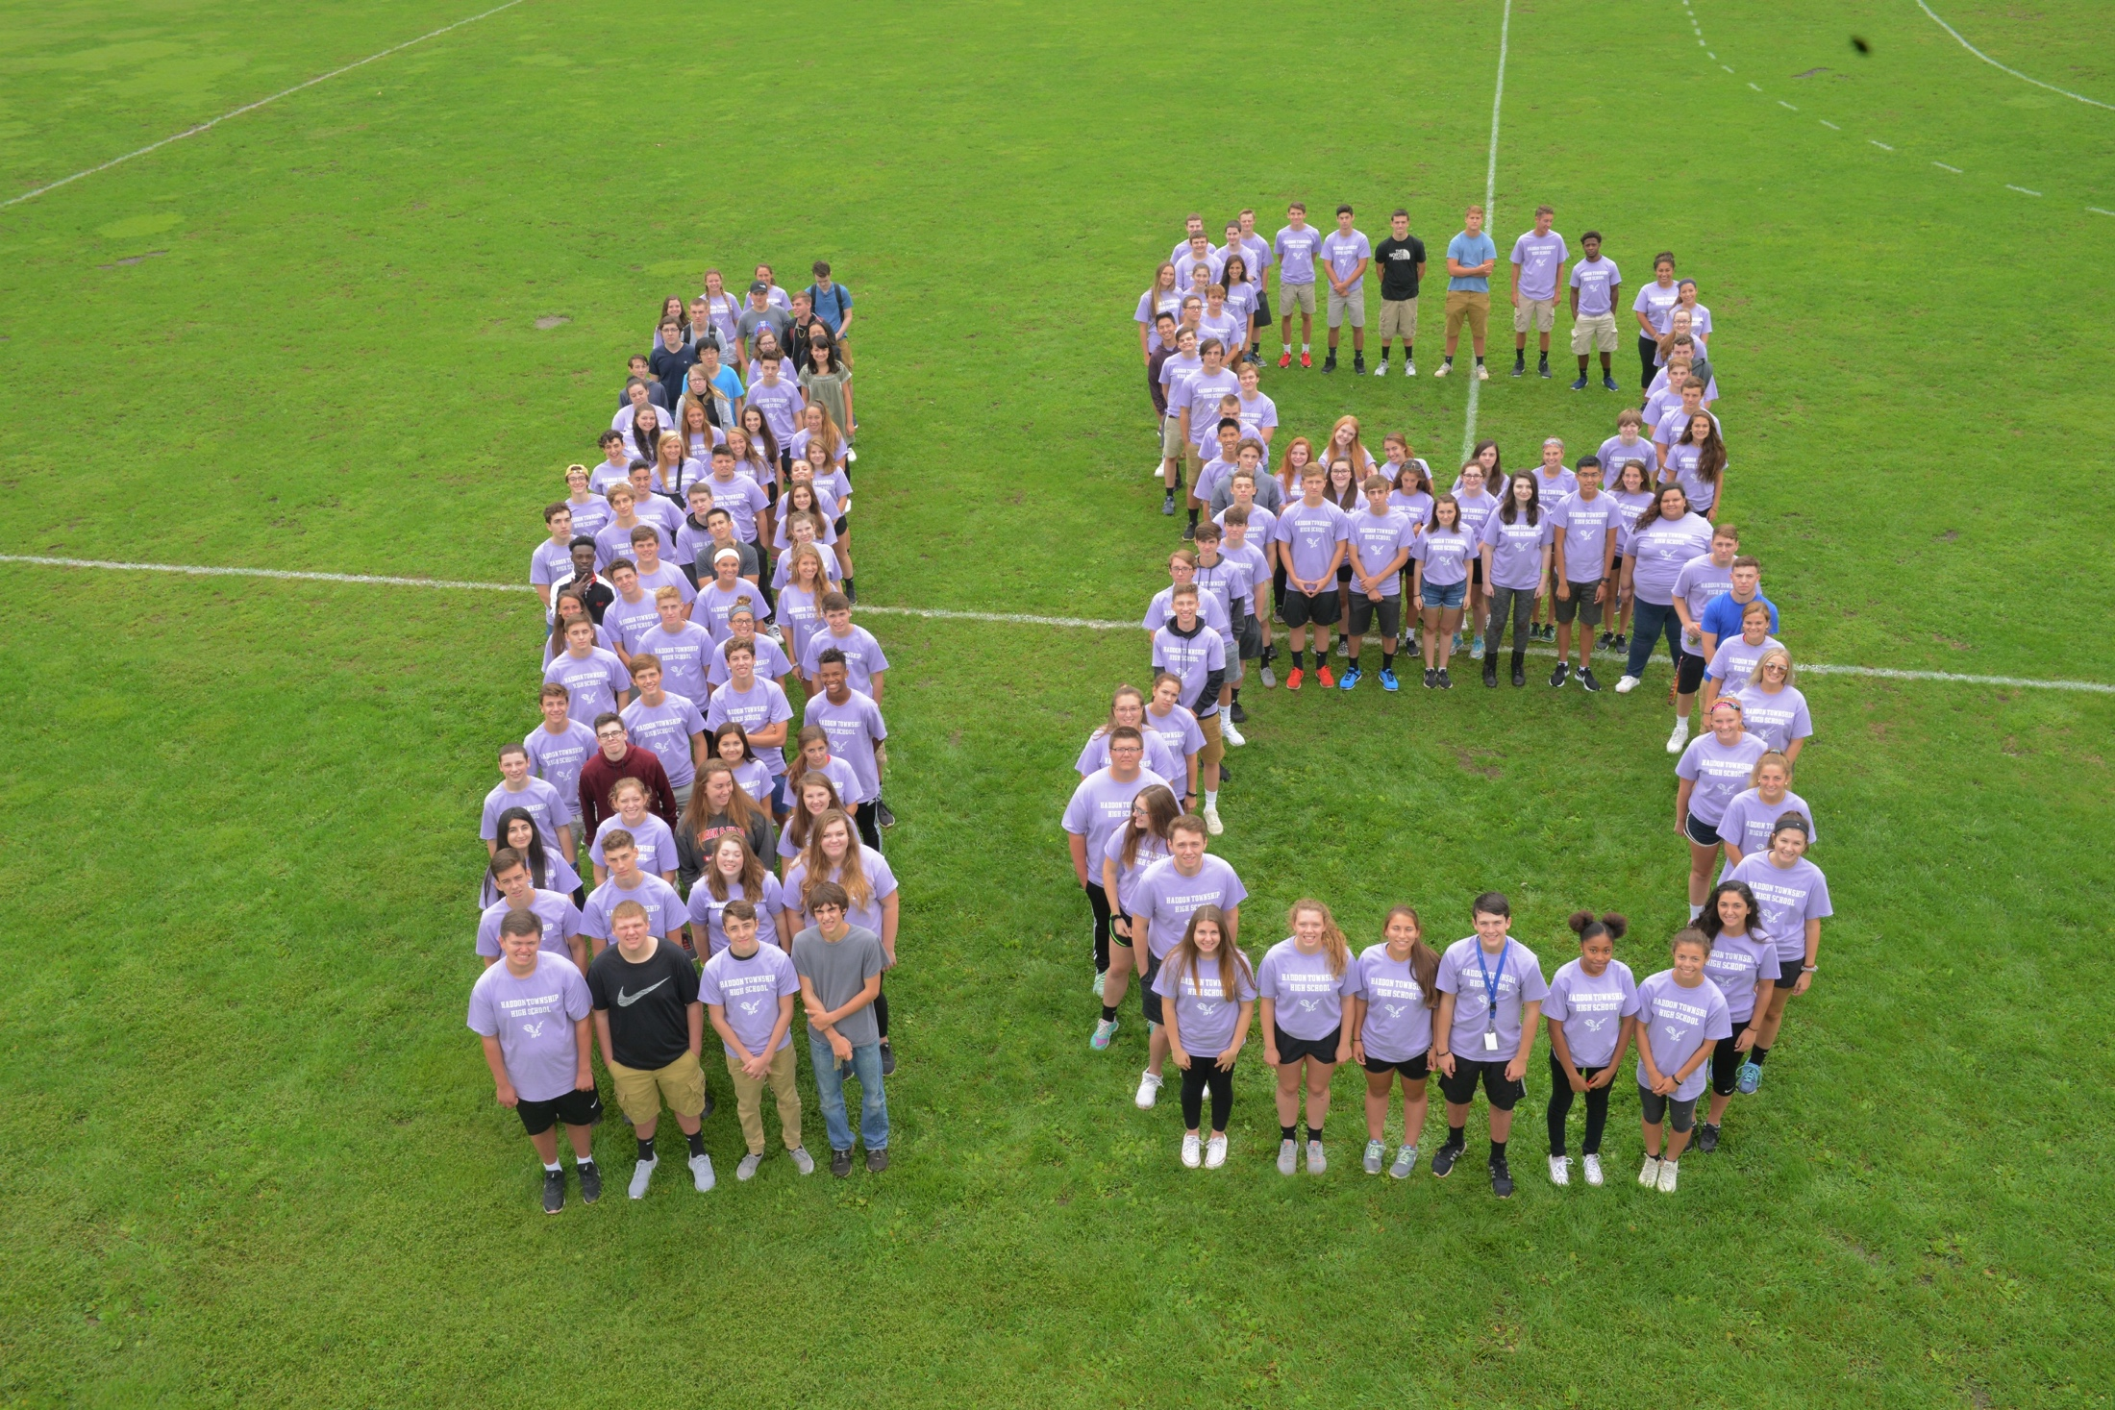
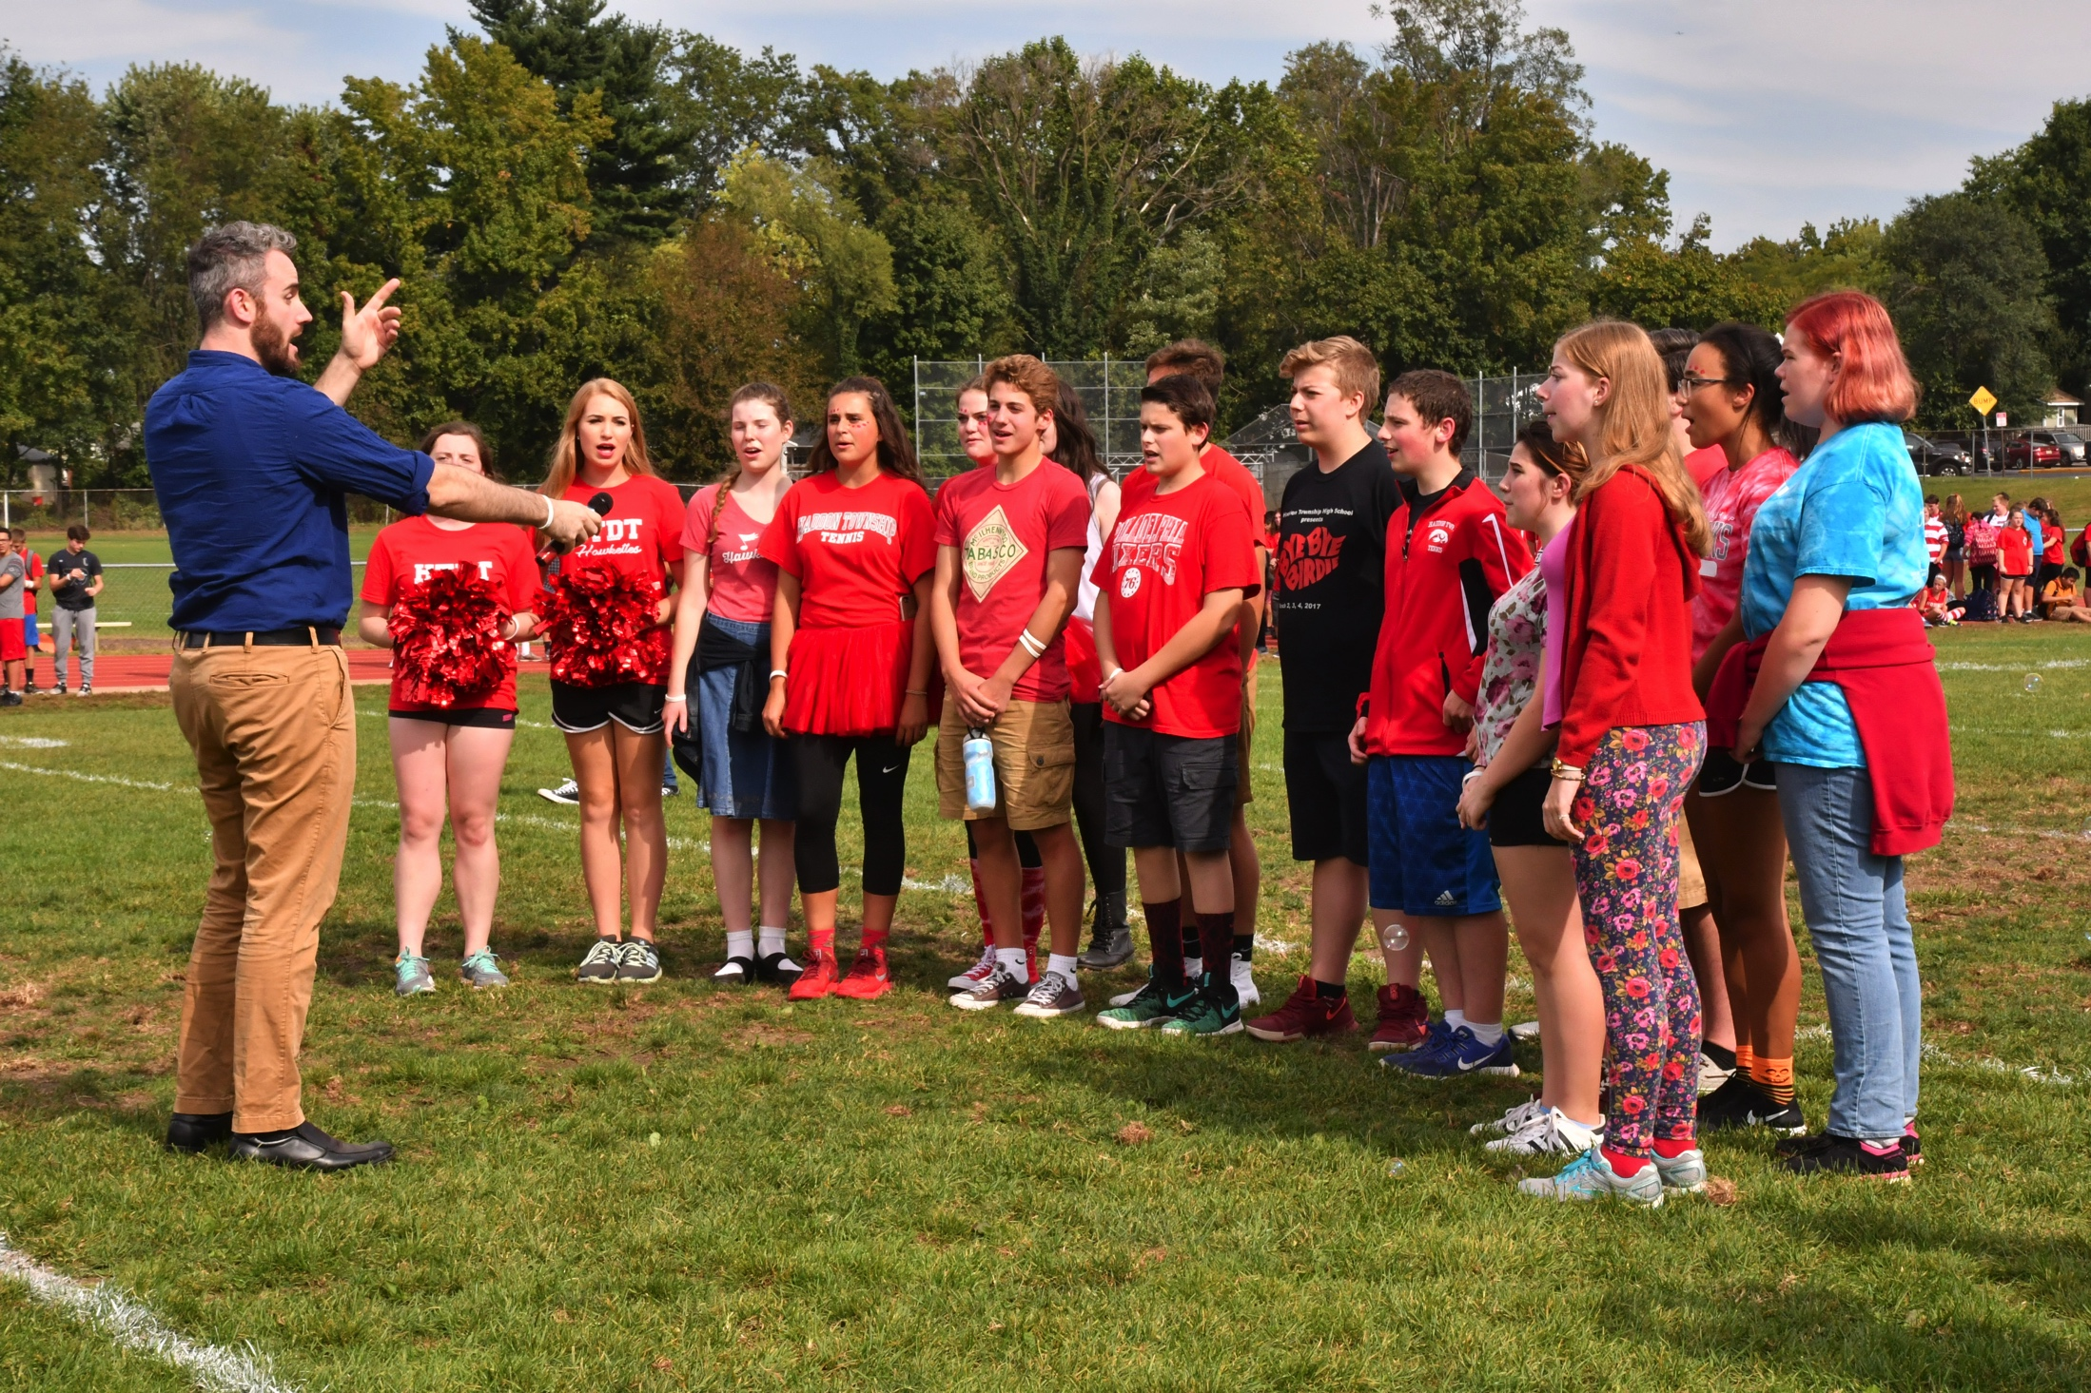
Student Highlights

Slide 16


Student Highlights

Slide 17
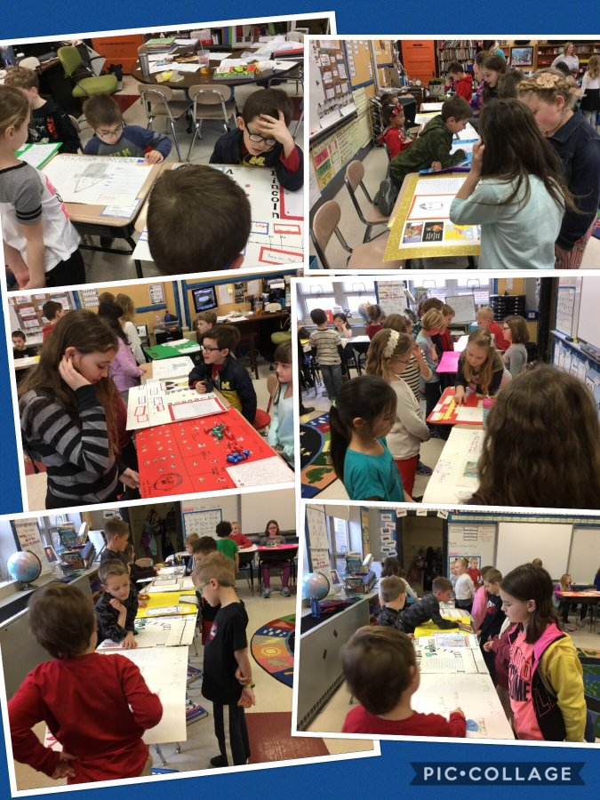

Student Highlights

Slide 18
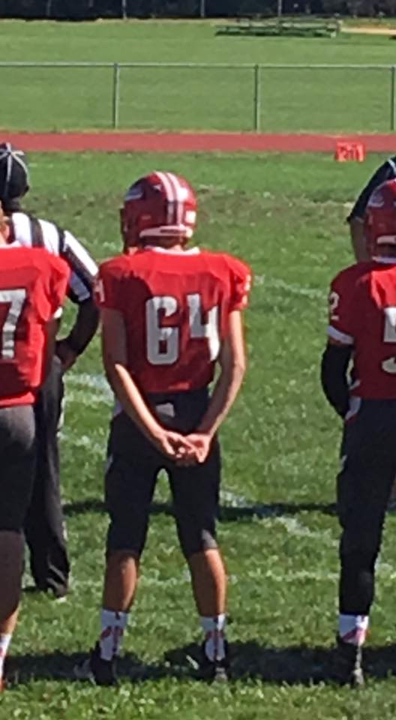
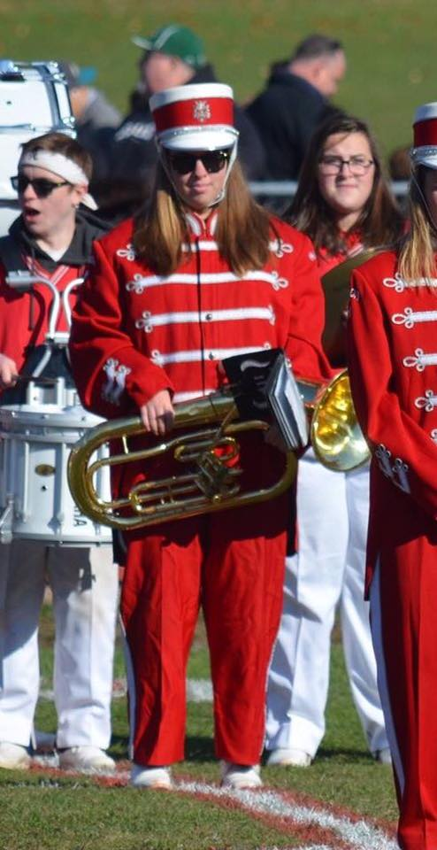

Student Highlights

Slide 19
In Summary
Without being restored to the 2009-10 levels of State Aid, smart fiscal oversight allows the district to retain, restore and create programs and opportunities for our students
This will be done in the new school year with an increase of $88.69 for the average Haddon Township resident

Slide 20
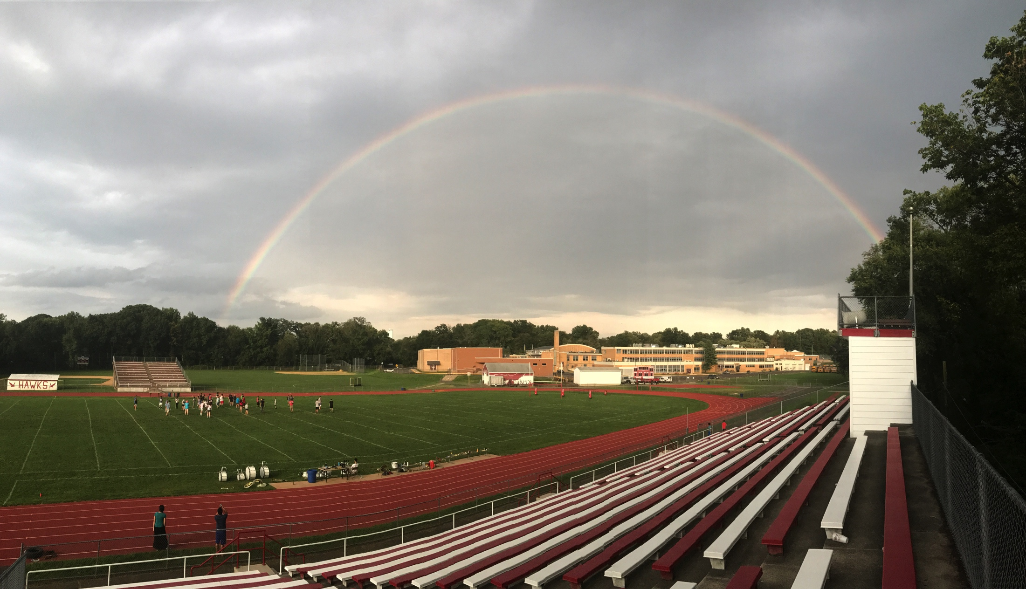
Questions?

