Slide 1
Rogers middle School
service projects
You are never too small…
To make a BIG difference!

Slide 2
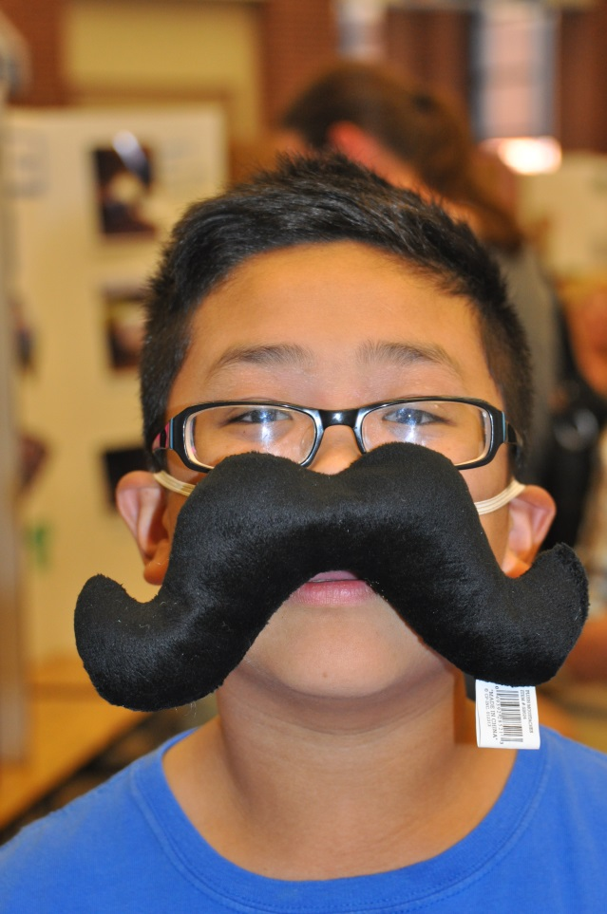
I “mustache” you a question??
How are you going to change
the world with your service??

Slide 3



Which area are you MOST passionate about helping?
People
Pets
Environment
Choose something that you CARE about/something that you are somehow personally connected to.

Slide 4
Introductional Parent email went out on Tuesday, November 27, 2018
Info Meeting (TODAY) on Thursday, November 29th,
4:00 pm – 4:45 pm
Plan signed by parents is due Thursday, December 6th
Service Fair will be on Thursday, January 24th.

Slide 5
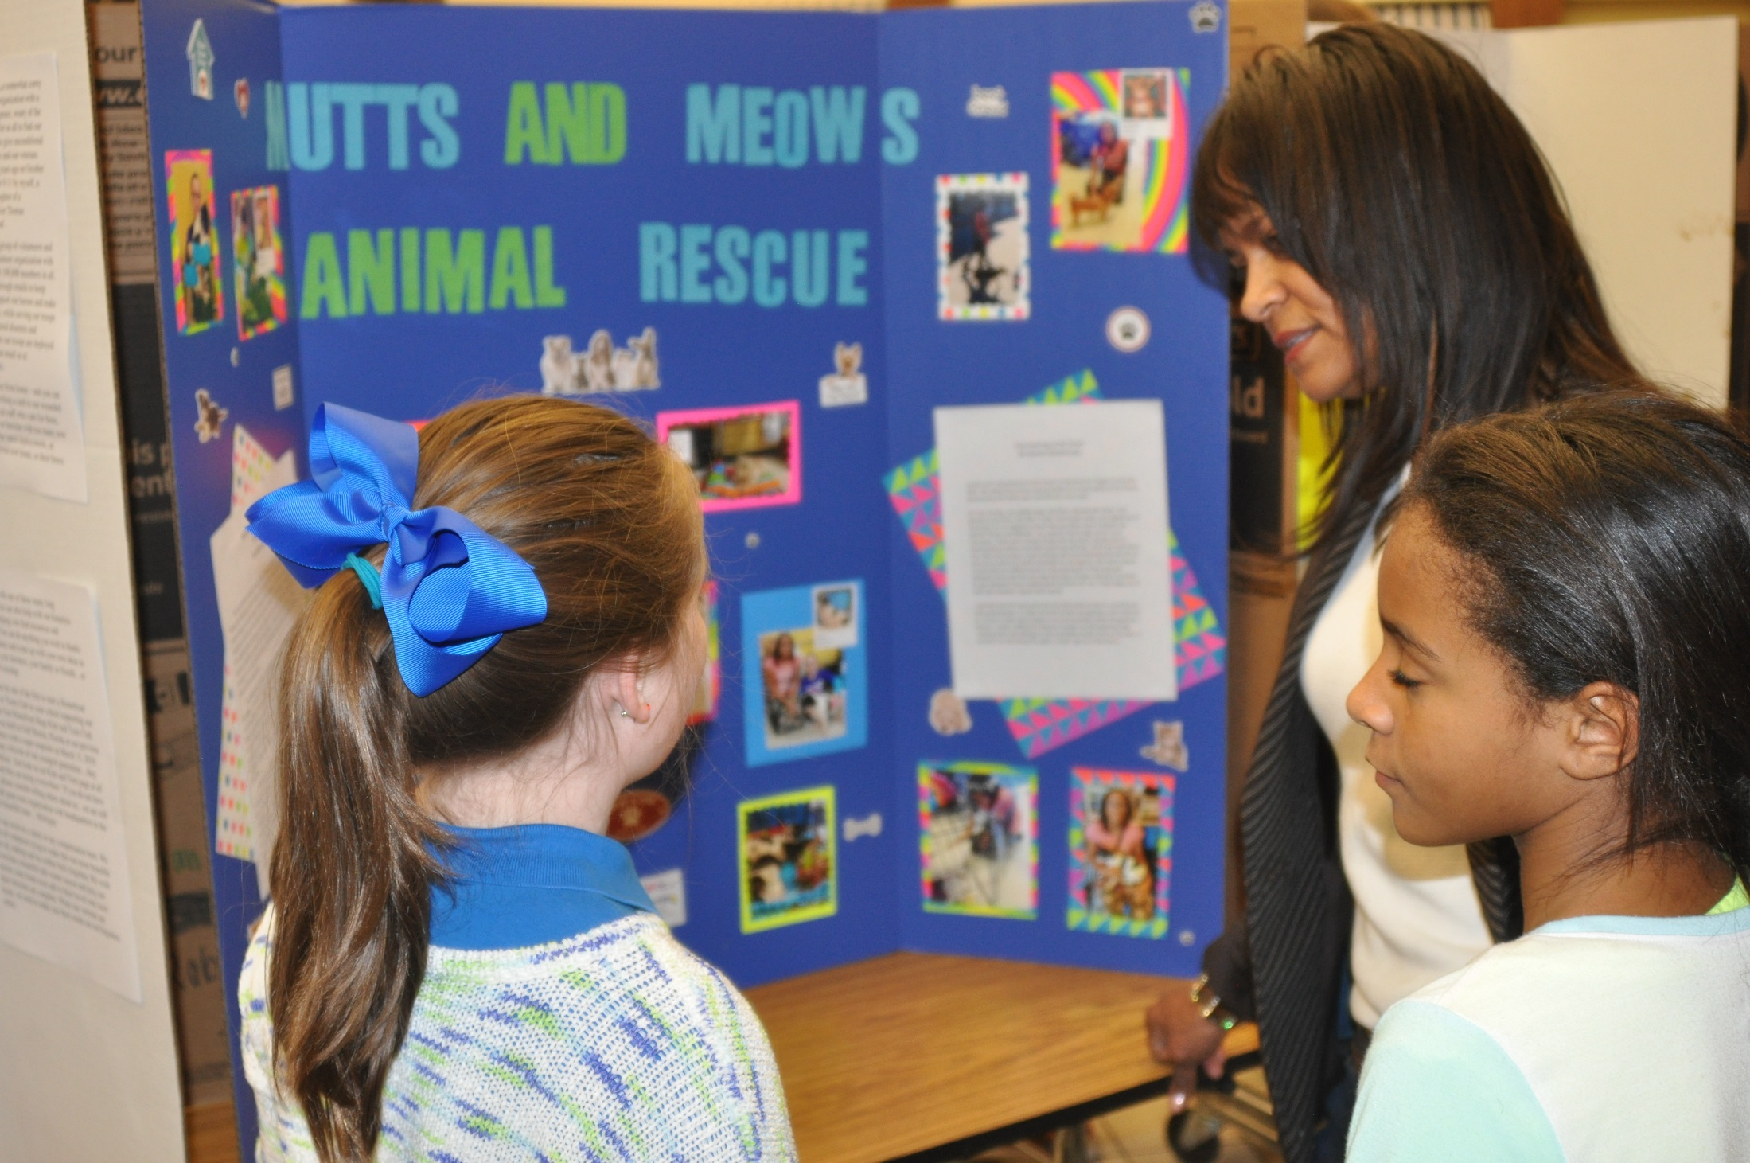

Slide 6
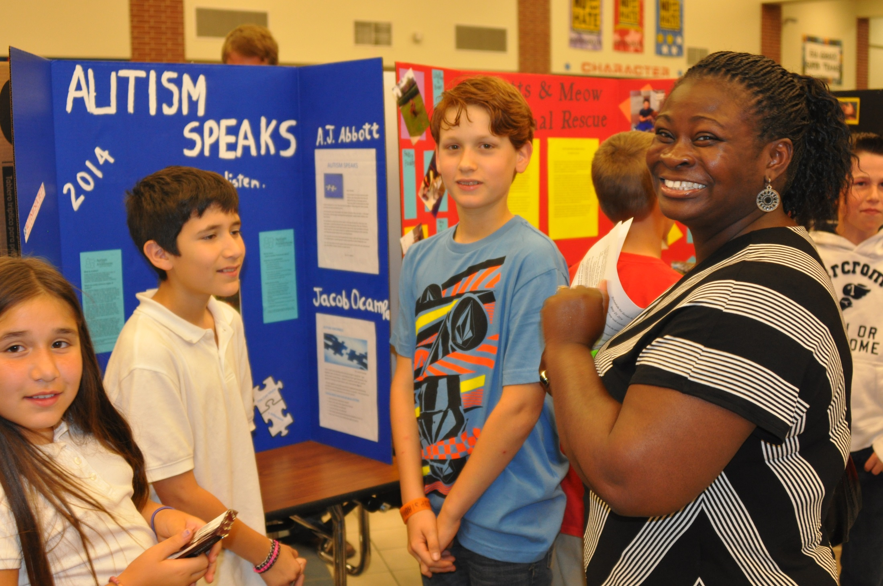

Slide 7
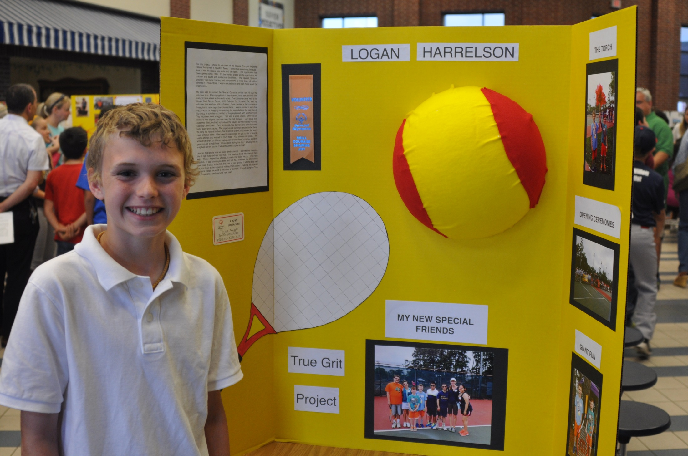

Slide 8
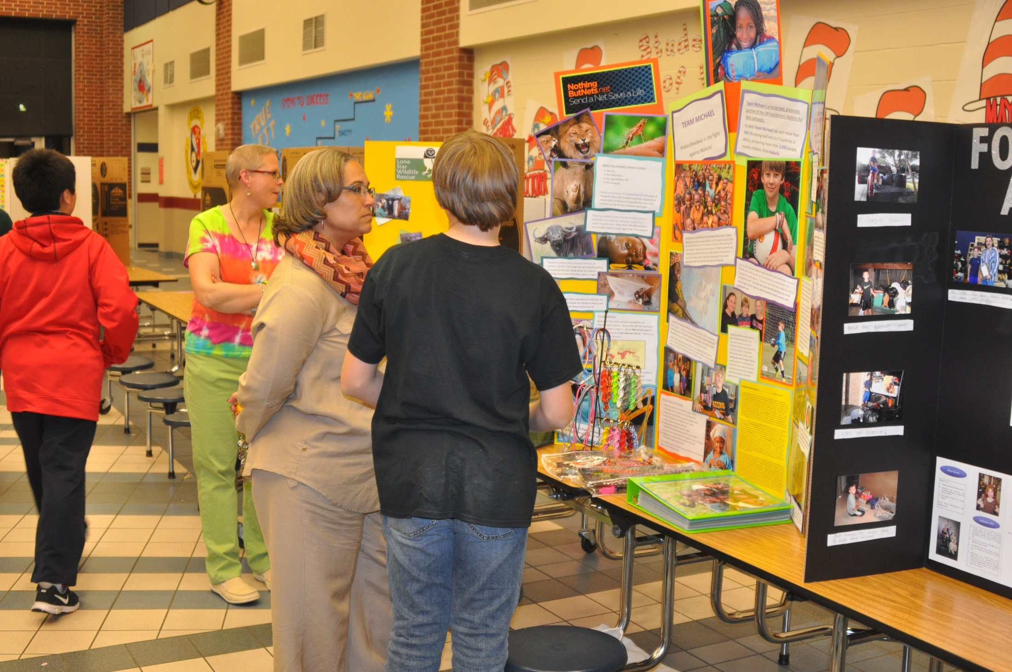

Slide 9
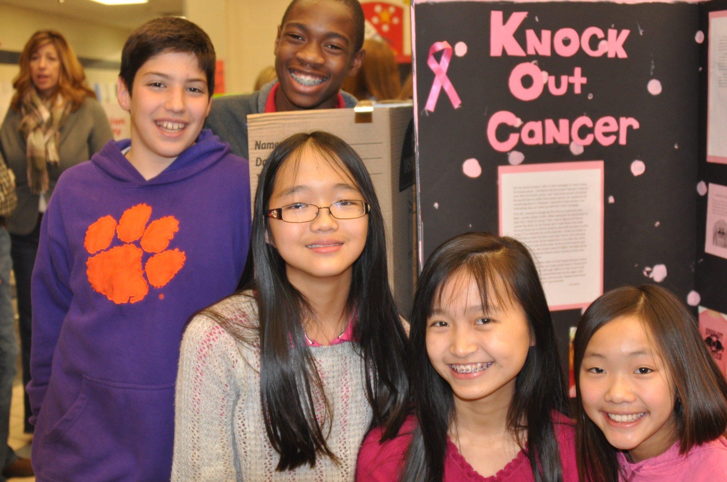

Slide 10
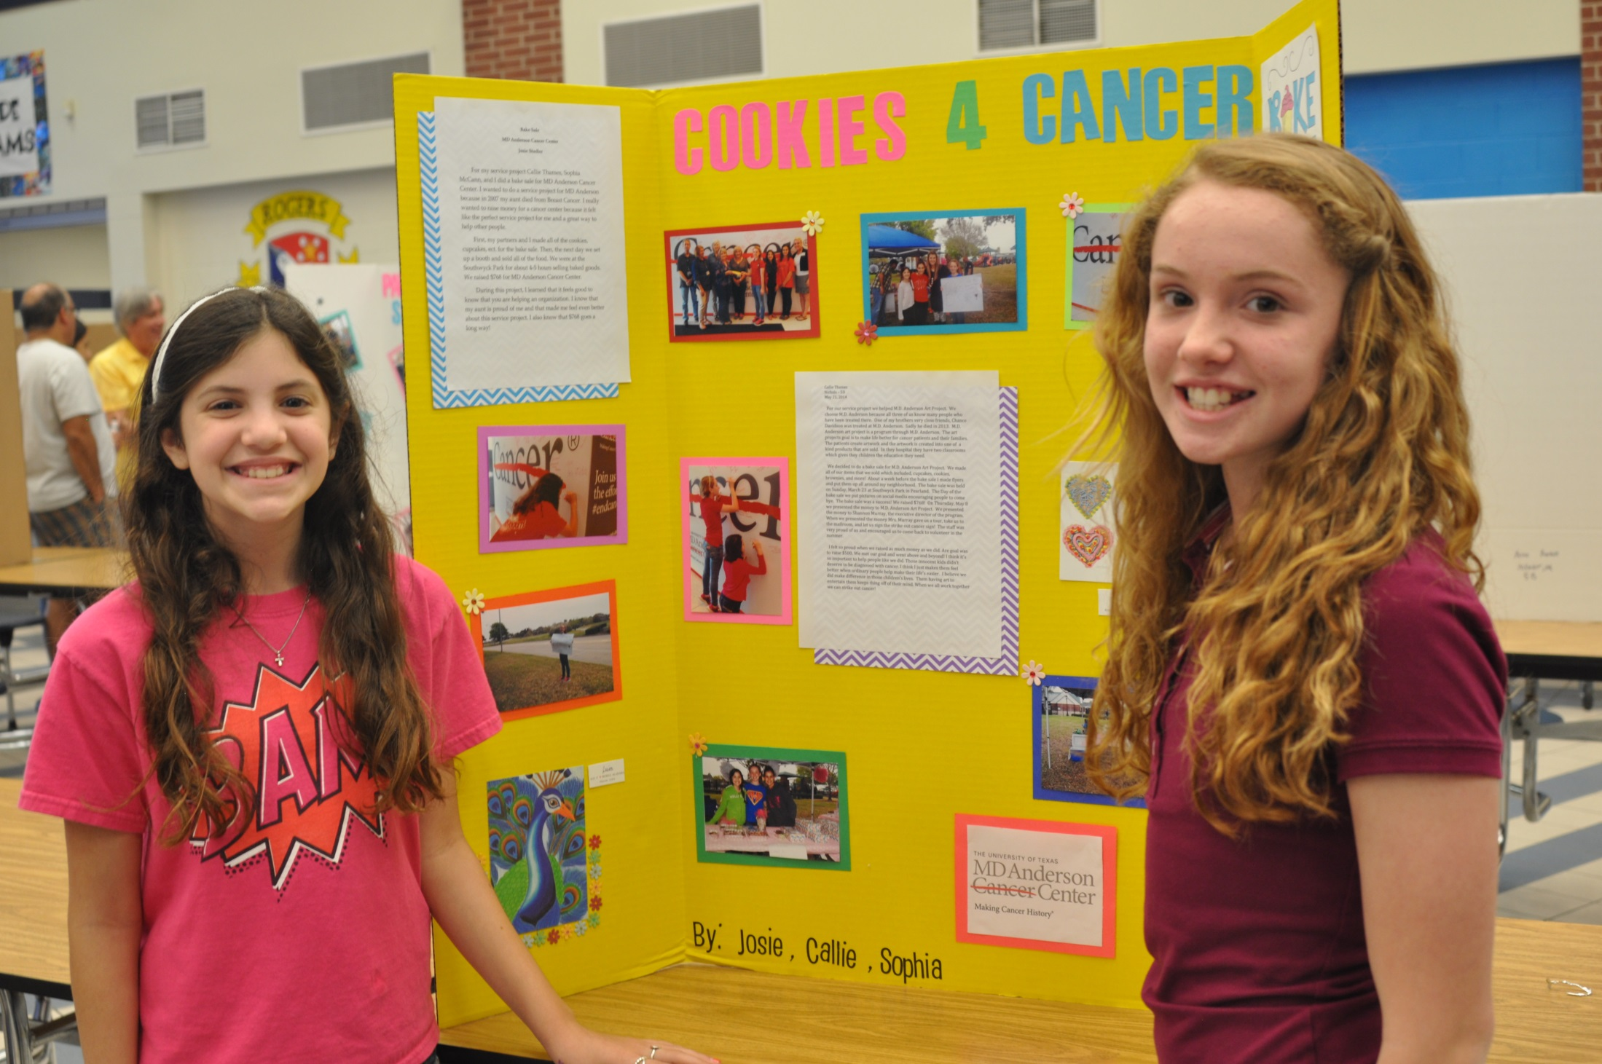

Slide 11
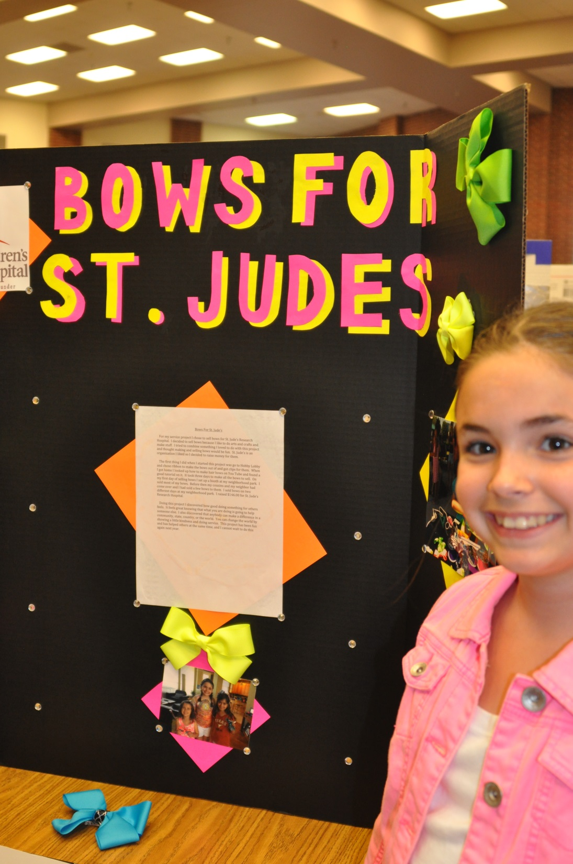

Slide 12
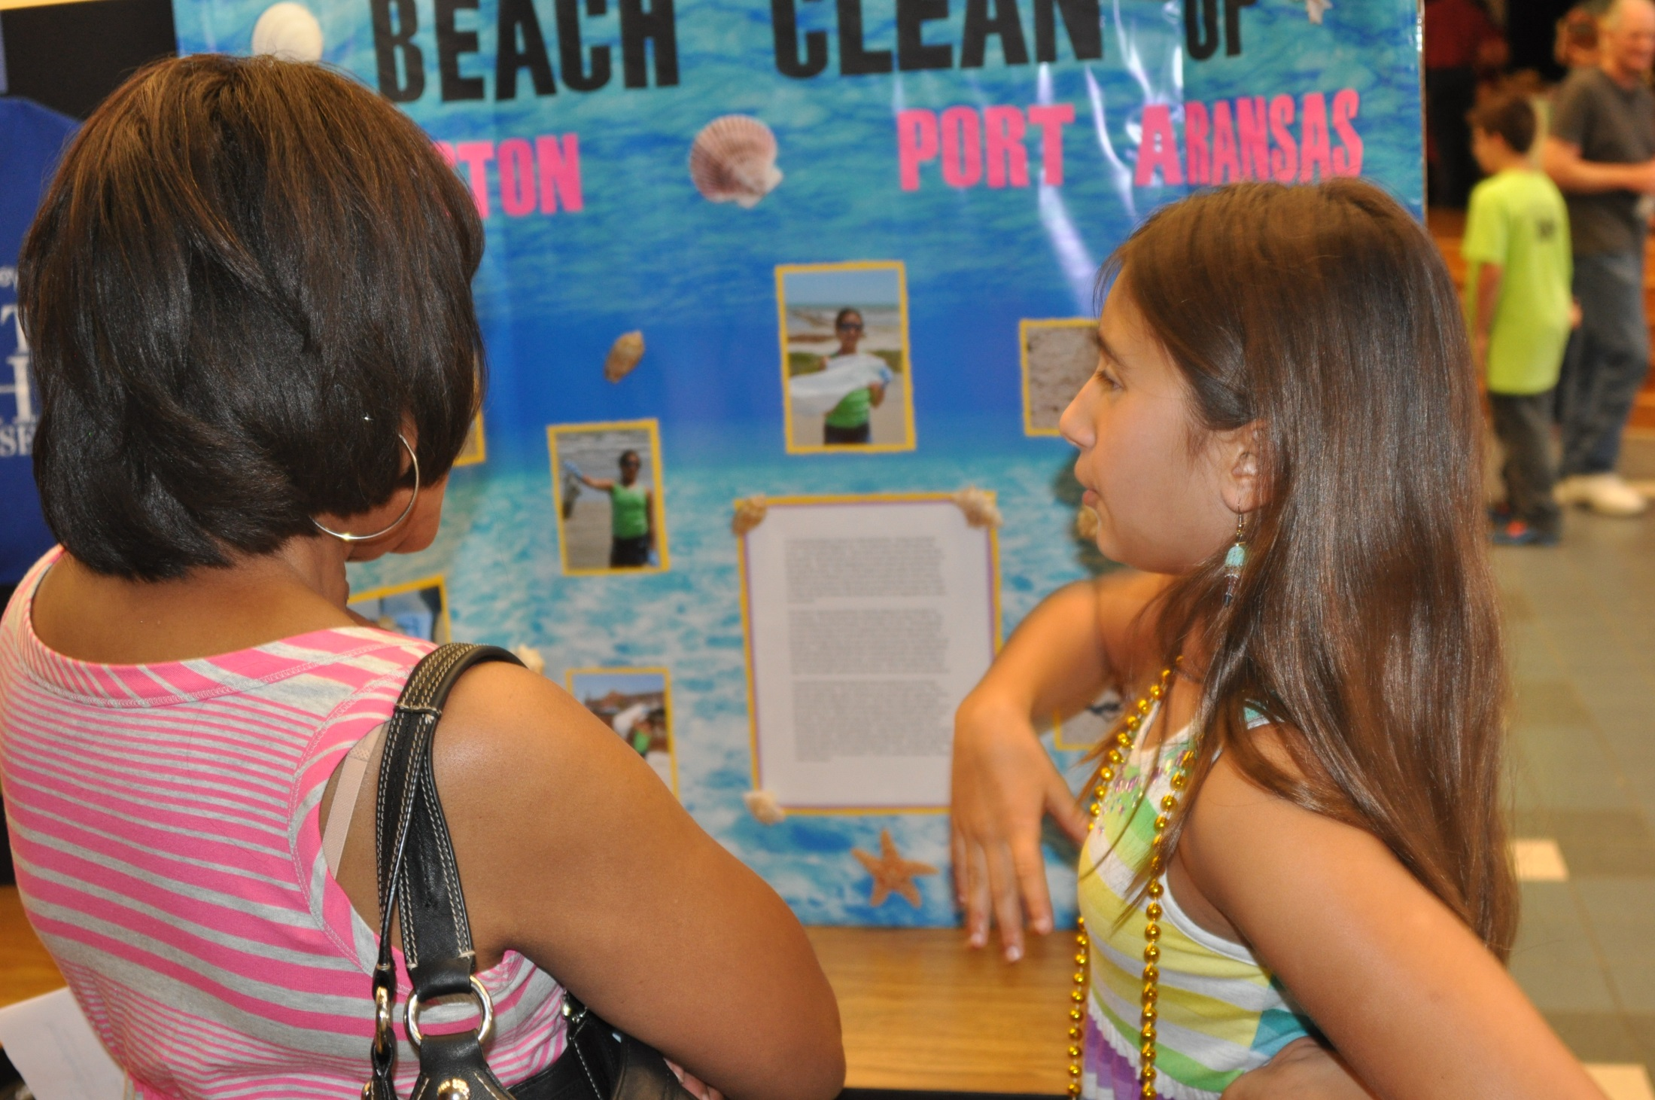

Slide 13
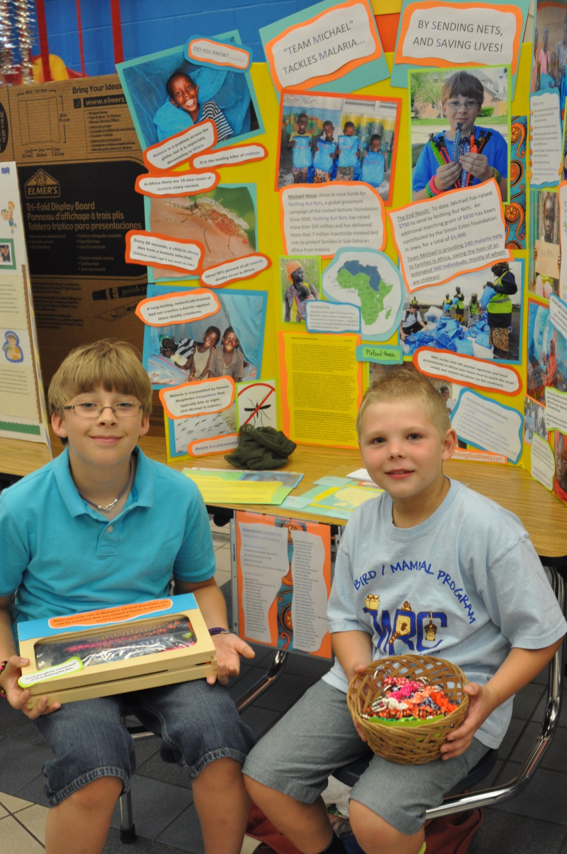

Slide 14
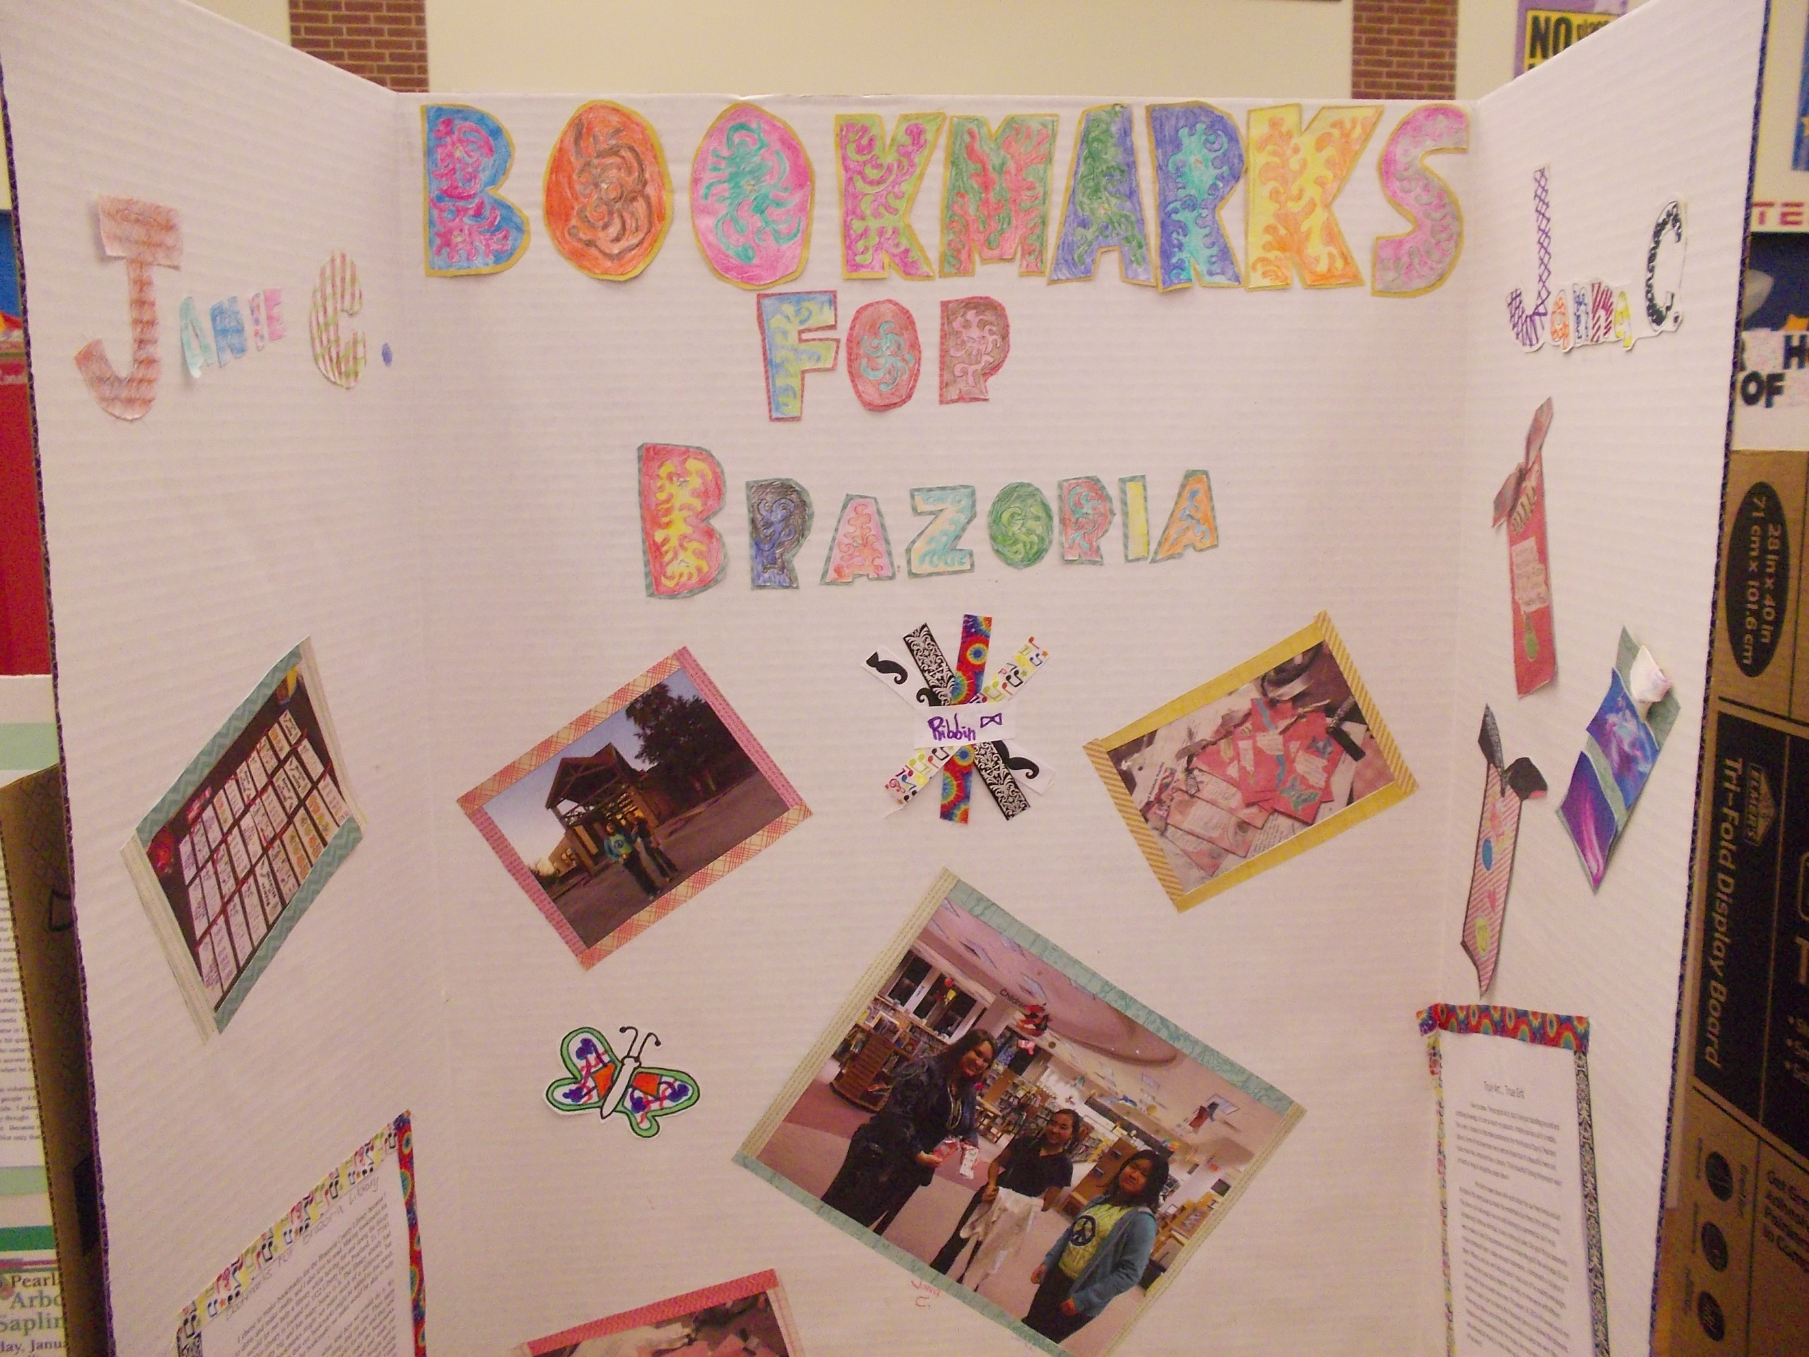

Slide 15
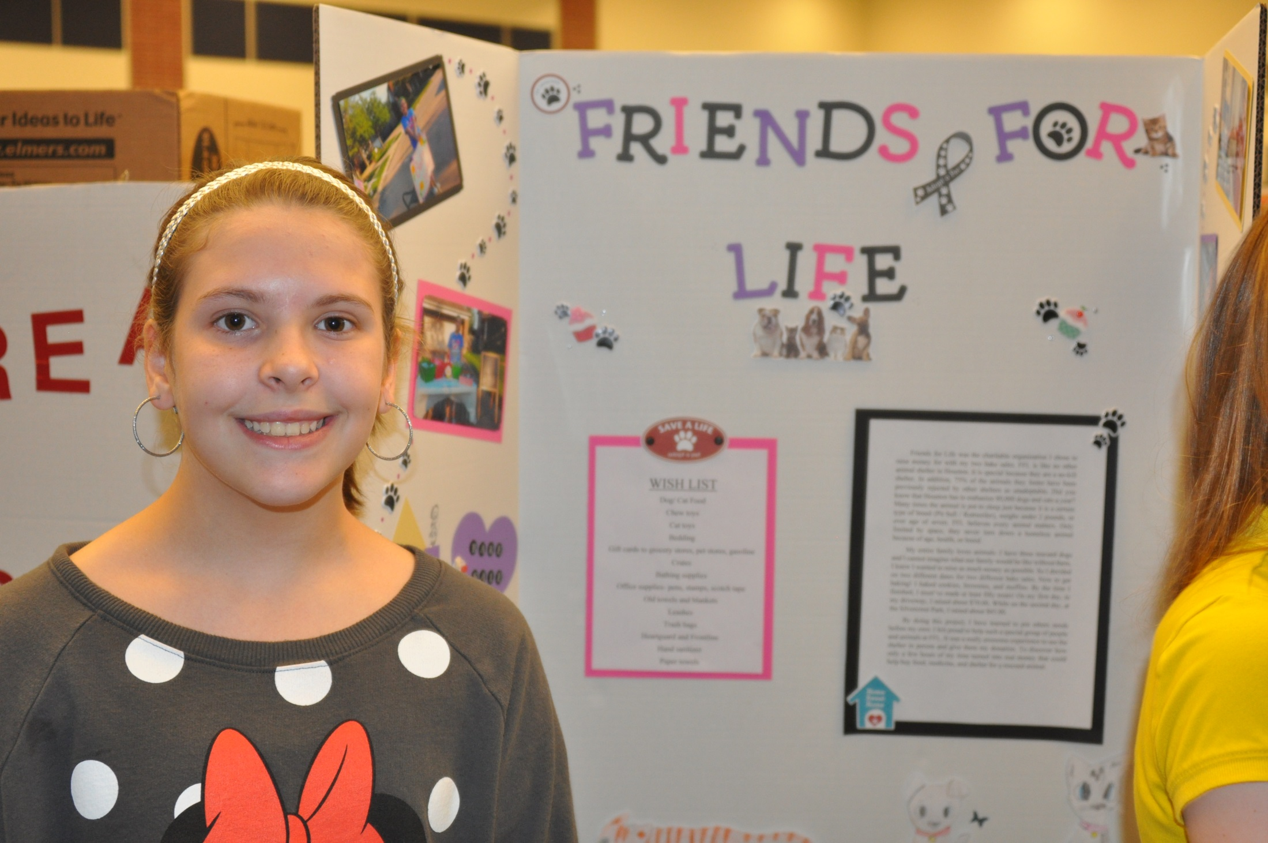

Slide 16
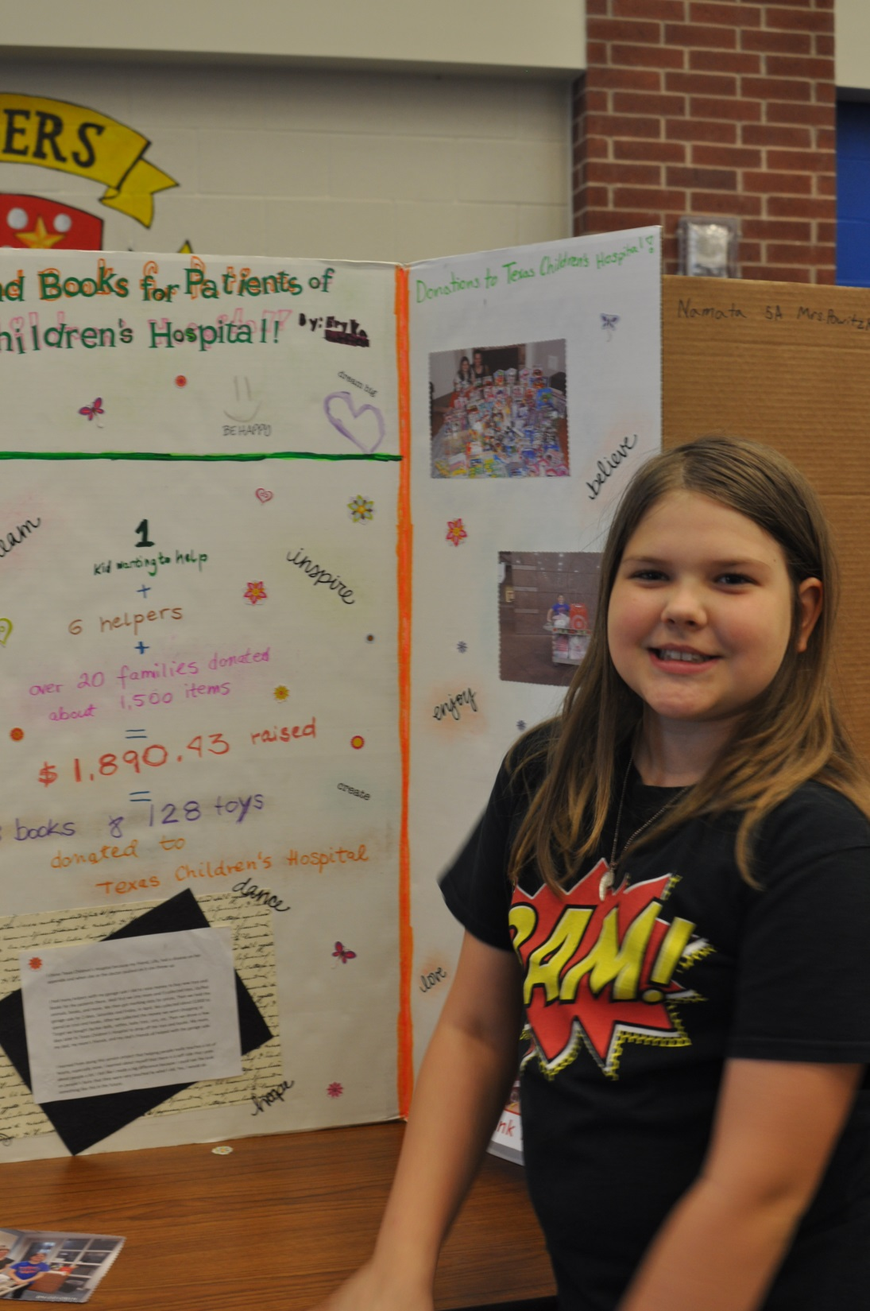

Slide 17
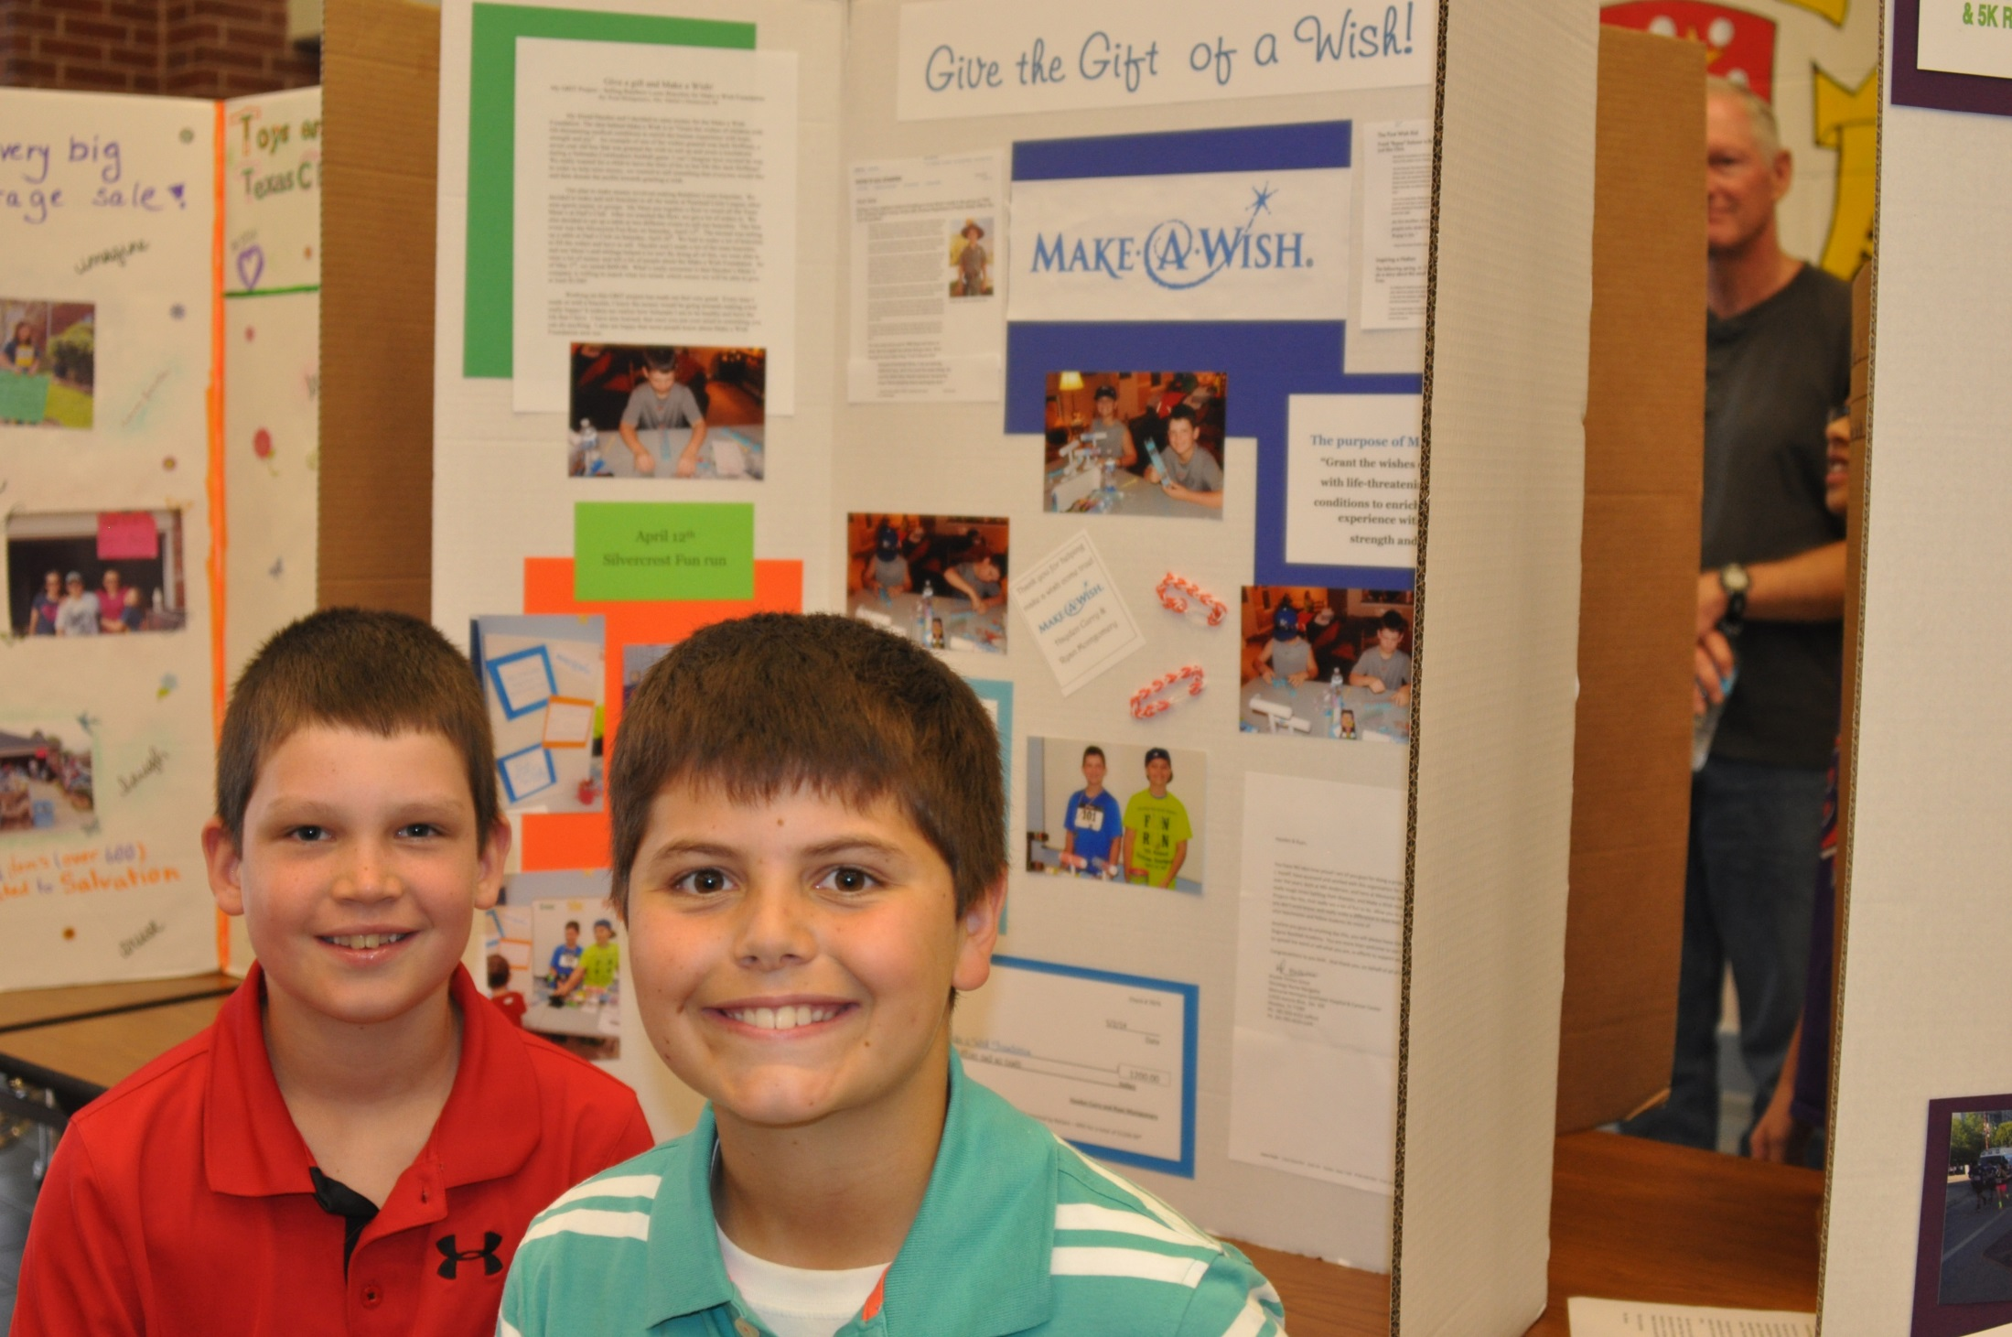

Slide 18
