Slide 1

Student Success.
Future Focused.
February 11, 2020 Capital Bond

Slide 2

Our Facility Needs
Growth and Planning Advisory Group:
  Looked at the age of buildings
  Studied past enrollment growth, projected enrollment
  Helped determine the facility priorities

Slide 3

Capital Projects Bond
Ensures all students have high-quality learning spaces by rebuilding aging school buildings and adding classrooms and classroom support spaces.

Slide 4
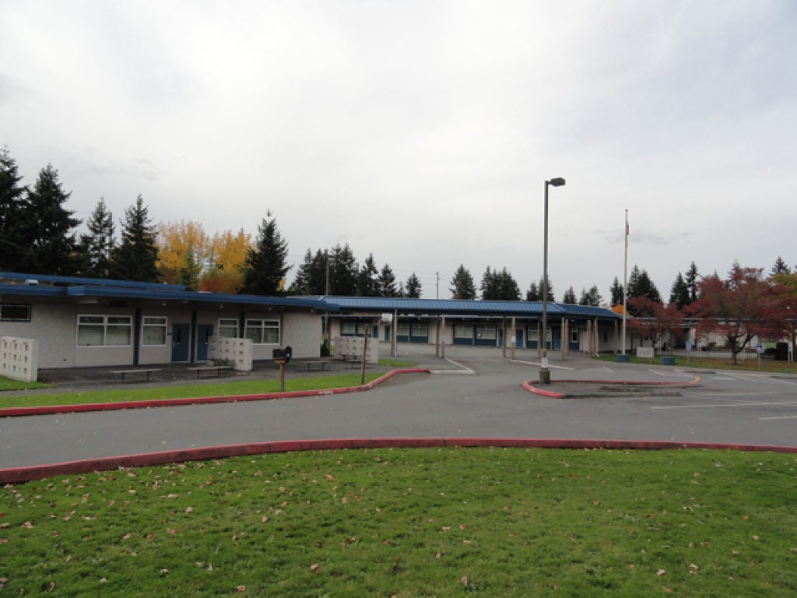
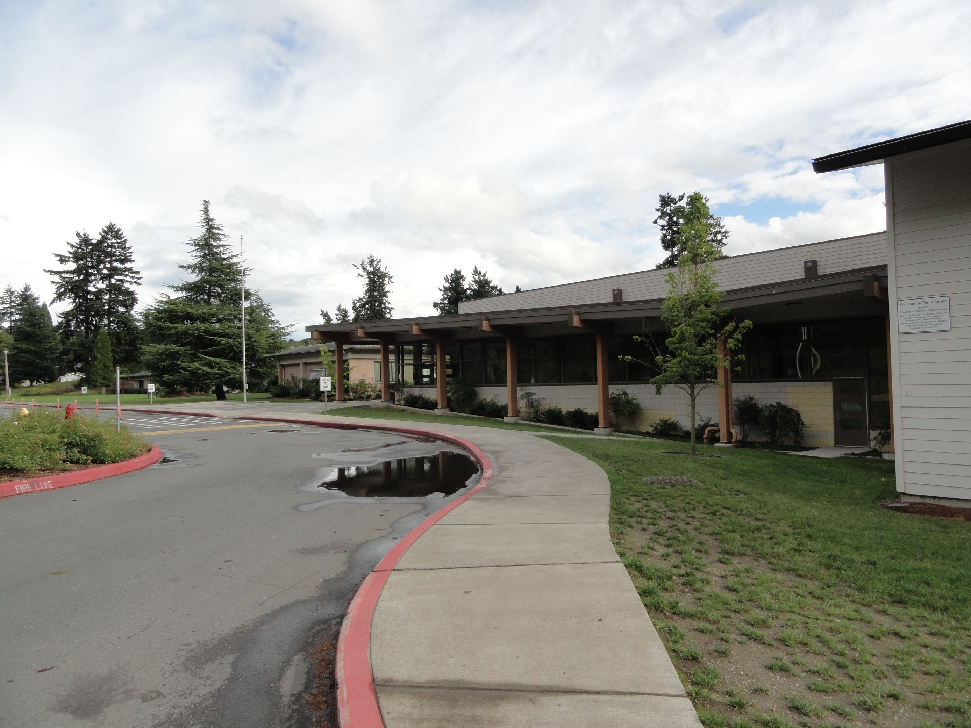
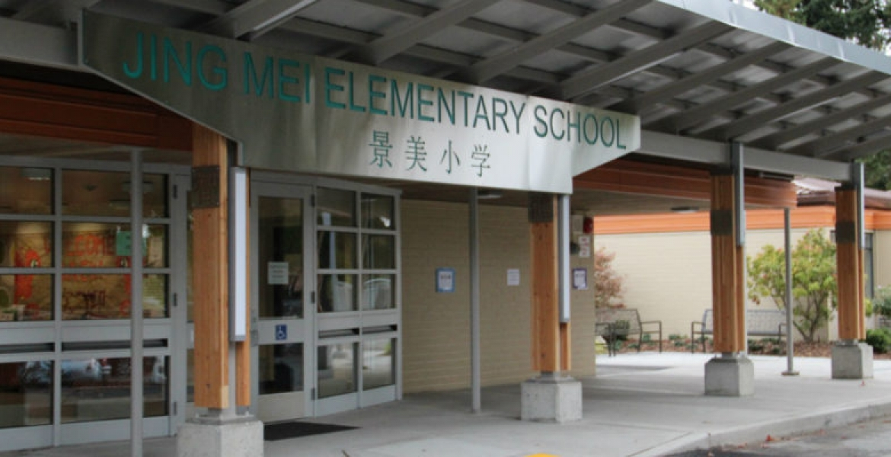
The 2020 Capital Projects Bond
Rebuilds three aging schools with the highest facility needs, replaces them with modern and safe school buildings with additional room for our students.
Big Picture School
International School
Jing Mei School

Slide 5
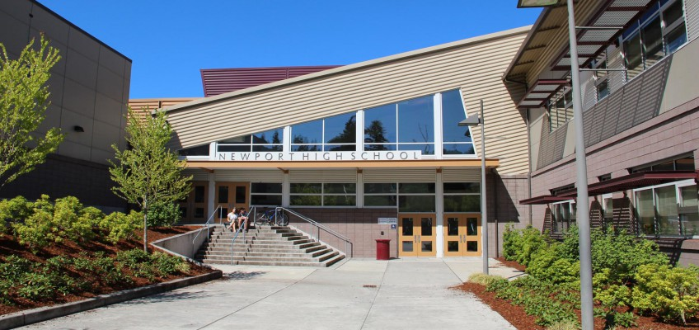
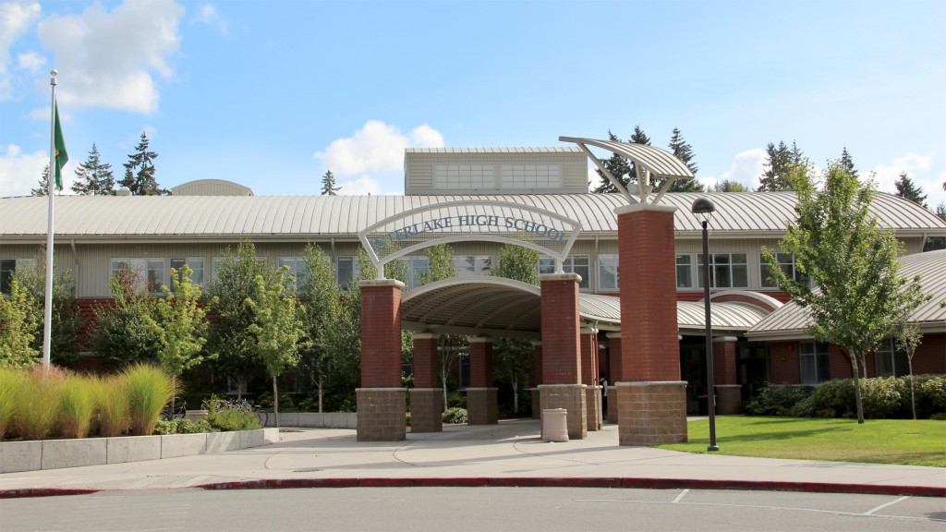
The 2020 Capital Projects Bond
Adds capacity to reduce crowding at two schools by through additions and renovations.
Newport High School
Interlake High School

Slide 6
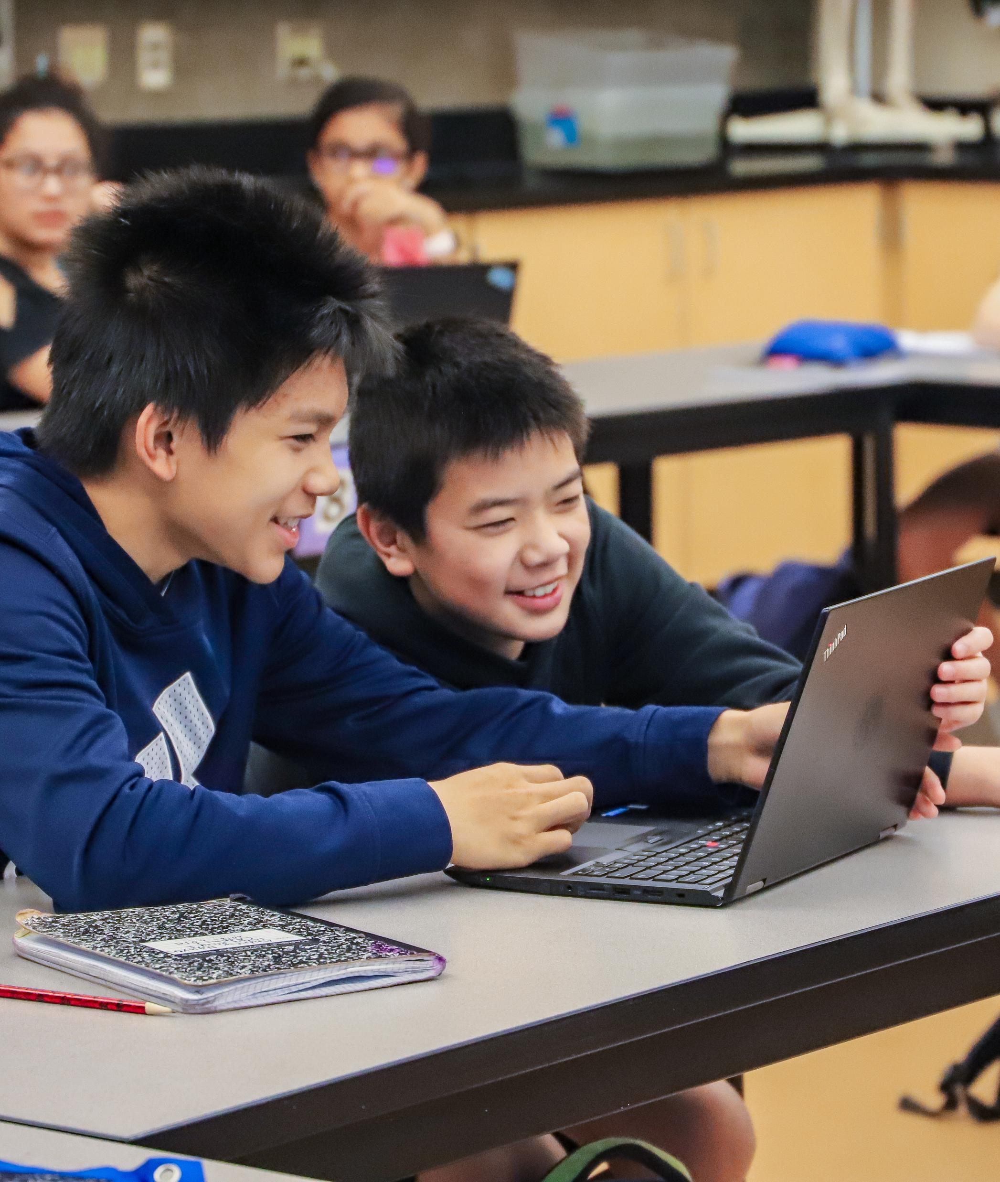
The 2020 Capital Projects Bond
These new school buildings and additions will provide modern learning spaces for science, technology, engineering and math classes (STEM), and extracurricular activities to prepare students for successful futures.

Slide 7
The 2020 Capital Projects Bond
Improves physical safety and security for students and schools.
Adding security vestibules to eight schools that currently do not have them. Vestibules require school visitors to enter the office and check in before gaining access school buildings.
Bellevue High School
Interlake High School
Newport High School
Chinook Middle School
Sherwood Forest Elementary School
Somerset Elementary School
Spiritridge Elementary School
Woodridge Elementary School

Slide 8
The 2020 Capital Projects Bond
Increases physical safety and security for students and schools.
Adding bollards (safety posts) in front of 19 school entrances that do not have them. These posts are best practices for school buildings to protect entrances from potential vehicle impact, protecting students, staff and families inside and around the doorway.
High schools:
Bellevue, Interlake, Newport, Sammamish
Middle schools:
Chinook, Highland, Tyee
Elementary schools:
Ardmore ,Cherry Crest, Clyde Hill, Eastgate, Lake Hills, Medina, Newport Heights, Phantom Lake, Sherwood Forest, Somerset, Spiritridge, Woodridge

Slide 9
The 2020 Capital Projects Bond
Rebuilds the aging education service centers
  Invests in more efficient facilities to allow central office staff to better support students, teachers and the community.
  Increases building efficiency and reduces the costs of maintaining an aging building.
  Will create community meeting spaces.

Slide 10
The 2020 Capital Projects Bond
Designates funding for future purchase of additional school locations.
  Allows a faster response by the district if appropriate property becomes available.
  Enables the district to plan for the future as our community continues to grow.
    For example, the Wilburton Elementary School property resulted in a school being built and alleviating crowding at other schools.

Slide 11

What is the cost of the bond?

Slide 12
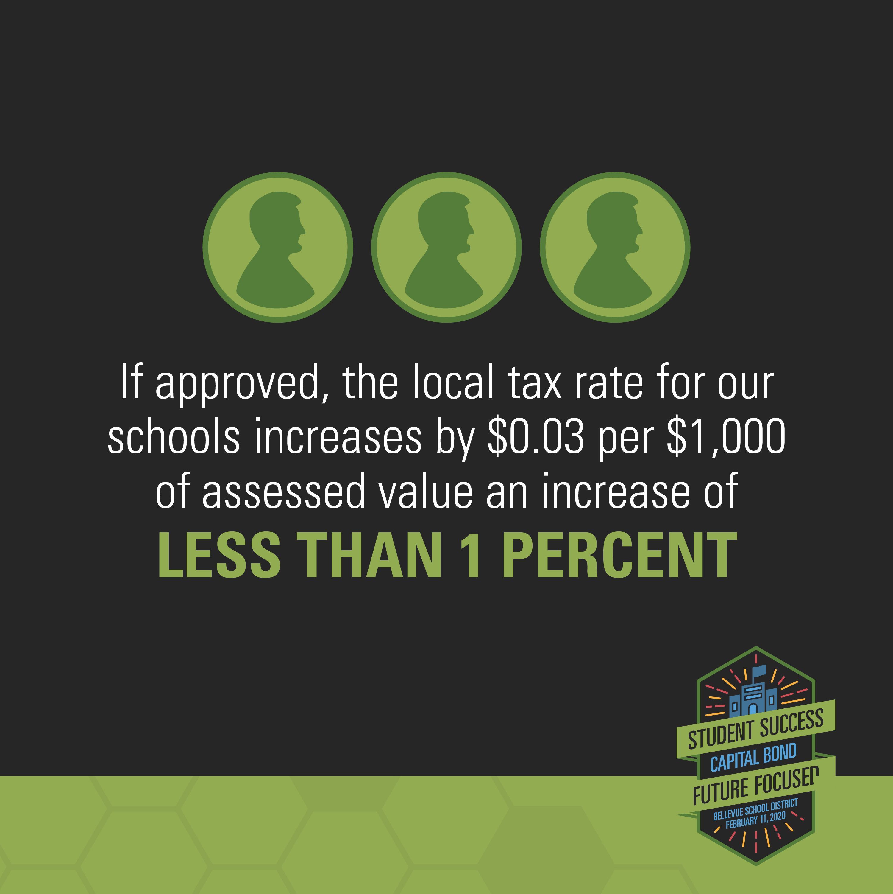
This Capital Bond
Maintains a consistent tax rate for Bellevue School District
Keeps all funds in the school district to benefit local students.
Funds major construction projects,
which are not funded with state dollars.
Will require 60 percent approval to pass.
Would generate $675 million, which the district will pay back over 20 years.
GRAPHIC?

Slide 13
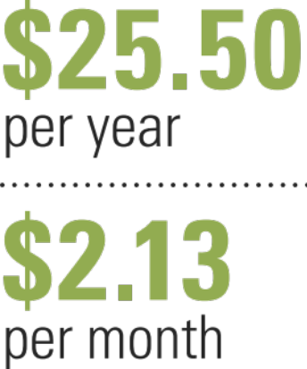

What is the cost?
Keeps the tax rate under $2.50 per $1,000 of assessed value.
For the average valued home ($850K), a Bellevue resident pays $2.43 per $1,000 of assessed value for local school property taxes.
With the proposed bond that will increase by .03 cents a year, or $2.46 per $1,000 of assessed value, or $25.50 per year for the average valued home.

Slide 14
Thank you for your time
Questions?
www.bsd405.org/2020bond
Please remember to vote by
FEBRUARY 11, 2020

