Slide 1
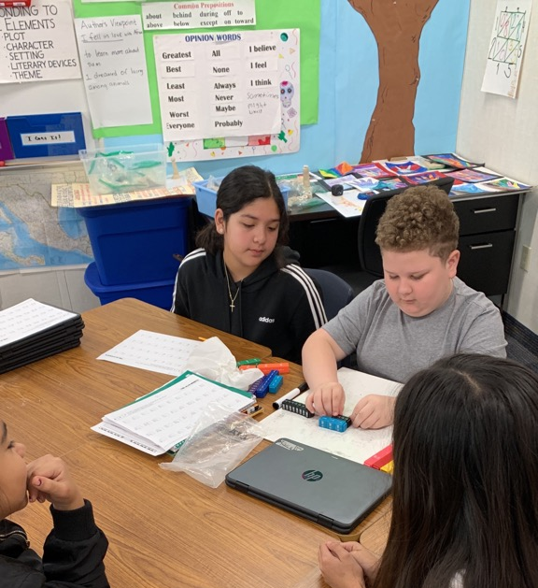
CHAMPS:
Video Conferencing With Students

Slide 2
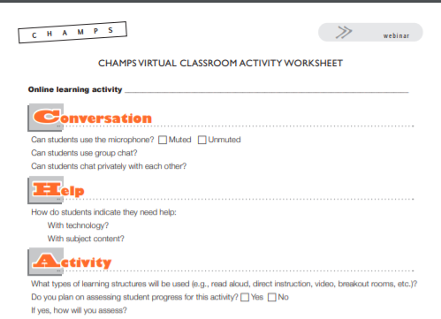
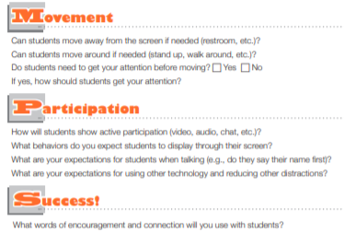

Slide 3


Slide 4
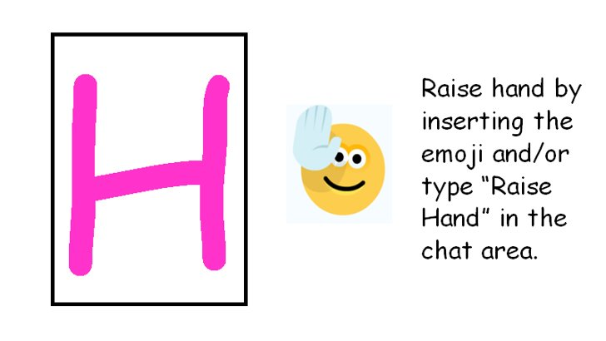

Slide 5


Slide 6

Stay in the Teams Chat meeting and be present.

Slide 7

Use thumbs up and thumbs down and/or nodding your head for a yes or no response. Answer questions in the chat area.

Slide 8


Slide 9
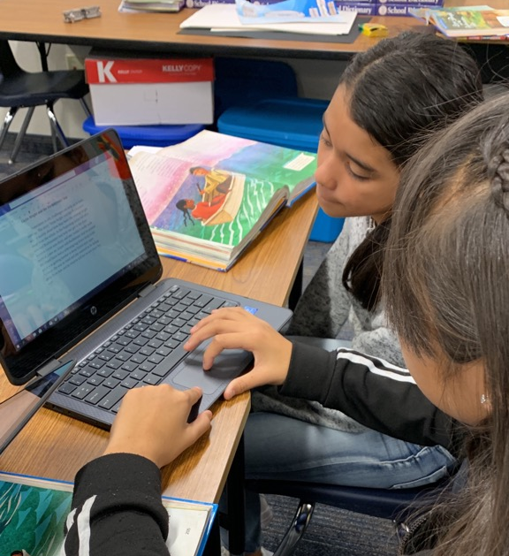
CHAMPS:
Teams Chat Student to Student

Slide 10

Communicate respectfully using Talking Stems such as “excuse me,” “thank you,” “please,” “I agree/disagree with,” and “I like to add.”

Slide 11

Ask other students or begin a new chat with your teacher for help.

Slide 13
Stay in the Teams Chat meeting and be present.

Slide 14
Listen, answer, ask questions and/or share.

