Slide 1


Curriculum
Assessment
Professional Development
Family Partnerships

Slide 2


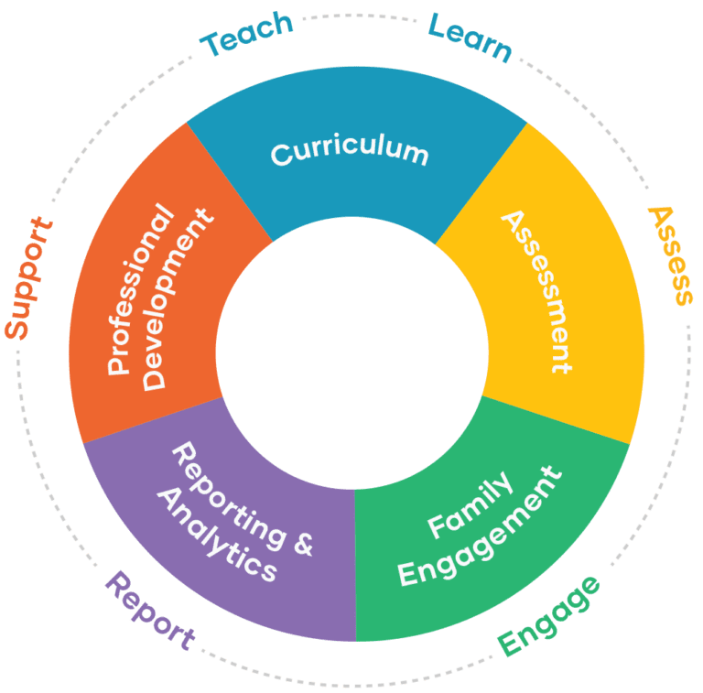




Preschool Ecosystem

Slide 3
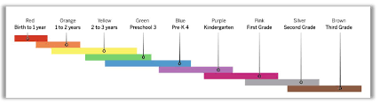

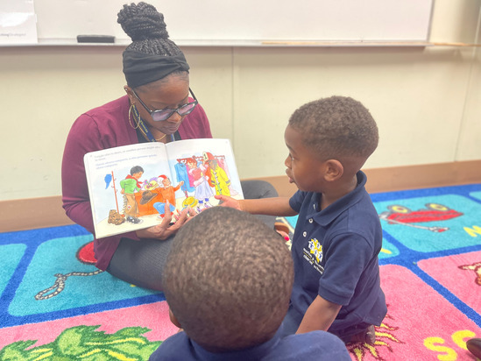
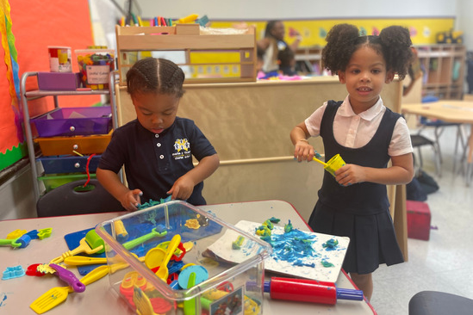
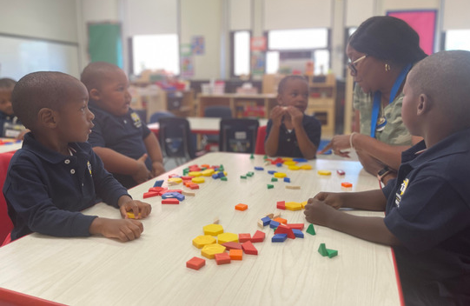
Preschool Curriculum
Overview
The Creative Curriculum
How does The Creative
Curriculum work?
Objectives for Development & Learning
How Curriculum & Assessment are linked
The Foundation is the knowledge base of the curriculum, with detailed information about the most current research and best practices in early childhood education.
The Teaching Guides, a component of the Daily Resources, offer daily plans to help teachers provide individualized instruction for every child and organize and manage every moment of their day
Social-Emotional
Physical
Language
Cognitive
Literacy
Mathematics
Science & Technology
Social Studies
The Arts
English Language Acquisitions
The curriculum is aligned with the assessment model used in GOLD follows widely held expectations for children from birth through third grade and enables a whole-child approach to assessment.
Color-coded progressions guide teachers toward selecting and adapting activities that support each child’s development and learning, including those with disabilities.
Child-centered, research-based curriculum that emphasizes play, integrated subjects, and individualized instruction.
It promotes ongoing assessment, family engagement, and professional development.

Slide 4
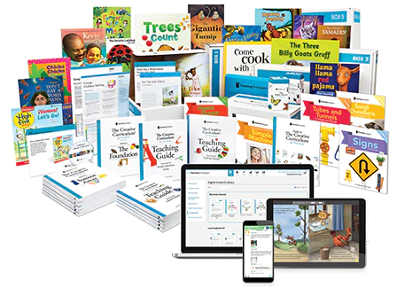
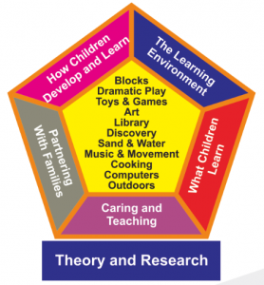
Curriculum Highlight
Themes vs. Studies
Instructional Focus
Social-emotional skills
Language and literacy
Math and science
Creative arts
Physical development
Studies
Initiation Phase: Children are introduced to the topic and begin to ask questions. Teachers provide resources and support to help children explore the topic.
Investigation Phase: Children gather information and conduct experiments. They use their senses, their imaginations, and their creativity to learn about the topic.
Celebration Phase: Children share what they have learned with others. They may create presentations, exhibits, or performances.

Slide 5

Curriculum Components
The Foundation
Volume 1: The Foundation presents all the information teachers need to set up their programs.
It summarizes the research foundation for the curriculum and addresses five key aspects of the curriculum: how children develop and learn, the learning environment, what children learn, caring and teaching, and partnering with families.
Volume 2: Interest Areas brings the five key aspects of the curriculum to life, applying them in each of the 10 interest areas and the outdoors.
Each chapter describes materials that enhance children’s experiences, as well as strategies for guiding children’s development and learning
Volume 3: Literacy prepares teachers with knowledge and tools that help them inspire children to read, write, and learn.
It includes practical strategies for intentionally teaching critical language and literacy skills, such as letter knowledge, and for integrating rich and enjoyable literacy experiences into all the interest areas.
Volume 4: Mathematics helps teachers fully understand the mathematical concepts and skills they will be teaching, and shows them how to purposefully include mathematics learning throughout the day.
Volume 5: Science and Technology, Social Studies & the Arts helps teachers make these essential content areas part of children’s everyday learning. With this new volume, teachers can encourage children to make and test hypotheses, develop skills for using technology, explore their world and the people in it, and engage their creative thinking skills.
Volume 6: Objectives for Development & Learning describes in detail the 38 objectives in The Creative Curriculum® for Preschool. Based on an extensive review of the latest research and professional literature in early childhood education, these objectives include predictors of school success and are aligned with early learning standards for the state.

Slide 6

Curriculum Components
Daily Resources
Teaching Guides feature comprehensive, detailed plans that span several weeks and offer moment by-moment guidance for every day. They also offer teachers plenty of opportunities to incorporate their own creativity and expertise—giving them the flexibility to follow children’s interests while ensuring they’re continuing to address all the important areas of learning and development.
Intentional Teaching Cards The experiences explained on these cards support social– emotional, physical, and language development, as well as development and learning in literacy and mathematics. One of the most important features of the Intentional Teaching Cards™ is the color-coded teaching sequence. These sequences allow teachers to quickly adapt an experience to make it more or less challenging, enabling every child to participate successfully.
Children’s Book Collection includes classic tales, contemporary works by well-known authors, and original nonfiction books created especially to complement the studies featured in the Teaching Guides. Each book was selected for its rich vocabulary; diverse characters, families, and cultures; or the new ideas and information in its pages. Many books have been adapted for the eLearning environment. Fully translated and read in both English and Spanish.
Book Discussion Cards ™ show teachers how to conduct multiple effective read-alouds and offer suggestions for introducing each book, emphasizing vocabulary as the story is read, commenting on characters, and asking probing questions. The cards also have specific guidance for supporting children’s social emotional development.
Mighty Minutes can be used anywhere, any time to intentionally teach language, literacy, math, science, social studies, or physical skills during “in-between” times—such as when teachers are preparing to go outside or gathering children for large-group time and is ® are rooted in curricular objectives

Slide 7
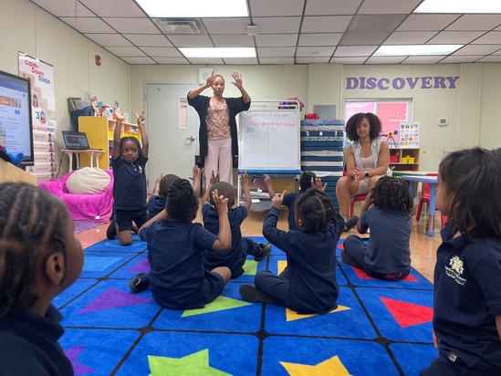
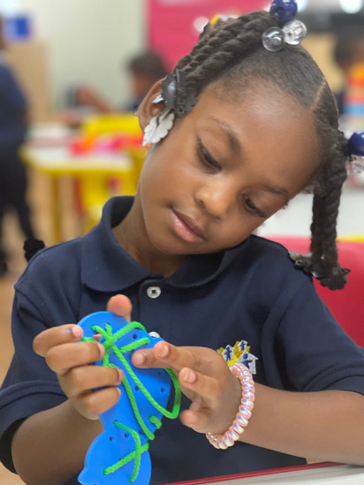
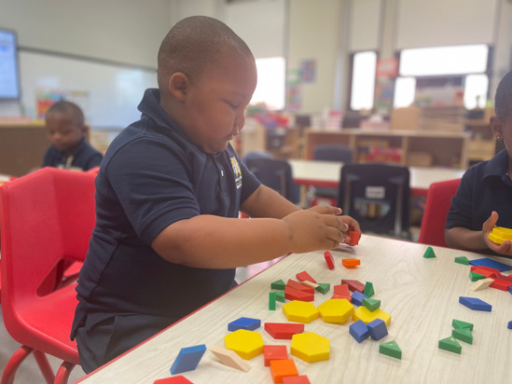
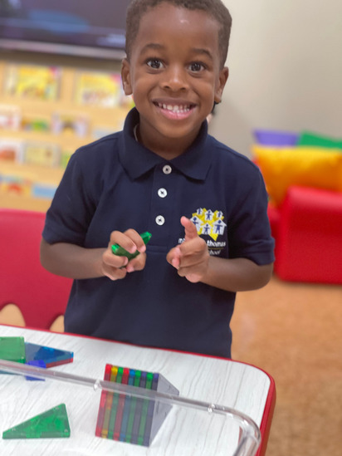
Embedded Professional Development
Support for all Teachers
Each of the resources contains embedded professional development support for teachers at all levels.
Teaching Guides include background information about each featured study topic, and references throughout draw teachers’ attention to the research behind each day’s activities.
Intentional Teaching Cards™ offer information to guide teachers’ observations and provide color coded teaching sequences to help teachers individualize instruction.
The Creative Curriculum® for Preschool provides moment-to-moment, day-to-day support for teachers who want it, but there’s also plenty of flexibility and choice for teachers at all levels of experience.

Slide 8

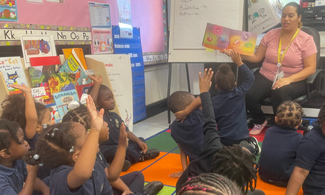
MAKING CONNECTIONS WITH FAMILIES
Home-School Connection
eBooks & Learning Games
English and Spanish titles from the Teaching Strategies® Children’s Book Collection are available on the cloud for family members to participate directly in literacy experiences that are essential for children’s development and learning
Learning Games® provide families with easy-to-use, engaging activities that bridge what is learned at school with what families can do at home.
Letters to Families
These letters introduce families to learning in each interest area and study, informing them of opportunities for family participation and support.
Teachers can use these letters as they were written or adapt them as necessary.
Online Classroom & Family Resources
Teachers can visit a password-protected website to easily download “Letters to Families,” “Weekly Planning Forms,” and Learning Games®.
Like the other curriculum materials, every family connection resource is available in both English and Spanish.
Weekly Plans
These pre-filled “Weekly Planning Forms” help teachers prepare for each day and share information with families.
Designed to be easily adapted by teachers, these convenient forms save time and assist with organization, allowing teachers to spend more time with children and less time on paperwork.

Slide 9


