Slide 1

Marple Newtown School District
State Testing Report SY 2023

Slide 2









Slide 3
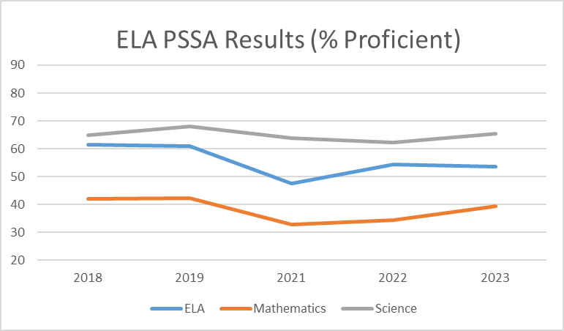
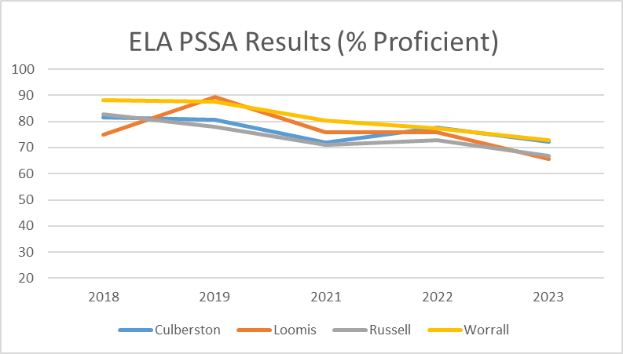
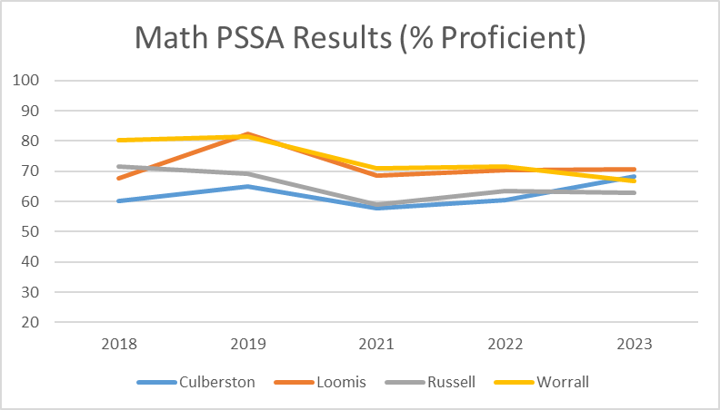
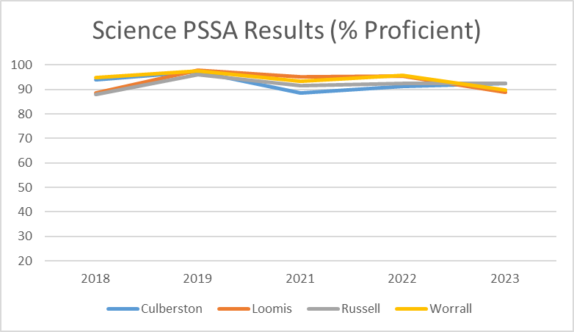
PSSA Grades 3 – Grades 5 Results 2018 - 2023
PA State Testing Data 2018 - 2023

Slide 4
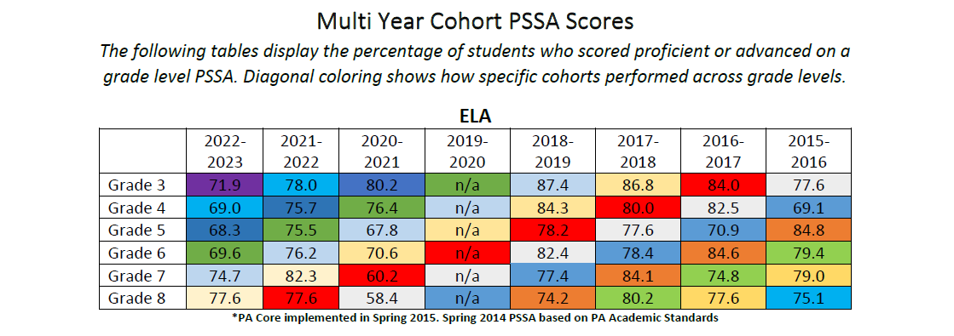
MNSD Long Term State Testing Datta

Slide 5
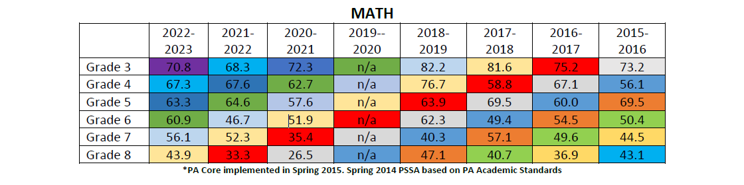
MNSD Long Term State Testing Datta

Slide 6
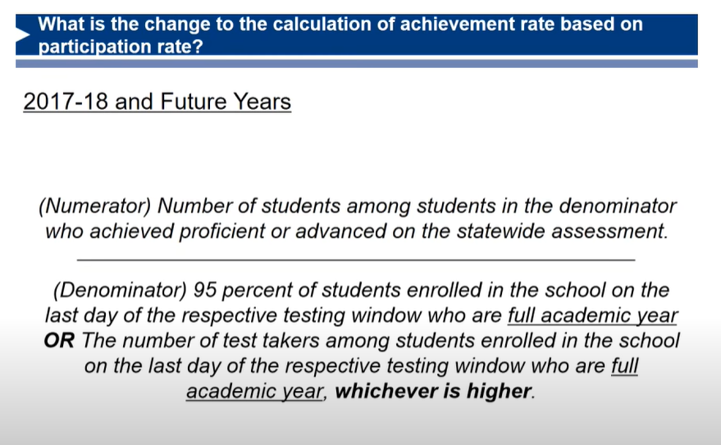
State Testing Participation
Below 95% counts against Proficiency/Advanced.

Slide 7
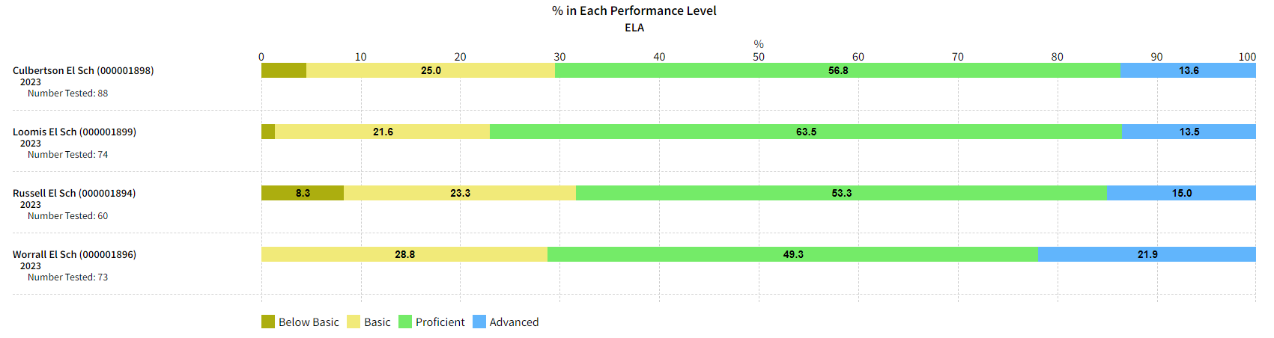
Third Grade English Language Arts by School 2023
PA Adv and Prof 54%

Slide 8
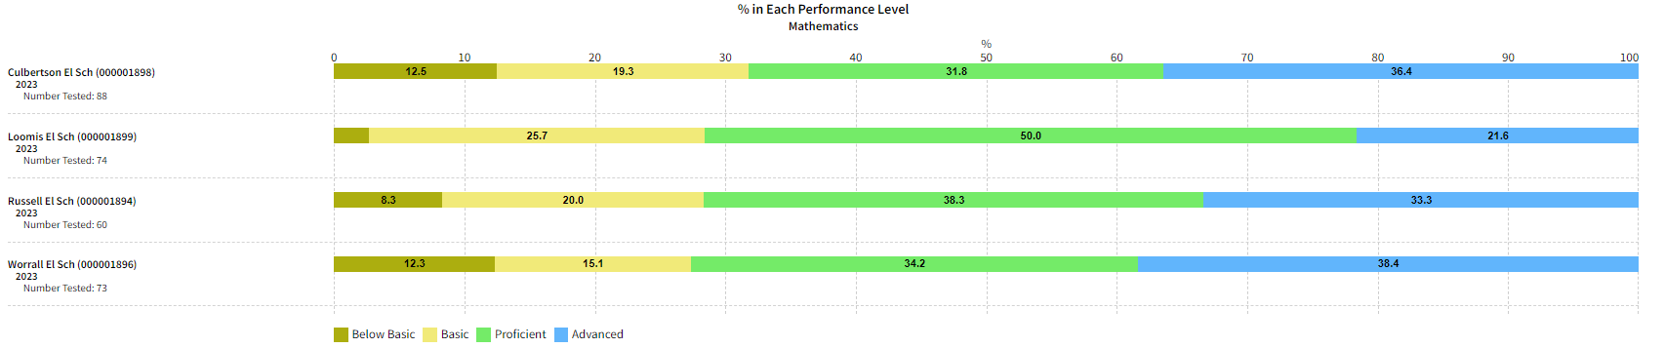
Third Grade Math by School 2023
PA Adv and Prof 52%

Slide 9
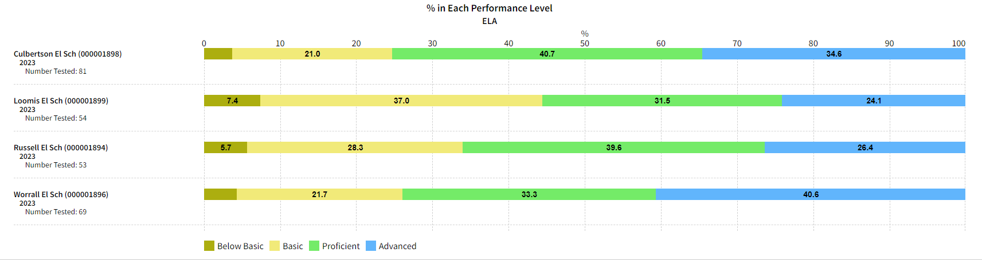
Fourth Grade English Language Arts by School 2023
PA Adv and Prof 51%

Slide 10
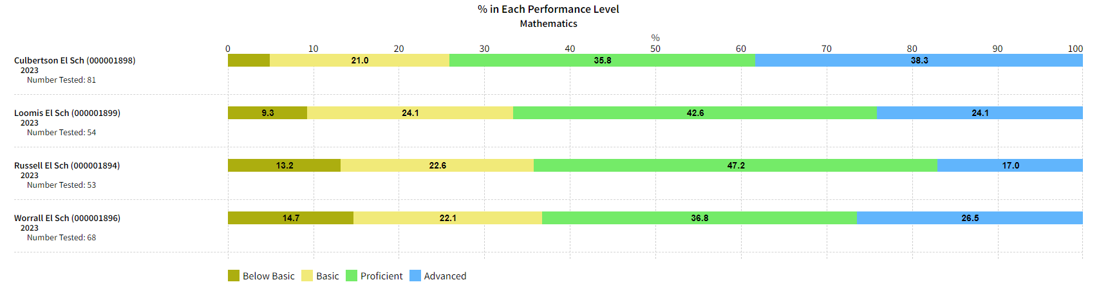
Fourth Grade Math by School 2023
PA Adv and Prof 47%

Slide 11
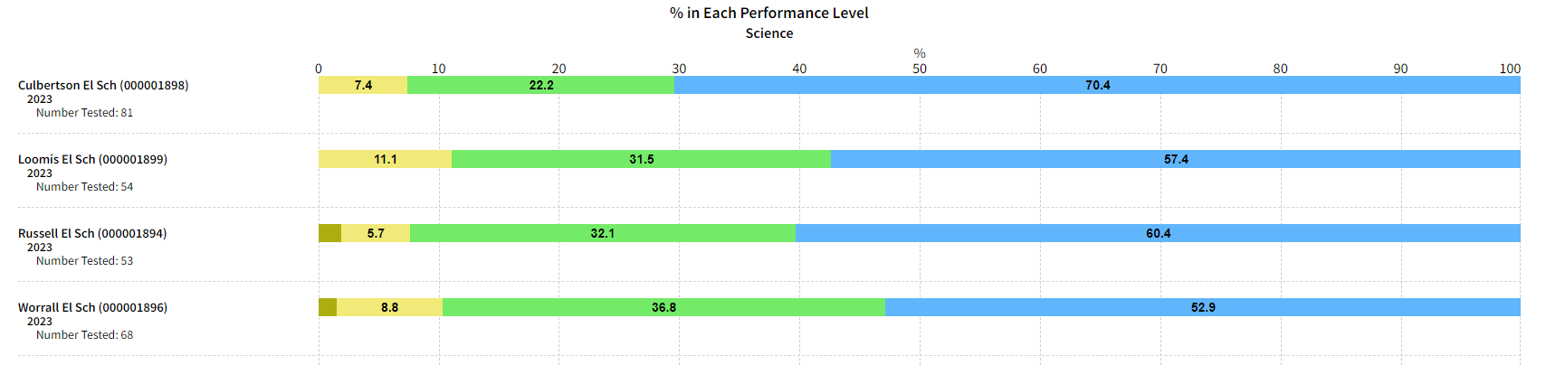
Fourth Grade Science by School 2023
PA Adv and Prof 74%

Slide 12
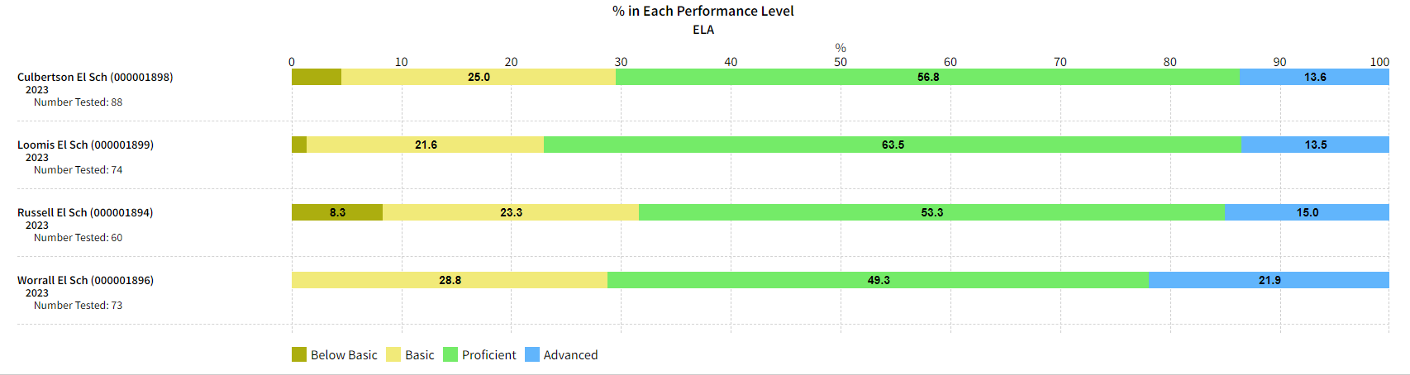
Fifth Grade English Language Arts by School 2023
PA Adv and Prof 53%

Slide 13
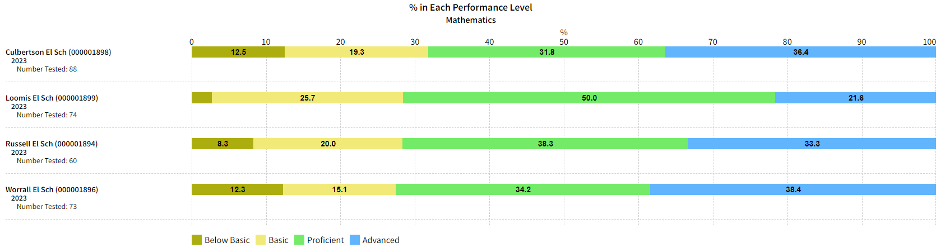
Fifth Grade Math by School 2023
PA Adv and Prof 43%

Slide 14
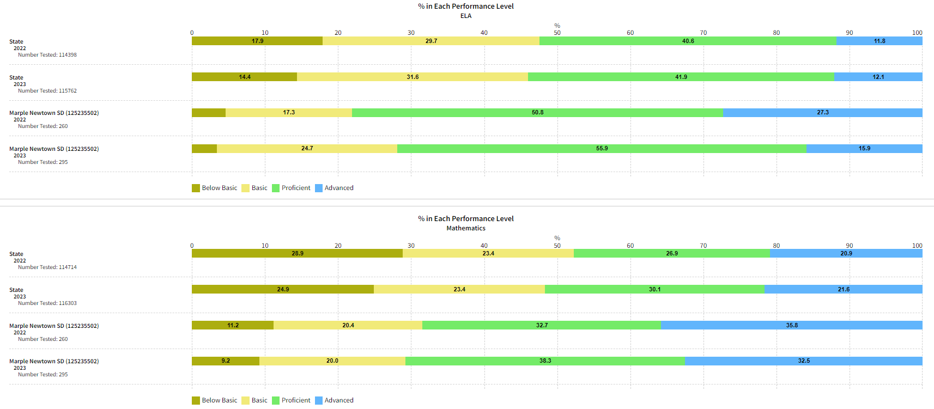
Sixth Grade ELA and Math PSSA 2022 and 2023 PA and MNSD

Slide 15
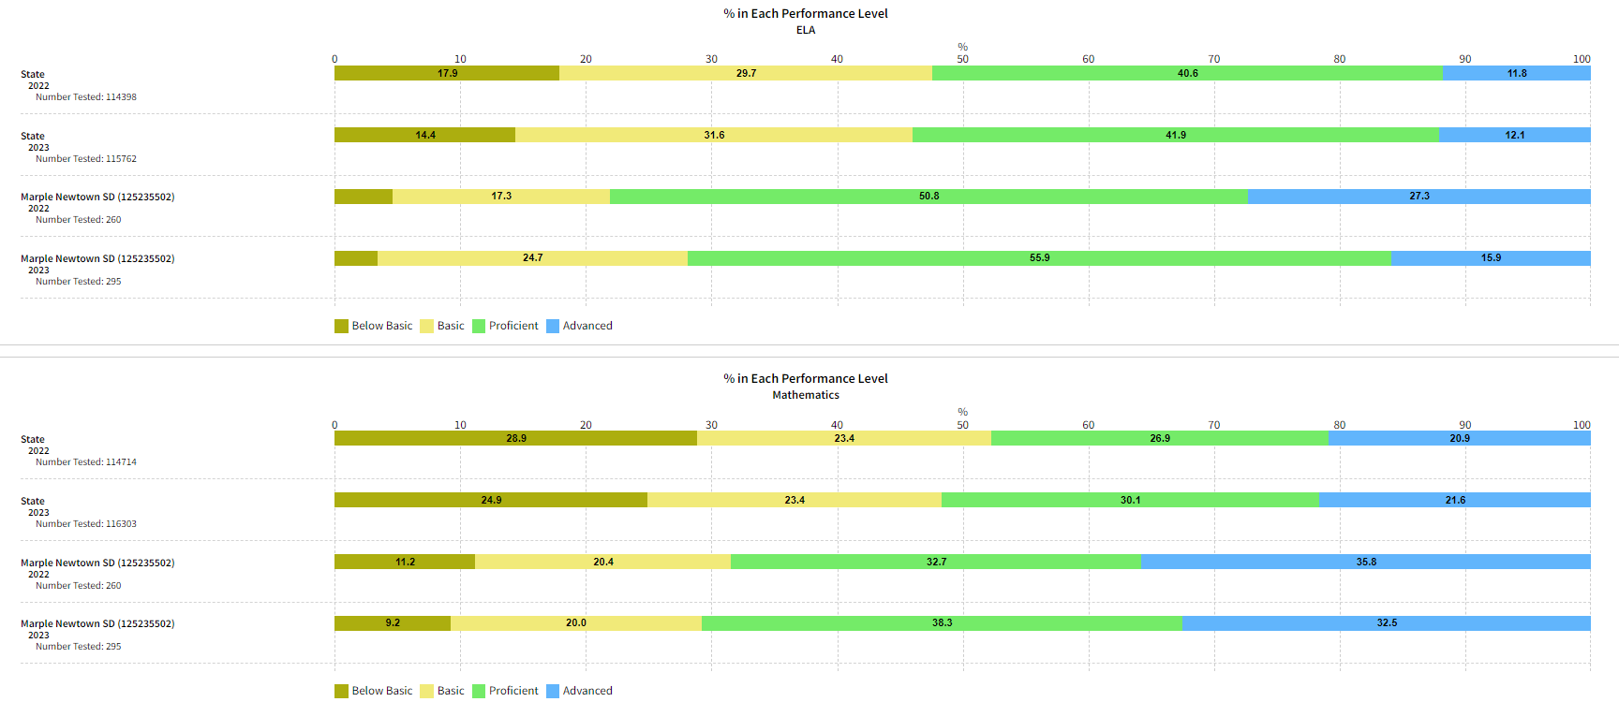
Seventh Grade ELA and Math PSSA 2022 and 2023 PA and MNSD

Slide 16
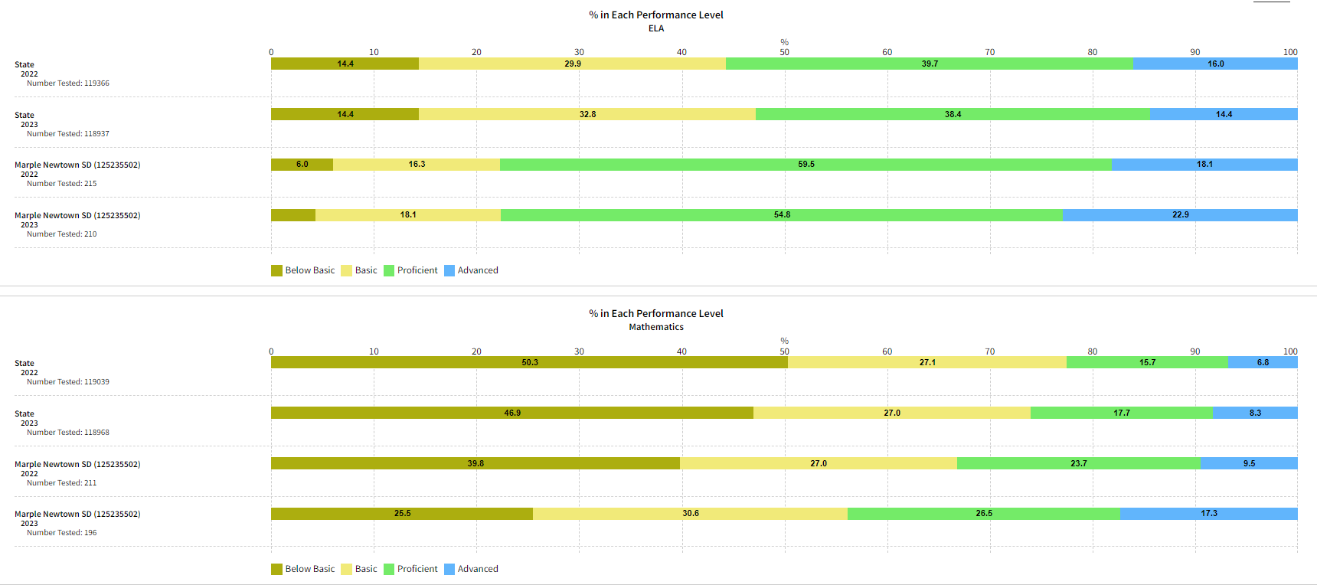
Eighth Grade ELA and Math PSSA 2022 and 2023 PA and MNSD

Slide 17
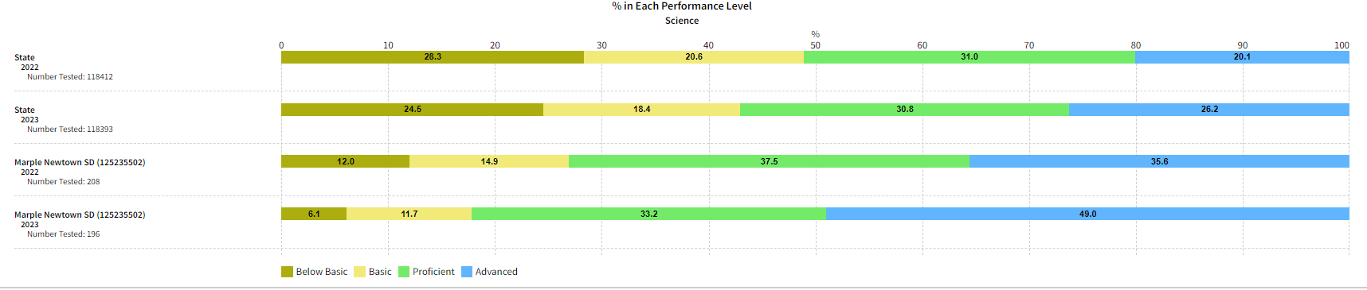
Eighth Grade Science 2022 and 2023 PA and MNSD

Slide 18
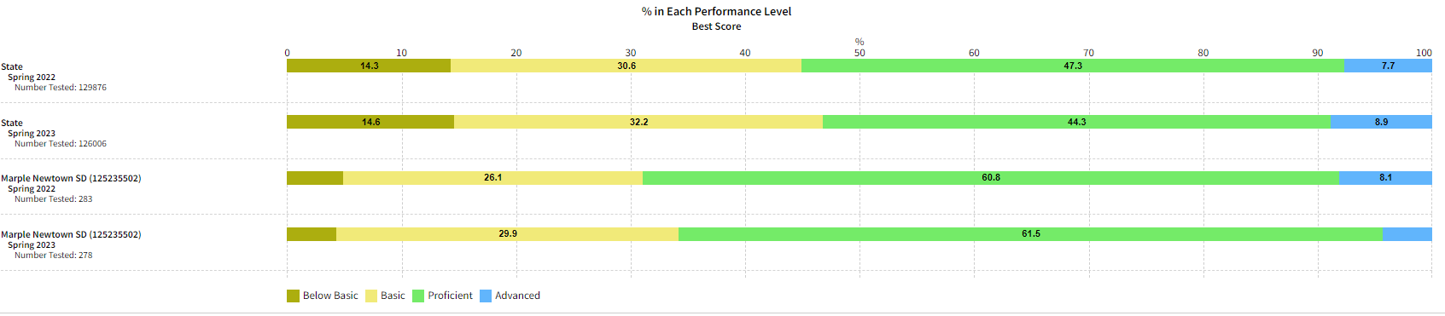
Literature Keystone 2022 and 2023 PA and MNSD
ADV: 4.3%

Slide 19
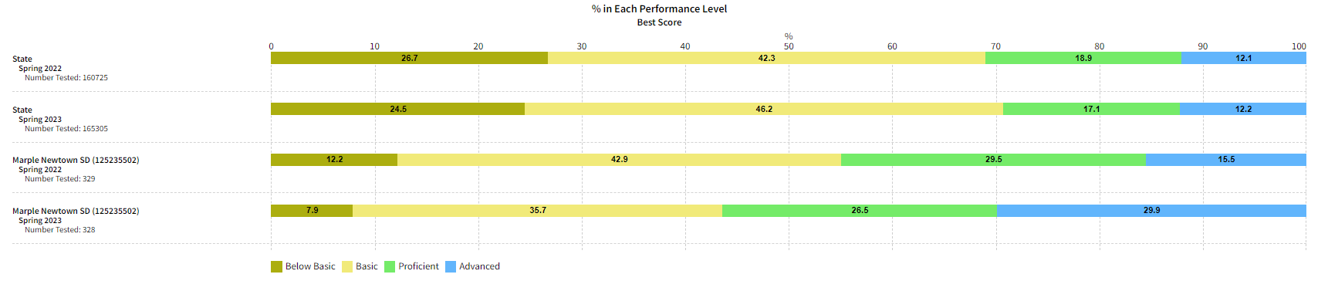
Algebra Keystone 2022 and 2023 PA with MNSD

Slide 20
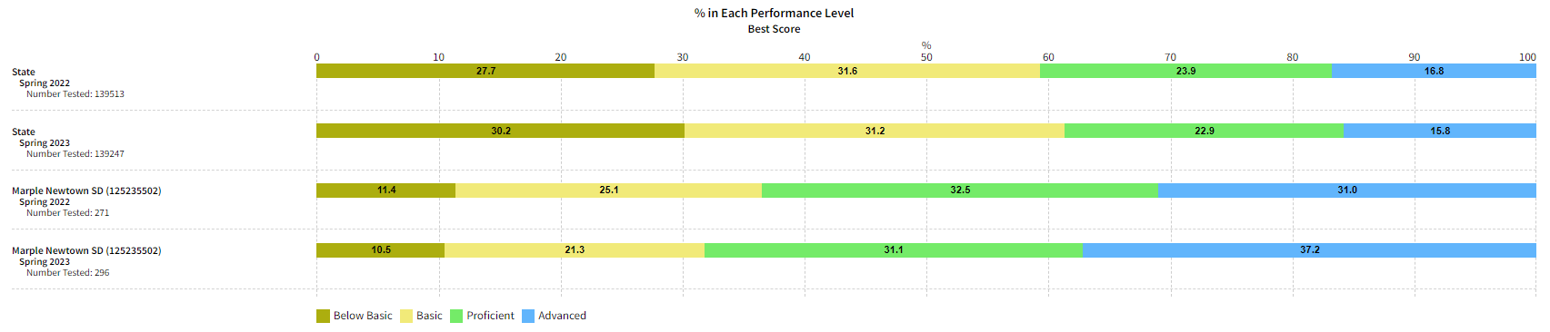
Biology Keystone 2022 and 2023 PA with MNSD

Slide 21
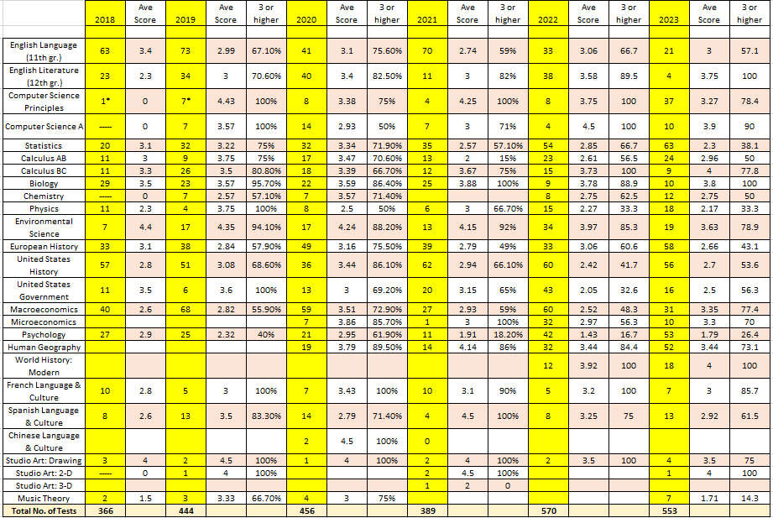
Advanced Placement Scores 2018 - 2023

Slide 22
Summary
2023 MNSD schools and grade levels show varied results in the 2023 PSSA scores.
  In general, MNSD Grades three through five follow the overall pattern of result seen in the state’s performance.
Keystone scores in Biology and Algebra show an increase over last year’s scores.
  Keystone Literature scores show a slight decrease.
Participation in state testing at secondary level does NOT meet 95% - negative effects on scores.
Law of small numbers at elementary level; Each student score correlates to over 1% point.
Each school is meeting with PDE representatives to analyze their school’s state testing information.
Positive correlation between the use of IXL in the classroom and student performance.
Year I (2023 – 2024) implementation of data meeting and action planning around data analysis.
MNSD Annual Report of District Data and Student Achievement 2023 is available
  District web pages > Data and Achievement link.

Slide 23

Questions?
*This PPT will be posted to the MNSD Teaching and Learning Web pages.

