Slide 1
Courageous Conversations
Ken Martinez, Psy.D.
Meridian Public School District
Professional Development Training
Moving Toward a Culturally and Linguistically Competent
School District
January 6, 2014
Mississippi State University Riley Center
Meridian, Mississippi

Slide 2

Goals
Define “courageous conversations”
Learn about strategies to prepare ourselves
Create a set of approaches to plan for and engage in courageous conversations

Slide 3
Courageous Conversations
Difficult conversations that move relationships, organizations, or schools forward in a respectful, constructive, and action-oriented manner.
They are:
  Strengths-based
  Planned
  Fact-based
  Respectful
  Honest
  Focused on actions for improvement
  Meant to build collaboration and raise emotional intelligence
They are not:
  Deficit-based
  Negative
  To belittle
  For retribution
  One-way
  Heated
  For hidden agendas
  (Ovenden, Hobbs)

Slide 4
Courageous Conversations - Why?
“The conversation needs to be had!”
“There’s stuff going on in our schools and community.”
“The consequences of not having the conversation are bad…”
“There are strong emotions around this…”
“We want things to get better!”
“Young people are suffering, we need to fix this!”

Slide 5
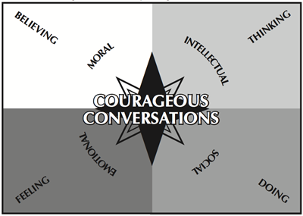
The Compass: Singleton and Linton, 2005

Slide 6
So what would we want to have courageous conversations about?

Slide 7
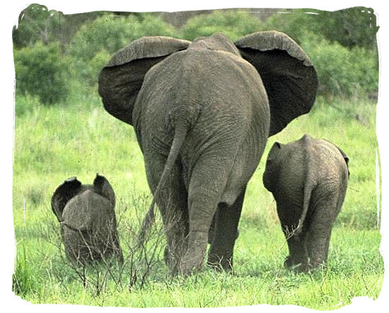
The Elephant(s) in the Room!

Slide 8
Courageous Conversations - Foundation
The Four Agreements
  Stay engaged
  Speak your own truth
  Expect to and allow yourself to experience discomfort
  Expect and accept non-closure

Slide 9
Gracious Space - What is It?
The group enters into an agreement honoring “gracious space.” Gracious space…
Creates and maintains an environment in which honesty, equity, reciprocity, and partnership can thrive
Is all about honor and respect for the place, time, and people involved in a particular conversation
Allows for safe space in which to engage in real meaningful thought and conversation
Ground rules are “rules” often set by others, have punitive consequences, and have a restraining connotation

Slide 10
Prepare Your SELF First
Personal story
Goal of conversation
Risks inherent in having the conversation
Risks of not having the conversation
Value for all concerned
Analysis of the situation

Slide 11
Personal Story
  What is your personal experience with the “Isms”?
    Victim
    Observer
    Perpetrator
  Experience of others?
    Personal stories
    News media and history
In conflict, are you
  Aggressing
  Avoiding
  Accommodating
  Compromising
  Negotiating

Slide 12
Goal of Conversation
What is the current situation?
  What needs to be talked about?
Who are the people involved?
  Let’s bring them together
How does this situation relate to you?
  Are you involved?

Slide 13
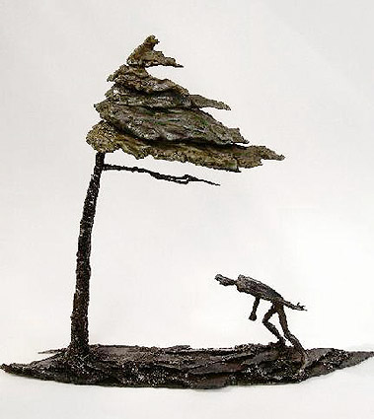
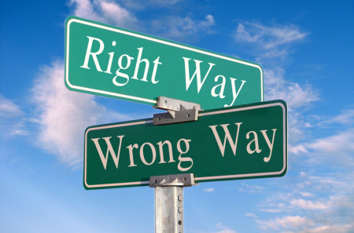
What are the Risks in Having the Conversation?
Power relationships in your job
Retribution
Being labeled as the “trouble-maker”
Not being invited back

Slide 14
What are the Risks in NOT Having the Conversation?
Injury to self esteem
Violation of personal values
Issue remains the same or gets worse
The “other” believes their position is confirmed

Slide 15

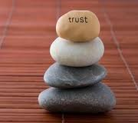
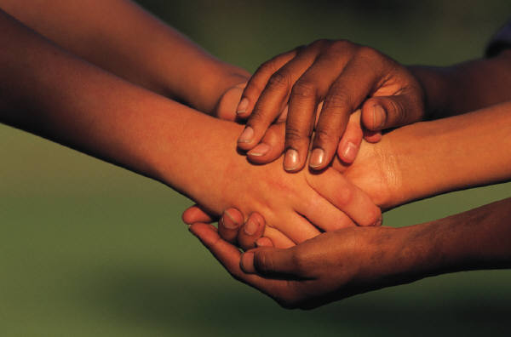
How Could it be Better for All Concerned?
Opens up
Creativity
Solution finding
Relationship-building

Slide 16
Take Action
Mobilize to make the case
  Stories
  Data
Exercise leadership within your scope of influence
Use your best conflict management and resolution skills
Promote formal or informal action

Slide 17
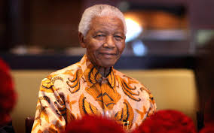
What are you going to do differently when you leave here?
__________________________________
“There can be no keener revelation of a society's soul than the way in which it treats its children.” Nelson Mandela
Nelson Mandela
Discussion and Reflection

Slide 18
Reference
Ovenden, S., Hobbs, H. Retrieved on December 6, 2013 from: http://www.patientflowtoolkit.ca/documents/Training/Forums/3.Pilot%20Forum/Wave%204/ED%20PIP%20-%20Wave%204%20-%20Pilot%20Forum%20-%20Courageous%20conversations.pdf
Singleton, G.E. & Linton, C., Eds., (2005). Courageous conversations about race: A field guide for achieving equity in schools. Thousand Oaks, CA: Corwin Press.

Slide 19
Contact Information
Ken Martinez, Psy.D.
American Institutes for Research
kmartinez@air.org

