Slide 1
It Takes A Village: Effective Strategies for Family and Community Engagement in Education - Marketa Garner Walters
Meridian Public School District
Professional Development Training
Moving Toward a Culturally and Linguistically Competent School District
January 6, 2014
Mississippi State University Riley Center
Meridian, Mississippi

Slide 2
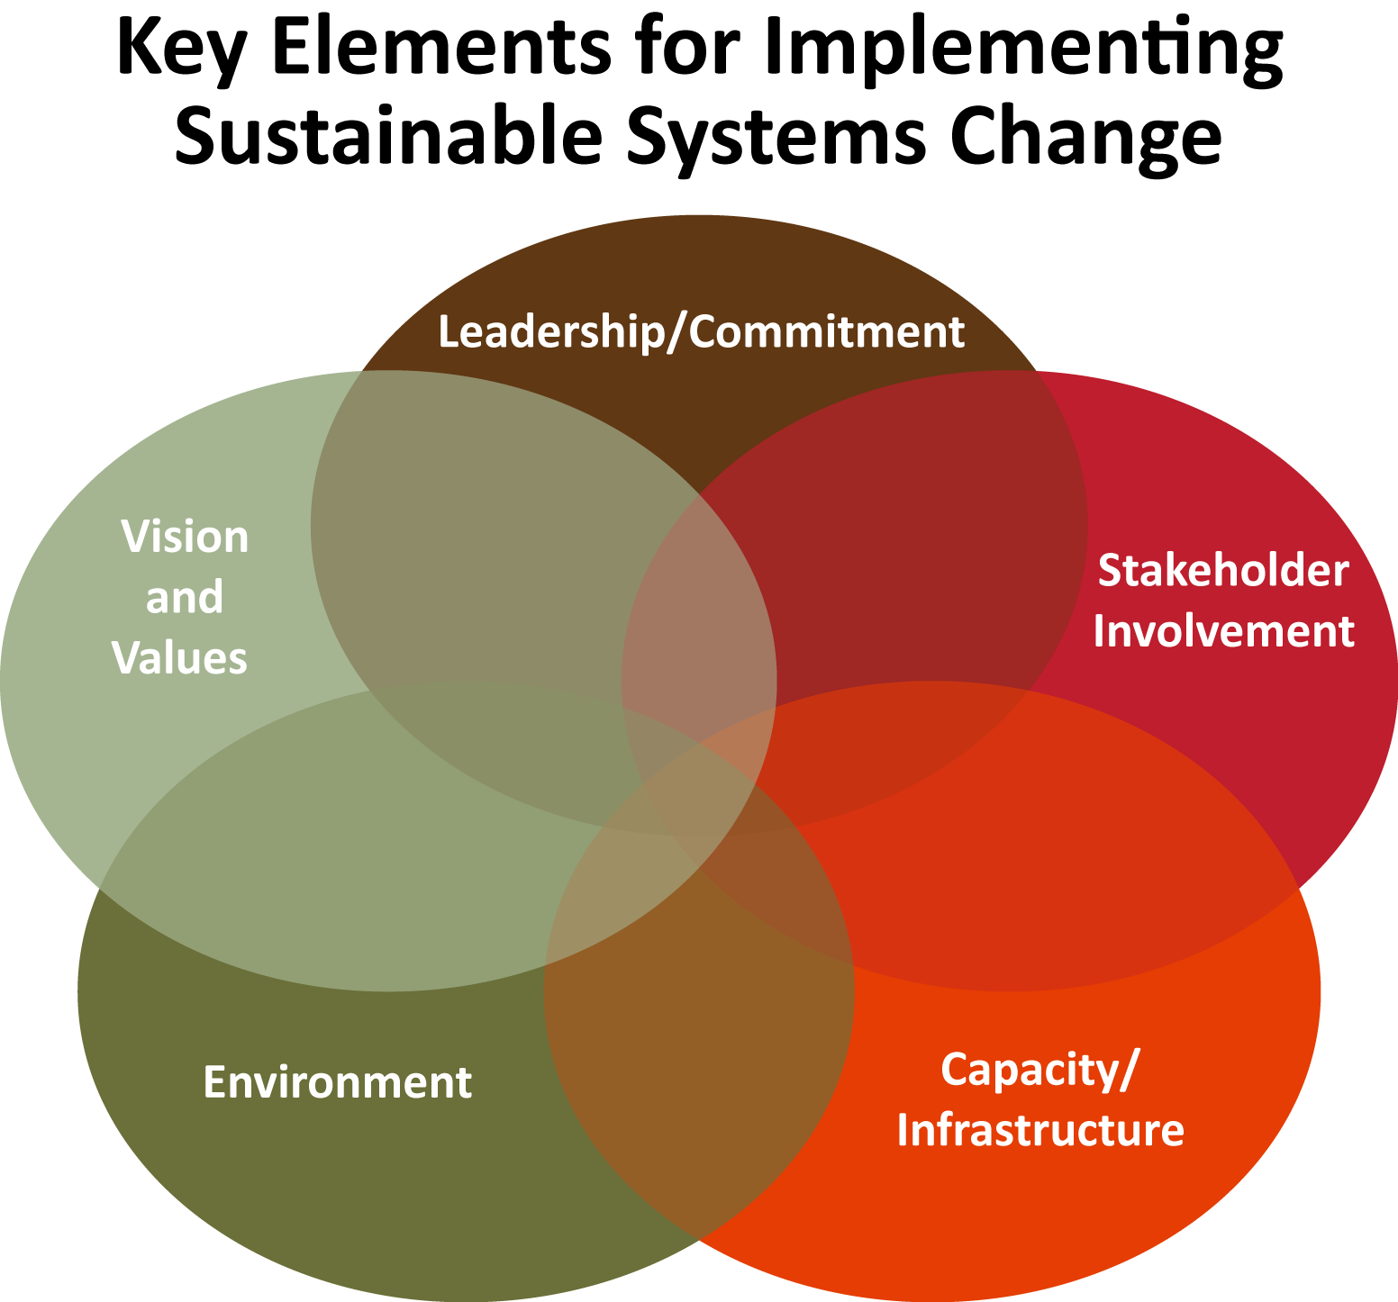
One Theory Of Change

Slide 3
Benefits to Family Engagement
“Countless studies have shown that children who receive consistent, loving attention from their parents perform better in school and lead happier lives than those who don’t. Parents are children’s most important teachers, role models and guides. They have a responsibility to stay involved with their children in positive ways, through school, family activities and daily conversation.”
Joan Dykstra, National PTA President, 1996-97

Slide 4
Research Findings
Studies of families show that what the family does with the children is more important to student success than family income or the education level of the parents. 1
Both students and schools benefit from active participation by families in the process of educating children. 2
Parent involvement is more than good attendance at school-sponsored events or having a strong volunteer program. 3
The need for strong family involvement starts by the time children are in preschool and continues through high school. 4

Slide 5
Six Types of Partnerships Framework
Parenting: Helping families establish home environments to support children as learners.
Communications: The use of effective forms for school-to-home and home-to-school communications.
Volunteering: The recruitment and organization of the school’s volunteer program.
Learning at Home: Helping families assist their children with homework and recognizing other learning at home opportunities.
Decision-making: Including parents, students, and community members in the school decision-making process.
Collaborating with the Community: The identification and integration of resources and services from the community.
Joyce Epstein, Johns Hopkins University (1995)

Slide 6
Strategies for Encouraging Positive Parenting Skills
Survey parents: Ask parents what information and workshops they find most helpful.
Consult with parents: Ask about their preferences and the best way to give messages to all parents.
Establish home visiting programs: When teachers visit with parents in the home, they share expectations; parents can share information that might affect student achievement.
Make referral information available: Put information on bulletin board, in newsletters, on information tables at school events.
Offer school space: Have a room available for parent-led support groups and parenting education classes.
Provide child development information: Conduct workshops on what parents can expect as their child moves into middle or high school.
Capitalize on parent attendance at neighborhood and community events: Have outreach materials—brochures, bookmarks, posters, tip sheets— available.
Offer a sharing night for parents: Have parents share their best practices for discipline, homework help, reading.

Slide 7
Questions
?
Are you open and friendly? When do you visit with parents? What kind of after hours availability do you have? Do you welcome feedback? Do you swap notes, send reports? Does the parent/other family feel comfortable talking to you? How welcoming are you? How do parents make appointments—do they have to go through the office or can they call you directly? How do you relate to them when they are with you—are you across a table, sitting in chairs conversationally? Is your environment non-threatening? Do you really listen to what they tell you happens at home?

Slide 8
Strategies for Enhancing Communication with Families
Emphasize the importance of strong family involvement.
Devote Title I or other funds to compensate teachers for time spent making home visits.
Solicit financial support to improve telephone communication with families.
Make sure all teachers have an email address with regular access.
Develop a format for classroom newsletters.
Have several mechanisms for gathering opinions from parents, guardians, students, and teachers.
Communicate frequently about school achievement.
Send information to both parents.
Update signs around the school.

Slide 9
Strategies for Increasing Volunteerism
Survey potential volunteers.
Hire or appoint a volunteer coordinator.
Offer a variety of times to volunteer.
Offer training to volunteers.
Invite parents to ride the bus or eat lunch with their children.
Train parents to become parent mentors.
Encourage opportunities for volunteers to be seen as positive role models.
Publicize volunteer opportunities throughout the year.
Include students in meetings with parents.

Slide 10
Strategies for Enhancing Learning at Home
Make parent support at home an important topic.
Offer suggestions to parents; support parents.
Have a family reading, math, or science night at school.
Ask parents for input on homework assignments.
Develop learning activities for families to use in the car.
Send home a simple newsletter.
Have a library of games that students can check out.
Help families celebrate successes.
Establish a homework hotline.

Slide 11
Strategies for Increasing Parents in Leadership
Award one parent a stipend to help other parents.
Make decisions after surveying comprehensive data.
Offer leadership training.
Do a parent check-in when nothing is wrong.
Deal with conflict promptly.
Evaluate after meetings—what worked and what didn’t.
Recognize parents for their efforts.

Slide 12
Strategies to Improve Community Collaborations
Convene at least three meetings a year.
Invite businesses to school events.
Publicly acknowledge partnerships.
Mention generosity frequently and prominently.
Get feedback and ideas to improve outreach to families.
Ask all who participate in meetings to evaluate progress and identify obstacles.
Write thank you notes.

Slide 13
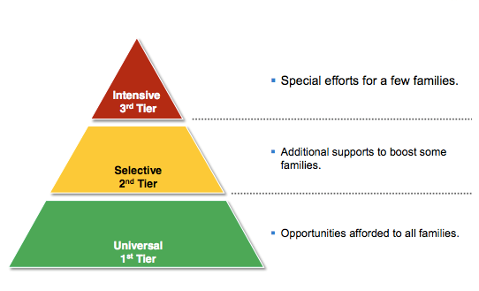
3- Tier Model for Differentiating Strategies to Maximize Family Engagement

Slide 14
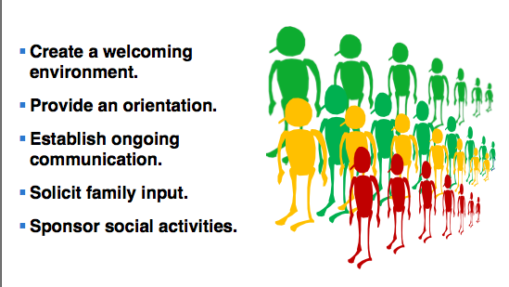
Universal Strategies for ALL Families: 1st Tier

Slide 15
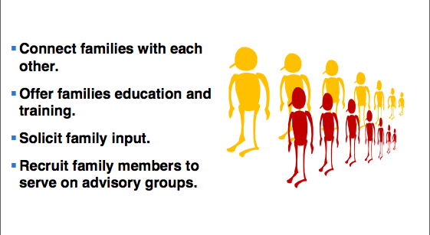
Selective Strategies to BOOST Some Families: 2nd Tier

Slide 16
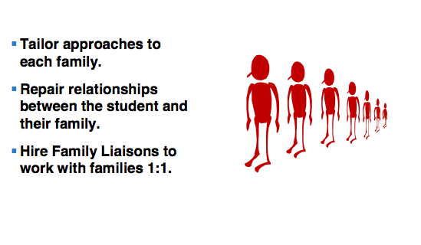
Intensive Strategies for Hard to REACH Families: 3rd Tier

Slide 17
Become Knowledgeable About the Community
Culture
Economic climate
Types of social groups and networks
Political and power structures
Community values
Demographic trends
History
Religion and spiritual beliefs
Educational status

Slide 18
References/Sources
Blau, Gary Blau, Moving beyond open house; Building meaningful relationships between parents/families and schools. Presentation conducted, September 2013. National Center on Safe and Supportive Learning Environments.
http://safesupportivelearning.ed.gov/sites/default/files/sssta/20130502_ParentalEngagementWebinarFinal.pdf
Sources:
1. Epstein, 1991; Henderson & Berla, 1994; Liontos, 1992; Reynolds, et al., 1991; Zellman, G.L. & Waterman, J.M., 1998
2. Clark, R., 1993, Griffith, J., 1996; Dauber, S.L. & Epstein J.L., 1993;
3. Dornbusch, S. et al., 1987; Dauber, S., 1993; Comer, J & Haynes, N.M., 1992; Zellman, G., 1998
4. Eagle, E., 1989, Funkhouser, J.E., & Gonzales, M. R., 1997; Scott-Jones, D., 1994; Goodman, J et al, 1995; Sheilds, P., 1995

Slide 19
Helpful Websites
http://smhp.psych.ucla.edu/publications/44%20guide%207%20fostering%20school%20family%20and%20community%20involvement.pdf
http://www.hcpss.org/parents/involvement.shtml
http://www.nea.org/assets/docs/PB11_ParentInvolvement08.pdf
http://www.pacer.org/mpc/pdf/titleipip/Supportinginvolvement_article.pdf
http://www.nationalpirc.org/engagement_webinars/webinar-education-reform.html
http://www.sps186.org/downloads/table/13040/6TypesJ.Epstien.pdf
http://ctb.ku.edu/en/enhancing-cultural-competence
http://www.seattleu.edu/CSCE/Inner.aspx?id=63839

Slide 20
Contact
Marketa Garner Walters
American Institutes for Research
mwalters@air.org

