Slide 1
Standing Up to Implicit Bias
Karen B. Francis, Ph.D.
Meridian Public School District
Professional Development Training
Moving Toward a Culturally and Linguistically Competent
School District
January 6, 2014
Mississippi State University Riley Center
Meridian, Mississippi

Slide 2
Objectives
The presenter will:
Define implicit bias
Discuss implicit bias and its impact on decision making in schools and classroom settings
Discuss strategies to effectively address implicit bias and the facilitation of culturally responsive school environments
Discuss the Implicit Association Tool (IAT) and how it can be used for self-reflection and a measure for effective decision making

Slide 3
Implicit Bias
“We are either unaware of, or mistaken about, the source of the thoughts or feelings” .
(Zajonc, 1980)

Slide 4
Implicit Bias
Implicit bias is “a positive or negative mental attitude towards a person, thing, or group that a person holds at an unconscious level”.
Source: http://med.stanford.edu/diversity/FAQ_REDE.html

Slide 5
Implicit Social Cognition
Thoughts and feelings outside of conscious awareness and control.

Slide 6
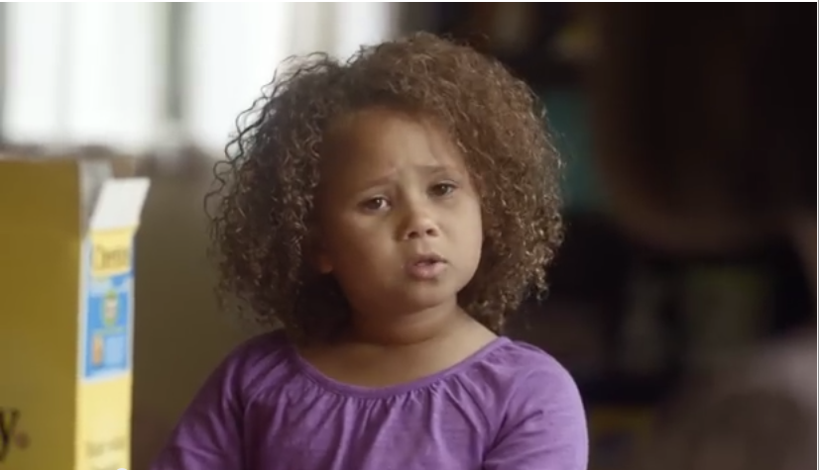
Video Clip 1

Slide 7
Group Discussion
  What is your reaction to the video?
  What message(s) do you think it sends?

Slide 8
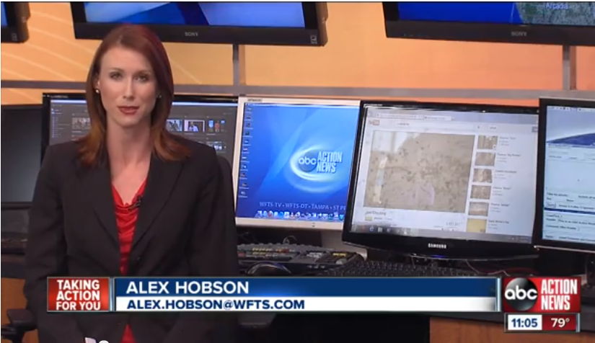
Video Clip 2

Slide 9
Group Discussion
  What is your reaction to the news segment?
  What do you think it says about implicit bias?

Slide 10
  How Does Implicit Bias Impact Our Lives?
Implicit bias impacts:
  The automatic nature of beliefs or stereotypes when they capture associations between social groups and their common stereotypes
  The automatic nature of attitudes or preferences when they capture associations between social groups and common evaluations of them
Source: http://www.fas.harvard.edu/~mrbworks/articles/InPress_Shafir.pdf

Slide 11
How Does Implicit Bias Impact Our Lives? (continued)
Professionally implicit bias impacts:
  The judgments we form about individuals (students, parents, co-workers), situations, and circumstances that are based on stereotypes
  Interpretation of student behavior and use of discipline measures
  Effective interaction with parents, families, and community members
  How these judgments impact our ability to effectively interact with students, parents, and co-workers to facilitate positive academic outcomes for students and the development of a supportive learning environment

Slide 12
  Strategies to Address Implicit Bias
Become aware of individual perceptions, stereotypes, and their impact on decision making.
Engage in opportunities to learn about diverse cultures.
Get to know your colleagues and students and their backgrounds – suspend negative judgments.
Recognize that diversity is real, dynamic, and legitimate – there is more than one way to do things.
Engage in courageous conversations to increase knowledge and address negative perceptions, stereotypes, and attitudes.

Slide 13
  Implications for Working With Students
Examine the application of discipline policies related to students.
Examine the implementation of student code of conduct and students/parent interpretation.
Be aware of the varying learning styles of students, and methods to maximize the learning experience for all students based on individual needs.
Identify strategies to effectively engage parents, families, and the community to form partnerships for student achievement, positive outcomes, and a nurturing school climate.

Slide 14
Implicit Association Tool (IAT)
Project Implicit was founded as a multi-university research collaboration in 1998 (University of Washington, Harvard University, University of Virginia).
Fosters dissemination and application of implicit social cognition research.

Slide 15
IAT (continued)
Examining the “automatic pilot” that drives our thoughts and actions.
The IAT measures implicit attitudes and beliefs that people are either unwilling or unable to report.
Examines social attitudes.
Offers one way to probe unconscious bias.

Slide 16
Resources
Website for Project Implicit:
http://www.projectimplicit.net/index.html
Website to view IAT Tools:
https://implicit.harvard.edu/implicit/

Slide 17
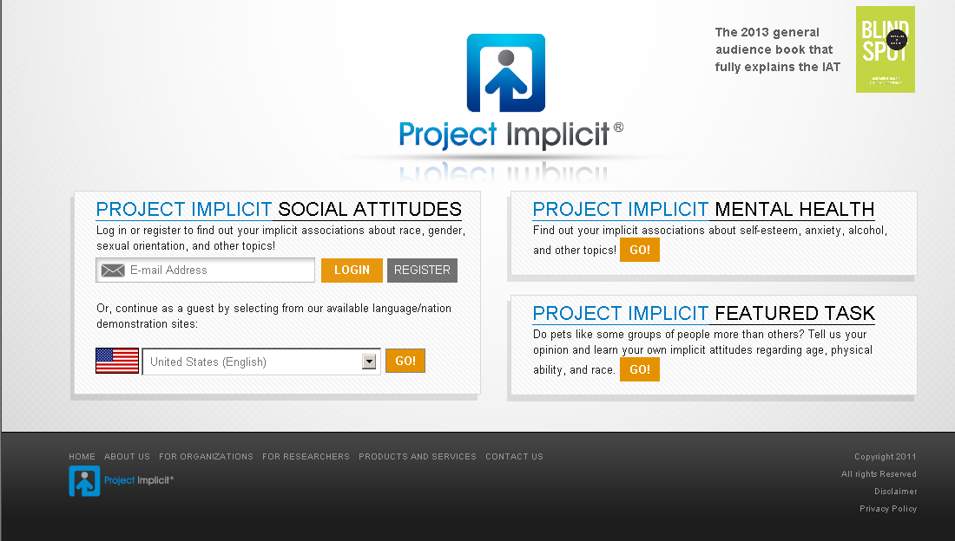
IAT Website

Slide 18
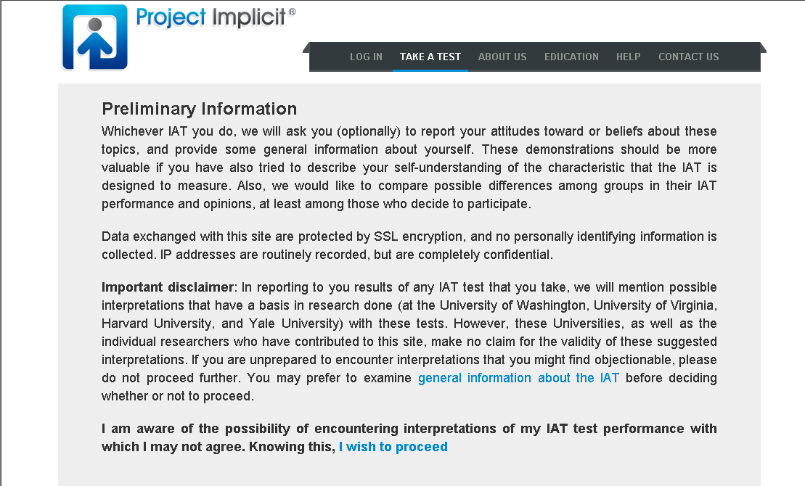
IAT Website

Slide 19
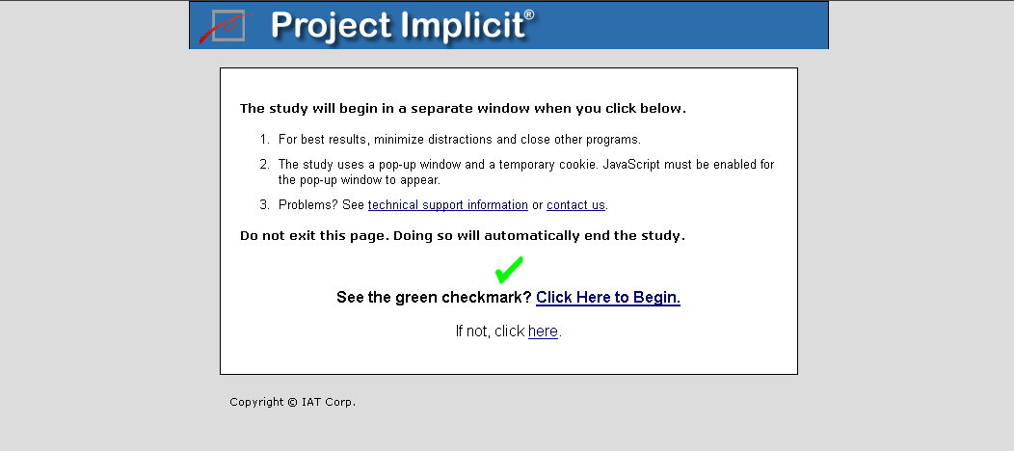
IAT Website

Slide 20
Contact Information
Karen B. Francis, Ph.D.
State Training and Technical Assistance Center kfrancis@air.org

