Slide 1
The Importance of Cultural and Linguistic Competence: Strategies for Meridian Public School District
Ken Martinez, Psy.D.
Karen Francis, Ph.D.
Meridian Public School District
Professional Development Training
Moving Toward a Culturally and Linguistically Competent
School District
January 6, 2014
Mississippi State University Riley Center
Meridian, Mississippi

Slide 2
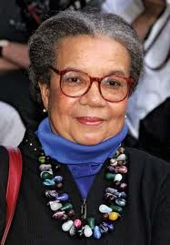
“Education is for improving the lives of others and for leaving your community and world better than you found it… Education is a precondition to survival in America today.”
Marian Wright Edelman
Children’s Defense Fund

Slide 3
Meridian Public School District
Mission Statement
The mission of the Meridian Public School District is to empower students to become productive, competitive, and responsible citizens in a global society guaranteeing a variety of rigorous, relevant, and stimulating learning opportunities in a nurturing environment, enriched by cultural, professional, technological, and business resources of the diverse community.

Slide 4
Meridian Public School District Beliefs
Each individual has intrinsic value and worth
Children are an indispensable asset
The willingness of its people to invest time, money and other necessary resources determines a community's success
All people must be treated with dignity and respect
Effective communication is essential to continue growth
A nurturing, supportive family is important in the life of the individual
Home, school, church, and community must work together to meet the needs of individuals

Slide 5
Meridian Public School District History
Since 1895, a rich history of people and accomplishments
Visionary educators like Dr. H. M. Ivy and Dr. L. O. Todd
Court ordered desegregation (Barnhardt & United States v. Meridian Municipal School District) - 1969
Consent Order - 2013
History in the buildings, the spirit, and the people
Willingness of the people to work for the common good
Administrators have projected the vision and teachers and staff have made it happen in the classrooms

Slide 6
Living Under a Consent Order
Stages in the Process
  Feeling blamed, accused, and defensive
  Living “under a microscope”
  More work and expectations
  Constant scrutiny and oversight
  Accountability
  Valuing the implementers’ assistance
  Eventual collaboration
  Embracing the work
  Championing the intent: Improving the educational experience of our children/youth and therefore improving their well-being

Slide 7
Major Provisions of the 2013 Consent Order
The District Shall:
Administer discipline without discrimination on the basis of race
Administer student discipline in a fair and non-discriminatory manner
Ensure that students remain in the regular classroom environment to the greatest extent possible under the Code of Conduct
Shall not administer exclusionary discipline consequences prior to attempting and documenting non-exclusionary corrective strategies and interventions

Slide 8
Major Provisions of the Consent Order (continued)
The District:
Requests the involvement of law enforcement agencies only when required
Has discipline practices that incorporate culturally responsive techniques, support, and reinforce positive behavior and character development
Continues to phase in a Positive Behavior Interventions and Supports (PBIS) approach to classroom management and student behavior
Appoints a Discipline Advisory Committee to advise the District

Slide 9
What You Have Done So Far
The Meridian Public School District (MSPD) has worked diligently over the last few months to complete the following requirements of the Consent Order:
  Prepared faculty and staff with an overview of the Consent Decree
  Revised the MPSD Student Handbook and Code of Conduct
  Established administrative discipline teams
  Established a PBIS Office with a director and assistant

Slide 10
What You Have Done So Far (continued)
  Hired PBIS coordinators at each school
  Established an approved Disciplinary Advisory Committee
  Conducted meetings with the Disciplinary Advisory Committee
  Created and implemented a comprehensive informational program for students and parents
  Implemented a straightforward complaint process
  Conducted discipline surveys for parents and teachers

Slide 11
What You Have Done So Far (continued)
  Provided professional development opportunities in the areas of the Consent Decree and PBIS
  Hired consultants to advise the district
  Determined new alternative placement procedures, as well as due process procedures
  Approved adjustments to PowerSchool as the district’s discipline data source
  Collected, reviewed, and completed analysis of discipline data
  Established a policy for receipt of the revised MPSD Student Handbook and Code of Conduct for all stakeholders

Slide 12
There is More Good News…
August and September 2013 Monthly Discipline Reports
All schools have demonstrated a decline in the total number of discipline referrals and exclusionary events since August 2011.
Declines in incidents of exclusionary discipline in August 2013 were a result of the lower number of discipline referrals submitted to administrative teams from teachers.

Slide 13
What Do Parent’s Think Now?
A confidential student discipline survey was conducted with parents on September 10, 2013
  “I believe that the use of PBIS at my child’s school has a positive impact on my child’s achievement”:
    96.5% agree or somewhat agree
  “The staff at my child’s school uses positive strategies on a regular basis to work with students to increase positive behavior”:
    99% agree or somewhat agree
  “My child feels safe at school”:
    97% agree or somewhat agree

Slide 14

The Importance of Cultural and Linguistic Competence

Slide 15

What is Culture?
“An integrated pattern of human behavior that includes thoughts, communications, languages, practices, beliefs, values, customs, courtesies, rituals, manners of interacting, roles, relationships and expected behaviors of a racial, ethnic, religious, social or political group; the ability to transmit the above to succeeding generations.” (Goode, National Center for Cultural Competence ,2006)
Traditions, spirituality, world view.
It is dynamic, connected to the social world we live in; multifaceted and complicated!

Slide 16
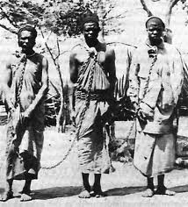
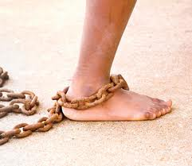
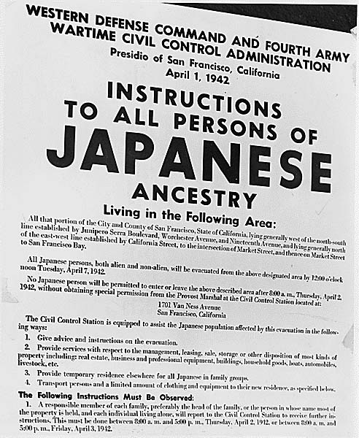
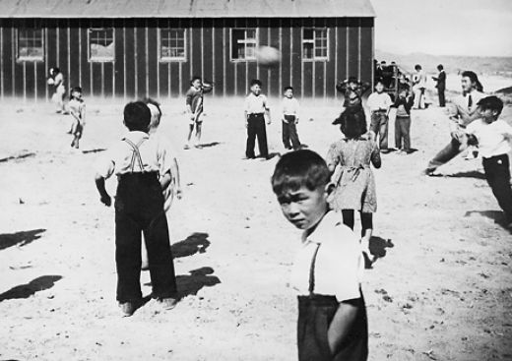
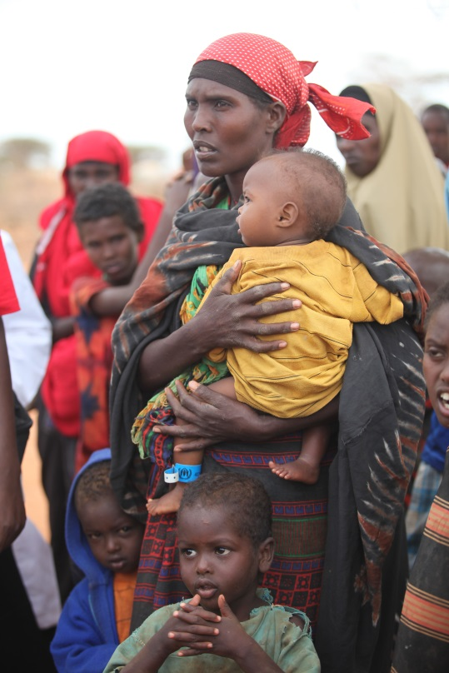
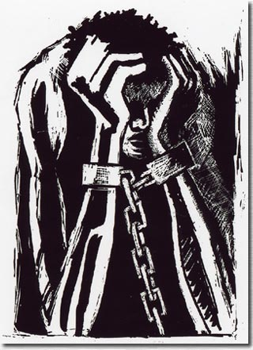
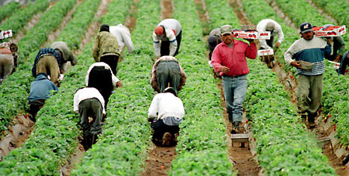
Historical Trauma
Notes:
16

Slide 17

Historical Trauma and Unresolved Grief
“Historical trauma is cumulative emotional and psychological wounding over the lifespan and across generations, emanating from massive group trauma.” (Brave Heart ,1998)
Historical unresolved grief accompanies that trauma. (Brave Heart, 1998, 1999, 2000)

Slide 18
Cultural Competence
“Cultural competence is the ability to successfully teach students who come from cultures other than our own. It entails developing certain personal and interpersonal awareness and sensitivities, developing certain bodies of cultural knowledge, and mastering a set of skills that, taken together, underlie effective cross-cultural teaching.” (Diller and Moule, 2005)
As adapted and applied to educational settings for:
  Facilitating inclusion.
  Promoting enhanced academic and social experiences for all students…

Slide 19
Factors Contributing to Disparities
“Social Determinants of Health are the conditions in which people are born, grow, live, work and age. These circumstances are shaped by the distribution of money, power and resources at global, national and local levels.”
Social support networks
Education and health literacy
Employment/working conditions
Social environments
Physical environments
Income and social status
Culture
Life skills
Personal health practices and coping skills
Healthy child development
Biology and genetic endowment
Health services
Gender
http://www.who.int/social_determinants/en/

Slide 20

The Myths of the “culture of poverty”
MYTH 1: Poor people are unmotivated and have weak work ethics
MYTH 2: Poor parents are uninvolved in their children's learning, largely because they do not value education
MYTH 3: Poor people are linguistically deficient
MYTH 4: Poor people tend to abuse drugs and alcohol (Gorski 2008)

Slide 21

The Myth of the “culture of poverty”
We ignore the fact that poor people:
  Suffer disproportionately the effects of nearly every major social ill
  Lack a living wage jobs, safe and affordable housing, clean air, and water
  Face environmental conditions that limit their abilities to achieve to their full potential

Slide 22
A Culturally and Linguistically Responsive School
Is one that:
  Admits to its challenges and channels its human and financial resources to solving them.
  Adjusts, adapts, and changes to be more adept at meeting individual children’s needs.
  Is strength-based.
  Partners with families as equal allies.
  Partners with the diverse community.

Slide 23
A Culturally and Linguistically Responsive School (continued)
Is one that:
  Emphasizes and validates “cultural knowledge” of students/families.
  Has a culturally relevant and inclusive curriculum.
  Celebrates the differences in culture, learning styles, relating, expression, language, aptitudes, and mental, emotional, behavioral, and physical challenges.
  Has “courageous conversations.”

Slide 24

A Culturally and Linguistically Responsive School (continued)
Is one that:
  Focuses on promotion, prevention, and early intervention.
  Uses data to improve.
    Track attendance, behavior, and drop in course performance
  Promotes social emotional learning.

Slide 25

Advantages to Promoting Diversity and CLC in Schools
Promotes appreciation of differences
Freedom from bias
Promotes education
Minimum adjustment issues
(Borkar 2010)

Slide 26
We Are All Champions
Each member of the MPSD is a champion for children and youth:
Providing educational services and programs that meet the diverse needs of all students.
Being culturally responsive.
Ensuring that program, policies, and services are in place to address the issues of disparities/disproportionality.
Providing services that are respectful and inclusive of students, family members, and the community.
Recognizing that we have an important role to play in ensuring that all students are provided with an opportunity to maximize their potential.

Slide 27
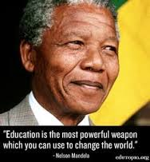

Slide 28
References
Borkar, R., (2010). Retrieved on January 2, 2014 from: http://www.buzzle.com/articles/cultural-diversity-in-schools.html
Brave Heart, M.Y.H. (1998). The return to the sacred path: Healing the historical trauma response among the Lakota. Smith College Studies in Social Work, 68(3), 287-305.
Brave Heart, M.Y.H. (1999). Oyate Ptayela: Rebuilding the Lakota Nation through addressing historical trauma among Lakota parents. Journal of Human Behavior and the Social Environment, 2(1/2), 109-126.
Brave Heart, M.Y.H. (2000). Wakiksuyapi: Carrying the historical trauma of the Lakota. Tulane Studies in Social Welfare, 21-22, 245-266.
Diller, J.V. and Moule, J. (2005). Cultural competence: A primer for educators. Belmont, CA: Thomas Wadsworth.

Slide 29
References
Goode, T. (2001, revised 2006). Key definitions. Washington D.C.: National Center for Cultural Competence, Georgetown University Center for Child and Human Development.
    Gorski, P. (2008). Educational Leadership. Poverty and Learning, The Myth of the Culture of Poverty. April 2008 , Volume 65, Number 7, pp. 32-36. Retrieved on November 4, 2013 from: http://www.ascd.org/publications/educational-leadership/apr08/vol65/num07/The-Myth-of-the-Culture-of-Poverty.aspx

Slide 30
Contact Information
Ken Martinez, Psy.D.
American Institutes for Research
kmartinez@air.org
Karen Francis, Ph.D.
State Training and Technical Assistance Center
American Institutes for Research
kfrancis@air.org

