Slide 1
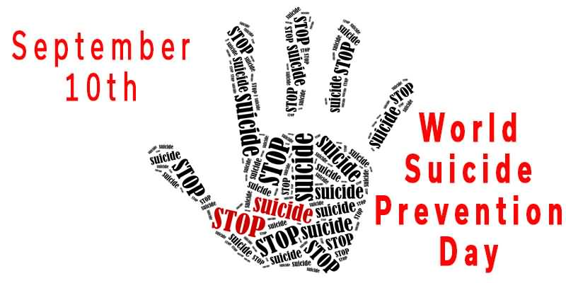

Slide 2
SUICIDE RISK FACTORS
Health Factors
Environmental
Historical Factors

Slide 3
HEALTH FACTORS
Depression
Alcohol and Drug Use Issues
Feelings of hopelessness/worthlessness
Bipolar Disorder
Schizophrenia
Impulsive or Aggressive Tendencies
Mood changes
Poor relationships
Conduct disorder
Anxiety Disorder
Physical Health Issues including Pain
Traumatic brain injury
Eating Disorders

Slide 4
ENVIRONMENTAL FACTORS
Easy access to lethal means:
Firearms
Medication/drugs
Unwillingness to seek help because of stigma attached to mental health or suicidal thought
stress:
Bullying/Harassment
Relationship problems
Unemployment
Loss:
Divorce/Rejection
Financial crisis
Life Transitions
Cultural and Religious Beliefs
Local epidemic of suicide
Barriers to getting mental health treatment
Isolation or feelings of being cut off

Slide 5
HISTORICAL FACTORS
Previous suicide attempts
Family history of suicide
Childhood abuse, neglect or trauma
History of mental illness

Slide 6


Slide 7
SUICIDE WARNING SIGNS

Slide 8
TALKING ABOUT
DYING OR killing themselves
Feeling hopeless
Having no reason to live
Being a burden
Feeling trapped/being out of options
Unbearable pain/talking of ending pain
Focusing on death/what it would be like to die

Slide 9
BEHAVIOR
Increased use of alcohol or drug
Looking for a way to end their lives, such as searching online for methods
Withdrawing FROM activities
Isolating from family and friends
Sleeping to much or too little
Visiting or calling people to say goodbye
Giving away possessions
Aggression
Fatigue
Reckless behavior
Practicing suicidal behaviors

Slide 10
MOOD
People who are considering suicide often display one or more of the following moods:
Depression
Anxiety
Loss of Interest
Humiliation/Shame
Agitation/Anger
Mood Swings
Relief/Sudden Improvement

Slide 11
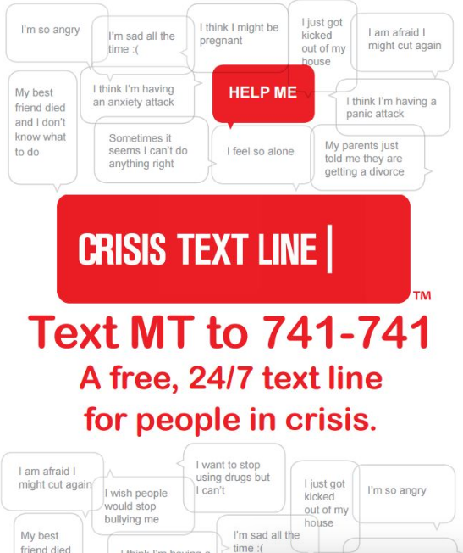

Slide 12
PROTECTIVE FACTORS
Getting professional care for mental, physical, and substance use disorders
Being connected to family friends and community
Self-esteem
Life skills (problem solving, adaptability to change, and coping skills)
Cultural, religious and personal beliefs that discourage suicide

Slide 13
