Slide 1

MTSS(multi-tiered support systems)
A Quick Overview

Slide 2
 | Tier 1 | Tier 2 | Tier 3
When | CORE/Block | EI | WIN
Subjects | CORE Math, ELA | ELA | Math & ELA component daily
Progress Monitoring | Classroom Learning Facilitator (as needed) | Classroom Learning Facilitator (Monthly) | MTSS Interventionists: Bi-weekly
Instruction | High Qualified Core Instruction, in regular education, all learners; whole group, small group, rotational model utilized as necessary and appropriate | Intensified instruction through push in paras, specialists, learning support and more individualized and small group instruction lead by the classroom learning facilitator | High intensity pull out facilitated by MTSS Interventionist and Title Paras (when necessary). Daily intense, direct instruction
Resources | CKLA Amplify (K-5), Amplify ELA (Gr. 6); Eureka Squared | mClass instruction; Assessment/Remediation Guide, CKLA Intervention Toolkit Eureka Equip lessons More focused skill groups within a homeroom or across a grade level | mClass Intervention Suite (MTSS Interventionists), CKLA Assessment and Remediation Guide, CKLA Intervention Toolkit
Qualifiers | Whole group and small group instruction ALL learners, regular and special education | Below proficient on formative & summative assessments Orange or Red on MAP Growth Yellow or Red on mClass, either composite score OR targeted area | K-1 Learner red for PA on mClass Gr. 2-3 Red for NWF Gr. 4-6 Red Composite CLF input Well below on math assessments

Slide 3

Elementary Assessments
MAP Growth
mClass DIBELS 8th edition
Eureka Equip Pre-Module Assessments
Module/Unit Assessments CKLA/Eureka
OnHand: Access through Clever
Testing Windows
September 27 & 28 Beginning of Year Testing Window
January 17 & 18 Middle of Year Testing Window
May 16 & 17 End of Year Testing Window

Slide 4
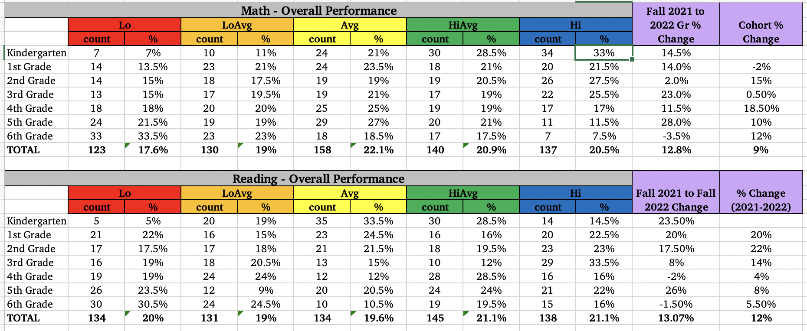

Slide 5
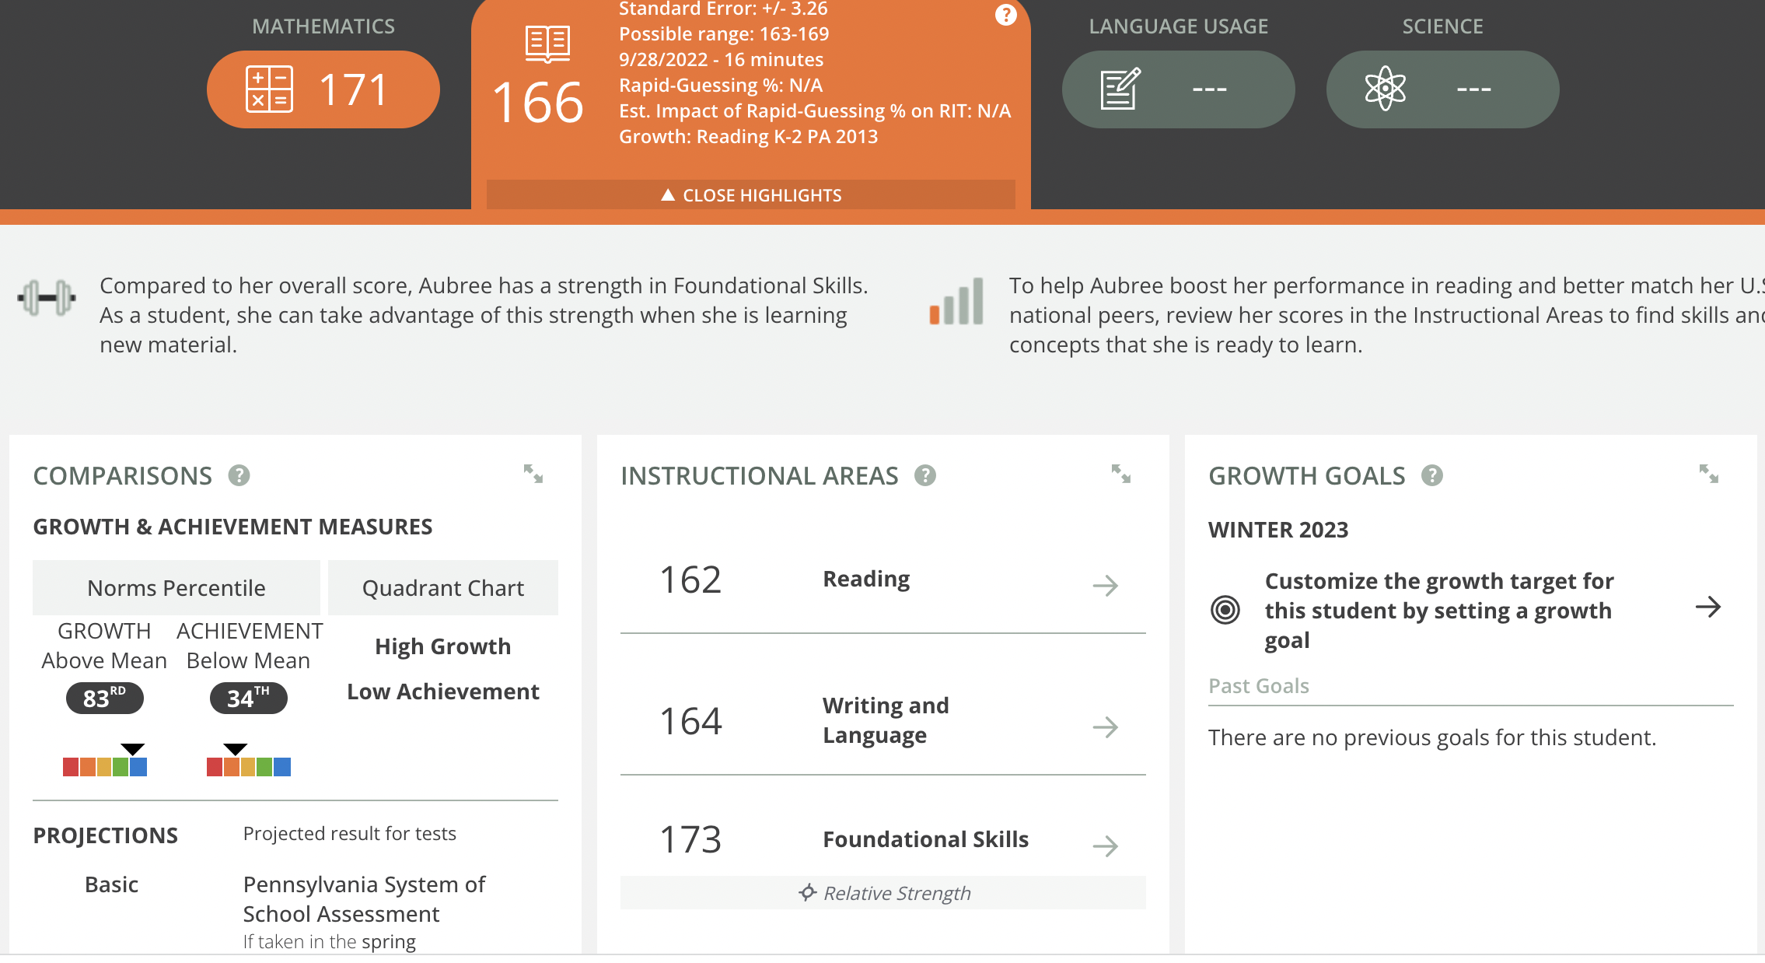
Fff f

Slide 6
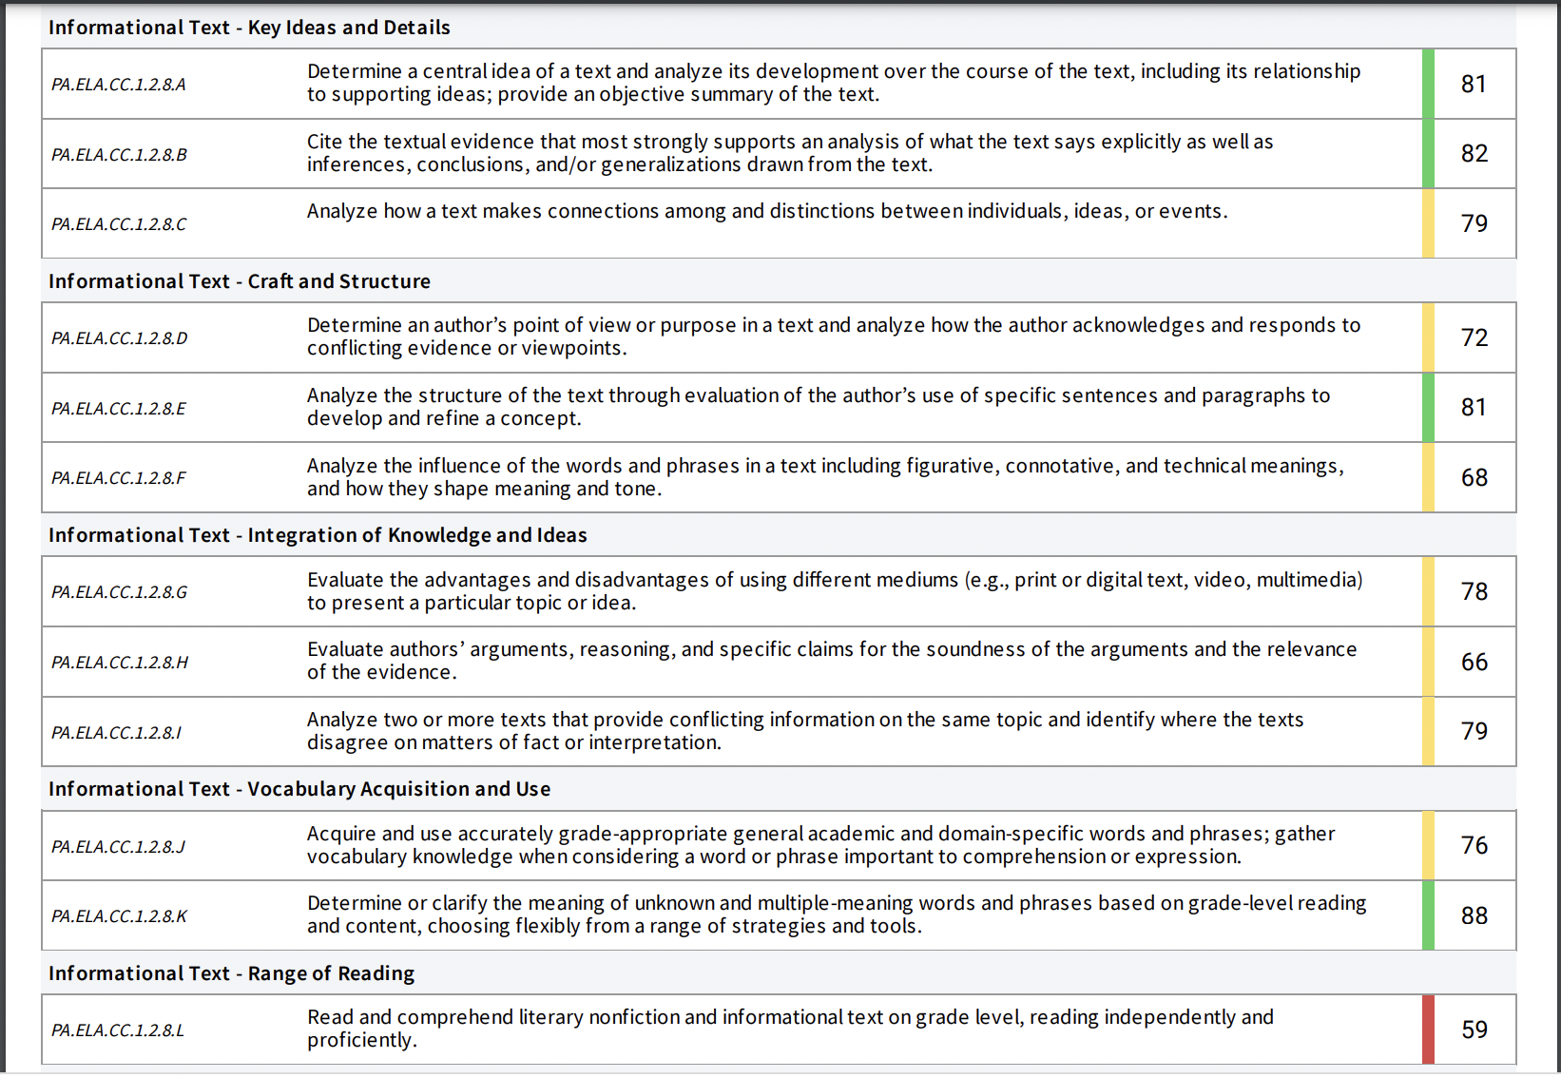

Slide 7
PVSD MTSS Tiers Defined
Tiered Qualifiers
*Learners should move fluidly between tiers
K-1 Learner red on mClass
Gr. 2-3 Red for NWF
Gr. 4-6 Red Composite
CLF input
Well below on math assessments
Progress Monitor bi-weekly
NOT Learners in Learning Support
Tier 3
Below proficient on formative & summative assessments
Orange or Red on MAP Growth
Yellow or Red on mClass, either composite score OR targeted area
Progress monitor at least once a month provided by homeroom facilitator using mClass
Tier 2
Whole group and small group instruction
ALL learners, regular and special education
Progress Monitor as needed
Tier 1
Notes:
teclassroom teachers progress monitor tier 2 kids once a month using M-Class. achers progress monitor tier 2 kids once a month using M-Class

Slide 8
PVSD MTSS Tiers Defined
mClass Intervention Suite (MTSS Interventionists),
CKLA Assessment and Remediation Guide,
CKLA Intervention Toolkit
High intensity pull out facilitated by MTSS Interventionist and Title Paras (when necessary). Daily intense, direct instruction with progress monitoring
Tiered Instructional Models
Tired Instructional Resources
Tier 3
Intensified instruction through push in paras, specialists, learning support and more individualized and small group instruction lead by the classroom learning facilitator
mClass instruction; Assessment/Remediation Guide,
CKLA Intervention Toolkit
Eureka Equip lessons
More focused skill groups within a homeroom or across a grade level
Tier 2
CKLA Amplify (K-5), Amplify ELA (Gr. 6);
Eureka Squared
High Qualified Core Instruction, in regular education, all learners; whole group, small group, rotational model utilized as necessary and appropriate
Tier 1

Slide 9
SST Process
Referral
https://forms.gle/nRUZt4i2YEjwHfuQ9
SST Meets
Friday mornings
Case Manager
3
2
Data
SST Discussion
4

