Slide 1
New Course Proposal for Wellness Education
Rob Joiner

Slide 2
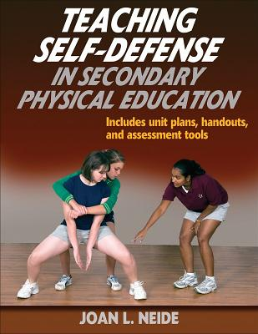
WHAT? Self-defense course
A half-credit elective for physical education
More choices - MCL for Wellness Education
Current Electives- Lifetime Fitness - Wellness Through Sport/Games - Adventure Education - Mindfulness
Virtual - Lifetime Fitness and Wellness for Athletes
Summer - Virtual Lifetime Fitness and Camp Experience

Slide 3
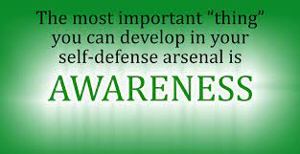
WHY? The rationale for a self-defense course
Prevention of violence - goal
Avoiding being a victim - awareness
Mental/emotional strategies for avoiding violence
Understanding the laws
Physical fitness and skill development
Mind-body connection
Self-confidence and self-discipline
Life skills (including “soft skills”)

Slide 4
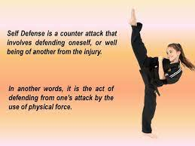
HOW? Learning methods for the course
Develop a foundation of physical fitness
Learning the physical skills of self-defense
Develop an awareness for personal safety
Curate a mindset of neutralizing conflict
Understand the role of self-defense
Learning how to practice self-discipline (mental/physical/emotional)
Examine the different forms of martial arts
Applying the skills to other areas of life

Slide 5

QUESTIONS?

