Slide 1
Pequea Valley CHAPTER 339
K-12 Comprehensive school counseling plan
Cathy Koenig
January 2, 2023​

Slide 2
What is the 339 Plan?
A written plan on file, approved by the Board of School Directors, for the comprehensive, sequential program of counseling services for all student Kindergarten -12th grade.
The 339 Plan addresses three counseling domains: Academic, Career, and Social/Emotional.
The 339 Plan is a working document that is reviewed yearly, ensuring our learners experience success in school while preparing them for their future.
The 339 Plan is aligned with PA Career and Work Standards.
The 339 plan must include procedures to provide guidance services to CTC.

Slide 3
Components of Chapter 339 plan
Mission Statement
Role of a Counselor
Program Goals
Stakeholder Action Plans
Monthly Calendar of Activities
System Delivery
Curriculum Action Plan
Career and Post Secondary Resources
Advisory Committee
Academic and Career Plan & Portfolio
CTC Strategies
Job Descriptions

Slide 4
Mission StaTement & Role of School Counselors
The mission of the Pequea Valley School Counseling Department is to collaborate with learners, staff, families, business/community, and postsecondary stakeholders to challenge all learners to reach their full potential in present and future endeavors. We will promote a safe and equitable learning environment where every learner counts, in order to assist them in their academic, career , and social/emotional development | School Counselors serve as leaders, advocates, collaborates, and agents of systematic change. School Counselors are critical to successful efforts to close the academic gaps of our learners. School counselors with their training are an intricate part of our school team with all of the challenges our learners face each day.
.

Slide 5
GOALS
Program goals were created for each grade range (elementary, middle, & high school) connected to the three domains in our mission statement.
We monitor these goals for completion and goals are reviewed yearly.

Slide 6
STAKE HOLDER PLANS
As a team, we look at different ways to engage stakeholders in planning for the future of our learners:
Learners
Parents
Educators
Business and Community
Post Secondary Institutions

Slide 7
AdVISORY COMMITTEE
We have had an advisory committee that has met each year 2016-2017, we did not meet last year due to scheduling. We will meet this year to help support our learners, staff and families in the three areas of academic, career, and social/emotional growth.

Slide 8
School Counseling
Program and delivery system
Pequea Valley School District counselors facilitate a variety of services across the three domains : Academic, Career, and Social/Emotional. As you review the plan you will see the activities divided into three areas and color coded under the four delivery models. You will also notice on-going monthly activities that occur that our school counselors take a part in.

Slide 9
School Counseling
CURRICULUM ACTION PLAN
Pequea Valley School counselors have created a curricular plan that is appropriate at each level for their development level.
The action plan lists the ASCA and CEW standards, as well material as location, assessments, and stakeholders.

Slide 10
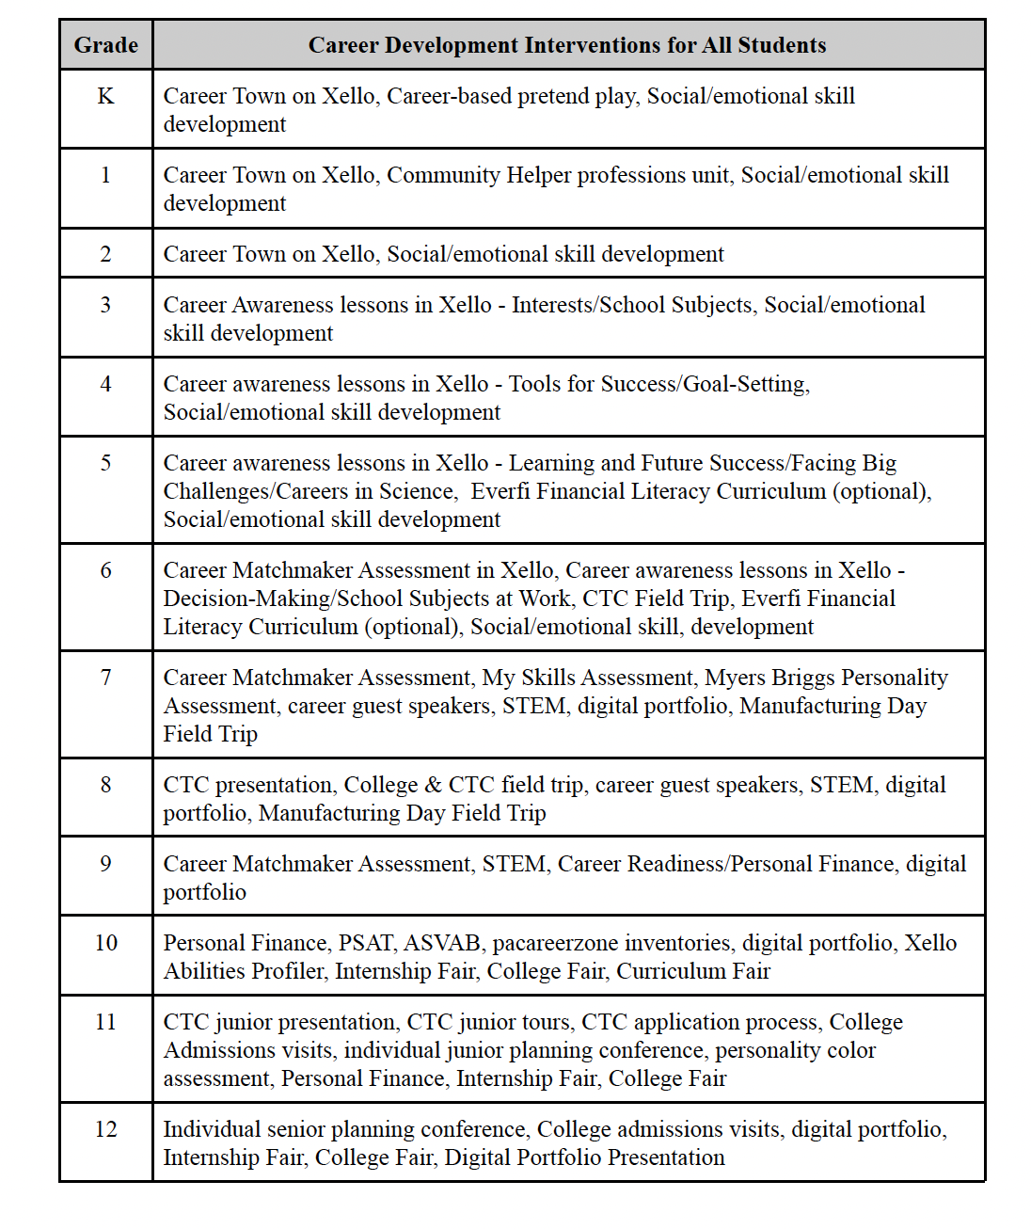
Academic and CarEer Planning

Slide 11
CTC Strategies
Parent Awareness Activities
Educator Awareness Activities
6th Grade Visit
8th Grade Visit
Matching CTC programs in portfolios
CTC Presentations
11th grade Visit

Slide 12
Any Questions?

